Slide 1


Planning
Prepared by Dr. Magdy Al-haj
MGM111
Principle of Management
Lecture 4

Slide 2



Planning
Lecture 4
MGM111
Principle of Management
Prepared by
Dr. Magdy Al-haj
www.midocean.ae

Slide 3

Learning Outcome
managers plan.
types of plans do managers use.
useful planning tools and techniques.
control process.
www.midocean.ae

Slide 4
Chapter
What is planning
4
  Identifying and selecting appropriate goals and courses of action for an organization.
    The organizational plan that results from the planning process details the goals and specifies how managers will attain those goals
www.midocean.ae

Slide 5
Chapter
Before You Plan
4
Mission Statement
what we do; purpose of organization
Vision Statement
how we want it to be; future state of organization
Values
what do we stand for; culture framework
Primary Objectives
how to get there; translated into goals and action plans
www.midocean.ae

Slide 6

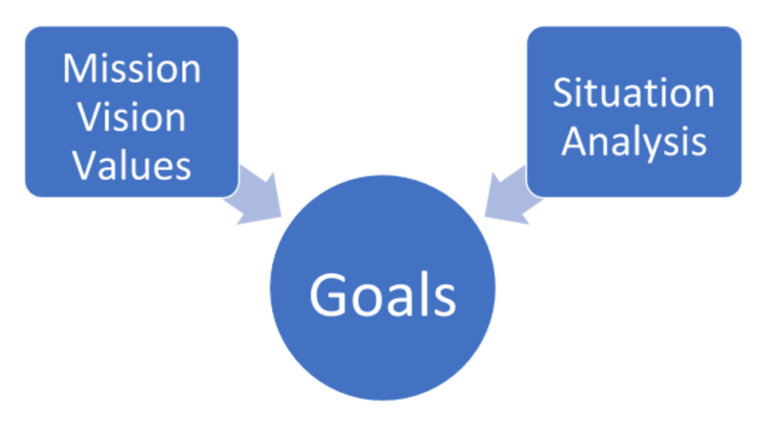
Chapter
Understanding Mission
4
Mission Statement
  describes what organization needs to do to achieve vision
  will be more specific than vision statement
  conveys to stakeholders why the organization exists
  explains how it creates value for the market or the larger community
www.midocean.ae

Slide 7
Chapter
Understanding Vision
4
Vision Statement
  is a statement of organization’s overarching aspirations of what it hopes to achieve
  should inspire people
  motivate people to want to be part of and contribute to the organization.
  should be clear and concise, usually not longer than a short paragraph
www.midocean.ae

Slide 8
Chapter
Understanding Values
4
Values Statement
  defines what organization believes in
  describes how people should behave
  must be reinforced at all levels of organization
  called the “code of ethics”
  provides a standard for employees to judge violations.
www.midocean.ae

Slide 9

Chapter
4
Why Should We Plan?
To set the organization up for positive outcomes such as:
Better leadership—more cohesive team
A clear picture of trends which may impact the organization now and in the future
A clearly defined mission, vision, and strategy
Identification of short- and long-term “attention” areas
Specific plans to improve performance
Consistent, sustained success, as opposed to marginal success
www.midocean.ae

Slide 10

Chapter
4
Why Should We Plan cont. …?
To directly address issues/threats such as:
Decreased membership
Unhappy members (retention)
Competitive threats
Financial instability
Succession planning
www.midocean.ae

Slide 11


Chapter
Why Plan?
4
Want to plan change, not become a victim of change
  planning is an effort to anticipate future change
Gives the organization a sense of direction
Involve staff in decision making
Helps coordinate the different functions and departments
Facilitate control and demonstrate accountability
www.midocean.ae

Slide 12

Chapter
Elements of Planning
4
Goals (also Objectives)
  Desired outcomes for individuals, groups, or entire organizations
  Provide direction and evaluation performance criteria
Plans
  Documents that outline how goals are to be accomplished
  Describe how resources are to be allocated and establish activity schedules
www.midocean.ae

Slide 13
Chapter
4
Types of Goals
Financial Goals - related to the expected internal financial performance of the organization.
Strategic Goals - related to the performance of the firm relative to factors in its external environment (e.g., competitors).
www.midocean.ae

Slide 14
Chapter
4
Well-Written Goals
Characteristics of well-written goals:
  Written in terms of outcomes rather than actions
  Measurable and quantifiable
  Clear as to time frame
  Challenging yet attainable
  Written down
  Communicated to all necessary organizational members
www.midocean.ae

Slide 15
Chapter
4
Steps in Goal Setting
Managers have to follow six steps when setting goals:
  Review the organization's mission and the employee’s key job tasks.
  Evaluate available resources.
  Determine the goals individually or with input of others.
  Make sure goals are well-written and then communicate them to all who need to know.
  Build in feedback mechanisms to assess goal progress.
  Link rewards to goal attainment.
www.midocean.ae

Slide 16

Chapter
Factors in Planning
4
Time frame
Collecting and analyzing data
Levels of planning in the organizational structure
Flexibility
Accountability
www.midocean.ae

Slide 17

Chapter
Types Of Plans in all department
Of organizations
4
Overall strategic plan
Annual budget/operations plan
Collection development plan
Information technology plan
Development (fund raising) plan
Staff development (training) plan
Marketing plan
Building / facilities plan
Instructional plan
Evaluation or outcomes assessment plan
www.midocean.ae

Slide 18
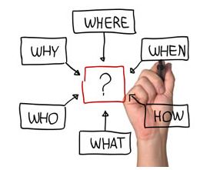
Chapter
4
managers plan
Planning
  The process of setting objectives and determining how to best accomplish them.
Objectives
  Identify the specific results or desired outcomes that one intends to achieve.
Plan
  A statement of action steps to be taken in order to accomplish the objectives.
www.midocean.ae

Slide 19
Chapter
4
Managers Planning -Process
Step 1 Situational Analysis
Step 2 Alternative Goals and Plans
Step 3 Goal and Plan Evaluation
Step 4 Goal and Plan Selection
Step 5 Implementation
Step 6 Monitor and Control
www.midocean.ae

Slide 20
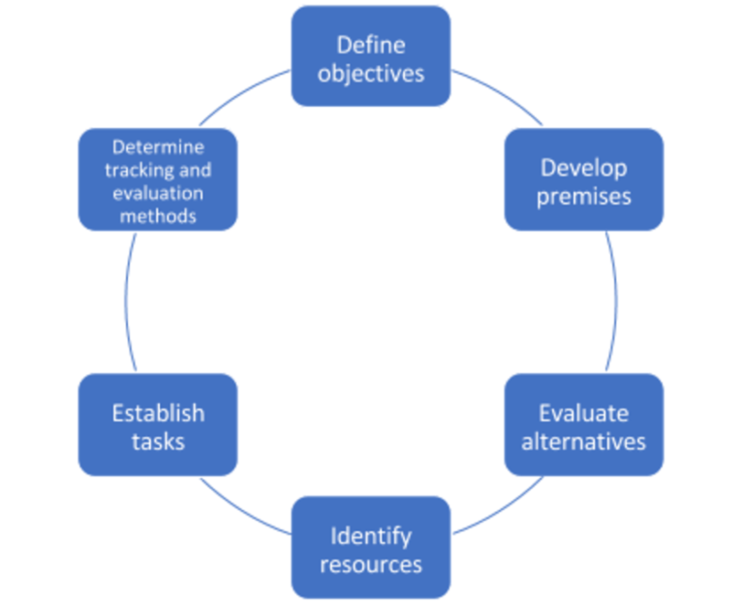
Chapter
4
Six Stages of the Planning Cycle
Define objectives
Develop premises
Evaluate alternatives
Identify resources
Plan and implement tasks
Determine tracking and evaluation methods
www.midocean.ae

Slide 21
Chapter
Essential Aspects of the Planning Cycle
4
Maintaining organizational focus
  Defining specific goals to consider the vision, mission, and values of the organization
Encouraging diverse participation
  Provides opportunity for input
  Establish planning committees that intentionally include people from diverse backgrounds
Empowering and motivating employees
  Empowers people to contribute
  Motivates them to support outcomes
www.midocean.ae

Slide 22
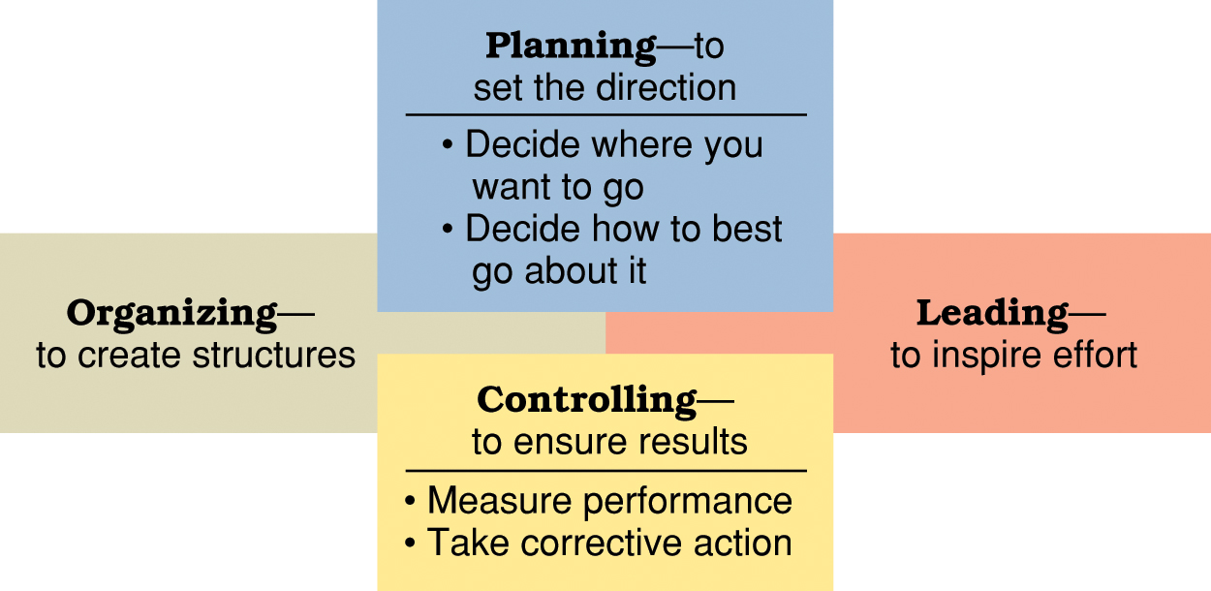
Chapter
The roles of planning and controlling in the management process.
4
www.midocean.ae

Slide 23

Chapter
managers plan
4
Benefits of planning:
  Improves focus and flexibility.
  Improves action orientation.
  Improves coordination.
  Improves time management.
  Improves control.
www.midocean.ae

Slide 24
Chapter
What types of plans do managers use(by time frame)?
4
Short-range and long-range plans:
  Short-range plans = 1 year or less
  Intermediate-range plans = 1 to 2 years
  Long-range plans = 3 or more years
People vary in their capability to deal effectively with different time horizons.
Higher management levels focus on longer time horizons.
www.midocean.ae

Slide 25
Chapter
4
Long-range plans
= 3 or more years
Intermediate-range plans = 1 to 2 years
Short-range plans = 1 year or less
www.midocean.ae

Slide 26
Chapter
What types of plans do managers use?
4
Strategic plans
operational plans
Policies and procedures
Budgets and project schedules
www.midocean.ae

Slide 27
Chapter
What types of plans do managers use?
4
Strategic plans
Strategic planning
  A set of procedures for making decisions about the organization’s long-term goals and strategies
Strategic goals
  major targets or end results that relate to the long-term survival, value, and growth of the organization.
  Strategic plans
  set broad, comprehensive, and longer-term action directions for the entire organization.
www.midocean.ae

Slide 28
Chapter
What types of plans do managers use?
4
operational plans
The process of identifying the specific procedures and processes required at lower levels of the organization
  Operational plans — define what needs to be done in specific areas to implement strategic plans.
    Production plans
    Financial plans
    Facilities plans
    Marketing plans
    Human resource plans
www.midocean.ae

Slide 29
Chapter
What types of plans do managers use?
4
Policies and procedures
  Standing plans
    Policies and procedures that are designed for repeated use.
  Policy
    Broad guidelines for making decisions and taking action in specific circumstances.
  Rules or procedures
    Plans that describe exactly what actions are to be taken in specific situations.
www.midocean.ae

Slide 30
Chapter
What types of plans do managers use?
4
Budgets and project schedules
  Single-use plans
    Only used once to meet the needs and objectives of a well-defined situation in a timely manner.
  Budgets
    Single-use plans that commit resources to activities, projects, or programs.
    Fixed, flexible, and zero-based budgets.
  Projects
    One-time activities that have clear beginning and end points.
    Project management and project schedules.
www.midocean.ae

Slide 31
Chapter
useful planning tools and techniques?
4
1- Forecasting
2- Contingency planning
3- Scenario planning
4- Benchmarking
5- Use of staff planners
www.midocean.ae

Slide 32
Chapter
useful planning tools and techniques?
4
Forecasting
  Making assumptions about what will happen in the future.
  Qualitative forecasting uses expert opinions.
  Quantitative forecasting uses mathematical and statistical analysis.
  All forecasts rely on human judgment.
  Planning involves deciding on how to deal with the implications of a forecast.
www.midocean.ae

Slide 33
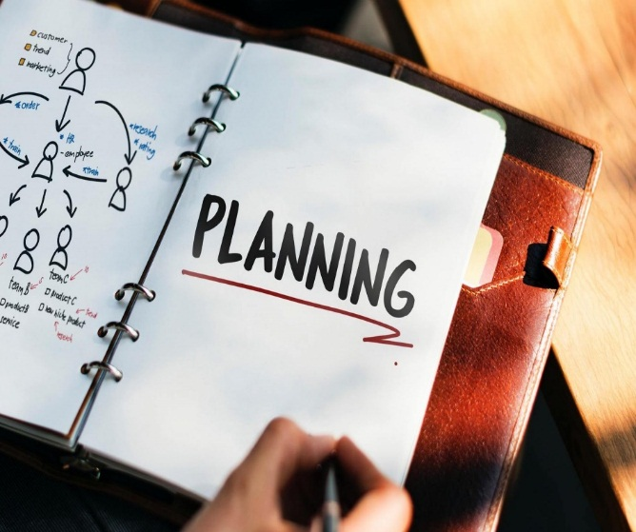
Chapter
4
useful planning tools and techniques?
Contingency planning
  Identifying alternative courses of action that can be implemented to meet the needs of changing circumstances.
  Contingency plans anticipate changing conditions.
  Contingency plans contain trigger points.
www.midocean.ae

Slide 34
Chapter
4
useful planning tools and techniques?
Scenario planning
  A long-term version of contingency planning.
  Identifying alternative future scenarios.
  Plans made for each future scenario.
  Increases organization’s flexibility and preparation for future shocks.
www.midocean.ae

Slide 35

Chapter
useful planning tools and techniques?
4
Benchmarking
  Use of external comparisons to better evaluate current performance and identify possible actions for the future.
  Adopting best practices of other organizations that achieve superior performance.
www.midocean.ae

Slide 36
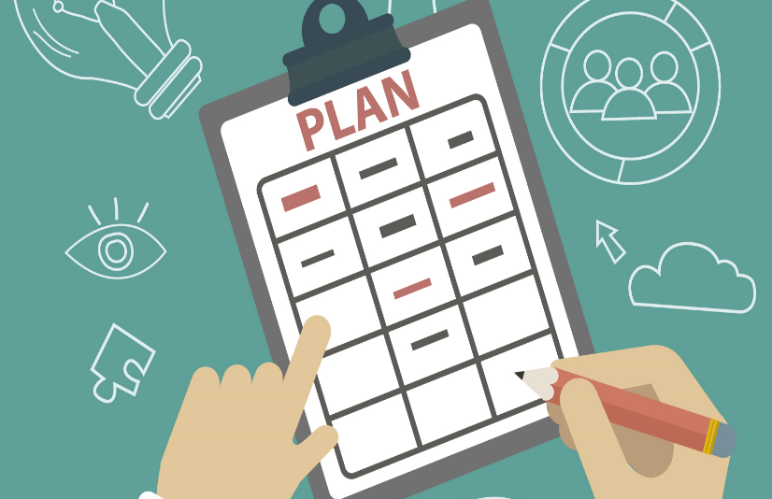
Chapter
useful planning tools and techniques?
4
Use of staff planners
  Coordinating the planning function for the total organization or one of its major components.
  Possible communication gaps between staff planners and line management.
www.midocean.ae

Slide 37
Chapter
4
STRATEGIC PLANNING
“If you don’t know where you’re going, any road will get you there?”
“If you don’t know where you’re going, how will you know when you get there?”
Strategic planning solves these problems.
www.midocean.ae

Slide 38
Chapter
4
Planning in a Dynamic Environment
Plans need to be specific and flexible
Planning should be an ongoing process
Managers need to stay alert to environmental changes
Make the organizational hierarchy flatter
www.midocean.ae

Slide 39
Chapter
Environmental Scanning
4
Environmental scanning: an analysis of the external environment that involves screening large amounts of information to detect emerging trends
Competitive intelligence: a type of environmental scanning that gives managers accurate information about competitors
www.midocean.ae

Slide 40



Thank You

