Slide 1



Introduction to Economics
Lecture 2
MGM112
Demand
Prepared by
Lec. Dina ElWakkad
www.midocean.ae

Slide 2


Chapter
Objectives of Lecture (2)
02
  What makes the prices of oil and gasoline double in just one year?
  Will the price of gasoline keep on rising?
  Some prices rise, some fall, and some fluctuate.
  This chapter explains how markets determine prices and why prices change.
www.midocean.ae

Slide 3
Chapter
Demand
02
v
  If you demand something, then you
  1. Want it,
  2. Can afford it, and
  3. Have made a definite plan to buy it.
  The quantity demanded of a good or service is the amount that consumers plan to buy during a particular time period, and at a particular price.
www.midocean.ae

Slide 4
Chapter
The Law of Demand
02
v
The law of demand states:
Other factors being constant (cetris peribus), price and quantity demand of any good and service are inversely related to each other.
  The higher the price of a good, the smaller is the quantity demanded;
  The lower the price of a good, the greater is the quantity demanded.”
www.midocean.ae

Slide 5
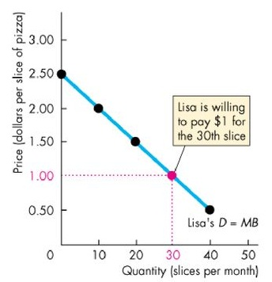
Chapter
The Law of Demand
02
v
The law of demand is illustrated by:
A downward-sloping demand curve drawn with the quantity demanded on the horizontal axis and the price on the vertical axis
The slope is negative to show the negative relation between P & Qd
www.midocean.ae

Slide 6
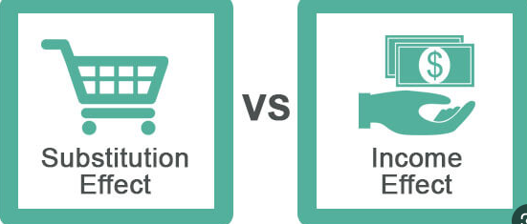
Chapter
The Law of Demand
02
v
The law of demand results from:
  Substitution effect
  Income effect
www.midocean.ae

Slide 7
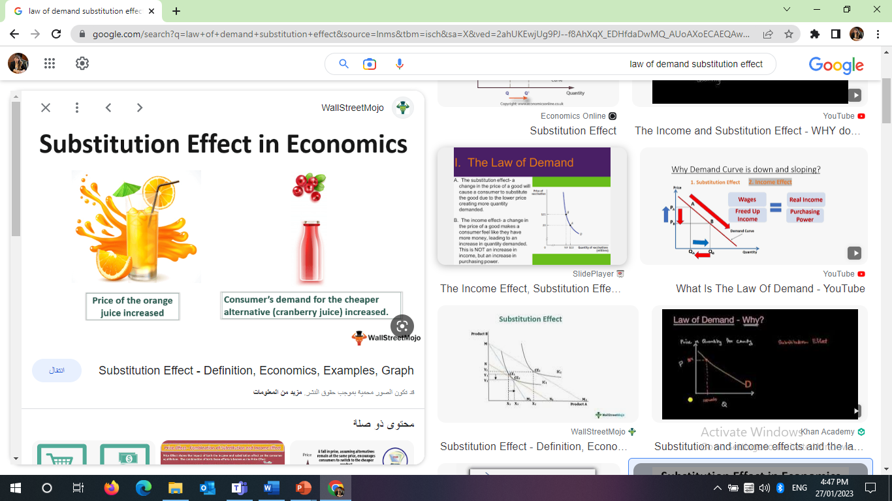
Chapter
The Law of Demand
02
v
The law of demand results from:
  Substitution effect
www.midocean.ae

Slide 8
Chapter
The Law of Demand
02
v
The law of demand results from:
  Substitution effect
    The portion of a change in quantity demanded that is due to a change in the relative price of the good
If the price of meat increases, then the higher price may encourage consumers to switch to alternative food sources, such as buying vegetables. Pmeat↑ Qd.meat↓ Qd.vegetables↑
www.midocean.ae

Slide 9
Chapter
The Law of Demand
02
v
The law of demand results from:
  Income effect
    The portion of a change in quantity demanded caused by a change in a consumer’s income when the price of a product changes
If the price of meat increases, it means that after buying some meat, they will have lower spare income Therefore, consumers will buy less meat because of this income effect. P meat ↑ Income ↓ Qd.meat ↓
www.midocean.ae

Slide 10
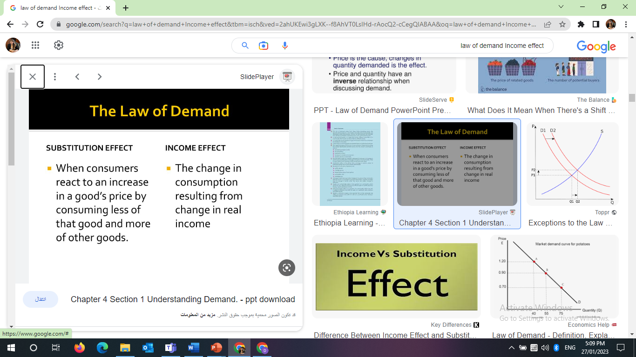
Chapter
The Law of Demand
02
v
The law of demand results from:
www.midocean.ae

Slide 11
Chapter
Change in Quantity Demanded
02
v
The Price of the good is the only one factor that affects Quantity demanded ∆P → ∆Qd
Change the Price of the good → Change in quantity demanded → Movement along the demand curve P↓→ Qd ↑→ Move down along demand curve P↑ → Qd ↓→ Move up along demand curve
www.midocean.ae

Slide 12
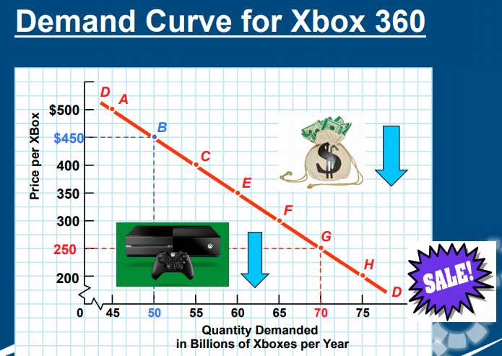
Chapter
Change in Quantity Demanded
02
v
The Price of the good is the only one factor that affects Quantity demanded ∆P → ∆Qd
Point | P | Qd
A | 500 | 45
B | 450 | 50
C | 400 | 55
E | 350 | 60
F | 300 | 65
G | 250 | 70
H | 200 | 75
www.midocean.ae

Slide 13
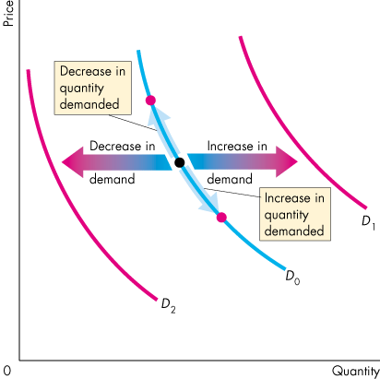
Chapter
Change in Demand
02
v
When price is constant, as the other Factors on buying plans change, Demand will change
Shift demand curve at given price level
  Factor changes→ D ↑→ Shift Right
  Factor changes→ D ↓→ Shift Left
www.midocean.ae

Slide 14

Chapter
Change in Demand
02
v
At given price level, the Main factors that change demand are:
  P rices of other goods (substitute (+) or complementary (-))
  O utlook (Expected future prices (+) - Expected future income and credit (+))
  I ncome (Normal good (+), inferior good (-))
  N umber of potential customers (Population) (+)
  T aste (Preferences)for a good (+) / against the good (-)
www.midocean.ae

Slide 15
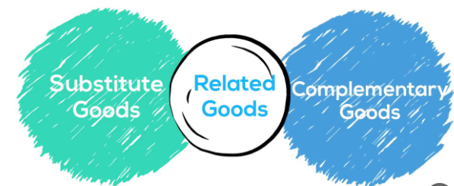
Chapter
Change in Demand
02
v
Prices of other goods:
www.midocean.ae

Slide 16
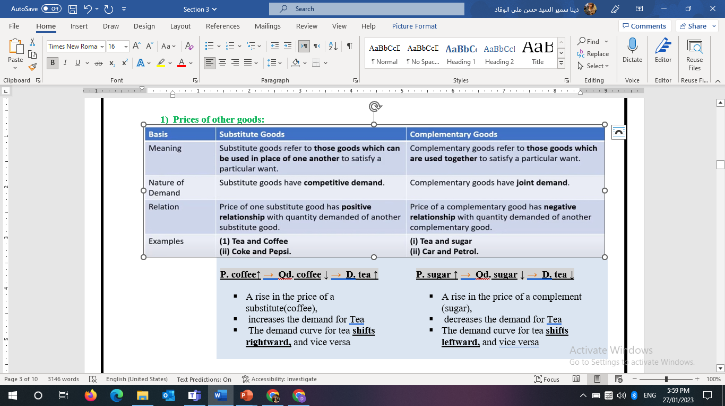

Chapter
Change in Demand
02
v
Prices of other goods:
www.midocean.ae

Slide 17
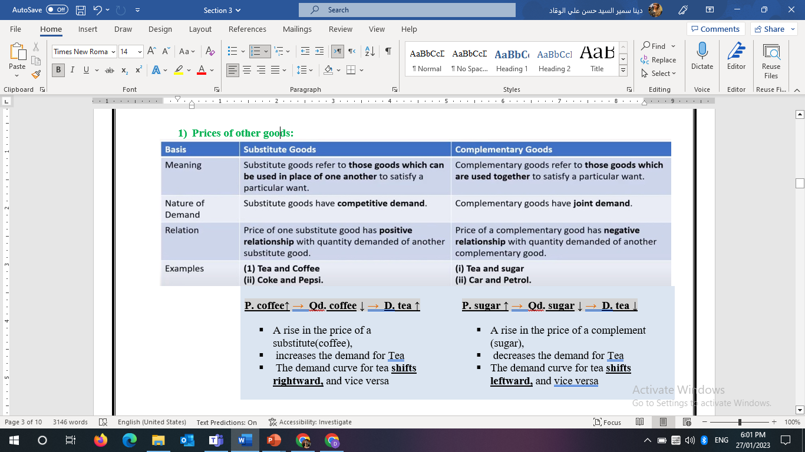

Chapter
Change in Demand
02
v
Prices of other goods:
www.midocean.ae

Slide 18
Chapter
Change in Demand
02
v
2) Outlook
Expected future prices of the good (+VE)
  If the expected future price of a good rises, current demand for the good increases and the demand curve shifts rightward, and vice versa
لو انا متوقع ان سعر العربية هيغلي كمان سنة , فبالتالى هروح مشتريها دلوقتي قبل ما تغلي فبكدة توقع زياد السعر فى المستقبل ادى الى زيادة الطلب على العربية دلوقتى
Expected future income and credit. (+VE)
  When expected future income increases or when credit is easy to obtain, the demand might increase now and the demand curve shifts rightward, and vice versa
www.midocean.ae

Slide 19
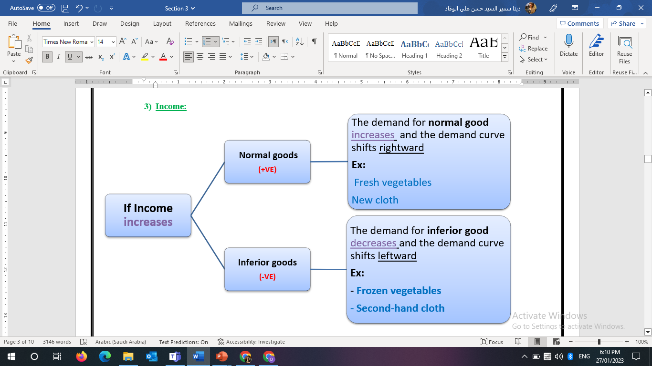
Chapter
Change in Demand
02
v
3) Income:
www.midocean.ae

Slide 20
Chapter
Change in Demand
02
v
4) Number of potential customers (Population)
Number of potential customers (Population) (+VE)
An increase in population → increases the demand for all goods→ and the demand curve shifts rightward, and vice versa
www.midocean.ae

Slide 21
Chapter
Change in Demand
02
v
5) Tastes (People’s preferences)
Tastes (People’s preferences) :
If people’s preferences for a good rise→ the demand increases → and the demand curve shifts rightward, and vice versa (+VE)
If people’s preferences against a good rise→ the demand decreases → and the demand curve shifts leftward, and vice versa (-VE)
www.midocean.ae

Slide 22
Chapter
The demand curve & the willingness -and-ability-to-pay
02
v
A demand curve is a willingness-and-ability-to-pay curve:
The price indicates consumer's Willingness to pay which is equal to that consumer's Marginal Benefit (MB). (WTP = P = MB)
For any fixed quantity of a good available, the smaller the quantity available, the higher is the price that someone is willing to pay for another unit,
www.midocean.ae

Slide 23
Chapter
The demand curve & the willingness -and-ability-to-pay
02
v
If available quantity of pizza 30 slices, Lisa is WTP = MB = P = 1
If available quantity f pizza decreases to 10 slices, Lisa is WTP =MB=P= 2
www.midocean.ae

Slide 24
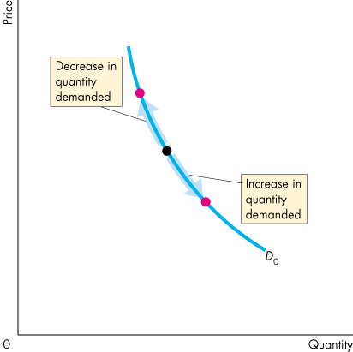
Chapter
A Change in the Quantity Demanded Vs a Change in Demand
02
v
  Movement Along the Demand Curve
  When the price of the good changes and everything else remains the same, the quantity demanded changes and there is a movement along the demand curve.
www.midocean.ae

Slide 25
Chapter
A Change in the Quantity Demanded Vs a Change in Demand
02
v
  A Shift of the Demand Curve
  If the price remains the same but one of the other Factors on buyers’ plans changes, demand changes and the demand curve shifts.
www.midocean.ae

Slide 26
Chapter
A Change in the Quantity Demanded Vs a Change in Demand
02
v
Why does demand not change when the price of good changes with no change in the other influences on buying plans?
  Because price does not influence or lead to shift in Demand curve, price is the only factor that leads to change the Quantity demanded and cause a movement along demand curve
www.midocean.ae

Slide 27
Chapter
A Change in the Quantity Demanded Vs a Change in Demand
02
v
Change Quantity demanded | Change Demand curve
Other factors constant, as the price change, Quantity demanded will change at opposite direction Movement along demand curve | When price is constant, as the other influences on buying plans change, Demand will change Shift demand curve at given price level.
www.midocean.ae

Slide 28

Think
Chapter
02
v
Which of the following is consistent with the law of demand?
A) An increase in the price of a DVD causes an increase in the quantity of DVDs demanded.
B) An increase in the price of a soda causes a decrease in the quantity of soda demanded.
C) A decrease in the price of a gallon of milk causes a decrease in the quantity of milk demanded.
D) A decrease in the price of juice causes no change in the quantity of juice demanded.
The law of demand implies that if nothing else changes, there is-------------
A) a positive relationship between the price of a good and the quantity demanded.
B) a negative relationship between the price of a good and the quantity demanded.
C) a linear relationship between price of a good and the quantity demanded.
D) an exponential relationship between price of a good and the quantity demanded.
www.midocean.ae

Slide 29
Think
Chapter
02
v
In the market for magazines, the "income effect" means that-------
A) magazines are usually purchased by people with higher-than-average incomes.
B) a decrease in the price of a substitute product like books will make magazine readers feel a little poorer than they were before.
C) an increase in the price of magazines will reduce the total purchasing power of magazine readers, making them able to afford fewer magazines.
D) an increase in the price of magazines will raise the relative price of magazines to books, causing magazine readers to read more books and fewer magazines.
As the relative price of a good falls, the substitution effect implies that people buy----
A) less of that good and more of its substitutes.
B) more of that good and less of its substitutes.
C) less of that good and less of its substitutes.
D) more of that good and more of its substitutes.
www.midocean.ae

Slide 30
Think
Chapter
02
v
For normal goods which of the following explains why demand curves slope downward?
A) prices and income
B) substitutes and complements
C) resources and technology
D) substitution effect and income effect
Each point on the demand curve reflects-------------------
A) all the wants of a given household.
B) the highest price consumers are willing and able to pay for that particular unit of a good.
C) the highest price sellers will accept for all units they are producing.
D) the lowest-cost technology available to produce a good.
www.midocean.ae

Slide 31
Think
Chapter
02
v
Ham and eggs are complements. If the price of ham rises, the demand for eggs will------
A) increase or decrease but the demand curve for ham will not change.
B) decrease and the demand curve for ham will shift rightward.
C) not change but there will be a movement along the demand curve for eggs.
D) decrease and the demand curve for eggs will shift leftward.
A change in which of the following shifts the demand curve for hamburgers?
A) an increase in the price of the meat used to produce hamburgers
B) an increase in the price of a hamburger
C) a fall in the price of French fries, a complement for hamburgers
D) an increase in the number of hamburger restaurants
www.midocean.ae

Slide 32
Summary outlines
Chapter
02
v
Demand
The Law of Demand
Change in Quantity Demanded
Change in Demand Curve
The demand curve & the willingness -and-ability-to-pay.
A Change in the Quantity Demanded Vs a Change in Demand
www.midocean.ae

Slide 33


Thank You

