Slide 1

Digital Consumer Behavior
Prepared by Dr. Noha El Aswad
Lecture 9
MKT713_
Master of Digital Marketing

Slide 2
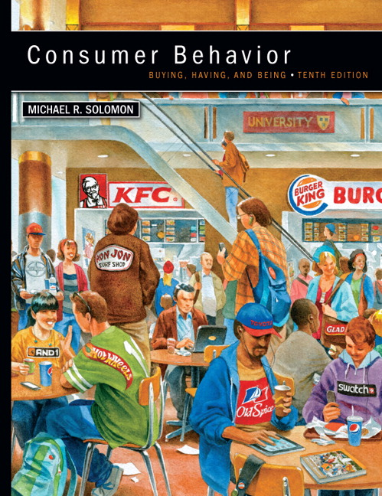

Chapter
02
Buying, Having, Being
CONSUMER BEHAVIOR, 10e
Michael R. Solomon

Slide 3
Chapter
02
Chapter Objectives
When you finish this chapter, you should understand why:
  Ethical business is good business.
  Marketers have an obligation to provide safe and functional products as part of their business activities.
  Consumer behavior impacts directly on major public policy issues that confront our society.
  Consumer behavior can be harmful to individuals and to society

Slide 4
Chapter
02
Lecture Objectives 1/2
When you finish this lecture, you should understand why:
Part 2 Learning objective three in chapter 2 (Consumer behavior impacts directly on major public policy issues that confront our society.).
  Market access
  Literacy
    Media literacy
    Functionally illiterate
  Sustainability and environmental Stewardship
    Sustainability
    Green Marketing and Greenwashing

Slide 5
Chapter
02
Lecture Objectives 2/2
When you finish this lecture, you should understand why:
Part 1Learning objective 4 in chapter 2 (Consumer behavior can be harmful to individuals and to society).
  The Dark Side of Consumer Behavior
    addictive Consumption
    Compulsive consumption
    Consumed consumers

Slide 6
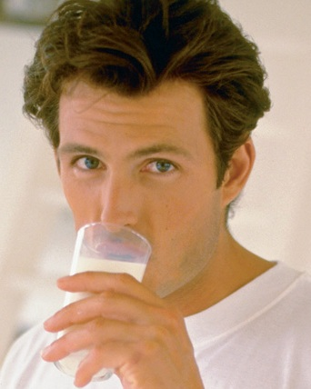
Chapter
2
Market access 1/2
Many of us take for granted that we are free to shop anywhere we want or that we can easily learn about our purchase options—everything we need is just a click of a mouse away, right?

Slide 7
Chapter
2
Market access 2/2
In reality, however, large numbers of people can’t make this claim. For one reason or another their market access (i.e., their ability to find and purchase goods and services) is limited because of physical, mental, economic, or social barriers.

Slide 8
Chapter
2
Literacy (Media literacy) 1/5
Media literacy refers to a consumer’s ability to access, analyze, evaluate, and communicate information in a variety of forms, including print and non-print messages.

Slide 9
Chapter
2
Literacy (Media literacy) 2/5
Media literacy empowers people to be both critical thinkers and creative producers of an increasingly wide range of messages using image, language, and sound.

Slide 10
Chapter
2
Literacy (Media literacy) 3/5
This movement reminds us that we are bombarded with thousands of messages every day that espouse a particular point of view or try to persuade us to buy this or that.

Slide 11
Chapter
2
Literacy (Media literacy) 4/5
It’s our job to critically evaluate this information and not everyone has the skills to do that.

Slide 12
Chapter
2
Literacy (Media literacy) 5/5
This task is even more difficult in the age of Google, where many of us assume that whatever comes up in a Google search or on Wikipedia is completely true and accurate (Hint: not by a long shot). As the tried-but-true phrase says, “Caveat Emptor”—let the buyer beware!

Slide 13
Chapter
2
Functionally illiterate 1/4
This term describes a person whose reading skills are not adequate to carry out everyday tasks, such as reading the newspaper or the instructions on a pill bottle

Slide 14
Chapter
2
Functionally illiterate 2/4
This limitation impedes market access for a couple of reasons: First, the illiterate or “low-literate” consumer is at a disadvantage because he or she encounters difficulty in learning about the best purchase options.

Slide 15
Chapter
2
Functionally illiterate 3/4
Second, this person may experience feelings of shame and embarrassment and avoid market situations where he or she will be forced to reveal the inability to read a label or other written material.

Slide 16
Chapter
2
Functionally illiterate 4/4
Some of these people (whom researchers term social isolates) cope with the stigma of illiteracy by avoiding situations in which they will have to reveal this problem. They may choose not to eat at a restaurant with an unfamiliar menu, for example.

Slide 17

Chapter
2
Sustainability and environmental Stewardship 1/4
Almost everyone today is concerned about saving our planet. Worries about climate change, entire species going extinct, widespread exposure to carcinogens and harmful bacteria and many other issues are front and center.

Slide 18
Chapter
2
Sustainability and environmental Stewardship 2/4
Some solutions are no-brainers: Unilever launched a campaign on Facebook and YouTube tied to its Axe brand to encourage reduced usage of hot water. The “Shower-pooling” campaign asks fans to take a pledge to share a shower with a like-minded acquaintance or attractive stranger.

Slide 19
Chapter
2
Sustainability and environmental Stewardship 3/4
Of course, that’s a trivial approach to a big problem but real solutions are a huge priority for many individuals and organizations.
A sustainable business model is not just about “do-gooder” efforts that reduce a company’s carbon footprint or the amount of plastic that goes into landfills. Indeed, about 6 out of every 10 companies that convert to a sustainable business model report that they have profited financially as well.

Slide 20
Chapter
2
Sustainability and environmental Stewardship 4/4
A triple bottom-line orientation refers to business strategies that strive to maximize return in three ways:
1. The financial bottom line: Provide profits to stakeholders.
2. The social bottom line: Return benefits to the communities where the organization operates.
3. The environmental bottom line: Minimize damage to the environment or even improve natural conditions.

Slide 21

Chapter
2
Sustainability 1/4
is based on a simple principle: Everything that we need for our survival and well-being depends, either directly or indirectly, on our natural environment.

Slide 22
Chapter
2
Sustainability 2/4
Sustainability creates and maintains the conditions under which humans and nature can exist in productive harmony, that permit fulfilling the social, economic and other requirements of present and future generations.

Slide 23

Chapter
2
Sustainability 3/4
Some people refer to this way of thinking as cradle to cradle; the target to aim for is a product made from natural materials that is fully reusable or recyclable so that the company actually uses zero resources to make it.

Slide 24
Chapter
2
Sustainability 4/4
That is a tough goal, but many organizations work hard to get as close to it as they can—and consumers increasingly take notice. Many of us are much more mindful of these issues when we shop and when we make decisions about the foods we eat, the clothes we wear, the buildings in which we live and work, and the cars we drive. The consumer’s focus on personal health is merging with a growing interest in global health. Some analysts call this new value conscientious consumerism

Slide 25
Chapter
2
Green Marketing and Greenwashing 1/4
Because sustainability and related issues such as climate change, pollution, and toxic products are so pervasive, it is important to distinguish this term from another widely used buzzword: Green marketing describes a strategy that involves the development and promotion of environmentally friendly products and stressing this attribute when the manufacturer communicates with customers.

Slide 26
Chapter
2
Green Marketing and Greenwashing 2/4
Although some specialized companies such as Seventh Generation have successfully built a following around their green products, this strategy has not fared well in recent years. Nonetheless, there still is demand for environmentally friendly products: U.S. consumers spend more than $40 billion a year on them.

Slide 27

Chapter
2
Green Marketing and Greenwashing 3 /4
Why would this be? We know that consumers increasingly pay more attention to environmental issues, and many even say they will pay more for products that manufacturers produce under ethical conditions (e.g., in humane workplaces and without harmful chemicals).

Slide 28
Chapter
2
Green Marketing and Greenwashing 4 /4
In one typical study, the researchers gave subjects a description of a coffee company that either used or did not use Fair Trade principles to buy its beans. They found that participants were willing to pay an additional $1.40 for a pound of the coffee if it was ethically sourced and were negative about the company if it did not adhere to these principles. The study obtained similar results for shirts that were made with organic cotton..

Slide 29
Chapter
2
Learning objective 4
Consumer behavior can be harmful to individuals and to society.

Slide 30

Chapter
2
  The Dark Side of Consumer Behavior 1 /2
A few years ago a crowd assembled for a big holiday sale at a Walmart store in New York. When the doors opened, the crowd trampled a temporary worker to death as people rushed to grab discounted merchandise off the store shelves.

Slide 31
Chapter
2
  The Dark Side of Consumer Behavior 2 /2
A lawsuit filed on behalf of the man’s survivors claimed that in addition to providing inadequate security, the retailer “engaged in specific marketing and advertising techniques to specifically attract a large crowd and create an environment of frenzy and mayhem.”.

Slide 32
Chapter
2
  A- addictive Consumption 1 /2
A woman in New Zealand apparently died from drinking too much Coca-Cola. Her family said she drank about 2.2 gallons of the beverage every day for years. Prior to her death she had several rotten teeth removed, and she gave birth to a baby who was born without any tooth enamel.

Slide 33
Chapter
2
  A- addictive Consumption 2/2
Consumer addiction is a physiological or psychological dependency on products or services. Many companies profit from selling addictive products or from selling solutions for kicking a bad habit.

Slide 34
Chapter
2
  B- Compulsive consumption 1 /3
Some consumers take the expression “born to shop” quite literally. They shop because they are compelled to do so rather than because shopping is a pleasurable or functional task.
Compulsive consumption refers to repetitive and often excessive shopping performed as an antidote to tension, anxiety, depression, or boredom.

Slide 35
Chapter
2
  B- Compulsive consumption 2 /3
“Shopaholics” turn to shopping much the way addicted people turn to drugs or alcohol.101 One man diagnosed with compulsive shopping disorder (CSD) bought more than 2,000 wrenches and never used any of them. Therapists report that women clinically diagnosed with CSD outnumber men by four to one.

Slide 36
Chapter
2
  B- Compulsive consumption 3 /3
They speculate that women are attracted to items such as clothes and cosmetics to enhance their interpersonal relationships, whereas men tend to focus on gadgetry, tools, and guns to achieve a sense of power.

Slide 37
Chapter
2
  C- Consumed consumers 1 /2
Consumed consumers are people who are used or exploited, willingly or not, for commercial gain in the marketplace. Here are some examples:

Slide 38
Chapter
2
  C- Consumed consumers 2 /2
  Organ, blood, and hair donors—
In the United States, millions of people sell their blood. A lively market also exists for organs (e.g., kidneys), and some women sell their hair to be made into wigs. Bidding for a human kidney on eBay went to more than $5.7 million before the company ended the auction (it’s illegal to sell human organs online … at least so far).

Slide 39
Chapter
2
Lecture summary
We have been learning:-
Part 2 Learning objective three in chapter 2 (Consumer behavior impacts directly on major public policy issues that confront our society.).
  Market access
  Literacy
    Media literacy
    Functionally illiterate
  Sustainability and environmental Stewardship
    Sustainability
    Green Marketing and Greenwashing
Part 1Learning objective 4 in chapter 2 (Consumer behavior can be harmful to individuals and to society).
  The Dark Side of Consumer Behavior
    addictive Consumption
    Compulsive consumption
    Consumed consumers

Slide 40


