Slide 1


Database Management System
IT 261
Bachelor of Information Technology
Prepared by Dr. Khaled Eskaf
Lecture 9

Slide 2

www.midocean.ae

Slide 3

Chapter
08
www.midocean.ae

Slide 4
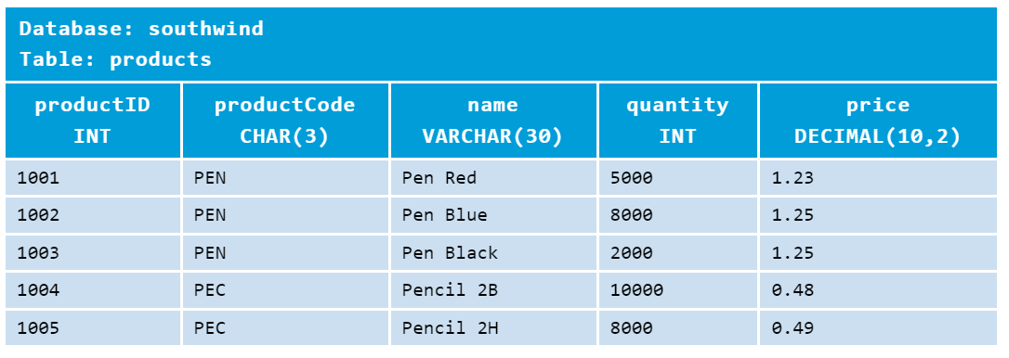
Chapter
08
Example
a product sales database. A product sales database typically consists of many tables, e.g., products, customers, suppliers, orders, payments, employees, among others. Let's call our database "southwind"
We shall begin with the first table called "products" with the following columns (having data types as indicated) and rows:
www.midocean.ae

Slide 5
Chapter
08
Creating and Deleting a Database - CREATE DATABASE and DROP DATABASE
mysql> CREATE DATABASE southwind;
Query OK, 1 row affected (0.03 sec)
mysql> DROP DATABASE southwind;
Query OK, 0 rows affected (0.11 sec)
mysql> CREATE DATABASE IF NOT EXISTS southwind;
Query OK, 1 row affected (0.01 sec)
mysql> DROP DATABASE IF EXISTS southwind;
Query OK, 0 rows affected (0.00 sec)
You can create a new database using SQL command "CREATE DATABASE databaseName"; and delete a database using "DROP DATABASE databaseName". You could optionally apply condition "IF EXISTS" or "IF NOT EXISTS" to these commands. For example,
IMPORTANT: Use SQL DROP (and DELETE) commands with extreme care, as the deleted entities are irrecoverable. THERE IS NO UNDO!!!
www.midocean.ae

Slide 6
Chapter
08
-- Remove the database "southwind", if it exists.
-- Beware that DROP (and DELETE) actions are irreversible and not recoverable!
mysql> DROP DATABASE IF EXISTS southwind;
Query OK, 1 rows affected (0.31 sec)
-- Create the database "southwind"
mysql> CREATE DATABASE southwind;
Query OK, 1 row affected (0.01 sec)
www.midocean.ae

Slide 7
Chapter
08
-- Create the table "products". Read "explanations" below for the column defintions
mysql> CREATE TABLE IF NOT EXISTS products (
productID INT UNSIGNED NOT NULL AUTO_INCREMENT,
productCode CHAR(3) NOT NULL DEFAULT '',
name VARCHAR(30) NOT NULL DEFAULT '',
quantity INT UNSIGNED NOT NULL DEFAULT 0,
price DECIMAL(7,2) NOT NULL DEFAULT 99999.99,
PRIMARY KEY (productID)
);
-- Show all the tables to confirm that the "products" table has been created
mysql> SHOW TABLES;
www.midocean.ae

Slide 8
Chapter
08
The types are:
productID is INT UNSIGNED - non-negative integers.
productCode is CHAR(3) - a fixed-length alphanumeric string of 3 characters.
name is VARCHAR(30) - a variable-length string of up to 30 characters.
We use fixed-length string for productCode, as we assume that the productCode contains exactly 3 characters. On the other hand, we use variable-length string for name, as its length varies - VARCHAR is more efficient than CHAR.
quantity is also INT UNSIGNED (non-negative integers).
price is DECIMAL(10,2) - a decimal number with 2 decimal places.
DECIMAL is precise (represented as integer with a fix decimal point). On the other hand, FLOAT and DOUBLE (real numbers) are not precise and are approximated. DECIMAL type is recommended for currency.
www.midocean.ae

Slide 9
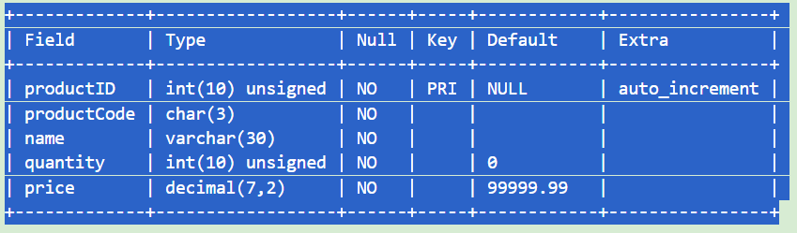
Chapter
08
-- Describe the fields (columns) of the "products" table
mysql> DESCRIBE products;
www.midocean.ae

Slide 10
Chapter
08
Inserting Rows - INSERT INTO
Let's fill up our "products" table with rows. We set the productID of the first record to 1001, and use AUTO_INCREMENT for the rest of records by inserting a NULL, or with a missing column value. Take note that strings must be enclosed with a pair of single quotes (or double quotes).
-- Insert a row with all the column values
mysql> INSERT INTO products VALUES (1001, 'PEN', 'Pen Red', 5000, 1.23);
-- Insert multiple rows in one command
-- Inserting NULL to the auto_increment column results in max_value + 1
mysql> INSERT INTO products VALUES
(NULL, 'PEN', 'Pen Blue', 8000, 1.25),
(NULL, 'PEN', 'Pen Black', 2000, 1.25);
Query OK, 2 rows affected (0.03 sec)
Records: 2 Duplicates: 0 Warnings: 0
www.midocean.ae

Slide 11
Chapter
08
-- 2nd column (productCode) is defined to be NOT NULL
mysql> INSERT INTO products values (NULL, NULL, NULL, NULL, NULL);
ERROR 1048 (23000): Column 'productCode' cannot be null
-- Insert value to selected columns
-- Missing value for the auto_increment column also results in max_value + 1
mysql> INSERT INTO products (productCode, name, quantity, price) VALUES
('PEC', 'Pencil 2B', 10000, 0.48),
('PEC', 'Pencil 2H', 8000, 0.49);
Query OK, 2 row affected (0.03 sec)
-- Missing columns get their default values
mysql> INSERT INTO products (productCode, name) VALUES ('PEC', 'Pencil HB');
Query OK, 1 row affected (0.04 sec)
-- 2nd column (productCode) is defined to be NOT NULL
mysql> INSERT INTO products values (NULL, NULL, NULL, NULL, NULL);
ERROR 1048 (23000): Column 'productCode' cannot be null
www.midocean.ae

Slide 12
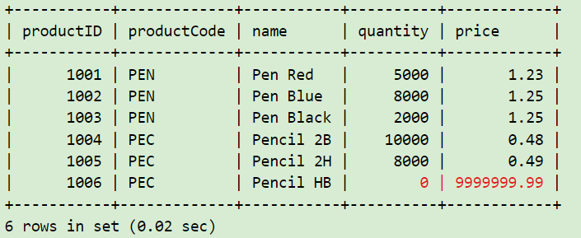
Chapter
08
-- Query the table
mysql> SELECT * FROM products;
www.midocean.ae

Slide 13
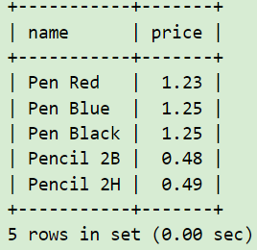
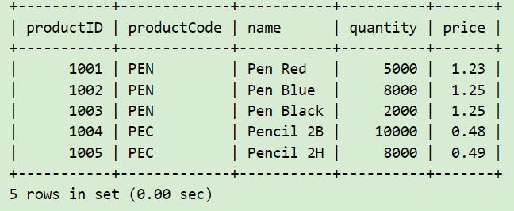
Chapter
08
Querying the Database - SELECT
-- List all rows for the specified columns
mysql> SELECT name, price FROM products;
-- List all rows of ALL the columns. The wildcard * denotes ALL columns
mysql> SELECT * FROM products;
www.midocean.ae

Slide 14
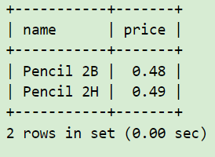
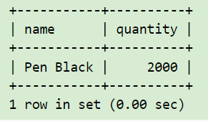
Chapter
08
Comparison Operators
For numbers (INT, DECIMAL, FLOAT), you could use comparison operators: '=' (equal to), '<>' or '!=' (not equal to), '>' (greater than), '<' (less than), '>=' (greater than or equal to), '<=' (less than or equal to), to compare two numbers. For example, price > 1.0, quantity <= 500.
mysql> SELECT name, price FROM products WHERE price < 1.0;
mysql> SELECT name, quantity FROM products WHERE quantity <= 2000;
www.midocean.ae

Slide 15
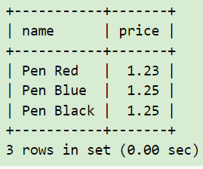
Chapter
08
CAUTION: Do not compare FLOATs (real numbers) for equality ('=' or '<>'), as they are not precise. On the other hand, DECIMAL are precise.
For strings, you could also use '=', '<>', '>', '<', '>=', '<=' to compare two strings (e.g., productCode = 'PEC'). The ordering of string depends on the so-called collation chosen. For example,
SELECT name, price FROM products WHERE productCode = 'PEN';
-- String values are quoted
www.midocean.ae
Notes:
تنبيه: لا تقارن FLOATs (الأرقام الحقيقية) للمساواة ('=' أو '<>')، لأنها ليست دقيقة. من ناحية أخرى، DECIMAL دقيقة.
Quoted = مقتبس

Slide 16
Chapter
08
String Pattern Matching - LIKE and NOT LIKE
For strings, in addition to full matching using operators like '=' and '<>', we can perform pattern matching using operator LIKE (or NOT LIKE) with wildcard characters. The wildcard '_' matches any single character; '%' matches any number of characters (including zero). For example,
'abc%' matches strings beginning with 'abc';
'%xyz' matches strings ending with 'xyz';
'%aaa%' matches strings containing 'aaa';
'___' matches strings containing exactly three characters; and
'a_b%' matches strings beginning with 'a', followed by any single character, followed by 'b', followed by zero or more characters.
www.midocean.ae

Slide 17
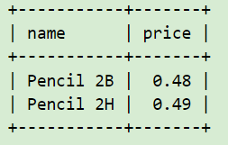
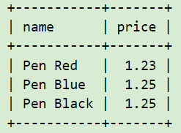
Chapter
08
-- "name" begins with 'PENCIL'
mysql> SELECT name, price FROM products WHERE name LIKE 'PENCIL%';
-- "name" begins with 'P', followed by any two characters,
-- followed by space, followed by zero or more characters
mysql> SELECT name, price FROM products WHERE name LIKE 'P__ %';
www.midocean.ae

Slide 18
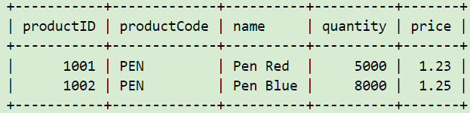
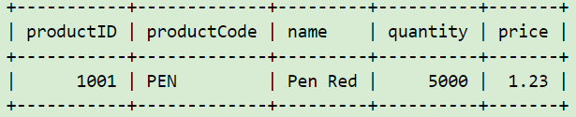
Chapter
08
Logical Operators - AND, OR, NOT
You can combine multiple conditions with boolean operators AND, OR. You can also invert a condition using operator NOT. For examples,
SELECT * FROM products WHERE quantity >= 5000 AND name LIKE 'Pen %';
SELECT * FROM products WHERE quantity >= 5000 AND price < 1.24 AND name LIKE 'Pen %';
www.midocean.ae

Slide 19
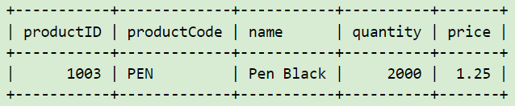
Chapter
08
BETWEEN, NOT BETWEEN
To check if the value is within a range, you could use BETWEEN ... AND ... operator. Again, this is easier and clearer than the equivalent AND-OR expression.
SELECT * FROM products
WHERE (price BETWEEN 1.0 AND 2.0) AND (quantity BETWEEN 1000 AND 2000);
www.midocean.ae

Slide 20
Chapter
08
IS NULL, IS NOT NULL
Using comparison operator (such as = or <>) to check for NULL is a mistake - a very common mistake. For example,
SELECT * FROM products WHERE productCode = NULL;
-- This is a common mistake. NULL cannot be compared.
NULL is a special value, which represent "no value", "missing value" or "unknown value". You can checking if a column contains NULL by IS NULL or IS NOT NULL. For example,
SELECT * FROM products WHERE productCode IS NULL;
Using comparison operator (such as = or <>) to check for NULL is a mistake - a very common mistake. For example,
SELECT * FROM products WHERE productCode = NULL;
-- This is a common mistake. NULL cannot be compared.
www.midocean.ae

Slide 21
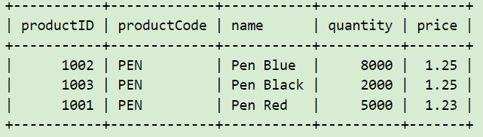
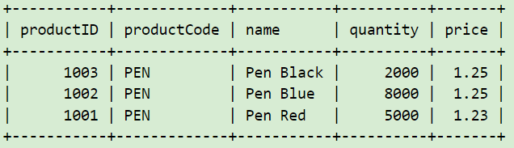
Chapter
08
ORDER BY Clause
-- Order the results by price in descending order
SELECT * FROM products WHERE name LIKE 'Pen %' ORDER BY price DESC;
-- Order by price in descending order, followed by quantity in ascending (default) order
mysql> SELECT * FROM products WHERE name LIKE 'Pen %' ORDER BY price DESC, quantity;
www.midocean.ae

Slide 22
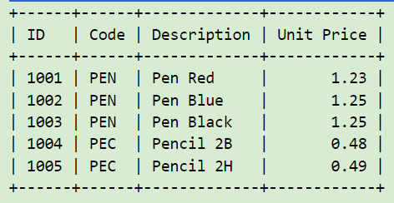
Chapter
08
AS - Alias
SELECT productID AS ID, productCode AS Code,
name AS Description, price AS `Unit Price` -- Define aliases to be used as display names
FROM products
ORDER BY ID; -- Use alias ID as reference
www.midocean.ae

Slide 23
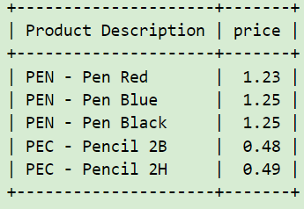
Chapter
08
Function CONCAT()
SELECT CONCAT(productCode, ' - ', name) AS `Product Description`, price FROM products;
www.midocean.ae

Slide 24
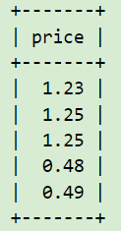
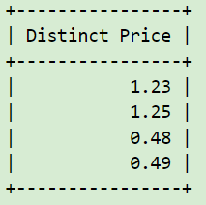
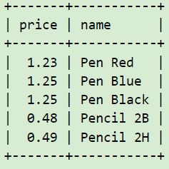
Chapter
08
Producing Summary Reports
DISTINCT
-- Without DISTINCT
SELECT price FROM products;
-- With DISTINCT on price
SELECT DISTINCT price AS `Distinct Price` FROM products;
-- DISTINCT combination of price and name
SELECT DISTINCT price, name FROM products;
www.midocean.ae

Slide 25
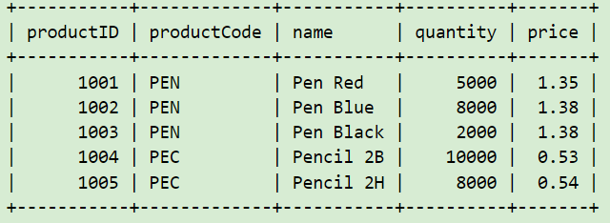
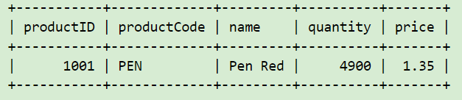
Chapter
08
Modifying Data - UPDATE
-- Increase the price by 10% for all products
UPDATE products SET price = price * 1.1;
SELECT * FROM products;
-- Modify selected rows
mysql> UPDATE products SET quantity = quantity - 100 WHERE name = 'Pen Red';
mysql> SELECT * FROM products WHERE name = 'Pen Red';
www.midocean.ae

Slide 26
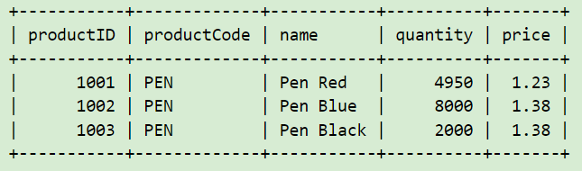
Chapter
08
Deleting Rows - DELETE FROM
DELETE FROM products WHERE name LIKE 'Pencil%';
SELECT * FROM products;
www.midocean.ae

Slide 27

Chapter
09
Database normalization
www.midocean.ae

Slide 28
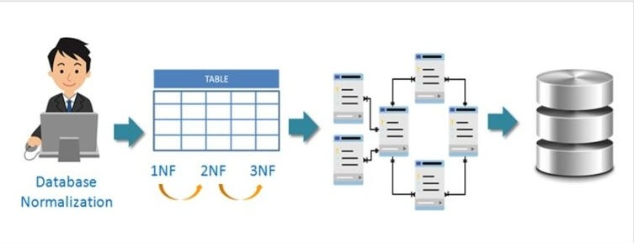
Chapter
09
Database normalization — Normal forms - 1nf 2nf 3nf
www.midocean.ae
Notes:
فهم عملية التوحيد Normalization المستخدمة عند تصميم قاعدة البيانات
لا تتجنب التكرار فحسب ، بل تجعل أيضًا استخدام أي قاعدة بيانات علائقية أكثر كفاءة: تتجنب أي خطأ في إدخال البيانات ، الحذف العرضي ، ويمكنك أيضًا تسهيل عملية تحديث البيانات.

Slide 29
Chapter
09
In relational database design, we not only want to create a structure that stores all of the data, but we also want to do it in a way that minimize potential errors when we work with the data. The default language for accessing data from a relational database is SQL. In particular, SQL can be used to manipulate data in the following ways: insert new data, delete unwanted data, and update existing data. Similarly, in an un-normalized design, there are 3 problems that can occur when we work with the data:
INSERT ANOMALY: This refers to the situation when it is impossible to insert certain types of data into the database.
DELETE ANOMALY: The deletion of data leads to unintended loss of additional data, data that we had wished to preserve.
UPDATE ANOMALY: This refers to the situation where updating the value of a column leads to database inconsistencies (i.e., different rows on the table have different values).
www.midocean.ae

Slide 30
Chapter
09
To address the 3 problems above, we go through the process of normalization. When we go through the normalization process, we increase the number of tables in the database, while decreasing the amount of data stored in each table. There are several different levels of database normalization:
1st Normal Form (1NF)
2nd Normal Form (2NF)
3rd Normal Form (3NF)
www.midocean.ae

Slide 31
Chapter
09
What Is Normalization?
Normalization is the branch of relational theory that provides design insights. It is the process of determining how much redundancy exists in a table.
The goals of normalization are to:
Be able to characterize the level of redundancy in a relational schema
Provide mechanisms for transforming schemas in order to remove redundancy
www.midocean.ae
Notes:
لتوحيد هو فرع من فروع النظرية العلائقية الذي يوفر رؤى التصميم، وهو عملية تحديد مقدار التكرار redundancy الموجود في الجدول.
أهداف التوحيد هي:
القدرة على وصف مستوى التكرار في مخطط علائقي.
توفير آليات لتغيير المخططات بهدف إزالة التكرار.

Slide 32
Chapter
09
Normal Forms
All the tables in any database can be in one of the normal forms we will discuss next.
Ideally we only want minimal redundancy for PK to FK. Everything else should be derived from other tables.
There are three basic normal forms, which are:
First normal form (1NF)
Second normal form (2NF)
Third normal form (3NF)
Boyce-Codd normal form (BCNF)
BCNF is rarely used.
www.midocean.ae
Notes:
يمكن أن تكون جميع الجداول الموجودة في قواعد البيانات ضمن أحد النماذج الموحَّدة التي سنناقشها الآن. نريد الحد الأدنى من التكرار بين المفتاح الرئيسي PK، والمفتاح الخارجي FK من الناحية المثالية، كما يجب اشتقاق كل شيء آخر من جداول أخرى.
هناك 3 نماذج موحَّدة، وهي:
النموذج الموحَّد الأول First normal form، أو 1NF اختصارًا.
النموذج الموحَّد الثاني Second normal form، أو 2NF اختصارًا.
النموذج الموحَّد الثالث Third normal form، أو 3NF اختصارًا.
نموذج بويس-كود الموحَّد Boyce-Codd normal form، أو BCNF اختصارًا، وهو نادر الاستخدام.

Slide 33
Chapter
09
Advantages of Normal Form
Reduced data redundancy: Normalization helps to eliminate duplicate data in tables, reducing the amount of storage space needed and improving database efficiency.
Improved data consistency: Normalization ensures that data is stored in a consistent and organized manner, reducing the risk of data inconsistencies and errors.
Simplified database design: Normalization provides guidelines for organizing tables and data relationships, making it easier to design and maintain a database.
Improved query performance: Normalized tables are typically easier to search and retrieve data from, resulting in faster query performance.
Easier database maintenance: Normalization reduces the complexity of a database by breaking it down into smaller, more manageable tables, making it easier to add, modify, and delete data.
www.midocean.ae
Notes:
ما هي فوائد تطبيع البيانات؟
تصغير حجم قاعدة البيانات
عندما يكون لديك بيانات تكرر نفسها في قاعدة البيانات الخاصة بك ، فأنت بحاجة إلى مساحة كبيرة لتخزين تلك البيانات ، لكنها إهدار كامل. يؤدي تطبيع البيانات إلى تقليل مساحة تخزين قاعدة البيانات ، وهذا يعني ، كما تعلم ، أنك توفر الموارد والمال.
تبسيط الاستفسارات
دائمًا ما يكون البحث عن المعلومات من خلال قاعدة بيانات جيدة التنظيم أسهل من القيام بالشيء نفسه داخل مكان فوضوي ، سواء كنت تقوم بذلك يدويًا أو باستخدام أداة رقمية آلية.
تسهيل الصيانة
تسوية قاعدة البيانات تمنع حدوث المشاكل وتجعل صيانة قاعدة البيانات أسهل. مرة أخرى ، هذا من شأنه تجنب إهدار الموارد والمال.

Slide 34
Chapter
09
Important Points Regarding Normal Forms in DBMS:
First Normal Form (1NF): This is the most basic level of normalization. In 1NF, each table cell should contain only a single value, and each column should have a unique name. The first normal form helps to eliminate duplicate data and simplify queries.
Second Normal Form (2NF): 2NF eliminates redundant data by requiring that each non-key attribute be dependent on the primary key. This means that each column should be directly related to the primary key, and not to other columns.
Third Normal Form (3NF): 3NF builds on 2NF by requiring that all non-key attributes are independent of each other. This means that each column should be directly related to the primary key, and not to any other columns in the same table.
Boyce-Codd Normal Form (BCNF): BCNF is a stricter form of 3NF that ensures that each determinant in a table is a candidate key. In other words, BCNF ensures that each non-key attribute is dependent only on the candidate key.
www.midocean.ae

Slide 35
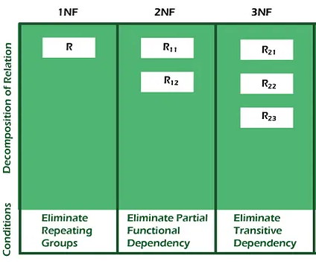
Chapter
09
First Normal Form (1NF)
www.midocean.ae

Slide 36
Chapter
09
In Short
First Normal Form (1NF)
The first normal form (1NF), is the most basic form of data normalization. The core outcome of this rule ensures that there are no repeating entries in a group. This means:
Every cell should only have one single value.
Every record should be unique.
For a table to be in the first normal form, it must meet the following criteria:
A single cell must not hold more than one value (atomic)
There must be a primary key for identification
No duplicated rows or columns
Each column must have only one value for each row in the table
www.midocean.ae

Slide 37
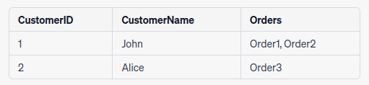
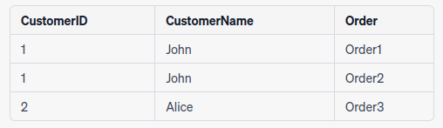
Chapter
09
Example:
Suppose you have a table that stores information about customers and their orders. This table is not in 1NF because the “Orders” column contains multiple values separated by commas, violating the rule of atomic values:
To bring it into 1NF, you can split the “Orders” column into separate rows:
www.midocean.ae

Slide 38
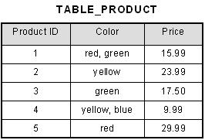
Chapter
09
1st Normal Form Example
How do we bring an unnormalized table into first normal form? Consider the following example:
This table is not in first normal form because the [Color] column can contain multiple values. For example, the first row includes values "red" and "green."
www.midocean.ae

Slide 39
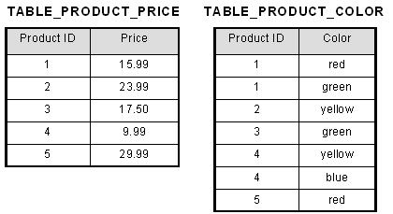
Chapter
09
1st Normal Form Example
To bring this table to first normal form, we split the table into two tables and now we have the resulting tables:
www.midocean.ae

Slide 40
Chapter
09
Second Normal Form (2NF)
www.midocean.ae

Slide 41
Chapter
09
Second Normal Form (2NF)
2NF is the second normal form that builds on the rules of the first normal form. Again, the goal is to ensure that there are no repeating entries in a dataset. Entries with this data normalization rule applied must:
Adhere to all the 1NF requirements.
Have one primary key applied.
The application of one primary key essentially means that a separate table needs to be created for subsets of data that can be placed in multiple rows. The data in each table can then be linked with foreign key labels (numbers in this case).
www.midocean.ae

Slide 42
Chapter
09
In Short
Second Normal Form (2NF)
A table is in 2NF if it meets the following criteria:
It is in 1NF.
All non-key attributes (columns) are fully functionally dependent on the primary key.
www.midocean.ae

Slide 43
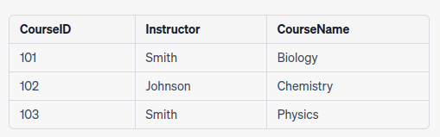


Chapter
09
Example 1:
Consider a table that stores information about courses and the instructors who teach them:
In this table, the combination of “CourseID” and “Instructor” forms a composite primary key. However, the “CourseName” column depends only on “CourseID,” not on “Instructor.” To bring this table into 2NF, you can split it into two separate tables:
Table 1 (Courses)
Table 2 (Instructors)
www.midocean.ae

Slide 44
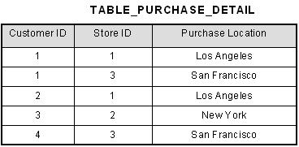
Chapter
09
2nd Normal Form Example 2
Consider the following example:
Example Not In Second Normal Form
This table has a composite primary key [Customer ID, Store ID]. The non-key attribute is [Purchase Location]. In this case, [Purchase Location] only depends on [Store ID], which is only part of the primary key. Therefore, this table does not satisfy second normal form.
www.midocean.ae

Slide 45
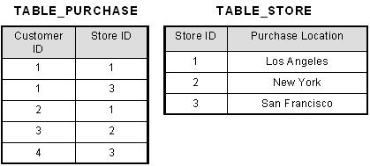
Chapter
09
To bring this table to second normal form, we break the table into two tables, and now we have the following:
What we have done is to remove the partial functional dependency that we initially had. Now, in the table [TABLE_STORE], the column [Purchase Location] is fully dependent on the primary key of that table, which is [Store ID].
www.midocean.ae

Slide 46
Chapter
09
Third Normal Form (3NF)
www.midocean.ae

Slide 47
Chapter
09
Third Normal Form (3NF)
A relation will be in 3NF if it is in 2NF and not contain any transitive partial dependency.
3NF is used to reduce the data duplication. It is also used to achieve the data integrity.
If there is no transitive dependency for non-prime attributes, then the relation must be in third normal form.
A relation is in third normal form if it holds atleast one of the following conditions for every non-trivial function dependency X → Y.
X is a super key.
Y is a prime attribute, i.e., each element of Y is part of some candidate key.
www.midocean.ae

Slide 48
Chapter
09
Third Normal Form (3NF)
A table is in 3NF if it meets the following criteria:
It is in 2NF.
There is no transitive dependency between non-key attributes.
By transitive functional dependency, we mean we have the following relationships in the table: A is functionally dependent on B, and B is functionally dependent on C. In this case, C is transitively dependent on A via B.
www.midocean.ae

Slide 49



Chapter
09
Example:
Continuing with the “Courses” and “Instructors” tables from 2NF, suppose you add an “InstructorEmail” column to the “Instructors” table. If the email is unique to each instructor and not related to a course, you have a transitive dependency issue. To achieve 3NF, you would create a separate “InstructorInfo” table:
Table 1 (Courses): (Unchanged from 2NF)
Table 3 (InstructorInfo): (Instructor and Email)
Table 2 (Instructors): (Without email)
www.midocean.ae

Slide 50
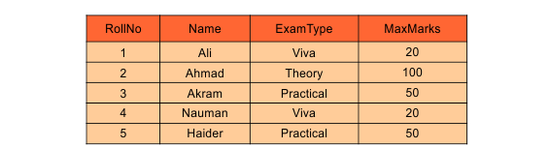
Chapter
09
Example:
In the following table Roll_No is the candidate key which determines ExamType and ExamType determines the MaxMarks. So the following table holds transition property. That’s why it in not in 3NF.
Exam table
www.midocean.ae

Slide 51
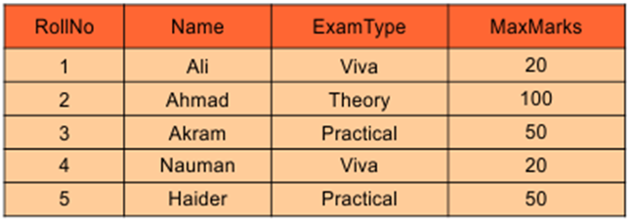
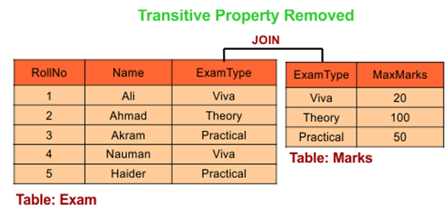
Chapter
09
Transitive property can be removed by dividing the table into its parts.
Exam table
www.midocean.ae
Notes:
خاصية متعدية = Transitive property

Slide 52
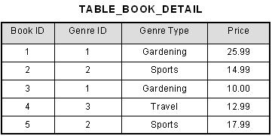
Chapter
09
3rd Normal Form Example 3:
Consider the following example:
In the table able, [Book ID] determines [Genre ID], and [Genre ID] determines [Genre Type]. Therefore, [Book ID] determines [Genre Type] via [Genre ID] and we have transitive functional dependency, and this structure does not satisfy third normal form.
www.midocean.ae
Notes:
في الجدول الممكن، يحدد [معرف الكتاب] [معرف النوع]، ويحدد [معرف النوع] [نوع النوع]. لذلك، يحدد [معرف الكتاب] [نوع النوع] عبر [معرف النوع] ولدينا تبعية وظيفية متعدية، وهذه البنية لا تلبي الشكل العادي الثالث.

Slide 53
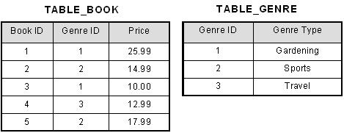
Chapter
09
To bring this table to third normal form, we split the table into two as follows:
Now all non-key attributes are fully functional dependent only on the primary key. In [TABLE_BOOK], both [Genre ID] and [Price] are only dependent on [Book ID]. In [TABLE_GENRE], [Genre Type] is only dependent on [Genre ID].
www.midocean.ae

Slide 54
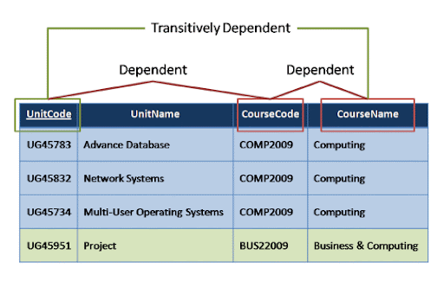
Chapter
09
www.midocean.ae

Slide 55
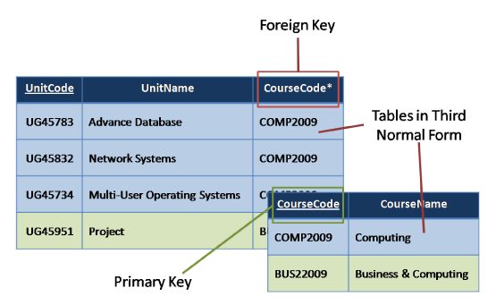
Chapter
09
www.midocean.ae

Slide 56
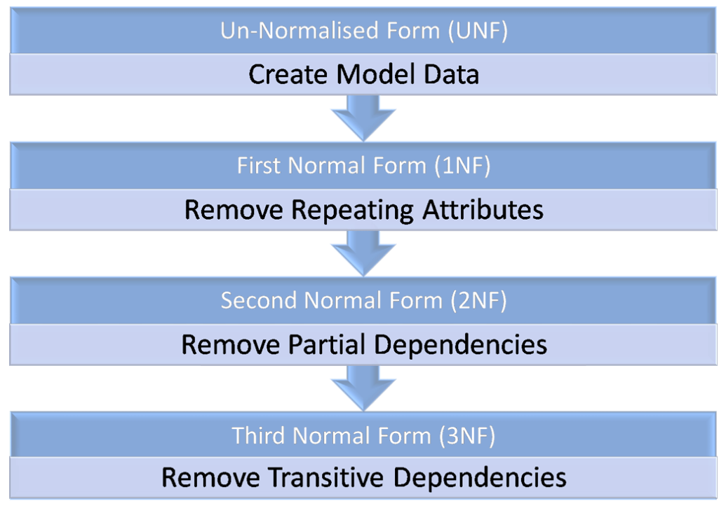
Chapter
09
Un-Normalised Form (UNF) – Data Modelling
First Normal Form (1NF) – Repeating Groups
Second Normal Form (2NF) – Partial Dependencies
Third Normal Form (3NF) – Transitive Dependencies
www.midocean.ae

Slide 57



Thank You

