Slide 1

Advanced Project Management APM
Prepared by Dr. Ahmad Al Ghamdi
PMG 506
Advanced Project Management (APM)

Slide 2
Advanced Project Management
Prepared by Dr. Ahmad Al Ghamdi
Lecture 2
PMG 506
Strategic Management
and Project Selection

Slide 3
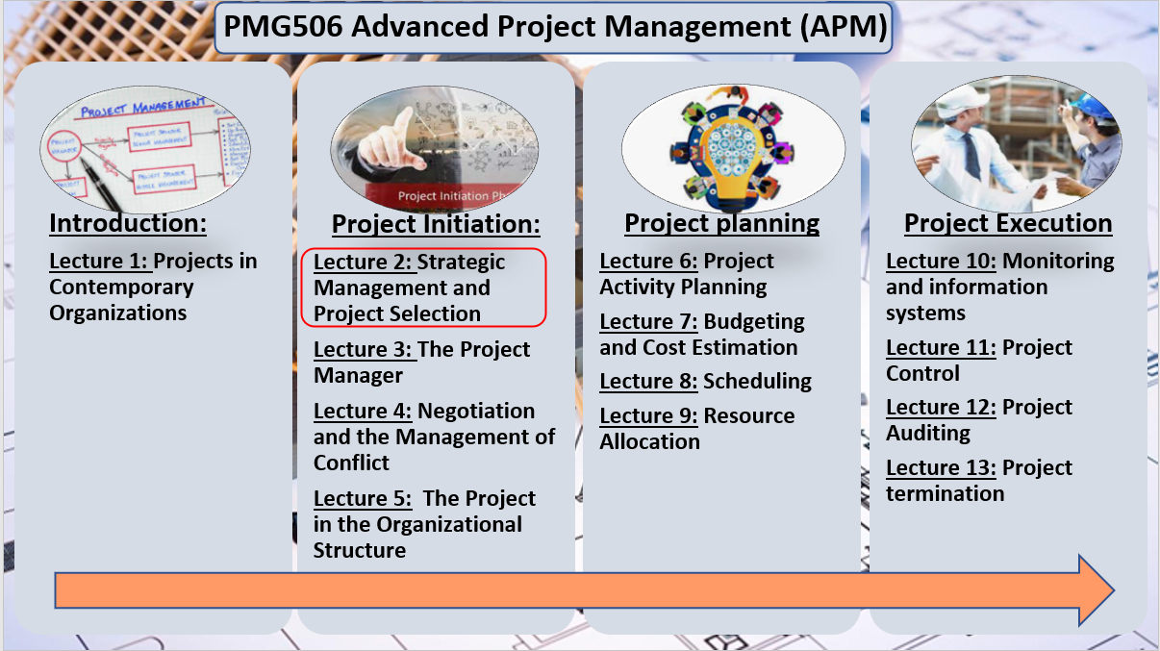

Lecture 2
Strategic Management and Project Selection

Slide 4
Lecture 2
Strategic Management and Project Selection
With so many ongoing projects it becomes difficult for smaller projects to get adequate support, or even the attention of senior management. Three common problems in organizations trying to manage multiple projects are:
1- Delays in one project cause delays in other projects because of common resource needs or technological dependencies.
2- The inefficient use of corporate resources results in peaks and valleys of resource utilization. 3- Bottlenecks in resource availability or lack of required technological inputs result in project delays that depend on those scarce resources or technology.
This enforce the need for Project Management Office (PMO).
It is expected that the PMO will promote those projects that capitalize on the organization’s strengths, offer a competitive advantage, and mutually support each other, while avoiding those with resource or technology needs in areas where the organization has no desire for development.

Slide 5
Lecture 2
Strategic Management and Project Selection
Given that the organization has an appropriate mission statement and strategy, projects must be selected that are consistent with the strategic goals of the organization.
Project selection is the process of evaluating individual projects or groups of projects and then choosing to implement some set of them so that the objectives of the parent organization will be achieved.
Because considerable uncertainty may surround one’s initial notions of precisely how most projects will be carried out, what resources will be required, and how long it will take to complete the project, we will introduce risk analysis
The project manager who does not understand what a given project is expected to contribute to the parent organization lacks critical information needed to manage the project in order to optimize its contribution to the parent organization

Slide 6
Lecture 2
Strategic Management and Project Selection
2.1 PROJECT MANAGEMENT MATURITY
Project management maturity is a measure of the organization’s project managers mastery of the skills required to manage projects competently.
A number of consulting firms, as well as scholars, have devised formal maturity measures including:
IPMA, PMI, PM3® and others.

Slide 7
Lecture 2
Strategic Management and Project Selection
2.2 PROJECT SELECTION AND CRITERIA OF CHOICE
Project selection is the process of evaluating proposed projects or groups of projects, and then choosing to implement some set of them so that the objectives of the parent organization will be achieved.
This systematic process can be applied to any area of the organization’s business in which choices must be made between competing alternatives.
It is critically important to the success of the PM that he or she fully understands the parent organization’s objectives in undertaking a project that the PM is expected to lead. Most of the decisions that the PM is forced to make will have an impact on the degree to which the project contributes to those objectives the parent organization expected from the project.
modeling the problem is the process of carving away the unwanted reality from the bones of a problem.
many models include graphs, analogies, diagrams, as well as flow graph and network models to help solve scheduling problems, and symbolic (mathematical) models for a number of purposes.

Slide 8
Lecture 2
Strategic Management and Project Selection
2.2 PROJECT SELECTION AND CRITERIA OF CHOICE
If the input data for a model are not known precisely, we often use probabilistic information; that is, the model is said to be stochastic rather than deterministic.
When a firm chooses a project selection model, the following criteria are most important:
Realism The model should reflect the reality of the firm’s decision situation. It should also take into account the realities of the firm’s limitations on facilities, capital, personnel, and so forth, and include factors that reflect project technical and market risks: performance, cost, time, customer rejection, and implementation.
Capability The model should be sophisticated enough to deal with the relevant factors: multiple time periods, situations both internal and external to the project (e.g., strikes, interest rate changes), and so on.
Flexibility The model should give valid results within the range of conditions that the firm might experience. It should be easy to modify in response to changes.

Slide 9
Lecture 2
Strategic Management and Project Selection
2.2 PROJECT SELECTION AND CRITERIA OF CHOICE
Ease of use The model should be reasonably convenient, not take a long time to execute, and be easy to use and understand. It should not require special interpretation, data that are difficult to acquire, excessive personnel, or unavailable equipment.
Cost Data-gathering and modeling costs should be low relative to the cost of the project and less than the potential benefits of the project. All costs should be considered, including the costs of data management and of running the model.
Easy computerization It should be easy and convenient to gather and store the information in a computer database, and to manipulate data in the model through use of a widely available, standard computer package such as Excel®

Slide 10
Lecture 2
Strategic Management and Project Selection
2.3 THE NATURE OF PROJECT SELECTION MODELS
There are two basic types of project selection models, numeric and nonnumeric. Both are widely used. Many organizations use both at the same time, or they use models that are combinations of the two.
Nonnumeric models, as the name implies, do not use numbers as inputs.
Numeric models do, but the criteria being measured may be either objective or subjective.
It is important to remember that the qualities of a project may be represented by numbers, and that subjective measures are not necessarily less useful or reliable than objective measures.
Never forgetting two critically important, but often overlooked, facts:
• Models do not make decisions—people do.
• All models, however sophisticated, are only partial representations of the reality they are meant to reflect.

Slide 11
Lecture 2
Strategic Management and Project Selection
2.4 TYPES OF PROJECT SELECTION MODELS
Nonnumeric Models:
The Sacred Cow The project is suggested by a senior and powerful official in the organization with a simple comment such as, “If you have a chance, why don’t you look into…,” The immediate result of this bland statement is the creation of a “project” to investigate whatever the boss has suggested. The project is “sacred” in the sense that it will be maintained until successfully concluded, or until the boss, personally, recognizes the idea as a failure and terminates it.
The Operating Necessity If a flood is threatening the plant, a project to build a protective dike does not require much formal evaluation, which is an example of this scenario.
If the project is required in order to keep the system operating, the primary question becomes: Is the system worth saving at the estimated cost of the project? If the answer is yes, project costs will be examined to make sure they are kept as low as is consistent with project success, but the project will be funded.

Slide 12
Lecture 2
Strategic Management and Project Selection
2.4 TYPES OF PROJECT SELECTION MODELS
Nonnumeric Models:
The Competitive Necessity Is the company decision to go for some projects if the firm want to maintain its competitive position in the market area.
Investment in an operating necessity project takes precedence over a competitive necessity project, but both types of projects may bypass the more careful numeric analysis used for projects deemed to be less urgent or less important to the survival of the firm.
The Product Line Extension A project to develop and distribute new products would be judged on the degree to which it fits the firm’s existing product line, fills a gap, strengthens a weak link, or extends the line in a new, desirable direction. Sometimes careful calculations of profitability are not required. Decision makers can act on their beliefs about what will be the likely impact on the total system performance if the new product is added to the line.

Slide 13
Lecture 2
Strategic Management and Project Selection
2.4 TYPES OF PROJECT SELECTION MODELS
Nonnumeric Models:
Comparative Benefit Model Senior management would like to select a subset of the projects that would most benefit the firm, but the projects do not seem to be easily comparable.
The organization has no formal method of selecting projects, but members of the Selection Committee think that some projects will benefit the firm more than others, even if they have no precise way to define or measure “benefit.”
Of the several techniques for ordering projects, the Q-Sort is one of the most straightforward. First, the projects are divided into three groups—good, fair, and poor—according to their relative merits. If any group has more than eight members, it is subdivided into two categories, such as fair-plus and fair-minus. When all categories have eight or fewer members, the projects within each category are ordered from best to worst. Again, the order is determined on the basis of relative merit. The rater may use specific criteria to rank each project, or may simply use general overall judgment.

Slide 14
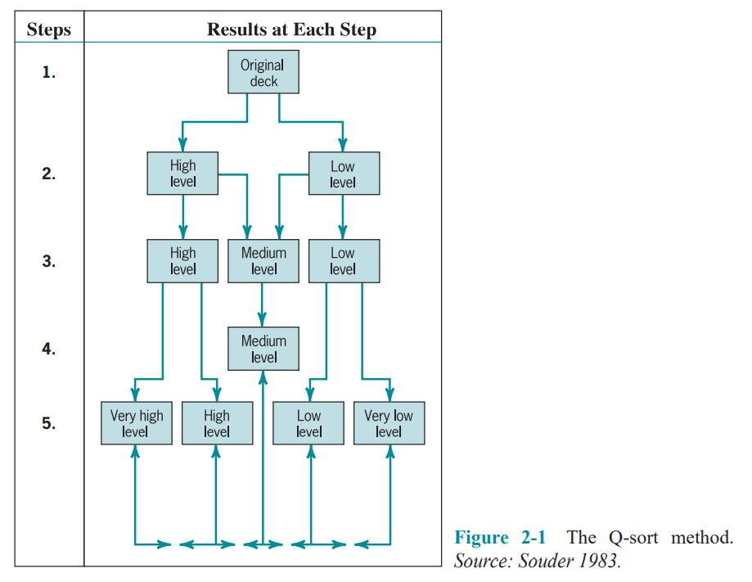
Lecture 2
Strategic Management and Project Selection
2.4 TYPES OF PROJECT SELECTION MODELS

Slide 15
Lecture 2
Strategic Management and Project Selection
2.4 TYPES OF PROJECT SELECTION MODELS
Numeric Models: Profit/Profitability
A large majority of all firms using project evaluation and selection models use profitability as the sole measure of acceptability.
Payback Period The payback period for a project is the initial fixed investment in the project divided by the estimated annual net cash inflows from the project. The ratio of these quantities is the number of years required for the project to repay its initial fixed investment.
For example, assume a project costs $100,000 to implement and has annual net cash inflows of $25,000. Then
Payback period = $100,000/$25,000 =4 years
This method assumes that the cash inflows will persist at least long enough to pay back the investment, and it ignores any cash inflows beyond the payback period. The method also serves as an (inadequate) proxy for risk. The faster the investment is recovered, the less the risk to which the firm is exposed.

Slide 16
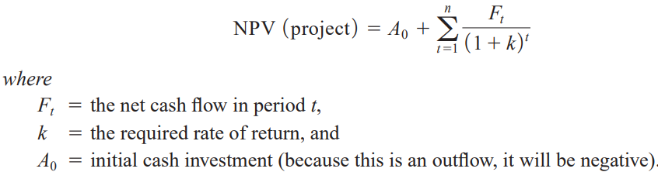
Lecture 2
Strategic Management and Project Selection
2.4 TYPES OF PROJECT SELECTION MODELS
Numeric Models: Profit/Profitability
Discounted Cash Flow Also referred to as the net present value (NPV) method, the discounted cash flow method determines the net present value of all cash flows by discounting them by the required rate of return (also known as the hurdle rate, cutoff rate, and similar terms) as follows:

Slide 17

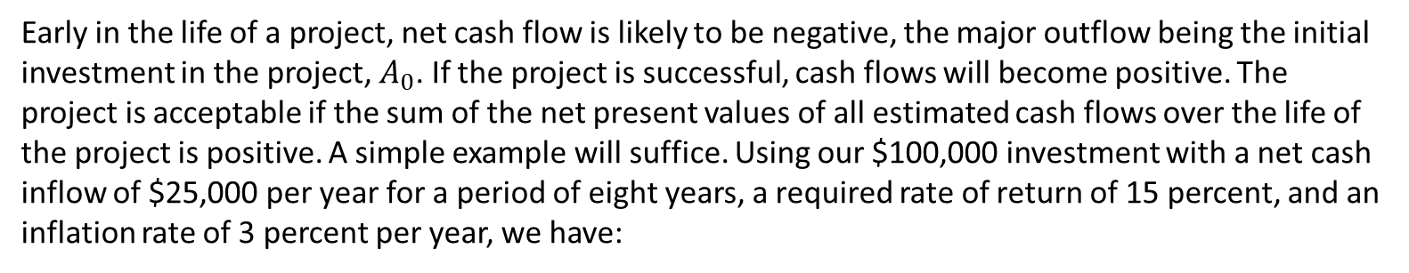
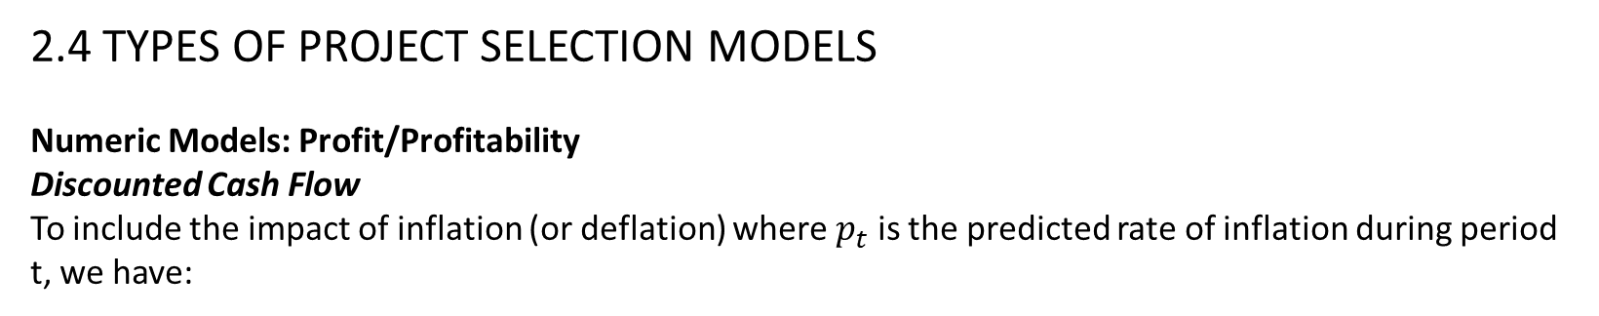
Lecture 2
Strategic Management and Project Selection
2.4 TYPES OF PROJECT SELECTION MODELS
Numeric Models: Profit/Profitability
Discounted Cash Flow
To include the impact of inflation (or deflation) where $p_{t}$ is the predicted rate of inflation during period t, we have:
Early in the life of a project, net cash flow is likely to be negative, the major outflow being the initial investment in the project, $A_{0}$. If the project is successful, cash flows will become positive. The project is acceptable if the sum of the net present values of all estimated cash flows over the life of the project is positive. A simple example will suffice. Using our $100,000 investment with a net cash inflow of $25,000 per year for a period of eight years, a required rate of return of 15 percent, and an inflation rate of 3 percent per year, we have:

Slide 18
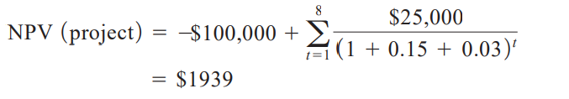
Lecture 2
Strategic Management and Project Selection
2.4 TYPES OF PROJECT SELECTION MODELS
Numeric Models: Profit/Profitability
Discounted Cash Flow
Because the present value of the inflows is greater than the present value of the outflow i.e, the net present value is positive, the project is deemed acceptable.

Slide 19

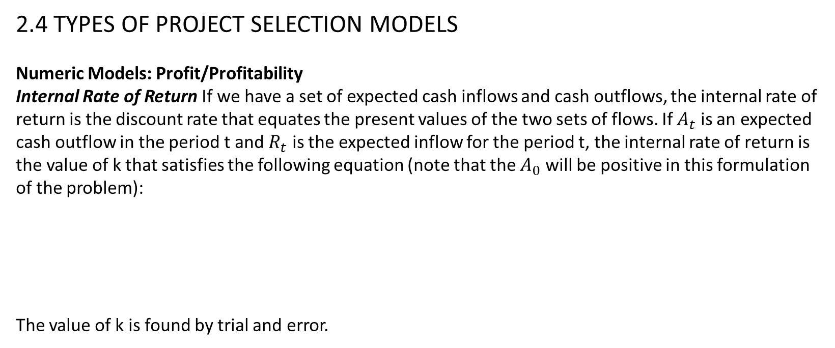
Lecture 2
Strategic Management and Project Selection
2.4 TYPES OF PROJECT SELECTION MODELS
Numeric Models: Profit/Profitability
Internal Rate of Return If we have a set of expected cash inflows and cash outflows, the internal rate of return is the discount rate that equates the present values of the two sets of flows. If $A_{t}$ is an expected cash outflow in the period t and $R_{t}$ is the expected inflow for the period t, the internal rate of return is the value of k that satisfies the following equation (note that the $A_{0}$ will be positive in this formulation of the problem):
The value of k is found by trial and error.

Slide 20
Lecture 2
Strategic Management and Project Selection
2.4 TYPES OF PROJECT SELECTION MODELS
Numeric Models: Profit/Profitability
Profitability Index Also known as the benefit–cost ratio, the profitability index is the net present value of all future expected cash flows divided by the initial cash investment. (Some firms do not discount the cash flows in making this calculation.) If this ratio is greater than 1.0, the project may be accepted.
Other Profitability Models There are a great many variations of the models just described. These variations fall into three general categories:
those that subdivide net cash flow into the elements that comprise the net flow.
(2) those that include specific terms to introduce risk (or uncertainty, which is treated as risk) into the evaluation.
(3) those that extend the analysis to consider effects that the project might have on other projects or activities in the organization.
Several comments are in order about all the profit-profitability numeric models.

Slide 21
Lecture 2
Strategic Management and Project Selection
2.4 TYPES OF PROJECT SELECTION MODELS
Numeric Models: Profit/Profitability
First, let us consider their advantages:
1. The undiscounted models are simple to use and understand.
2. All use readily available accounting data to determine the cash flows.
3. Model output is in terms familiar to business decision makers.
4. With a few exceptions, model output is on an “absolute” profit/profitability scale and allows “absolute” go/no-go decisions.
5. Some profit models can be amended to account for project risk.
The disadvantages of these models are the following:
1. These models ignore all nonmonetary factors except risk.
2. Models that do not include discounting ignore the timing of the cash flows and the time value of money.
3. Models that reduce cash flows to their present value are strongly biased toward the short run.

Slide 22
Lecture 2
Strategic Management and Project Selection
2.4 TYPES OF PROJECT SELECTION MODELS
Numeric Models: Profit/Profitability
5. The internal rate of return model can result in multiple solutions.
6. All are sensitive to errors in the input data for the early years of the project.
7. All discounting models are nonlinear, and the effects of changes (or errors) in the variables or parameters are generally not obvious to most decision makers.
8. All these models depend for input on a determination of cash flows, but it is not clear exactly how the concept of cash flow is properly defined for the purpose of evaluating projects.
In general, the net present value models are preferred to the internal rate of return models. Despite wide use, financial models rarely include nonfinancial outcomes in their benefits and costs.
Real Options Recently, a project selection model was developed based on a notion well known in financial markets. When one invests, one foregoes the value of alternative future investments.
Economists refer to the value of an opportunity foregone as the “opportunity cost” of the investment made.

Slide 23
Lecture 2
Strategic Management and Project Selection
2.4 TYPES OF PROJECT SELECTION MODELS
Numeric Models: Scoring
In an attempt to overcome some of the disadvantages of profitability models, particularly their focus on a single decision criterion, a number of evaluation/selection models that use multiple criteria to evaluate a project have been developed.
Unweighted 0–1 Factor Model A set of relevant factors is selected by management and then usually listed in a preprinted form. One or more raters score the project on each factor, depending on whether or not it qualifies for an individual criterion. The criteria for choice are (1) a clear understanding of organizational goals and (2) a good knowledge of the firm’s potential project portfolio.
The main advantage of such a model is that it uses several criteria in the decision process. The major disadvantages are that it assumes all criteria are of equal importance and it allows for no gradation of the degree to which a specific project meets the various criteria.

Slide 24
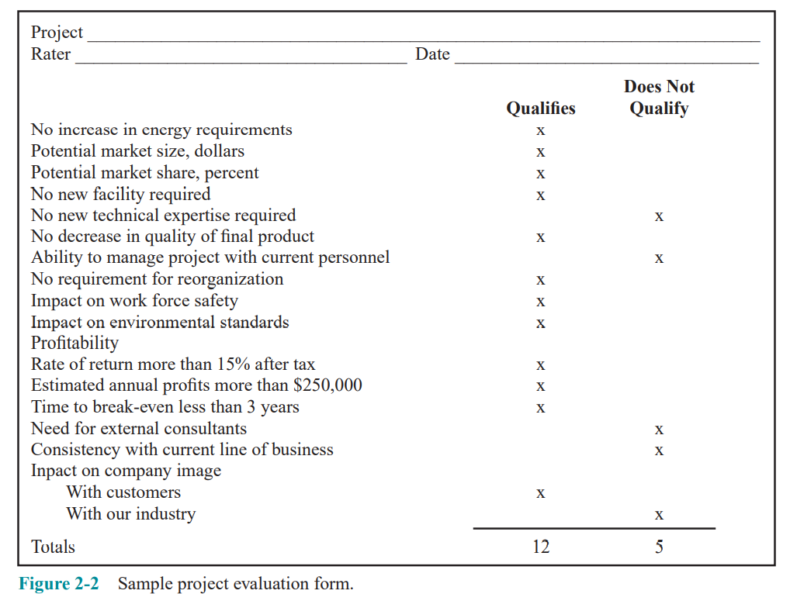
Lecture 2
Strategic Management and Project Selection
2.4 TYPES OF PROJECT SELECTION MODELS
Numeric Models: Scoring
Unweighted 0–1 Factor Model

Slide 25
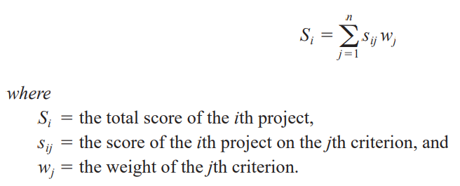
Lecture 2
Strategic Management and Project Selection
2.4 TYPES OF PROJECT SELECTION MODELS
Numeric Models: Scoring
Unweighted Factor Scoring Model The second disadvantage of the 0–1 factor model can be dealt with by constructing a simple linear measure of the degree to which the project being evaluated meets each of the criteria contained in the list. Often a five-point scale is used, where 5 is very good, 4 is good, 3 is fair, 2 is poor, 1 is very poor. (Three-, seven-, and 10-point scales are also common.) The column of scores is summed, and those projects with a total score exceeding some critical value are selected.
However, the criticism that the criteria are all assumed to be of equal importance still holds.
Weighted Factor Scoring Model When numeric weights reflecting the relative importance of each individual factor are added, we have a weighted factor scoring model.

Slide 26
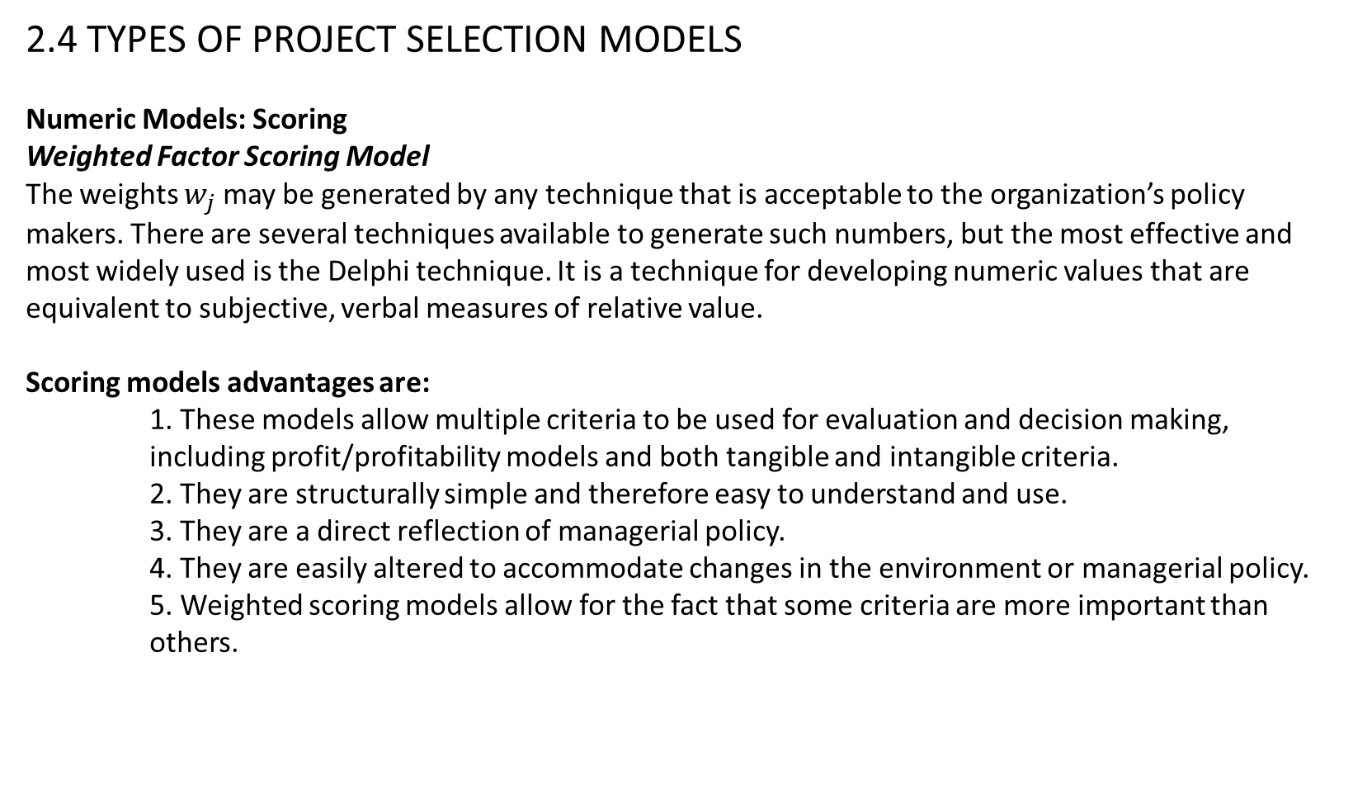
Lecture 2
Strategic Management and Project Selection
2.4 TYPES OF PROJECT SELECTION MODELS
Numeric Models: Scoring
Weighted Factor Scoring Model
The weights $w_{j}$ may be generated by any technique that is acceptable to the organization’s policy makers. There are several techniques available to generate such numbers, but the most effective and most widely used is the Delphi technique. It is a technique for developing numeric values that are equivalent to subjective, verbal measures of relative value.
Scoring models advantages are:
1. These models allow multiple criteria to be used for evaluation and decision making, including profit/profitability models and both tangible and intangible criteria.
2. They are structurally simple and therefore easy to understand and use.
3. They are a direct reflection of managerial policy.
4. They are easily altered to accommodate changes in the environment or managerial policy.
5. Weighted scoring models allow for the fact that some criteria are more important than others.

Slide 27
Lecture 2
Strategic Management and Project Selection
2.4 TYPES OF PROJECT SELECTION MODELS
Numeric Models: Scoring
6. These models allow easy sensitivity analysis. The trade-offs between the several criteria are readily observable.
The disadvantages are:
1. The output of a scoring model is strictly a relative measure. Project scores do not represent the value or “utility” associated with a project and thus do not directly indicate whether or not the project should be supported.
2. In general, scoring models are linear in form and the elements of such models are assumed to be independent.
3. The ease of use of these models is conducive to the inclusion of a large number of criteria, most of which have such small weights that they have little impact on the total project score. 4. Unweighted scoring models assume all criteria are of equal importance, which is almost certainly contrary to fact.

Slide 28
Lecture 2
Strategic Management and Project Selection
2.4 TYPES OF PROJECT SELECTION MODELS
Numeric Models: Scoring
5. To the extent that profit/profitability is included as an element in the scoring model, this element has the advantages and disadvantages noted earlier for the profitability models.
Window-of-Opportunity Analysis
That one ability to achieve a new technology does not necessarily imply that the new technology is worth implementing, or economically profitable. Given some idea for a new product or process, we can invert this traditional approach by attempting to determine the cost, timing, and performance specifications that must be met by this new technology before any R & D is undertaken. (This is called the window-of-opportunity for the innovation.)

Slide 29
Lecture 2
Strategic Management and Project Selection
2.4 TYPES OF PROJECT SELECTION MODELS
Choosing a Project Selection Model
Selecting the type of model to aid the evaluation/selection process depends on the philosophy and wishes of management.
We strongly favor weighted scoring models for three fundamental reasons.
First, they allow the multiple objectives of all organizations to be reflected in the important decision about which projects will be supported and which will be rejected.
Second, scoring models are easily adapted to changes in managerial philosophy or changes in the environment.
Third, they do not suffer from the bias toward the short run that is inherent in profitability models that discount future cash flows

Slide 30
Lecture 2
Strategic Management and Project Selection
2.5 ANALYSIS UNDER UNCERTAINTY — THE MANAGEMENT OF RISK
Risk has been interpreted as being unsure about project task durations and/or costs, but uncertainty plagues all aspects of the work on projects and is present in all stages of project life cycles. In this section, we will consider uncertainty as it affects the selection process.
Before proceeding, it is useful to discuss briefly the distinction between two words, “risk” and “uncertainty.” The outcome of any decision depends on two things:
(1) what the decision maker does; and
(2) what nature does—“nature” being the set of exogenous factors that interact with the decision maker’s course of action to produce an outcome.
If the decision maker knows the probability of each and every state of nature and thus of each and every outcome, she can find the expected value of each alternative course of action she has.
The expected value of a specific action is the sum of the values of each outcome associated with the action times the probability that it will occur. . She can select the course of action associated with the best of these expected values. This is decision making under conditions of risk

Slide 31
Lecture 2
Strategic Management and Project Selection
2.5 ANALYSIS UNDER UNCERTAINTY — THE MANAGEMENT OF RISK
If the decision maker’s information is not so complete and she does not know and cannot collect sufficient data to determine the probability of occurrence for some states of nature, she cannot find the expected value for each of her alternative actions. This is decision making under conditions of uncertainty.
When relationships between inputs and outputs in the projects are complex, Monte Carlo simulation can handle such uncertainty by exposing the many possible consequences of embarking on a project. Risk analysis is a method based on such a procedure. With the great availability of microcomputers and user-friendly software, these procedures are becoming very common.
Risk Analysis and Simulation
While a project manager may be able to reduce uncertainty, it cannot be eliminated. Decisions must be made in the face of the ambiguity that results from uncertain information. Risk analysis does not remove the ambiguity, it simply describes the uncertainties in a way that provides the decision maker with a useful insight into their nature.

Slide 32
Lecture 2
Strategic Management and Project Selection
2.5 ANALYSIS UNDER UNCERTAINTY — THE MANAGEMENT OF RISK
Risk Analysis and Simulation
To apply risk analysis, one must make assumptions about the probability distributions that characterize key parameters and variables associated with a decision and then use these
to estimate the risk profiles or probability distributions of the outcomes of the decision. This can be done analytically or by Monte Carlo simulation, an easy-to-use technique that is
well-adapted to evaluating the risk in certain situations.
When the decisions involve several input variables or parameters, simulation is highly preferable to the tedious calculations required by analytic methods.
General Simulation Analysis
The analysis gives a picture of the proposed change in terms of the costs and times that will be affected. The uncertainty associated with each individual element of the process is included. Simulation runs will then indicate the likelihood of achieving various levels of savings. Note also that investigation of the simulation model will expose the major sources of uncertainty in the final cost distributions

Slide 33
Lecture 2
Strategic Management and Project Selection
2.6 COMMENTS ON THE INFORMATION BASE FOR SELECTION
Our bias in favor of weighted scoring models is quite clear and weighted scoring models can be simulated because both the scores and the weights are usually estimates.
The use of any project selection model assumes that the decision-making procedure takes place in a reasonably rational organizational environment.
Three special problems affecting the data used in project selection models are:
Accounting Data
Managers can find it useful to reflect on the methods and assumptions used in the preparation of accounting data. Among the most crucial are the following:
Cost and revenue data are assumed to vary linearly with associated changes in inputs and outputs.
The cost-revenue information that is derived from standard cost analyses may or may not be accurate representations of the cost-revenue structure of the physical system they purport to represent.
The data provided by the accounting system may or may not include overhead costs.

Slide 34
Lecture 2
Strategic Management and Project Selection
2.6 COMMENTS ON THE INFORMATION BASE FOR SELECTION
Measurements
To use the scoring methods discussed or to practice risk management in project selection, we need to represent expected project performance for each criterion in numeric form.
Subjective versus Objective
All too often the word objective is held to be synonymous with fact and subjective is taken to be a synonym for opinion. Where fact = true and opinion = false. A measurement taken by reference to an external standard is said to be “objective.” Reference to a standard that is internal to the system is said to be “subjective.”
Quantitative versus Qualitative
The true distinction is that one may apply the law of addition to quantities but not to qualities. For example, Water has a volumetric measure and a density measure. The former is quantitative and the latter qualitative. Two one-gallon containers of water poured into one larger container give us two gallons, but the density of the water, before and after joining the two gallons, is still the same

Slide 35
Lecture 2
Strategic Management and Project Selection
2.6 COMMENTS ON THE INFORMATION BASE FOR SELECTION
Measurements
Reliable versus Unreliable
A data source is said to be reliable if repetitions of a measurement produce results that vary from one another by less than a prespecified amount.
Valid versus Invalid
Validity measures the extent to which a piece of information actually means what we believe it to mean. A measure may be reliable but not valid.
To be satisfactory when used in the previous project selection models, the measures may be either subjective or objective, quantitative or qualitative, but they must be numeric, reliable, and valid.

Slide 36
Lecture 2
Strategic Management and Project Selection
2.6 COMMENTS ON THE INFORMATION BASE FOR SELECTION
Uncertain Information
In the section on weighted scoring models, we noted some useful methods for finding the numeric weights and criteria scores when they take the form of verbal descriptors rather than numbers. These same methods are also useful when estimating the inputs for risk analysis models.

Slide 37
Lecture 2
Strategic Management and Project Selection
2.7 PROJECT PORTFOLIO PROCESS (PPP)
Important inputs to this process are the organization’s goals and strategies, and we assume here that the organization has already identified its mission, goals, and strategies—by using some formal analytic method such as SWOT analysis (strengths, weaknesses, opportunities, threats), and that these are well known throughout the organization.
Symptoms of a misaligned portfolio included:
• Many more projects than management expected
• Inconsistent determination of benefits, including double-counting
• Competing projects
• “Interesting” projects that don’t contribute to the strategy
• Projects whose costs exceed their benefits
• Projects with much higher risks than others in the portfolio
• Lack of tracking against the plan, at least quarterly

Slide 38
Lecture 2
Strategic Management and Project Selection
2.7 PROJECT PORTFOLIO PROCESS (PPP)
If the goals and strategies have been well articulated, however, then the PPP can serve many purposes:
• To identify proposed projects that are not really projects and should be handled through other processes
• To prioritize the list of available projects
• To intentionally limit the number of overall projects being managed so the important projects get the resources and attention they need
• To identify projects that best fit the organization’s goals and strategy
• To identify projects that support multiple organizational goals and cross-reinforce other important projects
• To eliminate projects that incur excessive risk and/or cost
• To eliminate projects that bypassed a formal selection process and may not provide benefits corresponding to their risks and/or costs
• To keep from overloading the organization’s resource availability

Slide 39
Lecture 2
Strategic Management and Project Selection
2.7 PROJECT PORTFOLIO PROCESS (PPP)
The PPP attempts to link the organization’s projects directly to the goals and strategy of the organization. This occurs not only in the project’s initiation and planning phases, but also throughout the life cycle of the projects as they are managed and eventually brought to completion. The steps in this process are:
Step 1: Establish a Project Council
To establish and articulate a strategic direction for those projects spanning internal or external boundaries of the organization, such as cross-departmental or joint venture. The council will also be responsible for allocating funds to those projects and controlling the allocation of resources and skills to the projects. In addition to senior management, members of the project council are:
• the project managers of major projects; • the head of the Project Management Office; • relevant general managers; • those who can identify key opportunities and risks; and • anyone who can derail the progress of the PPP.
Step 2: Identify Project Categories and Criteria
Various project categories are identified so the mix of projects funded by the organization will be spread appropriately across areas making major contributions to the organization’s goals. Within each category, criteria are established to discriminate between very good and better projects.

Slide 40
Lecture 2
Strategic Management and Project Selection
2.7 PROJECT PORTFOLIO PROCESS (PPP)
Wheelwright et al. (1992) have developed a matrix called the aggregate project plan. Based on the extent of product change and process change, they identified four separate categories of projects:
1- Derivative projects. These are projects with objectives or deliverables that are only incrementally different in both product and process from existing offerings. (lower priced version, upscale version)
2- Platform projects. The planned outputs of these projects represent major departures from existing offerings in terms of either the product/service itself or the process used to make and deliver it, or both.
(new model of automobile)
3- Breakthrough projects. Breakthrough projects typically involve a newer technology than platform projects. (fiber-optic cables for data transmission)
4- R&D projects. These projects are visionary endeavors oriented toward using newly developed technologies, or existing technologies in a new manner.

Slide 41
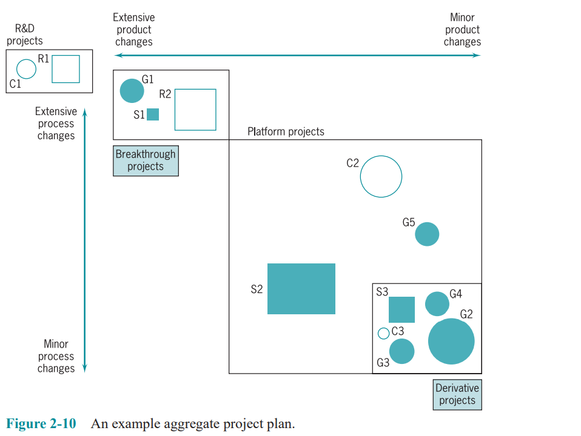
Lecture 2
Strategic Management and Project Selection
2.7 PROJECT PORTFOLIO PROCESS (PPP)

Slide 42
Lecture 2
Strategic Management and Project Selection
2.7 PROJECT PORTFOLIO PROCESS (PPP)
Step 3: Collect Project Data
Assemble the data appropriate to that category’s criteria. Be sure to update the data for ongoing projects and not just use the data from the previous evaluation. Document any assumptions made so that they can be checked in the future as the project progresses.
Step 4: Assess Resource Availability
Assess the availability of both internal and external resources, by type, department, and timing. Note that labor availability should be estimated conservatively, leaving time for vacations, personal needs, illness, holidays, and regular functional (nonproject) work. Add perhaps10 percent, to allow for the fact that human beings need occasional short breaks to rest or meet other human needs.
Step 5: Reduce the Project and Criteria Set
Multiple screens are employed to try to narrow down the number of competing projects. The first screen is each project’s support of the organization’s goals.

Slide 43
Lecture 2
Strategic Management and Project Selection
2.7 PROJECT PORTFOLIO PROCESS (PPP)
Step 6: Prioritize the Projects within Categories
Apply the scores and criterion weights to rank the projects within each category. It is acceptable to hold some hard-to-measure criteria out for subjective evaluation, such as riskiness, or development of new knowledge.
Step 7: Select the Projects to Be Funded and Held in Reserve
Determining the mix of projects across the various categories and time periods. leave 10–15 percent of the organization’s resource capacity free for new opportunities, crises in existing projects, errors in estimates, and so on. Then allocate the categorized projects in rank order to the categories according to the mix desired. It is usually a good practice to include some speculative projects in each category to allow future options, knowledge improvement, additional experience in new areas, and such.

Slide 44
Lecture 2
Strategic Management and Project Selection
2.7 PROJECT PORTFOLIO PROCESS (PPP)
Step 8: Implement the Process
Make the results of the PPP widely known, including the documented reasons for project cancellations, deferrals, and non-selection. Top management must now make their commitment to this project portfolio process totally clear by supporting the process and the results. This may require a PPP champion near the top of the organization. As project proposers come to understand the workings and importance of the PPP, their proposals will more closely fit the profile of the kinds of projects the organization wishes to fund. As this happens, it is important to note that the council will have to concern itself with the reliability and accuracy of proposals competing for limited funds.

Slide 45
Lecture 2
Strategic Management and Project Selection
2.8 PROJECT PROPOSALS
The set of documents submitted for evaluation of selected project is called the project proposal.
Generally, these decisions are made on the basis of their overall expected values, perhaps as reflected in a scoring model. In-house proposals submitted by a firm’s personnel to that firm’s top management do not usually require the extensive treatment given to proposals submitted to outside clients or agencies such as the Department of Defense. For outside clients, a proposal must be precisely structured to meet the requirements contained in the official Request for Proposal (RFP) or Request for Quotation (RFQ)—more specifically, in the Technical Proposal Requirements (TPR) that is part of the RFP or RFQ.
All proposals should begin with a short summary statement “Executive Summary” covering the fundamental nature of the proposal in minimally technical language, as well as the general benefits that are expected. All proposals should be accompanied by a “cover letter.” In addition, every proposal should deal with four distinct issues: (1) the nature of the technical problem and how it is to be approached; (2) the plan for implementing the project once it has been accepted; (3) the plan for logistic support and administration of the project; and (4) a description of the group proposing to do the work, plus its past experience in similar work.

Slide 46
Lecture 2
Strategic Management and Project Selection
Summary
This chapter initiated our discussion of the project management process by describing procedures for strategically evaluating and selecting projects. We first described the strategic objective of using projects to help achieve the organization’s goals and strategy, and a project portfolio process to help achieve this. We then outlined some criteria for project selection models and then discussed the general nature of these models. The chapter then described the types of models in use and their advantages and disadvantages. Considering the degree of uncertainty associated with many projects, a section was devoted to evaluating the impact of risk and uncertainty. Concluding the discussion, some general comments were made about data requirements and the use of these models. The final section discussed the documentation of the evaluation/selection process via project proposals. The following specific points were made in this chapter:
• The role of projects in achieving the organization’s goals and strategy is critical.
• The eight-step project portfolio process is an effective way to select and manage projects that are tied to the organization’s goals.
• Primary model selection criteria are realism, capability, flexibility, ease of use, and cost.

Slide 47
Lecture 2
Strategic Management and Project Selection
Summary
• Preparatory steps in using a model include: (1) identifying the firm’s objectives; (2) weighting them relative to each other; and (3) determining the probable impacts of the project on the firm’s competitive abilities.
• Project selection models can generally be classified as either numeric or nonnumeric; numeric models are further subdivided into profitability and scoring categories.
• Nonnumeric models include: (1) the sacred cow; (2) the operating necessity; (3) the competitive necessity; and (4) comparative benefit.
• Profitability models include standard forms such as: (1) payback period; (2) average rate of return; (3) discounted cash flow; (4) internal rate of return; and (5) profitability index.
• Project management maturity measurement is a way of assessing an organization’s ability to conduct projects successfully.
• Scoring models—the authors’ preference—include: (1) the unweighted 0–1 factor model; (2) the unweighted factor scoring model; (3) the weighted factor scoring model; and (4) the constrained weighted factor scoring model.

Slide 48
Lecture 2
Strategic Management and Project Selection
Summary
• For handling uncertainty: (1) pro forma documents; (2) risk analysis; (3) and simulation with sensitivity analysis are all helpful.
• Special care should be taken with the data used in project selection models. Of concern are data taken from an accounting data base, how data are measured and conceived, and the effect of technological shock.
• Project proposals generally consist of a number of sections: (1) the technical approach; (2) the implementation plan; (3) the plan for logistic support and administration; and (4) past experience.
In the next chapter we consider the selection of the appropriate manager for a project and what characteristics are most helpful for such a position. We also address the issue of the project manager’s special role, and the demands and responsibilities of this critical position.

Slide 49
Lecture 2
Strategic Management and Project Selection
Glossary
Decision Support System A computer package and data base to aid managers in making decisions. It may include simulation programs, mathematical programming routines, and decision rules.
Deterministic Predetermined, with no possibility of an alternate outcome. Compare with stochastic. Expert System A computer package that captures the knowledge of recognized experts in an area and can make inferences about a problem based on decision rules and data input to the package.
Maturity The sophistication and experience of an organization in managing multiple projects.
Model A way of looking at reality, usually for the purpose of abstracting and simplifying it, to make it understandable in a particular context.
Network A group of items connected by some common mechanism.
Portfolio A group or set of projects with varying characteristics.
Pro forma Projected or anticipated, usually applied to financial data such as balance sheets and income statements.
Programming An algorithmic methodology for solving a particular type of complex problem, usually conducted on a computer.

Slide 50
Lecture 2
Strategic Management and Project Selection
Glossary
Project portfolio process An eight-step procedure for selecting, implementing, and reviewing projects that will help an organization achieve its strategic goals.
Risk analysis A procedure that uses a distribution of input factors and probabilities and returns a range of outcomes and their probabilities.
Sensitivity analysis Investigation of the effect on the outcome of changing some parameters or data in the procedure or model.
Simulation A technique for emulating a process, usually conducted a considerable number of times to understand the process better and measure its outcomes under different policies.
Stochastic Probabilistic, or not deterministic.
Delphi A formalized method of group decision making that facilitates drawing on the knowledge of experts in the group.

Slide 51
Lecture 2
Strategic Management and Project Selection
Thank you

