Slide 1
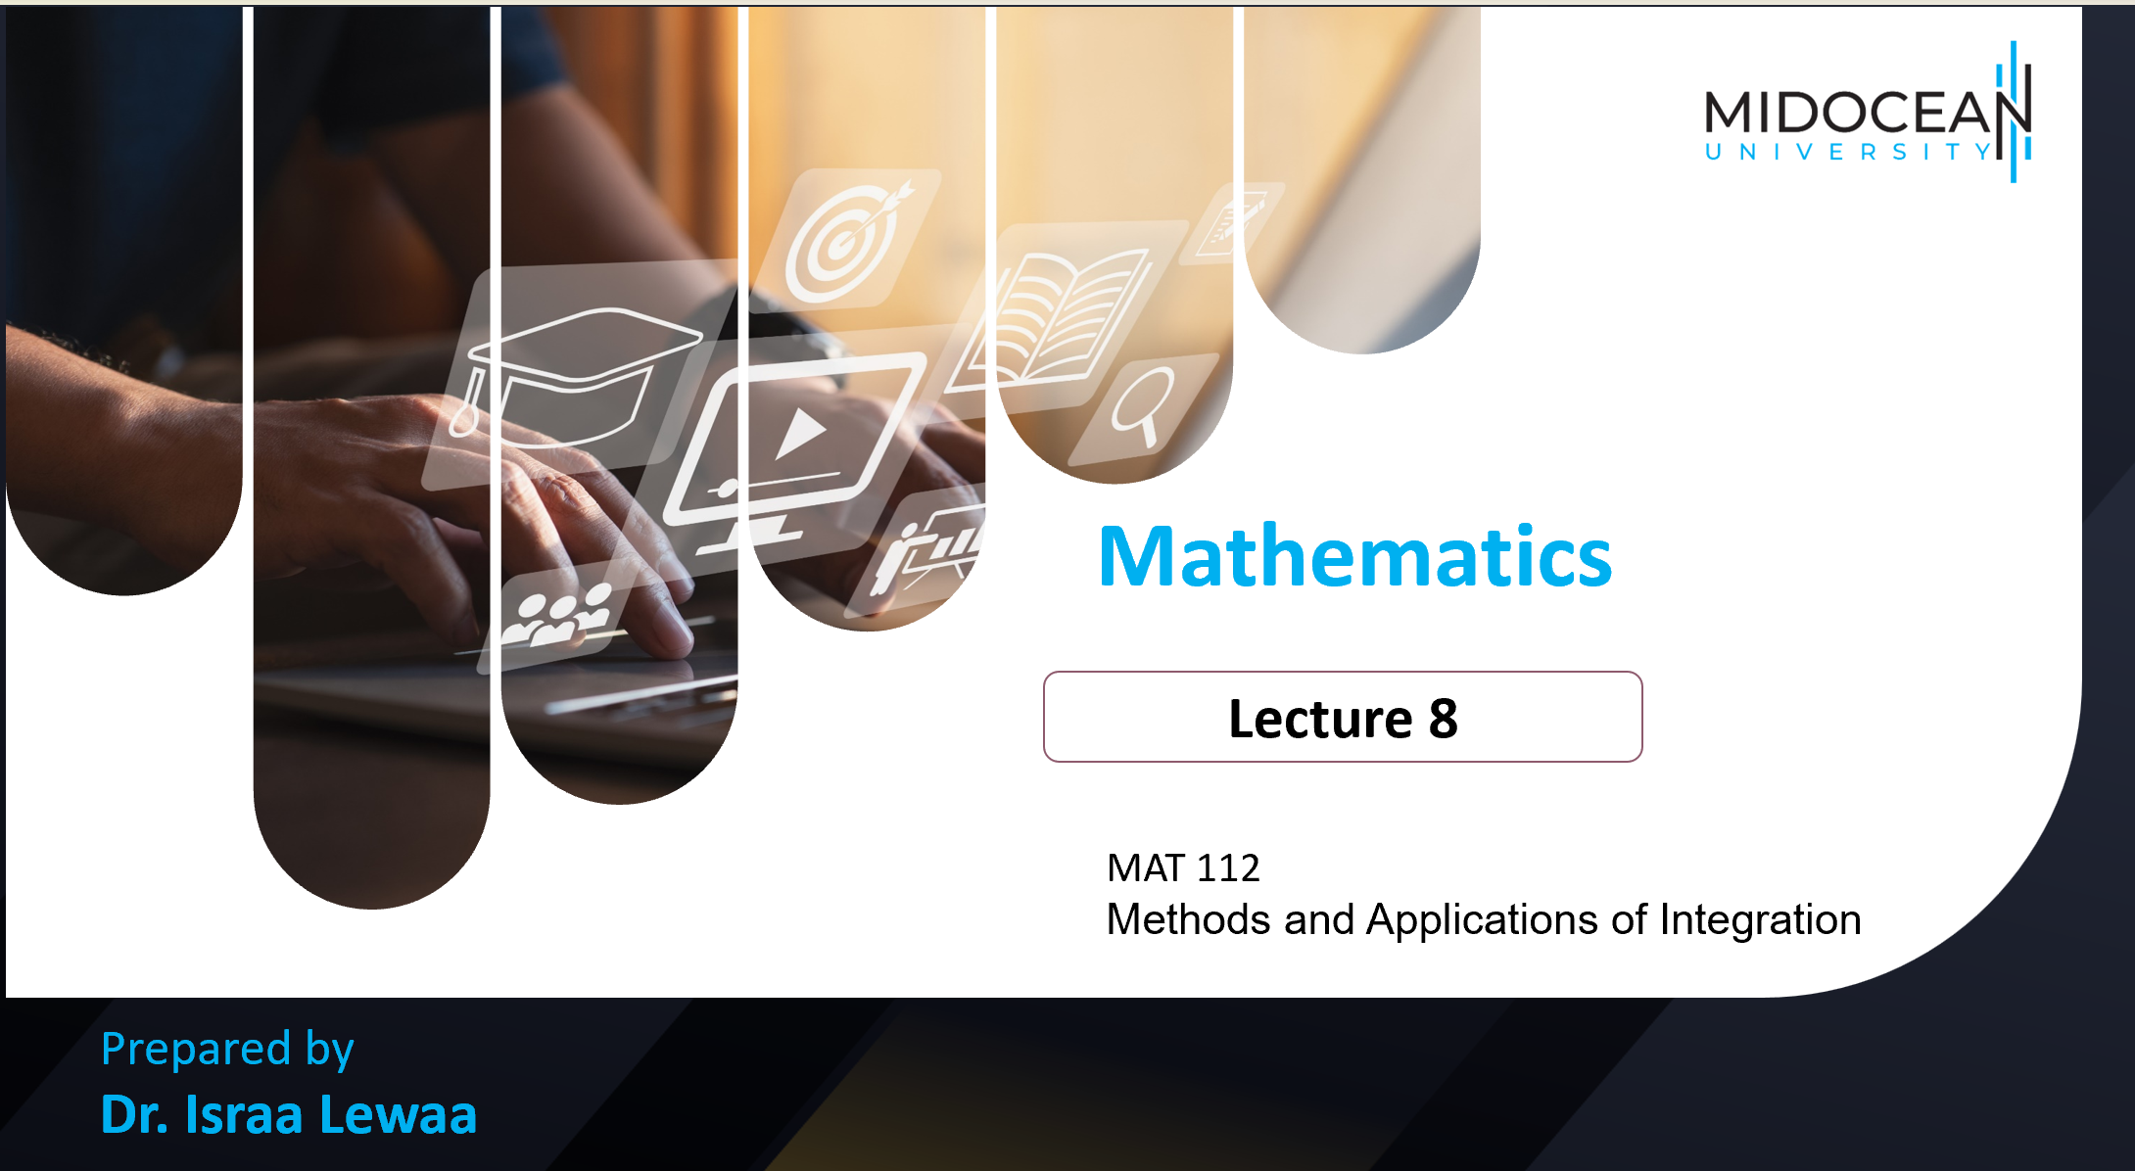
MAT 112
Methods and Applications of Integration

Slide 2

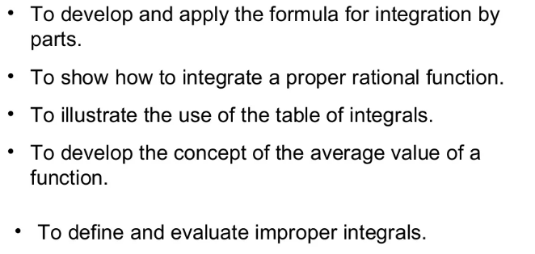
Lecture
08
Lecture Objectives

Slide 3
Lecture
08
Lecture Outline
Integration by Parts
Integration with initial Conditions ( One Condition )
Various Examples for different methods of Integration
Extra Practice

Slide 4
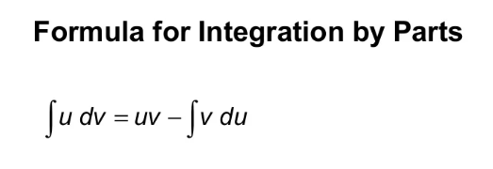
Lecture
08
1- Integration by parts

Slide 5
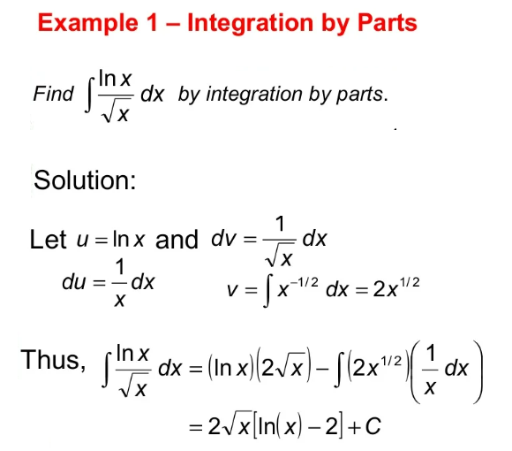
Lecture
08
Example

Slide 6
Lecture
08
Example

Slide 7
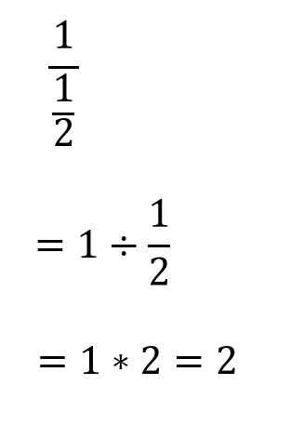
Lecture
08
** Revision – Fundamentals

Slide 8
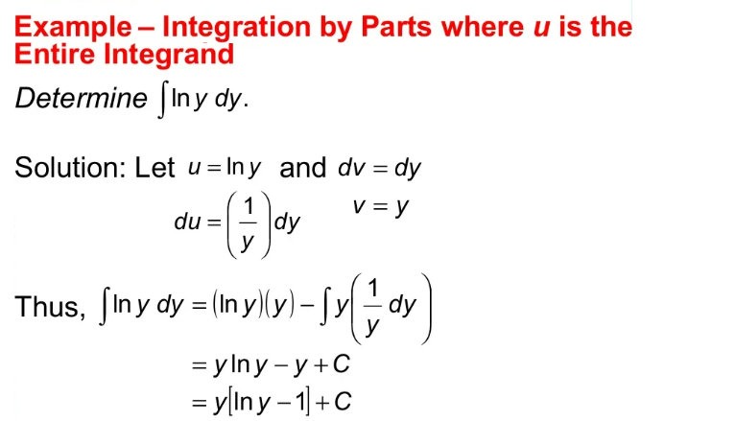
Lecture
08
Example

Slide 9

Lecture
08
Integration with initial Conditions
Integration with initial Conditions

Slide 10
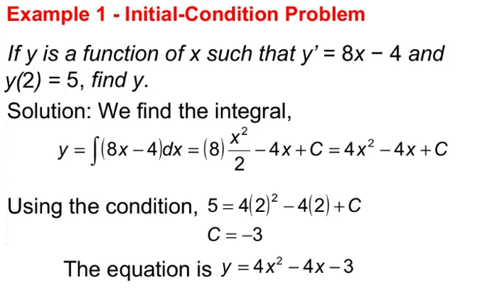
Lecture
08
Example

Slide 11
Lecture
08
Example

Slide 12
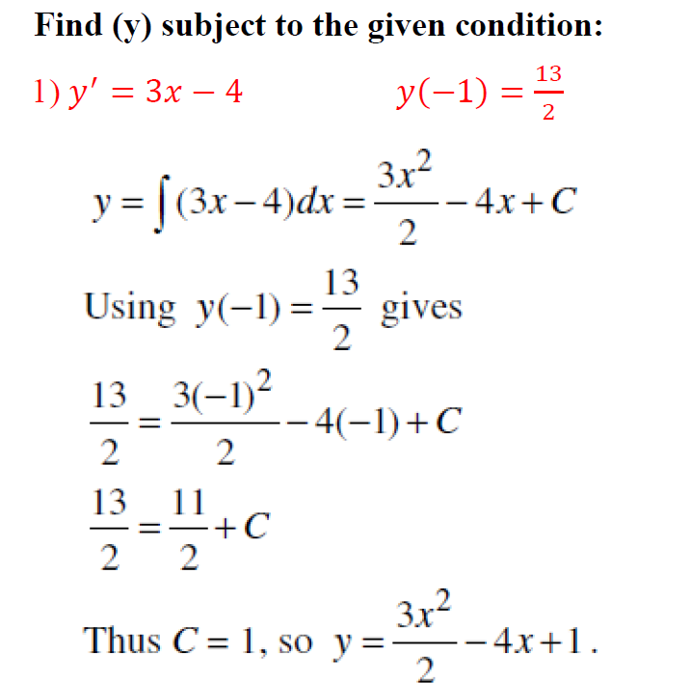
Lecture
07
** EXTRA PRACTISE

Slide 13
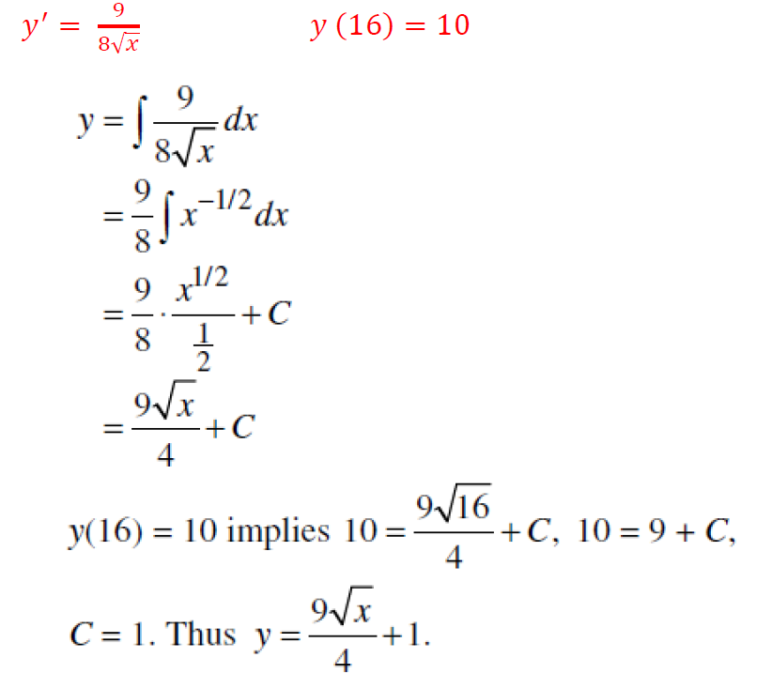
Lecture
07
** EXTRA PRACTISE

Slide 14
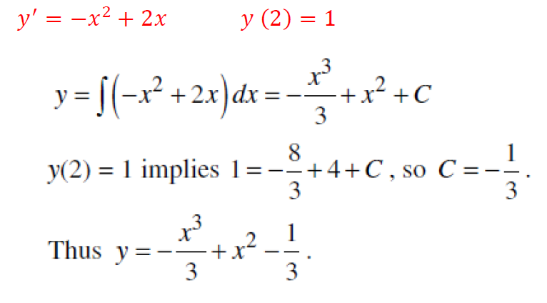
Lecture
07
** EXTRA PRACTISE

Slide 15
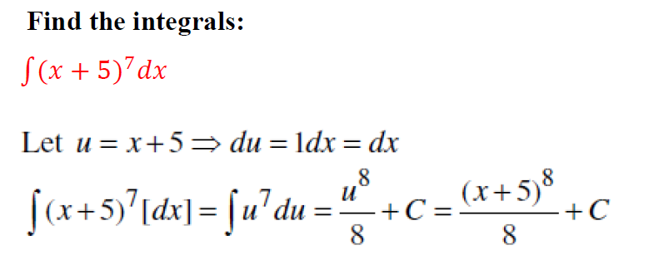
Lecture
08
Examples for different Methods of Integration

Slide 16
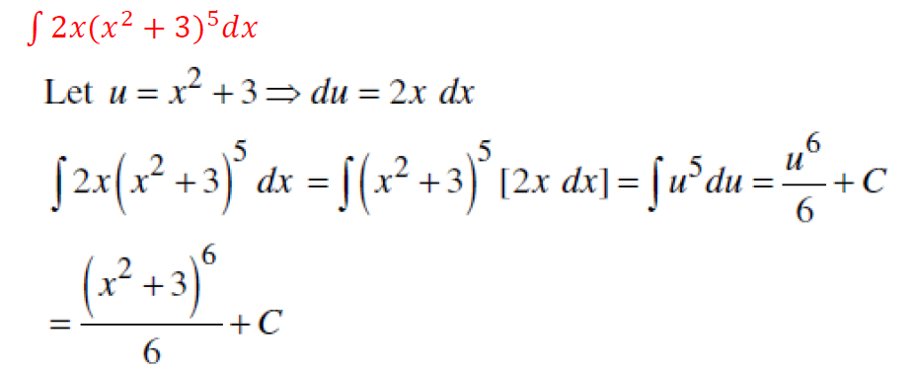
Lecture
08
Example

Slide 17
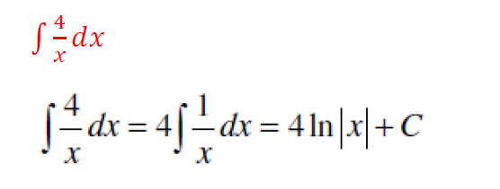
Lecture
08
Example

Slide 18
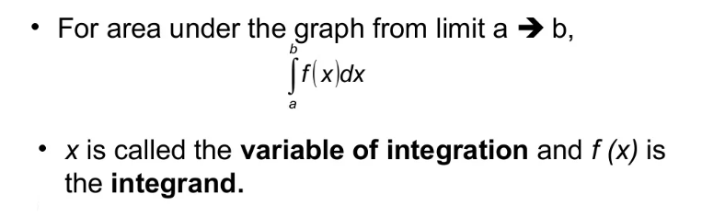
Lecture
08
The Definite Integral

Slide 19

Lecture
08
Example 1 - Definite Integration

Slide 20
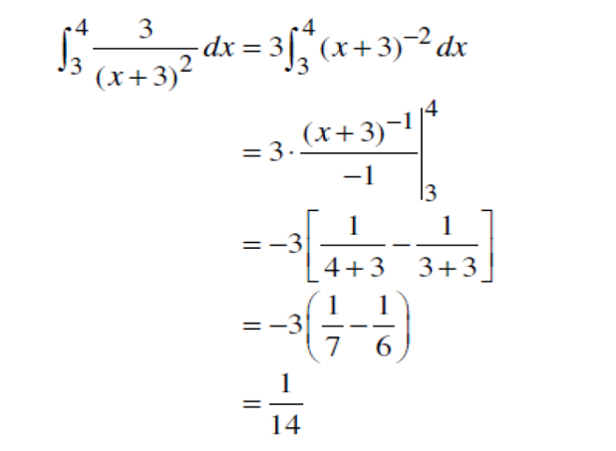
Lecture
08
Example 1 Solution

Slide 21
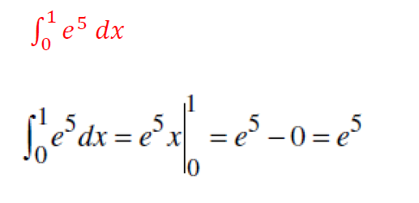
Lecture
08
Example

Slide 22
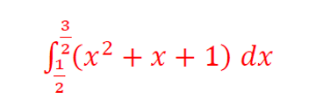
Lecture
08
Example

Slide 23
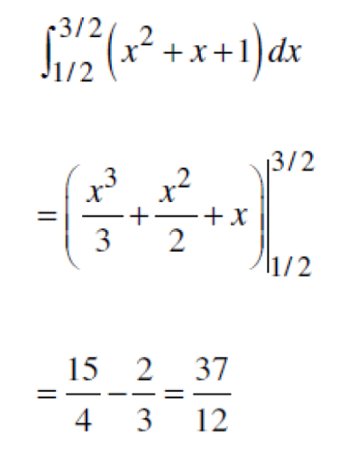
Lecture
08
Example

Slide 24

Lecture
08
** EXTRA PRACTISE

Slide 25
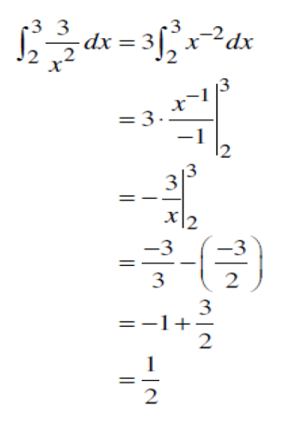
Lecture
08
** EXTRA PRACTISE

Slide 26

Lecture
08
** EXTRA PRACTISE

Slide 27
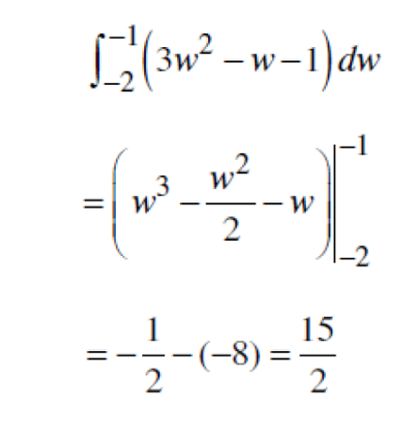
Lecture
08
** EXTRA PRACTISE

Slide 28
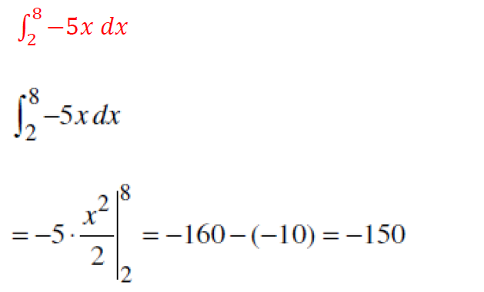
Lecture
08
** EXTRA PRACTISE

Slide 29
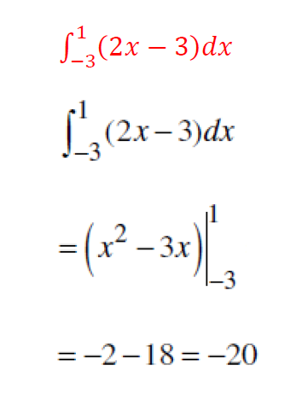
Lecture
08
** EXTRA PRACTISE

Slide 30
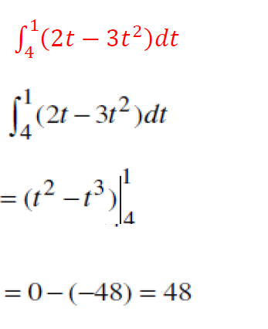
Lecture
08
** EXTRA PRACTISE

Slide 31
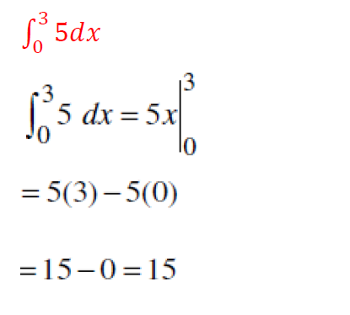
Lecture
08
** EXTRA PRACTISE

Slide 32
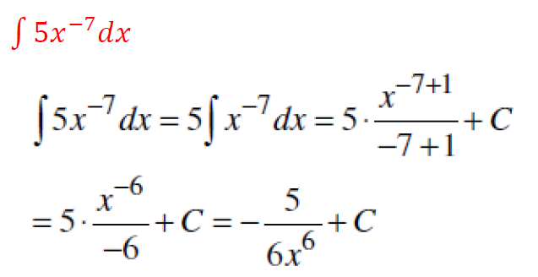
Lecture
07
** EXTRA PRACTISE

Slide 33
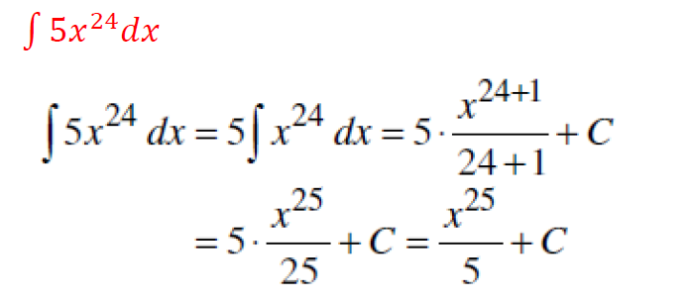
Lecture
07
** EXTRA PRACTISE

Slide 34
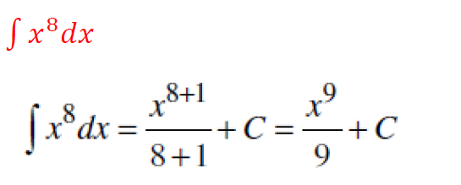
Lecture
07
** EXTRA PRACTISE

Slide 35
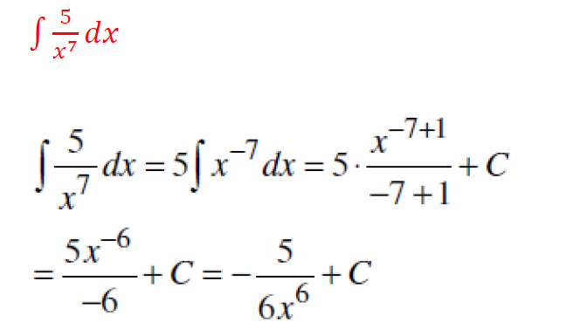
Lecture
07
** EXTRA PRACTISE

Slide 36
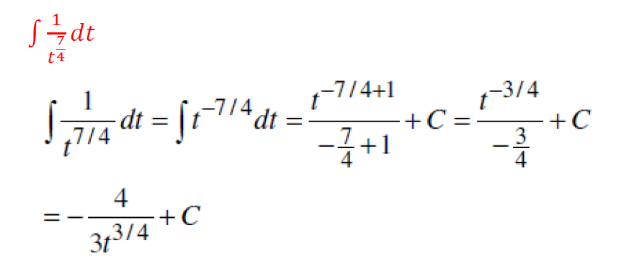
Lecture
07
** EXTRA PRACTISE

Slide 37
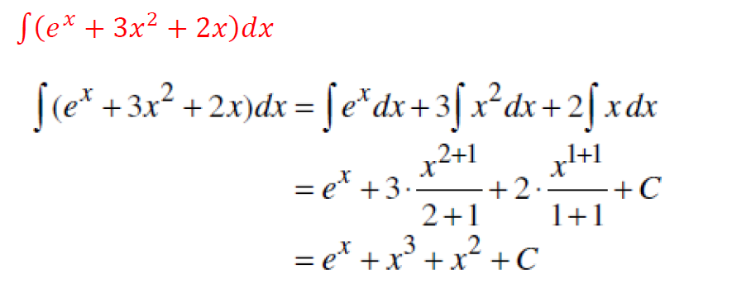
Lecture
07
** EXTRA PRACTISE

Slide 38
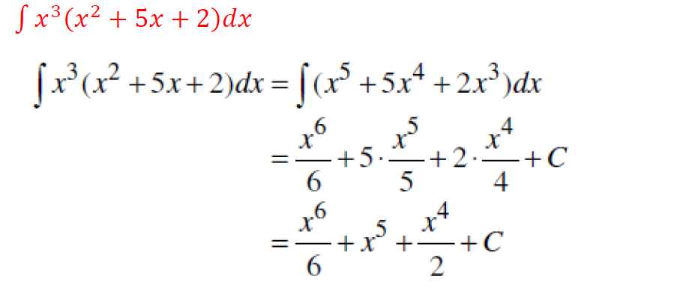
Lecture
07
** EXTRA PRACTISE

Slide 39
Lecture
08
Lecture Summary
Integration by Parts
Integration with initial Conditions ( One Condition )
Definite Integral
Various Examples for different methods of Integration

