Slide 1



Internet and Information Technology
Lecture 6
ITC202
Application Software
Prepared by
Dr. Eng. Youssef Ntefeh

Slide 2

Chapter 6:
Application
Software
The Basics of Application Software
Software Ownership Rights
Desktop vs. Mobile Software
Installed vs. Web-Based Software
Software Suites
Common Software Commands
Word Processing Concepts
Creating a Word Processing Document
Tables, Graphics, and Templates
Spreadsheet Concepts
Creating a Spreadsheet
Entering Data into a Spreadsheet Cell
Database Concepts
What Is a Database
Creating a Database
Presentation Graphics Concepts
Creating a Presentation
Finishing a Presentation
Graphics and Multimedia Software
Graphics Software
Audio Capture and Editing Software
Video Editing and DVD Authoring Software
Media Players
Other Types of Application Software

Slide 3
Learning Objectives
Describe what application software is, the different types of ownership rights, and the difference between installed and Web-based software.
Detail some concepts and commands that many software programs have in common.
Discuss word processing and explain what kinds of documents are created using this type of program.
Explain the purpose of spreadsheet software and the kinds of documents created using this type of program.

Slide 4
Learning Objectives
Identify some of the vocabulary used with database software and discuss the benefits of using this type of program.
Describe what presentation graphics and electronic slide shows are and when they might be used.
List some types of graphics and multimedia software consumers frequently use.
Name other types of application software programs and discuss what functions they perform.

Slide 5

The Basics of Application Software
Software Ownership Rights
The ownership rights of a software program specify the allowable use of that program.
After a software program is developed, the developer decides whether or not the program can be sold, shared with others, or otherwise distributed.
When a software program is purchased, the buyer is not actually buying the software. Instead, the buyer is acquiring a software license that permits him or her to use the software.
This license specifies the conditions under which a buyer can use the software, such as the number of computers on which it may be installed.

Slide 6

Software Ownership Rights
Commercial software is software that is developed and sold for a profit.
When you buy a commercial software program (such as Microsoft Office) it typically comes with a single-user license, which means you cannot legally make copies of the installation CD
You cannot even install the software on a second computer
that you own, unless allowed by the license.
Software license: determine which activities are allowable for a particular commercial software program.

Slide 7

Software Ownership Rights
Shareware: are software programs that are distributed on the honor system.
Shareware programs distributed freely so users can evaluate it before deciding to buy it then require a small fee if you choose to use the program regularly (WinZip).
By paying the requested registration fee, you can use the program for as long as you want to use it and may be entitled to product support, updates, and other benefits.
Many shareware programs have a specified trial period,
Although it is not illegal to use shareware past the specified trial period, it is unethical to do so.

Slide 8
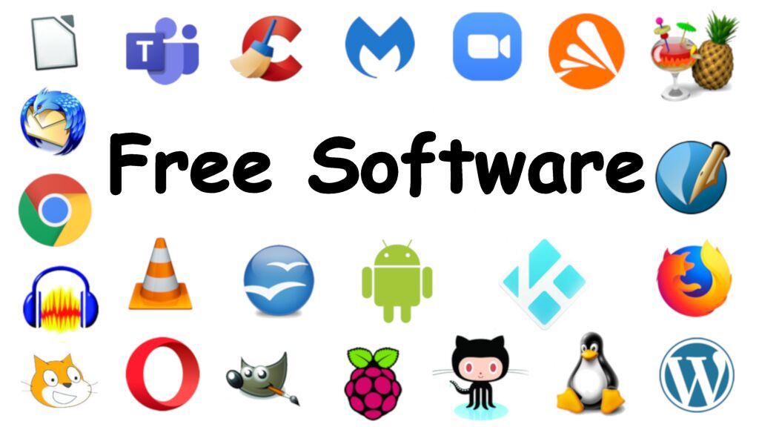
Software Ownership Rights
Freeware: Software programs that are given away by the author for others to use free of charge.
Author retains the ownership rights to the program, so you cannot do anything with it—such as sell it or modify it.
Microsoft’s Internet Explorer

Slide 9

Software Ownership Rights
Public domain software is not copyrighted; instead, the ownership rights to the program have been donated to the public domain.
Consequently, it is free and can be used, copied, modified, and distributed to others without restrictions.

Slide 10

Desktop vs. Mobile Software
Mobile devices typically require software specifically designed for a specific type of mobile device.
There are mobile versions of popular programs like Word or PowerPoint, games, media players, calendars and programs that allow you to organize notes and voice recordings.
In addition to having a more compact, efficient appearance, many mobile applications include features for easier data input, such as an onscreen keyboard, a phrase list, or handwriting recognition capabilities.

Slide 11
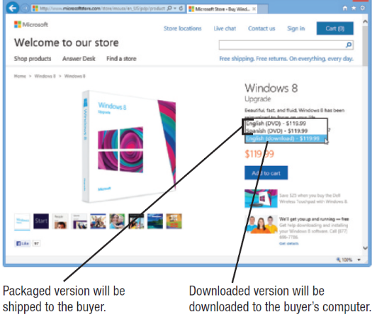
Installed vs. Web-Based Software
Installed software: Must be installed on the computer before it can be run:
  Can be purchased in physical form.
  Can be downloaded from the Internet.

Slide 12
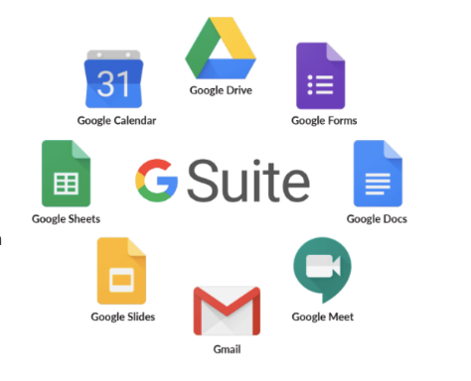
Installed vs. Web-Based Software
Web-based software: Run directly from the Internet.
Also called Software as a Service (SaaS) and use a subscription pricing scheme
Web-based software advantages:
  Programs and your files can be accessed from any computer or mobile phone with an internet connection
  The ability to try out new applications for little or no out-of-pocket costs while decide whether or not to continue subscribing to the software.
  The benefit of always working with the most current version of the software without having to perform software updates on company computers.

Slide 13
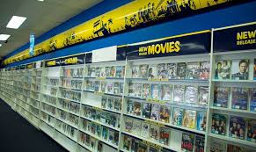

Case Study 1: Blockbuster’s Failure Due to Poor Adoption of Application Software
Company Overview:
Blockbuster was a global leader in movie and video game rentals, founded in 1985. At its peak in the 1990s, it operated over 9,000 stores worldwide. However, by 2010, the company filed for bankruptcy, becoming a textbook example of digital disruption and strategic failure.

Slide 14

Case Study 1: Blockbuster’s Failure Due to Poor Adoption of Application Software
📉 Strategic Failures:
1. Ignoring Digital Transformation:
  Blockbuster declined an offer to purchase Netflix in 2000 for $50 million, dismissing its subscription-based model as unsustainable.
  The company continued to rely heavily on physical store rentals while consumer preferences shifted toward digital streaming.
2. Rigid Business Model:
  A significant portion of Blockbuster’s revenue came from late fees, which frustrated customers and created a negative experience.
  The company failed to adapt its model to offer more flexible, user-friendly options.

Slide 15

Case Study 1: Blockbuster’s Failure Due to Poor Adoption of Application Software
📉 Strategic Failures:
3. Lack of Innovation:
  Blockbuster was slow to adopt digital technologies and did not invest in improving the customer experience.
  Its attempt to launch a streaming service came too late and lacked competitive features.
4. Underestimating Emerging Competitors:
  Netflix, Redbox, and other startups introduced more convenient and cost-effective alternatives.
  Netflix leveraged data analytics and AI to personalize content recommendations, while Blockbuster remained traditional.

Slide 16
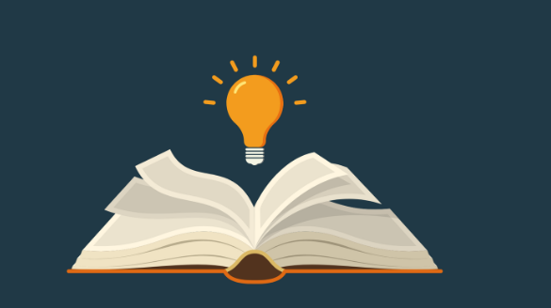
Case Study 1: Blockbuster’s Failure Due to Poor Adoption of Application Software
Key Lessons Learned:
✅ Embrace Change: Companies must be willing to evolve with technological advancements to remain competitive.
✅ Customer-Centric Thinking: Ignoring customer preferences can lead to loss of loyalty and market share.
✅ Continuous Innovation: Market dominance is not permanent; innovation is essential for survival.
✅ Respect Disruptors: Small startups can become major threats if they offer better value and vision.

Slide 17

Case Study 1: Blockbuster’s Failure Due to Poor Adoption of Application Software
Blockbuster vs. Netflix Comparison:
Feature | Blockbuster | Netflix
Business Model | Physical rentals | Digital subscription streaming
Innovation Level | Low | High (AI, original content)
Expansion Strategy | Traditional retail | Global digital reach
User Experience | Inconvenient (late fees) | Personalized and seamless

Slide 18
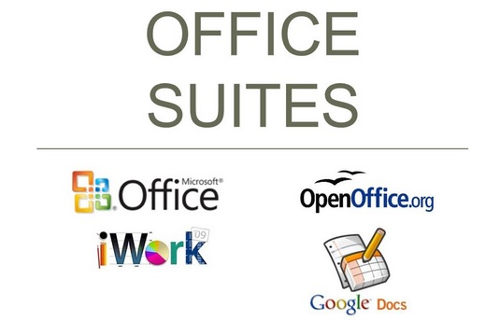
Software Suites
Software suite: Collection of software programs bundled together and sold as a single software package .
Provides a common interface among programs in the suite.
Cost lower than buying each program separately.

Slide 19
Software Suites
Office suites Typically include:
  Word processing software: allows users to easily create and edit complex textbased documents that can also include images and other content.
  Spreadsheet software: Provides users with a convenient means of creating documents containing complex mathematical calculations
  Database software: allows users to store and organize vast amounts of data and retrieve specific information when needed.
  Presentation graphics software: allows users to create visual presentations to convey information more easily to others

Slide 20
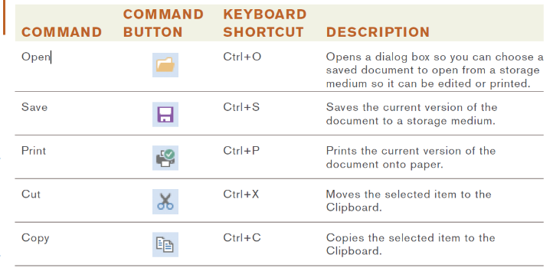
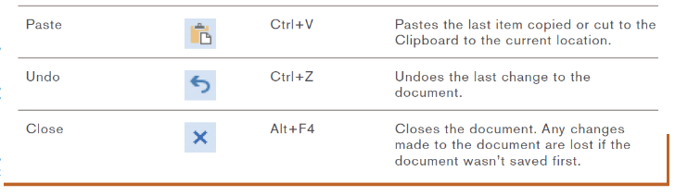
Common Software Commands
Application programs today have a number of concepts and commands in common

Slide 21

Common Software Commands
Editing a document: Changing the content of the document, such as inserting or deleting words.
  Insertion point: Indicates the current location in a document, which is where the changes will be made.
  Typing text will insert it.
  Delete and Backspace key will delete text.
  Text and objects can typically be selected to be moved, copied, deleted, or formatted.

Slide 22
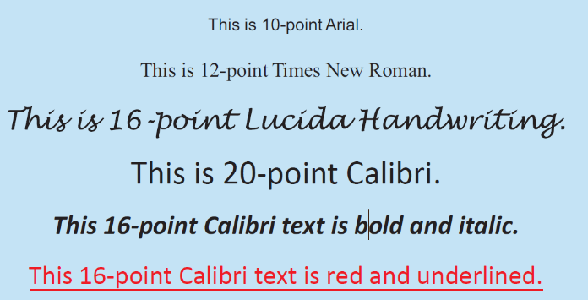
Common Software Commands
Formatting a document: Changing the appearance of the document.
  Changing font face, size, style, or color.
  Changing line spacing or margins.
  Adding page numbers or borders

Slide 23
Chapter 6:
Application
Software
The Basics of Application Software
Software Ownership Rights
Desktop vs. Mobile Software
Installed vs. Web-Based Software
Software Suites
Common Software Commands
Word Processing Concepts
Creating a Word Processing Document
Tables, Graphics, and Templates
Spreadsheet Concepts
Creating a Spreadsheet
Entering Data into a Spreadsheet Cell
Database Concepts
What Is a Database
Creating a Database
Presentation Graphics Concepts
Creating a Presentation
Finishing a Presentation
Graphics and Multimedia Software
Graphics Software
Audio Capture and Editing Software
Video Editing and DVD Authoring Software
Media Players
Other Types of Application Software

Slide 24
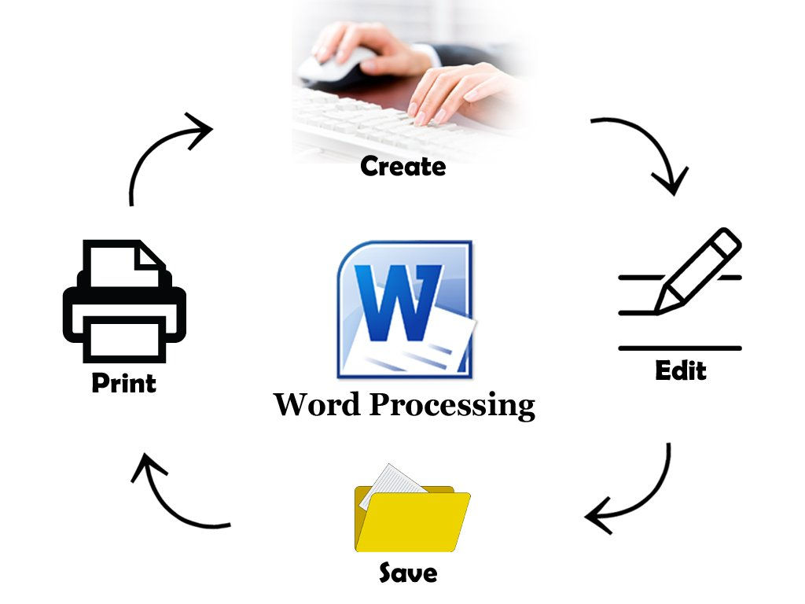
Word Processing Concepts
Word processing: Using a computer and word processing software to create, edit, save, and print written documents such as letters, contracts, and manuscripts.
Common programs:
  Microsoft Word.
  Corel WordPerfect.
  Apple Pages.
Recent versions of Word save documents using the .docx extension by default,

Slide 25
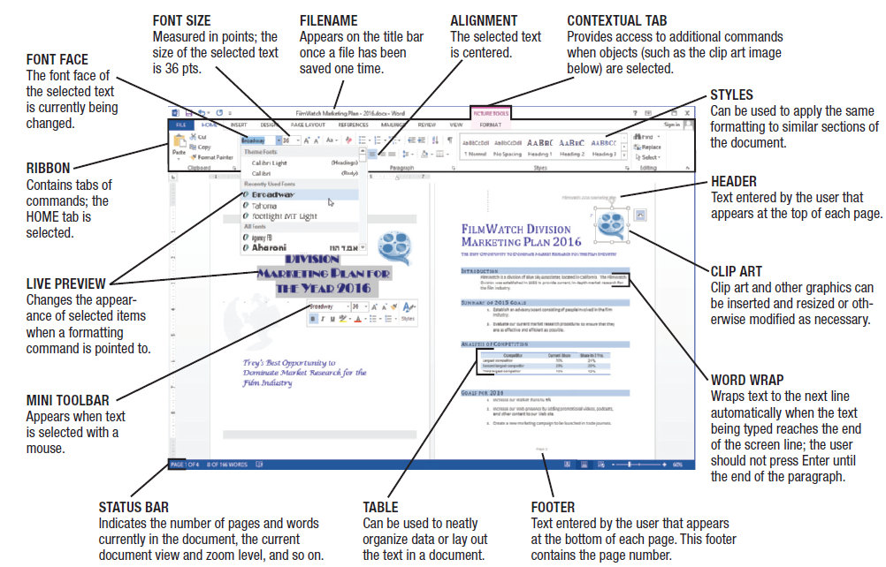
Microsoft Word

Slide 26
Creating a Word Processing Document
Character formatting (font face, size, style, or color).
Paragraph formatting (line spacing, indentation, tabs, alignment, and styles).
Page formatting (margins, paper size, orientation, headers, footers).
Document formatting (table of contents, index, background, theme).

Slide 27
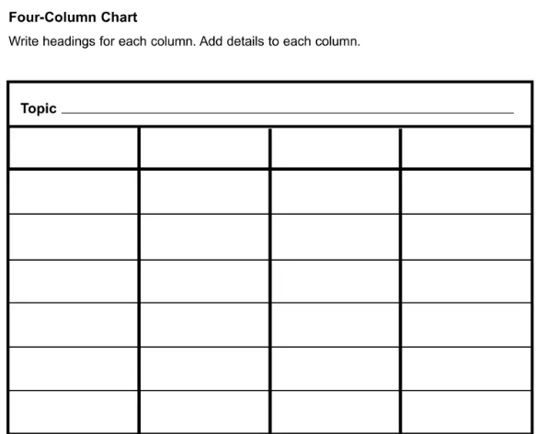

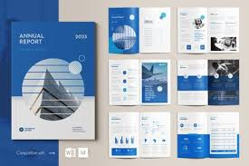
Tables, Graphics, and Templates
Tables: Allow content to be organized in a table consisting of rows and columns.
Templates: Help users create new documents quickly.

Slide 28
Chapter 6:
Application
Software
The Basics of Application Software
Software Ownership Rights
Desktop vs. Mobile Software
Installed vs. Web-Based Software
Software Suites
Common Software Commands
Word Processing Concepts
Creating a Word Processing Document
Tables, Graphics, and Templates
Spreadsheet Concepts
Creating a Spreadsheet
Entering Data into a Spreadsheet Cell
Database Concepts
What Is a Database
Creating a Database
Presentation Graphics Concepts
Creating a Presentation
Finishing a Presentation
Graphics and Multimedia Software
Graphics Software
Audio Capture and Editing Software
Video Editing and DVD Authoring Software
Media Players
Other Types of Application Software

Slide 29
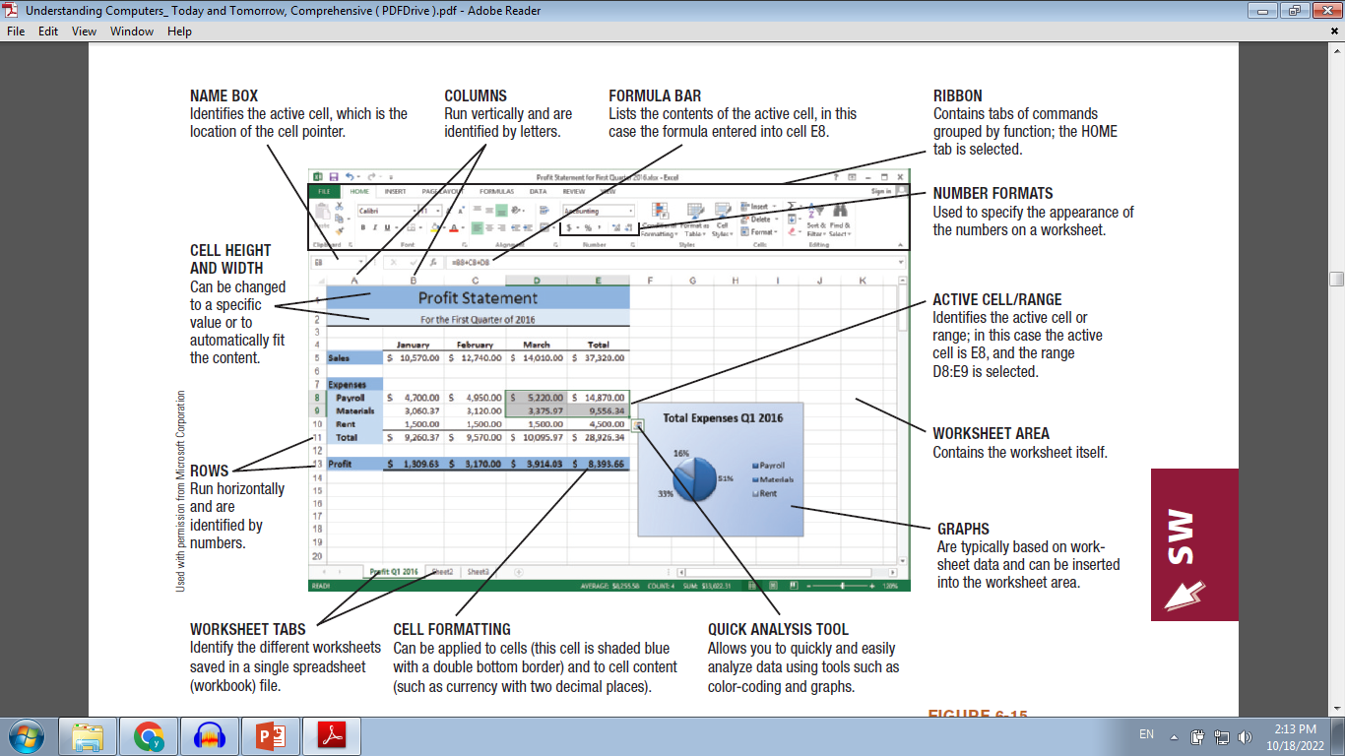
Microsoft Excel

Slide 30
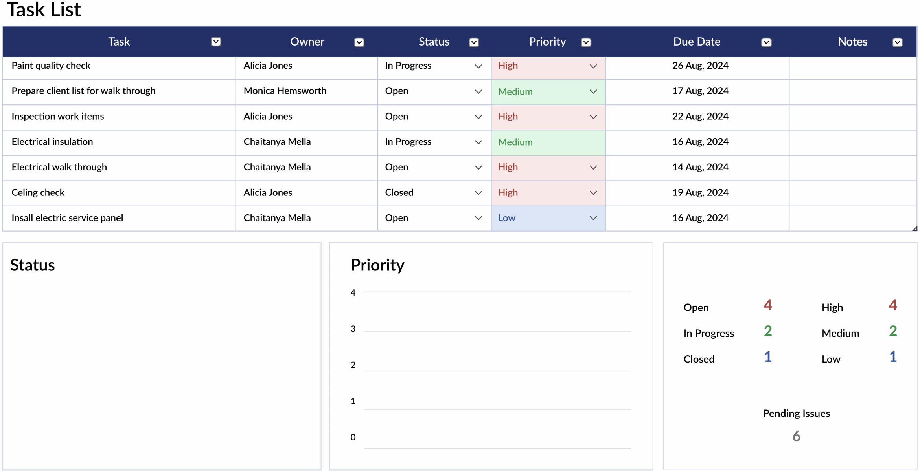
Spreadsheet Concepts
Spreadsheet software: Used to create electronic spreadsheets.
Spreadsheets: Documents containing a group of numbers and other data organized into rows and columns.
Worksheet: A single spreadsheet.
Workbook: A collection of
worksheets saved in a single file.
Most widely used spreadsheet programs:
  Microsoft Excel.
  Corel Quattro Pro.
  Apple Numbers.

Slide 31
Creating a Spreadsheet
Worksheets are divided into rows and columns.
Cell: The intersection of a row and a column.
  Each cell is identified by a cell address.
  Cell pointer marks current cell.
  Groups of cells are called ranges or blocks; can be selected with mouse or keyboard.
  Data is entered into current cell.

Slide 32
Entering Data into a Spreadsheet Cell
Cells can contain:
  Labels: Text-based entry in a worksheet cell that identifies data on the worksheet.
  Constant values: Numerical entry in a worksheet cell
  Formulas: Performs mathematical operations on the content of other cells.
    Usually reference cell address, not the current data in a cell.
    Use mathematical operators + - / * ^.
    e.g. A1 =B8+C8+D8.
  Functions: Named programmed formula.
    e.g. A1=SUM(B8:D8).

Slide 33
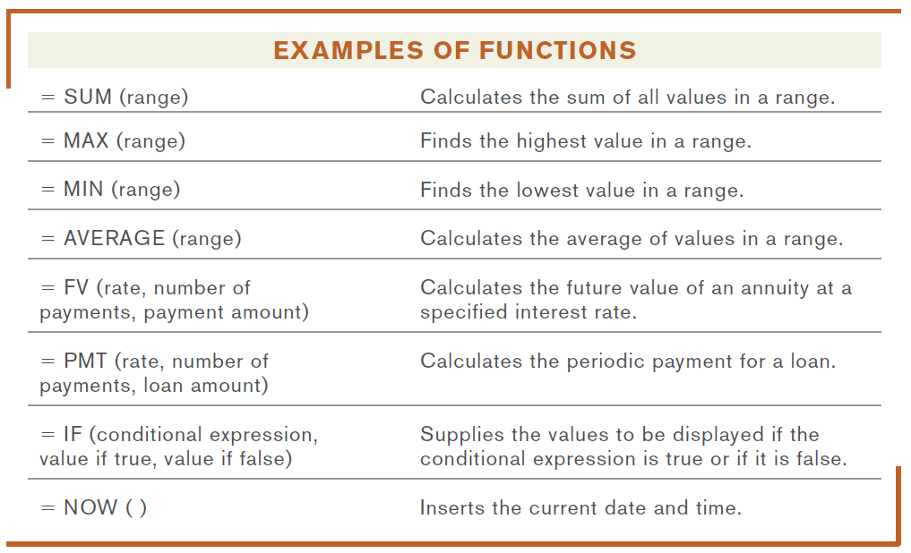
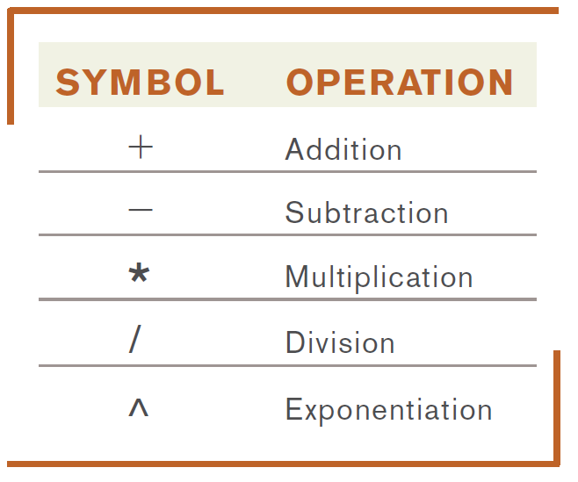
Entering Data into a Spreadsheet Cell

Slide 34
Chapter 6:
Application
Software
The Basics of Application Software
Software Ownership Rights
Desktop vs. Mobile Software
Installed vs. Web-Based Software
Software Suites
Common Software Commands
Word Processing Concepts
Creating a Word Processing Document
Tables, Graphics, and Templates
Spreadsheet Concepts
Creating a Spreadsheet
Entering Data into a Spreadsheet Cell
Database Concepts
What Is a Database
Creating a Database
Presentation Graphics Concepts
Creating a Presentation
Finishing a Presentation
Graphics and Multimedia Software
Graphics Software
Audio Capture and Editing Software
Video Editing and DVD Authoring Software
Media Players
Other Types of Application Software

Slide 35

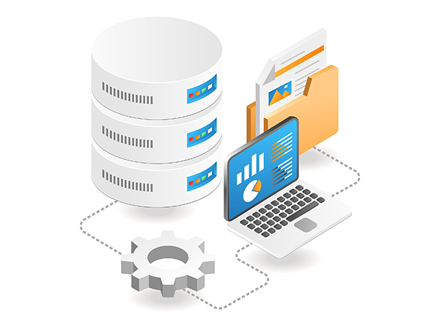
Database Concepts
Database: A collection of related data that is stored in a manner enabling information to be retrieved as needed.
Database management system (DBMS): Software that allows the creation and manipulation of an electronic database.
Most widely used database programs:
  Microsoft Access.
  Oracle Database.

Slide 36
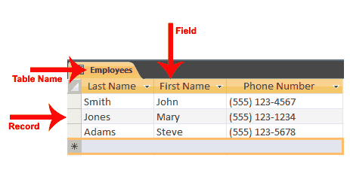
Database Concepts
  Most PC-based databases are relational databases and organized into fields (columns), records (rows), and tables.
  Field (column): A single type of data to be stored in a database.
  Record (row): A collection of related fields.
  Table: collection of related records.
  Database file: Collection of related tables.

Slide 37
Creating a Database
Database file is created first.
Tables can then be created.
Typically, the table structure is specified first .
  Includes a list of fields and their properties, including:
    Field name (unique identifying name).
    Data type (text, number, date, object).
    Field size (maximum number of characters).
    Default value (initial content of the field).

Slide 38
Chapter 6:
Application
Software
The Basics of Application Software
Software Ownership Rights
Desktop vs. Mobile Software
Installed vs. Web-Based Software
Software Suites
Common Software Commands
Word Processing Concepts
Creating a Word Processing Document
Tables, Graphics, and Templates
Spreadsheet Concepts
Creating a Spreadsheet
Entering Data into a Spreadsheet Cell
Database Concepts
What Is a Database
Creating a Database
Presentation Graphics Concepts
Creating a Presentation
Finishing a Presentation
Graphics and Multimedia Software
Graphics Software
Audio Capture and Editing Software
Video Editing and DVD Authoring Software
Media Players
Other Types of Application Software

Slide 39
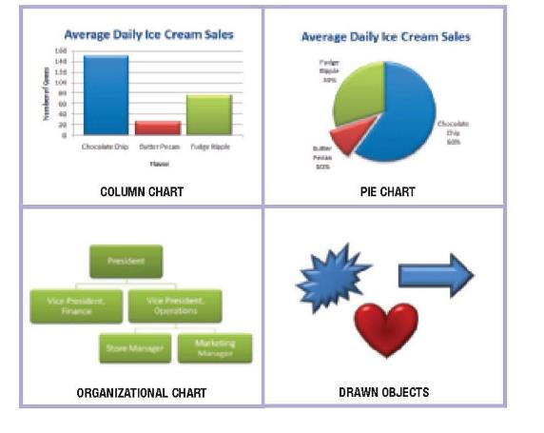

Presentation Graphic Concepts
Presentation graphic: An image designed to visually enhance a presentation.
  Can be used in electronic slide shows, as well as in printed reports.
Slide: A one-page presentation graphic that can be displayed in a group with others to form an electronic slide show.

Slide 40
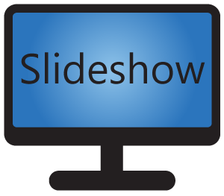
Presentation Graphic Concepts
Electronic slide show: A group of electronic slides that are displayed one after the other on a computer monitor or other display device
Presentation graphics software: Used to create presentation graphics.
Most common presentation graphics programs are:
  Microsoft PowerPoint.
  Corel Presentations.
  Apple Keynote.

Slide 41
Creating a Presentation
Templates and preformatted slide layouts can often be used.
New slides can be added as needed.
Slides can contain a variety of elements:
  Text, Images, Charts, Audio clips, and Video clips.
Multimedia and animation can be added to slides:
  Animation.
  Transitions.

Slide 42
Finishing a Presentation
Once all of the slides been created the slide show is ready to be finalized.
When the slide show is run, the slides are displayed in the designated order.
The slides advance either automatically or manually, depending on how the presentation is set up.
Speaker can choose a ballpoint pen, felt tip pen, or highlighter tool and “write” on the slides while the slide show is running, perhaps to circle a particular sentence for emphasis or to draw an arrow pointing to one part of the slide.

Slide 43
Chapter 6:
Application
Software
The Basics of Application Software
Software Ownership Rights
Desktop vs. Mobile Software
Installed vs. Web-Based Software
Software Suites
Common Software Commands
Word Processing Concepts
Creating a Word Processing Document
Tables, Graphics, and Templates
Spreadsheet Concepts
Creating a Spreadsheet
Entering Data into a Spreadsheet Cell
Database Concepts
What Is a Database
Creating a Database
Presentation Graphics Concepts
Creating a Presentation
Finishing a Presentation
Graphics and Multimedia Software
Graphics Software
Audio Capture and Editing Software
Video Editing and DVD Authoring Software
Media Players
Other Types of Application Software

Slide 44
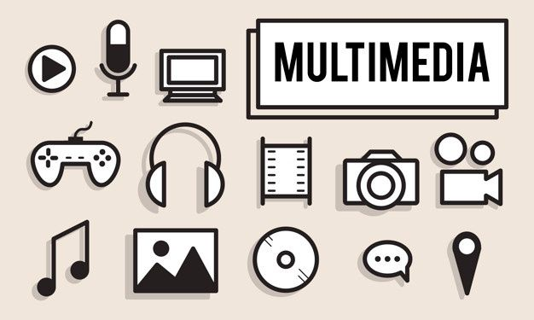
Graphics and Multimedia Concepts
Graphics: such as digital photographs, clip art, scanned drawings, and original images created using a software program.
Multimedia: Typically refers to any application that contains more than one type of media.
  Often used to refer to audio or video content.
Large variety of graphics and multimedia software, such as to:
  Create or modify graphics.
  Edit digital audio or video.
  Play multimedia files.
  Burn CDs and DVDs.

Slide 45
Graphics Software
Graphics software: Used to create or modify images.
  Painting programs: Typically used to create bit-mapped images (Microsoft Paint)
  Drawing programs: Typically create images using mathematical formulas (Adobe Illustrator, CorelDRAW ).
  Image editing or photo editing programs: Designed for touching up or modifying images:
    Correcting brightness/contrast.
    Cropping/eliminating red eye.
    Optimize file size for the Web.
    Adobe Photoshop, Apple iPhoto, etc.

Slide 46

Audio Editing Software
Audio editing software: Used to create and edit audio files (narrations, podcasts, etc.)
  Capture sound from a microphone.
  Capture sound from a CD using ripping software.
  Edit and apply special effects.
  Windows Sound Recorder, Apple Garage Band, etc.

Slide 47
Video Editing and DVD Authoring Software
Video editing software: Used to modify existing videos.
  Prepare video clips for presentations or Web sites
DVD authoring software: Used to create DVD content.
  Importing videos, creating menus, burning onto a DVD.
DVD burning software: Used to record data on recordable or rewritable DVDs.
  BurnAware, Ashampoo Burning, and Nero Burning ROM

Slide 48
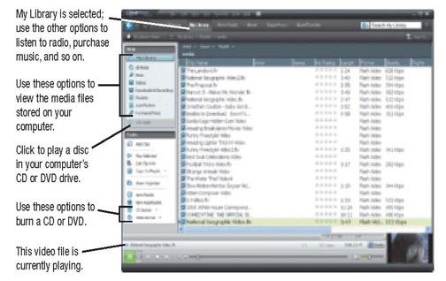
Media Players
Media players: Programs designed to play audio and video files.
  Music CDs, downloaded music, online audio.
  Downloaded and online video.
  RealPlayer, Apple QuickTime, Windows Media Player, etc.

Slide 49
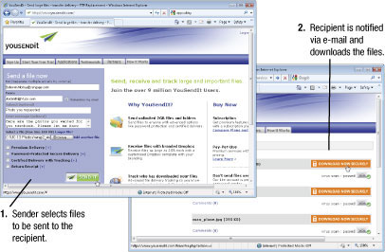
Other Types of Application Software
CAD and other types of design software.
Accounting and personal finance software.
Project management, collaboration, and remote access software.

Slide 50

Case Study 2: Coca-Cola’s Strategic Use of Microsoft Office Applications to Enhance Managerial Efficiency
🏢 Company Overview:
The Coca-Cola Company, a global leader in the beverage industry, operates in over 200 countries with a complex network of suppliers, distributors, and internal departments. To manage this vast ecosystem, Coca-Cola relies heavily on application software, particularly the Microsoft Office suite, to streamline operations, enhance communication, and support data-driven decision-making.
This case study illustrates how Coca-Cola integrates Word, Excel, and PowerPoint into its daily business functions and why mastering these tools is essential for future managers.

Slide 51
Case Study 2: Coca-Cola’s Strategic Use of Microsoft Office Applications to Enhance Managerial Efficiency
Application Software in Action at Coca-Cola:
1. Microsoft Word – Documentation and Internal Communication
  Used for drafting contracts, internal memos, policy documents, and formal correspondence.
  Standardized templates ensure consistency across departments and regions.
  Collaboration features (comments, track changes) facilitate multi-level document review and approval.

Slide 52
Case Study 2: Coca-Cola’s Strategic Use of Microsoft Office Applications to Enhance Managerial Efficiency
Application Software in Action at Coca-Cola:
2. Microsoft Excel – Financial Analysis and Operational Planning
  Essential for budgeting, forecasting, and performance tracking across markets.
  Advanced features like PivotTables, VLOOKUP, and conditional formatting are used to analyze sales trends, inventory levels, and marketing ROI.
  Excel dashboards help managers visualize KPIs and make data-driven decisions.

Slide 53
Case Study 2: Coca-Cola’s Strategic Use of Microsoft Office Applications to Enhance Managerial Efficiency
Application Software in Action at Coca-Cola:
3. Microsoft PowerPoint – Strategic Presentations and Training
  Used to present quarterly results, marketing strategies, and operational updates to stakeholders.
  Visual storytelling through charts, infographics, and animations enhances message clarity.
  PowerPoint is also used in employee training programs and onboarding sessions.

Slide 54
Case Study 2: Coca-Cola’s Strategic Use of Microsoft Office Applications to Enhance Managerial Efficiency
📊 Impact of Application Software on Coca-Cola’s Operations:
Area of Impact | Role of Application Software | Resulting Benefit
Financial Management | Excel for budgeting and forecasting | Improved accuracy and agility
Internal Communication | Word for standardized documentation | Enhanced clarity and professionalism
Strategic Planning | PowerPoint for executive presentations | Better stakeholder engagement
Team Collaboration | Integrated Office tools with cloud sharing | Faster decision-making and coordination

Slide 55
Case Study 2: Coca-Cola’s Strategic Use of Microsoft Office Applications to Enhance Managerial Efficiency
📌 Conclusion:
Coca-Cola’s strategic use of Microsoft Office applications exemplifies how software tools can drive operational excellence and managerial effectiveness. For business students, learning these tools is not optional—it is a critical step toward becoming competent, data-driven, and communicative leaders in the modern workplace.

Slide 56
Software Selection from a Business Perspective
Classification of Software from a Managerial Perspective
1. Installed Software
  Installed locally on the company’s devices or servers.
  Usually purchased as a perpetual license (one-time payment).
  Requires internal maintenance and updates.
  Offers full control over data.
2. Cloud-Based Software (Web-Based Software / SaaS)
  Used directly via the internet without installation.
  Based on a subscription model (monthly/yearly).
  Maintained and updated by the service provider.
  Accessible from anywhere.

Slide 57
Software Selection from a Business Perspective
Classification of Software from a Managerial Perspective
3. Open Source Software
  Freely downloadable and modifiable.
  Often free, but may incur support or development costs.
  Supported by an active developer community.
  Requires internal technical expertise to fully utilize.
4. Custom Software
  Developed specifically to meet the organization’s needs.
  Requires significant time and development cost.
  Offers high flexibility and precise integration with operations.
  Maintenance depends on the development team or external provider.
There is no "perfect solution" for all organizations; the decision depends on the organization's size, budget, infrastructure, and digital strategy.

Slide 58
Software Selection from a Business Perspective
Comparison Between Software Types
Criteria | Installed Software | Cloud-Based Software (SaaS) | Open Source Software | Custom Software
Deployment | Local installation on company devices/servers | Accessed via web browser | Downloaded and hosted internally or externally | Developed and deployed based on company needs
Cost Model | One-time license fee | Subscription-based (monthly/yearly) | Free or low-cost (support may cost extra) | High initial development cost
Maintenance | Internal IT team responsible | Handled by provider | Requires internal or community support | Handled by internal team or contracted developer
Flexibility | Limited to vendor’s features | Moderate, depending on provider | High (modifiable source code) | Very high (fully tailored)
Data Control | Full control over data | Data stored on provider’s servers | Depends on hosting setup | Full control
Security | Depends on internal infrastructure | Depends on provider’s security measures | Varies; requires technical oversight | Can be designed to meet specific security needs
Scalability | Limited by hardware | Easily scalable | Depends on infrastructure | Scalable if designed properly
Examples | Microsoft Office (on-prem), AutoCAD | Google Workspace, Salesforce | Moodle, LibreOffice, Odoo | Custom ERP, internal HR systems

Slide 59
Software Selection from a Business Perspective
Administrative factors influencing decision-making
When choosing the appropriate type of software, management should consider a range of strategic and organizational factors, including:
1. Organization Size and Operational Complexity
  Small businesses may prefer off-the-shelf or cloud-based solutions to reduce costs.
  Large enterprises with complex operations may require custom solutions.
2. Available Budget
  Custom software requires a high upfront investment.
  Cloud-based solutions offer flexible payment models (monthly/yearly).
  Open-source software may appear free but requires technical resources.

Slide 60
Software Selection from a Business Perspective
Administrative factors influencing decision-making
3. Total Cost of Ownership (TCO): Includes not only the purchase or subscription cost, but also:
  Maintenance and technical support.
  Training and onboarding costs.
  Upgrades and scalability.
  Downtime and potential disruptions.
TCO helps assess the long-term financial impact, not just the initial price.
4. Required Flexibility
  Does the organization need deep customization?
  Are business processes fixed or evolving?

Slide 61
Software Selection from a Business Perspective
Administrative factors influencing decision-making
5. Security and Data Control
  Some sectors (e.g., banking, government) require full control over data.
  Less sensitive organizations may accept third-party data hosting.
6. Internal Technical Readiness
  Is there an in-house IT team capable of managing and maintaining the software?
  Or does the organization rely on external vendors?

Slide 62
Software Selection from a Business Perspective
Administrative factors influencing decision-making
7. Scalability and Future Growth
  Can the system grow with the organization?
  Does it support modular expansion or integration with other systems?
8. Implementation Timeframe
  Off-the-shelf solutions can be deployed within days.
  Custom solutions may take months to develop and implement.

Slide 63
Software Selection from a Business Perspective
Practical Examples from Real-World Scenarios
🏢 1. Small Business Using Cloud-Based Software
  Context: A digital marketing startup with 10 employees.
  Choice: Google Workspace, Trello, and Zoho CRM.
  Managerial Rationale: Minimize costs, ease of use, no need for internal IT staff.
  Outcome: Fast setup, remote work flexibility, and tool integration.

Slide 64
Software Selection from a Business Perspective
Practical Examples from Real-World Scenarios
🏭 2. Manufacturing Enterprise Using Custom Software
  Context: A large automotive factory requiring a fully integrated ERP system.
  Choice: Custom-developed software for supply chain, production, and inventory management.
  Managerial Rationale: Complex operations needing precise integration with production lines.
  Outcome: High operational efficiency, but with significant development and maintenance costs.

Slide 65
Software Selection from a Business Perspective
Practical Examples from Real-World Scenarios
3. Government Entity Using Open Source Software
  Context: A Ministry of Education aiming to launch a national e-learning platform.
  Choice: Moodle as an open-source learning management system.
  Managerial Rationale: Reduce dependency on foreign vendors and maintain full data control.
  Outcome: Major cost savings, with the need for an internal technical team.

Slide 66
Software Selection from a Business Perspective
Practical Examples from Real-World Scenarios
4. Consulting Firm Using Installed Software
  Context: A mid-sized legal firm requiring secure office tools.
  Choice: Microsoft Office (on-premises version) with internal servers.
  Managerial Rationale: High privacy requirements and no reliance on internet access.
  Outcome: Strong data security and full control, with ongoing internal maintenance costs.

Slide 67
Software Selection from a Business Perspective
Analysis tools that help managers make decisions
SWOT Analysis for Software Selection
- Ease of use (in off-the-shelf and cloud-based software) - Full control over data (in installed and custom software) - Flexibility for customization (in custom and open-source software) | Strengths
- High development costs (in custom software) - Reliance on an external provider (in cloud software) - Requirement of technical expertise (in open source software) | Weaknesses
- Easy scalability (in cloud software) - Integration with AI technologies - Supporting internal innovation through customization | Opportunities
- Security and privacy risks (especially in cloud solutions) - Support discontinuation or changes to terms of service (in commercial software) - Long-term maintenance difficulties (in custom or open source software without official support) | Threats

Slide 68
Software Selection from a Business Perspective
Software selection in organizations is not simply a technical decision; it is a strategic one closely linked to the organization's size, budget, operational complexity, technical readiness, and future goals.
Understanding the various software categories—from installed software to cloud, open source, and custom software—helps managers make informed decisions that balance operational efficiency, financial flexibility, and information security.
Using analytical tools such as SWOT analysis enhances management's ability to comprehensively evaluate available options.
Ultimately, there is no perfect software that fits all organizations; success lies in selecting the most appropriate solution that aligns with each organization's organizational and strategic context.

Slide 69
Review
The basics of application software
Application software is software designed to carry out a specific task.
Many application software programs today are commercial software programs that are developed and sold for a profit.
When a software program is purchased, individual users receive a software license authorizing them to use the software.
Other software is available as shareware, freeware, or public domain software.
Software is designed as either desktop software or mobile software.
Installed software is installed on a local computer or network server; web-based software, which is also called software as a service (saas) and cloudware, is run from the internet instead.

Slide 70
Review
The basics of application software
Many office-oriented programs are sold bundled together as a software suite.
One of the most widely used software suites is microsoft office.
Editing a document changes its content
Formatting a document changes its appearance (such as by changing the font face, font size, or font style of text, or by changing the line spacing or margins).

Slide 71
Review
Word processing concepts
Word processing refers to using a computer and word processing software to create, manipulate, and print written documents, such as letters, contracts, and so forth.
Formatting can be applied at the character, paragraph, or document level.
Other enhancements found in most word processing programs include the ability to include graphical images and tables, and to use styles, and templates.
Most word processors also include a spelling and grammar check feature and other useful tools.

Slide 72
Review
Spreadsheet concepts
Spreadsheet software is used to create documents that typically include a great deal of numbers and mathematical computations
A collection of worksheets stored in the same spreadsheet file is called a workbook.
A worksheet is divided into rows and columns that intersect to form cells, each of which can be accessed through a cell address, such as b3.
A rectangular group of cells is referred to as a range.
Content is entered into individual cells and may consist of labels, constant values, formulas, or functions.

Slide 73
Review
Database concepts
A database management system (DBMS) enables the creation of a database
Database: a collection of related data stored in a manner so that information can be retrieved as needed.
In a relational dbms
Field or column is a collection of characters that make up a single piece of data, such as a name or phone number
Record or row is a collection of related fields;
Table is a collection of related records.
One or more tables can be stored in a database file.

Slide 74
Review
Presentation graphics concepts
Presentation graphics are images used to visually enhance the impact of information communicated to other people.
Presentation graphics software can be used to create presentation graphics and electronic slide shows consisting of electronic slides.
Multimedia elements, such as images and video clips, can also be included.
After all slides have been created for a presentation, the order of the slides can be rearranged and transitions between the slides can be specified.

Slide 75
Review
Graphics and multimedia concepts
Graphics are graphical images, such as digital photographs, clip art, and original art. Multimedia refers to applications that include more than one type of media, but often refers to audio and video content.
To create graphics, graphics software—such as a painting, a drawing, or an image editing program—can be used.
Audio editing, video editing, and dvd authoring software are common types of multimedia programs, as are the media player programs used to play audio and video files.
Cd and DVD burning software can be used to burn songs or other data on a cd or dvd disc.

Slide 76
Review
Other types of application software
Computer-aided design (CAD) and other types of design software, accounting software, personal finance software, and project management software.
The use of collaboration, remote access, and note taking software is growing.
Educational, entertainment, and reference software are very popular with home users.

Slide 77

Reference

