Slide 1


Storage Technologies
IT403
Prepared by
Dr. Ahmed El-Douh
Lecture 10

Slide 2



Storage Technologies
Lecture 10
IT403
Modern Data Center
Prepared by
Dr. Ahmed El-Douh

Slide 3
Foreword
This module mainly introduces the development history of Data Centers, and the basic modules and components of Data Centers. This module also introduces the evolution and trends of Cloud Data Centers.

Slide 4
Objectives
Upon completion of this module, you will be able to:
  Understand the history of Data Centers.
  Familiar with the basic components and modules of the Data Center.
  Understand the evolution and current trends of cloud Data Centers.

Slide 5
Chapter
Outlines
10
History of Data Centers.
Basic Components and Modules of Data Centers.
Data Center Architecture
Challenges of Cloud Data Centers and its Development Trends.
Innovation Data Center
Cloud Data Center Development Trend

Slide 6


Chapter
10
History of Data Centers

Slide 7
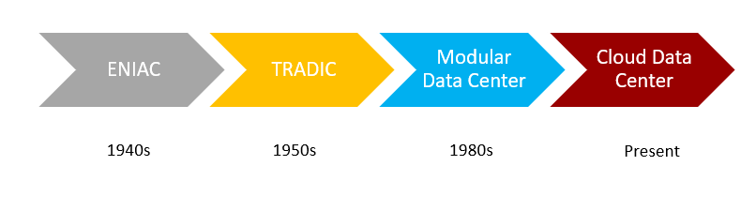
Evolution of Data Centers

Slide 8
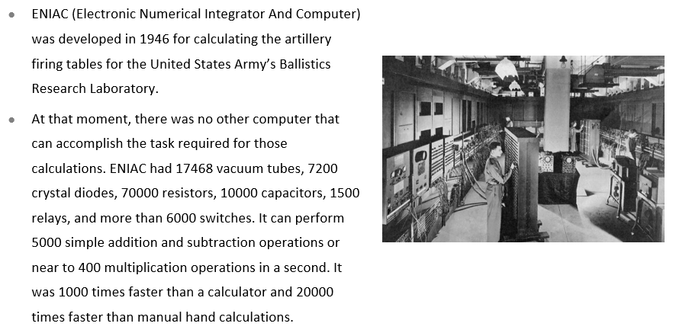
Earliest Development of Data Centers - ENIAC

Slide 9
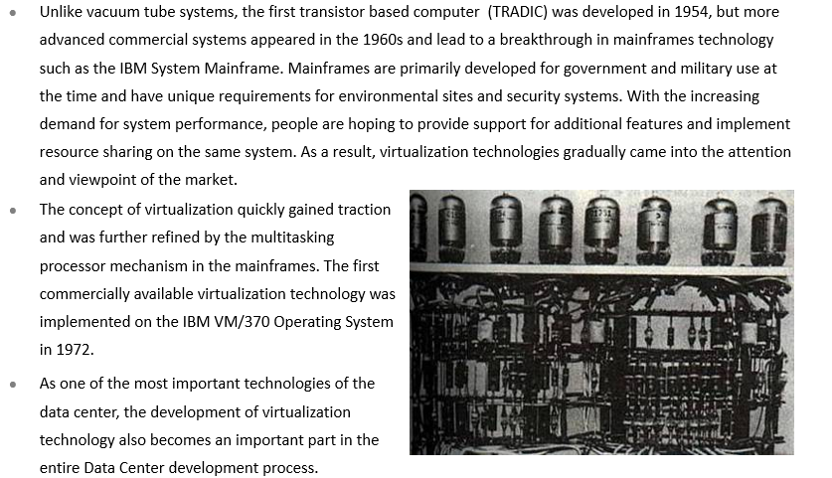
Commercialization of Virtualization Technologies in
Data Centers - TRADIC

Slide 10
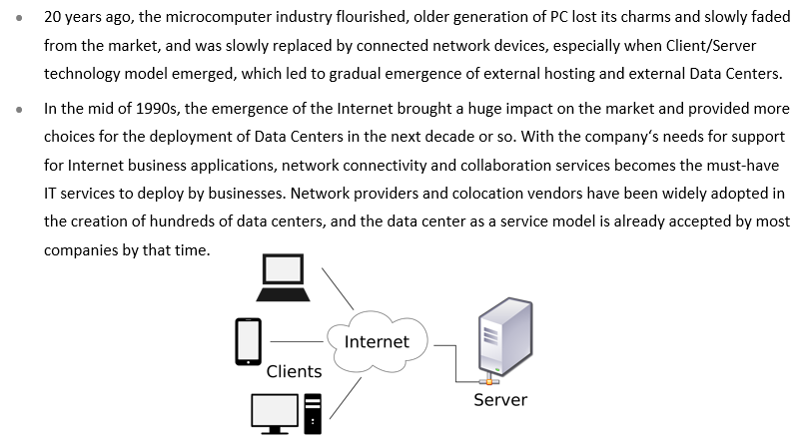
C/S Architecture Computing Model and the Internet

Slide 11
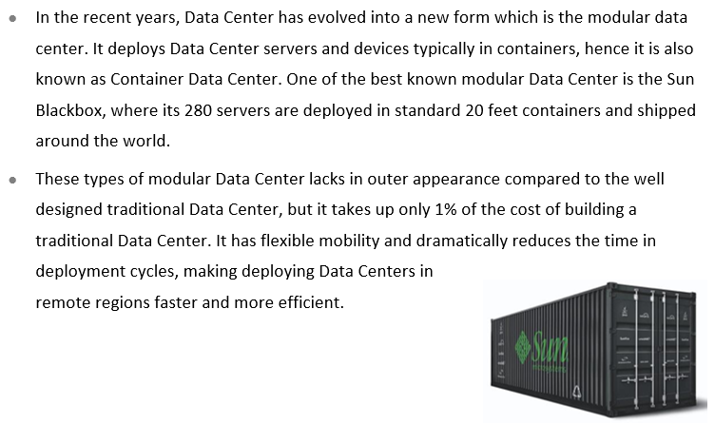
Emergence of Modular Data Centers

Slide 12
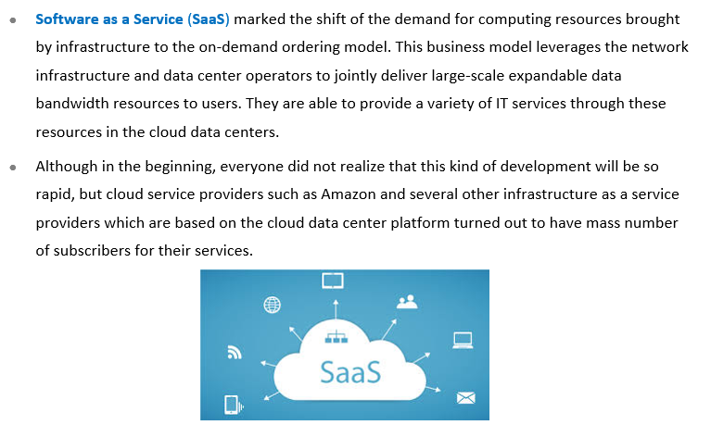
Cloud Data Centers

Slide 13
Chapter
Basic Components and Modules
of Data Centers
10

Slide 14
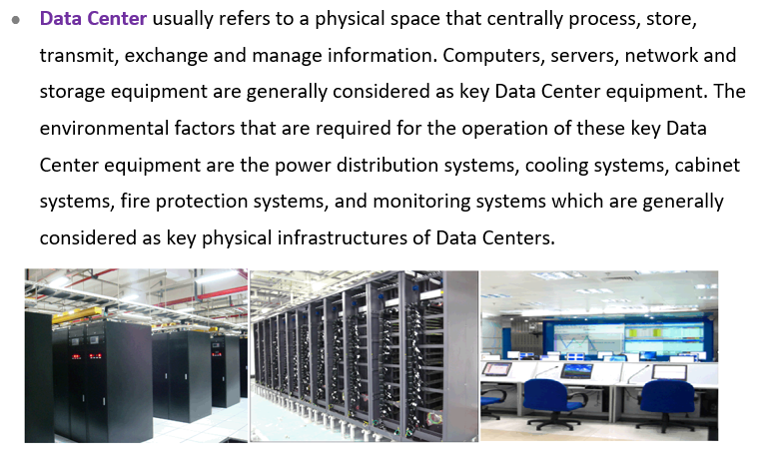
What is a Data Center ?

Slide 15
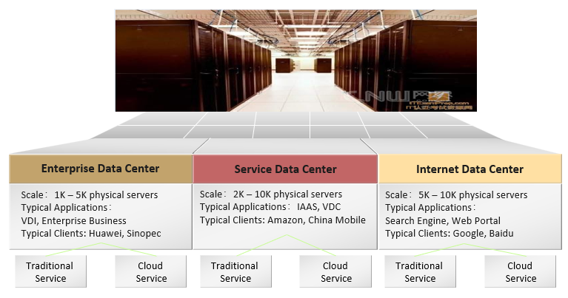
Types of Data Center

Slide 16
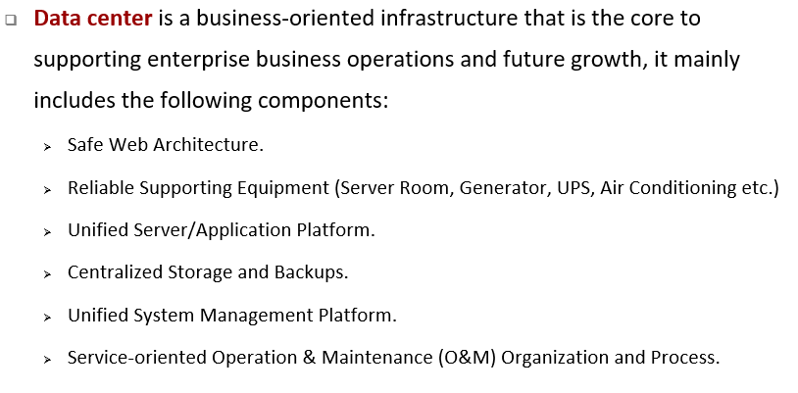
Components of Data Center

Slide 17
Chapter
10
Data Center Architecture

Slide 18
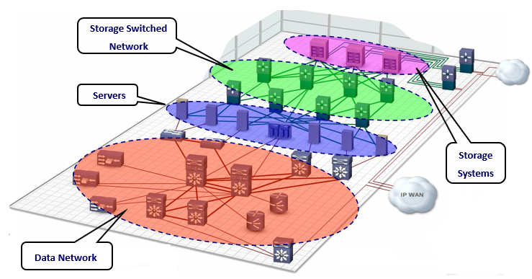
Standard Data Center Architecture

Slide 19
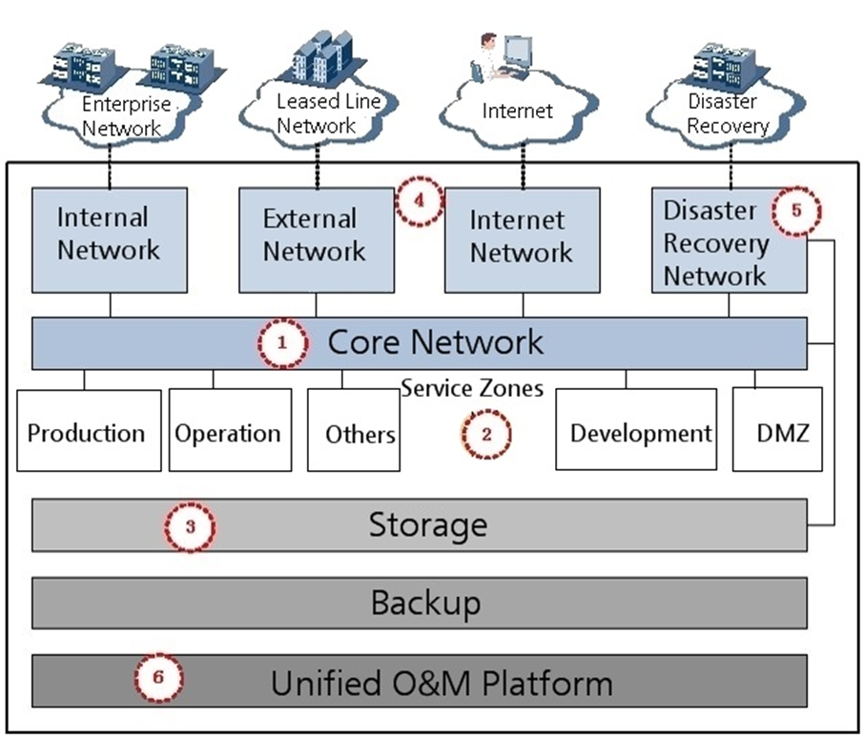
Logical Architecture of Data Centers

Slide 20
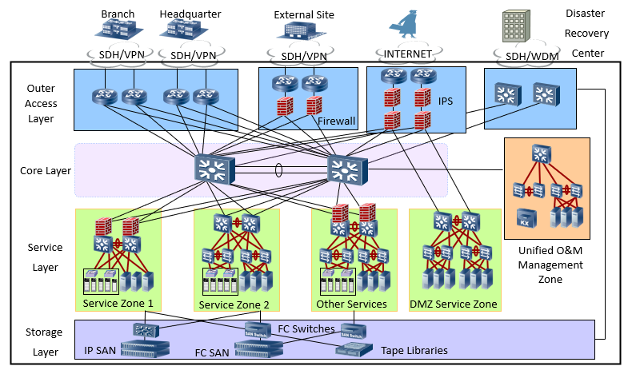
Physical Architecture of the Data Center

Slide 21
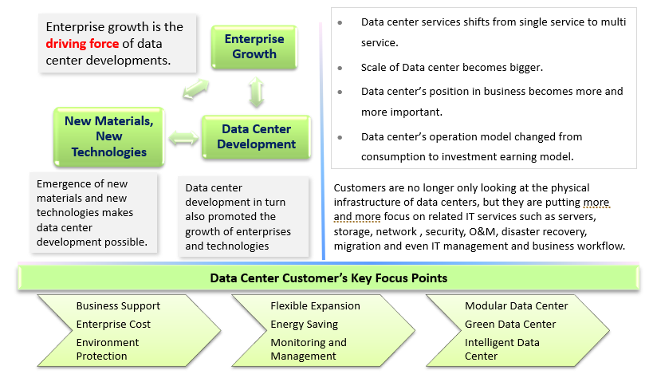
Data Center Infrastructure Development Trends

Slide 22
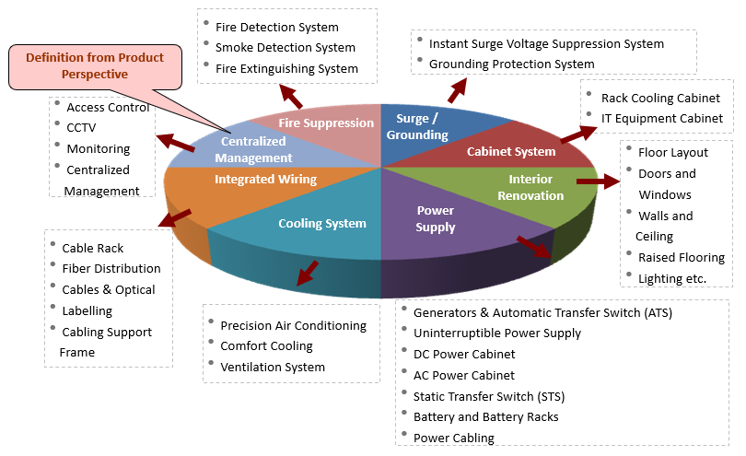
Components of Data Center Infrastructure

Slide 23
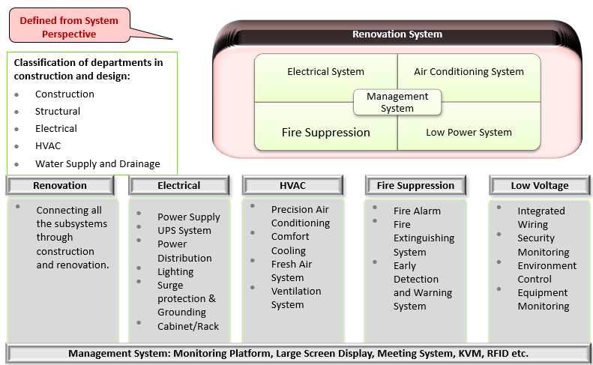
Classification of Data Center Infrastructure

Slide 24
Chapter
Challenges of Cloud Data Centers and
its Development Trends
10

Slide 25
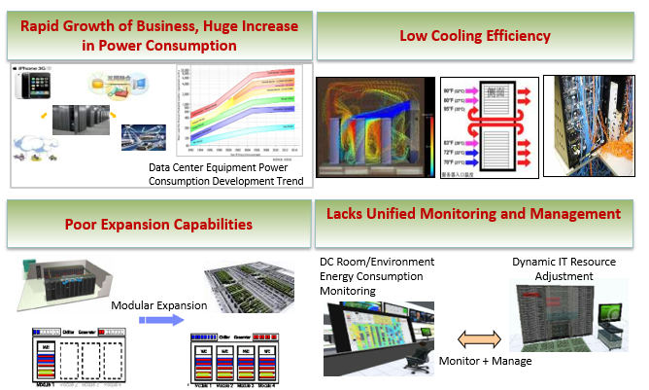
Challenges of Traditional Data Center

Slide 26
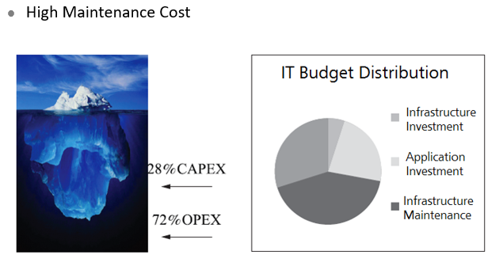
Challenges of Traditional Data Center - Maintenance Cost

Slide 27
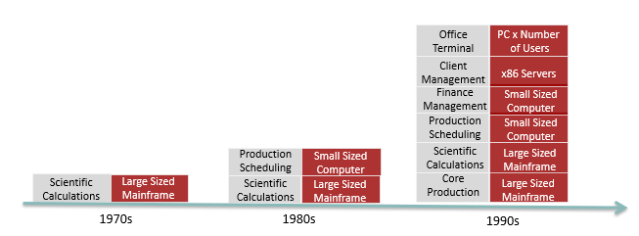
Challenges of Traditional Data Center - Increase in Services and Equipment (1)

Slide 28
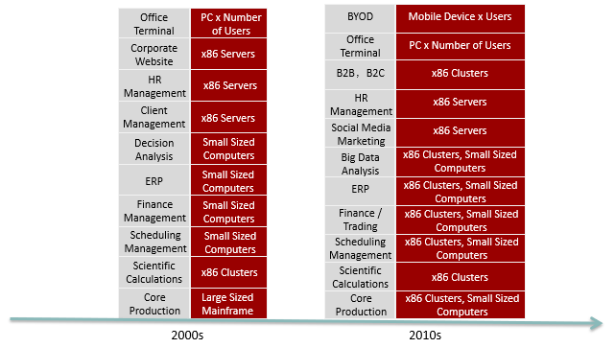
Challenges of Traditional Data Center - Increase
in Services and Equipment (2)

Slide 29
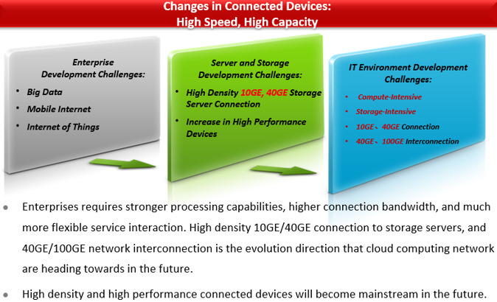
Challenges of Traditional Data Center – Increase
in Data Traffic (1)

Slide 30
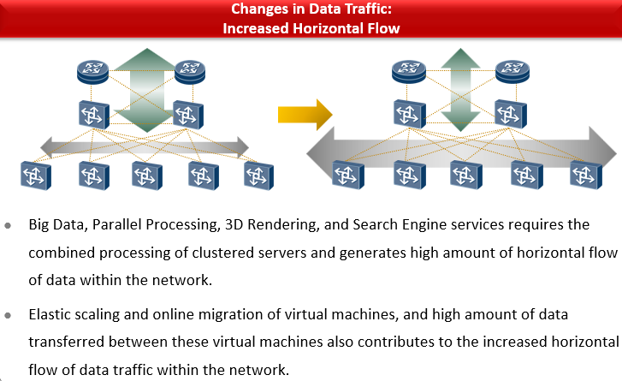
Challenges of Traditional Data Center – Increase
in Data Traffic (2)

Slide 31
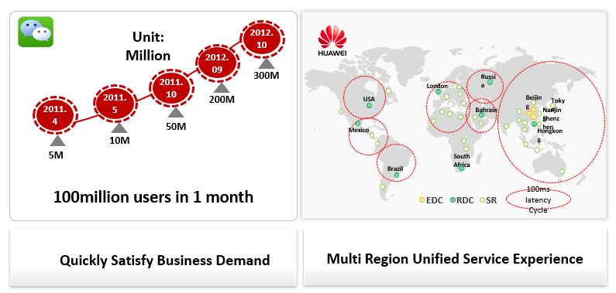
Challenges of Traditional Data Center - Business
Driven Growth

Slide 32
Chapter
10
Innovation Data Center

Slide 33
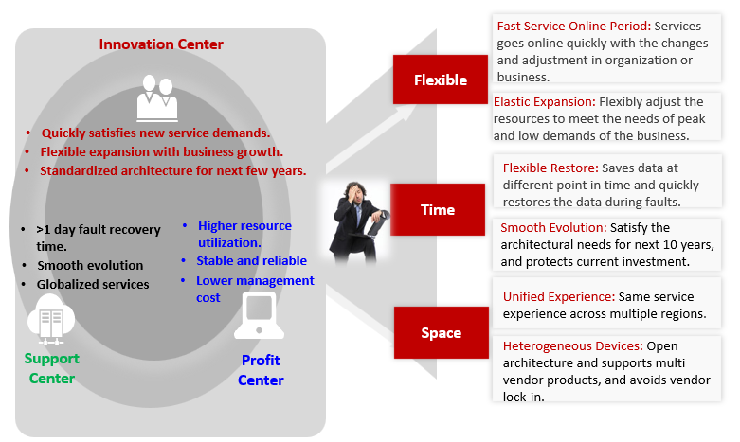
What Kind of Data Center is Needed by Enterprises ?

Slide 34
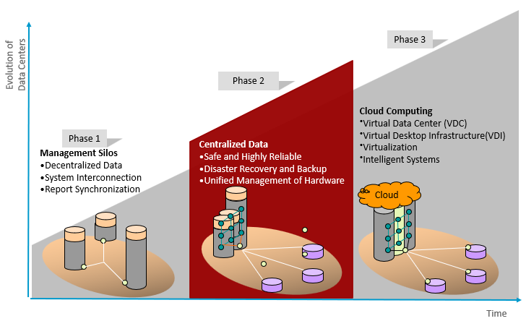
Data Center Development Stages

Slide 35
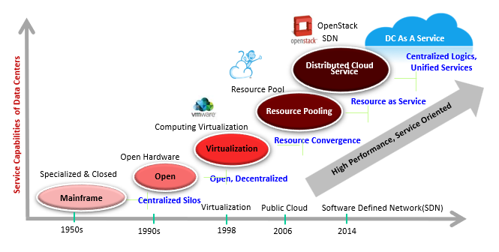
Service Oriented Cloud Data Center

Slide 36
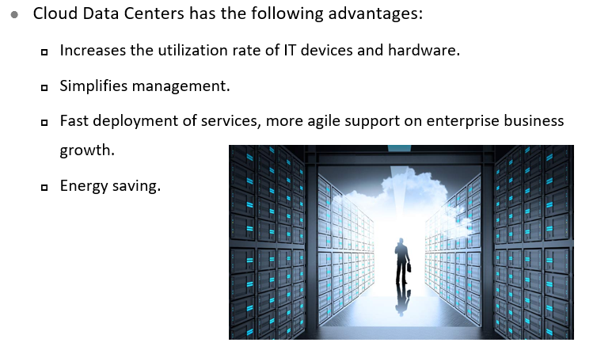
Unique Features of Cloud Data Centers

Slide 37
Chapter
10
Cloud Data Center Development Trend

Slide 38
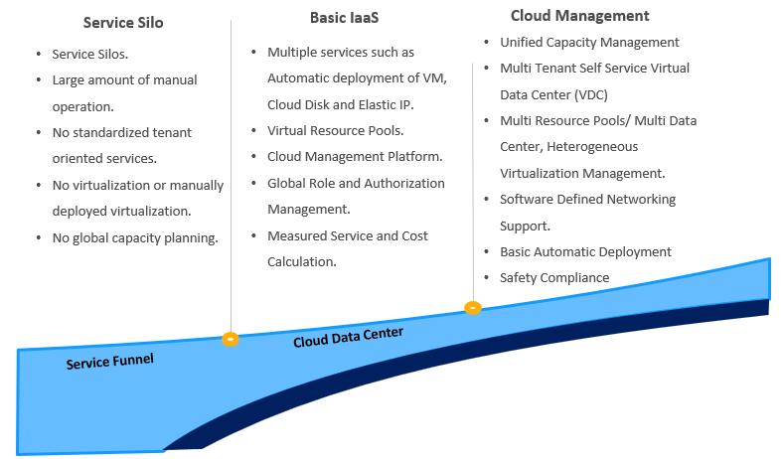
Cloud Data Center Development Trend (1)

Slide 39
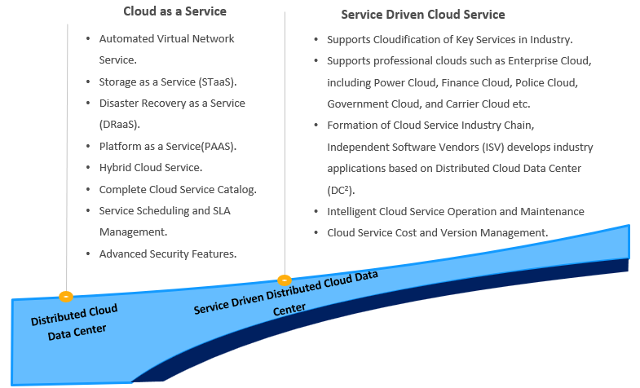
Cloud Data Center Development Trend (2)

Slide 40



Thank You

