Slide 1

PMG 622
Agile Project Management
LECTURE 11: Teams / Professional ethics / acp q&a [1/2]
Everyone’s Smart
University
دكتور مهندس استشاري ادارة المشروعات
Eng. Dr. Akram Mustafa Suliman Ali,
PhD. AU, BEng. & MSc. AAST, CEng CMarEng MIMarEST, PE, PMP®,
ASQ CSSBB, ISO Lead Auditor, NDT Level II,

Slide 2
المنتدى المفتوح -The Open Forum
This is a Standard Forum displayed in a blog-like format
Students may start new topics in this format.
Allow multiple topics listed with the most recent topic at the top of the page and replies behind a link.
في هذا المنتدى يستطيع اي طالب بدء المناقشة ليرد عليه باقي الطلبة
و اشكركم على مشاركتكم
Forum Topic:
المنتدى المفتوح
-The Open Forum

Slide 3

TEAMS
Notes:
Transparency → Team Work → Collaboration

Slide 4
Great Teams Are
Teams are what gets things done in the real world
Slow individuals take 10:1 times quick individuals
Slow teams take times quick teams
Teams can be improved 300-400 % up to 800% in terms of velocity & double the quality level
2000:1
Pull the right lever.
Improving teams performance yields drastic results
Notes:
300-400 % up to 800% & double the quality level

Slide 5
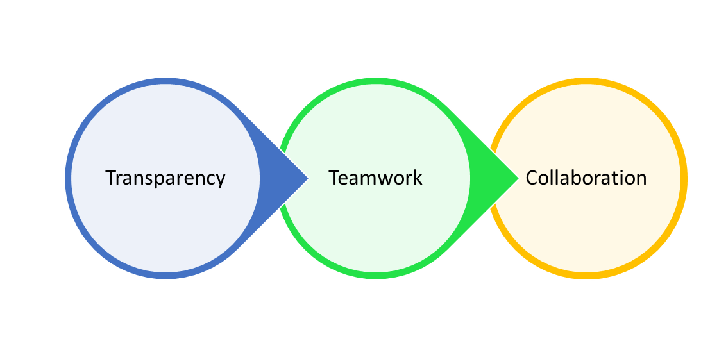
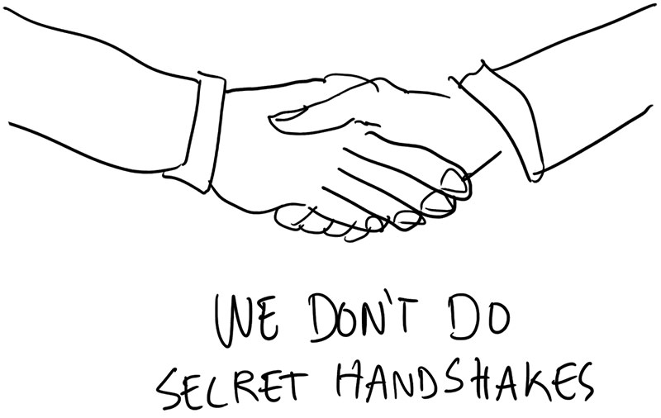
Team Rules
The things that make people happy are the same that make a great team
Absolute alignment of purpose and trust
The must be
  Cross-functional: Have every skill needed to complete the project.
  Autonomous: Freedom on how to effect planned actions
  Transcendent: Greater purpose than individual
Transparency
Notes:
قصة جلال علام
Diversity of:
Skills set
Thinking
Experience
NONE OF US IS AS SMART AS ALL OF US
Informational Silos → Suspicion & distrust
If you do not trust the people that are working with you, then what are you doing?

Slide 6

Accelerating Teams
Producing faster NOT working longer hours.
Productivity through working better and smarter is threefold.

Slide 7
Brook’s Law
Adding manpower to a late software project makes it later
Classic team formula:-
            7 +/- 2
            New formula 6 +/- 3 – (Max # is still 9 people)
            Groups made up of 3-7 people required about 25% of the effort of groups of 9-20 people to get the same amount of work done.
Notes:
Communications channels: N(N-1)/2
Lack of clear communication due to increased cross channels
Social and functional sub teams → cross purpose → loss of cross functionality
Very long meetings

Slide 8

Team Happiness
Happy people do better
Build trust every day.
Quantify happiness → Leading KPI
Solve issues bothering team members
Notes:
Mastering work motivates people
Happiness = Positive and passionate engagement
Thriving employees stay and attract more like them → Reversed boiled frog
Maslow's Triangle:
Base: Physiological needs: Air, Water; Food; Clothing and Shelter
Middle: Safety (physical and financial); good health; love; belonging; connectedness; self esteem and respect from others
Top: Achieve full potential

Slide 9
The HAPPINESS Metric
On a scale of 1-5 how do you feel about your role in the company?
On the scale how do you feel about the company as a whole?
What one thing that would make you happier in the next sprint?
The Ability to Control Your Own Destiny: It is the feeling that you are getting better at something, and it is knowing that you are serving something bigger than yourself

Slide 10
transparency

Slide 11
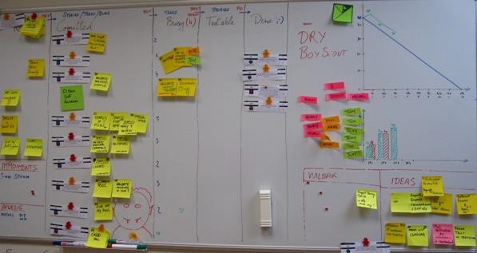
UP-TO-DATE Information Radiators
Notes:
Visible charts and figures that display project progress and current status for all team members and stakeholders to use.

Slide 12
Professional Responsibility and Ethics
Notes:
Steps that definitely create value.
Steps that create no value, but are necessary given the current state of the system.
Steps that create no value and can be eliminated.

Slide 13

Contents
Professional Responsibility
  Responsibility to the Profession
  Responsibility to the Customer and Public
PMI Ground Ethics
Sample Questions

Slide 14
PMI Code of Ethics & Professional Conduct
Who does it apply to?
  All members of PMI
What are the Values?
  Responsibility – We take full responsibility for our actions and conduct
  Respect – We respect our duties, ourselves, and those around us
  Fairness – We treat everyone and our decisions with objectivity
  Honesty – We act in a truthful manner both in our conduct and communications

Slide 15



Professional Responsibility
Adhering to PMI Code of Ethics and Professional Conduct
Maintaining high professional ethics
Developing cultural competency in our emerging global society

Slide 16
Professional Responsibility
Responsibility to the Profession:
1. Be truthful at all times and in all situations.
2. Report Code violations (with factual basis).
3. Disclose conflicts of interest.
4. Comply with laws.
5. Respect other's intellectual property rights.
6. Support the Code.

Slide 17
Professional Responsibility
Responsibility to Customers and the Public:
1. Be truthful at all times and in all situations.
2. Maintain professional integrity (satisfy the scope of your professional services).
3. Respect the confidentiality of sensitive information.
4. Refrain from gift or compensation giving/receiving where inappropriate.
5. Ensure conflicts of interest do not interfere with client's interest or interfere with professional judgment.

Slide 18
PMI Ground Ethics
Tell the Truth and Tell It Fast
Communicate Frequently
Invite Everyone
Answer All Questions Willingly and Truthfully
Be Responsible
Respect and Respect
Be Fair
Be Honest

Slide 19


Slide 20
QUESTION 1
A story point is the:
A. Relative measure of the size of a user story.
B. Duration it takes to complete a user story.
C. Priority of the user story in the backlog.
D. Business value of the user story.
Correct Answer: A

Slide 21
Question 2
On a particular project, product quality is being measured at regular intervals and is consistently below the acceptable level. In a Lean environment, how should this problem be addressed?
A. The team should implement more rigorous testing at the end of each development cycle.
B. Management should direct the team on specific actions that they should take to improve quality.
C. Management should guide the team as it seeks to improve itself and reduce errors in the system.
D. The Project Champion should review the acceptable quality threshold to ensure that it is realistic.
Correct Answer: C

Slide 22
Question 3
What key benefits might stakeholders realize from an Agile approach?
A. The ability to bypass the change-management process, inserting new requirements and changes directly into the team as they meet daily
B. The early and continuous delivery of valuable software, providing increased visibility and the opportunity for more frequent adjustments
C. Increased access to the project and less reliance on formal reports and status meetings to better understand the current work and the risks the team is accepting
D. The team’s flexibility to make changes mid-iteration as business needs or priorities change, increasing the ability of the team to meet project commitments
Correct Answer: B

Slide 23
QUESTION 4
The primary purpose of a Sprint Review is for the team to:
A. Demonstrate what was accomplished during the sprint.
B. Discuss what went well, what didn’t, and ways to improve.
C. Prioritize and estimate stories planned for the next sprint.
D. Individually provide status updates on user stories in progress.
Correct Answer: A

Slide 24
Question 5
In reference to Scrum, each sprint should produce:
A. An increment of potentially shippable product functionality.
B. A set of documented product requirements and specifications.
C. A release with testable and measurable functionality.
D. An increment of potentially testable product functionality.
Correct Answer: A

Slide 25
Question 6
The primary purpose of a Sprint Review is for the team to:
A. Demonstrate what was accomplished during the sprint.
B. Discuss what went well, what didn’t, and ways to improve.
C. Prioritize and estimate stories planned for the next sprint.
D. Individually provide status updates on user stories in progress.
Correct Answer: A

Slide 26
Question 7
On what should Agile estimates be based?
A. A Work Breakdown Structure (WBS) from each iteration aligned with the project management plan
B. A disciplined iteration schedule, which improves predictability, combined with reaction to changes
C. Ball park figures collected from past Agile projects with scopes similar to the current project
D. Initial resource breakdown based on the available person days in the full project duration
885CB989129A5F974833949052CFB2F2
Correct Answer: B

Slide 27
Question 8
When estimating initial velocity, the team should most likely:
A. Discuss among the team their expectations of how many story points they can address.
B. Use a Kanban workflow to identify steps and calculate velocity.
C. Use velocity of past iterations or make a calculated guess.
D. Discuss with the customer their expectation for the velocity of producing the product.
Correct Answer: C

Slide 28
Question 9
After three iterations, the problems impeding an Agile team appear to be similar in nature to problems faced in earlier iterations. Inspection of the retrospectives for past iterations reveals information organized into columns entitled “What worked for us” and “What did not work for us. ” Based on this information, one can infer that the team did not capture:
A. user stories
B. milestones
C. action items
D. requirements
Correct Answer: C

Slide 29
Question 10
Which is the best option to improve project velocity?
A. Shield programmers from interruptions
B. Minimize customer involvement
C. Shorten the iteration length
D. Increase project team size
Correct Answer: C

Slide 30
Question 11
Continuous integration ensures that a product is:
A. Ready to ship when all features are complete.
B. Delivered for testing at the end of each day.
C. Technologically ready to deploy at any time.
D. Deployed after final business approvals.
Correct Answer: C

Slide 31
Question 12
Which are some of the most important benefits of an Agile team sitting together in a co-located, open environment?
A. Osmotic communication is reduced; space is used more efficiently; groups work together more effectively, and team dynamics are improved.
B. Costs are reduced as the need for conference rooms decreases, and the team can keep track of where members are more accurately.
C. Team members can be held more accountable for their time and effort, and pair programming is easier as people have less distance to move to sit with their
partner.
D. Communication is improved; wait-time and rework are reduced; barriers between groups break down, and groups gain respect for each other professionally.
Correct Answer: D

Slide 32
Question 13
Which layer of the product planning structure defines details at the capability or feature level?
A. Iteration
B. Roadmap
C. Release
D. Wave
Correct Answer: C

Slide 33
Question 14
In an Agile approach, at which meeting does a team examine the effectiveness of risk responses by conducting a risk audit?
A. Release planning
B. Sprint planning
C. Sprint Retrospective
D. Daily Scrum
Correct Answer: C

Slide 34
Question 15
The ScrumMaster and the Product Owner disagree on the value of a Product Backlog item. In order to resolve the disagreement, the first step the ScrumMaster should take is to ask:
A. The Product Owner to clarify the requirement.
B. The business owner to resolve the problem.
C. The business analyst to research the product value.
D. Another project manager how to resolve the problem.
Correct Answer: A

Slide 35
Question 16
The most powerful capability of Scrum teams is that they:
A. Work in timeboxed sprints.
B. Are self-organized and empowered.
C. Work from a prioritized backlog.
D. Value individuals and interactions.
Correct Answer: B

Slide 36
Question 17
Which type of story would be used when an estimate is not available due to lack of knowledge of the technology required to implement the story?
A. Defect
B. Slack
C. Spike
D. Nonfunctional
Correct Answer: C

Slide 37
Question 18
A company is starting to introduce Agile practices, and the project manager has been asked to identify how to introduce the new process. The project manager’s initial plan should be to:
A. Institute daily standup meetings immediately.
B. Communicate the Agile Manifesto to the team.
C. Balance teaching principles with Agile practices.
D. Rate the team’s progress in learning new methods.
Correct Answer: C

Slide 38
Question 19
A project team is distributed across multiple countries, and they are having issues agreeing on what is being delivered and how it should be developed. Which of the following should the project manager do to alleviate some of the tension between team members, break down cultural barriers, and improve communication?
A. Ask the team to communicate only through email to clearly document issues.
B. Discuss this issue with senior management and recommend that the team be co-located.
C. Monitor performance and discuss the issues in detail at the next retrospective.
D. Hold daily standup meetings with the two teams at a time that works best for everyone.
885CB989129A5F974833949052CFB2F2
Correct Answer: D

Slide 39
Question 20
Which tool allows the Product Owner to focus on providing the greatest value and Return on Investment (ROI) to the organization?
A. Burn up chart
B. Product Backlog
C. Affinity estimate
D. Cost Benefit Analysis (CBA)
Correct Answer: B

