Slide 1



Creative Strategy:
Planning and Development
&
Media Planning and Strategy
MKT728
Prepared by Dr. Perihan Salah
Lecture 5

Slide 2



Chapter
05
Learning Objectives
To discuss what is meant by advertising creativity and examine the role of creative strategy in advertising
To consider the process that guides the creation of advertising messages and the research inputs into the stages of the creative process
To examine creative strategy development and the roles of various client and agency personnel involved in it
To examine various approaches used for determining major selling ideas that form the basis of an advertising campaign
To understand the key terminology used in media planning
To know how a media plan is developed
To know what constitutes media objectives
To know the process of developing and implementing media strategies
To be familiar with various characteristics of media

Slide 3
Chapter
Creative Strategy and Tactics
05
Creative strategy
  Determines what the advertising message will say or communicate
Creative tactics
  Determine how the message strategy will be executed

Slide 4
Chapter
Different Perspectives on Advertising Creativity
05
Managers’ perspective
Creative people’s perspective
  Advertising is creative only if it sells the product
  Ads are promotional tools used to communicate favorable impressions to the marketplace
  Creativity of an ad is in its artistic value and originality
  Ads are communication vehicles for promoting their own aesthetic viewpoints and personal career objectives

Slide 5
Chapter
05
Advertising Creativity
Ability to generate fresh, unique, and appropriate ideas that can be used as solutions to communication problems

Slide 6
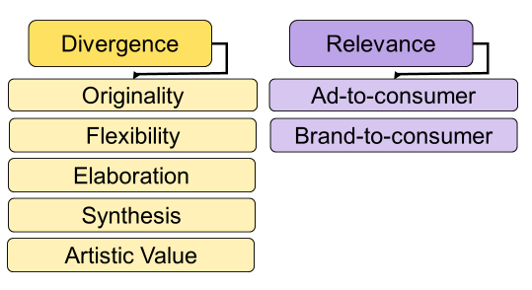
Chapter
05
Determinants of Creativity

Slide 7

Divergence
Extent to which an ad contains elements that are novel, different, or unusual
Achieved through:
  Originality
  Flexibility
  Elaboration
  Synthesis
  Artistic value

Slide 8
Relevance
Degree to which the elements of an ad are meaningful, useful, or valuable to the consumer
Achieved through:
  Ad-to-consumer relevance - Ad contains execution elements that are meaningful to consumers
  Brand-to-consumer relevance - Advertised brand of a product or service is of personal interest to consumers

Slide 9
Planning Creative Strategy
Creative challenge
  Every marketing situation is different and each campaign or advertisement requires a different creative approach
Creative risks
  Essential for creating breakthrough advertisements that get noticed

Slide 10
Account Planning
Conducting research and gathering relevant information about a client’s:
  Product/service and brand
  Consumers in the target audience
Account planners
  Provide decision makers with information required to make an intelligent decision
  Responsible for research conducted during the creative strategy development process

Slide 11
Background Research
Fact-finding techniques
  Read everything related to the product or market
  Ask everyone involved with the product for information
  Listen to what people are talking, particularly the client
  Use the product or service and become familiar with it
  Learn about the client’s business

Slide 12
Input Verification and Revision
Objective
Evaluate ideas
Reject the inappropriate
Refine the remaining
Give ideas final expression
Techniques
Directed focus groups
Message communication studies
Portfolio tests
Viewer reaction profiles

Slide 13
Verification and Revision
Techniques used
Directed focus groups
Message communication studies
Portfolio tests and evaluation measures
Storyboard: Series of drawings that present a proposed commercial’s visual layout
  Animatic: Videotape of a storyboard along with an audio soundtrack

Slide 14
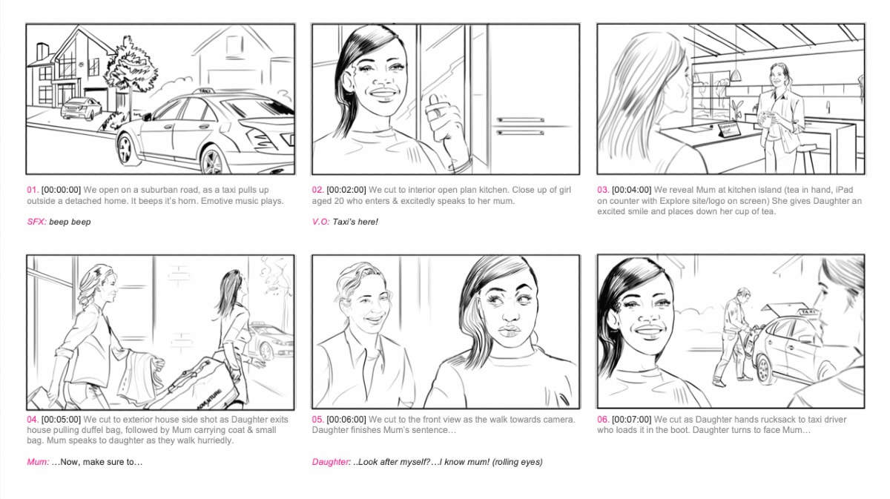
Storyboards and Animatics

Slide 15
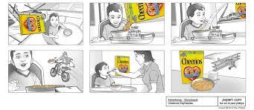
Storyboards and Animatics

Slide 16
Chapter
Advertising Campaign
05
Set of interrelated and coordinated marketing communications activities that center on a single theme or idea
  Appear in different media across a specified time period
Campaign theme
  Central message communicated in all the advertising and promotional activities
  Expressed through a slogan or tagline
Slogan
  Summation line that briefly expresses the company or brand’s positioning and the message it is trying to deliver to the target audience

Slide 17
An Advertising Campaign
Integrated
Interrelated
Coordinated
Marketing Communication Activities
Centered on a Theme or Idea
In Different Media
Over a Time Period

Slide 18
Advertising Campaign Themes
The central message that will be communicated
in all of the various IMC activities
Miller
Lite
Nike
BMW
Under Armour
Red Bull
“ Just Do It”
“ We Must Protect This House. I will.”
“Red Bull Gives You Wings”

Slide 19
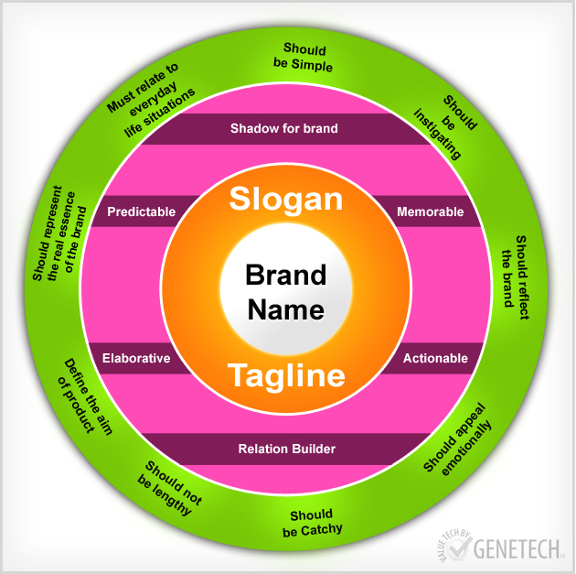
Criteria for Effective Slogans

Slide 20
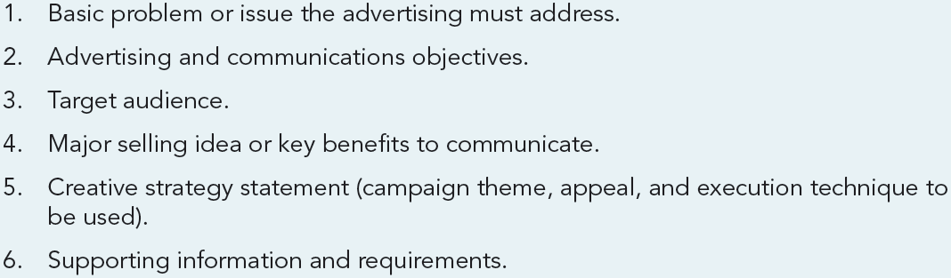
Creative Brief Outline

Slide 21
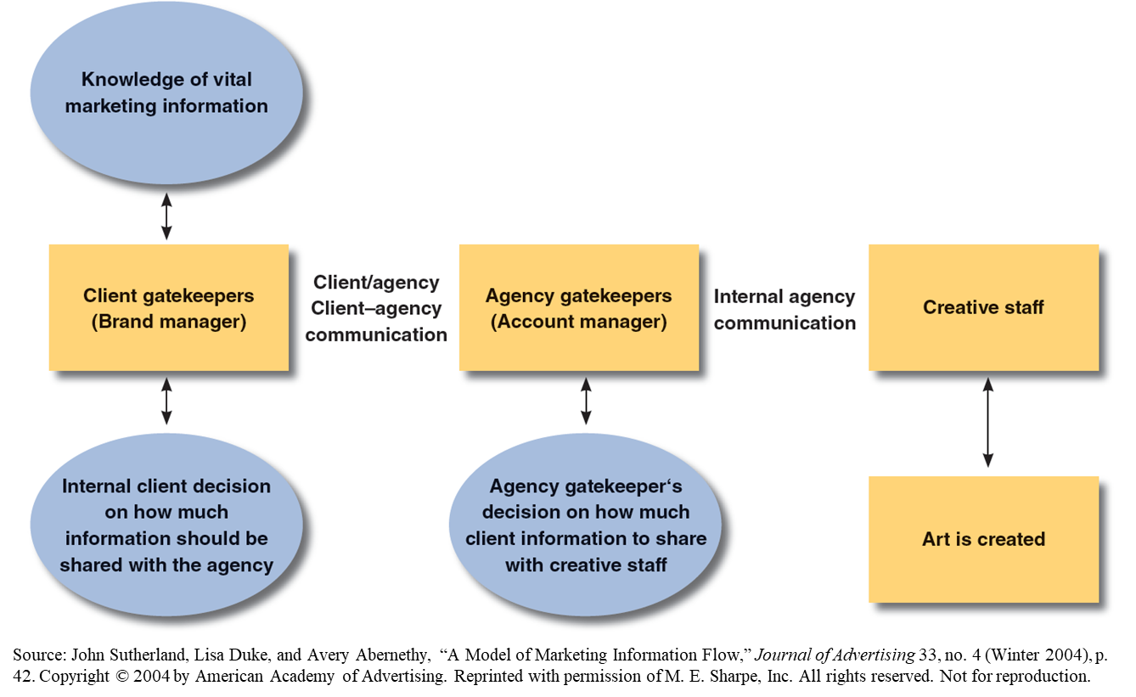
Model of Marketing Information Flow from the Marketing Manager to the Creative Staff

Slide 22
Developing the Major Selling Idea
Using a unique selling proposition
Creating a brand image
Approaches
Finding the inherent drama
Positioning

Slide 23
The Unique Selling Proposition (USP)
Benefit
Unique
Potent
Characteristics
  Each advertisement must make a proposition to the consumer
  Proposition must be unique in brand or in claim
  Proposition must be strong enough to move the mass millions
Buy this product/service and you get this benefit
Must be unique to this brand or claim; rivals can't or don't offer it
Promise must be strong enough to move mass millions

Slide 24
Creating a Brand Image
Image advertising: Strategy used to develop a strong, memorable identity for a brand
To be successful:
  Associate the brand with symbols or artifacts that have cultural meaning
  Use visual appeals that convey psychosocial associations and feelings

Slide 25
Positioning
Establishes the product or service in a particular place in the consumer’s mind
Done on the basis of a distinctive attributes
Basis of a firm’s creative strategy when it has multiple brands competing in the same market

Slide 26
Inherent Drama
Characteristic of a product that makes the consumer purchase it
Advertising should:
  Be based on a foundation of consumer benefits
  Emphasis on the dramatic element in expressing those benefits

Slide 27
Contemporary Approaches to the Big Idea
Big ideas must:
  Be adaptable - Used across a variety of media
  Be able to connect - Engage consumers and enter into a dialogue with them

Slide 28
Chapter
Media Terms and Concepts
05
Media planning
  Series of decisions involved in delivering the promotional message to the prospective users of the product or brand
Media objectives
  Objectives formulated to organize a media plan
Media strategies
  Plans of action designed to attain the media objectives
Medium
  General category of available delivery systems

Slide 29
Chapter
Media Terms and Concepts
05
Media vehicle
  Specific carrier within a medium category
Reach
  Measure of the number of different audience members exposed at least once to a media vehicle in a given period of time
Coverage
  Potential audience that might receive the message through a vehicle
Frequency
  Number of times the receiver is exposed to the media vehicle in a specified period

Slide 30
Chapter
05
Media Plan
Guides media selection (helps me select the proper media based on my objective)
Aims to find a combination of media to communicate a message:
  In the most effective manner
  To the largest number of potential customers
  At the lowest cost

Slide 31
Chapter
Activities Involved in Developing the Media Plan (what are the data to know)
05
Situation
analysis
Marketing
strategy plan
Creative
strategy plan
Setting media objectives
Determining media strategy
Selecting broad media classes
Selecting media within class
Media use decisions
— broadcast
Media use decisions
— other media
Media use decisions
— print

Slide 32
Chapter
05
Problems in Media Planning
Insufficient information (who said all are watching amr adeeb)
Sweeps periods: Used for measuring TV audiences and setting advertising rates (measured 5 times a year)
Inconsistent terminologies (copy – advert – slot – spot)
Time pressures (price/seconds airtime)
Difficulty measuring effectiveness (adverts or PR?)

Slide 33
Developing the Media Plan
Why choosing matches on tv? Inc sales?
Market research

Slide 34
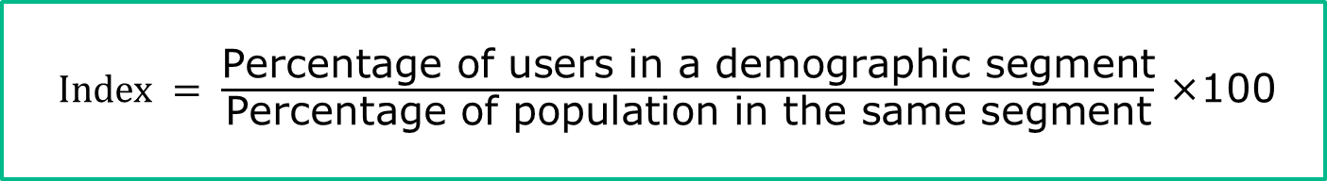
Target Market Identification (to whom will we advertise)
Primary research and/or secondary sources help determine which specific groups to target
Index number: Good indicator of the potential of a market

Slide 35
Internal and External Factors Influencing Media Strategies
Internal factors
Size of the media budget
Managerial and administrative capabilities (internal or outsourcing)
Organization of the agency
External factors
Rising costs of media (cost per second)
Changes in technology (SM platforms)
Competitive factors (do ads bcoz of the competitor did)

Slide 36
Using Indexes to Determine Where to Promote
Survey of buying power index
  Gives media planners insight into the relative value of a market
Brand development index (BDI)
  Factors the rate of product usage by geographic area into the decision process (Nestle)
Category development index (CDI)
  Provides information on the potential for development of the total product category and not specific brands (Mineral water)

Slide 37
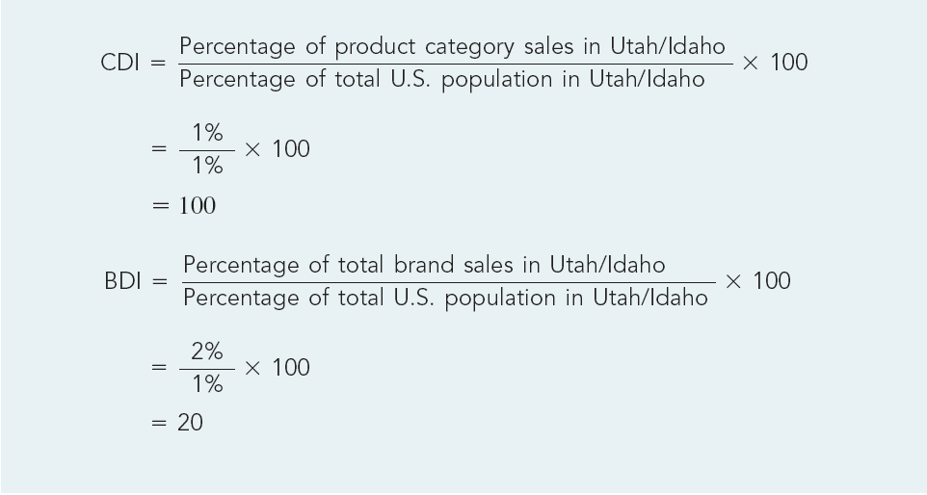
Using CDI and BDI to Determine Market Potential

Slide 38
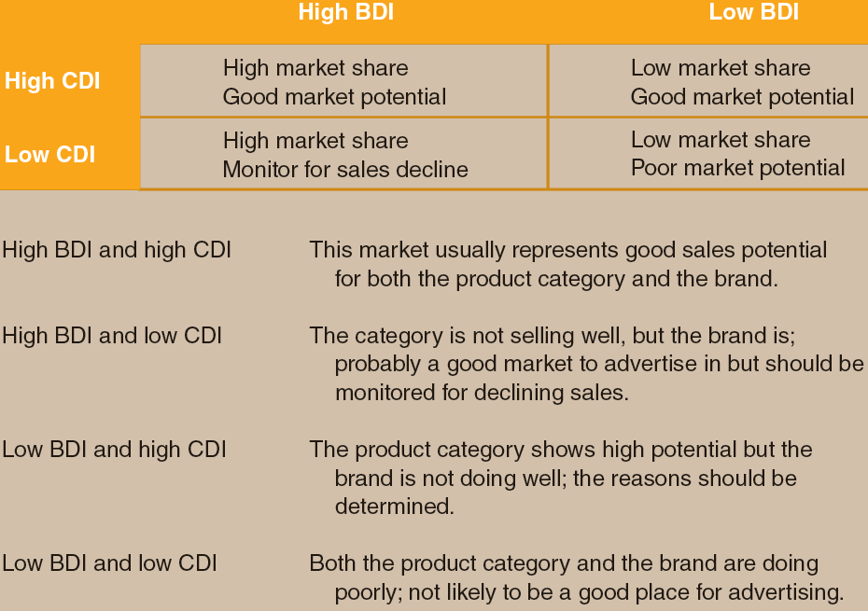
Using BDI and CDI Indexes

Slide 39
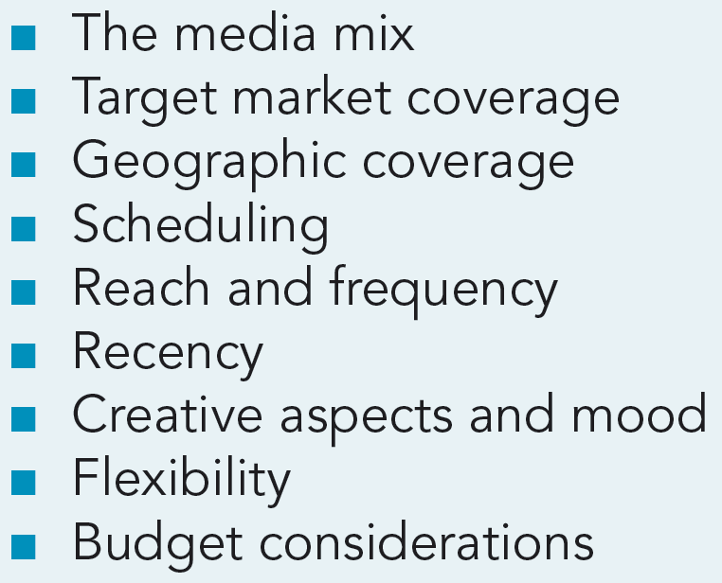
Criteria Considered in the Development of Media Plans

Slide 40
Developing & Implementing Media Strategy
1. Media Mix
Adds more versatility to the media strategies
Increases coverage, reach, and frequency levels
Improves the likelihood of achieving overall communications and marketing goals
2. Target Market Coverage
Matches the most appropriate media to a market
Goal - Extend media coverage to members of the target audience while minimizing waste coverage
  Waste coverage: Media coverage that reaches people who are not potential buyers and/or users

Slide 41
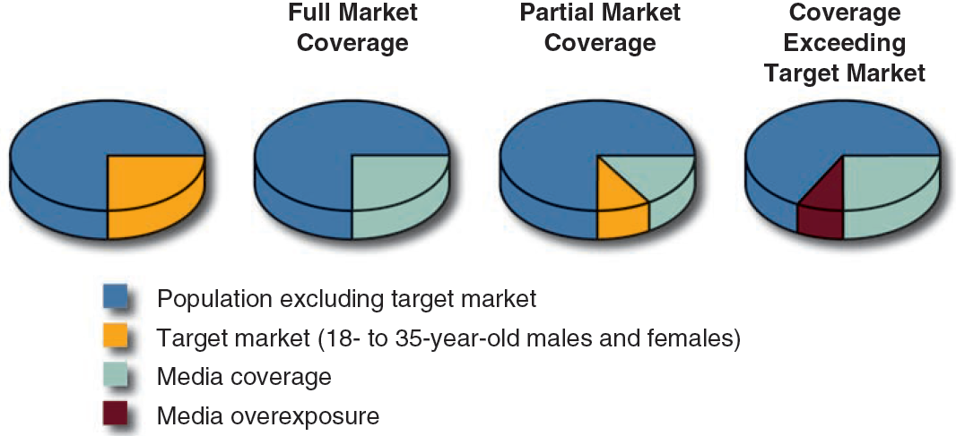
Developing & Implementing Media Strategy
3. Marketing Coverage Possibilities

Slide 42
Developing & Implementing Media Strategy
4. Scheduling (based on budget & competition)
Timing promotional efforts such that they coincide with the highest potential buying times
Methods
  Continuity: Regular pattern of advertising without gaps or nonadvertising periods (FMCGs)
  Flighting: Involves intermittent periods of advertising and nonadvertising (seasonal)
  Pulsing: Maintains continuity, but promotional efforts are stepped up at times (+BTL)

Slide 43
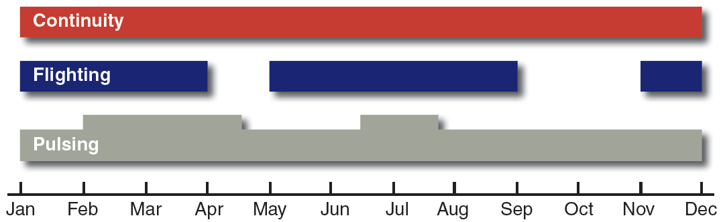
Three Methods of Promotional Scheduling

Slide 44
Characteristics of Scheduling Methods
 | Advantages | Disadvantages
Continuity | Serves as a constant reminder to the consumer Covers the entire buying cycle Allows for media priorities | Higher costs Potential for overexposure Limited media allocation possible (limited tv channels)
Flighting | Cost efficiency of advertising only during purchase cycles Allows for more than one medium or vehicle with limited budgets | Weighting may offer more exposure and advantage over competitors Increased likelihood of wearout Lack of awareness, interest, retention of promotional message during nonscheduled times Vulnerability to competitive efforts during nonscheduled periods
Pulsing | All of the same as the previous two methods | Not required for seasonal products

Slide 45
Effective Reach
Represents the percentage of audience reached at each effective frequency increment
Based on assumption that one exposure to an ad may not be enough to convey the desired message

Slide 46
Important Factors in Determining Frequency Levels
Marketing factors
Message Factors
Media Factors
  Brand history
  Brand share
  Brand loyalty
  Purchase cycles
  Usage cycle
  Competitive share of voice
  Target group
  Message complexity
  Message uniqueness
  New versus continuing campaigns
  Image versus product sell
  Message variation
  Wearout
  Advertising units
  Clutter
  Editorial environment
  Attentiveness
  Scheduling
  Number of media used
  Repeat exposures

Slide 47
Important Factors in Determining Frequency Levels
The various marketing, message, and media factors that affect the advertisers’ decisions regarding frequency levels needed to communicate effectively.
Marketing factors
  Brand history - New brands require higher frequency
  Brand loyalty - The higher the loyalty the less frequency required
  Brand share - The higher the share the less frequency required
  Usage cycle - Products needing to be replaced frequently require higher frequency to maintain top-of-mind awareness
  Share of voice - When strong competition exists, higher frequency is required
  Purchase cycles - Shorter purchasing cycles require higher frequency to maintain top-of-mind awareness
  Target group - The ability to learn and retain messages has an impact on frequency

Slide 48
Important Factors in Determining Frequency Levels
The various marketing, message, and media factors that affect the advertisers’ decisions regarding frequency levels needed to communicate effectively.
Message factors
  Message complexity - The simpler the message, the less frequency required
  Message uniqueness - The more unique the message, the less frequency required
  New vs. continuing campaign - New campaigns require a higher frequency
  Image vs. product sell - Creating an image requires a higher frequency
  Message variation - A single message requires less frequency
  Wearout - Higher frequency leads to faster wearout
  Advertising units - Larger units require less frequency

Slide 49
Important Factors in Determining Frequency Levels
The various marketing, message, and media factors that affect the advertisers’ decisions regarding frequency levels needed to communicate effectively.
Media factors
  Clutter - More clutter requires higher frequency to break through it.
  Repeat exposures - Media that allow for more repeat exposures require less frequency
  Editorial environment - The more consistent the ad is with the editorial environment, the less frequency is required
  Number of media used - The fewer the media, the lower the frequency required.
  Attentiveness - The higher the level of attention achieved by the media, the less frequency required.
  Scheduling - Continuous scheduling requires less frequency

Slide 50
Recency Planning
Focusing on short interval reach at minimum frequency levels as close to the purchase decision as possible
Has continuous schedule over a one week period
Targets less to gain exposure to reach as many potential consumers as possible
(Black Friday X Jumia)

Slide 51
Creative Aspects and Mood
Creative aspects
  Effective implementation of creativity requires appropriate medium
  Required media and creative departments to work together to achieve the greatest impact with the audience
Mood
  Appropriate media should be used to create a mood that enhances the creativity of a message

Slide 52
Budget Considerations
Absolute cost: Actual total cost required to place the message
Relative cost: Relationship between price paid for advertising time or space and the size of audience delivered
  Used to compare media vehicles

Slide 53
Factors to Consider During Evaluation and Follow-up
Effectiveness of the strategies in achieving the media objectives
Media plan’s contribution in attaining the overall marketing and communications objectives

Slide 54
Media Characteristics
Media | Advantages | Disadvantages
Television | Mass coverage and high reach Impact of sight, sound, and motion High prestige Low cost per exposure Attention getting Favorable image | Low selectivity Short message life High absolute cost High production costs Clutter
Radio | Local coverage Low cost High frequency Flexible Low production costs Well-segmented audiences | Audio only Clutter Low attention getting Fleeting message (quick)
Magazines | Segmentation potential Quality reproduction High information content Longevity Multiple readers | Long lead time for ad placement Visual only Lack of flexibility

Slide 55
Media Characteristics
Media | Advantages | Disadvantages
Newspapers | High coverage and low cost Short lead time for placing ads Ads can be placed in interest sections Timely (current ads) Reader controls exposure Can be used for coupons | Short life and poor reproduction quality Clutter Low attention-getting capabilities Selective exposure
Outdoor | Location specific High repetition Easily noticed | Short ads Poor image Local restrictions
Direct mail | High selectivity Reader controls exposure High information content Enables repeat exposures | High cost/contact Poor image (junk mail) Clutter
Digital/ Interactive | User selects information User attention Interactive relationship Direct selling potential Flexible message platform | Privacy concerns Potential for deception Clutter Lack of measurement techniques

Slide 56
Chapter
05
To Sum Up…
To discuss what is meant by advertising creativity and examine the role of creative strategy in advertising
To consider the process that guides the creation of advertising messages and the research inputs into the stages of the creative process
To examine creative strategy development and the roles of various client and agency personnel involved in it
To examine various approaches used for determining major selling ideas that form the basis of an advertising campaign
To understand the key terminology used in media planning
To know how a media plan is developed
To know what constitutes media objectives
To know the process of developing and implementing media strategies
To be familiar with various characteristics of media

Slide 57


Thank You
Dr. Perihan Salah

