Slide 1


Entrepreneurial Leadership & Organizational Behaviour
ENT 612
Master of Entrepreneurship Program
Lecture 3

Slide 2
Lecture 3
Finding a Commercially Viable Problem

Slide 3
Lecture 3
The previous lecture
The previous lecture has covered the following topics
Finding a Commercially Viable Problem
An excellent example
Demand: How Much Is Enough?
Total addressable market
The Perils of Head-to-Head Competition
Small Niches Can Be Profitable

Slide 4
Lecture 3
The previous lecture
“Find a need and fill it.”
Successful companies solve problems
Identify the problem that is causing the pain.
“In niches there are riches”

Slide 5
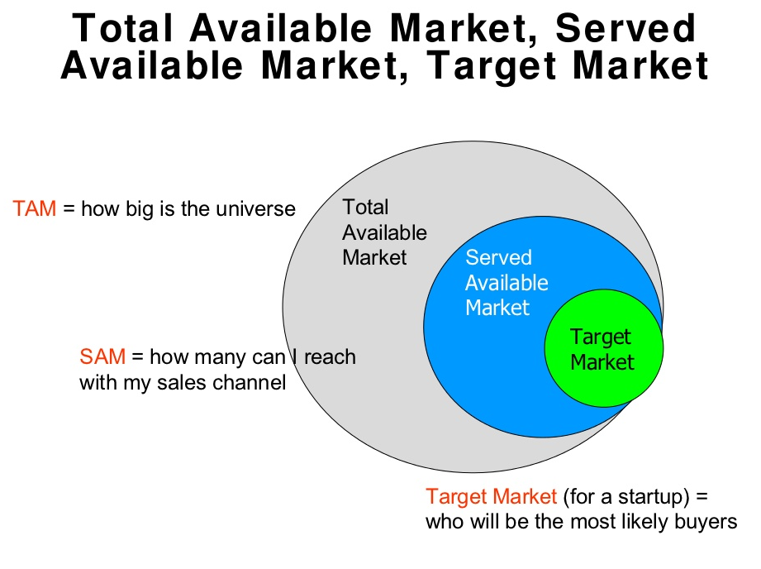
Lecture 3
The previous lecture

Slide 6
Lecture 3
This lecture covers the following topics
Understanding Primary Demand
Is it possible to create primary demand?
The Value of Being Prepared
Understanding Human Behaviour
Local Needs and Wants
General Needs
Customer Service
Timing and Strategy

Slide 7
Lecture 3
This lecture covers the following topics
The Best-Case Scenario: When Strategy Meets Technology
Changes = Opportunity
Demographic Changes
Changes in Perception
Changes Resulting from National and Worldwide Instability
Solving Problems That Don’t Exist
Disruption
Never Buy a Business You Don’t Understand

Slide 8
Lecture 3
This lecture covers the following topics
How Much Do I Need to Know?
Making Something Out of Nothing Is “Special”
Closing Thoughts: Ideas versus Opportunities
Funding
What is crowdfunding and how it works?
Types of crowdfunding
What are the disadvantages of crowdfunding?

Slide 9
Lecture 3
Understanding Primary Demand
“Is it possible to create primary demand?”
Once we have identified a class of products or services, then our search for a commercially viable problem becomes much clearer. A good example is the travel industry. According to the US Department of Transportation, Americans flew over 575 million miles in 2011 and drove over 3.65 billion miles in passenger cars.

Slide 10
Lecture 3
Understanding Primary Demand
“Is it possible to create primary demand?”
The passenger airliner is an extension of the donkey. This always gets a look of astonishment. “What we’re talking about,” “is the travel industry. When people wanted to go farther than their legs would carry them, they started riding donkeys, then horses, bikes, railroads, cars, buses, and then aeroplanes.” The desire to travel is the “primary demand,” and the many ways we do it are how we solve the consumer’s problem of how to get this done.

Slide 11
Lecture 3
The Value of Being Prepared
In the previous example, entrepreneurs thinking about launching a start-up airline should know how airline travel started and how it has evolved—what’s worked and what hasn’t. Whenever I start a new project, I study the relevant industry to see who and what is successful and how they’re doing what I’m trying to do. We should learn from the successes and failures of others.
Doing your homework means being on top of what’s happening today in an industry.
Some of the best entrepreneurial ideas come from studying human behaviour. It’s my favourite place to look for a commercially viable problem.

Slide 12
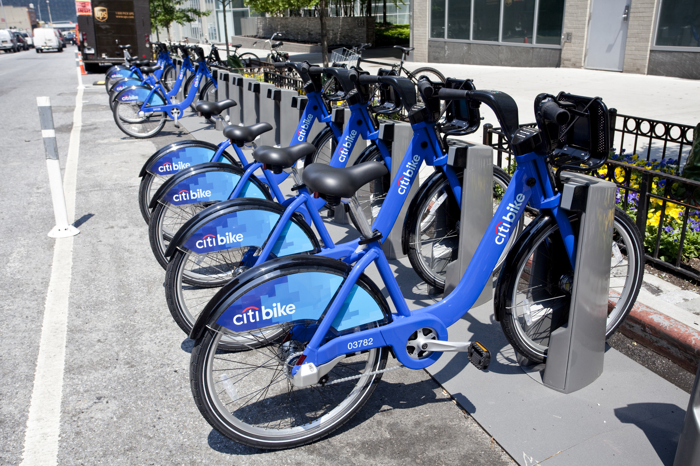
Lecture 3
The Value of Being Prepared
In the broader travel industry, entrepreneurs have developed new and different, unique ways of solving our problems. For example, the Citi Bike system, operated by NYC Bike Share, features thousands of bikes at hundreds of stations around New York. Citi Bikes are available 24/7, 365 days a year. Station locations are based on population and transit needs and were selected through a participatory public input process. In New York City, storage space is limited; not having to own a bike but being able to use one at your convenience (and paying a fee to do so) solves real problems for countless consumers.

Slide 13
Lecture 3
Understanding Human Behaviour
“Mother-in-Law” Research
Watch closely what all the people are doing, and also do what call ‘mother-in-law’ research. When you are at parties or gatherings, always interview people, asking what they drink, eat, read, watch on TV, and what they think the hot topic of the day is.
Observe people in stores and interview them about their purchases and choices. Always watched closely when companies changed their logos and product designs. Monitoring new technology and developments

Slide 14
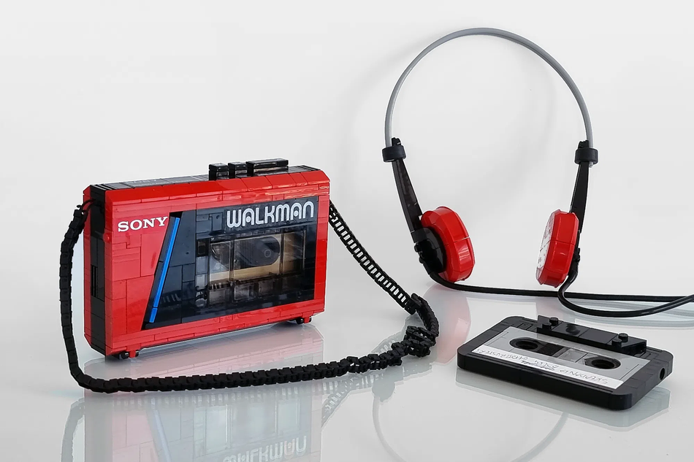
Lecture 3
Understanding Human Behaviour
A favourite story about human behaviour leading to a product is the Walkman. Akio Morita, co-founder and former chairman of Sony, is said to be the inspiration behind the development of the Walkman. He identified with the global hip-hop culture and loved art and music, especially opera, and he wanted to be able to listen to his favourite music on the very long flights he often took. For this to be feasible, the device would have to provide the listener with as good of an experience as a car stereo and yet be portable, allowing the user to listen to music while doing something else.
He was confident that the Walkman would be successful after observing his children and their friends, who seemed to want to play their music all day and into the night. He was also encouraged by the increasing number of people who actually took bulky stereos with them to the beach and park.

Slide 15
Lecture 3
Understanding Human Behaviour
He gave his engineering team less than four months to produce the model, saying, “This is the product that will satisfy those young people who want to listen to music all day. They’ll take it everywhere with them, and they won’t care about record functions. If we put a playback-only headphone stereo like this on the market, it’ll be a hit.”
Since their launch in 1979, an estimated 400 million Walkmans have been sold. In 2010, they were discontinued. Without Sony’s Walkman, it would be difficult to envision the iPod or enjoy digital music on our smartphones today.

Slide 16
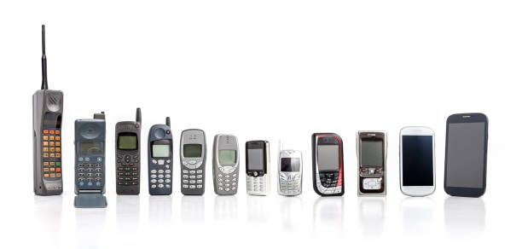
Lecture 3
Local Needs and Wants
Oftentimes entrepreneurs will have more luck by examining what’s missing in local or regional markets. In many cases, certain products available in larger cities may not have trickled down to smaller markets.
General Needs
The cell phone is an excellent example of finding an opportunity through a general need. People have always wanted to be able to communicate away from home in a convenient manner, and the cell phone filled this need.

Slide 17
Lecture 3
Customer Service
Another great place to look for opportunities is within the realm of customer service in a pre-existing organization. It’s the easiest need to fill because it’s something that almost anyone can do. It doesn’t require a great deal of education, money, or training. All that is needed is the desire and will to serve others.
Timing and Strategy
Timing is a crucial factor in making a strategy successful. Strategy is a goal accompanied by a plan to achieve it. Timing, as I define it, is “doing the right thing at the right time.”

Slide 18
Lecture 3
The Best-Case Scenario: When Strategy Meets Technology
There’s no magic formula as to when the timing is right. The trick is in knowing and studying history, human behaviour, and your environment.
Conversely, entrepreneurial leaders always have to be on the lookout for a “negative” convergence of timing and a need being met.
In the late eighties, an owner of a video store said he was concerned about movies being available through cable. “Ange,” he said, “it’s just a matter of time before our stores will be out of business. I’m going to make as much money as I can and invest it somewhere else before this happens.”
He nailed this: Netflix’s business model took a while to catch on, but once it did, it decimated “physical” video stores like Blockbuster, which closed all its stores on January 11, 2014.

Slide 19

Lecture 3
The Best-Case Scenario: When Strategy Meets Technology
A few months ago, Apple made it so that prediction thirty years ago finally came true: people are talking into their watches. As they say, the world is a-changing, which leads us to our next area to search: change.

Slide 20
Lecture 3
Changes = Opportunity
Change is perhaps the most “constant” place to seek a commercially viable opportunity. certain changes tend to yield more entrepreneurial opportunities than most. They include demographic changes, societal “changes in perception,” and “disruptive” changes, including new technologies and worldwide areas of instability.
Demographic Changes
Demographic shifts in our population can create significant problems for society and tremendous opportunities for entrepreneurs. The aging US population, for example, is creating many opportunities for entrepreneurs in the health-care market. The federal government provided $40 billion in incentives for health-care providers to convert to meaningful electronic records. Companies assisting in this transition have found a great deal of new business.

Slide 21
Lecture 3
Changes in Perception
Closely related to demographic shifts are changes in perception. One only has to watch the morning TV news shows to see how a change in perception has impacted a whole industry. Until recently, women weren’t seen as credible hosts of morning shows or network nightly news programs.
There also weren’t a heck of lot of women entrepreneurs, and now we have a host of them, including the incredible Oprah.
Changes Resulting from National and Worldwide Instability
On a macro level, unexpected change that’s causing a serious problem for the general public can be an excellent way to capitalize on an entrepreneurial opportunity. Ideally, this should be a change that’s receiving a great deal of publicity.

Slide 22
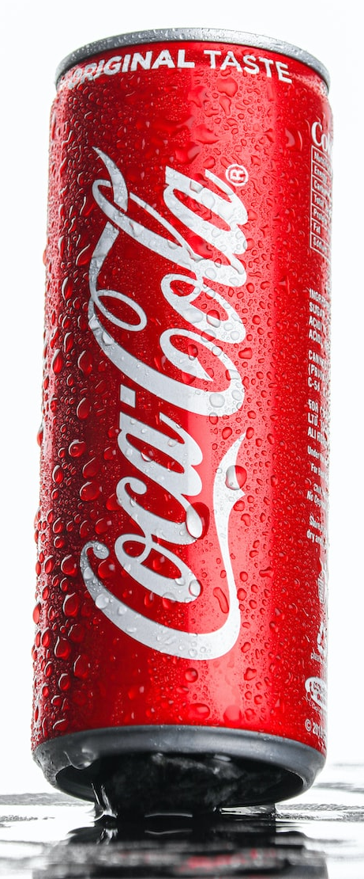
Lecture 3
Solving Problems That Don’t Exist
In searching for a commercially viable opportunity, beware of trying to “solve” a “problem” that doesn’t necessarily need solving. In 1985, Coca-Cola announced that they were changing their original formula and introducing “New Coke” instead. Almost immediately, consumers expressed their outrage. After only seventy-nine days Coca-Cola brought back the old formula, which the company rebranded as “Coca-Cola Classic.” In just two days after the announcement of Coca-Cola Classic, the company received 31,600 hotline calls reassuring them that they’d made the right decision. This should have been all the proof Coke needed to understand that there never was a problem.

Slide 23
Lecture 3
Disruption
The concept of “disruptive” technology certainly isn’t new in the field of entrepreneurship. In his 1942 book Capitalism, Socialism, and Democracy, the great economist Joseph A. Schumpeter wrote:
Innovation by the entrepreneur leads to gales of creative destruction as innovations cause old inventories, ideas, technologies, skills, and equipment to become obsolete.
Even if you’re the market leader, “attacking yourself before your competitors do” is an excellent defensive strategy.
Introducing new products, or better versions of existing products and services, even if you’re the market leader, will beat your competition to the punch.
“Never Buy a Business You Don’t Understand”
“ never buy a business that you don’t understand, because you’ll go broke before you learn it.”

Slide 24

Lecture 3
How Much Do I Need to Know?
you might wonder if you have to be business-savvy or a marketing expert in order to find a commercially viable problem to solve. The answer is a resounding no.
To prove this point, let’s take a look at how wheels ended up on luggage. Although wheels have been around for thousands of years, they didn’t appear on luggage in their current form until 1987, when a Northwest Airlines pilot named Bob Plath was tired of lugging his heavy overnight bag and flight bag through airports around the world. Being a creative kind of guy, Plath spent weekends working on a wheeled “pilot” bag in his garage.
The result of his efforts was to attach two wheels and a long handle to a suitcase that rolled upright

Slide 25
Lecture 3
How Much Do I Need to Know?
Mr Plath initially sold his creations to his fellow crewmembers. But when everyday travellers saw flight attendants striding easily through airports with their “Rollaboards” in tow, a new way to carry luggage was created.
Mr. Plath’s understanding of the user was a very good reason why he was successful. His company, Travelpro, enjoyed first-year sales around $1.5 million. Within a few years, Mr. Plath left the flying to others and held fifteen patents on a diverse line of rolling luggage. By 2003 Travelpro’s annual sales reached $45 million.

Slide 26

Lecture 3
Making Something Out of Nothing Is “Special”
Mr. Plath and L. L. Bean were successful by making existing products better with new technology and materials. Creating products and services with large budgets and organizations is fine and beneficial, but creating something with scarce resources and no special technology is considerably more difficult—and special, in an entrepreneurial sense.
This is what David (“Dave”) Maione, CEO of Night Shift, a commercial cleaning company, managed to do with the help of his brother and partner, Anthony (“Tony”).

Slide 27
Lecture 3
Making Something Out of Nothing Is “Special”
When Dave was fifteen and his brother nineteen, they took their mother’s mop, bucket, and cleaning materials and headed out to a local bank whose manager they’d convinced to give them his cleaning contract. This was the beginning of their cleaning business in Endicott, New York, which has since blossomed into the largest and most dominant cleaning company in our area. Their customers include Security Mutual Life Insurance Company, Columbian Financial Group, and Willow Run Foods.

Slide 28
Lecture 3
Making Something Out of Nothing Is “Special”
What Dave and Tony did is that they took a problem that most people truly dislike (dirt and cleaning) and turned it into two businesses with annual multimillion-dollar revenues. They did this with no money, no formal education, and no powerful friends. Now that’s making something special out of nothing!

Slide 29
Lecture 3
Closing Thoughts: Ideas versus Opportunities
Are all ideas opportunities? Considering that the average person has 70,000 thoughts per day, most are definitely not.
It goes without saying that not all ideas are opportunities.
How can I tell the difference between an idea and an opportunity? First, let me give you an example. I have an idea for an electric car that would be able to travel five hundred miles per battery charge. Is this a good idea? You bet! Is it a good opportunity? Not for me, since I have no expertise in this area. I also have no access to an organization capable of turning this idea into an opportunity.

Slide 30
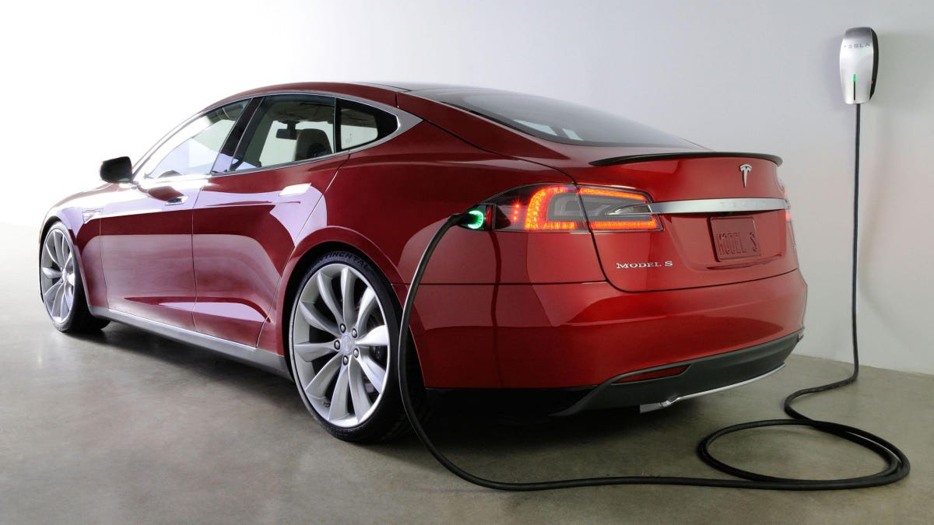
Lecture 3
Closing Thoughts: Ideas versus Opportunities
On the other hand, it’s an excellent opportunity for Tesla Motors and its founder, Elon Musk. Tesla already has a car with a 300-mile range per battery charge, terrific patented battery technology, and a talented product development department. Its main challenge might be its competitor, the Israel-based car company Phinergy, which hoped to have a car that will have a range of 1,000 miles by 2017.

Slide 31
Lecture 3
Funding
As you move forward with pursuing your opportunity, you’ll want to think about funding. If you’re like the great majority of entrepreneurs, you’ll probably be reaching toward your own pocket. According to a recent study funded by the Ewing Marion Kauffman Foundation, nearly 70 per cent of entrepreneurs rely on their personal savings. About a quarter of entrepreneurs rely on venture capital and “angel” or private investors, while only 15 per cent rely on friends and family. An even smaller percentage—about 7 per cent—received funding through corporate investments.

Slide 32
Lecture 3
Funding
Crowdfunding is also becoming a popular alternative. According to Fundable, a small-business crowdfunding platform, crowdfunding raised $5.1 billion in capital in 2012.
Yet these aren’t the only available funding methods, and as an entrepreneurial leader, you’ll often have to think outside the box.
You’ll definitely want to determine if your country has a program in place to help local entrepreneurs.

Slide 33
Lecture 3
What is crowdfunding and how it works?
What is crowdfunding and how it works?
Crowdfunding is a way of raising money to finance projects and businesses. It enables fundraisers to collect money from a large number of people via online platforms. Crowdfunding is most often used by startup companies or growing businesses as a way of accessing alternative funds.
Interest and repayment free investment.

Slide 34
Lecture 3
Types of crowdfunding
Types of crowdfunding
Donation: Donation-based crowdfunding is when people give a campaign, company or person money for nothing in return.
Debt: Debt-based donations are peer-to-peer (P2P) lending, which is a form of crowdfunding.
Rewards: This is when donors receive something in return for their donations.
What are the disadvantages of crowdfunding?
failed projects risk damage to the reputation of your business and people who have pledged money to you. if you haven't protected your business idea with a patent or copyright, someone may see it on a crowdfunding site and steal your concept

Slide 35
Lecture 3
Conclusion
This lecture covered the following topics
Understanding Primary Demand
Is it possible to create primary demand?
The Value of Being Prepared
Understanding Human Behaviour
Local Needs and Wants
General Needs
Customer Service

Slide 36
Lecture 3
Conclusion
This lecture covered the following topics
Timing and Strategy
The Best-Case Scenario: When Strategy Meets Technology
Changes = Opportunity
Demographic Changes
Changes in Perception
Changes Resulting from National and Worldwide Instability
Solving Problems That Don’t Exist

Slide 37
Lecture 3
Conclusion
This lecture covered the following topics
Disruption
Never Buy a Business You Don’t Understand
How Much Do I Need to Know?
Making Something Out of Nothing Is “Special”
Closing Thoughts: Ideas versus Opportunities
Funding
What is crowdfunding and how it works?
Types of crowdfunding
What are the disadvantages of crowdfunding?

Slide 38
Lecture 3
References
- Entrepreneurial Leadership: A practical Guide to Generating New Business by Angelo Mastrangelo 1st Edition.
- https://web.ankeny.org/CleaningMaintenance/Night-Shift-Commercial-Cleaning-Services-2428
https://republic.com/blog/investor-education/what-is-crowdfunding-and-how-does-it-work

Slide 39
Lecture 3
Contact information with Dr Nahed Ahmed
nahed.kamal@esu.ac.ae

Slide 40

Lecture 3
Wish you all the best

