Slide 1


Change Management
Prepared by Dr. Ranya Mahfouz
MGM323
Lecture 5

Slide 2


Change Management
Lecture 5
The change agent
MGM323
Prepared by
Dr. Ranya Mahfouz

Slide 3
Agenda The change agent
Introduction
Models of change agency;
The consulting process and the role of the change agent within it;
Change agent tools and frameworks;
The competencies of the change agent;
Deeper aspects of being a change agent.

Slide 4
Agenda The change agent
Introduction
Models of change agency;
The consulting process and the role of the change agent within it;
Change agent tools and frameworks;
The competencies of the change agent;
Deeper aspects of being a change agent.

Slide 5

Change Management
This subject is about learning how to manage change. The world around us is changing very quickly. Almost every day, there is a new discovery or innovation, especially in science. Globalization also has a big effect on how we think about politics and business. At the same time, the problems that come with globalization are growing just as fast, which is also a big concern.

Slide 6
Agenda The change agent
Introduction
Models of change agency;
The consulting process and the role of the change agent within it;
Change agent tools and frameworks;
The competencies of the change agent;
Deeper aspects of being a change agent.

Slide 7

Chapter
MODELS OF CHANGE AGENCY
05
1- Leadership Models
Change agents are identified as leaders or senior executives at the very top of the organization who envision, initiate or sponsor strategic change of a far-reaching or transformational nature.

Slide 8
Chapter
MODELS OF CHANGE AGENCY
05
1- Leadership Models
Key strengths
Leadership models Clear sponsorship and clear direction Power and authority to ‘make change happen’
Things to watch out for
Potential for the change to be too top-down and have too directive an
approach

Slide 9

Chapter
MODELS OF CHANGE AGENCY
05
2- Management Models
Change agents are conceived as middle level managers and functional specialists who adapt, carry forward or build support for strategic change within business units or key functions.

Slide 10
Chapter
MODELS OF CHANGE AGENCY
05
2- Management Models
Key strengths
The ability to translate strategic vision so greater knowledge of what works
Things to watch out for
Capacity and capability issues for middle managers given their necessary attention on business as usual as well as the changes.

Slide 11

Chapter
MODELS OF CHANGE AGENCY
05
3- Consultancy Models
Change agents are conceived as external or internal consultants who operate at a strategic, operational, task, or process level within an organization, providing advice, expertise, project management, change programme coordination, or process skills in facilitating change.

Slide 12
Chapter
MODELS OF CHANGE AGENCY
05
3- Consultancy Models
Key strengths
Ability to coach advise and work in partnership with the organization Change management expertise and experience in a multitude of settings
Things to watch out for
Can be detached with no demonstrable commitment to the area undergoing change Staff might feel ‘done to’

Slide 13
Agenda The change agent
Introduction
Models of change agency;
The consulting process and the role of the change agent within it;
Change agent tools and frameworks;
The competencies of the change agent;
Deeper aspects of being a change agent.

Slide 14

Chapter
05
The consulting process and the role of the change agent within it;
The consulting process suggests that different sets of knowledge, cognitive skills and behaviours are needed at different stages in the consulting process. The next points summarize the work of a number of researchers who suggest what is required of the change agent at each stage.

Slide 15

Differences between internal
and external consultants
Chapter
05
Entry
Internal change agent
Ready access to clients, Ready relationships, Knows company jargon, Understands root causes
External change agent
Source (find) clients, Build relationships, Learn company jargon

Slide 16

Differences between internal
and external consultants
Chapter
05
Contracting
Internal change agent
Informal agreements, Must complete projects, assigned
External change agent
Formal documents, Can terminate project at will, Guard against out of pocket expenses

Slide 17

Differences between internal
and external consultants
Chapter
05
Diagnosing
Internal change agent
Has a relationship with many organization members Prestige determined by job rank
External change agent
Meet most organization members for the first time

Slide 18

Differences between internal
and external consultants
Chapter
05
Evaluating
Internal change agent
Rely on repeat business, pay rise, and promotion as key measures of success
External change agent
Rely on repeat business and customer referral as key measures of project success

Slide 19
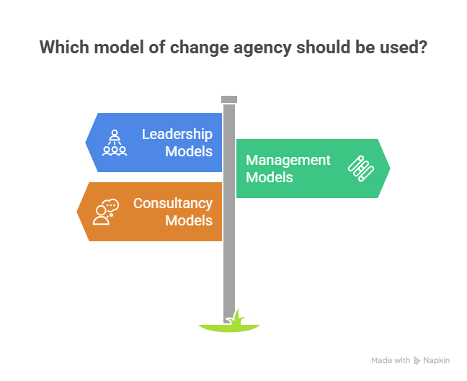
Chapter
Differences between internal and external consultants
05

Slide 20
Agenda The change agent
Introduction
Models of change agency;
The consulting process and the role of the change agent within it;
Change agent tools and frameworks;
The competencies of the change agent;
Deeper aspects of being a change agent.

Slide 21
Choices of intervention based on the nature of
the cultural change
Chapter
05
1- Organization change required
Change within current culture norms (local restructure, geographic
expansion, etc)
Change agent stance
Role modelling based on current ways of doing things including management style, degree of consultation, decision-making processes, etc

Slide 22
Choices of intervention based on the nature of
the cultural change
Chapter
05
2- Organization change required
Change outside current culture norms (diversification requiring new way of working, partnership working, etc)
Change agent stance
Role modelling based on new ways of doing things including management style, degree of consultation, decision-making processes, etc

Slide 23
Choices of intervention based on the nature of
the cultural change
Chapter
05
3- Organization change required
Culture change itself (eg new ways of doing things to meet external or internal drivers for change)
Change agent stance
Role modelling based on effective change management practices including management style, degree of consultation, decision making processes, etc

Slide 24
Agenda The change agent
Introduction
Models of change agency;
The consulting process and the role of the change agent within it;
Change agent tools and frameworks;
The competencies of the change agent;
Deeper aspects of being a change agent.

Slide 25
Chapter
The competencies of the change agent;
05
The change agent will need to have a good understanding of how business works, together with knowledge (or a knowledgeable partner) in the field of Human Resources. The final aspect referred to by Cummings and Worley is the skills set acquired through management

Slide 26
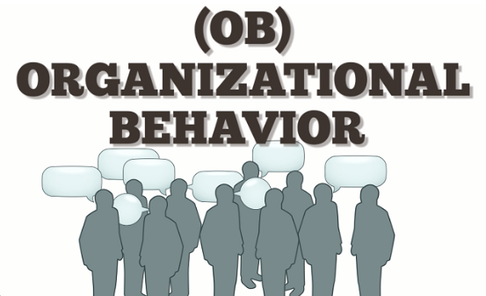
Knowledge and skill requirements of
the organization development practitioner
Chapter
05
Existing system − Knowledge
Organization behavior
A. Organization culture
B. Work design
C. Interpersonal relations
D. Power and politics
E. Leadership
F. Goal setting

Slide 27
Knowledge and skill requirements of
the organization development practitioner
Chapter
05
How systems change over time − Knowledge
Organization design Decision making process associated with formulating and aligning HR systems; information systems; reward systems; work design; political systems; culture; etc.
A. The concept of fit and alignment
B. Diagnostic and design model for sub-systems
C. Key thought leaders in organization design

Slide 28

Knowledge and skill requirements of
the organization development practitioner
Chapter
05
How systems change over time − Skills
Managing the consulting process
A. Entry
B. Contracting
C. Diagnosing
D. Designing interventions
E. Implementation
F. Managing emergent issues
G. Evaluation

Slide 29
Agenda The change agent
Introduction
Models of change agency;
The consulting process and the role of the change agent within it;
Change agent tools and frameworks;
The competencies of the change agent;
Deeper aspects of being a change agent.

Slide 30
Chapter
Deeper aspects of being a change agent
05
One of Freud’s definitions of psychoanalysis was the procedure for the investigation of mental processes that are almost inaccessible in any other way – that is the unconscious phenomena in human interaction. As such it is one way of being able to understand the more irrational aspects of human behaviour. The next points list a number of psychoanalytic terms which describe phenomena.

Slide 31

Chapter
Psychoanalytic terms useful in the change agent’s practice
05
Psychoanalytic term
Transference
The process by which emotions and desires originally associated with one person, such as a parent or sibling, are unconsciously shifted to another person, especially to the analyst.

Slide 32

Chapter
Psychoanalytic terms useful in the change agent’s practice
05
Psychoanalytic term
Projection
The attribution of one’s own attitudes, feelings, or suppositions to others

Slide 33
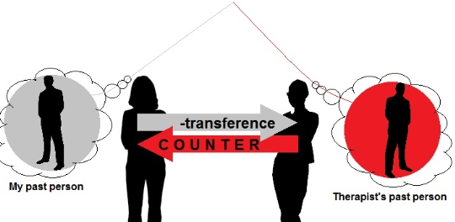
Chapter
Psychoanalytic terms useful in the change agent’s practice
05
Psychoanalytic term
Counter-transference
The psychoanalyst’s displacement of emotion onto the patient or more generally the psychoanalyst’s emotional involvement in the therapeutic
interaction

Slide 34

Chapter
Principles of presence
05

Slide 35
Chapter
Principles of presence
05
Be Honourable
Align personal assumptions, values, beliefs, behaviour Stand for something; take a position Dare to be different (or similar) State the obvious Speak the unspeakable

Slide 36
Chapter
Principles of presence
05
Be an Effective Agent of Change
Be an awareness expert Facilitate enhanced interaction among members of the client system and with self Teach basic behavioural skills

Slide 37
Chapter
Principles of presence
05
Be Curious
Stay in a space of perpetual wonderment Show genuine interest in the client Be interested in self Explore the nature of relationships between self and client and among individuals in the client system

Slide 38
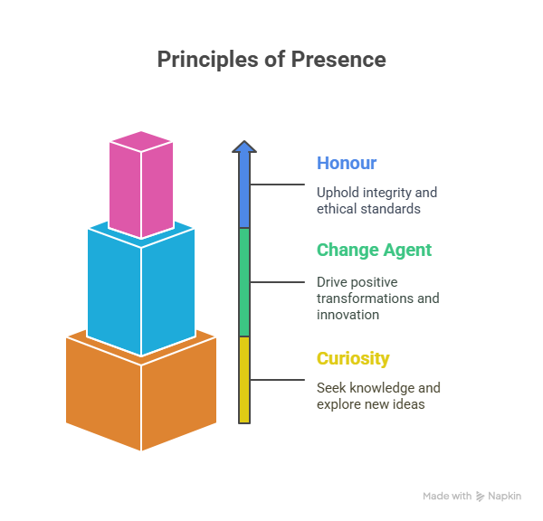
Chapter
Principles of presence
05

Slide 39
Chapter
Case Study Digital Transformation at Banque Misr
05
Background:In 2020, Banque Misr launched a strategic digital transformation plan aiming to improve service quality and operational efficiency. The plan involved introducing new digital platforms and redesigning internal work processes to become more flexible and technology-driven.
Model of Change Agency Used:The Management Model was applied.Middle managers acted as the key change agents, responsible for:Translating the strategic vision of top management into daily operations.Training branch teams on the new digital systems.Monitoring progress and solving implementation challenges.
🔹 Strength: Close connection with employees and practical understanding of operations.
🔹 Challenge: Balancing daily business tasks with the added workload of implementing change.

Slide 40
Case Study Digital Transformation at Banque Misr
Chapter
2. The Consulting Process:Entry: The change was introduced gradually through workshops and readiness assessments for each department.Contracting: Internal agreements clarified roles and responsibilities between top management and middle managers.Diagnosing: Resistance to change was identified, mainly due to fear of technology and job insecurity.Implementation: Training programs were carried out to familiarize employees with new banking systems.Evaluation: Post-implementation performance was measured through indicators such as service speed and customer satisfaction.
3. Role of the Change Agent:The change agent played a key role in:Facilitating communication between top management and employees.Building trust and reducing resistance to change.Providing both technical and emotional support during the transformation process.
4. Required Competencies:Strong leadership and motivational skills.Deep understanding of banking operations.Excellent communication and conflict resolution abilities.Analytical and diagnostic skills to address resistance effectively.
5. Deeper Aspects (Psychological Dimension):Change agents faced projection behaviors — some employees expressed their anxiety about losing jobs by criticizing the new systems.The change agents had to recognize these emotions and redirect them toward constructive engagement and skill development.

Slide 41
Case Study Digital Transformation at Banque Misr
Chapter
Final Results:After one year of implementation:Use of digital banking services increased by 60%.Branch productivity improved by 25%.Customer satisfaction levels rose significantly.
📘 Conclusion:The success of Banque Misr’s digital transformation was not solely due to new technology but largely because of the effective role of the change agents—who combined leadership, communication, and psychological insight to manage change smoothly.

Slide 42

Textbook
Thank You

