Slide 1



Orientation Lecture
FNT 628
Blockchain and Cryptocurrencies
Prepared by Dr. Yara Ibrahim
www.midocean.ae

Slide 2
Program Learning Outcomes
Implement different financial technologies using advanced algorithms with a clear understanding of software and hardware architectures.
Use statistical and quantitative analysis and predictive and exploratory models to make financial decisions.
Conceptualize, analyze, design, and implement digital services for building FinTech applications.
Analysis, design, and implement artificial intelligence systems, including biometrics, prediction systems, and object recognition.

Slide 3
Course Basic Information
Course Instructor | Dr Yara Magdy
Course Title | Blockchain and Cryptocurrencies
Course Code | FNT628
Credit Hours | 3
Program | Master of Financial Technology
Faculty | Faculty of Humanities
Academic Year | Spring 2024
Language of Instruction | English
Teaching References | Blockchain and Cryptocurrency: Building a High Quality Marketplace for Crypt Data, Yano, Makoto; Dai, Chris;Masuda, Kenichi; & Kishimoto, Yoshi, springer, 2020 IMF working papers https://www.imf.org/en/Blogs/Articles/2023/11/20/central-bank-digital-currency-development-enters-the-next-phase
Instructor Email | yara.ibrahim@midocean.edu.km

Slide 4
Course Description
This course introduces basic concepts and technologies of blockchain from engineering perspectives, such as Bitcoin architecture, consensus protocol of Bitcoin, proof of work, Ethereum, Hyperledger, and smart contracts, as well as blockchain applications.
The course also covers the limitations and possible improvements of the blockchain system.

Slide 5
Course Learning Outcomes
Upon completion of this course, students should be able to:
Understand the blockchain technology and its applications in finance.
Understand the concept of digital currencies.
Analyze the crypto markets.
Outline the usage of digital currencies in central banks.
Analyze the importance of decentralized finance.
Understand the impact of cryptocurrency on banking industry and monetary policy.
Evaluate the performance of Cryptocurrencies using technical analyses.
Understand the investment strategies of cryptocurrency investment.

Slide 6
Course Syllabus
Week | Topic
Week 1 | Orientation Session
Week 2 | Blockchain Technology- Part 1
Week 3 | Blockchain Technology- Part 2
Week 4 | Digital Currencies
Week 5 | Decentralized Finance - DEFI
Week 6 | An Overview of Crypto Markets
Week 7 | Cryptocurrency
Week 8 | Cryptocurrency and Banking Industry
Week 9 | Cryptocurrency and Monetary Policy
Week 10 | Crypto Investment Strategies
Week 11 | Technical Trading and Cryptocurrency
Week 12 | Discussion
Week 13 | Final Exams

Slide 7
Teaching and Learning Methods
Lectures
Discussion
Problem Solving
Quizzes
Final exams

Slide 8
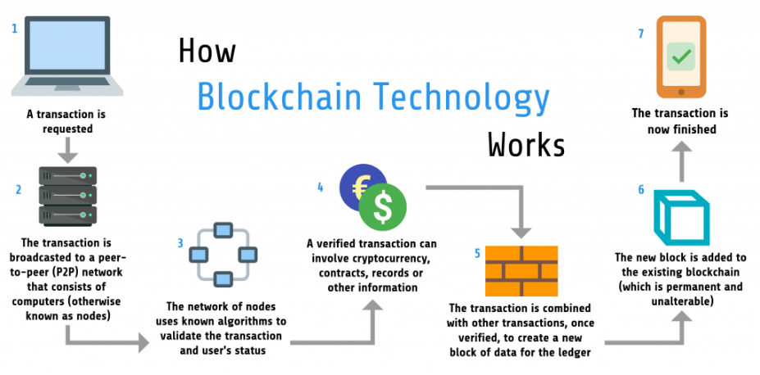

Slide 9
Block Chain and Cryptocurrency
Blockchain and cryptocurrency have revolutionized the world of finance, offering innovative ways of managing transactions and revolutionizing financial systems.
In this in-depth exploration, we delve into the intricacies of blockchain technology and its impact on the traditional financial landscape.
Discover how this decentralized system is shaping the future of finance and transforming the way we store, transfer, and secure value.

Slide 10
Understanding the History of Financial System
To truly appreciate the impact of blockchain and cryptocurrency, it's crucial to understand the history of financial systems.
From bartering to the development of fiat currency and centralized banking systems, we will explore the evolution of money and transactions throughout time.
This historical context will provide a foundation for understanding the revolutionary potential of blockchain technology in reshaping the financial landscape.

Slide 11
The Power of Decentralization and Trust
Decentralization is a key aspect of blockchain and cryptocurrency. Unlike traditional financial systems, which rely on centralized institutions, blockchain offers a decentralized network where transactions are verified by multiple participants.
This decentralized nature ensures transparency, eliminates intermediaries, and enables trust between parties, revolutionizing the way we conduct transactions and manage financial systems.

Slide 12
BlockChain Components
Blockchain technology consists of four key components: distributed ledger, consensus mechanism, cryptographic security, and smart contracts.
The distributed ledger ensures that all participants have a copy of the same information, promoting transparency and immutability.
The consensus mechanism enables agreement on the validity of transactions.
Cryptographic security ensures data integrity and privacy.
Smart contracts are self-executing contracts stored on the blockchain, automating the fulfillment of predefined conditions.

Slide 13
The Future of Digital Currency
Cryptocurrency, such as Bitcoin and Ethereum, is a revolutionary application of blockchain technology.
It offers a decentralized, secure, and transparent means of conducting financial transactions.
With the potential to disrupt traditional monetary systems, cryptocurrency provides individuals with more control over their finances and eliminates the need for intermediaries like banks.
As its adoption continues to grow, understanding the concept and implications of cryptocurrency is crucial in navigating the future of digital currencies.

Slide 14
BlockChain Impact on Financial Intermediaries
Blockchain technology has the potential to revolutionize traditional financial institutions.
Its decentralized nature eliminates the need for intermediaries and creates a more secure and transparent system.
However, this poses challenges for banks and other institutions that rely on intermediaries for financial transactions.
Understanding the impact of blockchain on traditional financial systems is crucial for adapting to the changing landscape of digital currencies.

Slide 15
Challenges and Limitations of Blockchain
While blockchain technology holds great promise, there are challenges and limitations to its implementation.
Scalability remains a concern, as blockchain networks can struggle to handle large transaction volumes.
Additionally, regulatory and legal frameworks are still evolving, creating uncertainty and potential hurdles for widespread adoption.
Addressing these challenges and finding solutions will be crucial for the successful integration of blockchain into traditional financial systems.

Slide 16
Regulatory Framework and Legal Considerations
As blockchain technology continues to disrupt traditional financial systems, regulatory frameworks and legal considerations play a vital role in its widespread adoption.
Clear guidelines and regulations are needed to ensure transparency, security, and accountability.
Collaboration between governments, financial institutions, and blockchain experts is crucial to establish a robust framework that fosters trust and encourages innovation in the emerging cryptocurrency landscape.

Slide 17
Opportunities for Innovation and Disruption in Finance
The advent of blockchain and cryptocurrency presents numerous opportunities for innovation and disruption in the finance sector.
By leveraging decentralized and transparent systems, financial institutions can streamline processes, reduce costs, and enhance security.
However, navigating regulatory challenges, addressing scalability issues, and building trust among consumers are crucial aspects to consider while exploring the full potential of blockchain technology in revolutionizing finance.

Slide 18
Conclusion
Blockchain and cryptocurrency have the potential to revolutionize the financial sector by offering secure, transparent, and decentralized solutions.
While there are challenges to overcome, such as regulations and scalability, the benefits of these technologies far outweigh the obstacles.
As we continue to explore the possibilities, it is evident that blockchain and cryptocurrency can reshape traditional financial systems and unlock new opportunities for innovation and disruption.

Slide 19

Thank You

