Slide 1


Employment Relations
Prepared by Dr. Nourhan Sayed
HRM 624
1st Lecture
Lecture (1)

Slide 2




Employment Relations
Lecture (1)
HRM 624
1st Lecture
Prepared by
Dr. Nourhan Sayed
www.midocean.ae

Slide 3
Introduction
www.midocean.ae
Labor union: Group of workers who join together to influence the nature of their employment
Collective voice, protection, and influence.
For employers, labor relations are about managing relationships with employees and labor unions in ways that promote organizational goals or cost-effective service delivery

Slide 4
Introduction
www.midocean.ae
Most nonunion employers try to remain union-free through preventive labor relations strategies.
Some unionized employers try to undermine labor unions by using the same strategies; most deal with unions constructively.

Slide 5
Objectives of Labor Relations
www.midocean.ae
Efficiency: Productive use of scarce resources for economic prosperity.
Equity: Standard of fair treatment for employees.
Voice: The ability of employees to have meaningful input into workplace decisions.
Ideally, efficiency, equity, and voice support each other in a virtuous cycle.

Slide 6
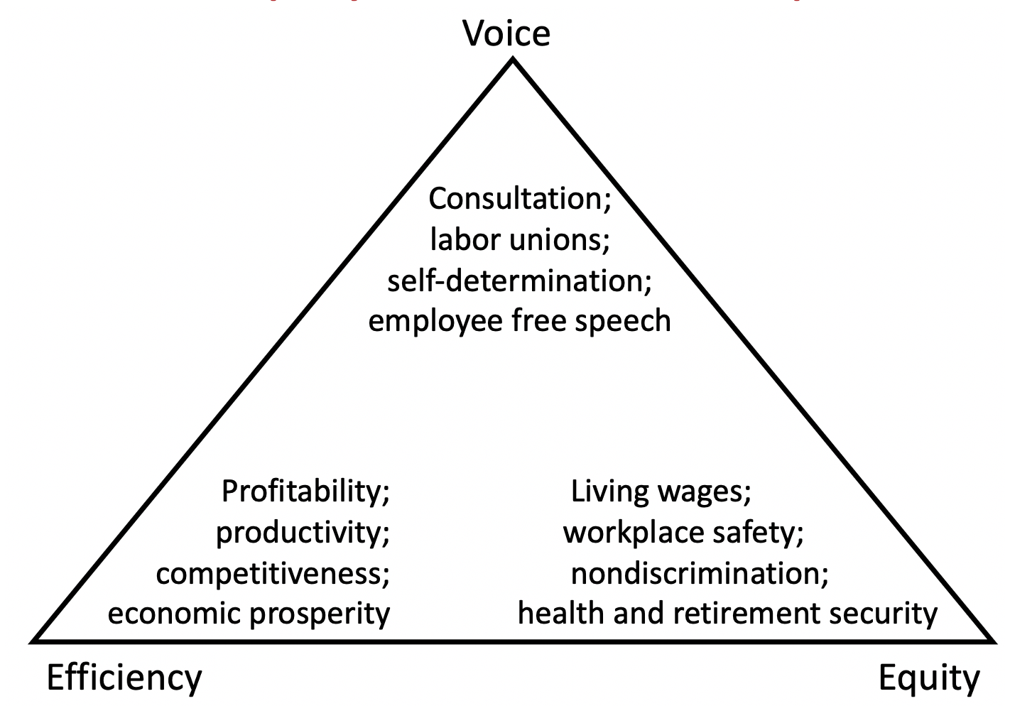
Aspects of Efficiency, Equity, and Voice in the Employment Relationship
www.midocean.ae

Slide 7
Objectives of Labor Relations
www.midocean.ae
But efficiency, equity, and voice can clash:
Equitable treatment might reduce flexibility
and efficiency.
Employee voice might make decision making more cumbersome and less efficient.
Unions centralize power to better achieve equity, but become less responsive to individuals.

Slide 8
Objectives of Labor Relations
www.midocean.ae
Labor relations must strike a balance between these conflicting goals
Studying labor relations involves analyzing how employee representation through independent labor unions contributes to achieving a balance among efficiency, equity, and voice.

Slide 9
Objectives of Labor Relations
www.midocean.ae
United States public policy encourages collective bargaining
Everyone has the right to form and join trade unions for the protection of his or her interests.
But why should society encourage or discourage the formation of labor unions?

Slide 10
Objectives of Labor Relations
www.midocean.ae
Alternative perspectives on what labor unions do
Inflate wages and restrict work rules?
Secure better wages, protect against unfair treatment by management, provide voice and representation?
What should unions do?

Slide 11
Isn’t Efficiency Enough?
www.midocean.ae
Efficiency is important to the employment relationship because of its effect on:
Competitiveness.
Economic development.
Economic prosperity.
Many see efficiency as the sole objective of the employment relationship
Business serves society through economic prosperity.
Businesses are not designed to be democratic training grounds.
A company has no obligation to provide personal and moral development.

Slide 12
Isn’t Efficiency Enough?
www.midocean.ae
But workers are human beings, not simply economic factors of production
The quality of employment and the nature of the workplace are important for individuals, families, and society.
Inequality is harmful.
Work is not simply an economic transaction.

Slide 13
Isn’t Efficiency Enough?
www.midocean.ae
Work is a fully human activity such that employees are entitled to fair treatment and opportunities to have input into decisions that affect their daily lives.
Equity and voice provide the social and human boundaries for the drive for efficiency

Slide 14
Isn’t Efficiency Enough?
www.midocean.ae
The lack of at least minimal standards and nondiscriminatory treatment (equity) contradicts the basic ideals of democracy with free and equal citizens, and it violates religious and moral views on the sanctity of human life and human dignity

Slide 15
Isn’t Efficiency Enough?
www.midocean.ae
Employee voice has similar justifications, ranging from moral, religious, and psychological beliefs about the importance of human self-determination to political views of liberty and democracy
Industrial democracy: belief that workers in a democratic society are entitled to the same democratic principles of participation in the workplace.

Slide 16
Isn’t Efficiency Enough?
www.midocean.ae
Equity and voice are also consistent with what workers want
Workers want fairness, justice, and security
Workers want influence over decisions that affect their job or work life
Believe that they would enjoy their jobs more.
Believe that their employers would be more competitive.

Slide 17
Aspects of Efficiency, Equity, and Voice in the Employment Relationship
www.midocean.ae
The important aspects of efficiency in an employment relationship are as follows: profitability, productivity, competitiveness, and economic prosperity. The important aspects of equity in an employment relationship are as follows: living wages, workplace safety, nondiscrimination, and health and retirement security. The important aspects of voice in an employment relationship are as follows: consultation, labor unions, self-determination, and employee free speech.

Slide 18
Conflicting Goals Mean Balancing Rights
www.midocean.ae
The greatest challenges in labor relations arise from conflicting goals
Conflicts are generally resolved privately through bargaining and other means by:
Individuals.
Unions.
Companies.

Slide 19
Conflicting Goals Mean Balancing Rights
www.midocean.ae
But society establishes the ground rules.
Labor law tries to balance property rights and labor rights in order to promote a balance between efficiency, equity, and voice.
Understanding conflicts between property rights and workers’ rights and the desire to balance them is vital for understanding labor relations.

Slide 20
www.midocean.ae
In a Nonunion Workplace, Can Managers…?
Scenario One: You implement a new pay-for-performance program and five employees together decide to refuse to work until the program is withdrawn. Can you fire the employees?

Slide 21
www.midocean.ae
In a Nonunion Workplace, Can Managers…?
Scenario Two: You are interviewing applicants for a Web designer position in your organization. One applicant has a Graphic Communications International Union day planner and pen. Can you refuse to hire this qualified individual because you don’t want any union troublemakers in your organization?

Slide 22
www.midocean.ae
In a Nonunion Workplace, Can Managers…?
Scenario Three: You overhear two employees discussing a union during a break in the employee cafeteria. Can you stop their conversation?

Slide 23
www.midocean.ae
In a Nonunion Workplace, Can Managers…?
Scenario Four: You want to change your company’s health care insurance provider, but only if the employees feel that it is a positive change. Can you handpick an employee committee to represent the other employees in discussions about new health insurance options?

Slide 24
Continued Relevance of Labor Relations
www.midocean.ae
Labor relations involves diverse factors
Market forces.
Individual emotions.
Managerial strategies.
Forms of work organization.
Constitutional and legal issues.

Slide 25
Continued Relevance of Labor Relations
www.midocean.ae
Labor relations involves diverse factors
History.
Questions of human rights.
Negotiation and conflict resolution strategies.
Debates over globalization.
Ethical challenges.

Slide 26
Labor Unions – Good or bad ?
www.midocean.ae
Popular stereotypes of labor unions
Once useful, but no longer needed.
Good for members, but bad for business, nonunion workers, consumers, and investors.
Essential to understand how different views on unions are rooted in alternative schools of thought

Slide 27
The Labor Problem
www.midocean.ae
Today’s critical issues in human resources and industrial relations
Growing labor market disparities.
Problems of low-wage workers trying to move out of poverty and support families.
Corporate pressures for cost control, quality, and flexibility to compete in a global, information-rich economy.
The need to educate individuals as lifelong learners because
of ever-changing technologies.
Problems of work–life balance, especially for working mothers.
But what were the key challenges 120 years ago?

Slide 28
The Labor Problem
www.midocean.ae
The critical human resources and industrial relations issue in the early 1900s was the labor problem
Undesirable outcomes of inequitable and contentious, or oppressive and exploitative, employment relationship.
Important dimensions of the labor problem
Long hours, low wages, unsafe conditions, and insecurity.
Labor was frequently viewed as:
A production input.
No different from machines or raw materials.

Slide 29
The Labor Problem
www.midocean.ae
The poor conditions of the labor problem were a problem for two broad reasons:
The societal or human perspective.
People should have better lives.
Workers should be able to afford decent housing, clothing, food, and the like.
The business perspective.
Absenteeism and turnover were costly.
But how to solve the labor problem?
Depends on beliefs about causes / schools of thought.

Slide 30
Four Schools of Thought
www.midocean.ae
The Neoliberal School.
The Human Resource Management School.
The Industrial Relations School.
The Critical Industrial Relations School.

Slide 31
The Neoliberal School
www.midocean.ae
Focuses on the economic activity of self-interested agents.
Efficiency, equity, and voice achieved through free-market competition.
Idealized, prefect competition results in the optimal allocation and pricing of resources.

Slide 32
The Neoliberal School
www.midocean.ae
The conditions of the labor problem are not seen as exploitation
Rather, employees are paid their economic value.
Employees are free to quit if they feel they are being exploited.

Slide 33
The Neoliberal School
www.midocean.ae
Solution to the labor problem?
Ensure competition.
Macroeconomic stimuli to reduce unemployment.
Remove unnecessary government regulation.
The best protection an employee has against his or her current employer are other employers.
As long as there is (perfect) competition, employment outcomes are not seen as a problem.

Slide 34
The Neoliberal School
www.midocean.ae
View of labor unions in the neoliberal school of thought
Unions are seen as labor market monopolies that interfere with the invisible hand of free market competition; distort efficient outcomes.
Strike threat is used to raise wages above their competitive levels.
Restrictive work rules interfere with the discipline of the market by protecting lazy workers.
To those who believe in perfect competition
Labor unions are bad.

Slide 35
Human Resource Management School
www.midocean.ae
Believes that the labor problem stems from poor management
Poor selection, motivation, training, supervision.
Solution to the labor problem?
Better management.

Slide 36
Human Resource Management School
www.midocean.ae
Human resource management philosophy
Align the interests of workers and the firm via better management.
Create motivated and efficient workers.
Firms should design and implement better supervisory methods.
Selection procedures.
Training methods.
Compensation systems.
Evaluation and promotion mechanisms.

Slide 37
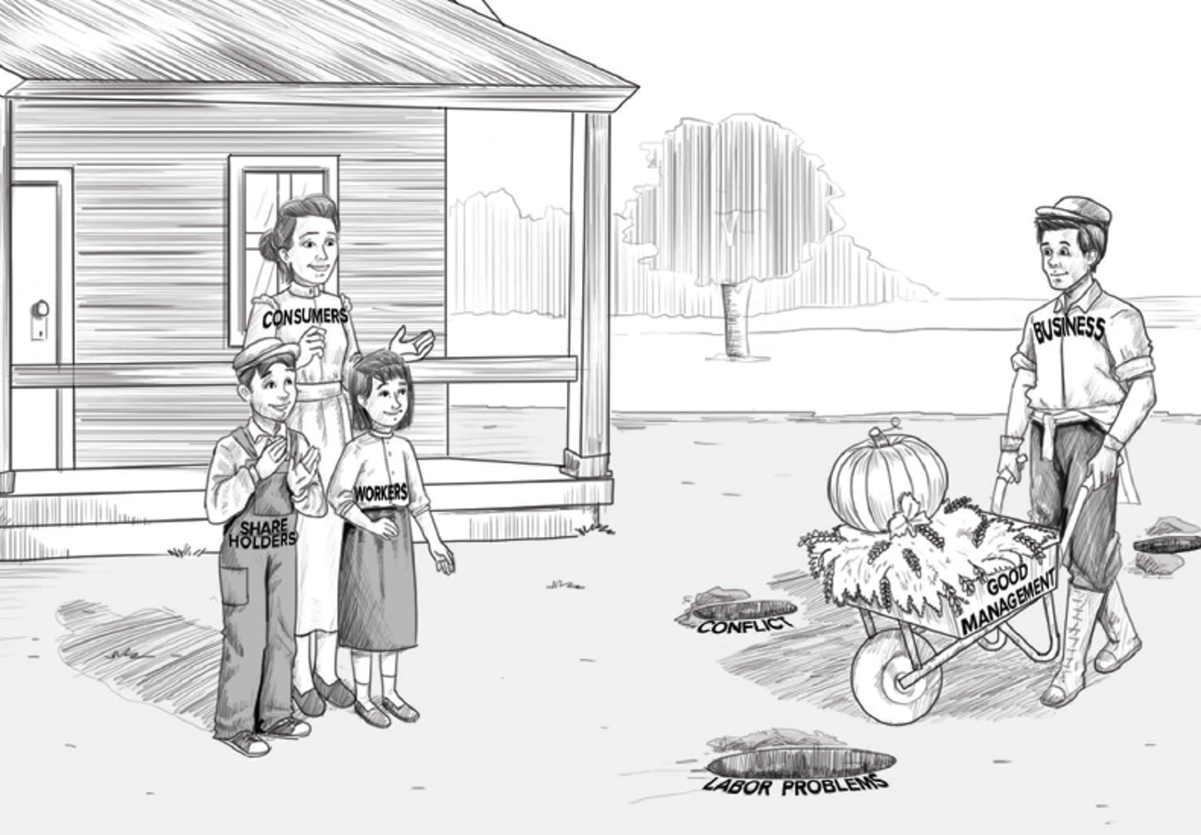
Human Resource Management School
www.midocean.ae

Slide 38
Human Resource Management School
www.midocean.ae
View of unions in this school of thought
Unions are unnecessary “outside, third parties”.
If a company has well-designed HR practices, workers will be satisfied and will not support a union.
Independent labor unions are also seen as adversarial, a barrier to cooperation.
But companies get the union they deserve.
If a company is practicing bad management, workers will seek unionization to combat these poor practices.

Slide 39
Human Resource Management School
www.midocean.ae
Nonunion collective voice such as a nonunion representation plan might be embraced, but not independent labor unions that are legally and functionally independent of employers and governments
Independent labor unions can elect their own leaders, collect and spend their own dues money, establish their organizational objectives and strategies, and strike.

Slide 40
John W. Budd , Labor relations text bok , MC Graw-Hill , 6th edition .
List of references
Textbook:
John W. Budd , Labor relations textbook , MC Graw-Hill , 6th edition .
www.midocean.ae

Slide 41



Thank You

