Slide 1


MIDOCEAN University
Using AI in Analyze and Improving Student Academic Performance
By Ahmed Al Moairfi &
Ibrahim Al Nakhli

Slide 2
Outlines
01
Introduction
02
Related works
03
Research Methods
04
Future works
05
Conclusion

Slide 3
Introduction
Background
AI is the new evolution in this generation. It has led to improvement in all fields. It must be used to improve education and academic outcomes. Instead of just letting students use AI generative models, users should have a comprehensive AI system that begins by creating a measurement process, monitors student performance, enhances the results, and suggests solutions.

Slide 4
Introduction
Problem Definition
Students need guidance to cross over the changes, identify their weaknesses, and resolve them.
.

Slide 5
Related Works
Study | Key Findings/Results | Methodology | Limitations | Advantages
Artificial Intelligence (AI) Towards Students’ Academic Performance, Mallillin,2024 | AI enhance student. learning and measures student. Attitude | Quantitative research use to Measure and detect the related factors to enhance academic performance. Qualitative research is used to evaluate and analyze the AI Enhance the academic performance of students among the respondents. | The study uses a mixed-methods approach (focus groups + survey), but lacks a control or comparison group to assess the effectiveness of AI interventions versus no intervention | Targets specific learning needs for improved outcomes. And Enhances motivation and attitudes toward learning.
Prediction and Analysis of University Student Performance Based on Machine Learning, Xiaobo Zhu, 2024 | The model provide a good result for student performance R² = 0.55, RMSE = 4.68 and MAE=3.61. analysis predict the learning difficulties and curriculum enhancement. | Predictive model based on random forest that analyze student performance specifically on python course. | Limited amount of data used in the research. Not all indicators have been used in this study such as classroom interaction frequency and homework completion time | It supports detecting at-risk students, refining education programs, and raising teaching standards.
The end of multiple-choice tests: using AI to enhance assessment, Klymkowsky, 2024 | Dewey delivered a detailed analysis for students and define the miss understand concept by allowing student to explain why they choose this answer. Then the AI bot “Dewey analyze the student answers and identify misconceptions and missing knowledge | Develop a AI Bot | The current answer is unsure student understanding. Training Data: Dewey’s accuracy depends on its curated knowledge base. Adoption Barriers: Instructors must embrace formative assessment and redesign courses around feedback. Expansion Needed: Larger trials across diverse subjects and student populations. | AI analysis of student explanations gives quick, detailed feedback, helping instructors spot misconceptions in complex topics. Using AI-based formative assessments improves learning outcomes and provides a more accurate measure of student understanding than traditional multiple-choice tests.

Slide 6
Related Works
Study | Key Findings/Results | Methodology | Limitations | Advantages
Data-Driven Insights: Using AI to Analyze Student Performance in English Language Courses, Adlin Jerusha, 2024 | The study result in enhancing the performance by analyzing the the factors such as motivation and resource availability using AI. This indicates that understanding these interconnections can lead to enhance educational strategies. | The study use SPSS for quantitative analysis to study the increase in student performance in English course as a second language.by using both descriptive and inferential statistics to analyze survey data that collected from student according to their study habits, demographics and the others factors. | The study focus on English courses student only, so the generalization in this research is limited | AI enhances personalized course development for students. Identifies key factors influencing student success and performance.
Leveraging Artificial Intelligence for Student Performance Monitoring. International Journal of Research Publication and Reviews, Rajeena,M., & Quraishi, 2024 | The study focus on detecting the positive effect of AI on students outcomes and how can AI provide a real time feedback. The research found that how can AI access just handle simple management task to analyze student performance and enhance student outcome. | The study review existing researches in AI tools used in effectiveness in monitoring and evaluating student performance. Which include examining adaptive learning platforms, AI-driven tutoring systems. That will lead in detecting struggling students which will lead to enhance education outcome. | The study discuss the ethical issues and challenges related in Using AI. including privacy issues which is counted as main limitation in using AI in analyzing student performance. | Provides real-time feedback and personalized learning experiences. Enables early intervention for struggling students.
Predicting Student Academic Performance Using Neural Networks: Analyzing the Impact of Transfer Functions, Momentum and Learning Rate, Agarwal, M., & Agarwal, 2024 | The study get great result in prediction student performance. The prediction accuracy is 98% using artificial neural network. As a comparative analysis of various Machine Learning Algorithms the result the ANN achieve Better result than SVM, KNN, NB, DT and others ML algorithms indicate that ANN has the potential to improve student performance. | The study utilizes Artificial Neural Networks (ANN) as the primary method of analyzing student performance. The study used SVM DT, KNN,LR,NB as comparative research to show the superiority of ANN with a 97% accuracy rate. | The dataset of students is not large which is less than 700 student. That can not lead to generalize the result. The research omit some factors like students' social interactions, interpersonal skills and academic engagement which might indicate a gap in the understanding all variables that affect student outline | This research used artificial intelligence specifically neural networks to predict student grades with very high accuracy (98%). - Can identify struggling students early, before failure occurs.

Slide 7
Related Works
Study | Key Findings/Results | Methodology | Limitations | Advantages
Student Performance Analysis using Machine Learning. International Journal of Innovative Technology and Exploring Engineering, Kalpana et al., 2020 | Random Forest model to predict student outcomes using assessment data | Machine Learning (Random Forest) | No live classroom application; lacks qualitative evaluation | The system helps teachers detect at-risk students early using grades and behavior. It combines psychology, education, and computer science, improves communication among stakeholders, offers a user-friendly interface with auto-generated reports, and supports institutions in understanding student levels and enhancing academic programs.
Educational data mining: Prediction of students’ academic performance using machine learning algorithms, Yağcı, 2022 | Midterm scores predict final grades with 70–75% accuracy | ML (SVM, RF, NB, KNN) | Simple features; lacks full behavioral data | The model predicts final exam grades using midterm scores and faculty data, based on real data from 1,800+ students. By testing various algorithms and selecting the most accurate, it provides early detection of at-risk students and supports data-driven smart learning environments
Bridging Human and AI Explanations to Support Students’ Revisions of Open-Ended Responses. Proceedings of the 17th International Conference on Educational Data Mining (EDM 2024), | Develops explainable feedback using LLMs; taxonomy of feedback types | LLMs + Text Analysis | Still theoretical; requires real classroom deployment | Intelligent Feedback Systems (Li & Botelho, 2024) Development of explainable systems that provide human-like, precise feedback using large language models like GPT Classification of feedback types according to specific educational objectives Analysis of student-AI interactions to improve educational tools Providing individualized feedback in large classrooms, enhancing educational equity
AI for Student Assessment - Systematic Review, González-Calatayud et al., 2021 | AI mostly used in formative assessment and auto-grading | Review of 22 studies | Lack of educational/pedagogical grounding | This review of 22 studies explores AI-based student assessment, emphasizing its role in formative assessment, instant feedback, and automated grading. It contrasts AI-enabled with traditional education, highlights the need for teacher training in pedagogical use of AI, and provides recommendations for institutions adopting AI in assessment.

Slide 8
Introduction
Research Questions
How to analyze student performance using AI?
How does artificial intelligence provide suggestions to improve student performance?

Slide 9
Introduction
Research Objectives
Create a ML model that analyzes students' performance
Provide a suggested solution to enhance the weak points.

Slide 10
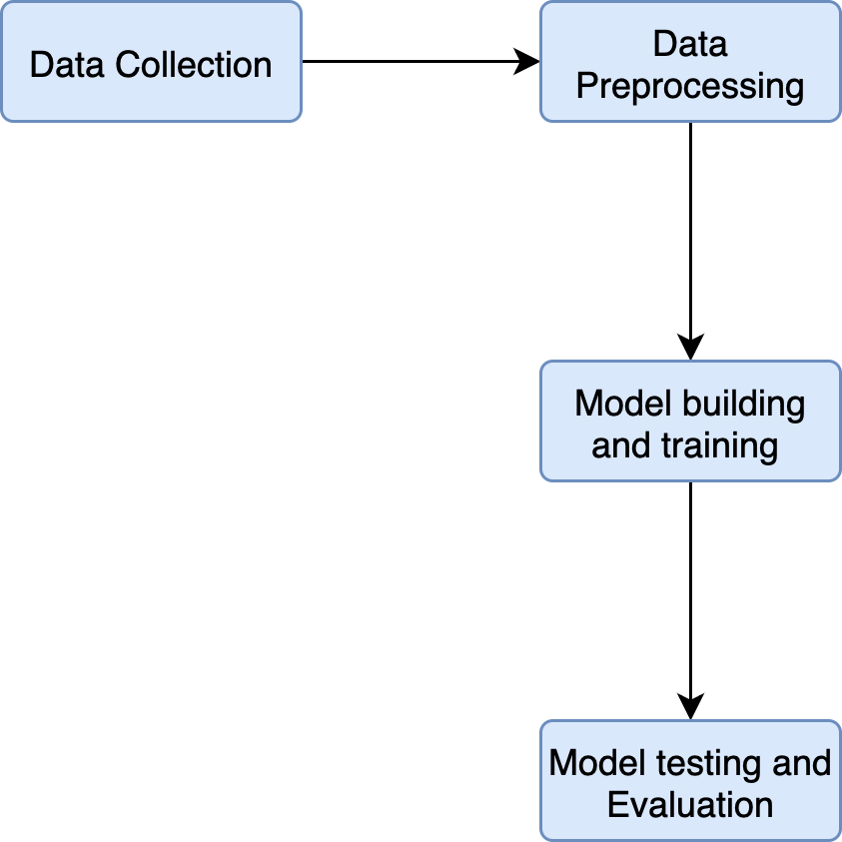
﻿Research Methods
Framework

Slide 11
﻿Research Methods
Data collection
The main part of the data will be collected from students at different educational levels. The remaining data resource will be from online available sources. Collecting data from our surrounding environment through parents' opinions about their children's academic performance.

Slide 12
﻿Research Methods
Data Preprocessing
Grades in short quizzes and comprehensive exams.
Explaining their answers, whether correct or incorrect to evaluate the accuracy of their knowledge. Reviewing attendance and absence rates. Teachers’ evaluation of students. The percentage of homework completed and the accuracy of their responses.

Slide 13
﻿Research Methods
Model/Method Selection
The model will contain multiple ML models, which will result in an accurate prediction.
The following models will be used with MCQ answers: Random Forest, SVM, Nearest neighbors, Naive Bayes, and ANN. These models will analyze the student's answer and based on expert answers, the model will label the answers. The answers will be divided into groups; in each group, part of the data will be the testing set, and the remaining will be the training set.
And for the answer explanation: ANN will be used. Student MCQ answer will be analyze.

Slide 14
﻿Research Methods
Testing and Evaluation
Will use accuracy, recall, precision, and F1 score to ensure the accuracy of the model.
In addition, as the model will not just depend on one model, comparing the performance of the different models, as each group has a different testing set, will enhance the performance.

Slide 15
﻿ Resources Needed
Resource Needed
Python programming language,
Pandas, Numby, Seaborn and matplotlib libraries for data analyzing
and preprocessing, Tenserflow, Pytorch, Keros and Scikit-learn for Models creation .

Slide 16
Future work
Task | Date
Data Collection | Oct 11 - 25
Preparation | Oct 25 - Nov 1
Model Building | Nov 1- 22
Training | Nov 22 - 29
Testing and Evaluation | Nov 29 - Dec 6
Final Adjustments and Reporting | Dec 6 – 13
Week1: Data collection
Collect the data from multiple resources. The first resource is from the teachers' support, by examining the students and providing the results. and from the online exam result.
Week2: Data preparation:
Prepare the data to be ready for training by integrating the data from multiple resources.
Week (3-5) Model Building:
Start building the ML models.
The models will be Random Forest, SVM, Nearest Neighbors, Naive Bayes, and ANN.
And NLP for answer explanation.
Week6 Training:
Train the data on the provided models and compare the result of reach model.
Week7 Testing and Evaluation:
Test each model using the test dataset
Finalize the best-performing models and improve them if necessary.
Use cross-validation to confirm model stability.
Analyze feature importance or confusion matrices.

Slide 17
﻿Conclusion
To guide students in their academic path, Machine learning models can analyze student performance and provide suggestions. In previous studies, a different Machine learning model has been used. For example, the Random Forest Algorithm, which is used to analyze student performance as in (Xiaobo Zhu 2024), is used to analyze student performance in a Python programming course. An AI chatbot built on a RAG has been used by (Klymkowsky 2024) to provide actionable feedback on student thinking in the context of formative assessments.
ANN has been used by (Agarwal, M., & Agarwal, B. B., 2024) and compared with SVM, Decision Trees, and other Machine learning models, and provides a better result. The limitation of the findings was mostly about the amount of data, which needs to be increased. For future work, we can depend more on ANN as it was the best for analyzing MCQ questions. And can use NLA for analyzing the student's explanation for each answer.

Slide 18


Question and Answer

Slide 19
Thank You

