Slide 1




Research Methodology in Computer Science (AI800)
Lecture 9
How to Write A Scientific Article
Prepared by
Dr. Mohammed Anbar
www.midocean.ae

Slide 2

Outlines
Getting Ready To Publish?
Are you ready to publish?
Choosing the Right Journal for Your Article
Tools to help you choose the right journal
Journals’ Instructions to Authors
Peer-review & responding to reviewers
Things to consider and Conclusion
Learning Outcomes
Research Article Writing
Scientific Paper in Computer Science Research
The Process of Paper Writing
Research Paper Contents and Tips to prepare.
Guidelines for Writing Scientific Paper
www.midocean.ae

Slide 3
Learning Outcomes
To help you write research paper and develop strategies for successfully writing a paper.
To learn about the impact factor and other metrics used to evaluate journals, as well as tips for navigating the submission and review process.
To help you to Choose the Right Journal for Your paper and understand the importance of selecting the right journal for your research
To gain a deeper understanding of the academic publishing process and the criteria used by journals to evaluate articles
www.midocean.ae

Slide 4
Scientific Paper in Computer Science Research
A scientific paper is a formal document that presents original findings, ideas, or experiments.
A scientific paper is a written and published report describing original research results.
A scientific paper follows a specific structure and format, including:
  Abstract
  Introduction
  Methodology
  Results
  Discussion
  Conclusion.
www.midocean.ae

Slide 5
Scientific Paper in Computer Science Research (cont.)
A scientific papers are typically published in peer-reviewed journals or presented at conferences to share knowledge and contribute to the advancement of computer science.
A scientific papers serve as a means for researchers to communicate their work to the scientific community and provide a foundation for further research and development.
www.midocean.ae

Slide 6
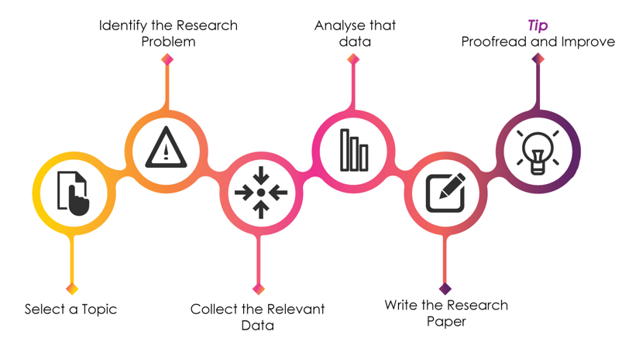
The Process of Paper Writing
www.midocean.ae

Slide 7
Research Paper Writing
Find suitable/specified journals
Get copy of Instructions to authors
Prepare article as per instructions
Select suitable titles
Authors and affiliations
Abstract
Highlights
Novelty statements
Introduction
Materials and methods
Results and discussion
Conclusions
Acknowledgements
References
www.midocean.ae

Slide 8
The Scientific Paper: Title
Title of a scientific paper is a concise and informative representation of the study's main findings or objectives.
Title should accurately reflect the content of the paper and catch the reader's attention.
A well-crafted title can effectively communicate the essence of the research, making it easier for others to locate and understand the study.
Additionally, a clear and compelling title can increase the visibility and impact of the paper within the scientific community.
www.midocean.ae

Slide 9
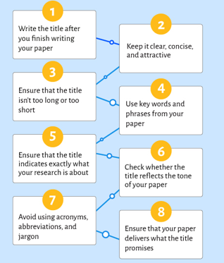
The Scientific Paper: Title (cont. )
Be concise and clear
Capture the essence of your study
Use descriptive language
Use a catchy phrase
Reflect the paper Essence
www.midocean.ae

Slide 10
The Scientific Paper: Abstract
The abstract is a concise summary of the scientific paper, providing an overview of the study's purpose, methods, results, and conclusions.
The abstract is typically written in a clear and concise manner to allow readers to quickly understand the main points of the research.
The abstract often includes keywords that help researchers locate relevant articles when conducting literature searches.
www.midocean.ae

Slide 11
Criteria of the Abstract
Abstract length shouldn't go past 250 words.
One paragraph should be used for the abstract.
Since the abstract refers to completed work, it should be written in the past tense.
The abstract abbreviation, which is used throughout the abstract and paper, should come after lengthy words.
Except in rare circumstances, references in an abstract should not be cited.
Never include any information or conclusions in the abstract that are not included in the paper. Must be precise regarding to the numbers cited in the main text.
www.midocean.ae

Slide 12
The Scientific Paper: Keywords
Keywords are an essential component of a scientific paper as they provide a concise summary of the main topics and themes explored in the research.
These words are carefully chosen to ensure that the paper is easily discoverable by other researchers and relevant to their specific areas of interest.
Keywords help to establish the paper's relevance within the larger scientific community and facilitate its inclusion in databases and search engines.
www.midocean.ae

Slide 13
Tips to Write Paper keywords
Be specific: Choose keywords that accurately reflect the main theme or topic of your paper. Avoid using broad or generic terms that may not effectively capture the essence of your research.
Consider relevance: Think about the keywords that are commonly used in your field or discipline. By including these relevant terms, you increase the chances of your paper being discovered by others in your area of study.
Use variations: Incorporate alternative terms for your main keywords to expand the reach of your paper
www.midocean.ae

Slide 14
The Scientific Paper: Introduction
The introduction section of a scientific paper serves as a roadmap for the reader, providing background information on the topic and outlining the purpose and objectives of the study.
The introduction sets the stage for the research by highlighting the gap in knowledge that the study aims to address.
The introduction may also include a brief review of relevant literature to establish context and justify the significance of the research.
www.midocean.ae

Slide 15
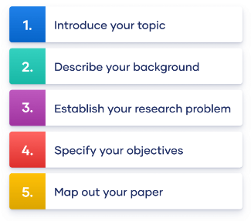
Tips to Write Paper Introduction
Draw audience in; be provocative
Target journal specific audience
Identify gaps in knowledge
End with question/hypothesis
www.midocean.ae

Slide 16
The Scientific Paper: Methods/Materials
The methods/materials section of a scientific paper provides a detailed description of the experimental procedures and the materials used in the study.
The methods/materials section allows other researchers to replicate the study and verify its findings. It typically includes information on the sample size, data collection methods, equipment used, and any statistical analyses performed.
The methods/materials may also mention any ethical considerations or approvals obtained for conducting the research.
www.midocean.ae

Slide 17
Tips to Write Paper Methods/Materials
Clearly outline the purpose and objectives of your study at the beginning of your methods section.
Describe your research design in detail, including any experimental or observational procedures used.
Provide a comprehensive list of all materials, equipment, and instruments used in your study.
www.midocean.ae

Slide 18
The Scientific Paper: Results
Results section presents the findings of the study and provides a detailed analysis of the data collected.
Results includes statistical analyses, graphs, and tables to support the conclusions drawn from the research.
The results section also highlights any significant patterns or trends observed in the data, allowing readers to evaluate the validity and reliability of the study's outcomes.
Results section may discuss any unexpected results and offer possible explanations or suggestions for further investigation.
www.midocean.ae

Slide 19

Tips to Write Paper Result
Organize around tables/figures
Past tense
No interpretation; just the facts!
Tables should stand on their own
Present Data:
  Directly in the text
  In a table
  In a figure
www.midocean.ae

Slide 20
The Scientific Paper: Discussion
In the discussion section of a scientific paper, researchers :
  Interpret and analyze their findings in relation to the existing literature.
  Discuss the implications of their results, identify limitations, and propose future directions for research.
  Address any unexpected results
The discussion section allows scientists to critically evaluate their own work and contribute to the broader scientific community's understanding of the topic.
www.midocean.ae

Slide 21
Tips to Write Paper Discussion
Start by summarizing the main findings and results of your research
Analyze and interpret your results in relation to the existing literature.
Discuss how your findings align with or differ from previous studies.
Explain any potential implications or limitations.
Consider addressing any unexpected or contradictory results
www.midocean.ae

Slide 22
The Scientific Paper: Conclusion
Conclusion section not only summarizes the key results and implications of the study but also provides avenues for future research and further exploration in the field.
Conclusion section allows scientists to reflect on the limitations of their study and suggest potential improvements or alternative methodologies for future investigations.
www.midocean.ae

Slide 23
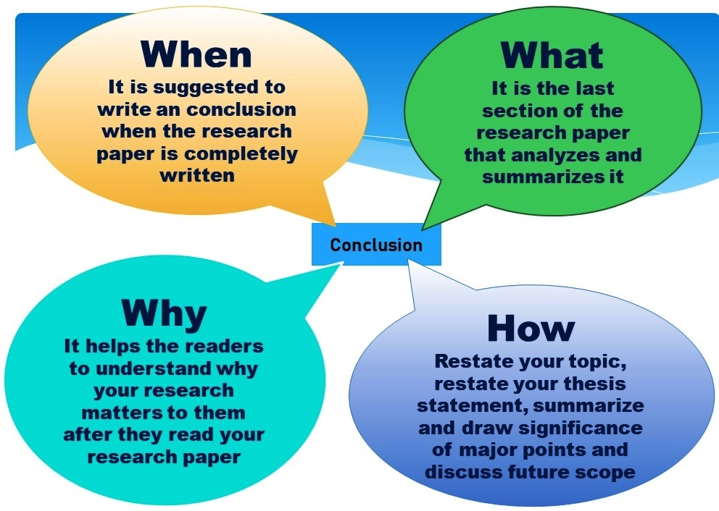
Tips to Write Paper Conclusion
Summarize the main points.
Provide a final thought or reflection.
briefly recap the key arguments or findings you have presented throughout your paper.
Explain how your findings contribute to the existing body of knowledge
www.midocean.ae

Slide 24
The Scientific Paper: Acknowledgment
The acknowledgment section of a scientific paper is a way for the authors to express gratitude and recognize individuals or organizations that have contributed to the research.
Acknowledgment is an important part of the paper as it allows researchers to show appreciation for those who have provided support, guidance, or resources throughout the study.
Acknowledging others also helps to establish credibility and foster collaboration within the scientific community.
www.midocean.ae

Slide 25
The Scientific Paper: References
The references section of a scientific paper is an essential component that provides credibility and support to the research findings.
The references section includes a list of all the sources cited within the paper, such as academic journals, books, and reputable websites.
These references not only acknowledge the work of other researchers but also allow readers to delve deeper into the topic and verify the accuracy of the information presented.
Additionally, proper citation and formatting in this section are crucial to adhere to academic standards and avoid plagiarism.
www.midocean.ae

Slide 26
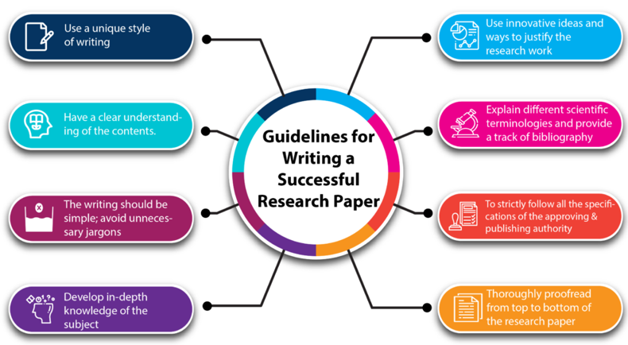
Guidelines for Writing Scientific Paper
www.midocean.ae

Slide 27

Getting Ready To Publish?
Do Not Rush
Choose the Right Publication, Magazine, or journal for Your paper.
All the necessary citation requirements are met.
Journal Terms and Conditions Apply
www.midocean.ae

Slide 28
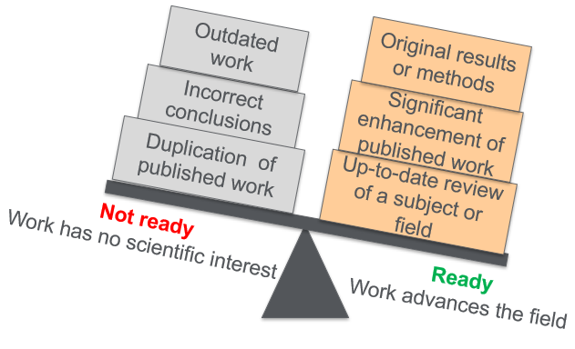
Are you ready to publish?
Your manuscript conveys a straightforward, actionable, and exciting message in a well-organized structure that readers will appreciate.
www.midocean.ae

Slide 29

Choosing the Right Journal for Your Article
Be sure to share your work with the intended audience.
Since concurrent submissions are prohibited, pick just one journal.
Supervisors and coworkers can offer helpful suggestions.
Choose a few potential journals for your shortlist.
Look into the journals on your shortlist:
  Aims & Scope
  Types of articles considered
  Readership e.g. academic versus practice
  Subscription versus Open Access
  Speed of publication
  Peer review process (single blind, double blind, open)
  Content innovation
www.midocean.ae

Slide 30







Tools to help you choose the right journal
Elsevier journal finder
EndNote Match: Find the Best Fit Journals for Your Manuscript
Springer journal Suggester
Think. Check. Submit
Web of Science
Master List
Journal/Author Name Estimator (JANE)
Publish or Flourish Open Access
www.midocean.ae

Slide 31
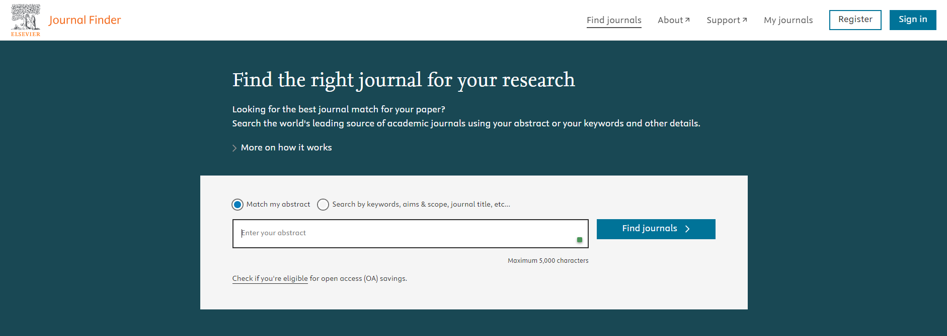
Tools to help you choose the right journal (cont.)
https://journalfinder.elsevier.com/
www.midocean.ae

Slide 32

Journals’ Instructions to Authors
Read the instructions to authors before starting to prepare your paper.
Consult the instructions while preparing your paper.
Check the instructions again before submitting your paper.
www.midocean.ae

Slide 33
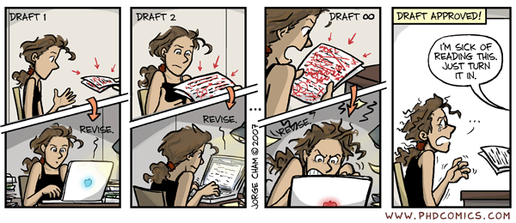
Revise before submission
www.midocean.ae

Slide 34
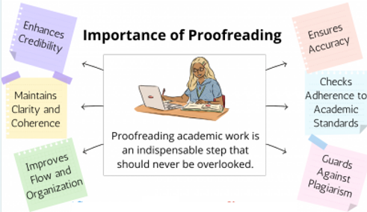
Proofread before Submitting
Are terms used consistently throughout?
Do numbers in abstract match numbers in text and tables?
Do citations in text match references?
Are Syntax and Grammar acceptable ?
www.midocean.ae

Slide 35
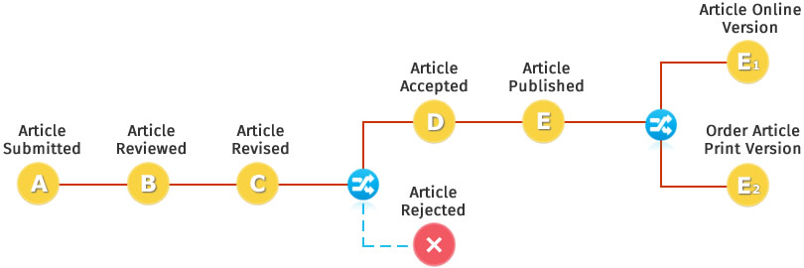
Peer-review & responding to reviewers
www.midocean.ae

Slide 36
Peer-review & responding to reviewers (cont.)
www.midocean.ae

Slide 37
Things to consider
It is possible for a journal to have a medium to high impact factor but a low h-index and g-index.
However, despite a high h- and g-index, a journal may not be ranked at all in JCR.
Using the h- and g-index to rank journals is not standardized practice.
Social sciences rank lower than sciences.
www.midocean.ae

Slide 38
Things to consider (cont.)
  Impact Factor is a metric that measures the average number of citations that articles published in a specific journal receive over a certain period, typically the past two years.
Impact Factor is often used to assess the relative importance and influence of a journal in a particular field. Journals with higher impact factors are generally considered more prestigious.
Here's a simplified example:
In 2023, you determine that "Science Journal X" received a total of 800 citations for articles published in 2021 and 2022.
During the same two-year period (2021 and 2022), "Science Journal X" published a total of 100 articles. Now, you can calculate the Impact Factor:
Impact Factor (IF) = Total citations in 2023 to articles published in 2021 and 2022 / Total number of articles published in 2021 and 2022
IF = 800 citations / 100 articles
IF = 8.0
www.midocean.ae

Slide 39
Things to consider (cont.)
The h-index, or Hirsch index, is a metric used to evaluate the research output and impact of a researcher or a journal. It is designed to measure both the productivity and impact of an individual or a journal's publications.
An h-index of 'h' means that a researcher (or journal) has 'h' papers that have each been cited at least 'h' times. For example, an h-index of 10 means that a researcher (or journal) has 10 papers cited at least 10 times each.
www.midocean.ae

Slide 40
References
Sheperis, C.J., Young, J.S. & Daniels M.H. (2017). Counseling research: Quantitative, qualitative, and mixed methods (2nd ed.). Boston, MA: Pearson. ISBN-13: 978-0-13-402509-4
VanderMey, R., Meyers, V., Van Rys, J., Kemper, D., & Sebrank, P. (2011). The college writer: A guide to thinking, writing, and researching (4th ed.). Boston: Houghton Mifflin.
Robert Day (1995): How to write and publish a scientific paper. 4th Edition, Cambridge University Press
Prof. Mani Maran Ratnam – How to write a report in journal format
Kingsley, D. A. (2014). Paying for publication: Issues and challenges for research support services. Australian Academic & Research Libraries, 45(4), 262-281.
Cuthbert, D., & Spark, C. (2008). Getting a GRiP: Examining the outcomes of a pilot program to support graduate research students in writing for publication. Studies in Higher Education, 33(1), 77-88.
www.midocean.ae

Slide 41



Thank You

