Slide 1



What is Planning?
Planning vs Scheduling
Plan vs Planning
Planning Effort
Planning Team
Elements of Project Plan
Questions Planner Asks- Fundamentals
Questions Planner Asks- Tasks
Questions Planner Asks
Deliverables Associated with the Plan
Project Planning and Setup
What Is Setup?
Keys to Successful Setup
Project Time Management
PMG212
Prepared by Dr. Nael Yousry
Presented by Dr. Amira Elfekky
مقرر: إداره وقت المشروع
الفصل الدراسي الثالث 2023
Lecture 5

Slide 2

Agenda
What is Planning?
Planning vs Scheduling
Plan vs Planning
Planning Effort
Planning Team
Elements of Project Plan
Questions Planner Asks- Fundamentals
Questions Planner Asks- Tasks
Questions Planner Asks
Deliverables Associated with the Plan
Project Planning and Setup
What Is Setup?
Keys to Successful Setup
www.midocean.ae

Slide 3
Agenda
What is Planning?
Planning vs Scheduling
Plan vs Planning
Planning Effort
Planning Team
Elements of Project Plan
Questions Planner Asks- Fundamentals
Questions Planner Asks- Tasks
Questions Planner Asks
Deliverables Associated with the Plan
Project Planning and Setup
What Is Setup?
Keys to Successful Setup
www.midocean.ae

Slide 4
Chapter
5
What is Planning?
Making decisions now with the objective of influencing the future. (AACE)
A detailed scheme, program, or method worked out beforehand for the accomplishment of an objective: “ A plan of attack”. (American Heritage Dictionary)
www.midocean.ae

Slide 5
Chapter
5
What is Planning?
The construction industry is notoriously risky. Much of the preparatory work and planning that precedes construction projects can be viewed as the formulation of Risk Allocation between the contracting parties.
The 6P’s!
Proper Prior Planning Prevents Poor Performance!
www.midocean.ae

Slide 6
Agenda
What is Planning?
Planning vs Scheduling
Plan vs Planning
Planning Effort
Planning Team
Elements of Project Plan
Questions Planner Asks- Fundamentals
Questions Planner Asks- Tasks
Questions Planner Asks
Deliverables Associated with the Plan
Project Planning and Setup
What Is Setup?
Keys to Successful Setup
www.midocean.ae

Slide 7
Chapter
5
Planning vs Scheduling
A Plan is a logical sequence of events to accomplish a goal.
A Schedule incorporates durations and dates into the sequence of events necessary to accomplish the Plan.
www.midocean.ae

Slide 8
Agenda
What is Planning?
Planning vs Scheduling
Plan vs Planning
Planning Effort
Planning Team
Elements of Project Plan
Questions Planner Asks- Fundamentals
Questions Planner Asks- Tasks
Questions Planner Asks
Deliverables Associated with the Plan
Project Planning and Setup
What Is Setup?
Keys to Successful Setup
www.midocean.ae

Slide 9
Chapter
5
Plan vs Planning
“Plans are of little importance, but planning is essential”
    (Winston Churchill)
“Plans are worthless, but planning is everything”
      (D. Eisenhower)
www.midocean.ae

Slide 10
Agenda
What is Planning?
Planning vs Scheduling
Plan vs Planning
Planning Effort
Planning Team
Elements of Project Plan
Questions Planner Asks- Fundamentals
Questions Planner Asks- Tasks
Questions Planner Asks
Deliverables Associated with the Plan
Project Planning and Setup
What Is Setup?
Keys to Successful Setup
www.midocean.ae

Slide 11
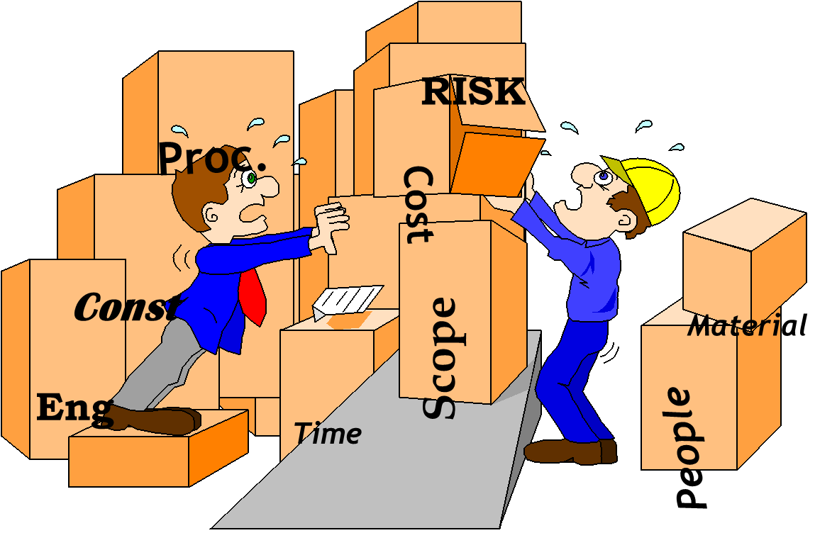
Chapter
5
Planning Effort
Planning involves the efficient use of the 4 Resources!
That being; Time, Money, People & Material
www.midocean.ae

Slide 12
Agenda
What is Planning?
Planning vs Scheduling
Plan vs Planning
Planning Effort
Planning Team
Elements of Project Plan
Questions Planner Asks- Fundamentals
Questions Planner Asks- Tasks
Questions Planner Asks
Deliverables Associated with the Plan
Project Planning and Setup
What Is Setup?
Keys to Successful Setup
www.midocean.ae

Slide 13
Chapter
5
Planning Team
Who makes up the TEAM to develop the Plan?
  Project Manager
  Engineering Manager
  Discipline Leads
  Construction Manager
    Craft Superintendents
www.midocean.ae

Slide 14
Chapter
5
Planning Team
Who makes up the TEAM to develop the Plan?
  Project Controls
      Planning / Scheduling
      Cost Controls
      Estimating
  Procurement - Major Suppliers
www.midocean.ae

Slide 15
Agenda
What is Planning?
Planning vs Scheduling
Plan vs Planning
Planning Effort
Planning Team
Elements of Project Plan
Questions Planner Asks- Fundamentals
Questions Planner Asks- Tasks
Questions Planner Asks
Deliverables Associated with the Plan
Project Planning and Setup
What Is Setup?
Keys to Successful Setup
www.midocean.ae

Slide 16
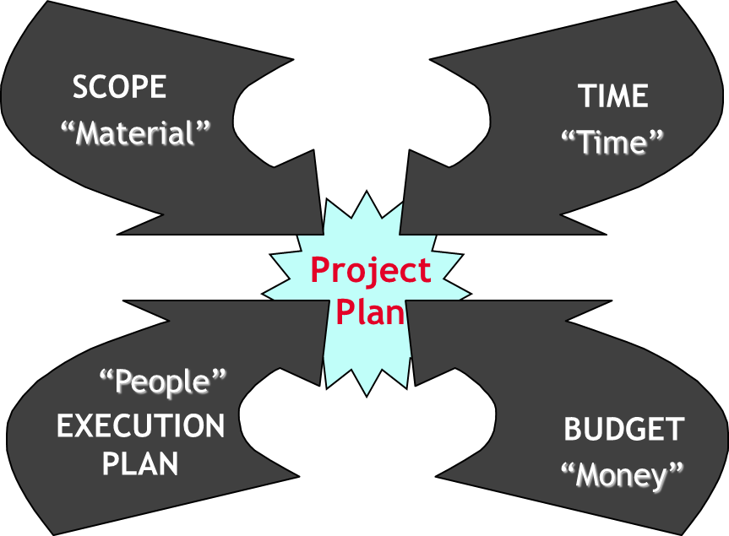
Chapter
5
Elements of Project Plan
Project Plan
Identifies the Project goals
Encompasses the Scope of Work.
Defines the Project Execution Plan.
Incorporates decisions that can influence the future.
Is a sequence of activities with which the Project Goals can be accomplished.
Identifies the resources required and cost.
Planning is the efficient use of the 4 Resources!
Time, Money, People & Material
www.midocean.ae

Slide 17
Chapter
5
Elements of Project Plan
Scope Definition
Execution strategy (EPC, D&B, C etc.)
Contract requirement
Discipline integration
Work Breakdown Structure (WBS)
www.midocean.ae

Slide 18
Chapter
5
Elements of Project Plan
Organizational Breakdown Structure
Work and Planning Packaging
Identifying / Defining the activities & milestones necessary
Level of detail
www.midocean.ae

Slide 19
Agenda
What is Planning?
Planning vs Scheduling
Plan vs Planning
Planning Effort
Planning Team
Elements of Project Plan
Questions Planner Asks- Fundamentals
Questions Planner Asks- Tasks
Questions Planner Asks
Deliverables Associated with the Plan
Project Planning and Setup
What Is Setup?
Keys to Successful Setup
www.midocean.ae

Slide 20
Chapter
5
Questions Planner Asks- Fundamentals
What is the scope of work?
What is the execution strategy? E? EP? EPC? EPCM? CM? PMC?
When is the official contract award or notice to proceed date?
What constitutes completion?
www.midocean.ae

Slide 21
Agenda
What is Planning?
Planning vs Scheduling
Plan vs Planning
Planning Effort
Planning Team
Elements of Project Plan
Questions Planner Asks- Fundamentals
Questions Planner Asks- Tasks
Questions Planner Asks
Deliverables Associated with the Plan
Project Planning and Setup
What Is Setup?
Keys to Successful Setup
www.midocean.ae

Slide 22
Chapter
5
Questions Planner Asks- Tasks
What tasks will be performed? (Scope)
How will the tasks be performed? (Execution Plan)
What is the sequence the tasks will be performed? (Execution Plan & Resources)
Who will perform the tasks? (Resources & Execution Plan)
www.midocean.ae

Slide 23
Agenda
What is Planning?
Planning vs Scheduling
Plan vs Planning
Planning Effort
Planning Team
Elements of Project Plan
Questions Planner Asks- Fundamentals
Questions Planner Asks- Tasks
Questions Planner Asks
Deliverables Associated with the Plan
Project Planning and Setup
What Is Setup?
Keys to Successful Setup
www.midocean.ae

Slide 24
Chapter
5
Questions Planner Ask
Where is the equipment list, is there any exotic material used? (Scope & Execution Plan)
How many subcontractors do we plan to use? (Execution Plan & Resources)
What Permits are required and who is responsible for them? (Scope & Execution Plan)
Where is the Project to be executed? (Scope, Execution Plan & Resources)
www.midocean.ae

Slide 25
Agenda
What is Planning?
Planning vs Scheduling
Plan vs Planning
Planning Effort
Planning Team
Elements of Project Plan
Questions Planner Asks- Fundamentals
Questions Planner Asks- Tasks
Questions Planner Asks
Deliverables Associated with the Plan
Project Planning and Setup
What Is Setup?
Keys to Successful Setup
www.midocean.ae

Slide 26
Chapter
5
Deliverables Associated with the Plan
The Plan - How to achieve the Project’s Goals. In a Level II Schedule format
The Scope Book - A written document detailing our understanding of the Project’s Goals and therefore the basis of Plan.
The Execution Plan - A written document detailing the deliverables that support the Plan and the Risks that the Project is willing to accept and the resources that will be used on the Project.
www.midocean.ae

Slide 27
Chapter
5
Deliverables Associated with the Plan
Estimate - To the accuracy allowed, based on the information given or developed.
Budget - Cost of the Plan as presented and based on the Estimate.
Basis - Underlying Assumptions used in the development of the Plan and the Execution Plan.
www.midocean.ae

Slide 28
Agenda
What is Planning?
Planning vs Scheduling
Plan vs Planning
Planning Effort
Planning Team
Elements of Project Plan
Questions Planner Asks- Fundamentals
Questions Planner Asks- Tasks
Questions Planner Asks
Deliverables Associated with the Plan
Project Planning and Setup
What Is Setup?
Keys to Successful Setup
www.midocean.ae

Slide 29
Chapter
5
Project Planning and Setup
“Front-end planning is arguably the single most important process in the facility project lifecycle. It creates strong early links between the business or mission need and the project’s strategy, scope, cost, and schedule and maintains these links throughout the project life.”
From Construction Industry Institute (CII)
www.midocean.ae

Slide 30
Agenda
What is Planning?
Planning vs Scheduling
Plan vs Planning
Planning Effort
Planning Team
Elements of Project Plan
Questions Planner Asks- Fundamentals
Questions Planner Asks- Tasks
Questions Planner Asks
Deliverables Associated with the Plan
Project Planning and Setup
What Is Setup?
Keys to Successful Setup
www.midocean.ae

Slide 31
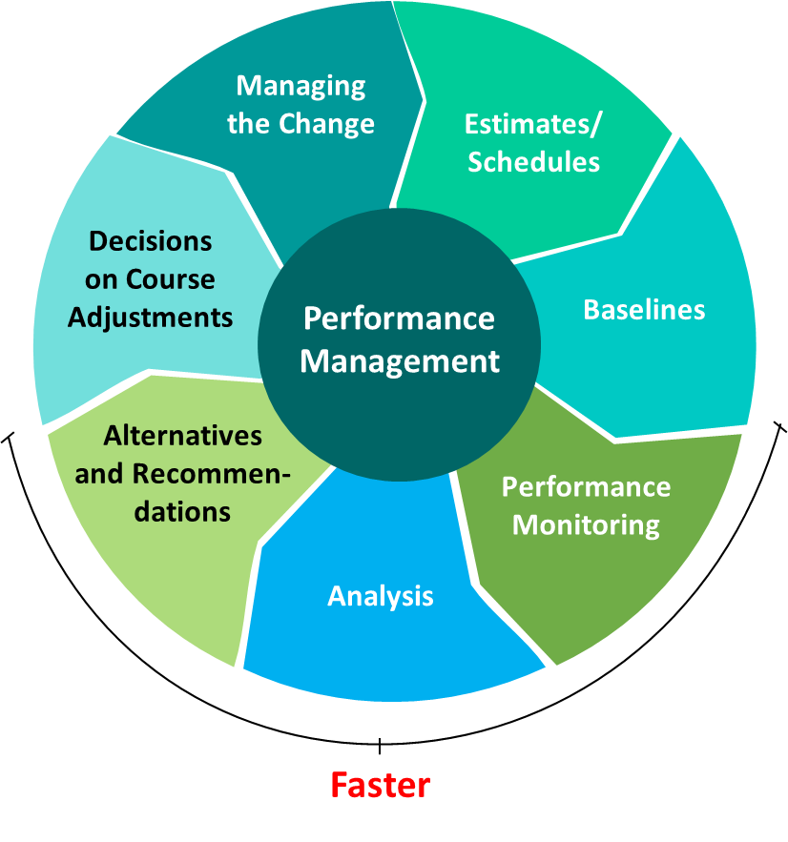
Chapter
5
What Is Setup?
Performance management setup is establishing how the project is going to do this progression—well and fast.
www.midocean.ae

Slide 32
Agenda
What is Planning?
Planning vs Scheduling
Plan vs Planning
Planning Effort
Planning Team
Elements of Project Plan
Questions Planner Asks- Fundamentals
Questions Planner Asks- Tasks
Questions Planner Asks
Deliverables Associated with the Plan
Project Planning and Setup
What Is Setup?
Keys to Successful Setup
www.midocean.ae

Slide 33
Chapter
5
Keys to Successful Setup
Utilize a Scope Packaging Matrix.
Ensure the baseline is owned.
Strive for less detail and more clarity.
Emphasize timeliness, especially related to trending and change management.
Focus on the data, not the tools, for data-driven decisions.
Hold rigorous (but few and short) performance review meetings.
Produce analytics versus reports.
www.midocean.ae

Slide 34

www.midocean.ae

Slide 35



Thank You

