Slide 1


Project Quality
Management
Prepared by Dr. Ehab Mahmoud

Slide 2



Project Quality
Management
Lecture 6
PMG354
Project philosophy
Prepared by
Dr. Ehab Mahmoud

Slide 3

Lecture
Objectives
06
At the end of this lecture, we expect to acquire fundamental knowledge about the projects starting by their definitions and ending to explanation of their inputs, outputs and tools.

Slide 4

Lecture
06
Contents
Introduction
What is a Project?
Project Management
Operations
Operations Management
Programs
Program Management
Portfolios
Portfolio Management
Portfolios, Programs, and Projects
Project Management Office (PMO)
Project Stakeholders
The Project Manager
The Project Management Life Cycle
The Project Life Cycle
Project Management Knowledge Areas
The Project Management Processes
Project Milestones
Project Management Deliverables
Project Timeline
Project Resources
Project Management Methodology
Inputs, Tools and Techniques, and Outputs
Project planning

Slide 5
Introduction
A project is a series of activities and tasks with a specified objective, starting and ending dates and resources.
Resources consumed by the project include time, money, people, and equipment.

Slide 6
Introduction (Cont.)
The Value of Project Management
    Allows for excellent organization and tracking
    Better control and use of resources
    Reduces complexity of inter-related tasks
    Allows measurement of outcome versus plans
    Early identification of problems and quick correction

Slide 7
Introduction (Cont.)
The Triple Constraint of Projects
On Time, Budget, Quality = Required Scope
Cost
Quality
Time
Integration
Trade – Off’s

Slide 8
What is a Project?
A Project: is a temporary integrative big task with a clearly defined beginning and end, resulting in a unique product or service using progressive elaboration.
It is different from an organization’s ongoing operations because a project ends when its objectives are achieved.

Slide 9
What is a Project?
Ongoing Work | Project Work
Repeating process | Temporary process
No clear beginning or ending | Clear beginning and ending
Same output each time | Output is created only once
Everyone in work group performs similar functions | Requires multi-disciplined team

Slide 10
Project Management
Project Management: is the planning, organizing, scheduling, leading, communicating and controlling of work activities to achieve a pre-defined outcome of a project.
Project Management: is defined as “The application of knowledge, skills, tools, and techniques to meet project requirements”.

Slide 11
Operations
Operations: are the ongoing and repetitive tasks that produce the same outcome every time they are performed.
The purpose of operations is to carry out day-to-day organizational functions, generate income to sustain the business, and increase the value of organizational assets; operational processes are aligned with the business requirements of the organization.

Slide 12
Operations Management
Operations Management: is the management of resources and processes involved in producing and delivering products and services.

Slide 13
Programs
A Program: is a group of related projects managed by a program manager and have a common objective; it offers great control over the organization projects and delivers benefits that the organization can use to meet its goals.
Organization’s projects always be a part of programs; projects that do not have a common objective, but still are managed in a group, are generally known as “multiple projects”.

Slide 14
Program Management
Program Management: managing multiple projects and integrating them towards a common goal; it requires managers to manage the interdependencies between the projects by allocating resources, prioritizing efforts, and maintaining the projects’ alignment with business objectives.

Slide 15
Portfolios
Portfolio: is a collection of a group of projects in alignment with the strategic goals of the organization.
The projects collected in a portfolio and managed together may or may not be interdependent, but they are grouped together to give management the long view of the organization’s projects and their adherence to organizational objectives.

Slide 16
Portfolio Management
Portfolio Management: a portfolio may collect several unrelated projects if they all support major goals or a significant product line and it resides at the top level of the organizational hierarchy.

Slide 17
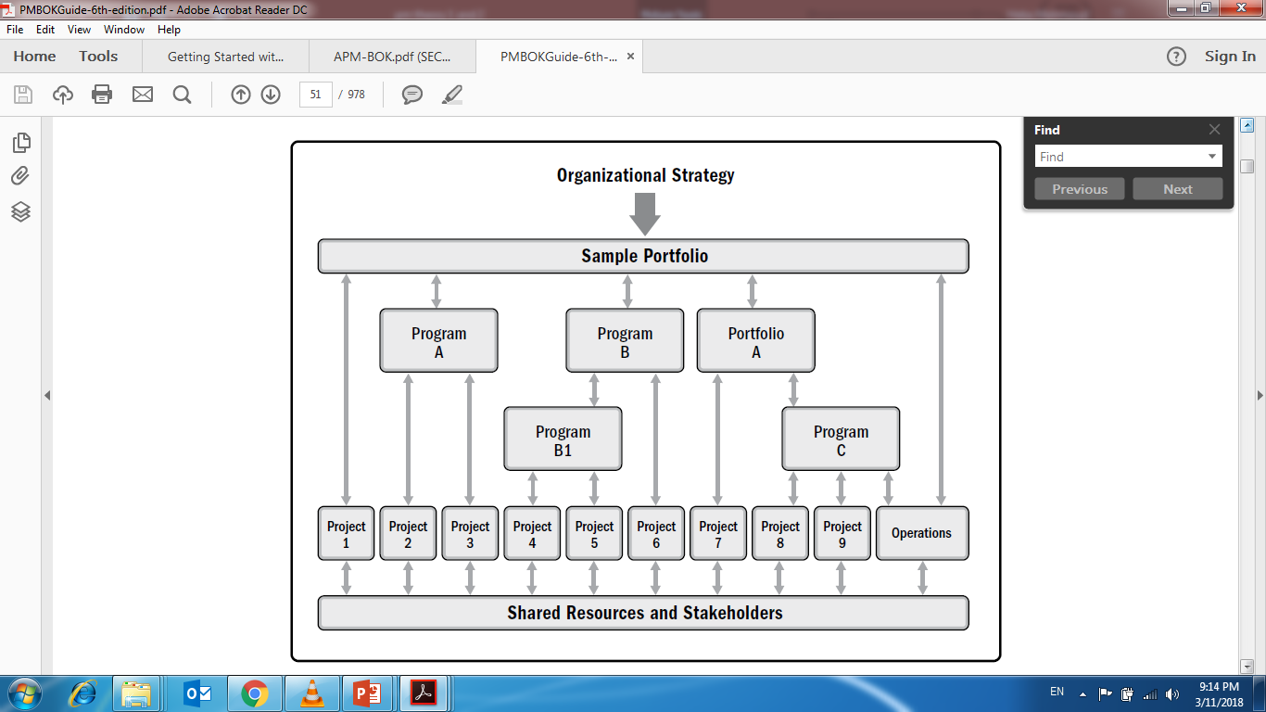
Portfolios, Programs, and Projects

Slide 18
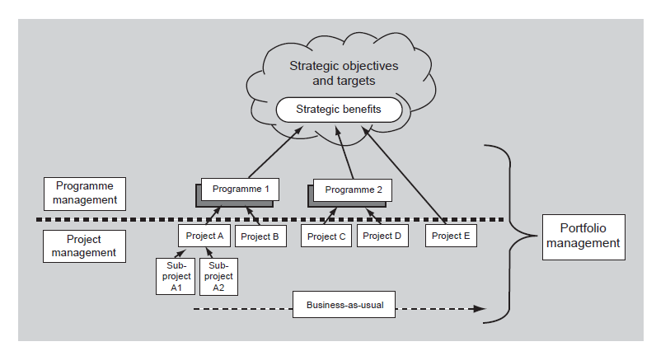
Portfolios, Programs, and Projects

Slide 19
Project Management Office (PMO)
A Project Management Office (PMO): is a centralized, permanent, ongoing administrative unit or department that serves to improve project-management performance within an organization.
The people in the PMO provide support, tools, training, and mentoring to project managers; they may or may not actually do hands-on project management themselves.

Slide 20
Project Management Office (PMO)
The PMO try to maintain standards across projects and improve efficiency.
The PMO may be referred to in some organizations as the “Project Office” or “Program Office” or “Program Management Office”.
The head of the project management office can be considered as a manager of project managers.
The project management office (PMO) will actually be responsible for direct management of large projects/programs.

Slide 21
PMO Functions
Maintaining project historical information.
Managing shared resources across projects managed by the PMO.
Monitoring project timelines, budget, and quality at an enterprise level.
Identifying and implementing new project management methodologies.
Creating effective project policies and templates.
Helping project managers develop cost estimates and schedules.
Managing communication across projects.

Slide 22
Project Stakeholders
A Stakeholder: is a person and/or organizations who has a business interest in the outcome of a project, or who is actively involved in a project (Sponsor, Customer, PM, Project team, PM team and any influencers).
Stakeholders have different interests, needs, and priorities; they may have different opinions about what the project should be trying to accomplish, or what a successful outcome might be; therefore, it is important to identify all stakeholders as early as possible in the initiation.

Slide 23
Project Stakeholders
  Often have conflicting expectations and objectives
  In general, differences should be resolved in favor of the customer – individual(s) or organization(s) that will use the outcome of the project
  Stakeholder management is a proactive task
    Project Mangers must determine all stakeholders and incorporate their needs into the project

Slide 24
Types of Project Stakeholders
Internal stakeholders | External stakeholders
Sponsor, | Customers,
Resource manager, | End users,
Project management office (PMO), | Suppliers,
Portfolio steering committee, | Shareholders
Program manager, | Regulatory bodies
Project managers of other projects, | Competitors
Team members.

Slide 25
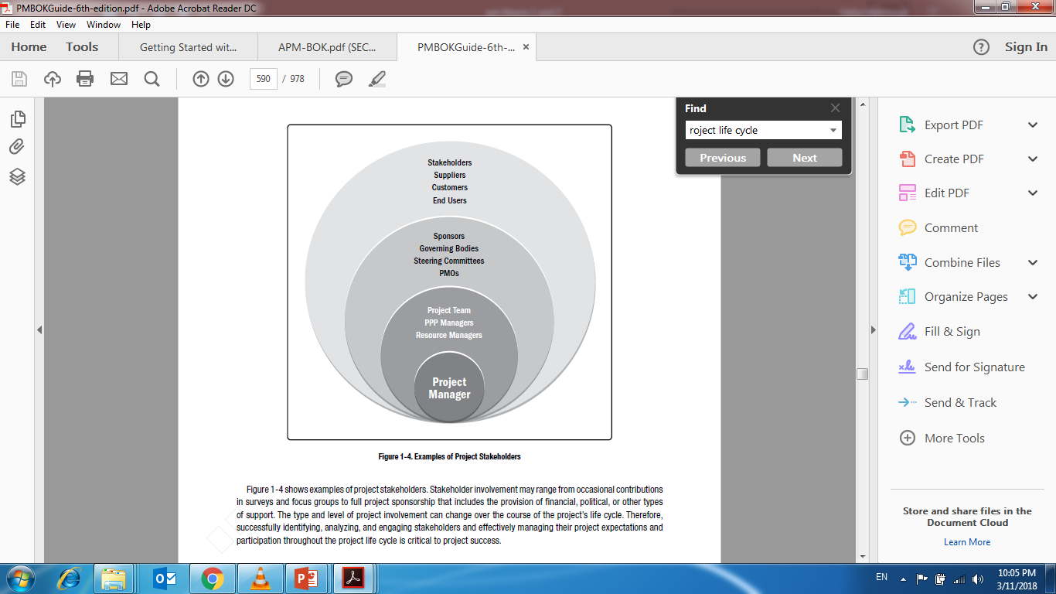
Types of Project Stakeholders

Slide 26
The Project Manager
The Project Manager is the individual responsible for managing all aspects of the project.
The project manager:
  Works with stakeholders to define the project.
  Plans, schedules, and budgets project activities.
  Monitors performance and takes corrective actions.
  Keeps the sponsor and the stakeholders informed.
  Requests and documents scope changes.
  Acts as a liaison between the project team and other stakeholders.

Slide 27
The Project Manager
If the sponsor is outside of the company (external customer); the project manager also:
  Has the financial resources for the project.
  Signs and publishes the project charter.
  Signs off on all planning documents and change requests.
  Authorizes team to use resources.
  Reviews progress and quality.

Slide 28
The Project Manager
The Successful Project Manager: A balance of soft and technical Skills.

Slide 29
A Successful Project Manager “Soft skills”
Takes ownership of the whole project
Is proactive not reactive
Adequately plans the project
Ability to negotiate and manage conflicts.
Is Decisive
Is a Good Communicator
Manages by data and facts not uniformed optimism
Leads by example
Has sound Judgement
Is a Motivator
Is Diplomatic
Ability to solve problems.

Slide 30
A Successful Project Manager “Technical skills”
Project Management Knowledge:
  Knowledge of project management tools and techniques.
  Ability to apply the project management knowledge to ongoing projects.
Knowledge of the Application Area:
  Knowledge of the industry, functional departments, and technical elements.
  Familiarity with accepted standards and regulations.

Slide 31
The Project Management Life Cycle
Once a project is initiated, you move into the planning processes where you develop a project management plan.
From there, you start executing the plan, control and monitor work results in the executing phase.

Slide 32
The Project Management Life Cycle
The work results your team generates may indicate a need for modifications to the project schedule, budget, or scope statement, which requires more planning.
The loop continues between planning, executing, and controlling and monitoring until the project’s objectives are completely and satisfactorily met; then, you move into the closing phase.

Slide 33
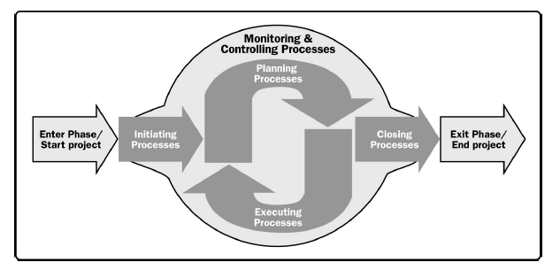
The Project Management Life Cycle

Slide 34
The Project Life Cycle
Project life cycle: is the series of phases that a project passes through from its start to its completion.
projects vary in size and the amount of complexity they contain, a typical project can be mapped to the following project life cycle structure:-
  Starting the project,
  Organizing and preparing,
  Carrying out the work, and
  Closing the project.

Slide 35
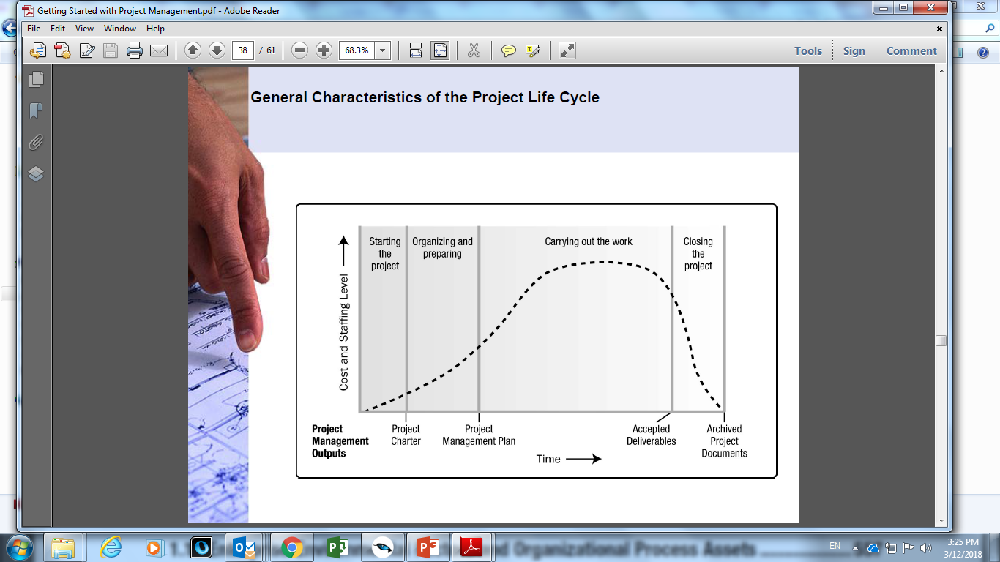
The Project Life Cycle

Slide 36
The Project Life Cycle
In order to improve management control, projects are typically broken down into manageable, sequential phases of work activities named: Project Life Cycle (in general: 5 phases).
  Initiating Phase
  Planning Phase
  Executing Phase
  Monitoring and controlling
  Closing Phase

Slide 37
Project life cycle
Initiation
Start
Planning
Plan
Execution
Project mandate
Requirements
gathering & Gap analysis
Project objectives and Feasibility
Stakeholders declaration
Project manager assignment
Preliminary cost, time and schedule
Scope definition
Activity list
Schedule planning
Cost planning
Resource planning
Risks declarations
Sign off
Kick off meeting
Do
Design
Installations
Development
tasks assignments
Monitoring& controlling
Check &act
Compare progress with baselines
Recommend change
Reporting
Risk monitoring
handover the deliverables
Contract closure
Resources release
Celebration
Closure

Slide 38
Project Management Knowledge Areas
The Project Management Knowledge Areas are fields or areas of specialization that are commonly employed when managing projects.
A Knowledge Area is a set of processes associated with a particular topic in project management.
These 10 Knowledge Areas are used on most projects most of the time.
The needs of a specific project may require additional Knowledge Areas

Slide 39
Project Management Knowledge Areas
No. | Knowledge Area | Definition
1 | Project Integration Management | includes the processes and activities to identify, define, combine, unify, and coordinate the various processes and project management activities within the Project Management Process Groups.
2 | Project Scope Management | includes the processes required to ensure that the project includes all the work required, and only the work required, to complete the project successfully
3 | Project Schedule Management | includes the processes required to manage the timely completion of the project.

Slide 40
Project Management Knowledge Areas
No. | Knowledge Area | Definition
4 | Project Cost Management | includes the processes involved in planning, estimating, budgeting, financing, funding, managing, and controlling costs so the project can be completed within the approved budget.
5 | Project Quality Management | includes the processes for incorporating the organization’s quality policy regarding planning, managing, and controlling project and product quality requirements, in order to meet stakeholders’ expectations.
6 | Project Resource Management | includes the processes to identify, acquire, and manage the resources needed for the successful completion of the project

Slide 41
Project Management Knowledge Areas
No. | Knowledge Area | Definition
7 | Project Communications Management | includes the processes required to ensure timely and appropriate planning, collection, creation, distribution, storage, retrieval, management, control, monitoring, and ultimate disposition of project information.
8 | Project Risk Management | includes the processes of conducting risk management planning, identification, analysis, response planning, response implementation, and monitoring risk on a project.
9 | Project Procurement Management | includes the processes necessary to purchase or acquire products, services, or results needed from outside the project team.

Slide 42
Project Management Knowledge Areas
No. | Knowledge Area | Definition
10 | Project Stakeholder Management | includes the processes required to identify the people, groups, or organizations that could impact or be impacted by the project, to analyze stakeholder expectations and their impact on the project, and to develop appropriate management strategies for effectively engaging stakeholders in project decisions and execution.

Slide 43
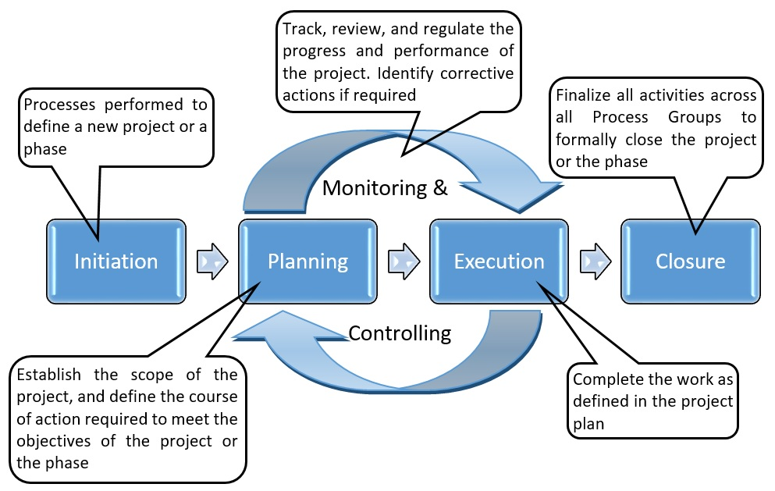
The Project Management Processes
Process Groups:

Slide 44
Project Milestones
Project Milestone: the end of each phase is often referred to as a Project Milestone.
In some organizations, these are referred to as Project Gates.
The project milestone is the time for the stakeholders in a project to evaluate the project’s progress, suggest changes, and decide whether to continue or discontinue working on the project.

Slide 45
Project Management Deliverables
Deliverable is an output from a project management activity/phase.
In each phase, you create project management deliverables as an output of project management activities.
Deliverables from each phase are used to manage the next phases of the project

Slide 46
Project Timeline
The time line is the most visible yardstick for measurement of project performance.
both early and late projects have the opportunity for poor quality.
it is the easiest resource to measure and the hardest to replace

Slide 47
Project Resources
Each project activity is broken into smaller tasks, the resources are assigned to complete those tasks.
Resource conflicts are resolved according to the circumstances in which they occur.

Slide 48
Project Resources (cont.)
Resource leveling is used
Resource leveling advantages are:
  Decrease costs through an more efficient use of resources
  Reduces unnecessary overtime and off shift premiums
  simplifies logistics, of resource availability

Slide 49
Project Management Methodology
Methodology
Manual
Automated

Slide 50
Manual Method
Advantage
Ease of use and low cost
Best for monitoring schedules and timing of events
A hands-on feel for the status off the project is generated
Training requirements are minimal
Can be customized to the specific project needs

Slide 51
Manual Method
Disadvantage
May not be transportable
Large or complex projects may be difficult to display
Project status information is only available at one site
Requires manual summarizing of the information
Potential problem activities and resource conflicts may be overlooked
After the project is completed, it is harder to analyze the results

Slide 52
Automated Method
Advantage
Able to model the what-if scenarios and show the impact of alternate options
Presents the same information in a variety of formats, e.g. Gantt, PERT
The project information can be displayed at different levels of detail
Project status reports are easier to generate
Critical path, slack times, resource usage, and schedules are automatic
Some data collection activities can be automated

Slide 53
Automated Method
Disadvantage
High learning curve for the user of the software program
Higher costs (although these may be low compared to overall project costs)
Data entry and updating can be a time consuming task
Poor data, Deeding to incorrect decisions, will be accepted by the computer
Environmental conditions and/or location may be unsuitable for computer use
The manager may focus on the computer and Bose touch with the project

Slide 54
Inputs, Tools and Techniques, and Outputs
Project management processes are implemented(Executed) through using inputs, tools and techniques, and outputs.
Inputs
Tools and
Techniques
Output

Slide 55
Inputs, Tools and Techniques, and Outputs
Inputs:
are information sources that can be gathered or created by project team or the output of some other processes.
Tools and Techniques
are the applied methodology, approach or templates followed by the project team upon the input data to provide outputs.
output
is the end result or deliverable that is useful to project goals or serves as an input to some other processes.

Slide 56



Thank You

