Slide 1


Strategic Workforce Planning
Prepared by Dr. Sahar Ahmed
Week Five
Lecture 4

Slide 2
Learning Outcome
Understand the objectives and benefits of strategic workforce planning
01
02
Explain the link between an organization’s strategy and its workforce plan
Gain an appreciation for the need for and value of succession planning
03
Appreciate the role that mentoring can play in succession planning
04

Slide 3

What is Strategic Workforce Planning
It is the process of identifying current and future human resources needs for an organization to achieve its goals.
Strategic HR planning should serve as a link between HRM and the overall strategic plan of the organization
www.midocean.ae

Slide 4
Workforce Planning & Strategic Workforce Planning (SWFP)
 | Manpower Planning | SWFP
Time Horizon | Present | Future
Link to Strategy | Less linked to strategy | More linked to strategy
Flexibility | Low | High
Collaboration | Require less collaboration across the organization | Require Greater collaboration across the organization
www.midocean.ae

Slide 5
Strategic Workforce Planning (SWFP)
The first component of HR management strategy is strategic workforce planning. All other functional HR activities, are derived from the SWP process.
When undertaking strategic workforce planning, the organization considers the implications of its future plans on the nature and types of individuals it will need to employ and the necessary skills and training they will require.
The organization also need to assess its current stock of employees as well as those available for employment externally.
The key facet of strategic workforce planning is that it is a proactive process.
www.midocean.ae

Slide 6
Strategic Workforce Planning (SWFP)
The future is unpredictable, so strategic workforce plans need to be flexible. This means companies shouldn't be stuck with outdated plans if things turn out differently than expected.
Changes to any planning initiatives should not be viewed as a weakness in the planning process. Rather, they should be a positive sign that the organization is carefully monitoring its external environment and responding appropriately to any changes taking place.
To facilitate this flexibility, it is critical that key decision makers in the organization clarify and write down all assumptions they make about the external environment and the organization when developing the HR plan.
www.midocean.ae

Slide 7
Strategic Workforce Planning (SWFP)
Clarifying and writing down these assumptions make subsequent intervention and corrective action much easier.
Strategic workforce planning isn't just about who you hire and fire. It's the big picture of how you use your people most effectively to achieve your company's goals. This goes beyond just hiring and letting people go - it includes retraining, moving people to different roles, using temporary workers, and even outsourcing when needed. Basically, modern companies need to be flexible with their workforce to reach their goals.
www.midocean.ae

Slide 8
Human Capital Management at the United States Postal Service
Introduction:
The United States Postal Service (USPS) has a massive workforce, second-largest in the country, facing retirement challenges.
Increased competition and a changing market landscape threaten the USPS's traditional dominance.
Challenge:
A significant portion of the USPS workforce, including executives, managers, and career employees, is nearing retirement age.
The organization needs a strategy to attract new talent and effectively deploy its existing workforce.
Introduction:
The United States Postal Service (USPS) has a massive workforce, second-largest in the country, facing retirement challenges.
Increased competition and a changing market landscape threaten the USPS's traditional dominance.
Challenge:
A significant portion of the USPS workforce, including executives, managers, and career employees, is nearing retirement age.
The organization needs a strategy to attract new talent and effectively deploy its existing workforce.
www.midocean.ae

Slide 9
Human Capital Management at the United States Postal Service
Introduction:
The United States Postal Service (USPS) has a massive workforce, second-largest in the country, facing retirement challenges.
Increased competition and a changing market landscape threaten the USPS's traditional dominance.
Challenge:
A significant portion of the USPS workforce, including executives, managers, and career employees, is nearing retirement age.
The organization needs a strategy to attract new talent and effectively deploy its existing workforce.
Solution:
The USPS has developed a four-pronged human capital management plan:
Aggressively recruit future leaders.
Build a motivated workforce through performance-based rewards and recognition.
Foster a positive work environment with strong labor-management relations.
Create a flexible workforce adaptable to changing conditions.
To achieve these goals, the USPS reorganized back-office functions and implemented technology tools to streamline operations. This includes more self-service transactions for employees and managers, allowing them to focus on more strategic tasks.
www.midocean.ae

Slide 10
Human Capital Management at the United States Postal Service
Introduction:
The United States Postal Service (USPS) has a massive workforce, second-largest in the country, facing retirement challenges.
Increased competition and a changing market landscape threaten the USPS's traditional dominance.
Challenge:
A significant portion of the USPS workforce, including executives, managers, and career employees, is nearing retirement age.
The organization needs a strategy to attract new talent and effectively deploy its existing workforce.
Solution- Contd.
Performance management is being integrated into virtually every organizational initiative to ensure that rewards are commensurate with productivity.
Succession planning has been established to identify vital skills and transfer them to up-and-coming employees through corresponding training and development initiatives.
The Advanced Leadership Program, a premier program for high-potential future executives, trains them to understand the strategic challenges faced by the organization and develop the skills to creatively address them.
www.midocean.ae

Slide 11
Key Objectives of Strategic Workforce Planning
01
Prevent overstaffing and understaffing
02
Ensure the organization has the right employees with the right skills in the right places at the right times
03
Ensure the organization is responsive to
changes in its environment
04
Provide direction and coherence to all HR activities and systems
05
Unite the perspectives of
line and staff managers
www.midocean.ae

Slide 12
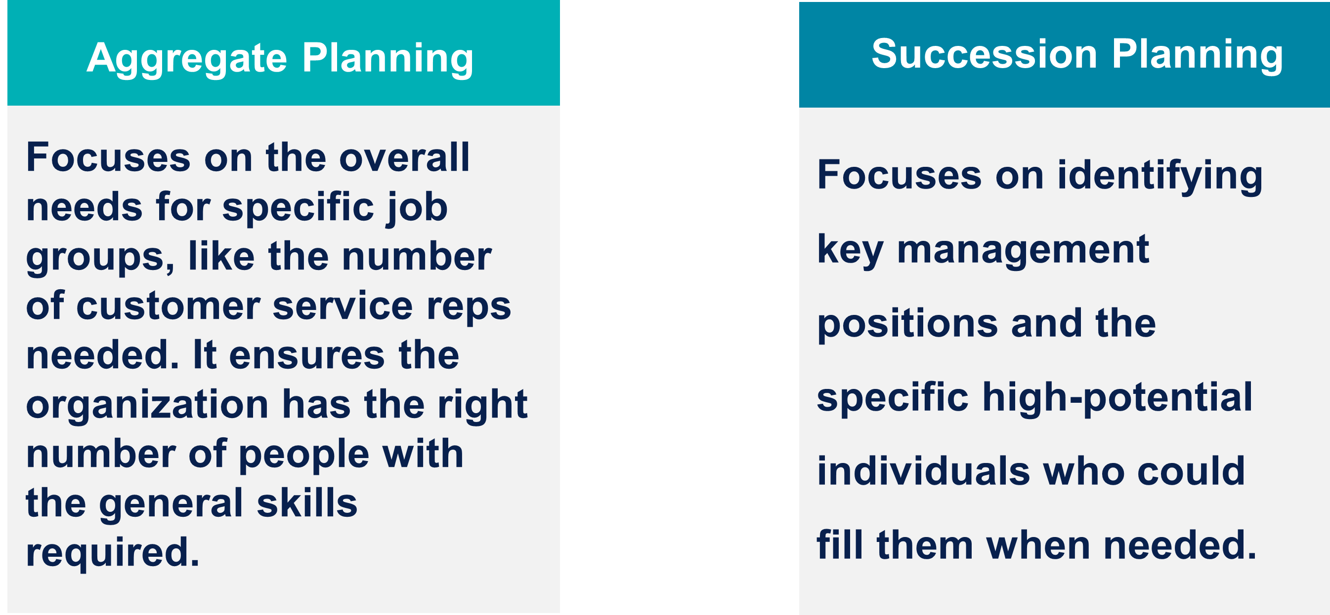
Week
Types of Planning
www.midocean.ae

Slide 13
Aggregate Planning- Forecasting Demand
Forecasting Demand:
The first step in aggregate planning is predicting how many employees the organization will need. This involves considering:
Strategic plans: Growth or decline in the organization's business will impact employee needs.
Demand for products/services: The main indicator of employee demand is the demand for what the organization produces or sells.
Future assumptions: Factors like new technology, competition, and changes in service delivery need to be considered when forecasting.
www.midocean.ae

Slide 14
Aggregate Planning
Forecasting Methods:
Mathematical methods: Techniques like regression analysis can help forecast employee demand, but most organizations rely on:
  Unit forecasting (bottom-up): Each department estimates its own employee needs based on its goals. This can be responsive to market needs but may lead to overestimation.
  Top-down forecasting: Senior management allocates a budget for employee payroll and divides it across departments. This is efficient but may not reflect market needs.
www.midocean.ae

Slide 15
Aggregate Planning- Forecasting Methods
The best approach depends on the organization's strategy:
Cost minimization: Choose top-down forecasting for efficient resource allocation.
Change and adaptability: Choose unit forecasting for responsiveness to market needs.
Balance: Combine both methods and negotiate differences between bottom-up and top-down forecasts.
www.midocean.ae

Slide 16
Week
Aggregate Planning
Beyond Headcount:
Forecasting also needs to consider the specific skills employees will need. Changing demographics and technology impact the skillsets available and required.
Forecasting Supply:
Once employee demand is forecasted, the organization needs to assess its internal supply of labor:
Skills inventory: A database containing information on employees' skills, experience, and career aspirations. This helps understand the capabilities of the existing workforce.
Mobility and turnover: Analyze how employees move within the organization and the rate at which they leave. Tools like Markov analysis can help predict these movements.
www.midocean.ae

Slide 17
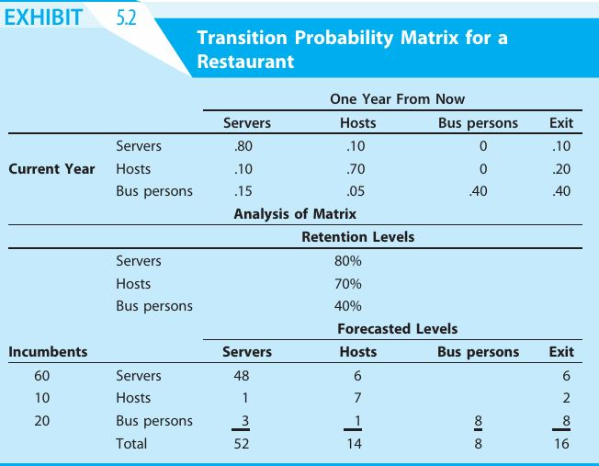
Forecasting Supply
Week
www.midocean.ae

Slide 18
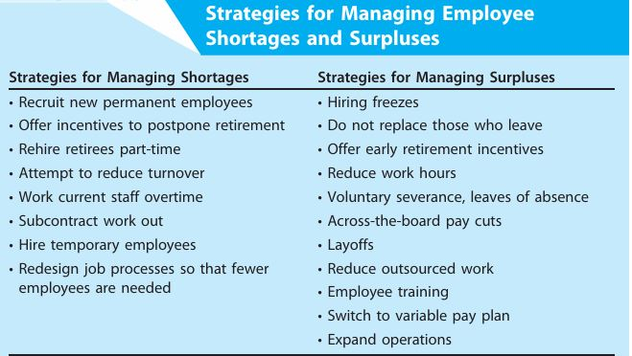
Planning for Shortages and Surpluses
Week
www.midocean.ae

Slide 19
Avoiding Layoffs at the University of Maryland, Baltimore
Week
Introduction:
The University of Maryland, Baltimore (UMB) faced a budget shortfall due to decreased state funding.
Maintaining employee salaries proved challenging despite suspending pay raises.
Challenge:
UMB needed to find a solution to address the budget deficit without resorting to layoffs.
Layoffs could have negatively impacted employee morale and overall university operations.
www.midocean.ae

Slide 20
Week
Avoiding Layoffs at the University of Maryland, Baltimore
Solution:
UMB implemented a two-step approach to avoid layoffs:
  Unpaid furloughs: Implemented on a tiered system based on salary to minimize the financial impact on lower-paid employees.
  Temporary salary reductions: Replaced furloughs with across-the-board salary reductions, again tiered to protect lower salaries. Additionally, employees received paid leave to compensate for the reductions.
www.midocean.ae

Slide 21
Week
Avoiding Layoffs at the University of Maryland, Baltimore
This approach aimed to minimize disruption and maintain staffing levels while addressing the budget shortfall.
Outcome:
UMB successfully avoided layoffs.
Employee turnover remained stable.
The university pledged to restore salaries and benefits when the state budget improves.
www.midocean.ae

Slide 22
Week
Succession Planning
What is Succession Planning?
Identifying key management positions critical to the organization's success.
Ensuring these positions are filled when they become vacant.
Purposes of Succession Planning:
Facilitates smooth transitions when employees leave.
Identifies high-potential employees and helps with their career development.
www.midocean.ae

Slide 23
Week
Succession Planning
The Importance of a Strategic Approach:
Effective succession planning isn't just about filling empty chairs. It's about aligning talent development with the organization's long-term goals. This means considering:
Future needs: What skills and competencies will be critical for future success? What leadership qualities will be needed?
Emerging trends: How might technology, competition, or market changes impact talent needs?
By understanding these factors, organizations can develop succession plans that cultivate the right talent pool to navigate future challenges.
www.midocean.ae

Slide 24
Week
Succession Planning
Effective Succession Planning Practices:
Align planning with organizational strategy and anticipated needs.
Monitor progress and measure outcomes regularly.
Integrate succession planning with other HR functions.
Centralize coordination to avoid competition for talent.
Engage managers throughout the organization.
www.midocean.ae

Slide 25
Week
Succession Planning
Benefits of Succession Planning:
Ensures key positions are filled.
Identifies training and development needs.
Invests in employees - potential return on investment.
Challenges of Succession Planning:
Traditional models may not keep pace with changing business needs.
Subjective assessments in replacement charts can lead to bias.
Cost of developing employees who may leave for better opportunities.
Retention strategies for high-potential employees who are passed over for promotions.
www.midocean.ae

Slide 26
Week
Succession Planning
Traditional Succession Planning Tools:
Replacement charts: Identify key positions, potential successors, and their readiness.
Modern Approaches to Succession Planning:
Focus on competencies and skills needed for the position.
Develop broader talent pools with diverse skill sets.
Integrate succession planning with talent management and development.
www.midocean.ae

Slide 27
Week
Succession Planning
Considerations for Transparency:
Informing employees can increase retention but may create unrealistic expectations.
Not informing employees provides flexibility but risks losing talent.
Conclusion:
Succession planning requires careful consideration of its benefits and challenges. Organizations need to weigh transparency, talent development costs, and retention strategies to implement an effective program.
www.midocean.ae

Slide 28
Week
Succession Planning at Dole Food Company
Introduction:
Dole Food Company, a large international producer and marketer of fruits, vegetables, and flowers, faced challenges managing its talent pool due to a decentralized structure.
This structure allowed each unit to operate independently but hindered effective management of human capital for executive positions.
Challenges:
Decentralized structure limited visibility into the capabilities and potential of employees across the entire organization.
Difficulty identifying and developing high-potential employees for executive roles.
Lack of a centralized system for assessing talent and filling executive vacancies.
www.midocean.ae

Slide 29
Week
Succession Planning at Dole Food Company
Outcome:
Dole implemented an online succession planning program focused on four key strategic competencies:
  Accountability
  Business acumen
  Multifunctionality (cross-training)
  Vision/originality
The program allowed for standardized evaluation of employees across the organization.
It identified talent gaps, enabling targeted development efforts.
The system considered employee career interests and mobility restrictions, potentially leading to better retention strategies.
www.midocean.ae

Slide 30
Week
CEO Succession Planning: A Pressing Need
Problem: Over 50% of US and Canadian organizations lack a CEO succession plan.
Consequences:
Vulnerability during unexpected CEO departures.
Difficulty finding qualified internal candidates.
Lack of onboarding support for new CEOs.
Solution: Two-pronged approach:
Short-term: Identify an interim CEO who can step in immediately (e.g., board member, retired executive).
Long-term: Conduct a strategic search for the most suitable permanent CEO.
www.midocean.ae

Slide 31
Week
CEO Succession Planning: A Pressing Need
Importance:
CEO job less attractive due to pressure for continuous profitability.
High CEO turnover (20% in top 200 corporations annually).
Disruption caused by unexpected CEO departures.
Overall, CEO succession planning is critical to ensure organizational stability in the face of CEO turnover.
www.midocean.ae

Slide 32
Week
CEO Succession Planning at General Electric
Introduction:
General Electric (GE) faced the challenge of replacing its highly successful CEO, Jack Welch.
Unlike many companies, GE stakeholders remained calm due to their well-established succession plan.
Problem:
Finding a qualified successor to a legendary CEO can be a major challenge for organizations.
www.midocean.ae

Slide 33
Week
CEO Succession Planning at General Electric
Solution:
GE implemented a long-term (6+ years) succession plan focused on developing internal candidates.
The plan involved:
  Regular job rotations (every 2-3 years) for executives.
  Carefully designed assignments to build experience and skills across different divisions.
  Clear performance goals and expectations for advancement.
www.midocean.ae

Slide 34
Week
CEO Succession Planning at General Electric
Outcome:
GE successfully transitioned leadership with minimal disruption.
The established plan produced multiple qualified internal candidates.
GE's reputation for developing top executives was further solidified.
Overall, GE's case highlights the effectiveness of a long-term, proactive approach to CEO succession planning, resulting in a smooth transition and a strong pool of internal leadership candidates.
www.midocean.ae

Slide 35
Week
Mentoring in Succession Planning
Mentoring is a tool for developing high-potential employees within a succession planning program.
Mentoring Programs:
Pair experienced executives/managers with promising employees (mentees).
Address both personal and professional development needs of the mentee.
Selecting Mentors:
Proven high performers with relevant skills and experience.
Genuine interest in mentoring and understanding mentee needs.
www.midocean.ae

Slide 36
Mentoring in Succession Planning
Week
Designing the Program:
Align with organizational strategy and identified skill gaps.
Consider diversity and inclusion initiatives.
Set specific goals and success metrics beforehand (individual and organizational).
Formal vs. Informal Approaches:
Formal programs offer structure and clear goals.
Informal programs can be less effective due to unconscious bias in mentor selection (e.g., seeking mentors who are similar demographically).
www.midocean.ae

Slide 37
Mentoring in Succession Planning
Week
Diversity and Inclusion:
Informal programs may perpetuate the promotion of majority employees.
Succession planning should work alongside diversity programs to ensure a representative leadership team.
Overall, mentoring is a valuable tool in succession planning, but careful program design and attention to diversity are crucial for its success.
www.midocean.ae

Slide 38
Week
Mentoring at Raytheon Vision Systems
Introduction:
Raytheon Vision Systems, a leading defense contractor based in Goleta, California, specializes in developing and manufacturing advanced detection and imaging devices for national security applications. The company faced a significant challenge in the form of an impending retirement wave.
www.midocean.ae

Slide 39
Mentoring at Raytheon Vision Systems
Week
Problem:
Within a five-year window, Raytheon Vision Systems projected that a staggering 35% of its workforce would be eligible for retirement. This mass exodus presented a major concern – many of these employees were the original inventors or possessors of vital, proprietary knowledge critical to the company's operations and product development. The potential loss of this expertise threatened to disrupt ongoing projects and hinder future innovation.
www.midocean.ae

Slide 40
Mentoring at Raytheon Vision Systems
Week
Solution
Raytheon implemented the "Leave-A-Legacy" mentoring program:
Paired retiring employees with high-potential mentees for knowledge transfer.
Activities included bringing mentees to meetings, introducing them to customers, and involving them in project development.
Third-party coaches assisted with setting individualized plans for each pair.
Benefits:
Retiring employees felt a sense of purpose and legacy preservation.
Mentees showed higher commitment and interest in staying with the company.
www.midocean.ae

Slide 41
Conclusion
Strategic workforce planning, a proactive approach to ensuring an organization has the right talent in the right place at the right time to achieve its strategic goals.
Key Objectives of HR Planning:
Prevent staffing imbalances: HR planning helps avoid overstaffing (inefficiency) and understaffing (lost opportunities).
Right talent, right place, right time: Ensure the organization has the necessary skills and expertise in the right positions at the right time.
Adaptability to change: Anticipate and plan for environmental shifts to maintain a competitive edge.
Alignment and coherence: Provide direction and ensure consistency across all HR activities and systems.
Collaboration: Foster communication and cooperation between line and HR managers for successful planning initiatives.
www.midocean.ae

Slide 42
Conclusion
Types of Planning:
Aggregate planning: Forecasts future needs for employee groups and skillsets to maintain high performance.
  Demand forecasting: Estimates employee needs based on product or service demand (can be susceptible to overestimation).
  Skills inventory: Assesses the current capabilities and experiences of the workforce.
  Markov analysis: Uses historical data to predict future supply and demand for human resources.
Succession planning: Focuses on identifying critical leadership positions and developing future successors.
Replacement charts: Identify potential successors and their suitability for key positions.
Development plans: Provide career development opportunities for high-potential employees.
www.midocean.ae

Slide 43
Conclusion
Mentoring as a Tool for Development:
Mentoring programs pair experienced executives with promising employees to facilitate knowledge transfer and leadership development. Careful selection of mentors with both technical and interpersonal skills is crucial for success.
www.midocean.ae

Slide 44
Conclusion
Overall Significance of Strategic Workforce Planning:
Strategic decision-making: Understanding future talent availability informs strategic plans.
Market competitiveness: Anticipation of labor market trends allows organizations to stay ahead of competitors.
Employee development: Skills gaps are identified, leading to targeted training and development programs.
Leadership continuity: Succession plans ensure smooth transitions and minimize leadership disruptions.
Budgetary planning: Resource allocation can be aligned with future workforce needs.
Operational efficiency: HR planning helps identify potential staffing imbalances.
Organizational adaptability: Organizations can adapt more effectively to changing environments with a well-defined HR plan.
www.midocean.ae

Slide 45
Week
01
References
Main Reference
Mello A .Jeffrey (2011). Strategic Management of Human Resources (3rd ed.) South-Western Cengage Learning.
Additional Resources for extra reading.
Boselie, Paul (2014). Strategic Human Resource Management: A Balanced Approach .McGraw Hill Companies.
Millmor, Mike, Philip Lewis, and others (2007), Strategic Human Resource Management Contemporary issues. Ft Prentice Hall.
www.midocean.ae

Slide 46



Thank You

