Slide 1


Project Time Management
مقرر: إداره وقت المشروع
Prepared by Dr. Amira Elfekky
PMG 212
Lecture 5

Slide 2

Agenda
Integrating the Schedule and the Budget
Schedule of Values
Matching Cost Values to Tasks
Planned vs. Actual Values
Critical Path method
Scheduling Terminology
Estimate the duration
Scheduling Consists
Develop the Schedule
The common Scheduling Failures

Slide 3
Agenda
Integrating the Schedule and the Budget
Schedule of Values
Matching Cost Values to Tasks
Planned vs. Actual Values
Critical Path method
Scheduling Terminology
Estimate the duration
Scheduling Consists
Develop the Schedule
The common Scheduling Failures

Slide 4
Chapter
05
Schedule of Values
Why Integration Matters
Project control depends on time + cost
Progress must be translated into earned value
Integration allows:
  Accurate cost control
  Reliable cash flow
  Better forecasting

Slide 5
Chapter
05
Schedule of Values
What is the Schedule of Values (SOV)?
  Financial breakdown of the contract
  Assigns dollar values to tasks
  Total SOV = Total contract price
  Used as the basis for:
  Progress measurement
  Payment approval

Slide 6
Agenda
Integrating the Schedule and the Budget
Schedule of Values
Matching Cost Values to Tasks
Planned vs. Actual Values
Critical Path method
Scheduling Terminology
Estimate the duration
Scheduling Consists
Develop the Schedule
The common Scheduling Failures

Slide 7
Chapter
05
Matching Cost Values to Tasks
Matching Schedule Tasks to Budget
  Every schedule task must have:
  A corresponding budget value
  Task cost includes:
  Direct cost
  Overhead
  Profit
  Incorrect values = inaccurate project control

Slide 8
Agenda
Integrating the Schedule and the Budget
Schedule of Values
Matching Cost Values to Tasks
Planned vs. Actual Values
Critical Path method
Scheduling Terminology
Estimate the duration
Scheduling Consists
Develop the Schedule
The common Scheduling Failures

Slide 9
Chapter
05
Planned vs. Actual Values
Planned vs Actual Values
To analyze performance, assume:
Skilled labor
Proper tools & materials
Optimal crew size
Continuous work
8-hour workday
These assumptions support accurate planning.

Slide 10
Agenda
Integrating the Schedule and the Budget
Schedule of Values
Matching Cost Values to Tasks
Planned vs. Actual Values
Critical Path method
Scheduling Terminology
Estimate the duration
Scheduling Consists
Develop the Schedule
The common Scheduling Failures

Slide 11
Chapter
05
Critical Path
One or more continuous chains of zero or negative float activities running from the start event to the finish event in the schedule.
The Critical Path is normally the Longest Path (longest series of continuous activities) in the schedule.
Any activity on the critical path is called a Critical Activity.

Slide 12
Chapter
05
Critical Path method
Activity | Duration
A | 1
B | 7
C | 6
D | 4
E | 8
F | 6
G | 4
H | 3
I | 5
J | 5
K | 3
Sum | 52
The critical path method (CPM) is a technique that’s used by project managers to create a project schedule and estimate the total duration of a project.

Slide 13
Chapter
05
Purpose of the Critical Path Method (CPM)
Developed to plan, schedule, and control complex projects
Focuses on identifying the longest sequence of dependent activities
Determines the shortest possible project duration
Helps managers monitor project progress and control delays

Slide 14
Chapter
05
Key Concepts of CPM
Critical Tasks: Tasks that directly affect project completion date
Concurrent Tasks: Can occur simultaneously with critical tasks
Float (Slack): Extra time available for non-critical tasks
Interdependency: Each critical task’s start and finish affect the next one

Slide 15
Chapter
05
Importance of the Critical Path
Represents the longest path through project activities
Any delay in a critical task delays the entire project
Used to identify which activities must start and finish on time
Guides decision-making for resource allocation and risk management

Slide 16
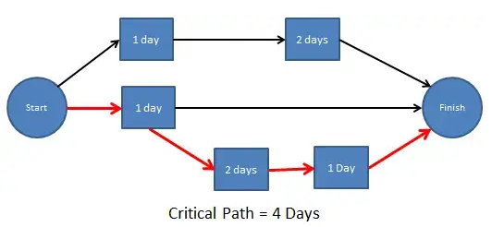
Chapter
05
Critical Path method

Slide 17
Chapter
05
Critical Path method
Why use critical path analysis?
CPA can provide valuable insight on how to plan projects, allocate resources, pace towards milestones, and schedule tasks.
Here are some reasons why you should use the critical path method:
Improves future planning: CPM can be used to compare expectations with actual progress. The data used from current projects can inform future project plans.
Facilitates more effective resource management: CPM helps project managers prioritize tasks, giving them a better idea of how to avoid resource constraints.

Slide 18
Chapter
05
Critical Path method
Helps avoid bottlenecks: Bottlenecks in projects can result in lost valuable time. Plotting out project dependencies using a network diagram will give you a better idea of which activities can and can’t run in parallel, allowing you to schedule work accordingly.

Slide 19
Chapter
05
Critical Path method
The seven (7) steps in the CPM are:
Step 1: List of all activities required to complete the project
Step 2: Determine the sequence of activities
Step 3: Draw a network diagram
Step 4: Determine the time that each activity will take to completion
Step 5: Determine the dependencies between the activities
Step 6: Determine the critical path
Step 7: Update the network diagram as the project progresses

Slide 20
Chapter
05
Critical Path method
The seven (7) steps in the CPM are:
Step 1 – List All Activities
List all the activities or tasks required to complete the project, such as measuring, cutting, assembling, painting, etc.
Identify every task that contributes to the final deliverable to ensure nothing is overlooked.
Step 2 – Determine the Sequence of Activities
Determine the order in which tasks should be performed.
Identify which activities must be completed before others can begin and which can run in parallel.

Slide 21
Chapter
05
Critical Path method
The seven (7) steps in the CPM are:
Step 3 – Draw a Network Diagram
Draw a network diagram showing how all activities are connected.
Use arrows to represent dependencies and boxes to represent activities.
Step 4 – Determine Activity Duration
Estimate the time required to complete each activity.
Base your estimates on available resources, experience, and task complexity.
Step 5 – Identify Dependencies
Identify which activities depend on others to start or finish.
This helps visualize constraints and prevents scheduling conflicts.

Slide 22
Chapter
05
Critical Path method
The seven (7) steps in the CPM are:
Step 6 – Determine the Critical Path
Find the longest sequence of dependent activities that determines the shortest project duration.
Delays in any of these critical activities will delay the entire project.
Step 7 – Update the Network Diagram
Regularly update the network diagram as the project progresses.
Adjust for any changes in schedule, duration, or dependencies to keep the plan accurate.

Slide 23
Agenda
Integrating the Schedule and the Budget
Schedule of Values
Matching Cost Values to Tasks
Planned vs. Actual Values
Critical Path method
Scheduling Terminology
Estimate the duration
Scheduling Consists
Develop the Schedule
The common Scheduling Failures

Slide 24
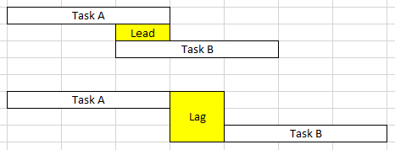
Chapter
05
Scheduling Terminology
Lead & Lag
Lead and Lag are the duration unit of tasks.
Lead is portrayed by negative (-) sign
whereas Lag is by positive (+) sign.

Slide 25
Chapter
05
Scheduling Terminology
Float
Total Float
Amount of time an activity can exceed its early finish date without affecting the project end date or other imposed dates.
Free Float
Amount of time by which an activity can exceed its early finish date without affecting the early start date of any successor(s).
Negative Float
Amount of time that the start or finish of any activity exceeds the time allowed.

Slide 26
Chapter
05
Scheduling Terminology
The disadvantages of showing float on the schedule
End user may delay start of activity thinking there is slack time
May cause false sense of security
Once used as an activity -- it’s gone forever
Assumes CPM is complete with correct logic

Slide 27
Agenda
Integrating the Schedule and the Budget
Schedule of Values
Matching Cost Values to Tasks
Planned vs. Actual Values
Critical Path method
Scheduling Terminology
Estimate the duration
Scheduling Consists
Develop the Schedule
The common Scheduling Failures

Slide 28
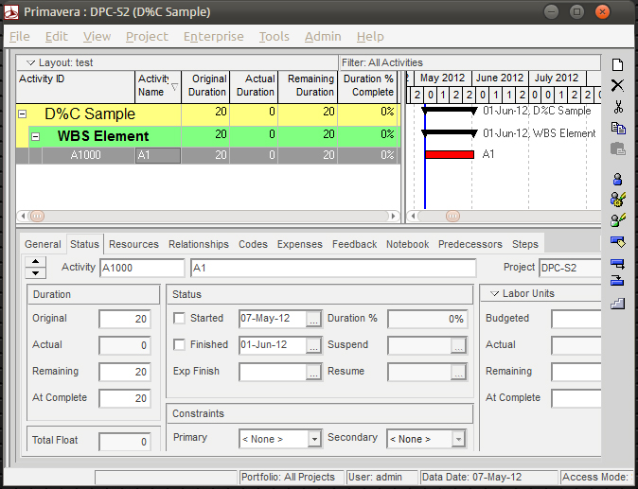
Chapter
05
Scheduling Terminology
Duration - Original / Remaining
Duration: is the amount of time required to complete an activity.

Slide 29
Chapter
05
Scheduling Terminology
Original Duration - the planned estimate of the number of work periods required to accomplish an activity.
Remaining Duration - the number of work periods currently forecast to complete the activity.
Work periods can be hours, days, weeks or months.

Slide 30
Chapter
05
Estimate the duration
Historical information
Market information
Rates of installation
What is a “Normal” rate of installation? How do we come up with this? Varies by area?

Slide 31
Chapter
05
Calendar(s)
The work periods and holidays defined for the Project.
There can be multiple Calendars on a Project:
Engineering - 5 day work week
Manufacturing - 7 day work week
Construction - 6 day work week
Different local Holidays ?

Slide 32
Chapter
05
Project Assumptions
Project assumptions are identified at the beginning of the project. Throughout the project life cycle, they will be refined and reanalyzed.
An assumption is what you believe to be true. These are anticipated events or circumstances that are expected during your project’s life cycle. You make assumptions based on your experience or the information available on hand.

Slide 33
Chapter
05
Project Constraints
Project Constraints are identified at the beginning of the project. Throughout the project life cycle, they will be refined and reanalyzed.
These constraints are defined at the beginning of your project, and you must work within their boundaries.
A constraint can be of two types:
usiness Constraints
Technical Constraints

Slide 34
Agenda
Integrating the Schedule and the Budget
Schedule of Values
Matching Cost Values to Tasks
Planned vs. Actual Values
Critical Path method
Scheduling Terminology
Estimate the duration
Scheduling Consists
Develop the Schedule
The common Scheduling Failures

Slide 35
Chapter
05
Scheduling Consists
Determining the activity duration's.
Ties individual plans together.
Timing of activities.
Minimizing resource conflicts.
Identifying critical activities.

Slide 36
Chapter
05
Scheduling Consists
Establishing the baseline.
Providing a tool for project evaluation.
Provides outputs for analysis.
Monitoring and analyzing progress.
Assists in developing work-arounds

Slide 37
Chapter
05
Information Gathering
  Information outlining the project is available in many forms and from many sources
  From the project scope description look for similar projects
  The Client - gather as much information about this Project and other similar Projects in which they have been involved.

Slide 38
Chapter
05
Information Gathering
Asking about these simple questions
What are you going to do?
How long is it going to take?
What do you need to start the activity?
What do you need to finish the activity?

Slide 39
Agenda
Integrating the Schedule and the Budget
Schedule of Values
Matching Cost Values to Tasks
Planned vs. Actual Values
Critical Path method
Scheduling Terminology
Estimate the duration
Scheduling Consists of
Develop the Schedule
The common Scheduling Failures

Slide 40
Chapter
05
Develop the Schedule
  Integrate individual plans
  Identify activities
  Determine activity duration
  Determine activity sequence
  Establish dependencies and constraints
  Identify critical activities
  Optimize the application of resources

Slide 41
Chapter
05
Types of logic among the activities
Mandatory/Hard logic
Preferential/Preferred/Discretionary/soft logic

Slide 42
Chapter
05
Developing an EPC Schedule
Engage in an iterative process.
  Starting with Level I and II, build the schedule.
  Check viability (milestone comparisons, curves, etc.).
  Build Level III with activity logic, resources, etc.
  Confirm Level I and II, and then finalize Level III baseline.
Planners facilitate discussions between Engineering, Procurement, Construction, and Startup team members, and interface between workgroups to optimize the overall schedule.

Slide 43
Chapter
05
Communicate the Schedule
The project’s principal sequences and overall strategy is clear to the team.
The project must have basic boundaries and commitments identified.
The project needs a workable plan to accomplish its objectives and everyone understands their role.

Slide 44
Chapter
05
Implement the Schedule
Once everyone (including the Client) agrees on the Schedule, it becomes the BASELINE Schedule.
This the reference point from which the Project will be measured from and from which all VARIANCES/ CLAIMS will be analyzed.
A copy of this Schedule will be updated with actual progress and then it becomes the Current Schedule which will change as the Project evolves.

Slide 45
Agenda
Integrating the Schedule and the Budget
Schedule of Values
Matching Cost Values to Tasks
Planned vs. Actual Values
Critical Path method
Scheduling Terminology
Estimate the duration
Scheduling Consists
Develop the Schedule
The common Scheduling Failures

Slide 46
Chapter
05
The common Scheduling Failures
Lack of buy-in by all project team members
Lack of planning
Poorly defined activities
Inappropriate scheduling detail
Inadequate logic ties

Slide 47
Chapter
05
The common Scheduling Failures
Poor duration estimating
Lack of information
Failure to disseminate the proper information to all parties
Excessive details that overwhelm the sanity
Updates without analysis

Slide 48



Thank You

