Slide 1


Entrepreneurship
& Innovation
Prepared by Dr. Amany Ramadan
ENT 611
Lecture 9

Slide 2




Lecture 9
ENT( 611)
Prepared by
Dr. Amany Ramadan
www.midocean.ae

Slide 3

Chapter
Marketing For Entrepreneurs
(Strategy and Planning)
09
www.midocean.ae

Slide 4

Learning objectives
Define objectives & Strategy
Quantify objectives
Meet objectives through tactical plan
Marketing plan - strategy and objectives - Matrix
Product plan
Price plan
Advertising plan/ promotional plan/ sales plan
Distribution plan
www.midocean.ae

Slide 5
Marketing Strategy and Marketing Planning
Class aim - to familiarise you with the marketing ethos. Key concepts, marketing strategy and marketing planning
Objectives
  To develop your ability to understand a range of strategic marketing strategies and apply them to your own product or service
  To understand and be able to demonstrate how intensive growth strategies can be employed to meet strategic objectives
  To understand and be able to develop a marketing plan
www.midocean.ae

Slide 6
What is marketing?
What is the difference between sales and marketing?
www.midocean.ae

Slide 7
What is marketing?
The management process responsible
for identifying, anticipating and
satisfying customer requirements
profitably.
Chartered Institute of Marketing
www.midocean.ae

Slide 8
What is marketing?
Marketing is an organisational function
and a set of processes for creating,
communicating, and delivering value
to customers and for managing
customer relationships
in ways that benefit the
organisation and its stakeholders.
www.midocean.ae

Slide 9
What is marketing?
Marriage between economics
(supply and demand) and customer
satisfaction
The company that best satisfies the
customer will achieve competitive
advantage
www.midocean.ae

Slide 10
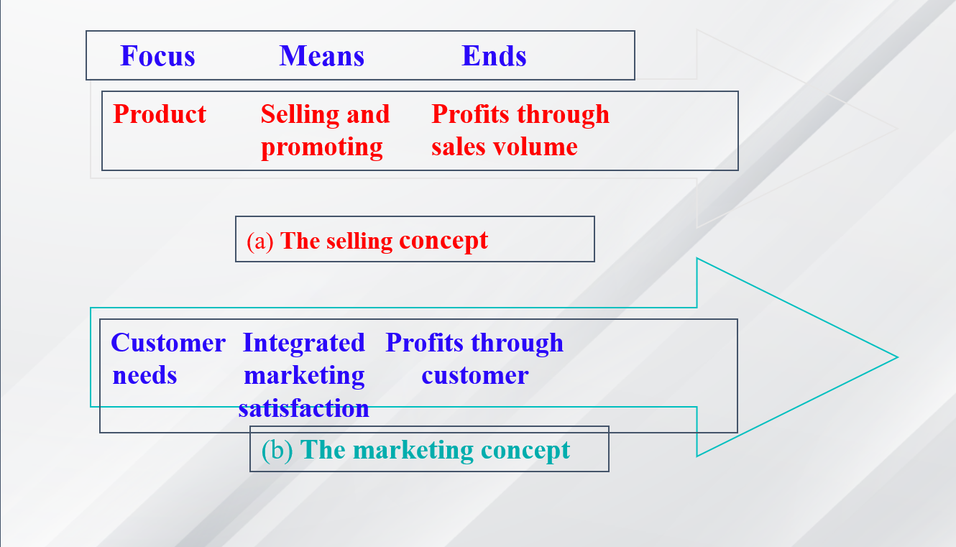
Sales V marketing focus
www.midocean.ae

Slide 11
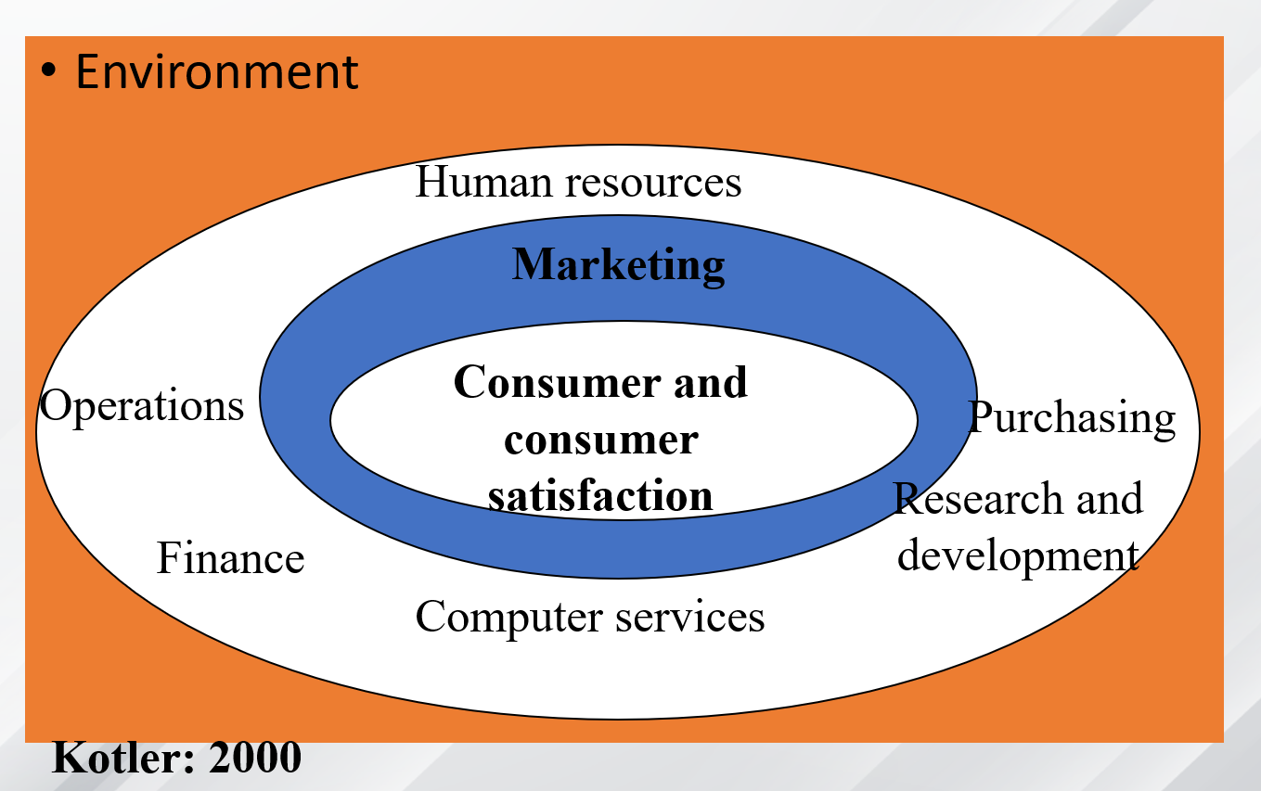
Structure of a consumer centred organisation
www.midocean.ae

Slide 12
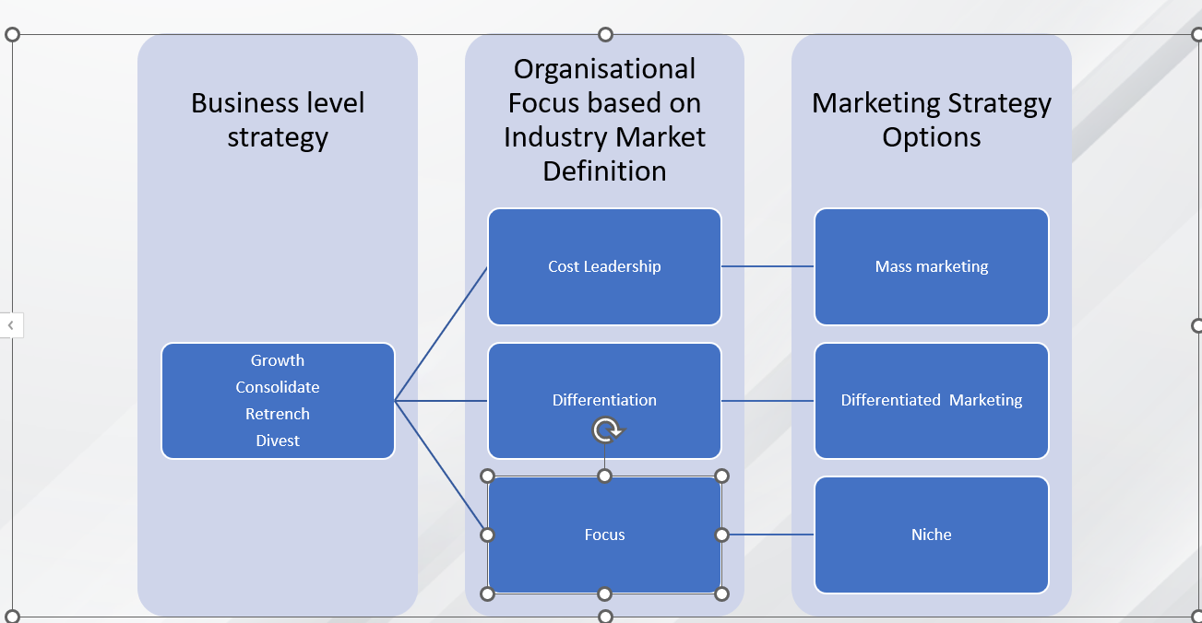
Organisational focus and marketing strategy
www.midocean.ae

Slide 13
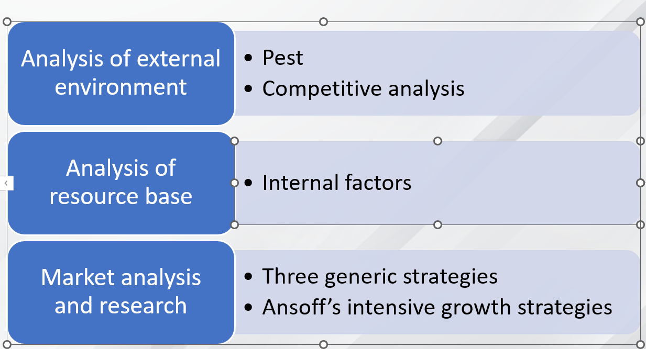
Fits with
www.midocean.ae

Slide 14
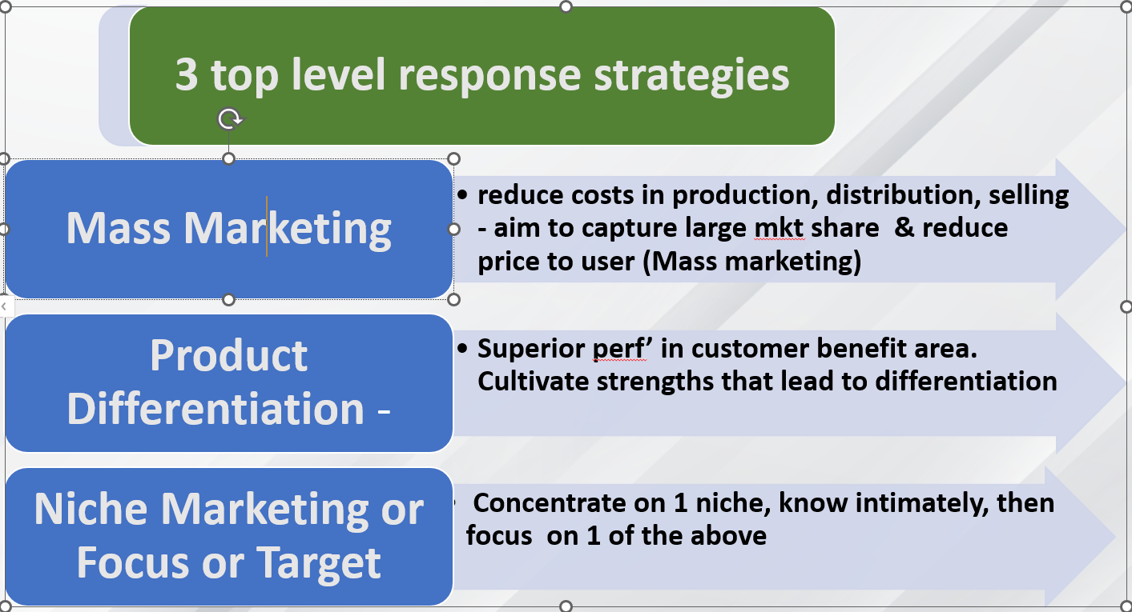
Strategies
www.midocean.ae

Slide 15
1.Mass marketing
Mass, production,distribution,promotion (Model T Ford, Coca-cola, McDonald’s) largest market and lowest costs)
Increasingly difficult to market on the basis of “one size fits all”
Treats all customers as average, customer anonymity, standard product - one way message, less dialogue
Align internal value chain
www.midocean.ae

Slide 16
2. Product differentiated marketing
Define the customer value model
Building the customer value hierarchy
  -Basic, Expected, Desired, Unanticipated
Decide on the customer value package - tangibles and intangibles, in order to outperform competitors
Meeting needs and creating customer satisfaction depends on our understanding of what the customer demands
Think….form, features, quality, image…position relative to demand and the competitive environment, CREATE THE BRAND
Align the internal value chain
www.midocean.ae

Slide 17
Target marketing and niche marketing
Success depends on the ability of the company to define the market and segment it adequately to:
  Position the product relative to the needs and required benefits of segment - value hierarchy
  Definition of the market and segments; size, and the characteristics of demand
Advantages over mass marketing
  Customer profile, customised market offering, two way dialogue, economies of scope
  Ability to ascertain the exact costs of customer acquisition, retention, response to campaigns, customer scoring, cross-selling
www.midocean.ae

Slide 18
Must review the attractiveness of the segment and the company’s objectives and resources
Evaluate then select segment/s that offer opportunity
Position the product relative to the needs and required benefits of segment - value hierarchy
Try to dominate a segment
Opp’ to jump to other segments
www.midocean.ae

Slide 19
Marketing Objectives and Strategy
An objective is what you want to achieve
A strategy is how you plan to achieve your objectives
Marketing objectives about PRODUCT AND MKT ONLY! MKTG objectives about:
  Existing products in existing markets
  New products for existing markets
  Existing products for new markets
  New products for new markets
  MUST BE CAPABLE OF MEASUREMENT - penetrate , increase only accept if quantified!
www.midocean.ae

Slide 20
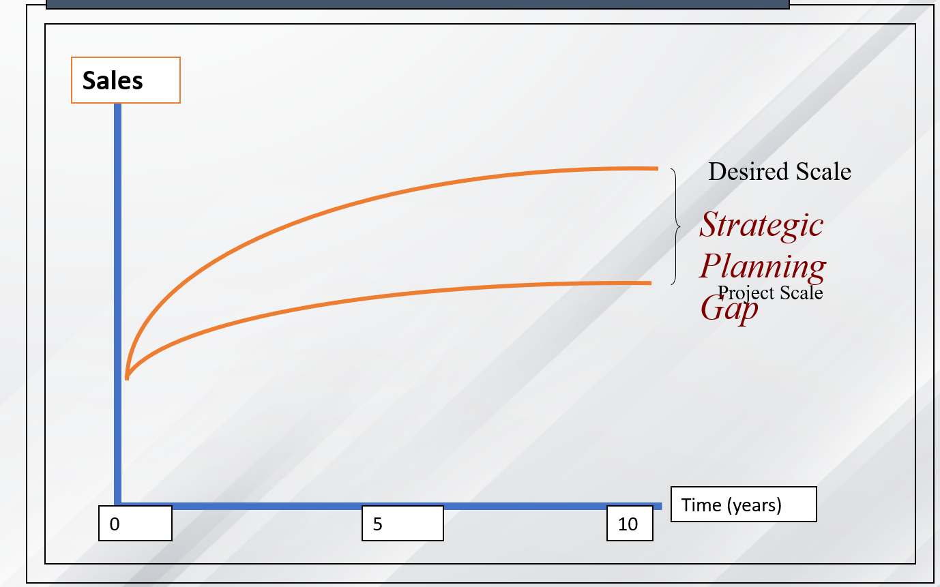
Strategic Objective
www.midocean.ae

Slide 21
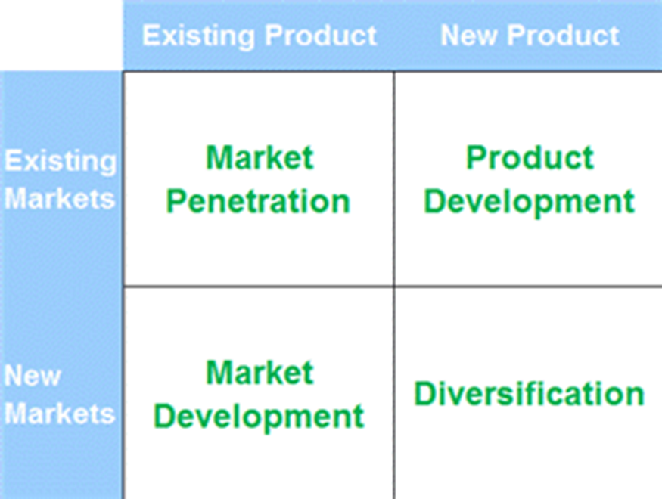
Ansoff’s Matrix - intensive growth strategies
www.midocean.ae

Slide 22
Goal Formulation - marketing plan
Should be arranged in order of importance
Goals should be quantified - top level goal
Market penetration strategy - objectives
To increase our product awareness within target market sectors from 0% to 50% within year 1
To increase our product awareness within target market sectors from 50% to 75% in year 2
  To achieve 12% market share in year 1 = T/O £120,00
  To achieve 25% market share in year 2 = T/O £250,00
  To achieve a net profit margin of 10% in year 1
www.midocean.ae

Slide 23
Goal Formulation - marketing plan
Product Development Strategy- objectives
To develop a new product during year one ready to launch in year 3
To increase awareness of the new product amongst current customer groups from 0-80% in year 2
To sell 10,000 units of the new product
To achieve t/o £350,000 from new product sales
To maintain a gross profit margin of 70%
To achieve a net profit margin of 15%
www.midocean.ae

Slide 24
Goal Formulation - marketing plan
Product Development Strategy- objectives
To develop a new product during year one ready to launch in year 3
To increase awareness of the new product amongst current customer groups from 0-80% in year 2
To sell 10,000 units of the new product
To achieve t/o £350,000 from new product sales
To maintain a gross profit margin of 70%
To achieve a net profit margin of 15%
www.midocean.ae

Slide 25
Goal Formulation - marketing plan
Market development strategy - objectives
To introduce the product within England
To increase awareness of the product within the target area from 5% to 20% within year 2
To attract 10 new customers within this area resulting in sales of £500,000, with an average unit sale value of x
To achieve an overall gross profit margin of 65% on all sales
To maintain a net profit margin of 10%
Goals should be realistic
www.midocean.ae

Slide 26
All strategies demand….
You establish a competitive position for the product relative to the competition
Detail a marketing mix
Achieve strategic fit
Product, service, price, promotion, distribution - relative to the market and competition
www.midocean.ae

Slide 27
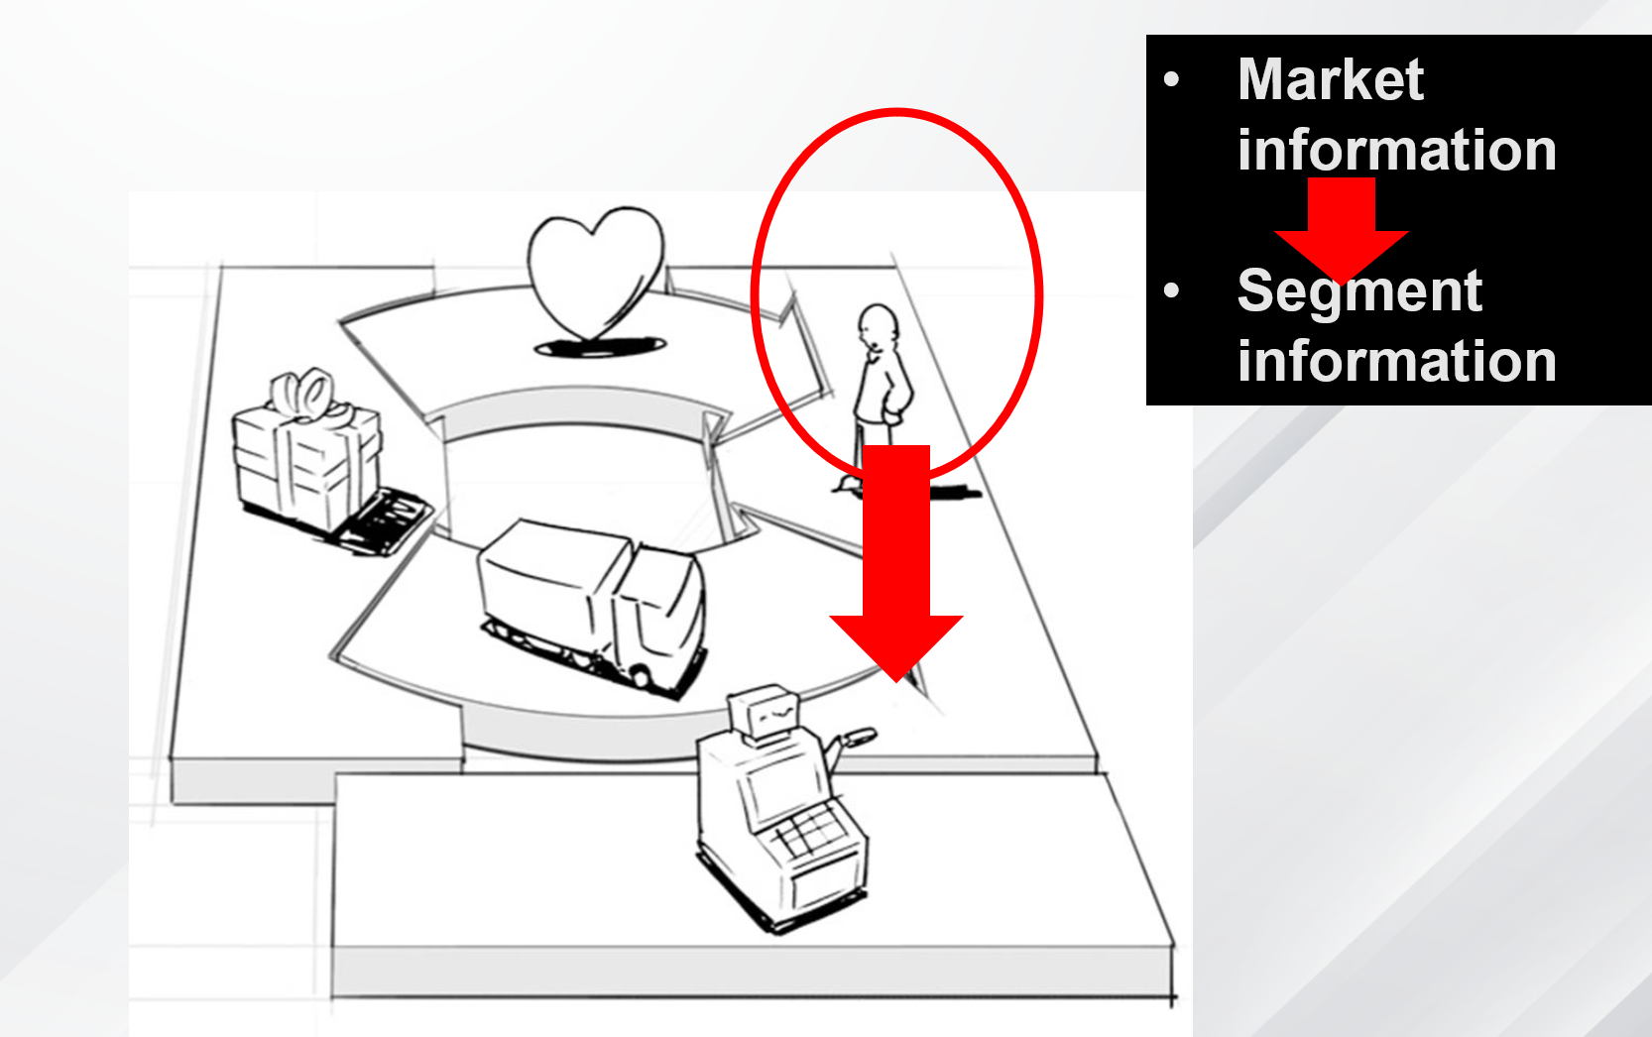
Market info – what’s out there, where do you fit?
Segment info – who are they, why do they buy, how many of them are there to buy!
Sales forecast – who, how, why, how often will inform your sales forecasts
www.midocean.ae

Slide 28
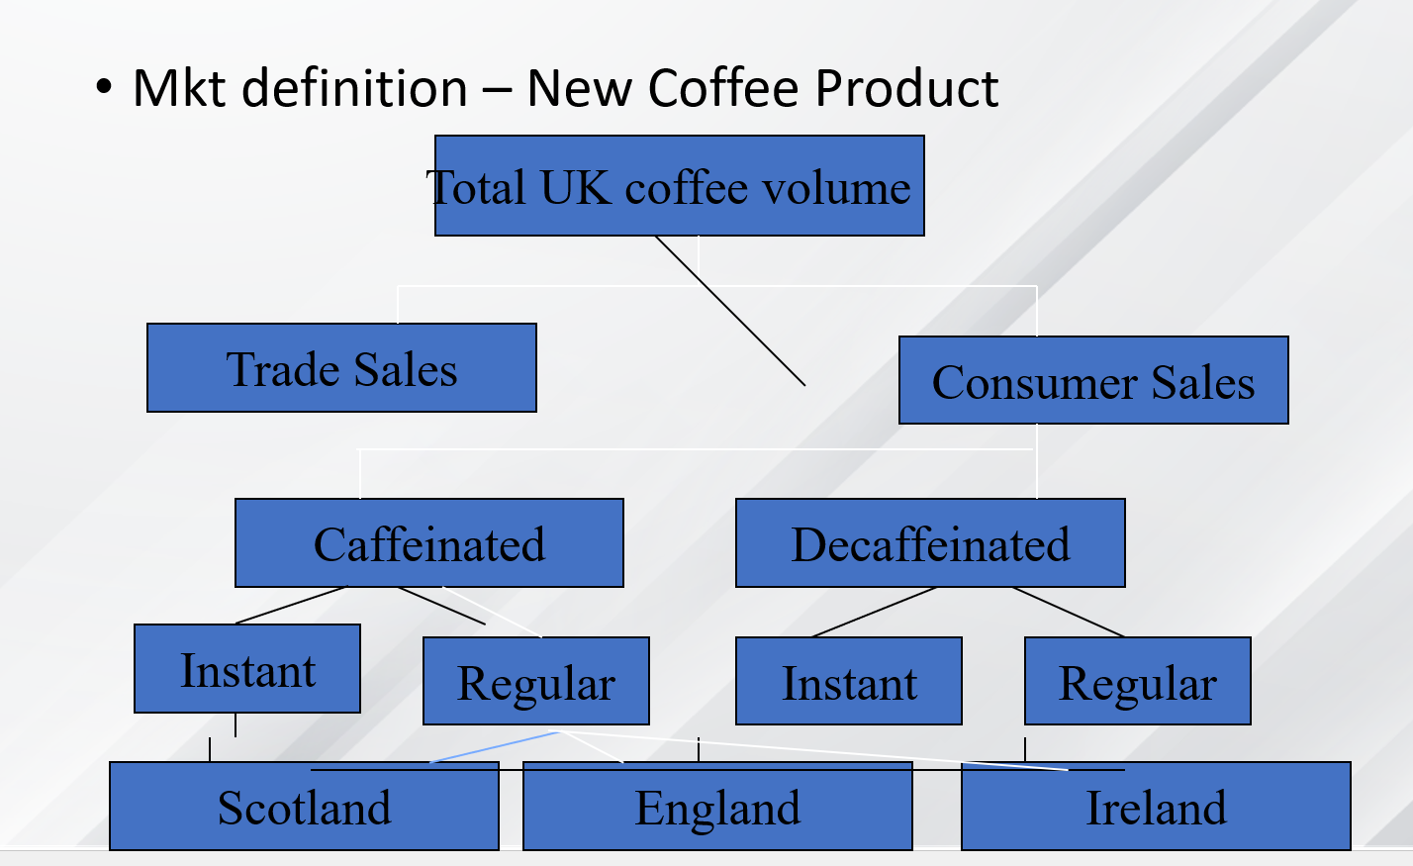
Market Segmentation
www.midocean.ae

Slide 29
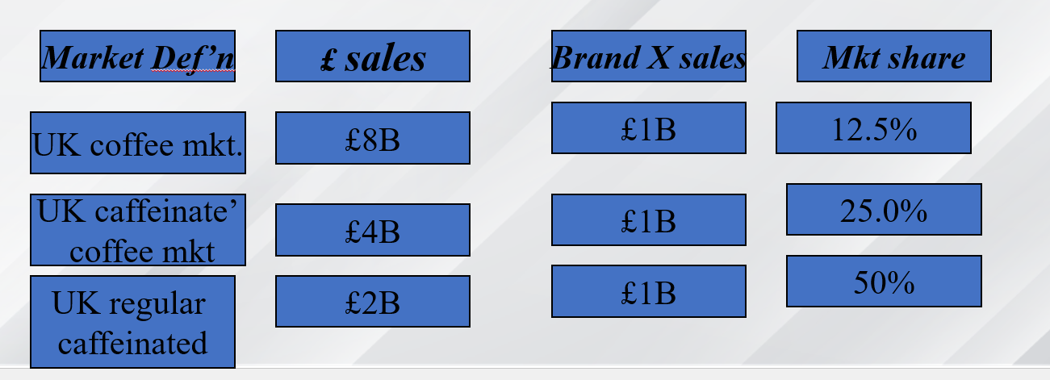
Strategy and segmentation
Identify who is competing in each sector, monitor demand changes for regular caffeinated, geographic preference. Concept of market definition.
Market share becomes meaningful
Defined as the sales of a firm, product or brand divided by the sales of the mkt
www.midocean.ae

Slide 30
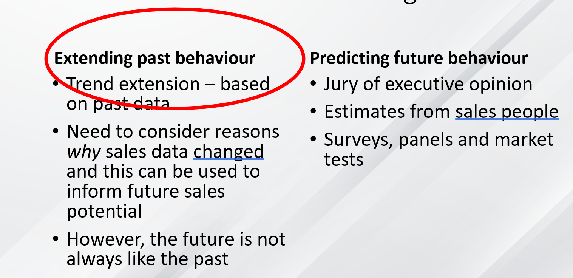
Sales Forecast:
This is where it all comes together
www.midocean.ae

Slide 31
Sales Forecast – Chain Ratio Method
This involves identifying the type of organisations or people who might buy, the number of organisations or people in each type, the proportion of the total number who actually will buy, and the consumption rate. In other words:
Market potential = Number who might buy
* Proportion who will buy
* Consumption rate
www.midocean.ae

Slide 32
Chain Ratio Method
Market Potential for Diet Bourbon in NZ
= population over 20 (2,000,000)
*proportion who drink Coca (5% 100,000)
* proportion who are diet conscious (10%) 10,000
* proportion who will buy diet Coca (80% 10,000)
* purchase rate, (10 bottles per year, 80,000 bottles)
Remember new product and will take time to achieve this
www.midocean.ae

Slide 33
But when will we break even?
This depends on your sales forecast
  Marketing activity
  Seasonality
  Promotional plans
  Production capacity
www.midocean.ae

Slide 34
The marketing plan – contents
Marketing audit
  External audit - PEST, Competitive analysis (OT)
  Internal audit - Internal Operations, market and marketing audit (ST)
Strategy
Intensive growth strategies
Marketing mix variables PLAN FOR EACH
  Product
  Price
  Promotion
  Place
www.midocean.ae

Slide 35
Positioning the product or service (old term USP)
Positioning is the act of designing the company’s offering and image to occupy a distinctive place in the target market’s mind
“Positioning starts with a product. A piece of merchandise, a service, a company even a person. Positioning is not what you do to a product. Positioning is what you do to the mind of a prospect”
Product strategy
Pricing strategy
Promotion
Distribution (Place)
www.midocean.ae

Slide 36
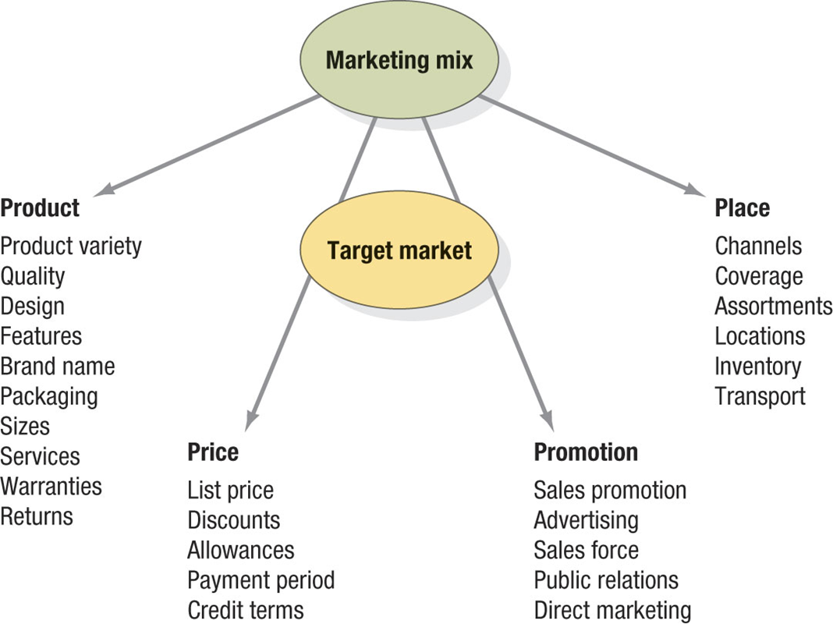
Operational marketing management
www.midocean.ae

Slide 37
Product- development, range quality
Is the concept clear and easy to understand?
  What are the benefits of the offering to the market/ segment?
Is there a some distinct benefit of this product over compet’?
  How does it comply with the customer value hierarchy?
How is the product positioned in terms of price and quality
  Can it be tried on a limited basis?
What has shaped demand in the past and likely to affect it in the future? (market trends and forecasts)
  Which are most profitable, consistent with resources, overall strategy?
  Product development and introduction plans
www.midocean.ae

Slide 38
Pricing - Establishing the most attractive and profitable price
Approaches
Premium
Cost +
Penetration
Going rate pricing
Sealed-bid pricing
Consider the psychology of pricing!
Price = quality?
Cash discounts, quantity discounts, seasonal discounts
www.midocean.ae

Slide 39
Communication process
Attention ‘/ awareness
Interest
Desire / evaluation
Action
Execution sales
www.midocean.ae

Slide 40
Promotion - Creating awareness and demand
Four types
Advertising - above the line and below the line- any paid form of non personal promotion of ideas, goods etc
Sales promotion - short term incentives to encourage sales of the product
Publicity - Non personal stimulation demand, obtaining favourable presentation TV radio, social networks
Personal selling- Oral presentation for the purposes of making sales
www.midocean.ae

Slide 41
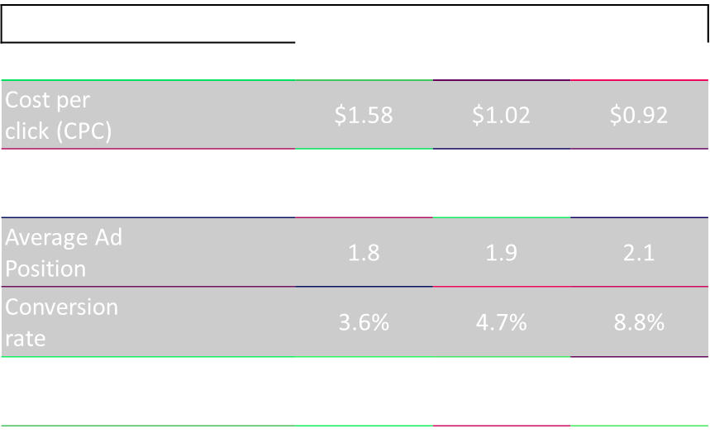
Internet advertising – Google adwords
www.midocean.ae

Slide 42
Websites
Web site must be clear.
Easy to understand.
Easy to use – e.g., quick downloads.
Experience must be good.
‘E-INFRASTRUCTURE’
        Security
        Reliability (eg. time, quality)
        Reliability of any ‘chain’ associates eg. suppliers, manufacturers
www.midocean.ae

Slide 43
  Trade Shows – New Toy
  Promotional activity =Trade Show (detail cost)
  Visits to stand, aim to collect 100 email addresses, email follow up results in calls to 50 potential business customers. 10% immediately interested, but allow 30 days for negotiation, 3 sales 2 months after the show, continue following up, results in10 further sales.
www.midocean.ae

Slide 44
Place - decisions based on markets to be reached and objectives
Distribution decisions
Direct to buyer
Middle man - wholesaler
Distributor
Retail outlet
Geography - transportation costs
Type of supporting promotion
Logistics
Proportion of sales from each channel - include the rational for channel selection
www.midocean.ae

Slide 45
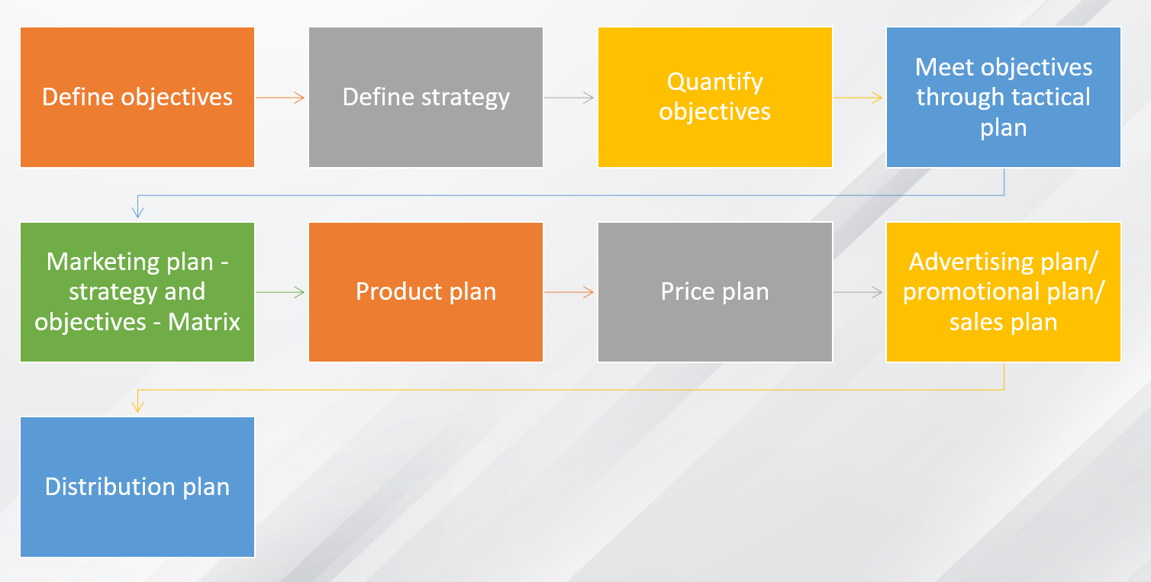
Summary
www.midocean.ae

Slide 46



Thank You

