Slide 1

Project Time Management
Prepared by Dr. Nael Zabel
Lecture 10
PMG 212
Resource Loading

Slide 2

Lecture 10
Agenda
Resource Loading
What is Resource Loading in Projects
Why use Resource Loading?
Resource Loading Benefits
Resource Loading Process
Baseline, Current, and Forecast Schedule Discipline
Schedule Analysis
Resource Leveling versus Resource smoothing
Estimate Cost Techniques

Slide 3
Lecture 10
Agenda
Resource Loading
What is Resource Loading in Projects
Why use Resource Loading?
Resource Loading Benefits
Resource Loading Process
Baseline, Current, and Forecast Schedule Discipline
Schedule Analysis
Resource Leveling versus Resource smoothing
Estimate Cost Techniques

Slide 4

Lecture 10
Resource Loading
What is resource scheduling?
Why do we use it?
How does it work?

Slide 5
Lecture 10
Agenda
Resource Loading
What is Resource Loading in Projects
Why use Resource Loading?
Resource Loading Benefits
Resource Loading Process
Baseline, Current, and Forecast Schedule Discipline
Schedule Analysis
Resource Leveling versus Resource smoothing
Estimate Cost Techniques

Slide 6
Lecture 10
What is Resource Loading in Projects
People, equipment, money, space, bulks...
It defines which resources should be utilized on specific tasks - between which dates.

Slide 7
Lecture 10
Agenda
Resource Loading
What is Resource Loading in Projects
Why use Resource Loading?
Resource Loading Benefits
Resource Loading Process
Baseline, Current, and Forecast Schedule Discipline
Schedule Analysis
Resource Leveling versus Resource smoothing
Estimate Cost Techniques

Slide 8
Lecture 10
Why use Resource Loading?
Produce more realistic schedules
Produce progress & resource curves
Comply with client requirements
Analytically manage and use schedule float
Analyze staffing requirements
Evaluate effects of limited staffing
Avoid wide fluctuations in daily need for various resources (leveling)

Slide 9
Lecture 10
Agenda
Resource Loading
What is Resource Loading in Projects
Why use Resource Loading?
Resource Loading Benefits
Resource Loading Process
Baseline, Current, and Forecast Schedule Discipline
Schedule Analysis
Resource Leveling versus Resource smoothing
Estimate Cost Techniques

Slide 10
Lecture 10
Resource Loading Benefits
Helps maximize utilization of resources
Produces realistic start/finish dates
Avoids peaks and valleys in staff
Helps in scheduling constrained resources
Good resource scheduling is the basis for maximizing the productivity of people and equipment while minimizing their cost.

Slide 11
Lecture 10
Resource Loading
ACTIVITY A
TF = O
ACTIVITY B
TF = 45
Competing for the same resource at the same time.
Activity with the least TF is scheduled first

Slide 12
Lecture 10
Agenda
Resource Loading
What is Resource Loading in Projects
Why use Resource Loading?
Resource Loading Benefits
Resource Loading Process
Baseline, Current, and Forecast Schedule Discipline
Schedule Analysis
Resource Leveling versus Resource smoothing
Estimate Cost Techniques

Slide 13
Lecture 10
Resource Loading Process
Budget Estimate
Engineering
Job hours
Drawings
Construction
Job hours
Quantities
PROJECT SCHEDULE
Engineering
Procurement
Construction

Slide 14
Lecture 10
Agenda
Resource Loading
What is Resource Loading in Projects
Why use Resource Loading?
Resource Loading Benefits
Resource Loading Process
Baseline, Current, and Forecast Schedule Discipline
Schedule Analysis
Resource Leveling versus Resource smoothing
Estimate Cost Techniques

Slide 15
Lecture 10
Baseline, Current, and Forecast
Schedule Discipline
Baseline Schedule
  Represents the approved project plan
  Contains project execution activities, logic, and budget resources
  Provides the means for measuring actual project progress against the plan
Revised Baseline Schedule
  The Baseline Schedule with updates for Schedule Change Notices (approved scope changes and Project Manager approved changes in the execution plan)

Slide 16
Lecture 10
Baseline, Current, and Forecast
Schedule Discipline
Current/Forecast Schedule
  Presents the actual progress of the project
  Includes projections

Slide 17
Lecture 10
Agenda
Resource Loading
What is Resource Loading in Projects
Why use Resource Loading?
Resource Loading Benefits
Resource Loading Process
Baseline, Current, and Forecast Schedule Discipline
Schedule Analysis
Resource Leveling versus Resource smoothing
Estimate Cost Techniques

Slide 18
Lecture 10
Schedule Analysis
Is the project on schedule?
  What activities are ahead or behind schedule?
  What impact will to-date poor or good productivity have on the to-go portion of schedule?
  Has the execution plan or work process changed?

Slide 19
Lecture 10
Schedule Analysis
What is the critical path?
  Has it changed from the baseline?
What are the means to recover the schedule?
  What are the resource requirements?
  What will it cost?

Slide 20
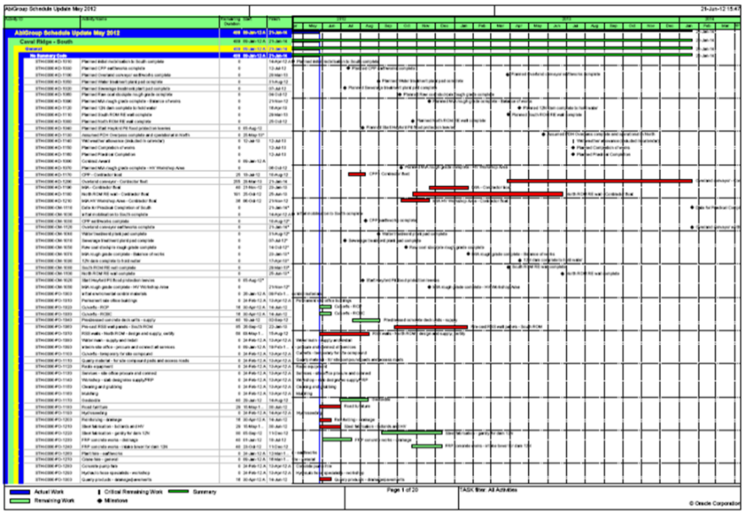
Lecture 10
Schedule Analysis Methods and Tools
Critical path analysis
  Changes to the primary critical path and key milestones
  Impact on near critical path
Float analysis
  Impact on overall schedule (total and free float)

Slide 21
Lecture 10
Agenda
Resource Loading
What is Resource Loading in Projects
Why use Resource Loading?
Resource Loading Benefits
Resource Loading Process
Baseline, Current, and Forecast Schedule Discipline
Schedule Analysis
Resource Leveling versus Resource smoothing
Estimate Cost Techniques

Slide 22
Lecture 10
Resource Leveling versus Resource smoothing
Resource leveling – This is used when scheduling the production of available resources is limited and needs to be used optimally.
Resource smoothing – This is used when time constraints are the biggest factor blocking production.

Slide 23
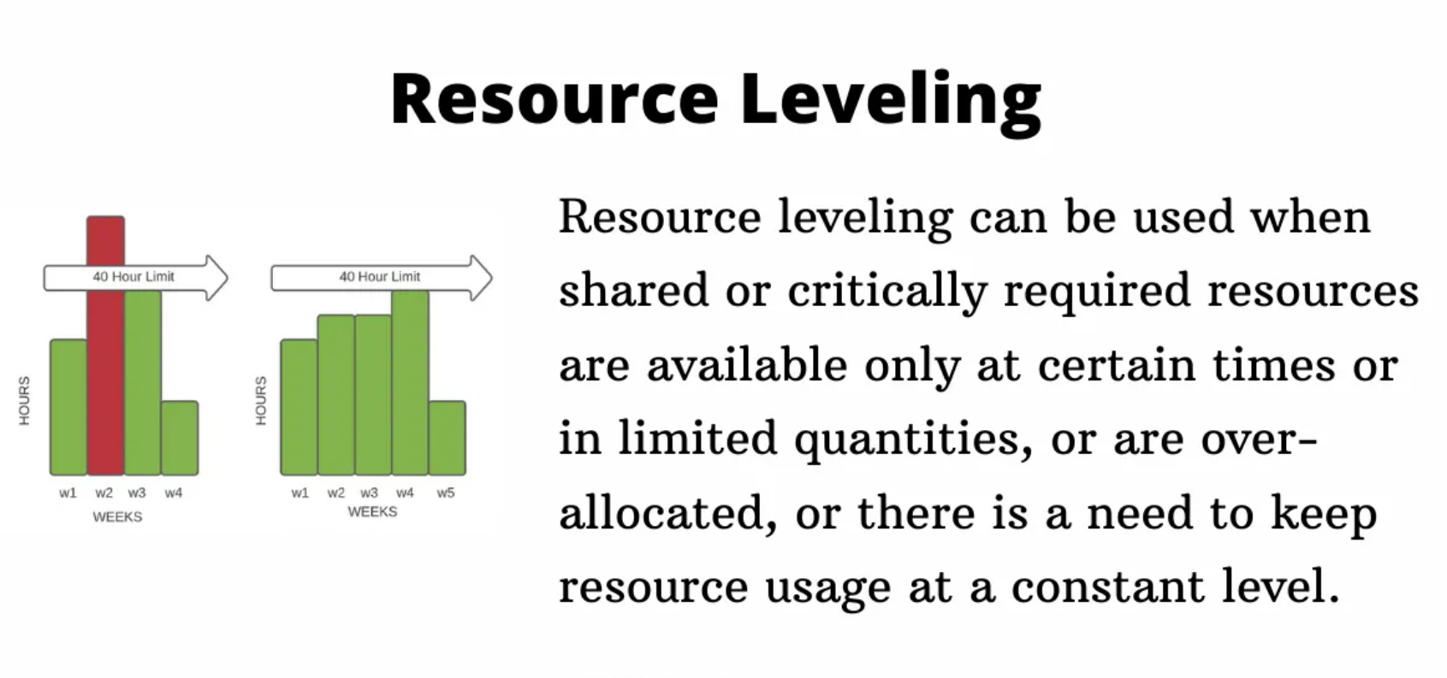
Lecture 10
Resource Loading

Slide 24
Lecture 10
Agenda
Resource Loading
What is Resource Loading in Projects
Why use Resource Loading?
Resource Loading Benefits
Resource Loading Process
Baseline, Current, and Forecast Schedule Discipline
Schedule Analysis
Resource Leveling versus Resource smoothing
Estimate Cost Techniques

Slide 25
Lecture10
Estimate Cost Techniques
Three-Point Estimates
  Triangular Distribution.
    cE = (cO + cM + cP) / 3
  Beta Distribution (from a traditional PERT analysis).
    cE = (cO + 4cM + cP) / 6
  Standard Deviation = (Pessimistic-optimistic) / 6

Slide 26
Lecture10
Estimate Cost Techniques
Earned Value Management (EVM) is a methodology that combines scope, schedule, and resource measurements to assess project performance and progress.
EVM can be used for analysis of cost and schedule baselines
Earned Value Management is carried out using the three main inputs:
Planned Value (PV)
Earned Value (EV)
Actual Cost (AC)

Slide 27
Lecture10
Earned Value Analysis
The earned value (EV), is a measure widely used in construction,
Earned Value Management (EVM) is a technique for calculating the 'percent complete' of a control account.
"Earned Value Analysis" is an industry standard way to:
• measure a project's progress,
• forecast its completion date and final cost,
• provide schedule and budget variances.

Slide 28
Lecture10
EVM Three Main Measurements
By integrating three measurements, it provides consistent, numerical indicators with which you can evaluate and compare projects.
Planned Value (PV) = Hourly Rate × Total Hours Planned
Actual Cost (AC) = Paid Hourly Rate x Actual Hours
Earned Value (EV) = Total value of work done = (Project value) x (% Completed)
EVM can measure VARIANCE and PERFORMANCE INDEX

Slide 29
Lecture10
Basic EVM Formulas
EVM is based on monitoring three aspects along the project in order to reveal the health of the project with the following indices:
(example of building 10 houses each has a value of US$10,000 expected to be completed in 10 Months in proportion):
Planned Value (PV) — The budgeted value of the work completed so far at a specific date
example: at end of Month 4, altogether 4 houses should be completed, the PV is US$40,000
Earned Value (EV) — The achieved value of the work completed so far at a specific date
example: by end of Month 4, only 3 houses are completed, the EV is US$30,000
Actual Cost (AC) — The total expenditure for the work so far at a specific date
example: by end of Month 4, $35,000 was spent, the AC is $35,000

Slide 30
Lecture10
Schedule and Cost Variance
Schedule Variance (SV) — difference between PV and EV, to tell whether the project work is
ahead of / on / behind schedule
  SV = EV – PV
  If the project is behind schedule the SV will be negative (i.e. achieved less than what planned)
  If the project is on schedule the SV = 0
  If the project is ahead of schedule the SV will be positive (i.e. achieved more than what planned)
  example: by end of Month 4, the SV = EV – PV = US$30,000 – US$40,000 = -US$10,000 (behind schedule)

Slide 31
Lecture10
Schedule and Cost Variance
Cost Variance (CV) — difference between PV and AC, to tell whether the project work is
under / on / over budget
  CV = EV – AC
  If the project is over budget the CV will be negative (i.e. achieved less than spent)
  If the project is on budget the CV = 0
  If the project is under budget the CV will be positive (i.e. achieved more than spent)
  example: by end of Month 4, the CV = EV – AC = $30,000 – $35,000 = - $5000 (over budget)

Slide 32
Lecture10
Schedule and Cost Performance Index
Schedule Performance Index (SPI) — ratio between EV and PV, to reflect whether the project work is ahead of / on / behind schedule in relative terms
  SPI = EV/PV
  If the project is behind schedule the SPI < 1 (i.e. achieved less than what planned)
  If the project is on schedule the SPI = 1
  If the project is ahead of schedule the SPI > 1 (i.e. achieved more than what planned)
  example: by end of week 4, the SPI = EV/PV = US$30,000/US$40,000 = 0.75 (behind schedule)

Slide 33
Lecture10
Schedule and Cost Performance Index
Cost Performance Index (CPI) — ratio between EV and AC, to reflect whether the project work is
under / on / over budget in relative terms
  CPI = EV/AC
  If the project is over budget the CPI < 1 (i.e. achieved less than spent)
  If the project is on budget the CPI = 1
  If the project is under budget the CPI > 1 (i.e. achieved more than spent)
  example: by end of week 4, the CPI = EV/AC = $30,000/ $35,000 = 0.86 (over budget)
Note both SV and SPI / CV and CPI give similar information on schedule / budget but the indices will give more insights into the actual performance with a meaning comparison.

Slide 34
Lecture 10
Thank You

