Slide 1

Understanding Leadership
Chapter 3
Everyone’s Smart
University
PMG511
Project Leadership
Dr.Sara Adel

Slide 2


Learning Outcomes:
3.1 The Leader’s Title.
3.2 Leadership Styles:
  Describe 7 basic leadership styles.
3.3 Who We Lead:
  Define 'stakeholder' in the context of a project effort.
3.4 Matching Leadership with Culture:
  Define ‘culture’ in the context of a project, team, and organization.
3.5 Summary and Conclusions.
3.6 Self assessment.
Dr.Sara Adel
Notes:
Corresponds to chapter 2, pages 25-77 of the Project Team Leadership and Communication book. ISBN: 9781732378902 (Softcover), 9781732378919 (Hardcover). These slides may only be posted or used in conjunction with the book in a training or classroom environment. Key terms (pages 74-75) are often italicized on the slides.
Outline:
What is a Project
Project Phases
Project Functions
Projects can Vary in Size and Scale
Organizational Structures
Functional
Project-Focused
Matrix
Organizational Values and Needs
Process
Plan-focused model
Cyclical model
Change-focused model
Quality
Project Quality
Product and Process Quality
Quality as a Balancing Act
The Project Triangle
Project Outcomes (The Layered Approach)
Goals, Scope Statements, Requirements/Specifications
Project Kickoff Meeting
Project Plan
Summary and Conclusion
Learning Objectives
2.1 What is a Project?
Define 'project,' identifying 2 defining features
List 4 project phases and 1 additional element
Recognize the interactions between projects/phases and the product lifecycle
2.2 The Project Environment
Identify 3 types of organizations in the context of how projects are organized
Recognize strengths and weaknesses of each of the 3 organizational types
2.3 Values, Needs, and Process
Recall factors influencing the values and needs of a project, team, or organization
List 3 fundamental process models and summarize the strengths and weaknesses of each
Recognize varying levels of detail/abstraction in documented processes
2.4 Quality and The Project Triangle
Define 'quality,' identifying 4 main aspects/concerns
Give examples of elements that are 'cost of quality' and 'cost of poor quality' in a project
Label the project triangle's 4 components
Relate examples of each project triangle component and the relationships between them
2.5 Defining Project Outcomes: A Layered Approach
Relate the concept of project goals, including examples of such
Relate the concept of project scope statements, including examples of such
Relate the concept of project requirements/specifications, including examples of such
Describe ‘the layered approach’ to project outcome definition
2.6 The Project’s Early Stages
Identify the primary objectives of a project kickoff meeting
List the essential elements of a basic project plan
2.7 Chapter Tool: Planning Project Quality
Relate basic steps for determining a project’s quality objectives
Associated Class Activities: (Separate Slides)
One Product, Multiple Projects (10 minutes, section 2.1)
Propose multiple projects within a single product’s life cycle
Organizational Culture and Structure (10 minutes, sections 1.5 and 2.2)
Analyze the cultural norms and organizational structures of multiple industries
‘Rolling Your Own’ Process (10-15 minutes, section 2.3)
Analyze a scenario and construct a basic process
Understanding Quality (10-15 minutes, section 2.4)
Develop scenario-specific quality-related elements of consideration
Layering Project Outcomes (10-15 minutes, section 2.5)
Construct scenario-specific goals, scope statements, and specifications/requirements
Outlining the Project Plan (10-15 minutes, section 2.6)
Design a project plan outline

Slide 3
1.3-The Leader’s Title
Dr.Sara Adel

Slide 4


1.3 The Leader’s Title
Leader can have many titles, he can be a manager, supervisor, boss, CEO, Expert, Foreman, Monitor.
Understand that title isn't synonymous with the need or authority to engage in leadership.
It is a sit of words that supposed all correlated to actual duties of jobs.
The actual title can affect perceptions.
Dr.Sara Adel
Notes:
Corresponds to section 1.1, page 2 of the Project Team Leadership and Communication book.
The word leadership evokes:
Responsibility
Burden
Honor
Duty
Calling
Ability
The book includes a 2-minute exercise on page 2 entitled: What’s in a Name?

Slide 5
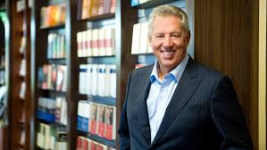
“Leadership is not about titles, positions or flowcharts. It is about one life influencing another.” - John C. Maxwell
Dr.Sara Adel
Notes:
Corresponds to chapter 1, pages 1-23 of the Project Team Leadership and Communication book. ISBN: 9781732378902 (Softcover), 9781732378919 (Hardcover). These slides may only be posted or used in conjunction with the book in a training or classroom environment. Key terms (page 21) are often italicized on the slides.
Outline:
Job Titles
Leadership Styles
Affiliative
Authoritarian / Commanding / Autocratic
Coaching
Democratic
Laissez-faire
Pacesetting
Transformational / Visionary
Influence
Types
Motivators
Extrinsic
Intrinsic
Organizational Culture
Stakeholders (“Who we lead”)
Project Management
The Discipline
Ethics
Summary and Conclusions
Learning Objectives:
1.1 The Leader’s Title
Understand that title isn't synonymous with the need or authority to engage in leadership
1.2 Leadership Styles
Describe 7 basic leadership styles
Recognize the importance of choosing an appropriate style
Identify common pitfalls related to appropriate leadership styles
1.3 Influence
Describe 5 types of influence
Recognize personal preferences and their relationship to influence
1.4 Motivators
Describe 6 types of motivators and give examples of each
Classify the 6 motivators as extrinsic or intrinsic
Relate biases individuals may have towards or against individual motivators
1.5 Matching Leadership with Culture
Define ‘culture’ in the context of a project, team, and organization
Recognize contexts that affect and are affected by culture
1.6 Who We Lead
Define 'stakeholder' in the context of a project effort
Identify 3 common groups of project stakeholders
1.7 The Discipline of Project Management
Relate the various leadership titles and the field of project management
Describe several aspects of professional discipline and ethics
1.8 Chapter Tool: Who We Are as Leaders
Examine individual preferences relating to motivators, influence, and previous project experience
Associated Class Activities: (Separate Slides)
Applying Leadership Styles (5 minutes, section 1.2)
Recommend basic leadership styles for basic team scenarios
Professionalism and Ethics (10-15 minutes, sections 1.1 and 1.7)
Compare leadership titles and relate ethical challenges each might face
Matching Influence to Leadership (5-10 minutes, sections 1.2 and 1.3)
Decide which type of influence is appropriate / inappropriate for multiple leadership styles
Your Motivators (5-10 minutes, section 1.4)
Contrast types of motivators and relate individual preferences
Who We Are As Leaders (15 minutes, section 1.9)
Analyze individual and group preferences relating to motivators, influence, and stakeholder experiences

Slide 6

The idea of team leadership is broken down into its digestible components:
Leadership styles.
Leadership theories.
Influences.
Motivators.
Influences on organizational team performance.
Culture.
Understanding of who is being led.
Dr.Sara Adel
Notes:
Corresponds to section 1.1, page 2 of the Project Team Leadership and Communication book.
The word leadership evokes:
Responsibility
Burden
Honor
Duty
Calling
Ability
The book includes a 2-minute exercise on page 2 entitled: What’s in a Name?

Slide 7
2.3 Leadership Styles
Dr.Sara Adel

Slide 8
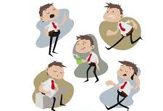
The early studies of leadership:
Researchers began studying leadership in the early part of the twentieth century and focused on the:
  The person (leader trait theories).
  The behaviors–how the leader interacted with his or her group members (behavior theories).
Early leadership theories focused on what qualities distinguished between leaders and followers, while subsequent theories looked at other variables such as situational factors and skill level.
Dr.Sara Adel

Slide 9
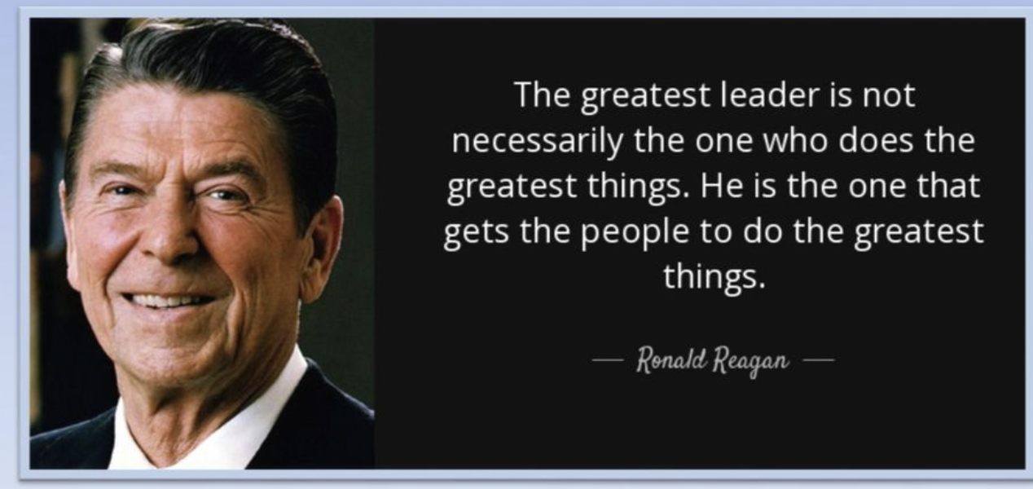
Dr.Sara Adel

Slide 10

Leadership Styles
People as a leader adopt different styles.
Leadership style should be chosen based on the team’s features, what they are trying to achieve.
Leaders have a ‘default’ style they prefer:
  This may not be appropriate for their team.
  Stress or circumstances can cause leaders to choose or revert to the wrong style.
There are (7 main styles covered here).
Dr.Sara Adel
Notes:
Corresponds to section 1.2, pages 2-5 of the Project Team Leadership and Communication book.
The next 7 slides are the styles:
Affiliative
Authoritarian / Commanding / Autocratic
Coaching
Democratic
Laissez-faire
Pacesetting
Transformational / Visionary

Slide 11
1.Affiliative Leadership Style
(people come first)
Dr.Sara Adel

Slide 12

1- Affiliative Leadership Style
Is one of 7 styles of Emotional leadership and promotes positivity, a harmonious workplace and team-building.
This leadership style focuses on conflict resolution and creating personal connections between employees and their managers to build a sense of community and trust.
Dr.Sara Adel
Notes:
Corresponds to page 3 of the Project Team Leadership and Communication book.
Emphasis is either on harmony or productivity, focus is on the leader, team, or individual.
The Affiliative Leadership Style emphasizes harmony and focuses on the team.

Slide 13
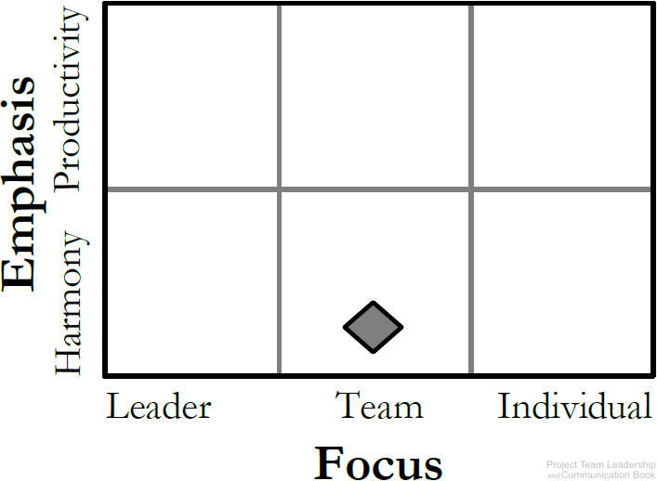
Affiliative Leadership Style (cont.)
The type of leadership a manager chooses to affect the emotional, mental and physical health of his team. Whether this effect is positive or negative.
Affiliative leadership is one of many styles of leadership that positively impacts employees.
It is Good for teams in need of a morale boost (team need to repair).
Dr.Sara Adel
Diagram: Malachowsky, Samuel. Project Team Leadership and Communication. Lintwood Press. 2018. p. 3.
Goleman, Daniel. Primal Leadership: Realizing the Power of Emotional Intelligence. Boston, Mass. :Harvard Business School Press, 2002.
Notes:
Corresponds to page 3 of the Project Team Leadership and Communication book.
Emphasis is either on harmony or productivity, focus is on the leader, team, or individual.
The Affiliative Leadership Style emphasizes harmony and focuses on the team.

Slide 14

Affiliative Leadership Style (cont.)
Pros:
This style Emphasizes connection, harmony, and conflict resolution.
It is Good for teams in need of a morale boost (team need to repair).
Creates effective teams.
It Increase employee morale.
It Builds employee trust.
It Provides guidance during crises.
It Resolves conflicts more efficiently.
It Reduces workplace stress.
Dr.Sara Adel
Notes:
Corresponds to page 3 of the Project Team Leadership and Communication book.
Emphasis is either on harmony or productivity, focus is on the leader, team, or individual.
The Affiliative Leadership Style emphasizes harmony and focuses on the team.

Slide 15

Affiliative Leadership Style (cont.)
Cons:
Can be abused. (too much Affiliative Style can become the disease-to-please).
Stuff may not receive enough advice.
Allow under-performers to go unchecked.
Ineffective when faced with complex challenge.
“Affiliative is really about letting people get to know you, and you making an effort to get to know them.”
Dr.Sara Adel
Notes:
Corresponds to page 3 of the Project Team Leadership and Communication book.
Emphasis is either on harmony or productivity, focus is on the leader, team, or individual.
The Affiliative Leadership Style emphasizes harmony and focuses on the team.

Slide 16
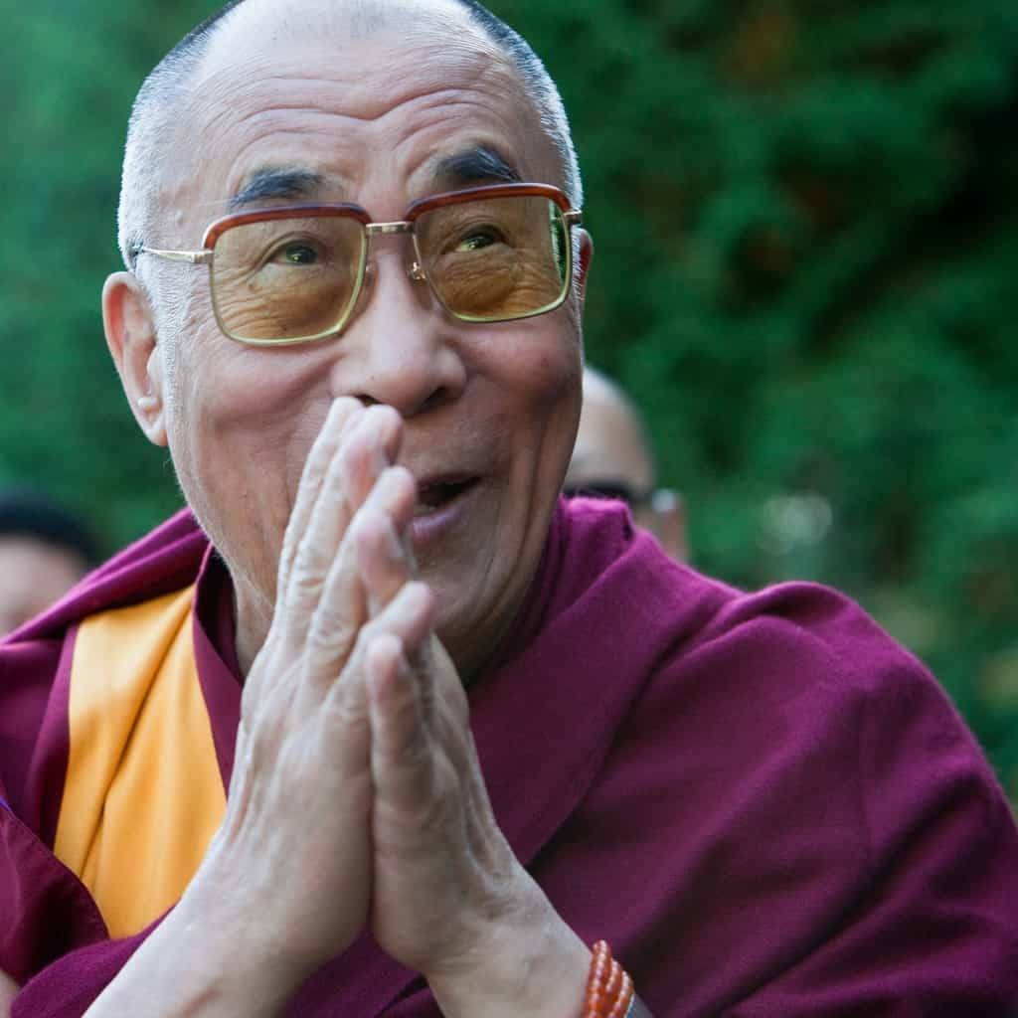
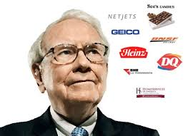
Dalai Lama
Warren Buffett
Dr.Sara Adel

Slide 17
2. Authoritarian / Commanding / The Boss/Autocratic Leadership Style
Dr.Sara Adel

Slide 18

2-Authoritarian / Commanding / Autocratic Leadership Style
Is centered on the boss. the leader holds all authority and responsibility.
The leader centralizing decision making, and limiting participation.
leaders make decisions on their own without consulting subordinates. They reach decisions, communicate them to subordinates and expect prompt implementation.
One of the famous examples for an authoritarian is of Napoleon Bonaparte and Hitler.
Dr.Sara Adel
Notes:
Corresponds to page 3 of the Project Team Leadership and Communication book.
Emphasis is either on harmony or productivity, focus is on the leader, team, or individual.
The Authoritarian / Commanding / Autocratic Leadership Style focuses heavily on the leader.

Slide 19
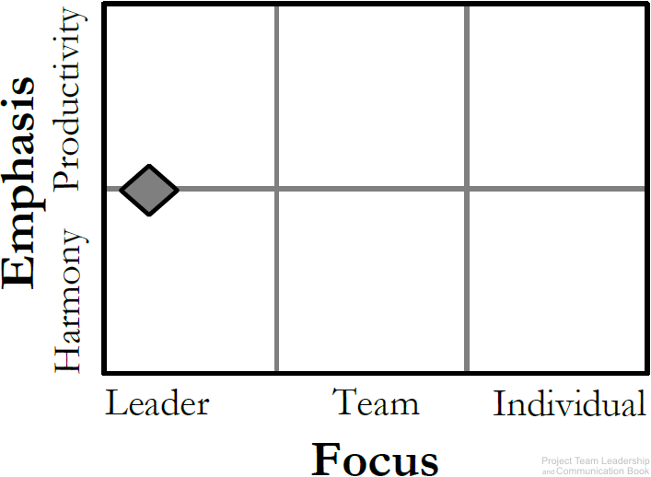
2-Authoritarian / Commanding / Autocratic Leadership Style (Cont.)
Leaders like this can achieve results and productivity quickly.
Best applied to situations where there is little time for group decision-making or where the leader is the most knowledgeable member in the group.
Dr.Sara Adel
Diagram: Malachowsky, Samuel. Project Team Leadership and Communication. Lintwood Press. 2018. p. 3.
Goleman, Daniel. Primal Leadership: Realizing the Power of Emotional Intelligence. Boston, Mass. :Harvard Business School Press, 2002.
Notes:
Corresponds to page 3 of the Project Team Leadership and Communication book.
Emphasis is either on harmony or productivity, focus is on the leader, team, or individual.
The Authoritarian / Commanding / Autocratic Leadership Style focuses heavily on the leader.

Slide 20
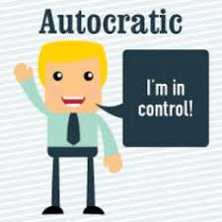
2-Authoritarian / Commanding / Autocratic Leadership Style (Cont.)
Pros:
Leaders like this can achieve results quickly.
Quick decision making.
Focused target.
Close supervision.
Maintain order and disciple.
Good for emergencies/crisis situations.
Dr.Sara Adel
Notes:
Corresponds to page 3 of the Project Team Leadership and Communication book.
Emphasis is either on harmony or productivity, focus is on the leader, team, or individual.
The Authoritarian / Commanding / Autocratic Leadership Style focuses heavily on the leader.

Slide 21
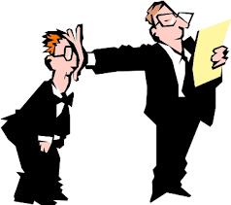
2-Authoritarian / Commanding / Autocratic Leadership Style (Cont.)
Cons:
Classic’ leadership structure.
Strong, dominating leader(s).
Can cause poor morale if teams aren’t used to it.
High stress, members feel stressed due to high expectation.
Group doesn't pick up from innovativeness and information of individuals, so benefits of collaboration are lost.
Dr.Sara Adel
Notes:
Corresponds to page 3 of the Project Team Leadership and Communication book.
Emphasis is either on harmony or productivity, focus is on the leader, team, or individual.
The Authoritarian / Commanding / Autocratic Leadership Style focuses heavily on the leader.

Slide 22
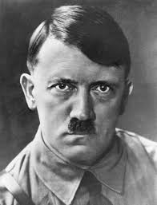
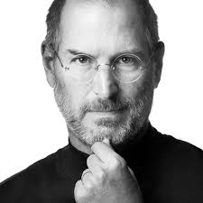
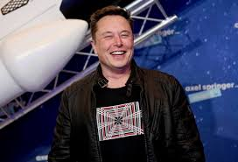
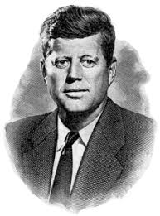

Dr.Sara Adel

Slide 23
3-Coaching Leadership Style
Dr.Sara Adel

Slide 24
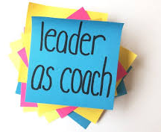
3-Coaching Leadership Style
• Coaching leadership involves teaching and supervising followers.
A coaching leader is highly operational in setting where results/ performance require improvement.
Basically, in this kind of leadership, followers are helped to improve their skills.
coaching leadership does the following: motivates followers, inspires followers and encourages followers.
A coaching leader is A great mentor is a pioneer who also has a remarkable ability to instruct and train.
They prep individuals to enhance both information and skills. (build the skills of others).
Dr.Sara Adel

Slide 25
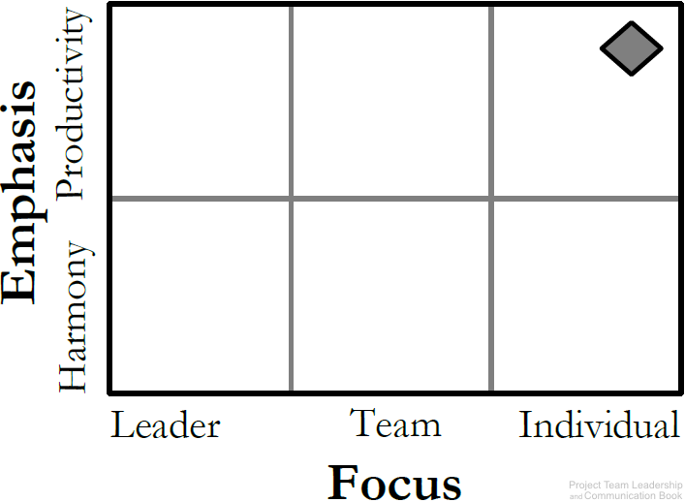
Coaching Leadership Style (Cont.)
About connecting the goals and productivity of the team/project with individuals.
Best for teams who have the desire to succeed and are motivated.
Dr.Sara Adel
Diagram: Malachowsky, Samuel. Project Team Leadership and Communication. Lintwood Press. 2018. p. 3.
Goleman, Daniel. Primal Leadership: Realizing the Power of Emotional Intelligence. Boston, Mass. :Harvard Business School Press, 2002.
Notes:
Corresponds to page 3 of the Project Team Leadership and Communication book.
Emphasis is either on harmony or productivity, focus is on the leader, team, or individual.
The Coaching Leadership Style emphasizes productivity and focuses on the individuals.

Slide 26

Coaching Leadership Style (Cont.)
Pros:
Leaders like this create very positive workplace.
Cons:
Results take time to achieve.
Work well if the leader has stuff already self motivated.
Dr.Sara Adel
Notes:
Corresponds to page 3 of the Project Team Leadership and Communication book.
Emphasis is either on harmony or productivity, focus is on the leader, team, or individual.
The Coaching Leadership Style emphasizes productivity and focuses on the individuals.

Slide 27

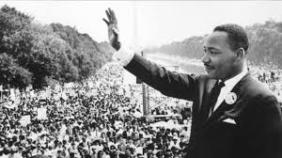
Martin Luther King Jr
Dr.Sara Adel

Slide 28
4-Democratic Leadership Style
Dr.Sara Adel

Slide 29

4-Democratic Leadership Style
In this leadership style, subordinates are involved in making decisions. Unlike autocratic.
This leadership is centered on subordinates’ contributions.
The democratic leader holds final responsibility, but he or she is known to delegate authority to other people, who determine work projects.
His style of authority depends on the group been counseled and their feelings being esteemed.
Dr.Sara Adel
Notes:
Corresponds to page 3 of the Project Team Leadership and Communication book.
Emphasis is either on harmony or productivity, focus is on the leader, team, or individual.
The Democratic Leadership Style focuses heavily on the team.

Slide 30
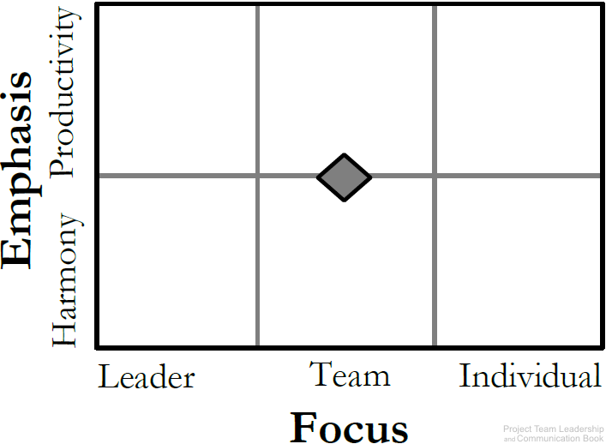
Democratic Leadership Style (Cont.)
Relies on the skills and knowledge of team members.
Group makes decisions collectively.
Dr.Sara Adel
Diagram: Malachowsky, Samuel. Project Team Leadership and Communication. Lintwood Press. 2018. p. 3.
Goleman, Daniel. Primal Leadership: Realizing the Power of Emotional Intelligence. Boston, Mass. :Harvard Business School Press, 2002.
Notes:
Corresponds to page 3 of the Project Team Leadership and Communication book.
Emphasis is either on harmony or productivity, focus is on the leader, team, or individual.
The Democratic Leadership Style focuses heavily on the team.

Slide 31

Democratic Leadership Style (Cont.)
Pros:
Higher quality work.
Allow follower to say any decision.
Create a well collaborative work place.
Cons:
The leader depend on the followers level of knowledge.
Leader spend too much time listening.
Can be time consuming (Collaboration may take time.)
difficult for indecisive teams.
Dr.Sara Adel
Notes:
Corresponds to page 3 of the Project Team Leadership and Communication book.
Emphasis is either on harmony or productivity, focus is on the leader, team, or individual.
The Democratic Leadership Style focuses heavily on the team.

Slide 32
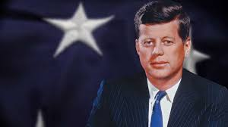
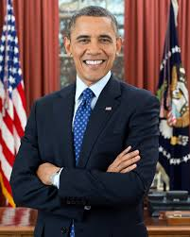
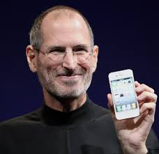
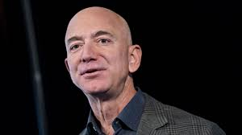
Dr.Sara Adel

Slide 33
5-Laissez-faire Leadership Style
Dr.Sara Adel

Slide 34

5-Laissez-faire Leadership Style (delegate leadership)
Laissez-faire leadership gives authority to employees. (LEAVE IT BE)
Subordinates are allowed to work as they choose, with complete freedom to make decision. with minimal or no interference.
This kind of leadership has been always found to be the least satisfying and least effective management style.
Dr.Sara Adel
Notes:
Corresponds to page 4 of the Project Team Leadership and Communication book.
Emphasis is either on harmony or productivity, focus is on the leader, team, or individual.
The Laissez-faire Leadership Style focuses heavily on the individual.

Slide 35
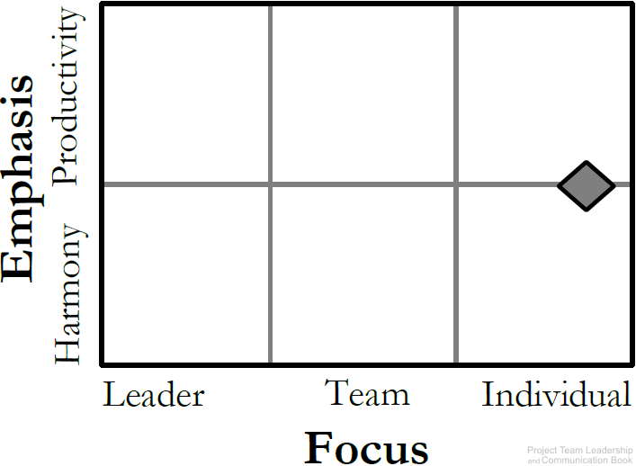
Laissez-faire Leadership Style (Cont.)
The ‘hands-off’ approach.
Management trusts the team members to make decisions and meaningful progress.
Leaders support rather than control.
style is frequently connected when the group is extremely fit, very much inspired and composed.
Dr.Sara Adel
Diagram: Malachowsky, Samuel. Project Team Leadership and Communication. Lintwood Press. 2018. p. 4.
Goleman, Daniel. Primal Leadership: Realizing the Power of Emotional Intelligence. Boston, Mass. :Harvard Business School Press, 2002.
Notes:
Corresponds to page 4 of the Project Team Leadership and Communication book.
Emphasis is either on harmony or productivity, focus is on the leader, team, or individual.
The Laissez-faire Leadership Style focuses heavily on the individual.

Slide 36

Laissez-faire Leadership Style (Cont.)
Pros:
Can promote creativity.
Easy management style to administer.
Complete empowerment for the followers.
Cons:
The leader plays the least role.
Requires self-motivated, hard-working, honest team members
Poor decision making may result.
Dr.Sara Adel
Notes:
Corresponds to page 4 of the Project Team Leadership and Communication book.
Emphasis is either on harmony or productivity, focus is on the leader, team, or individual.
The Laissez-faire Leadership Style focuses heavily on the individual.

Slide 37
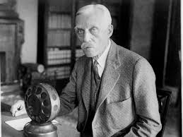
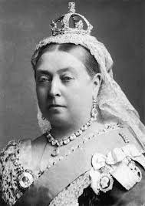
Warren Buffett
Andrew Mellon
Queen Victoria
Dr.Sara Adel

Slide 38
6-Pacesetting Leadership Style
Dr.Sara Adel

Slide 39

6-Pacesetting Leadership Style
Pacesetting leadership is when the leader sets an example of high performance, high pace and high quality.
Team members are expected to follow suit, and the pacesetting leader values results more than anything.
Dr.Sara Adel
Notes:
Corresponds to page 4 of the Project Team Leadership and Communication book.
Emphasis is either on harmony or productivity, focus is on the leader, team, or individual.
The Pacesetting Leadership Style emphasizes productivity and focuses on the leader.

Slide 40
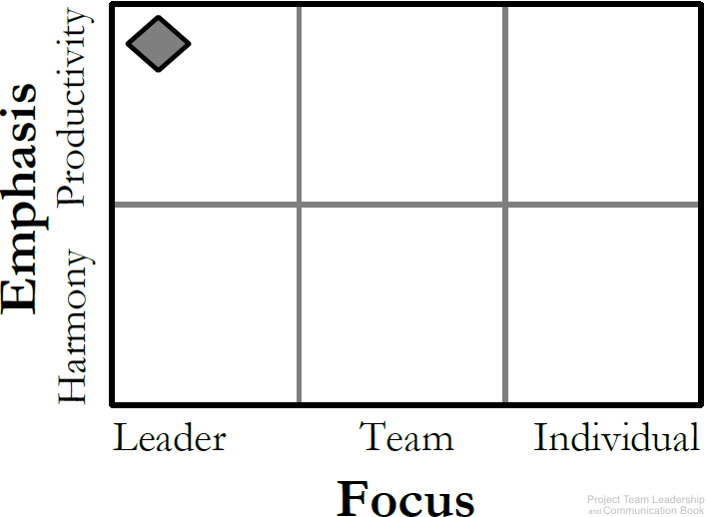
Pacesetting Leadership Style (Cont.)
This is ‘lead by example’ (do as I do, now).
Leader is highly focused on performance and expects the same of the team.
Works best with teams that already perform at a high level.
Role model, high standards.
Dr.Sara Adel
Diagram: Malachowsky, Samuel. Project Team Leadership and Communication. Lintwood Press. 2018. p. 4.
Goleman, Daniel. Primal Leadership: Realizing the Power of Emotional Intelligence. Boston, Mass. :Harvard Business School Press, 2002.
Notes:
Corresponds to page 4 of the Project Team Leadership and Communication book.
Emphasis is either on harmony or productivity, focus is on the leader, team, or individual.
The Pacesetting Leadership Style emphasizes productivity and focuses on the leader.

Slide 41

Pacesetting Leadership Style (Cont.)
Pros:
This leadership style can be good to reach short term results.
Ability to achieve results quickly.
Outstanding performance of the team.
Cons:
can be detrimental for employee engagement and motivation in the long run.
Team can be overwhelmed by the demand on them.
Team members can feel as they’ll never ‘measure up,’ lowering morale.
Dr.Sara Adel
Notes:
Corresponds to page 4 of the Project Team Leadership and Communication book.
Emphasis is either on harmony or productivity, focus is on the leader, team, or individual.
The Pacesetting Leadership Style emphasizes productivity and focuses on the leader.

Slide 42
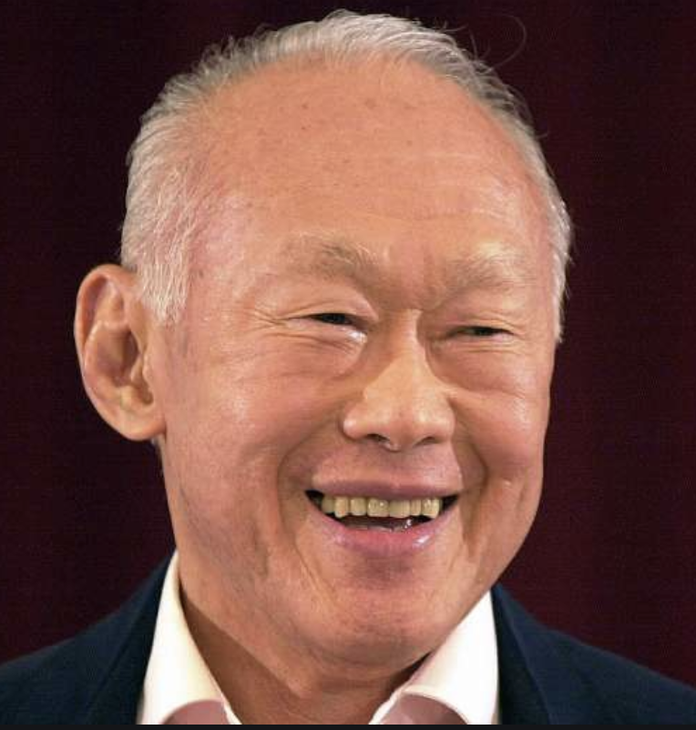
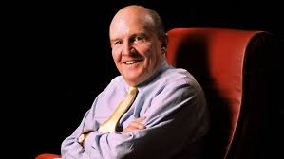
Lee Kuan Yew
Jack Welch
Dr.Sara Adel

Slide 43
7-Transformational / Visionary Leadership Style
Dr.Sara Adel

Slide 44

7-Transformational / Visionary Leadership Style
The transformational leadership style is one of the most implemented styles. It has integrity, defines clear goals, encourages clear steps to communication and expressive.
This type of leader inspires their team to work together towards a common target.
Transformational leaders combine the best practices and are leaders who are trusted and can motivate others.
Dr.Sara Adel

Slide 45

Transformational / Visionary Leadership Style (Cont.)
The transformational style requires a number of different skills. And its primary focus is to make change happen in our self, others, groups, and organizations.
Dr.Sara Adel

Slide 46
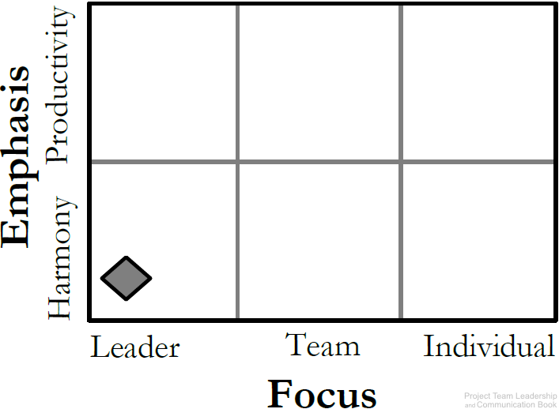
Transformational / Visionary Leadership Style (Cont.)
The leader focuses on setting a positive vision for the future.
Team members are infused with a sense of purpose and excitement.
leaders who stimulate and inspire (transform) followers to achieve extraordinary outcomes.
Dr.Sara Adel
Diagram: Malachowsky, Samuel. Project Team Leadership and Communication. Lintwood Press. 2018. p. 4.
Goleman, Daniel. Primal Leadership: Realizing the Power of Emotional Intelligence. Boston, Mass. :Harvard Business School Press, 2002.
Notes:
Corresponds to page 3 of the Project Team Leadership and Communication book.
Emphasis is either on harmony or productivity, focus is on the leader, team, or individual.
The Transformational / Visionary Leadership Style emphasizes harmony and focuses on the leader.

Slide 47

Transformational / Visionary Leadership Style (Cont.)
Pros:
This style of leadership encourages, motivates and supports employers, often involves recognizing and rewarding people for their good work.
Enhance innovation.
Good for teams that have recently experienced failure
Cons:
Can become unrealistic and overly optimistic.
Conflicts if other strong individual in the organization with competing vision
Dr.Sara Adel
Notes:
Corresponds to page 3 of the Project Team Leadership and Communication book.
Emphasis is either on harmony or productivity, focus is on the leader, team, or individual.
The Transformational / Visionary Leadership Style emphasizes harmony and focuses on the leader.

Slide 48

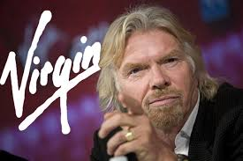
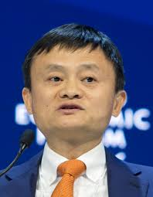
Richard Branson
Dr.Sara Adel

Slide 49
Charismatic Leadership
Style
Dr.Sara Adel

Slide 50

Charismatic Leadership
• In this leadership, the charismatic leader shows his or her revolutionary power.
• Charisma does not mean sheer behavioral change. It actually involves a transformation of followers’ values and beliefs.
Dr.Sara Adel

Slide 51

Charismatic Leadership (Cont.)
A charismatic leader is an enthusiastic, self-confident leader whose personality and actions influence people to behave in certain ways. The most comprehensive analysis of charismatic leaders identified the following personal characteristics they share:
They have a vision.
The have the ability to articulate that vision.
They are willing to take risks to achieve that vision.
They demonstrate behaviors that are out of the ordinary.
Dr.Sara Adel

Slide 52

Charismatic Leadership (Cont.)
Pros:
Create a vision that make everyone believes that the future will be better.
Cons:
Too connected to the leader’s personality.
Leader can get out of control.
Dr.Sara Adel

Slide 53
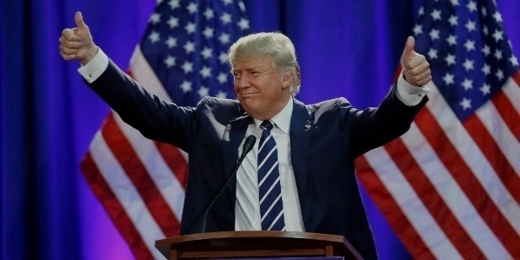


Dr.Sara Adel

Slide 54
3.3-Who We Lead?
Dr.Sara Adel

Slide 55
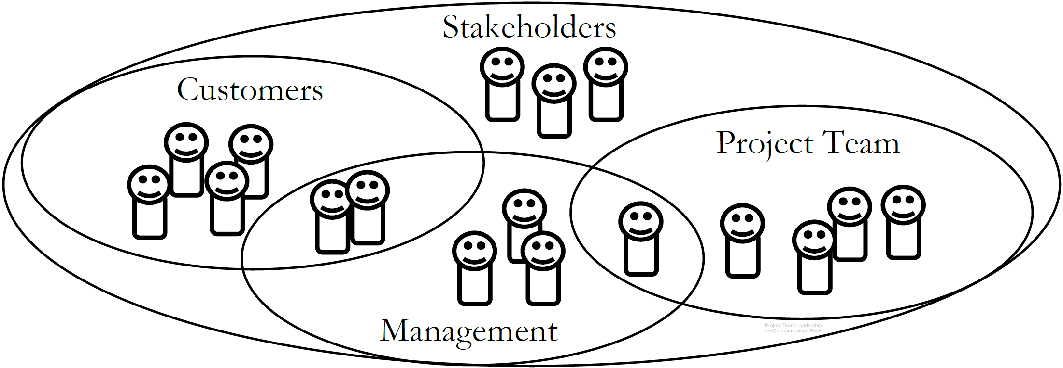
Stakeholders
Stakeholders are people who can affect or are affected by the execution or outcome of a project
Dr.Sara Adel
Diagram: Malachowsky, Samuel. Project Team Leadership and Communication. Lintwood Press. 2018. p. 12.
Notes:
Corresponds to section 1.6, pages 12-13 of the Project Team Leadership and Communication book.
The Venn diagram illustrates how there are major stakeholder groups, but they can overlap. Each requires specific considerations and strategies.
Stakeholders are covered further in other chapters/slides, especially section 3.8 (pages 102-105) and 5.7 (pages 171-172).

Slide 56
3.4 -Matching Leadership with Culture
Dr.Sara Adel

Slide 57
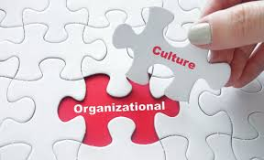
Organizational Culture
IS: The set of behaviors or beliefs that determine how an organization or team interacts or carries out work.
Awareness of culture and different circumstances/attitudes is key.
Influenced by:
  The industry, environment, customers, organizational practices.
  Personalities, values, principles, etc. of the organization, leader, and team.
Influences:
  Decision making, risk tolerance, decisiveness, orderliness, competitiveness .
  Level of attention to detail, amount of process, emphasis on achievement.
  Supportiveness, reward/punishment, team vs. individual contribution.
Dr.Sara Adel
Notes:
Corresponds to section 1.5, pages 10-12 of the Project Team Leadership and Communication book.

Slide 58
3.5-Summary and Conclusions
Dr.Sara Adel

Slide 59
Summary and Conclusions
A leader’s title can be everything.
Leaders adopt different leadership styles .
Culture influences every aspect of the organization and team.
Stakeholders are key to any project effort, and comprise multiple groups.
Dr.Sara Adel
Notes:
Corresponds to section 1.9, page 20 of the Project Team Leadership and Communication book. Summarizes chapter 1 and these slides.

Slide 60
3.6-Self Assessment
Dr.Sara Adel

Slide 61

Self Assessment
For each of the following situations, which leadership style or styles might be appropriate?
A team has recently suffered a rather demoralizing project failure
A team considers themselves to be high-performance, and morale is at its highest when they’re achieving at that level
A group of equals, the team loves the empowerment of making their own decisions
A recent crisis and some disagreement within their ranks means has created a situation where someone needs to ‘take control’ in order to meet their objectives
Dr.Sara Adel

Slide 62

Resources:
Project Team Leadership and Communication by Samuel Malachowsky, 2018.
Dr.Sara Adel

Slide 63
THANKS!
Dr.Sara Adel

