Slide 1


Strategic Management
Prepared by Dr. Amira El fekky
MGM414
Lecture2

Slide 2



Strategic Management
Lecture2
MGM414
Prepared by
Dr. Amira El Fekky

Slide 3

Chapter
Strategic Management
01

Slide 4

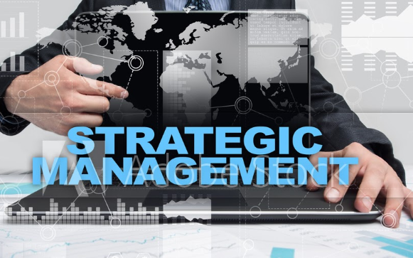
Strategic Management
Strategic management is the process of developing and implementing plans that enable an organization to achieve its goals and objectives. It typically involves formulating strategies, designing organizational structures, allocating resources, leading change initiatives, and overseeing processes and resource utilization to ensure alignment with strategic priorities.

Slide 5

Content
Part One / Analysis
Chapter 1 What Is Strategy?
Chapter 2 Strategic Leadership: Managing the Strategy Process
Chapter 3 External Analysis: Industry Structure, Competitive Forces, and Strategic Groups
Chapter 4 Internal Analysis: Resources, Capabilities, and Core Competencies
Chapter 5 Competitive Advantage, Firm Performance, and Business Models

Slide 6
Content
Part Two/ Formulation
Chapter 6 Business Strategy: Differentiation, Cost Leadership, and Blue Oceans
Chapter 7 Business Strategy: Innovation, Entrepreneurship, and Platforms
Chapter 8 Corporate Strategy: Strategic Alliances, Mergers, and Acquisitions
Chapter 9 Global Strategy: Competing Around the World
Part Three/ Implementation
Chapter 10 Organizational Design: Structure, Culture, and Control

Slide 7
Agenda Strategic Leadership: Managing the Strategy Process
2.1 Strategic Leadership
What Do Strategic Leaders Do?
How Do You Become a Strategic Leader?
The Strategy Process across Levels: Corporate, Business, and Functional Managers
2.2 The Strategic Management Process
Top-Down Strategic Planning
Scenario Planning
Strategy as Planned Emergence: Top-Down and Bottom-Up
2.3 Stakeholders and Competitive Advantage
Stakeholder Strategy
Stakeholder Impact Analysis
2.4 Implications for Strategic Leaders

Slide 8
Agenda Strategic Leadership: Managing the Strategy Process
2.1 Strategic Leadership
What Do Strategic Leaders Do?
How Do You Become a Strategic Leader?
The Strategy Process across Levels: Corporate, Business, and Functional Managers
2.2 The Strategic Management Process
Top-Down Strategic Planning
Scenario Planning
Strategy as Planned Emergence: Top-Down and Bottom-Up
2.3 Stakeholders and Competitive Advantage
Stakeholder Strategy
Stakeholder Impact Analysis
2.4 Implications for Strategic Leaders

Slide 9


Strategic Leadership
Strategic leadership pertains to executives’ use of power and influence to direct the activities of others when pursuing an organization’s goals.

Slide 10
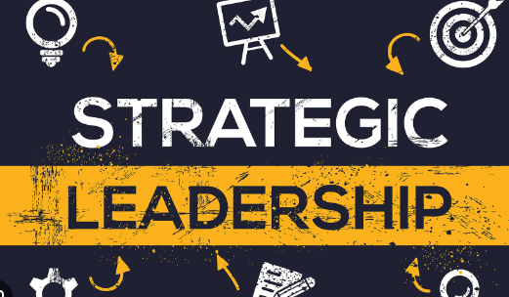
Strategic Leadership
Power is defined as the strategic leader’s ability to influence the behaviour of other organizational members to do things, including things they would not do otherwise.

Slide 11

What do strategic leaders do?
Explain the role of strategic leaders and what they do?
■ Executives whose vision and decisions enable their organizations to achieve competitive advantage demonstrate strategic leadership.
■ Strategic leaders use formal and informal power to influence the behavior of other organizational members to do things, including things they would not do otherwise.

Slide 12
What do strategic leaders do?
What do strategic leaders do that makes some more effective than others?
In a study of more than 350 CEOs, strategy scholars found that they spend, on average, 67 percent of their time in meetings, 13 percent working alone, 7 percent on e-mail, 6 percent on phone calls, 5 percent on business meals, and 2 percent on public events such as ribboncutting for a new factory.

Slide 13
What do strategic leaders do?
What do strategic leaders do that makes some more effective than others?
Other studies have also found that most managers prefer oral communication: CEOs spend most of their time “interacting—talking, soothing, selling, listening, and nodding—with a wide array of parties inside and outside the organization.”

Slide 14
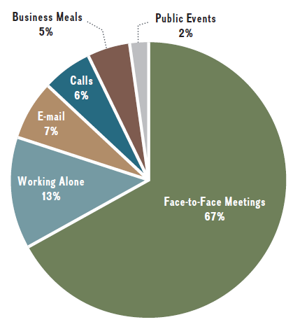
What do strategic leaders do?

Slide 15
How to become a strategic leader?
Is becoming an ethical and effective strategic leader innate? Can it be learned? The theory states that strategic leaders interpret situations through the lens of their unique perspectives, shaped by personal circumstances, values, and experiences.
Their leadership actions reflect characteristics of age, education, and career experiences, filtered through personal interpretations of the situations they face. The upper-echelons theory favours the idea that effective strategic leadership is the result of both innate abilities and learning.

Slide 16

Strategy process across levels: company, Business and career managers
Chapter
02
■ Corporate strategy concerns questions relating to where to compete as to industry, markets, and geography.
■ Business strategy concerns the question of how to compete. Three generic business strategies are available: cost leadership, differentiation, or value innovation.
■ Functional strategy concerns the question of how to implement a chosen business strategy. Different corporate and business strategies will require different activities across the various functions.

Slide 17
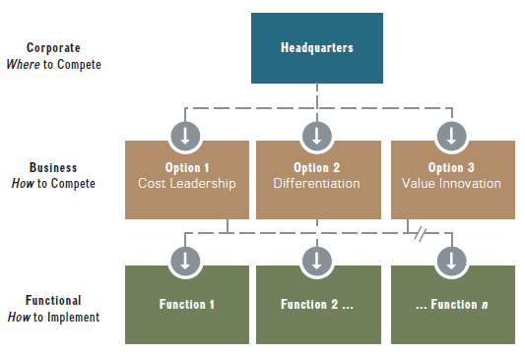
Strategy process across levels: company, Business and career managers
Chapter
02

Slide 18
Agenda Strategic Leadership: Managing the Strategy Process
2.1 Strategic Leadership
What Do Strategic Leaders Do?
How Do You Become a Strategic Leader?
The Strategy Process across Levels: Corporate, Business, and Functional Managers
2.2 The Strategic Management Process
Top-Down Strategic Planning
Scenario Planning
Strategy as Planned Emergence: Top-Down and Bottom-Up
2.3 Stakeholders and Competitive Advantage
Stakeholder Strategy
Stakeholder Impact Analysis
2.4 Implications for Strategic Leaders

Slide 19
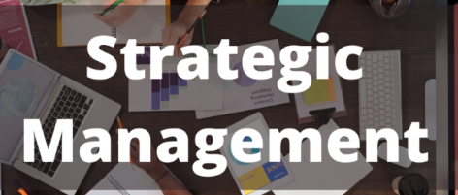
Chapter
02
The Strategic Management Process
Method put in place by strategic leaders to formulate and implement a strategy, which can lay the foundation for a sustainable competitive advantage.

Slide 20
Chapter
The Strategic Management Process
02
Here we turn to the process or method by which strategic leaders formulate and implement strategy. When setting the strategy process, strategic leaders rely on three approaches:
1. Strategic planning.
2. Scenario planning.
3. Strategy as planned emergence.

Slide 21
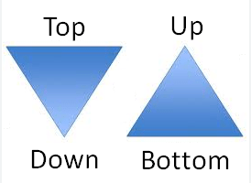
Chapter
The Strategic Management Process
02
Strategic planning from top to bottom
Top-down strategic planning A rational, data-driven strategy process through which top management attempts to program future success.

Slide 22
Chapter
The Strategic Management Process
02
Strategic planning from top to bottom
The prosperous decades after World War II resulted in tremendous growth of corporations. Top-down strategic planning, derived from military strategy, is a rational process through which executives attempt to program future success. In this approach, all strategic intelligence and decision-making responsibilities are concentrated in the office of the CEO.

Slide 23
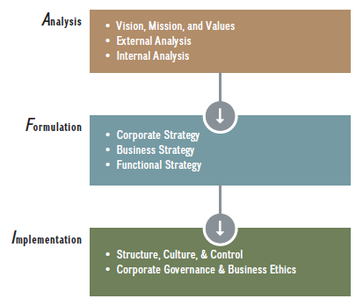
Chapter
The Strategic Management Process
02
Strategic planning from top to bottom

Slide 24
Chapter
The Strategic Management Process
02
Strategic planning from top to bottom
Description
A rational strategy process through which top management attempts to program future success; typically Concentrates Strategic intelligence and decision-making responsibilities in the office of the CEO.

Slide 25
Chapter
The Strategic Management Process
02
Strategic planning from top to bottom
Pros
• Provides a clear strategy process and lines of communication.
• Affords coordination and control of various business activities.
• Readily accepted and understood as process is well established and widely used.
• Works relatively well in stable environments.

Slide 26
Chapter
The Strategic Management Process
02
Strategic planning from top to bottom
Cons
• Fairly rigid and inhibits flexibility. جامدة إلى حد ما وتمنع المرونة.
• Top-down, one-way communication limits feedback.
• Assumes that the future can usually be predicted based on past data.
• Separates elements of AFI framework so that top management (analysis & formulation) are removed from line employees (implementation).

Slide 27
Chapter
The Strategic Management Process
02
Strategic planning from top to bottom
Where Best Used
• Highly regulated and stable industries such as utilities, e.g., state-owned nuclear operator in France.
• Government
• Military

Slide 28
Chapter
The Strategic Management Process
02
Scenario planning
Strategy planning activity in which top management envisions different what-if scenarios to anticipate plausible futures in order to derive strategic responses.

Slide 29
Chapter
The Strategic Management Process
02
Scenario planning
Scenario planning asks those “what if” questions. Similar to top-down strategic planning, scenario planning also starts with a top-down approach to the strategy process. In addition, in scenario planning, top management envisions different scenarios, to anticipate plausible futures in order to derive strategic responses.

Slide 30
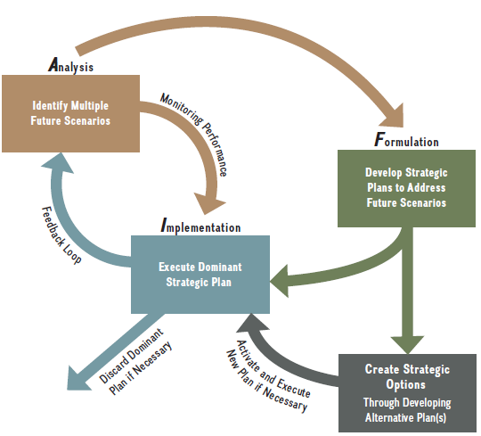
Chapter
The Strategic Management Process
02
Scenario planning

Slide 31
Chapter
The Strategic Management Process
02
Scenario planning
Description
Strategy-planning activity in which top management envisions different what-if scenarios to anticipate plausible futures in order to plan optimal strategic responses.

Slide 32
Chapter
The Strategic Management Process
02
Scenario planning
Pros
• Provides a clear strategy process and lines of communication.
• Affords coordination and control of various business activities.
• Readily accepted and understood as process is well established and widely used.
• Provides some strategic flexibility.

Slide 33
Chapter
The Strategic Management Process
02
Scenario planning
Cons
• Top-down, one-way communication limits feedback.
• Separates elements of AFI framework so that top management (analysis & formulation) are removed from line employees (implementation).
• As the future is unknown, responses to all possible events cannot be planned.
• Leaders tend to avoid planning for pessimistic scenarios.

Slide 34
Chapter
The Strategic Management Process
02
Scenario planning
Where Best Used
• Fairly stable industries, often characterized by some degree of regulation such as airlines, logistics, or medical devices, e.g., American Airlines, Delta Air Lines, and United Airlines; FedEx and UPS; Medtronic.
• Larger firms in industries with a small number of other large competitors (oligopoly).

Slide 35
Chapter
The Strategic Management Process
02
Strategy as planned contingency: top-down and Progressive
Strategic initiatives can be the result of top-down planning or can emerge through a bottom-up process from deep within the organization. They have the potential to shape a firm’s strategy.

Slide 36
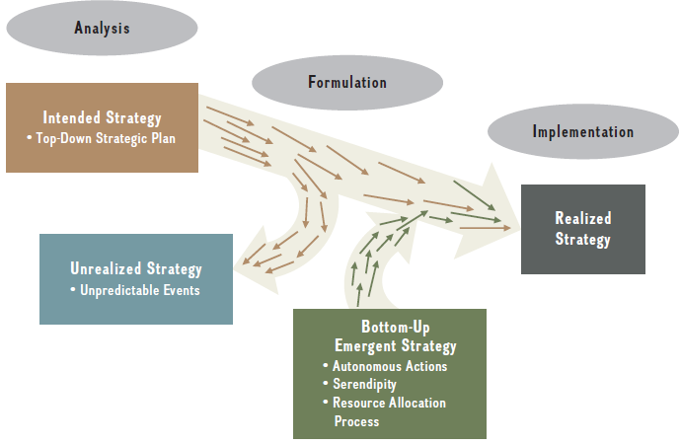
Chapter
The Strategic Management Process
02
Strategy as planned contingency: top-down and Progressive

Slide 37
Chapter
The Strategic Management Process
02
Strategy as planned contingency: top-down and Progressive
Description
Blended strategy process in which organizational structure and systems allow both top-down vision and bottom-up strategic initiatives to emerge for evaluation and coordination by top management.

Slide 38
Chapter
The Strategic Management Process
02
Strategy as planned contingency: top-down and Progressive
Pros
• Combines all elements of the AFI framework in a holistic and flexible fashion.
• Provides provisional direction through intended strategy.
يوفر التوجيه المؤقت من خلال الاستراتيجية المقصودة.
• Accounts for unrealized strategy (not all strategic initiatives can be implemented).
• The firm’s realized strategy is a combination of intended and emergent strategy.
• Highest degree of strategic flexibility and buy-in by employees.

Slide 39
Chapter
The Strategic Management Process
02
Strategy as planned contingency: top-down and Progressive
Cons
• Unclear strategy process and lines of communication can lead to employee confusion and lack of focus.
• Many ideas that bubble up from the bottom may not be worth pursuing.
• Firms may lack a clear process of how to evaluate emergent strategy, increasing the chances of missing mega opportunities or pursuing dead ends; may also contribute to employee frustration and lower morale.

Slide 40
Chapter
The Strategic Management Process
02
Strategy as planned contingency: top-down and Progressive
Where Best Used
• New ventures and smaller firms.
• High-velocity industries such as technology ventures.
• Internet companies; e.g., Airbnb, Alibaba, Alphabet (parent company of Google), Amazon, Facebook, Twitter, and Uber.

Slide 41
Agenda Strategic Leadership: Managing the Strategy Process
2.1 Strategic Leadership
What Do Strategic Leaders Do?
How Do You Become a Strategic Leader?
The Strategy Process across Levels: Corporate, Business, and Functional Managers
2.2 The Strategic Management Process
Top-Down Strategic Planning
Scenario Planning
Strategy as Planned Emergence: Top-Down and Bottom-Up
2.3 Stakeholders and Competitive Advantage
Stakeholder Strategy
Stakeholder Impact Analysis
2.4 Implications for Strategic Leaders

Slide 42

Chapter
2
2.3 Stakeholders and Competitive Advantage

Slide 43
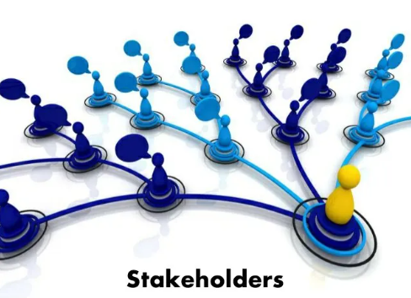
Chapter
2
2.3 Stakeholders and Competitive Advantage
stakeholder strategy An integrative approach to managing a diverse set of stakeholders effectively in order to gain and sustain competitive advantage.

Slide 44
Chapter
The Strategic Management Process
02
Assess the relationship between stakeholder strategy and sustainable competitive advantage.
■ Stakeholders are individuals or groups that have a claim or interest in the performance and continued survival of the firm. They make specific contributions for which they expect rewards in return.

Slide 45
Chapter
The Strategic Management Process
02
Assess the relationship between stakeholder strategy and sustainable competitive advantage.
■ Internal stakeholders include stockholders, employees (for instance, executives, managers, and workers), and board members.

Slide 46
Chapter
The Strategic Management Process
02
Assess the relationship between stakeholder strategy and sustainable competitive advantage.
■ External stakeholders include customers, suppliers, alliance partners, creditors, unions, communities, governments at various levels, and the media.
■ The effective management of stakeholders is necessary to ensure the continued survival of the firm and to sustain any competitive advantage. This is achieved through stakeholder strategy.

Slide 47
Chapter
Stakeholder strategy
02
Stakeholders have a vested claim or interest in the performance and continued survival of the firm. Stakeholders can be grouped by whether they are internal or external to a firm.
Internal stakeholders include employees (including executives, managers, and workers), stockholders, and board members. External stakeholders include customers, suppliers, alliance partners, creditors, unions, communities, governments at various levels, and the media.

Slide 48
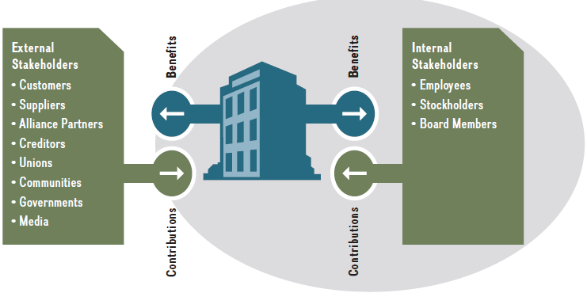
Chapter
Stakeholder strategy
02

Slide 49
Chapter
The Strategic Management Process
02
Conduct a stakeholder impact analysis.
■ Stakeholder impact analysis considers the needs of different stakeholders, which enables the firm to perform optimally and to live up to the expectations of good citizenship.

Slide 50
Chapter
The Strategic Management Process
02
Conduct a stakeholder impact analysis.
■ In a stakeholder impact analysis, managers pay particular attention to three important stakeholder attributes: power, legitimacy, and urgency.

Slide 51
Chapter
The Strategic Management Process
02
Conduct a stakeholder impact analysis.
■ Stakeholder impact analysis is a five-step process that answers the following questions for the firm:
1. Who are our stakeholders?
2. What are our stakeholders’ interests and claims?
3. What opportunities and threats do our stakeholders present?
4. What economic, legal, ethical, and philanthropic responsibilities do we have to our stakeholders?
5. What should we do to effectively address the stakeholder concerns?

Slide 52

Chapter
2
2.3 Stakeholders and Competitive Advantage
The five steps in stakeholder impact analysis and the key questions to be asked.

Slide 53
The five steps in stakeholder impact analysis
and the key questions to be asked.
Chapter
02
STEP 1: IDENTIFY STAKEHOLDERS.
In Step 1, strategic leaders ask, “Who are our stakeholders?”
In this step, the strategic leaders focus on stakeholders that currently have, or
potentially can have, a material effect on a company. This prioritization identifies the most powerful internal and external stakeholders as well as their needs.

Slide 54
The five steps in stakeholder impact analysis
and the key questions to be asked.
Chapter
02
STEP 2: IDENTIFY STAKEHOLDERS’ INTERESTS.
In Step 2, strategic leaders ask, “What are our stakeholders’ interests and claims?”
Managers need to specify and assess the interests and claims of the pertinent stakeholders using the power, legitimacy, and urgency criteria introduced earlier. As the legal owners, shareholders have the most legitimate claim on a company’s profits.

Slide 55
The five steps in stakeholder impact analysis
and the key questions to be asked.
Chapter
02
STEP 3: IDENTIFY OPPORTUNITIES AND THREATS.
In Step 3, strategic leaders ask, “What opportunities and threats do our stakeholders present?”
Since stakeholders have
a claim on the company, opportunities and threats are two sides of the same coin.

Slide 56
The five steps in stakeholder impact analysis
and the key questions to be asked.
Chapter
02
STEP 4: IDENTIFY SOCIAL RESPONSIBILITIES.
In Step 4, strategic leaders ask, “What economic, legal, ethical, and philanthropic responsibilities do we have to our stakeholders?”
To identify these responsibilities more effectively, scholars have advanced the notion of corporate social responsibility (CSR). This framework helps firms recognize and address the economic, legal, ethical that society has of the business enterprise at a given point in time.

Slide 57
The five steps in stakeholder impact analysis
and the key questions to be asked.
Chapter
02
STEP 5: ADDRESS STAKEHOLDER CONCERNS.
Finally, in Step 5, the firm asks, “What should we do to effectively address any stakeholder concerns?”
In the last step in stakeholder impact analysis, strategic leaders need to decide the appropriate course of action for the firm, given all of the preceding factors. Thinking about the attributes of power, legitimacy, and urgency helps to prioritize the legitimate claims and to address them accordingly.

Slide 58




Thank You

