Slide 1


Supply Chain Management
Prepared by Dr. Tarek Mohamed
MGM 660
Orientation Show

Slide 2


Supply Chain Management
Orientation Show
MGM 660
Prepared by
Dr. Tarek Mohamed
www.midocean.km

Slide 3

Course Agenda
Chapter
01
1-Introduction about the professor of the course.
2-Introduction to the course.
3-Primary goal of this course.
4-Learning outcomes.
5-Learning resources.
6-Units of course contents.
7-Assessment method.
8-Academic calendar.
www.midocean.km

Slide 4
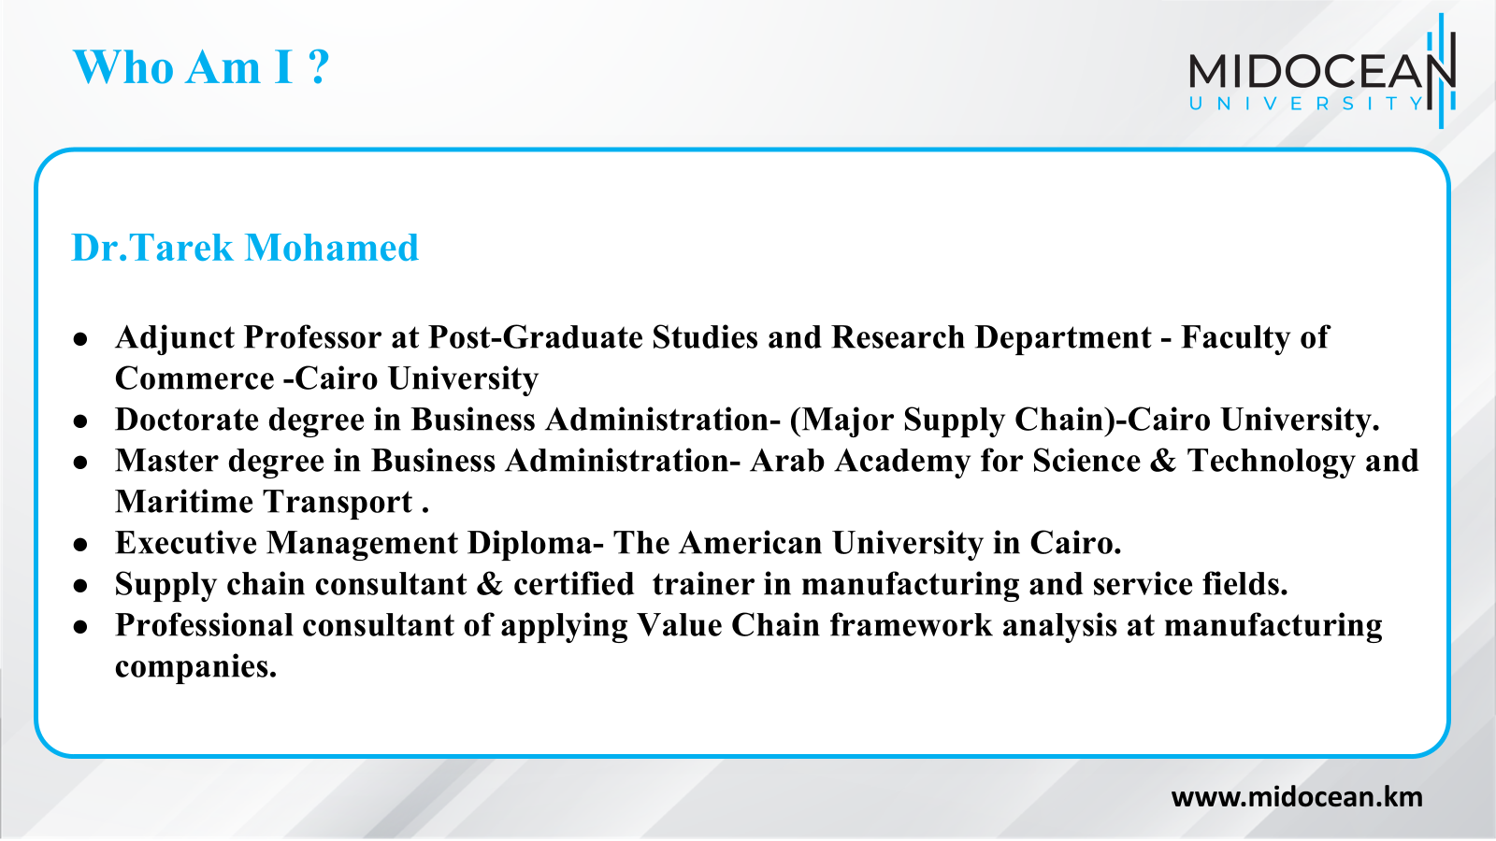

Slide 5
How to reach me ?
By Email : tarek.mohamed @ midocean.edu.km
Pls include“ Supply Chain Management ” in the subject line.
Via Moodle messages.
Vimeo Meeting.
Discussion time on Sunday ( 9-10 PM ) Every Week.
www.midocean.km

Slide 6
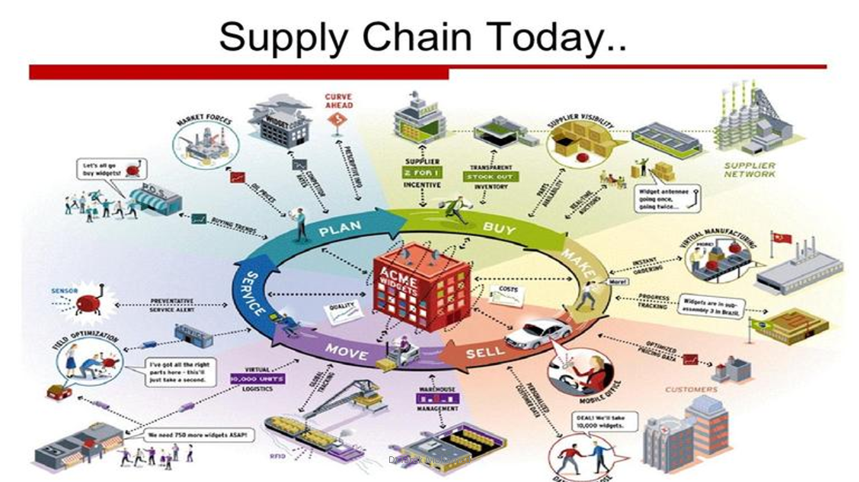

Slide 7
What is a Supply Chain Management
All stages involved, directly or indirectly, in fulfilling a customer request.
Includes manufacturers, suppliers, transporters, warehouses, retailers, and customers.
Within each company, the supply chain includes all functions involved in fulfilling a customer request (product development, marketing, operations, distribution, finance, customer service).
www.midocean.km

Slide 8
What is a Supply Chain Management
All parties involved directly/indirectly in fulfilling customer needs/demands.
All facilities, functions, activities, associated with flow and transformation of goods and services from raw materials to customer, as well as the associated information flows.
An integrated group of processes to “Plan,” “Source,” “Make,” and “deliver” products to customers.
www.midocean.km

Slide 9
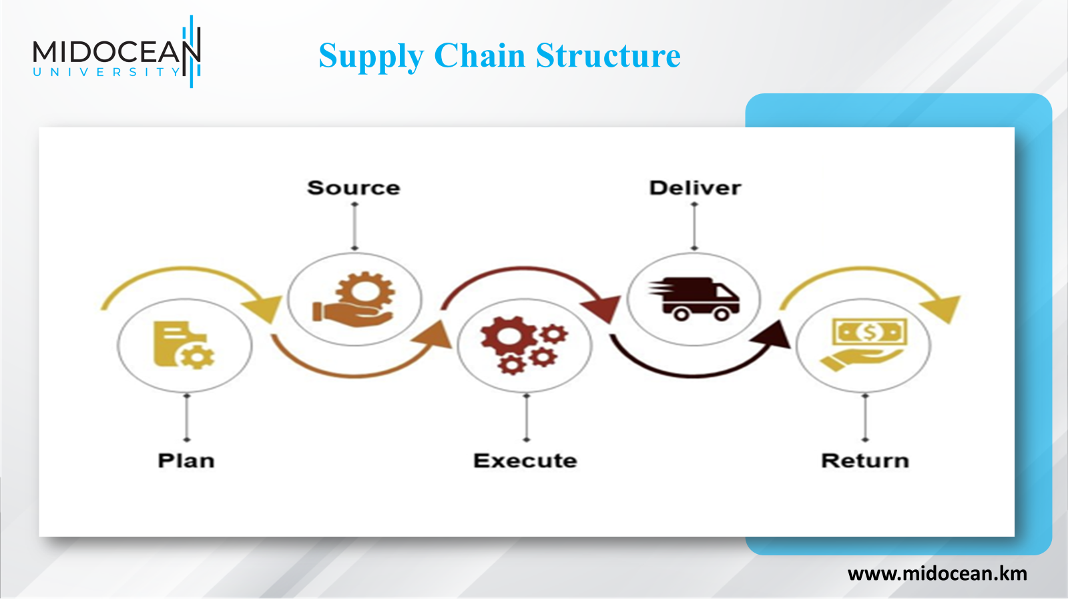

Slide 10
Primary Goal of this Course
Explaining how to build a strategic framework to analyze supply chains.
Identifying how to manage cross-functional drivers in a supply chain.
Describing the designing process of the supply chain network.
Identifying the planning and coordinating demand and supply in the supply chain.
Understanding how to plan and manage inventories in the supply chain.
Explaining the designing and planning of transportation networks in the supply chain.
www.midocean.km

Slide 11
Learning Resources
Credit Hours: 3 Credit Hours.
Required Textbook :
Supply Chain Management-Strategy, Planning and Operation, Sixth Edition, Sunil Chopra and Peter Meindl,Pearson Education Limited.
Essential References :
The main material and reference for each course will be the textbook mentioned in the course specifications,lecture notes and slides are additional resources that are prepared by the professor.
www.midocean.km

Slide 12
Learning Outcomes
At the end of the course, the students will be able to understand :
The important role of supply chains in today’s business and economy.
A wide scope of functions and concepts in supply chains.
The main components of supply chains.
The key drivers of good supply chain management to create a competitive advantage.
Apply conceptual decision-support to supply chain related decision problems.
The unique characteristics and issues of supply chains.
How to utilize the strategic framework concepts used in this text to achieve significant increases in performance.
www.midocean.km

Slide 13
Units of Course Contents
Course Unit | No.of. Weeks | Contact Hours
Part I Building a Strategic Framework to Analyze Supply Chains
Lecture 1- Understanding the Supply Chain | 1st | 3
Lecture 2- Supply Chain Performance: Achieving Strategic Fit and Scope | 2nd | 3
Lecture 3- Supply Chain Drivers and Metrics | 3rd | 3
Part II Designing the Supply Chain Network
Lecture 4- Designing distribution network in the Supply Chain | 4th | 3
Lecture 5- Network design in the Supply Chain | 5th | 3
Part III Planning and Coordinating Demand and Supply in a Supply Chain
Lecture 6- Demand forecasting in a supply chain | 6th | 3
Lecture 7- Aggregate planning in a supply chain | 7th | 3
Part IV Designing and Planning Transportation Networks
Lecture 8 -Transportation in a Supply Chain | 8th | 3
Part V Managing Cross-Functional Drivers in a Supply Chain
Lecture 9 -Sourcing decisions in a supply chain | 9th | 3
Lecture 10-Sustainability and the Supply Chain | 10th | 3
www.midocean.km

Slide 14
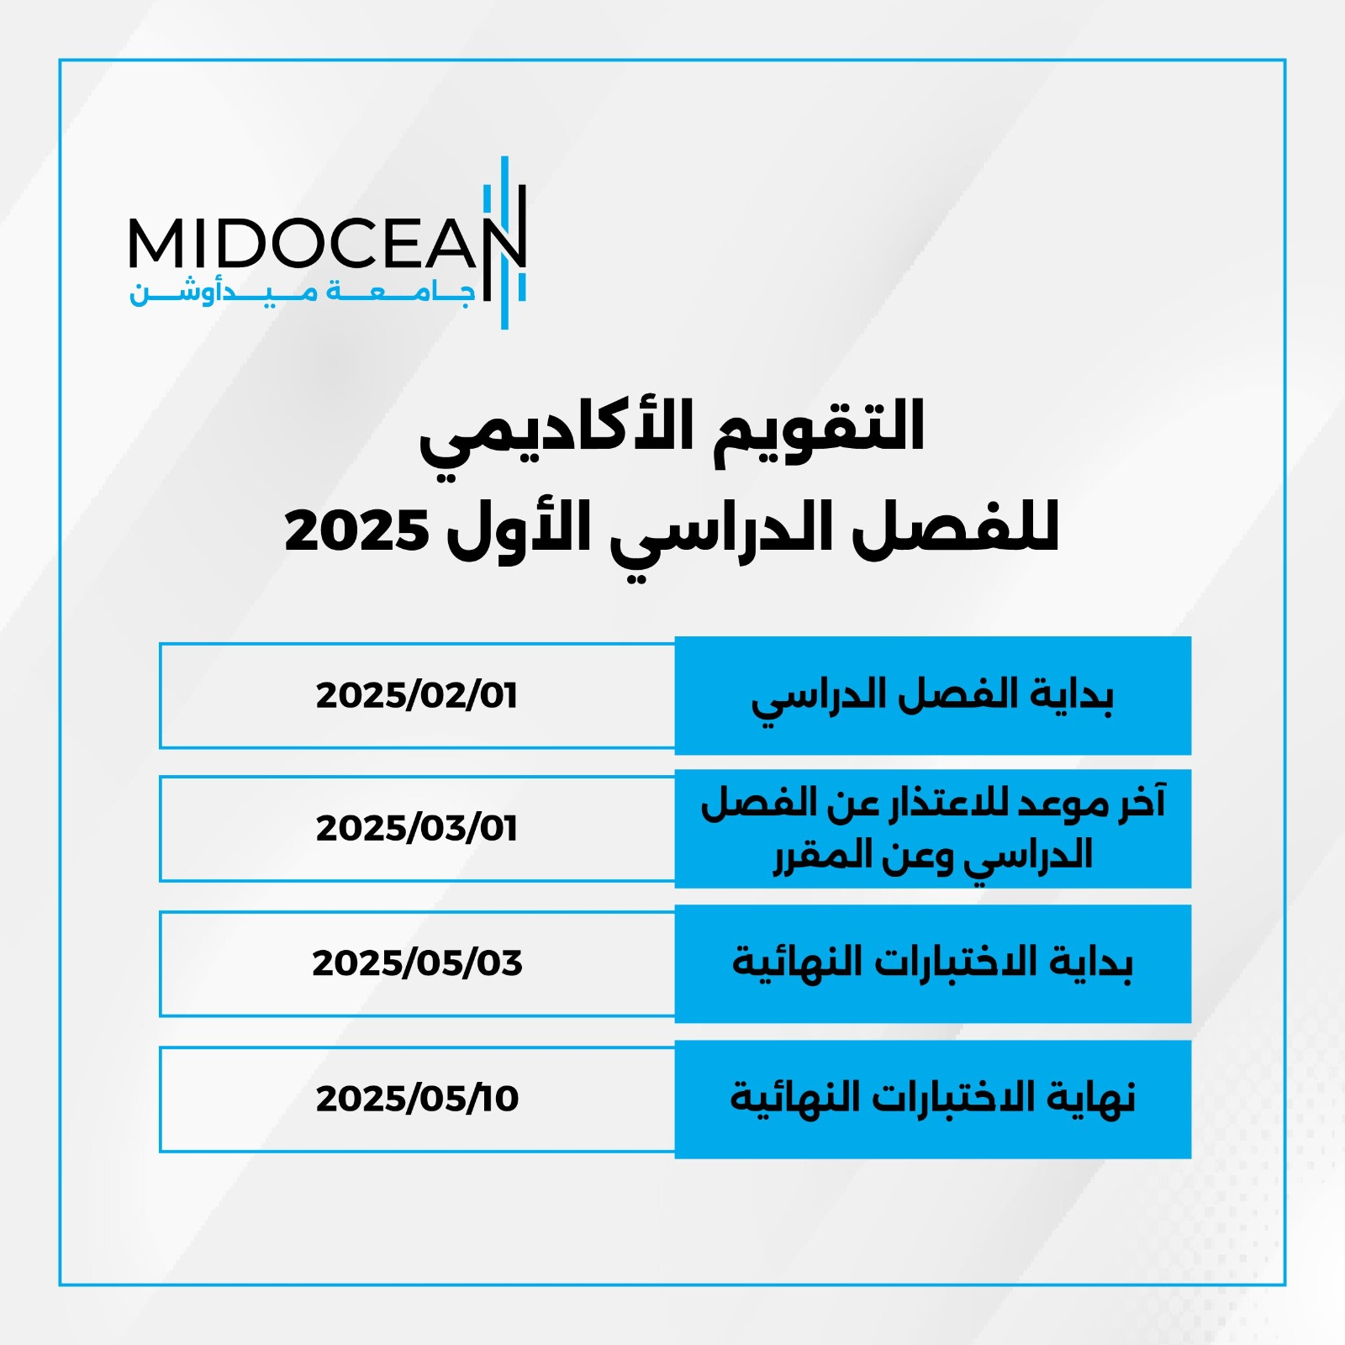
01
www.midocean.km

Slide 15
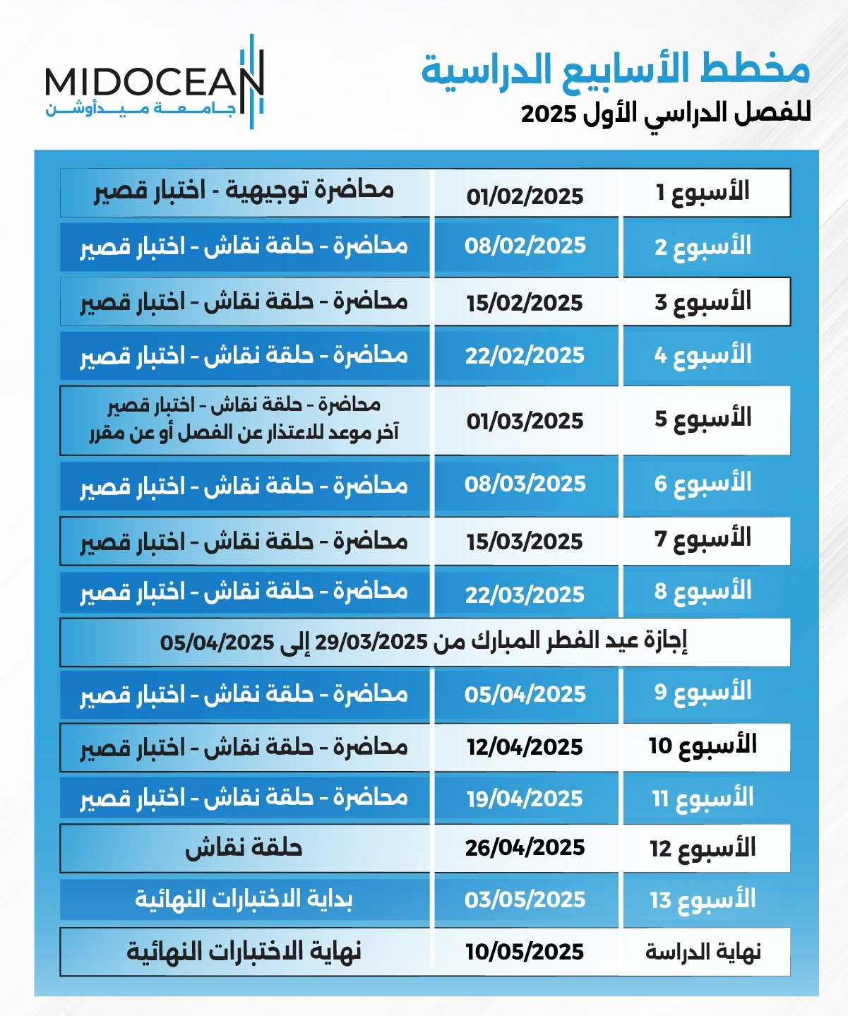
01
www.midocean.km

Slide 16

Chapter
01
www.midocean.km

Slide 17


Thank You

