Slide 1


College of Management
Project Communications
Lecturer: Dr. Raef Baraka
PMG 112
Lecture 05

Slide 2

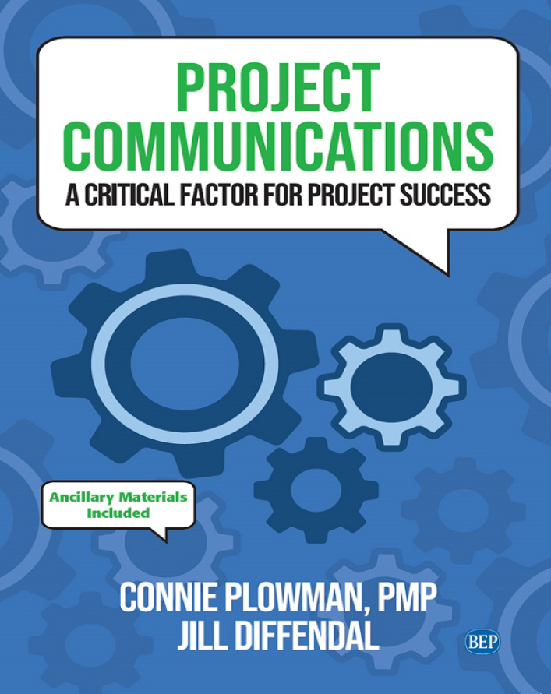
Reference Book:
Ch1: Introduction.
Ch2: Exploring Communication Theories.
Ch3: Knowing Your Audience.
Ch4: Starting with the Basics.
Ch5: Planning Project Communications.
Ch6: Managing and Monitoring Project Communications.
Ch7: Using Project Communication Tools.
Ch8: Communicating Change.
Ch9: Managing Conflict through Communication.
Ch10: Closing.

Slide 3
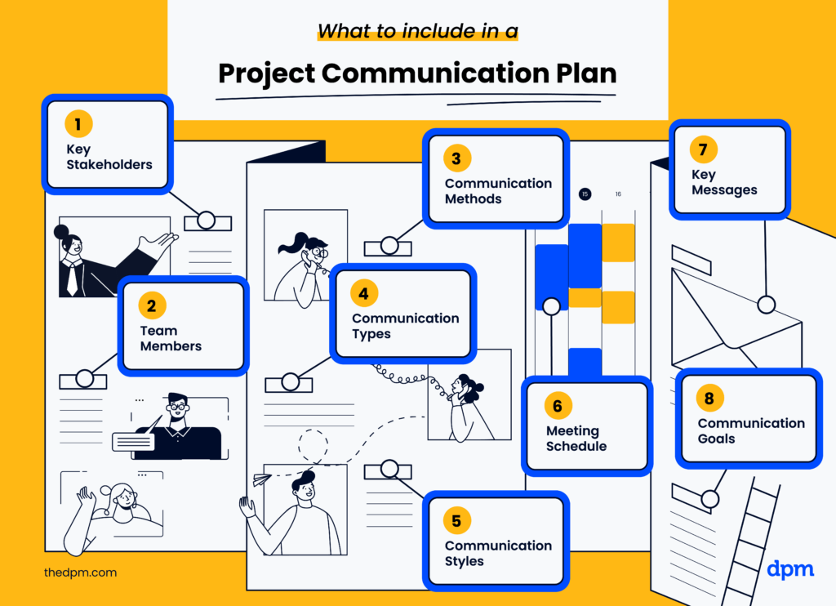
Chapter 5: Planning Project Communications
The purpose of this chapter is to help you:
Understand the purpose, content, and development of a project communications management plan.
Demonstrate how to effectively use a project communications management plan.
Examine a communications matrix.
Planning communications in traditional, agile, and virtual project teams.

Slide 4
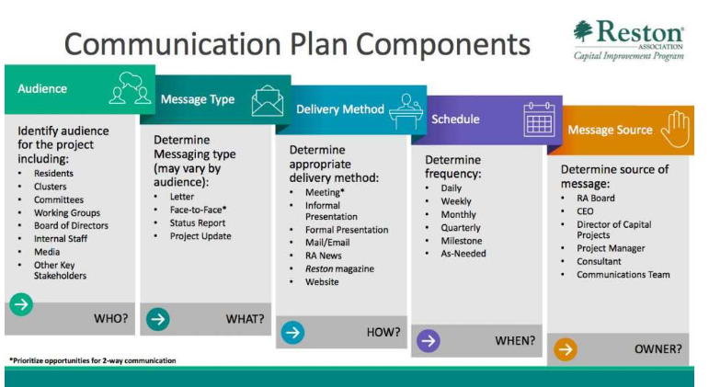
Planning Project Communications
If you fail to prepare, you are preparing to fail.
—The Reverend H. K. Williams, religious leader and author

Slide 5

Starting with the Basics
Planning Project Communications
Most often, we associate the concept of failing to plan or prepare with the overall project. If we fail to plan the project, we are planning for the project to fail. However, it can also be applied to planning communication on a project. What are the chances of project success if we fail to plan our communications?
Dr. Raef Baraka

Slide 6
Planning Project Communications
Planning Project Communications
If you are a project manager, how much time do you spend communicating when working on a project? This refers to how much time you are spending communicating on a project, not how much time you should be spending.
For team members, think about how much time you think your project manager spends communicating on a project. Put an X somewhere between 0 percent and 100 percent on the continuum below.
Dr. Raef Baraka

Slide 7

Planning Project Communications

Slide 8
Planning Project Communications
Planning Project Communications
“Top project managers spend about 90 percent of their time on a project in communicating”—with external stakeholders, groups, project teams, individuals, management, project sponsors, and others. Hopefully, you marked an X near 90 percent!
Since project managers are to be spending the majority of their time communicating, it is best to have a plan. A project communications management plan.
Dr. Raef Baraka

Slide 9
Planning Project Communications
Planning Project Communications
Plan Communications Management is “the process for developing an appropriate approach and plan for project communications activities based on the information needs of each stakeholder or group, available organizational assets, and the needs of the project.”
In other words, consider it your “how to” document. How will you communicate with various stakeholder groups? How will you utilize the processes, procedures, policies, plans, and knowledge already established by the organization? What new processes or procedures might be needed? What, when, and who will send and receive information?
Dr. Raef Baraka

Slide 10
Planning Project Communications
Planning Project Communications
And how will that information be distributed? Where will project information be stored, and how will it be retrieved? How will the information be disposed of at the end of the project?
The purpose of a project communications management plan is to answer these and other questions in guiding the project team’s communications to “ensure timely and appropriate planning, collection, creation, description, storage, retrieval, management, control, monitoring, and ultimate disposition of project information?
Dr. Raef Baraka

Slide 11
Planning Project Communications
Planning Project Communications
Plan Communications Management happens in the planning process group. It is our “communications road map.”
It is our guide for keeping everyone informed—with the right message, at the right time, using the right methods, for the right reasons. The other chapters
This book provides insight into these different factors. The project communications management plan is where you bring them all together.
Dr. Raef Baraka

Slide 12
Planning Project Communications
Planning Project Communications
Regardless of the size or complexity of the project, here is a word of caution: Just because you have a template or form does not mean that you fill it out and you are done.
Project management is not about “form filling.” It is about adapting the templates, tools, and techniques to meet your project, stakeholder, and organizational needs—and then using them.
Take a look at the example in the Exhibit. This is a sample outline of a table of contents for a project communications management plan.
Dr. Raef Baraka

Slide 13
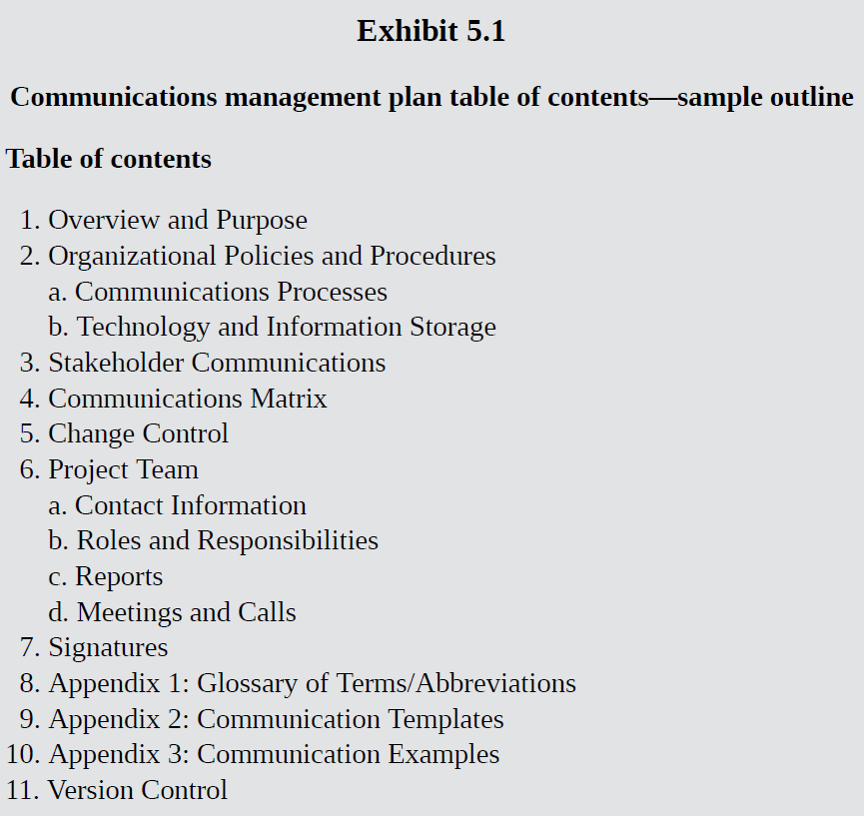
Planning Project Communications

Slide 14
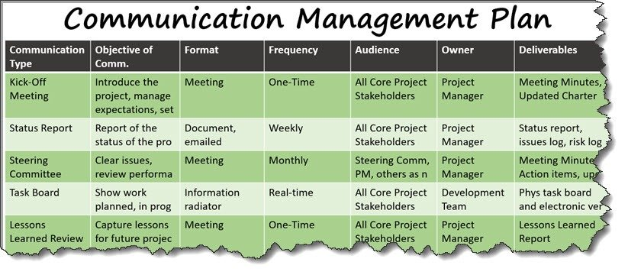
Planning Project Communications

Slide 15
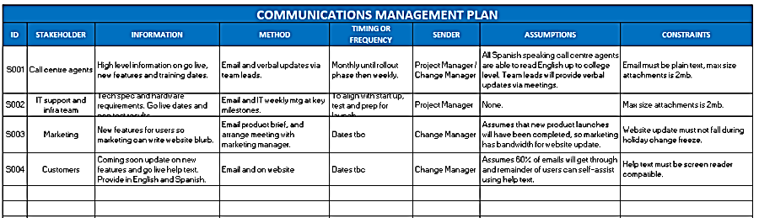
Planning Project Communications

Slide 16
Planning Project Communications
Planning Project Communications
Additional recommendation:
Do not make your project communications management plan so voluminous and so complicated that no one uses it. It needs to be proportionate to the size and complexity of your project and the project experience of your team.
The less project management experience your team has, the more information is included in your project communications management plan.
Otherwise, there is a greater risk of miscommunication occurring.
Dr. Raef Baraka

Slide 17
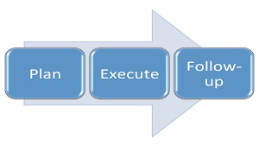
Create the Plan. Follow the Plan.

Slide 18
Planning Project Communications
Planning Project Communications
When developing a project communications management plan, where do you begin?:
Start by reviewing the project communications management plans of previous, similar projects. Review the lessons learned. What worked well? What needed improvement? What project communications areas were challenging? Share and discuss the findings with your project team.
You can learn a lot from the experiences of other project teams and avoid mistakes that others have made. Once you have completed the review and discussion, you can start to collaborate and develop your own project communications management plan as a team.
Dr. Raef Baraka

Slide 19
Planning Project Communications
Planning Project Communications
Your project communications management plan should include:
All stakeholders that you have identified in your project (see Chapter 3).
Address the aspects of the project that impact them most.
Incorporate the basics of good project communication discussed in Chapter 4, and make sure your plan aligns with the ground rules you set with your team.
Project communications management plan should incorporate elements for handling and communicating that change with stakeholders
Dr. Raef Baraka

Slide 20
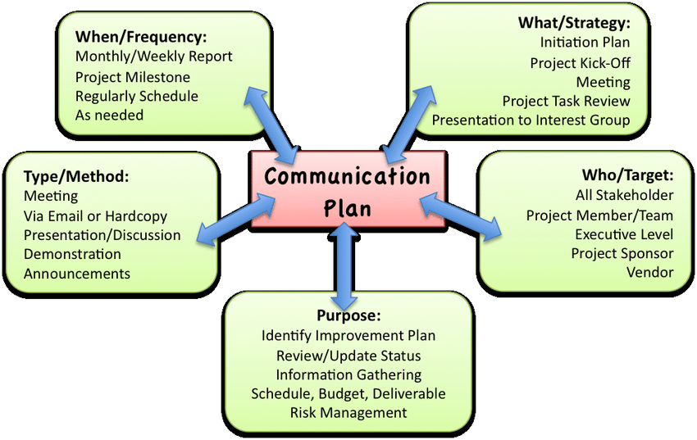
Create the Plan. Follow the Plan.

Slide 21
Planning Project Communications
Planning Project Communications
Why the project communications management plan is designed:
The project communications management plan is designed to be developed by and used by the project team to ensure that stakeholders are receiving the project information that they need and that the project communications are effective.
Once the project communications management plan has been developed, you now need to follow it.
Dr. Raef Baraka

Slide 22

Planning Project Communications
Planning Project Communications
List of techniques to ensure your project communications are being used effectively:
Take ownership: In project management, ownership is everything. Make sure that someone on the team owns the project communications management plan. This individual is responsible for ensuring that the project communications management plan is followed properly, reviewed regularly, and updated as needed.
Dr. Raef Baraka

Slide 23
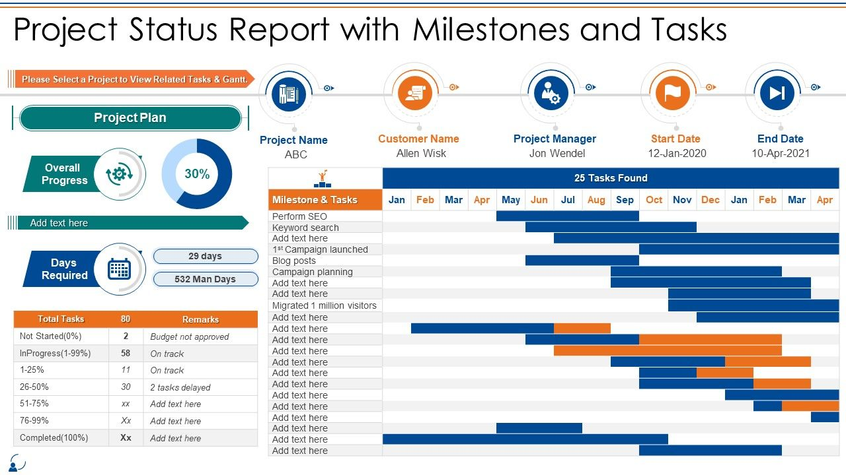
Planning Project Communications
Planning Project Communications
List of techniques to ensure your project communications are being used effectively:
Review regularly: Key elements in the project communications management plan should be reviewed at every project status meeting. Important communications should be reflected in project status reports.
Dr. Raef Baraka

Slide 24

Planning Project Communications
Planning Project Communications
List of techniques to ensure your project communications are being used effectively:
Keep a log: With so much information being shared on a project, maintain a log (or journal) of critical communications.
This will serve you well when documenting lessons learned.
Dr. Raef Baraka

Slide 25
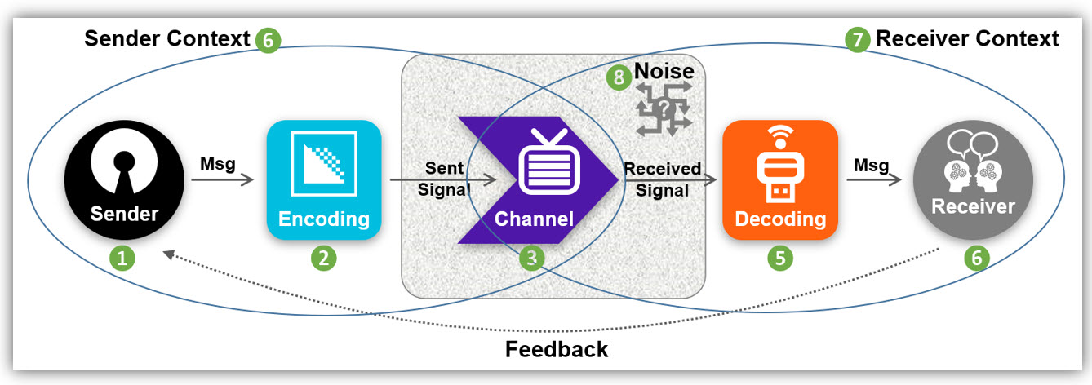
Planning Project Communications
Planning Project Communications
List of techniques to ensure your project communications are being used effectively:
Get feedback: Getting feedback is essential for effective project communications. In communicating and engaging with stakeholders, listen to their feedback and incorporate relevant input. We will discuss feedback further in Chapter 6.
Dr. Raef Baraka

Slide 26
Planning Project Communications
Planning Project Communications
List of techniques to ensure your project communications are being used effectively:
Do a systems assessment: Ask the project team and others who are accessing project information if systems for storing and retrieving project information are working properly. Make necessary adjustments or provide ongoing assistance.
Dr. Raef Baraka

Slide 27
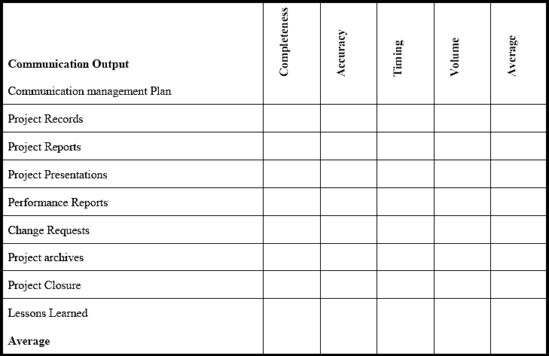
Planning Project Communications
Planning Project Communications
Dr. Raef Baraka

Slide 28
Planning Project Communications
Planning Project Communications
List of techniques to ensure your project communications are being used effectively:
Make updates: If something is not working in your project communications, make changes.
As changes occur, make necessary updates to the project communications management plan.
Keep track of changes through proper revision control.
Remember, the project communications management plan evolves over the life of the project.
Dr. Raef Baraka

Slide 29
Planning Project Communications
Planning Project Communications
List of techniques to ensure your project communications are being used effectively:
Ask questions: If you are uncertain about a process in the project communications management plan or a specific message, ask others. Get clarity before sending project information. One valuable technique is to have others read (or listen to) your message before sending (or saying) it. Ask: How does this read to you? How does this sound to you? This activity can make a tremendous difference.
Dr. Raef Baraka

Slide 30

Planning Project Communications
Planning Project Communications
List of techniques to ensure your project communications are being used effectively:
Lead by example: Make sure that you are effectively communicating. Over time, others will see your example and aspire to do the same.
Dr. Raef Baraka

Slide 31
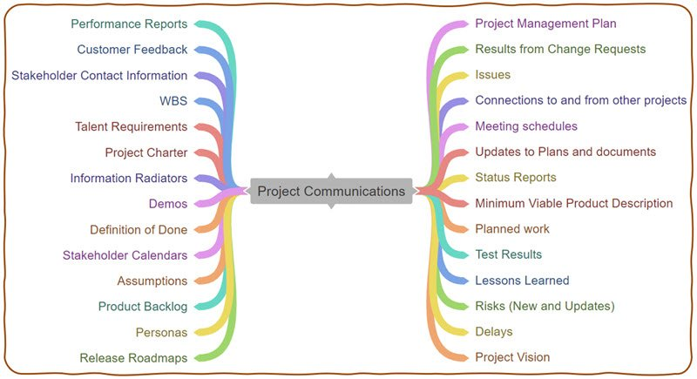
Project Communications Take Time

Slide 32
Planning Project Communications
Planning Project Communications
Having a communication expert on the project team could be extremely beneficial.:
This individual would work closely with the project manager to help orchestrate and support communications, assist in creating and executing the project communications management plan, and help reduce the risk of the wrong message being sent to the wrong stakeholder groups at the wrong time for the wrong purpose.
Keep in mind, however, that it is the project manager who is ultimately responsible for ensuring that the project communications management plan is created and properly executed.
Dr. Raef Baraka

Slide 33
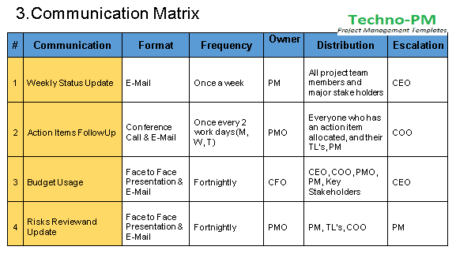
Communications Matrix

Slide 34
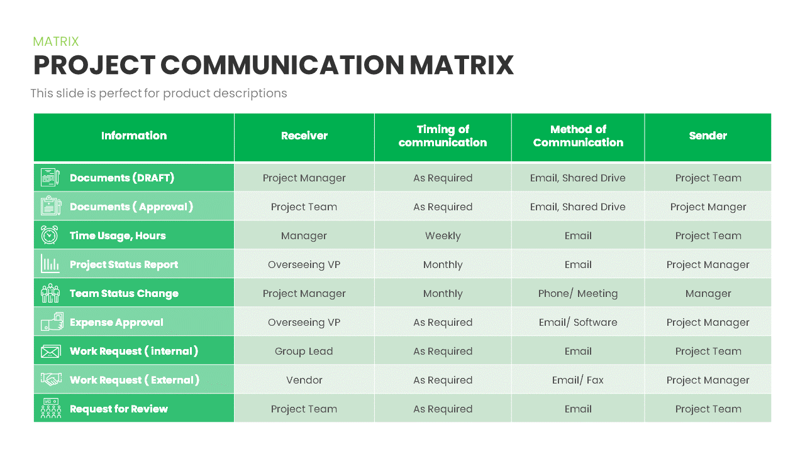
Communications Matrix

Slide 35
Communications Matrix
Communications Matrix
A communications matrix provides an “at a glance” document to quickly assess what information needs to be distributed, to whom, when, and how.
A communications matrix can also take many forms and is developed together by the project team. Information that is included in a communications matrix can come from a variety of sources—the sponsor, project manager, management, project team, stakeholder analysis, lessons learned from other projects, company requirements, etc.
Dr. Raef Baraka

Slide 36
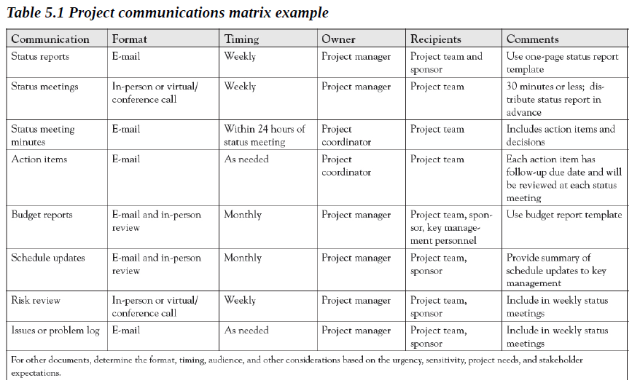

Slide 37
Communications Matrix
Communications Matrix
Since projects have lots of information, having an electronic document repository can be helpful.
This is a secure online location where all project data can be stored. Instead of e-mailing documents, a link to the information can be provided.
This helps with accessibility, version control, and data security.
Dr. Raef Baraka

Slide 38
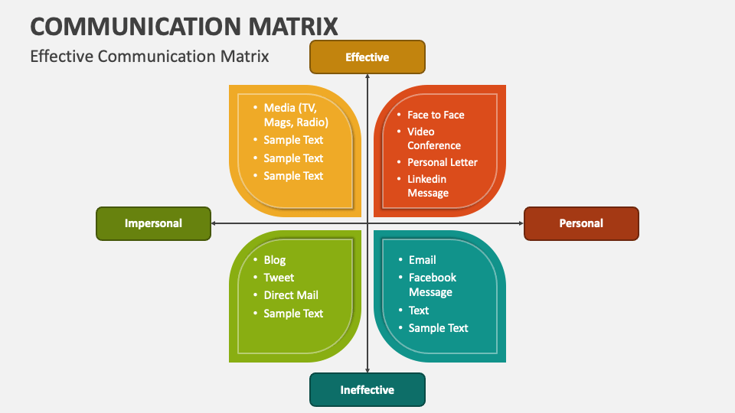

Slide 39
Starting with the Basics
Lecture Summary
Project communication is essential to project success. A project communications management plan helps you and the project team stay on track in keeping others informed—with the right message, at the right time, and for the right purpose. As the project team implements the project communications management plan, the team may find adjustments need to be made.
The project communications management plan should evolve throughout the life of the project. There are several techniques that you can use to ensure that your project communications management plan is being used effectively. Consider adding a communications specialist to your project team when needed.

Slide 40
Starting with the Basics
Lecture Summary
Project communications take time. A communications matrix provides an “at a glance” look at project communications. And finally:
If you fail to plan your project communications, you plan to fail.
Don’t overlook the importance and value of having an effective project communications management plan for your project—not only to have it, but to use it

Slide 41



Thank You

