Slide 1


System Administration (2)
IT401
Prepared by
Dr. Ahmed El-Douh
Lecture 8

Slide 2



System Administration 2
Lecture 8
IT401
Access Linux File Systems
Prepared by
Dr. Ahmed El-Douh

Slide 3
Objectives
Upon completion of this lecture, you will be able to:
  Identify the file system hierarchy.
  Access and view the contents of file systems.
  Use hard links and symbolic links to create multiple names for the same file.
  Search for files on mounted file systems.

Slide 4
Chapter
Outlines
08
Identifying File Systems and Devices
Mounting and Unmounting File Systems
Making Links Between Files
Locating Files on the System

Slide 5


Identifying File Systems and Devices

Slide 6
Storage Management Concepts
A file system is an organized structure that stores files and directories on a storage device such as a disk or partition.
The file system hierarchy combines all file systems into one directory tree with a single root: /.
One key advantage of this design is that storage can be expanded at any time by adding a new disk or partition that contains a supported file system.
Adding a new file system to the existing hierarchy is called mounting.
The directory where the new file system becomes accessible is called the mount point.
This is different from Microsoft Windows, where each new file system appears as a separate drive letter.

Slide 7
Storage Devices and Partitions
Hard disks and storage devices are divided into smaller units called partitions.
A partition allows you to organize a disk into separate sections.
Each section can have a different file system or a different purpose.
Example:
  One partition can store user home directories.
  Another partition can store system data and logs.
If one partition becomes full, other partitions remain usable.
This helps in planning and managing storage more efficiently.

Slide 8

Block Devices and Device Names
Storage devices in Linux are represented as block devices. These appear under the /dev directory.
Common device names:
  The first detected disk → /dev/sda
  The second disk → /dev/sdb
  The third → /dev/sdc
  …and so on.
Each disk is the whole device.
Partitions on that disk are numbered:
  First partition: /dev/sda1
  Second partition: /dev/sda2
  Third partition: /dev/sda3

Slide 9
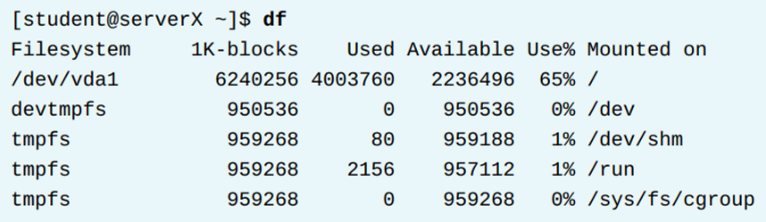
Examining File Systems
To view mounted file systems and check available and used disk space, use the df command.
Running df without any arguments displays:
  Total disk space
  Used space
  Available space
  Percentage of disk usage
  Mount points of all active file systems
The command reports information for both local and remote file systems.

Slide 10
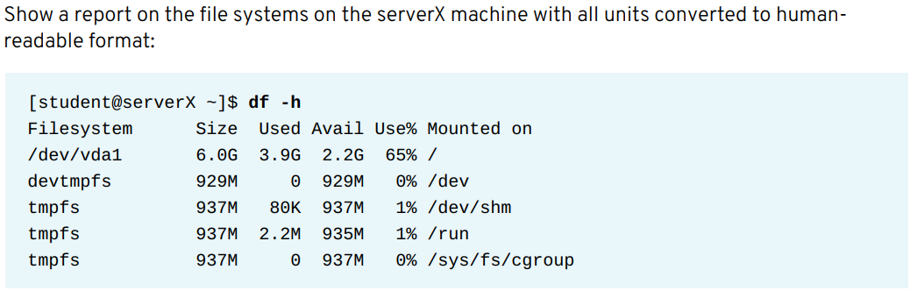
Examining File Systems

Slide 11
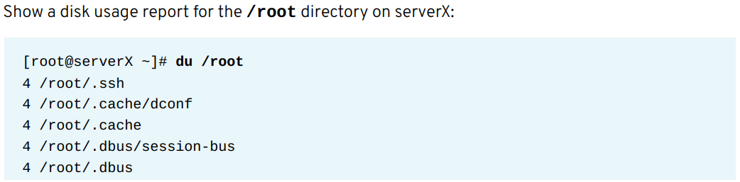
Examining File Systems

Slide 12
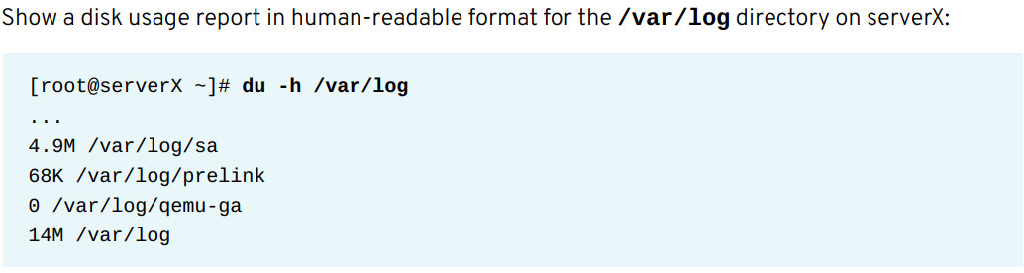
Examining File Systems

Slide 13
Mounting and Unmounting File Systems

Slide 14
Mounting and Unmounting File Systems
Objectives
After completing this section, students should be able to access the contents of file systems by adding file systems to the directory hierarchy through mounting.
Students should also be able to remove file systems from the directory hierarchy through unmounting.

Slide 15
Mounting File Systems Manually
Mounting File Systems Manually
A file system located on a SATA, PATA, or SCSI device must be mounted manually in order to access it.
The mount command allows the root user to manually mount a file system.
The first argument to the mount command specifies the file system to mount.
The second argument specifies the directory where the file system will be available after mounting.
This directory is called the mount point.
The mount command accepts the file system argument in two ways
The device file of the partition holding the file system, located under /dev
The UUID, which is the universal unique identifier of the file system

Slide 16
Mounting and Unmounting File Systems
Using blkid
The blkid command provides information about existing partitions that contain a file system.
It displays the UUID of each file system and the file system type used to format it.
Example Output

Slide 17
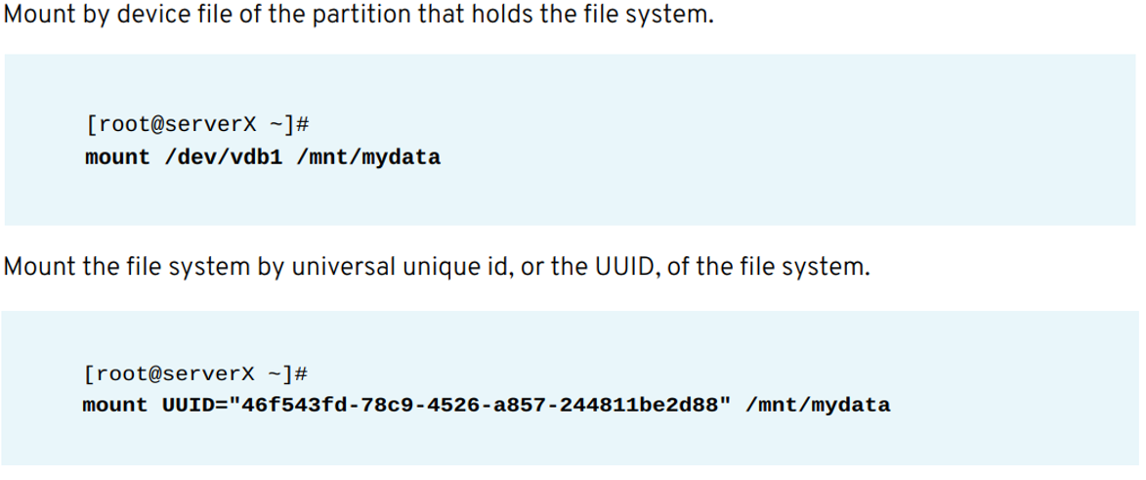
Mounting and Unmounting File Systems

Slide 18
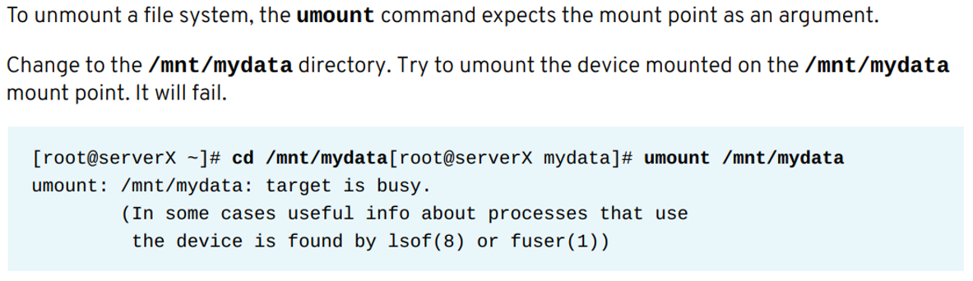
Unmounting File Systems

Slide 19
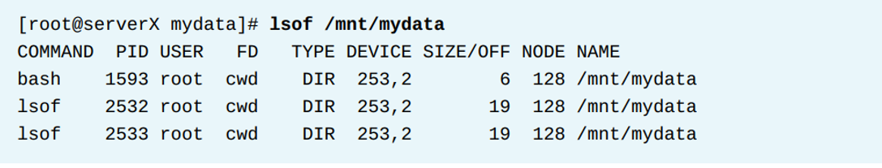
Mounting and Unmounting File Systems
A file system cannot be unmounted if a process is accessing the mount point.
To successfully unmount, the process must stop using the mount point.
The lsof command lists open files and the processes that are using them.
This helps identify which process is preventing the unmount operation.

Slide 20
Making Links Between Files

Slide 21
Making Links Between Files
Objectives
After completing this section, students should be able to create hard links and soft links.
Students should understand how multiple names can point to the same file.

Slide 22
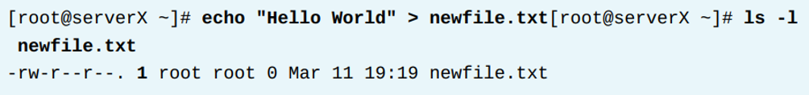
Making Links Between Files
Creating Hard Links
A hard link is a new directory entry that points to the same file on the file system.
Every file starts with one hard link by default.
Creating a hard link allows multiple file names to refer to the same content without copying the data.
Hard links must be created in the same file system.
All hard links share the same permissions, ownership, timestamps, and content.
The ls -l command shows the hard link count next to the permissions column.

Slide 23
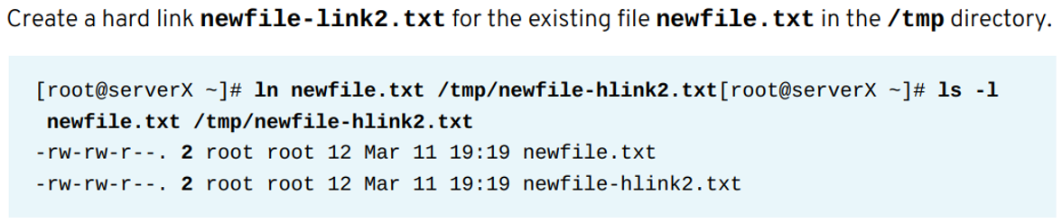
Making Links Between Files
Creating Hard Links with ln
The ln command is used to create new hard links to an existing file.
The first argument is the existing file.
The second argument is the name or location of the new hard link.
Hard links can be placed anywhere as long as they are on the same file system.
Once created, all hard links are identical and there is no way to know which one was the original name.
Example

Slide 24
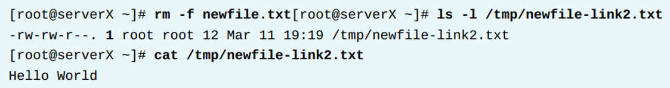
Making Links Between Files
Hard Links and File Deletion
When the original file name is removed, the data itself remains available as long as at least one hard link still exists.
The file content is not deleted until the last hard link is removed.
Example

Slide 25
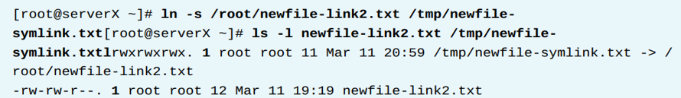
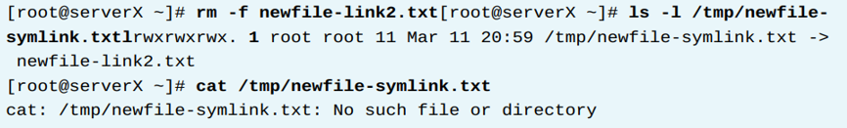
Making Links Between Files
Creating Soft Links
The ln -s command creates a soft link, also called a symbolic link.
A soft link is a special file that points to another file or directory.
Unlike hard links, soft links can point to directories and can point to targets on different file systems.
A soft link stores only the path of the original target.
When the original file is deleted, the soft link still exists but points to a missing file.
This is called a dangling soft link.

Slide 26
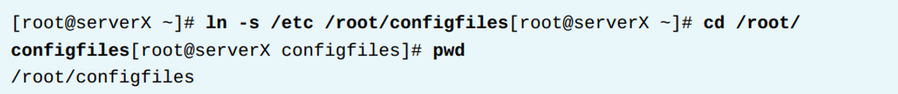
Making Links Between Files
Soft Links to Directories
A soft link can point to a directory.
When accessing the soft link with cd, it behaves exactly like entering the original directory.
Example

Slide 27
Locating Files on the System

Slide 28
Locating Files on the System
Objectives
After completing this section, students should be able to search for files on mounted file systems using the find and locate commands.
Tools for Finding Files
A system administrator needs tools for searching files based on specific criteria within the file system.
This section covers two commands for searching files:
locate searches a pre-generated database for file names or paths and returns results instantly.
find searches the file system directly in real time by crawling through directories and matching specific conditions.

Slide 29
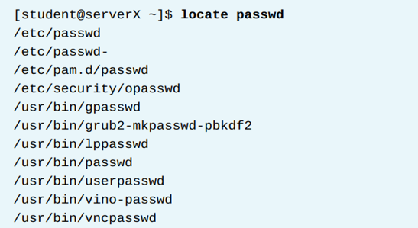
Locating Files on the System
Locating Files by Name with locate
The locate command searches for files by name or path using a local database.
The database contains a list of file names and paths.
Results are returned only from directories where the user has read permissions.
Use locate to quickly find files that match a specific keyword.

Slide 30
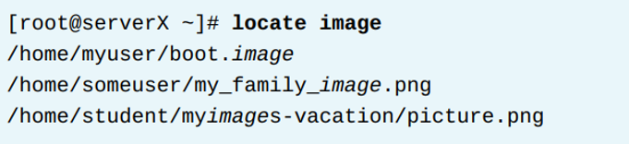
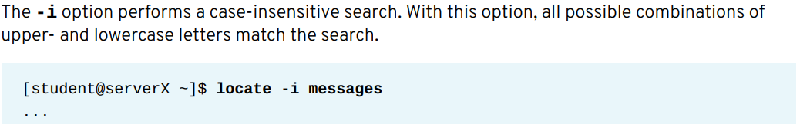
Locating Files on the System
Partial matches with locate
The locate command returns results even when the search keyword matches only part of the file name or directory path.
When a user searches for a term, any file or directory that contains this term in its name or in any part of its path will be listed.
Example:

Slide 31
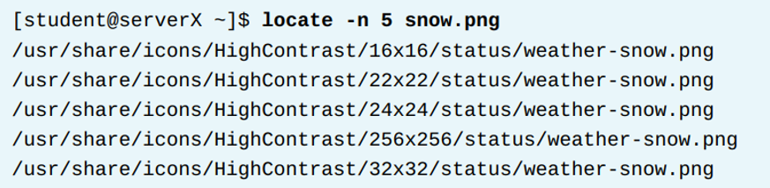
Locating Files on the System
Limiting results with the -n option
The -n option limits the number of search results returned by the locate command.
This is useful when the search keyword produces a large number of matches.
For example, the following command returns only the first five matches for the file name snow.png:

Slide 32
Locating Files on the System
Searching for Files with find
The find command performs a real-time search in the local file system.
It searches for files that match the criteria provided in the command-line arguments.
The command runs using the permissions of the current user.
The user running find must have read and execute permissions on directories to see their contents.
The first argument to find is the starting directory of the search.
If no directory is provided, find starts searching in the current directory and all its subdirectories.
To search the home directory of user student, start the search at:/ home /student
To search the entire system, start the search at: /

Slide 33
Locating Files on the System
Searching with the -name option
The name option allows find to look for files that match a specific file name.
It returns only the exact matches of the name provided.
To search for a file named sshd_config starting from the root directory and all subdirectories, use:
The name option can also match patterns when using wildcard characters.
To search for all files ending with .txt starting from the root directory, use:

Slide 34
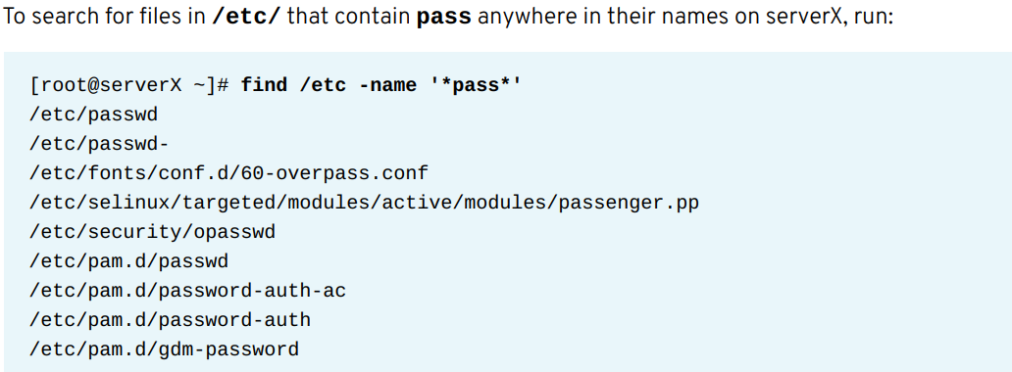
Locating Files on the System

Slide 35
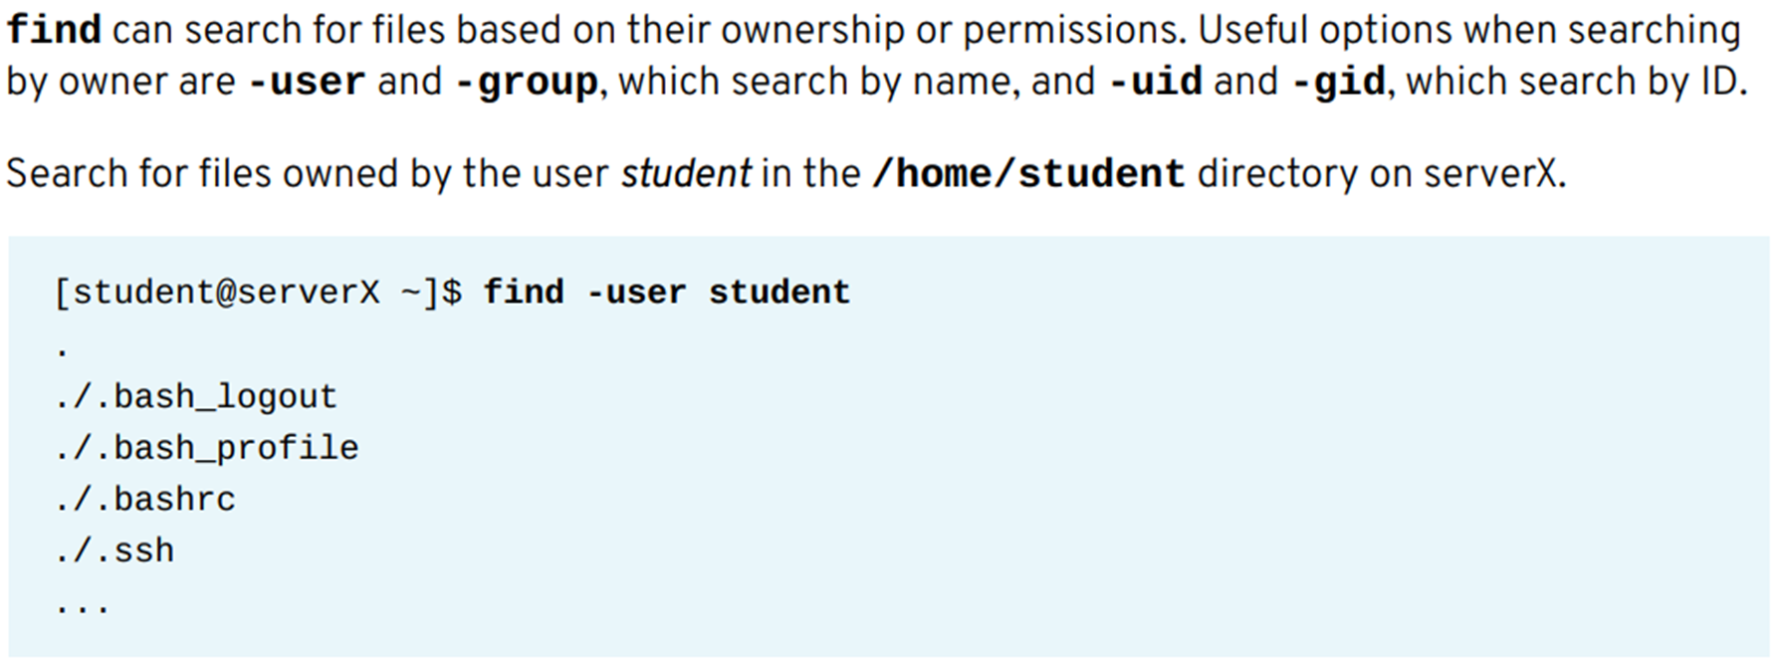
Locating Files on the System

Slide 36
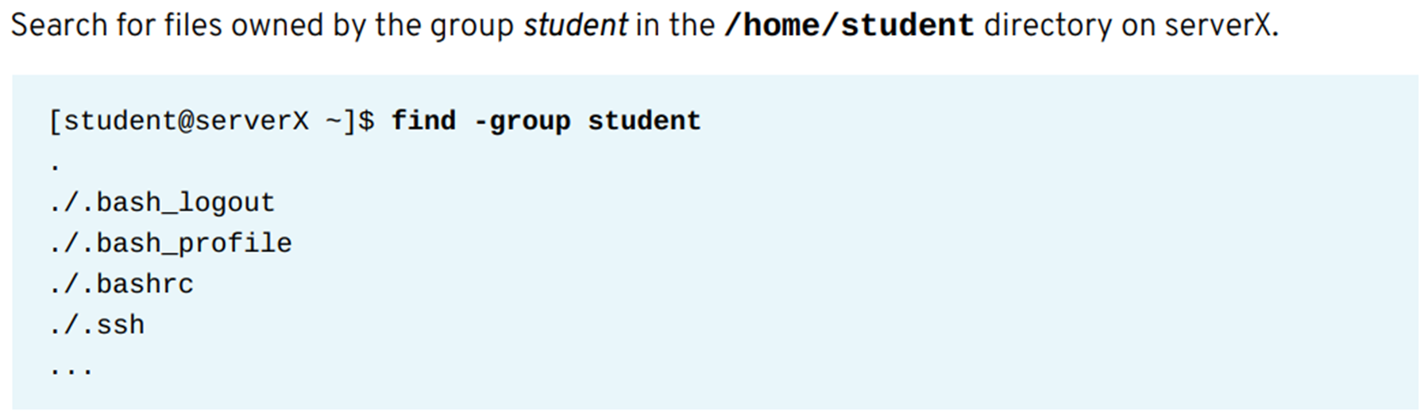
Locating Files on the System

Slide 37
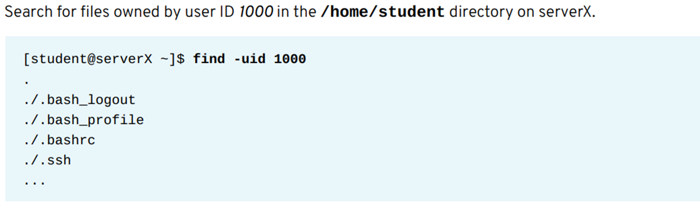
Locating Files on the System

Slide 38

Locating Files on the System

Slide 39
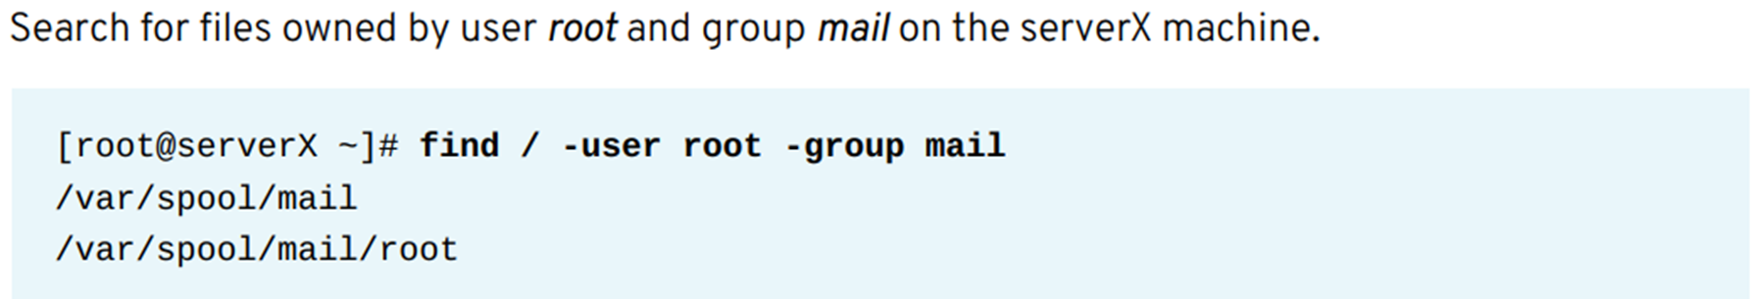
Locating Files on the System

Slide 40
Summary
Identified file systems and storage devices using commands like blkid, lsblk, and device paths.
Mounted and unmounted file systems using device names and UUIDs and handled mount point issues.
Created and managed hard links and soft links and understood behavior, usage, and differences.
Searched for files using locate and find based on name, type, ownership, patterns, and permissions.

Slide 41



Thank You

