Slide 1


Human Resources Management
Robert L. Mathis ⏐ John H. Jackson
Prepared by Dr. Samah Abdelfatah
MGM 243
Lecture 01

Slide 2



Changing Nature of Human
Resource Management
Chapter
01
Lecture 01
MGM 243
Prepared by
Dr. Samah Abdelfatah
www.midocean.ae

Slide 3

Chapter
LEARNING OBJECTIVES
01
After you read this chapter, you should be able to:
  Define human capital and explain its importance.
  Identify the seven categories of HR activities.
  Describe how the major roles of HR management are being
  transformed.
  Discuss four challenges facing HR today.
  Identify the purposes and uses of HR technology.
  Discuss why ethical issues affect HR management.
  Explain the key competencies needed by HR professionals
www.midocean.ae

Slide 4

www.midocean.ae
Human Resource Management
  The design of formal systems in an organization to ensure effective and efficient use of human talent to accomplish organizational goals.
Who Is an HR Manager?
  All managers at every level must concern themselves with human resource management
  HR specialists design processes and systems that operating managers help implement.
Chapter
01
NATURE OF HUMAN RESOURCE MANAGEMENT

Slide 5
Chapter
HUMAN CAPITAL IN ORGANIZATIONS
01
All these assets are crucial in varying degrees in different organizations. But the human assets are the “glue” that holds all the other assets together and guides their use to achieve results
In all organizations there are many resources that affect organizational performance. Organizations must manage four types of assets:
Physical: Buildings, land, furniture, computers, vehicles, equipment, etc.
Financial: Cash, financial resources, stocks, financial securities, etc.
Intangible: Specialized research capabilities, patents, information systems, designs, operating processes, etc.
Human: Individuals with talents, capabilities, experience, professional expertise, relationships, etc
All these assets are crucial in varying degrees in different organizations. But the human assets are the “glue” that holds all the other assets together and guides their use to achieve results
www.midocean.ae

Slide 6
Chapter
HUMAN CAPITAL AND HR
01
For example, f rms with high intellectual capital may have technical and research employees who create new biomedical devices, formulate pharmaceuticals that can be patented, and develop new software for specialized uses. All these organizational contributions illustrate the potential value of human capital
What is the difference between HR & HC?
Human capital : The collective value of the capabilities, knowledge, skills, life experiences, and motivation of an organizational workforce.
Sometimes it is called intellectual capital to reflect the thinking, knowledge, creativity, and decision making that people in organizations contribute
For example, firms with high intellectual capital may have technical and research employees who create new biomedical devices, formulate pharmaceuticals that can be patented, and develop new software for specialized uses. All these organizational contributions illustrate the potential value of human capital
www.midocean.ae

Slide 7


Chapter
HUMAN RESOURCES AS A CORE COMPETENCY
01
For example, f rms with high intellectual capital may have technical and research employees who create new biomedical devices, formulate pharmaceuticals that can be patented, and develop new software for specialized uses. All these organizational contributions illustrate the potential value of human capital
The development and implementation of specific organizational strategies must be based on the areas of strength in an organization
Core competency A unique capability that creates high value and differentiates an organization from its competitors.
www.midocean.ae

Slide 8


Slide 9
Chapter
HR ACTIVITIES
01
HR management can be thought of as seven interlinked activities taking place within organizations, as depicted in Figure 1-1.
Strategic HR Management
Equal Employment Opportunity
Staffing
Talent Management and Development
Total Rewards
Risk Management and Worker Protection
Employee and Labor Relations
www.midocean.ae

Slide 10
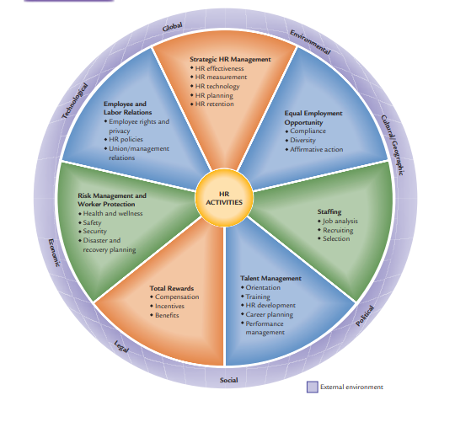
HR MANAGEMENT ACTIVITIES
Figure 1-1
www.midocean.ae

Slide 11
Chapter
TYPICAL DIVISION OF HR RESPONSIBILITIES
01
HR Unit
  Develops legal, effective interviewing techniques
  Trains managers in conducting selection interviews
  Conducts interviews and testing
  Sends top three applicants to managers for final review
  Checks references
  Does final interviewing and hiring for certain job classifications
Managers
  Advise HR of job openings
  Decide whether to do own final interviewing
  Receive interview training from HR unit
  Do final interviewing and hiring where appropriate
  Review reference information
  Provide feedback to HR unit on hiring/rejection decisions
www.midocean.ae

Slide 12
Chapter
HR MANAGEMENT ROLES
Administrative
Role
Operational and Employee Advocate Role for HR
Strategic Role for HR
Focusing on HR clerical administration and recordkeeping
Managing most HR activities in keeping with the strategy that has been identified by management and serving as employee “champion”
Helping to define the strategy relative to human capital and its contributing to organizational results
Figure1-2
www.midocean.ae

Slide 13
Chapter
ADMINISTRATIVE ROLE
01
Two major shifts driving the transformation of the administrative role : are greater use of technology and outsourcing.
Technology Transforming HR To improve the administrative efficiency of HR and responsiveness of HR to employees and managers, more HR functions are becoming available electronically or are being done on the Internet.
Outsourcing of HR Increasingly, many HR administrative functions are being outsourced to vendors. Outsourcing of HR administrative activities has grown dramatically with the value of outsourcing contracts tripling recently, and there are projections of large increases occurring over the next several years.
www.midocean.ae

Slide 14
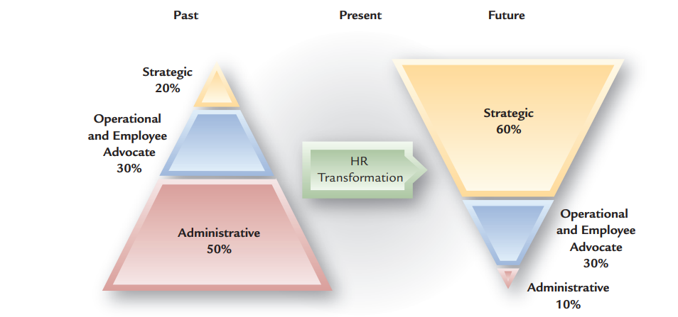
CHANGING ROLES OF HR MANAGEMENT
Figure 1-3
www.midocean.ae

Slide 15
OPERATIONAL AND EMPLOYEE ADVOCATE ROLE FOR HR
Chapter
01
Operational Role
  Identification and implementation of HR programs and policies—EEO, hiring, training, and other activities that support the organization.
Advocate Role
“Champion” for employee concerns
    Employee crisis management
    Responding to employee complaints
www.midocean.ae

Slide 16
Chapter
STRATEGIC ROLE FOR HR
01
HR becomes a strategic business partner by:
  Focusing on developing HR programs that enhance organizational performance .
  Involving HR in strategic planning at the onset.
  Participating in decision making on mergers, acquisitions, and downsizing.
  Redesigning organizations and work processes
  Accounting and documenting the financial results of HR activities.
www.midocean.ae

Slide 17
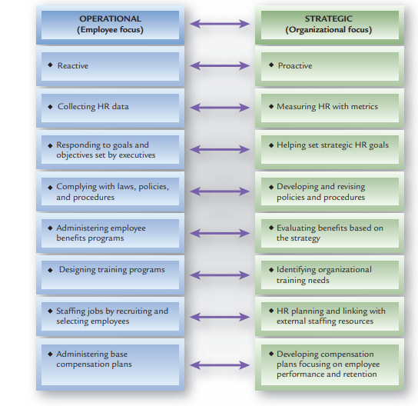
OPERATIONAL TO STRATEGIC TRANSFORMATION
OF HR
Figure 1-4
www.midocean.ae

Slide 18
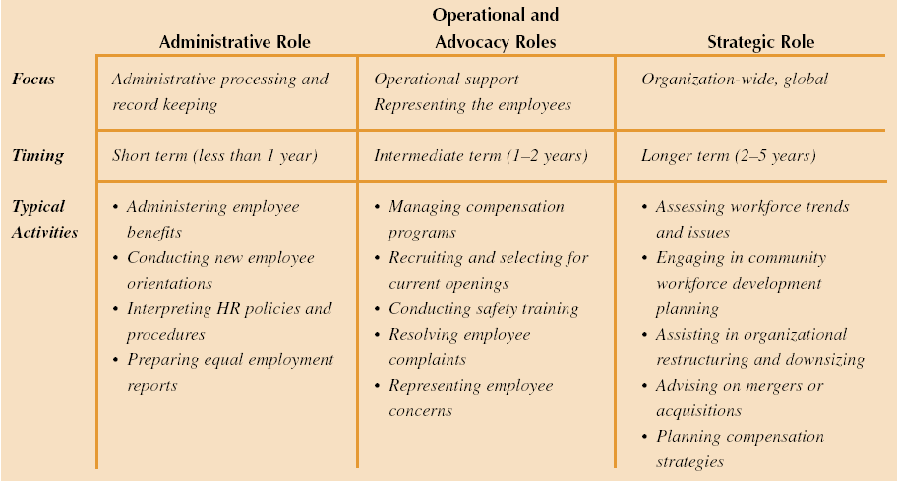
Overview of HR Management Roles
Figure 1-5
www.midocean.ae

Slide 19
Chapter
HR MANAGEMENT CHALLENGES
01
Globalization of Business
Economic and Technological Changes
Workforce Demographics and Diversity
Organizational Cost Pressures and Restructuring
Figure 1-6
www.midocean.ae

Slide 20
Chapter
GLOBALIZATION OF BUSINESS
01
Off-shoring U.S. businesses contracting out activities to unaffi liated companies or their affi liates in another country.
The internationalization of business has proceeded at a rapid pace.
The globalization of business has shifted from trade and investment to the integration of global operations, management, and strategic alliances, which has significantly affected the management of human resource
As a result:
Off-shoring : businesses contracting out activities to unaffiliated companies or their affiliates in another country.
In-shoring: Foreign businesses shifting activities to the home country
Outsourcing: Businesses contracting out activities to unaffiliated companies either at home or abroad
www.midocean.ae

Slide 21
Chapter
ECONOMIC AND TECHNOLOGICAL CHANGES
01
Off-shoring U.S. businesses contracting out activities to unaffi liated companies or their affi liates in another country.
Occupational Shifts A major change is the shift of jobs from manufacturing and agriculture to service and telecommunications.
Workforce Availability and Quality Concerns Many parts of the world face significant workforce shortages that exist due to an inadequate supply of workers with the skills needed to perform the jobs being added
www.midocean.ae

Slide 22
ECONOMIC AND TECHNOLOGICAL CHANGES
Growth in Contingent Workforce Contingent workers (temporary workers, independent contractors, leased employees, and part-timers). caused by:
    Need for flexibility in staffing levels
    Increased difficulty in firing regular employees.
    Reduced legal liability from contract employees
Technological Shifts and the Internet Globalization and economic shifts have been accelerated by technological changes, with the Internet being a primary driver.
www.midocean.ae

Slide 23
Chapter
WORKFORCE DEMOGRAPHICS AND DIVERSITY
01
Racial/Ethnic Diversity Racial and ethnic minorities account for a growing percentage of the overall labor force
Balancing Work and Family
Dual-career couples
Single-parent households
Decline in the “traditional family”
Working mothers and family/childcare
Aging Workforce In many economically developed countries, the population is aging, resulting in a significantly aging workforce
www.midocean.ae

Slide 24
ORGANIZATIONAL COST PRESSURES AND RESTRUCTURING
Chapter
01
As part of organizational changes, many organizations have “rightsized” by: (1) eliminating layers of managers, (2) closing facilities, (3) merging with other organizations, and (4) outplacing workers. To improve productivity, quality, and service while also reducing costs, they are redesigning jobs and affecting people.
An overriding theme facing managers and organizations is to operate in a “cost-less” mode, which means continually looking for ways to reduce costs of all types— financial, operations, equipment, and labor.
As part of organizational changes, many organizations have “rightsized” by:
(1) eliminating layers of managers,
(2) closing facilities,
(3) merging with other organizations, and
(4) outplacing workers.
www.midocean.ae

Slide 25
To improve productivity, quality, and service while also reducing costs, they are redesigning jobs and affecting people.
    Intended results are flatter organizations, increases in productivity, quality, service and lower costs.
    Loss of employee loyalty, and turnover of valuable employees.
  HR managers must work toward ensuring cultural compatibility in mergers.
www.midocean.ae

Slide 26
Chapter
JOBS OF THE FUTURE
01
As part of organizational changes, many organizations have “rightsized” by: (1) eliminating layers of managers, (2) closing facilities, (3) merging with other organizations, and (4) outplacing workers. To improve productivity, quality, and service while also reducing costs, they are redesigning jobs and affecting people.
AI and machine learning specialists
Cybersecurity experts
Data scientists and analysts
Healthcare professionals
Cybersecurity Analyst
Renewable energy technicians
Agricultural innovators
Data Analyst
Software developer
www.midocean.ae

Slide 27

Chapter
HR TECHNOLOGY
01
As part of organizational changes, many organizations have “rightsized” by: (1) eliminating layers of managers, (2) closing facilities, (3) merging with other organizations, and (4) outplacing workers. To improve productivity, quality, and service while also reducing costs, they are redesigning jobs and affecting people.
Human resource management system (HRMS) An integrated system providing information used by HR management in decision making
www.midocean.ae

Slide 28

Chapter
PURPOSES OF AN HRMS
01
As part of organizational changes, many organizations have “rightsized” by: (1) eliminating layers of managers, (2) closing facilities, (3) merging with other organizations, and (4) outplacing workers. To improve productivity, quality, and service while also reducing costs, they are redesigning jobs and affecting people.
An HRMS serves two major purposes in organizations.
One relates to administrative and operational efficiency, the other to effectiveness.
The first purpose is to improve the efficiency with which data on employees and HR activities are compiled. If automated, many HR activities can be performed more efficiently and quickly and with less paperwork
The second purpose of an HRMS is more strategic and is related to HR planning. Having accessible data enables HR planning and managerial decision making to be based to a greater degree on information rather than relying on managerial perceptions and intuition.
www.midocean.ae

Slide 29
Chapter
OTHER USES OF HR TECHNOLOGY
01
As part of organizational changes, many organizations have “rightsized” by: (1) eliminating layers of managers, (2) closing facilities, (3) merging with other organizations, and (4) outplacing workers. To improve productivity, quality, and service while also reducing costs, they are redesigning jobs and affecting people.
HR technology has many uses in an organization.
The most basic is the automation of payroll and benefits activity
tracking EEO/affirmative action activities.
Web-based information systems:
        Bulletin boards
        Data access
        Employee self-service
        Extended linkage
www.midocean.ae

Slide 30
Chapter
ETHICS AND HR MANAGEMENT
01
What is Ethical Behavior?
  What “ought” to be done.
  Organizations that are seen as operating with integrity are viewed more positively by individuals in the community and industry, as well as by consumers and employees.
  Examples for Unethical Practices(Enron, WorldCom, Tyco, numerous financial and investment firms, and other organizations).
www.midocean.ae

Slide 31
Chapter
ETHICS AND GLOBAL DIFFERENCES
01
    Differences in legal, political, and cultural values and practices in different countries often raise ethical issues for global employers. Those employers also must comply with their home-country laws.
www.midocean.ae

Slide 32
ETHICAL BEHAVIOR AND ORGANIZATIONAL CULTURE
Organizational culture The shared values and beliefs in an organization.
Basically, organizational culture is “how things are done here.”
HR plays a key role in ensuring ethical behavior in organizations.
www.midocean.ae

Slide 33
ETHICAL BEHAVIOR AND ORGANIZATIONAL CULTURE (CONT’D)
When the following four elements of ethics programs exist, ethical behavior is likely to occur:
A written code of ethics and standards of conduct
Training on ethical behavior for all executives, managers, and employees
Means for employees to obtain advice on ethical situations they face, often provided by HR
Systems for confidential reporting of ethical misconduct or questionable behavior
www.midocean.ae

Slide 34
Chapter
HR’S ROLE IN ORGANIZATIONAL ETHICS
01
Responding to Ethical Situations
  Guided by values and personal behavior “codes” that include:
    Does response meet all applicable laws, regulations, and government codes?
    Does response comply with all organizational standards of ethical behavior?
    Does response pass the test of professional standards for ethical behavior?
www.midocean.ae

Slide 35
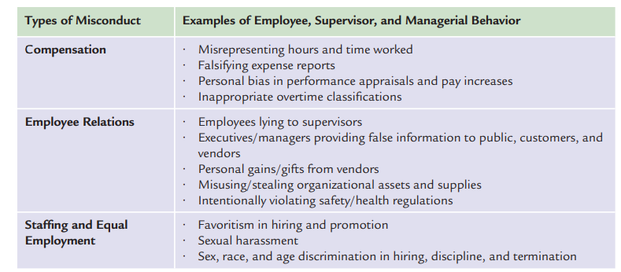
EXAMPLES OF ETHICAL MISCONDUCT IN HR ACTIVITIES
Figure 1-7
www.midocean.ae

Slide 36
Chapter
HR Management Competencies and Careers
01
The five areas of HR competencies are described briefly as follows
Strategic contribution: key competency that HR needs to fulfill its strategic role
Business knowledge: They must understand the financial, technological, and other facets of the industry and the organization.
www.midocean.ae

Slide 37
HR MANAGEMENT COMPETENCIES
AND CAREERS (CONT’D)
Chapter
01
HR delivery: HR activities must be delivered effectively and efficiently
in ways that meet the needs of both the organization and its employees.
HR technology: information systems and Web based resources, have become a significant part of HR management today.
Personal credibility: HR professionals must have credibility personally and professionally manage internal and external relationships
www.midocean.ae

Slide 38
Chapter
HR MANAGEMENT AS A CAREER FIELD
01
HR Generalist
  A person with responsibility for performing a variety of HR activities.
HR Specialist
  A person with in-depth knowledge and expertise in a limited area of HR.
www.midocean.ae

Slide 39
Chapter
HR PROFESSIONALISM AND CERTIFICATION
01
Professional Involvement and Development The most well-known certification programs for HR generalists are administered by the Human Resource Certification Institute (HRCI), which is affiliated with Society for Human Resource Management (SHRM)
PHR/SPHR Certification The most widely known HR certifications are the Professional in Human Resources (PHR) and the Senior Professional in Human Resources (SPHR), both sponsored by HRCI.
www.midocean.ae

Slide 40
Chapter
SUMMARY
01
Human Capital
HR Activities
HR Roles
HR Challenges
HR Technology
HR Ethics
Professional HR
www.midocean.ae

Slide 41



Thank You

