Slide 1


Slide 2


Slide 3
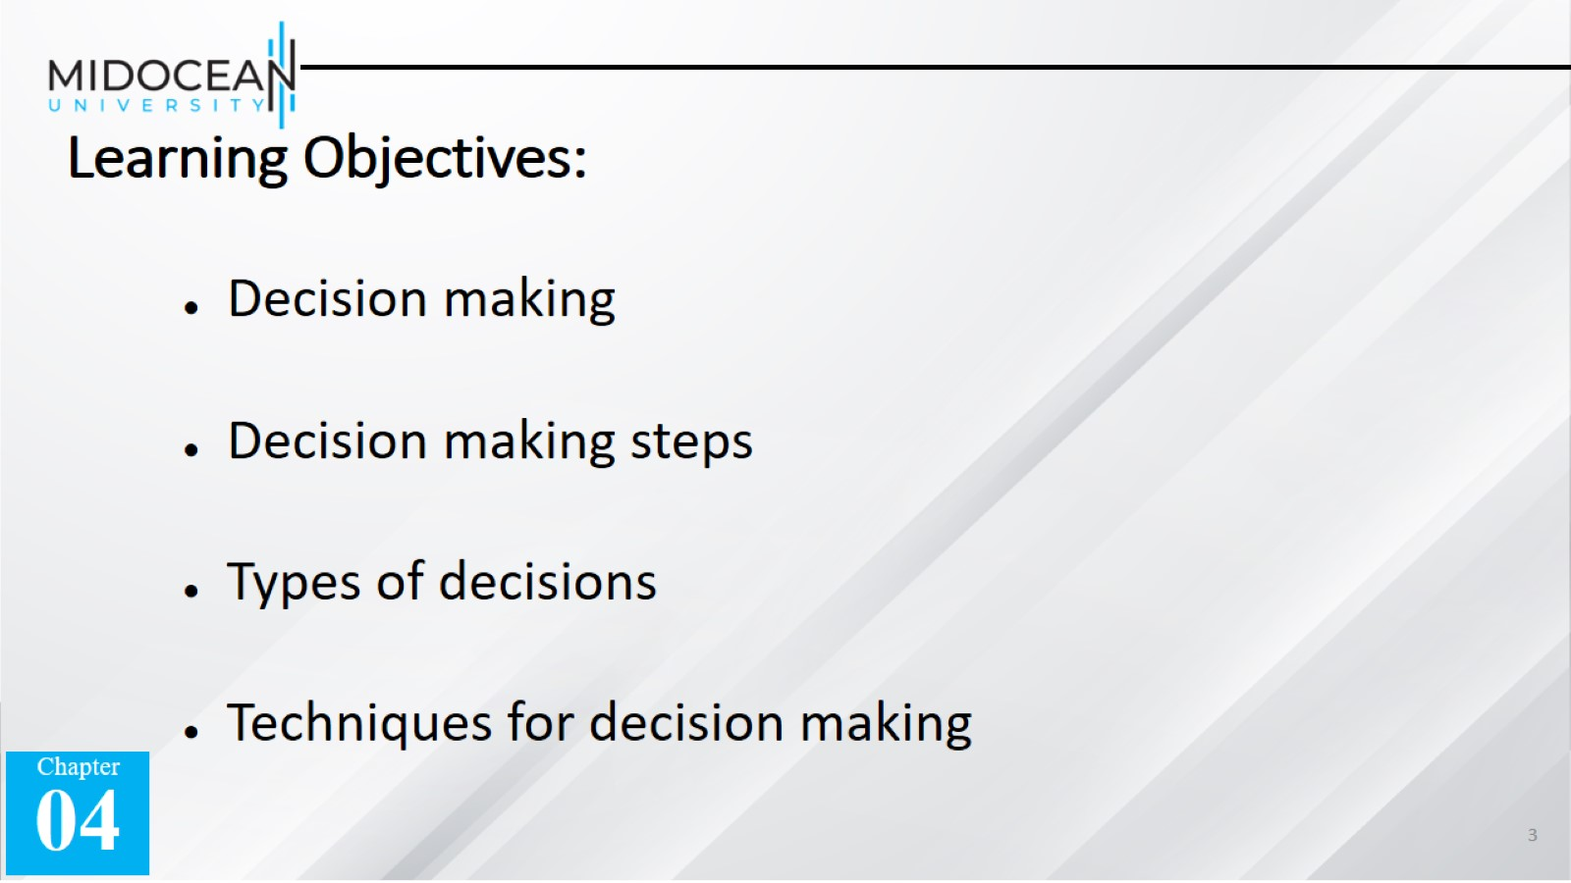
Learning Objectives:

Slide 4


Slide 5


Slide 6


Slide 7
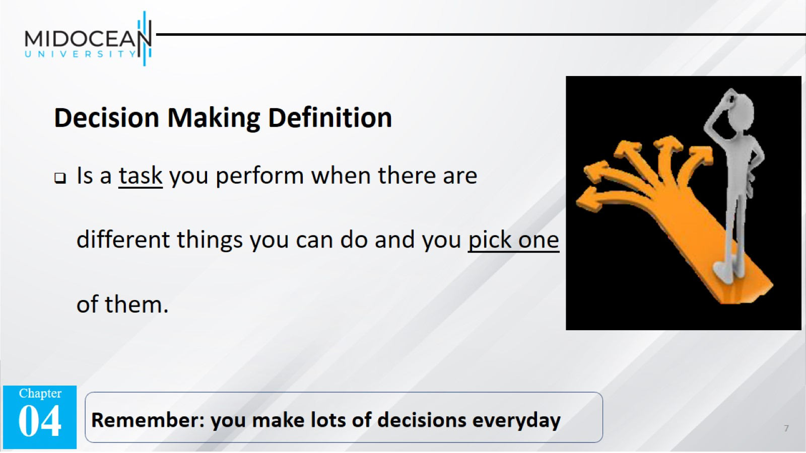

Slide 8
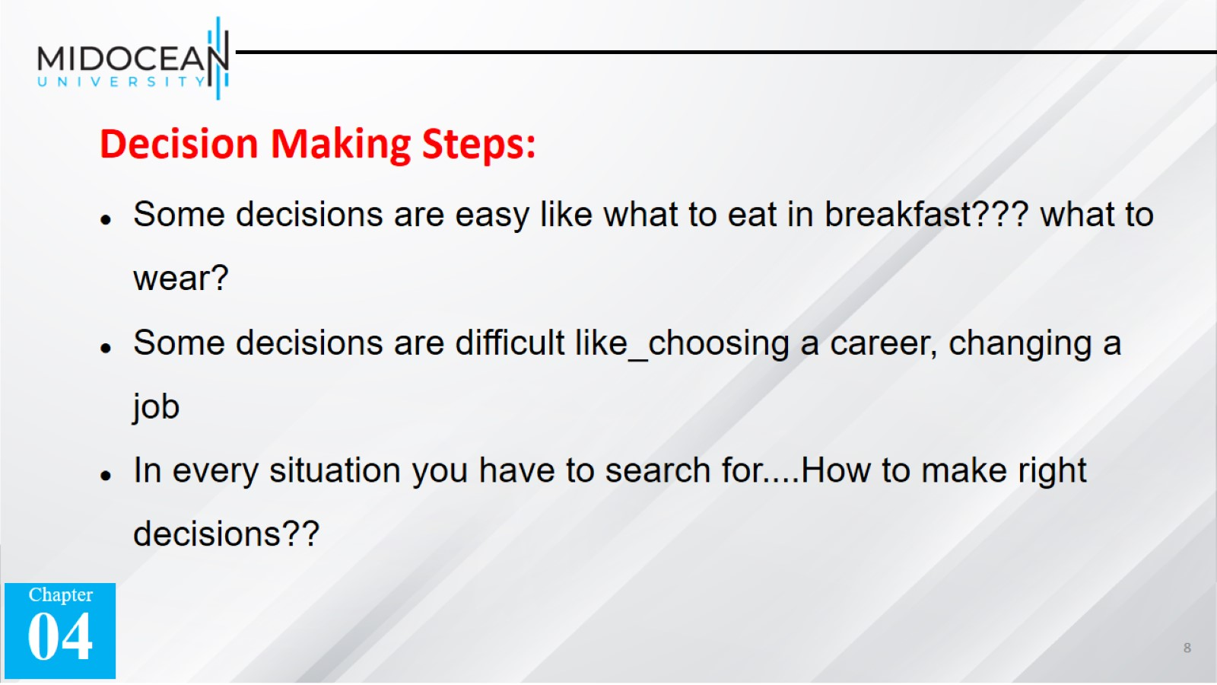

Slide 9
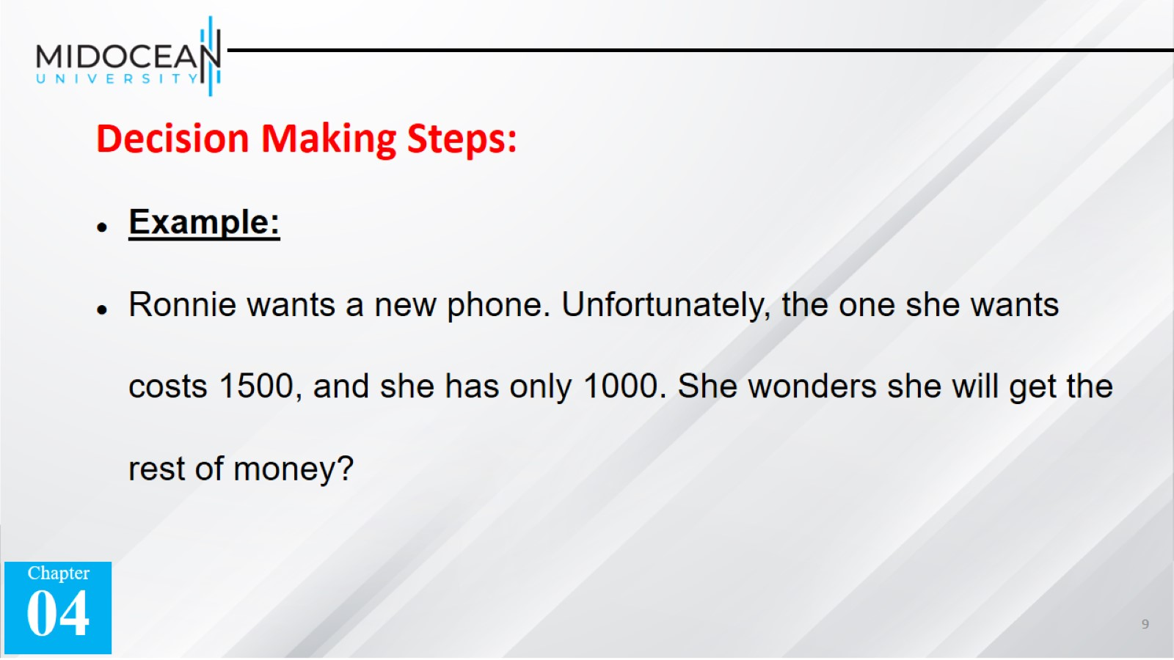

Slide 10


Slide 11
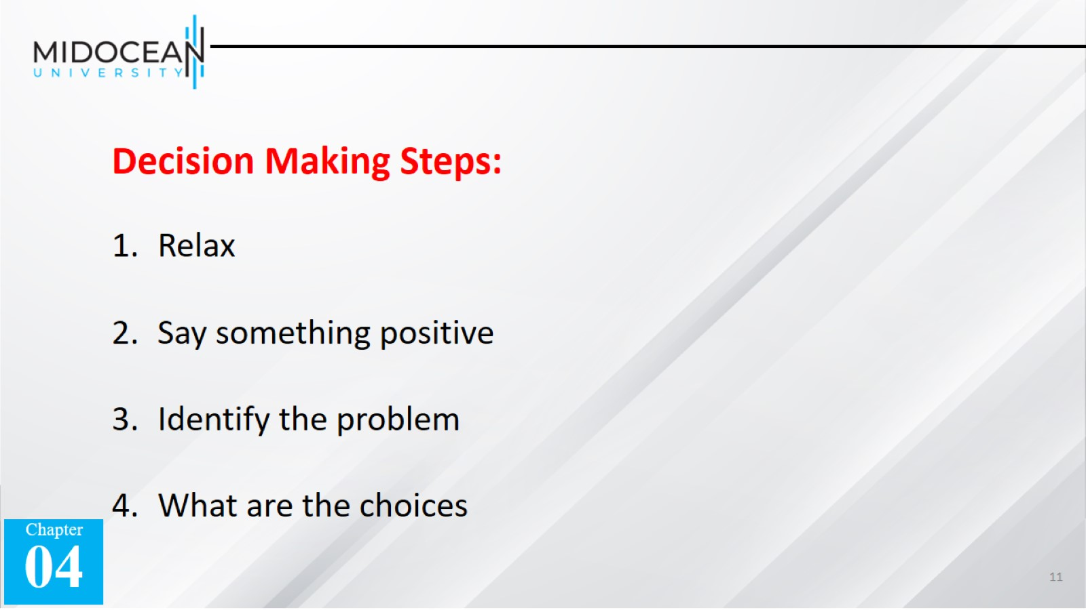

Slide 12
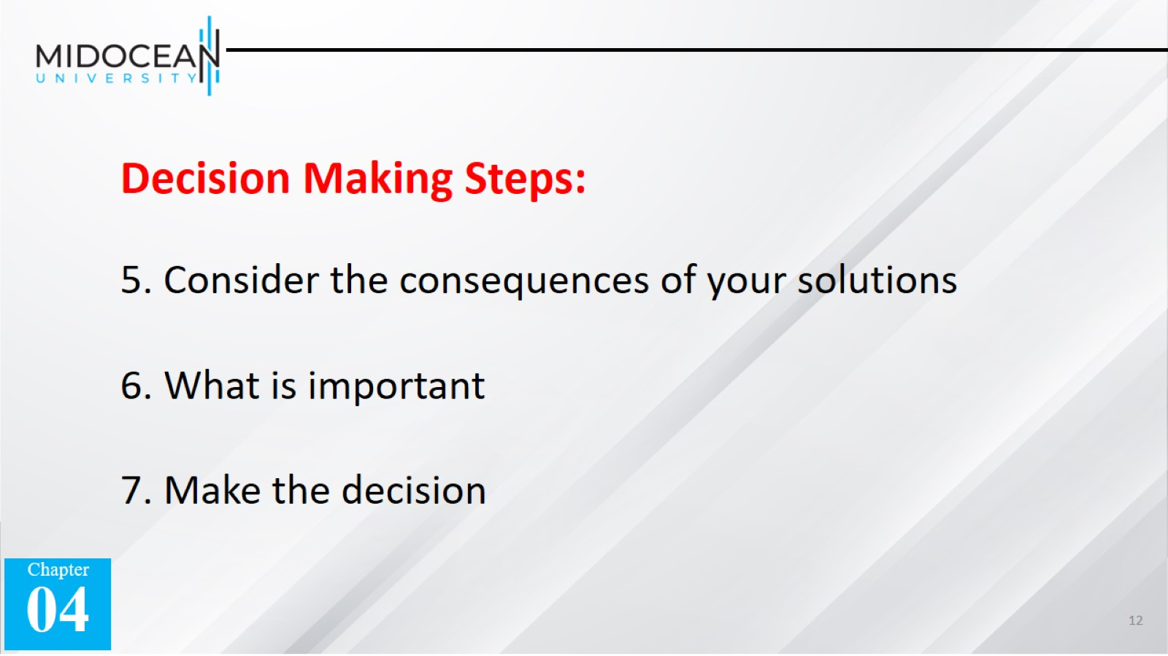

Slide 13


Slide 14
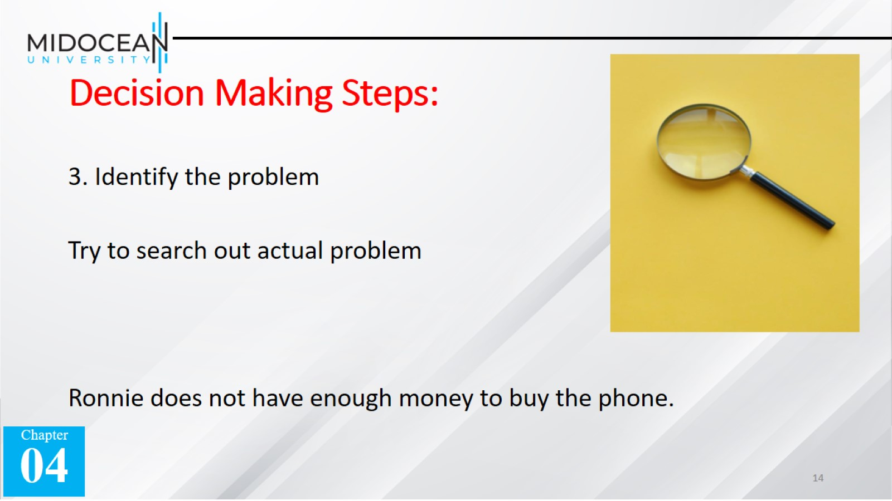
Decision Making Steps:

Slide 15
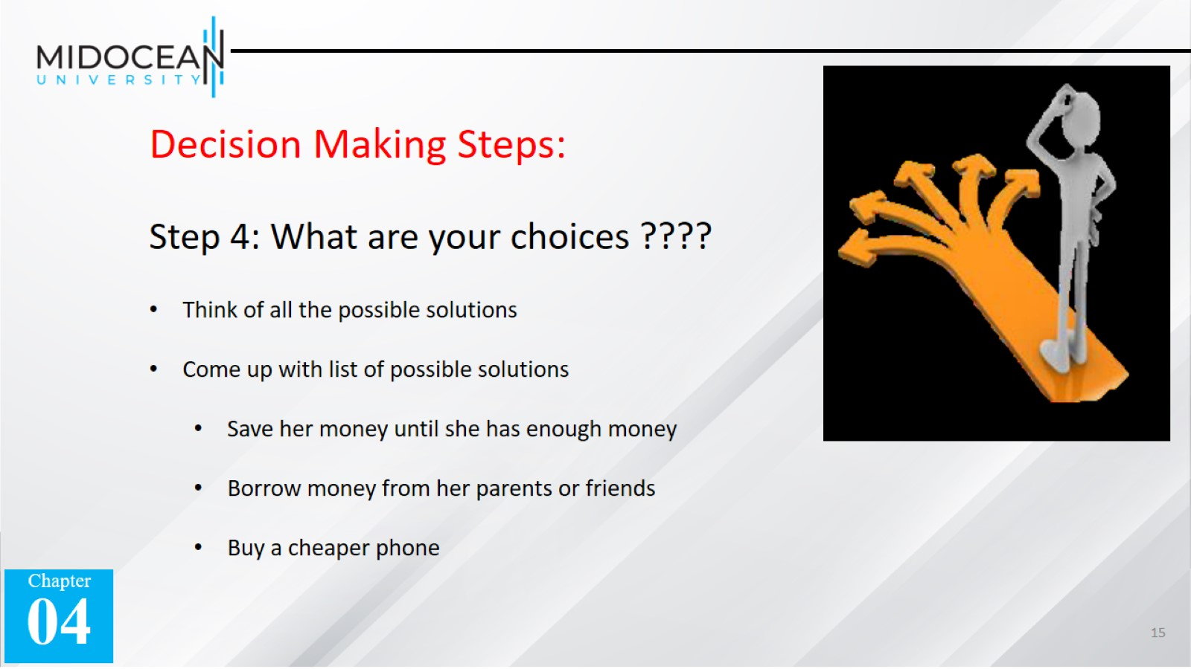

Slide 16
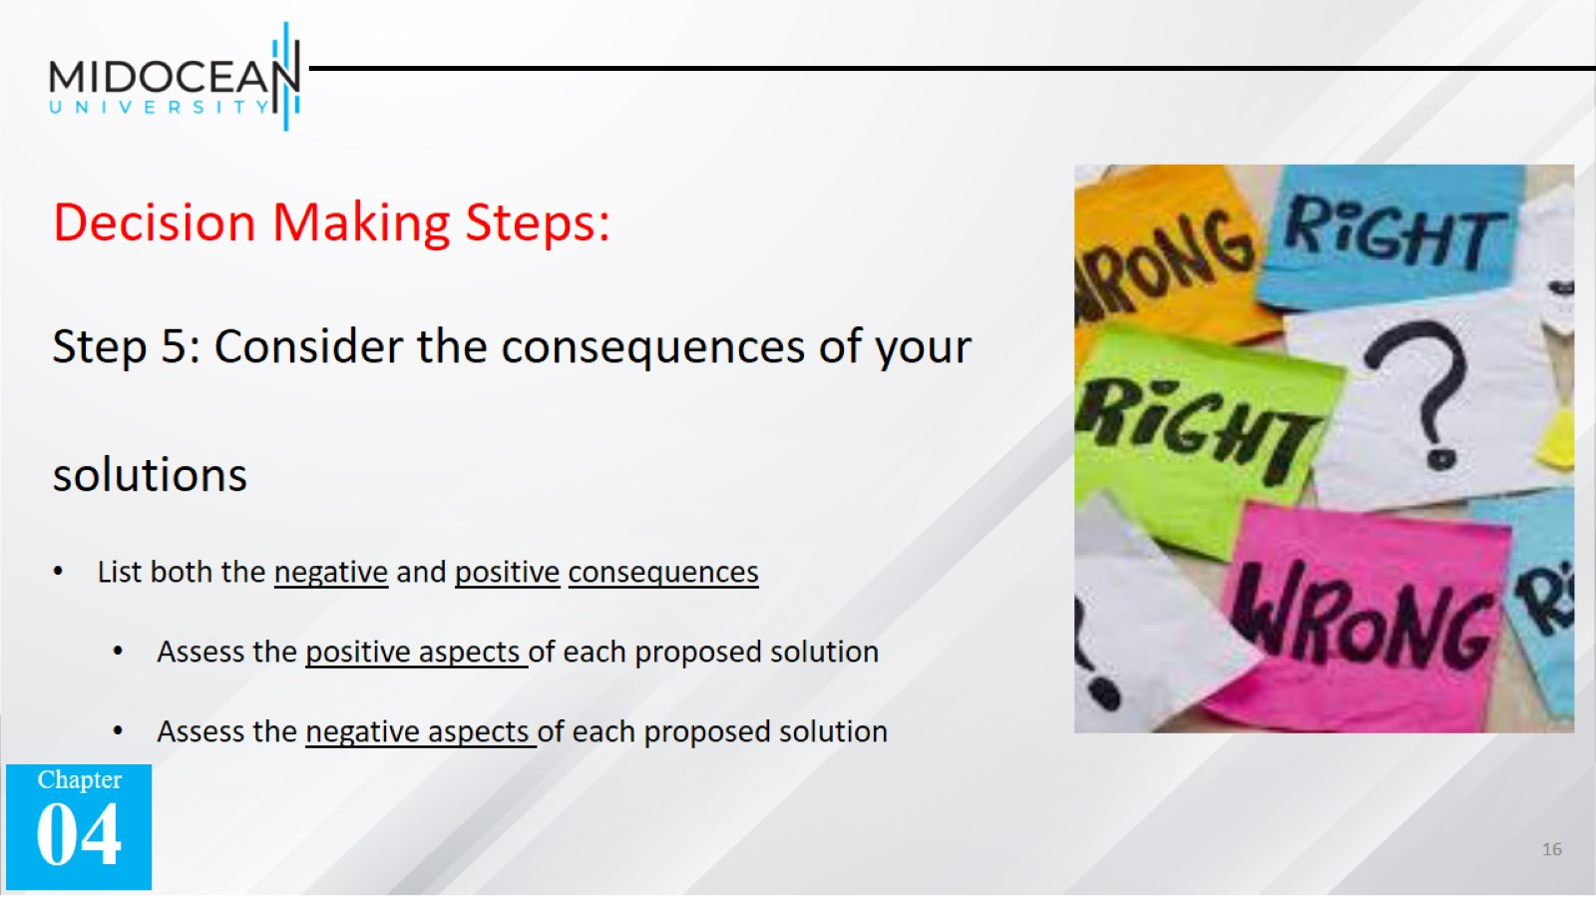

Slide 17
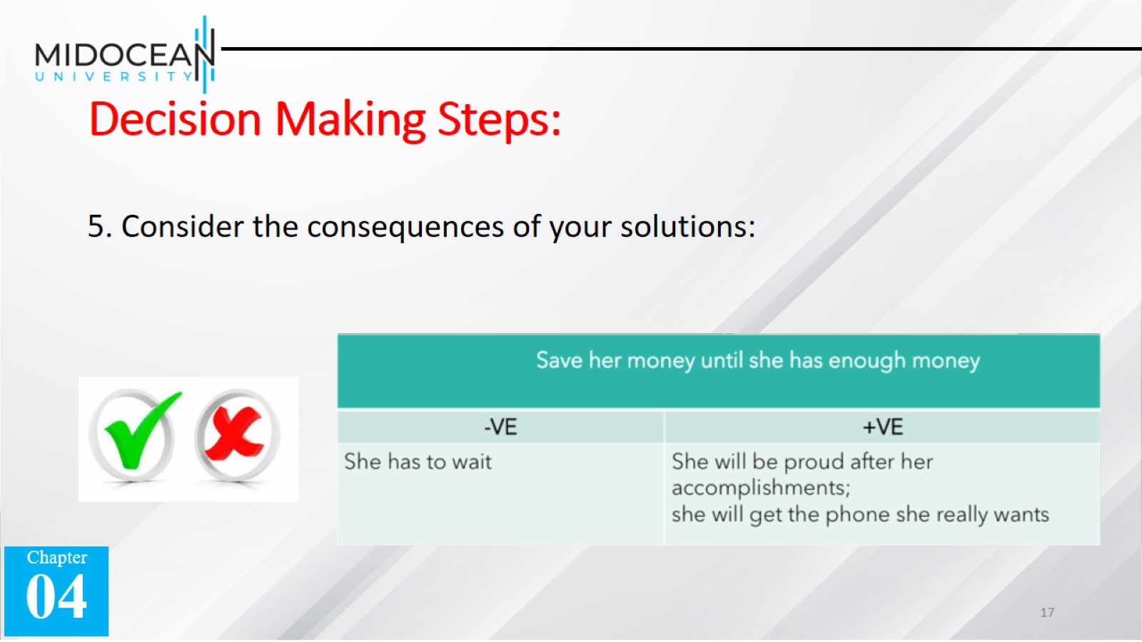
Decision Making Steps:

Slide 18
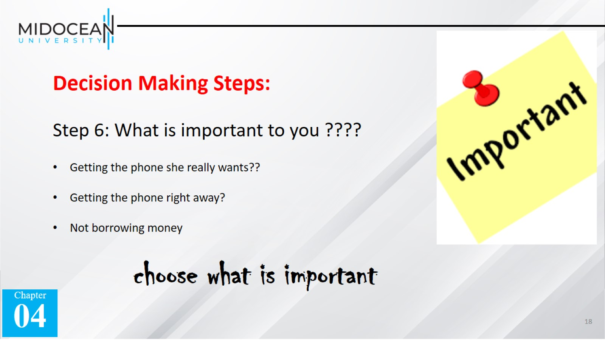

Slide 19
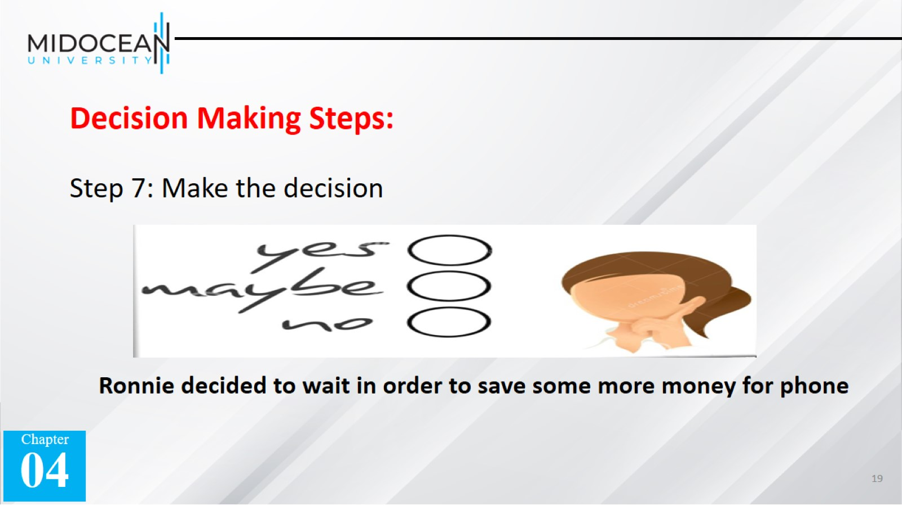

Slide 20


Slide 21
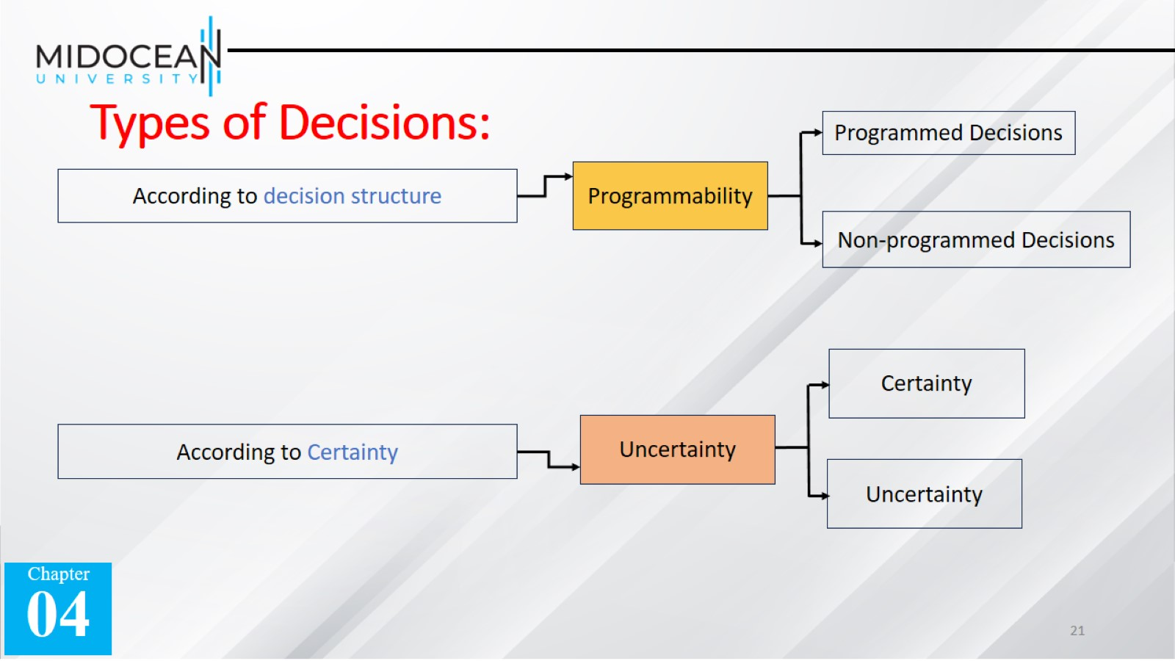
Types of Decisions:

Slide 22
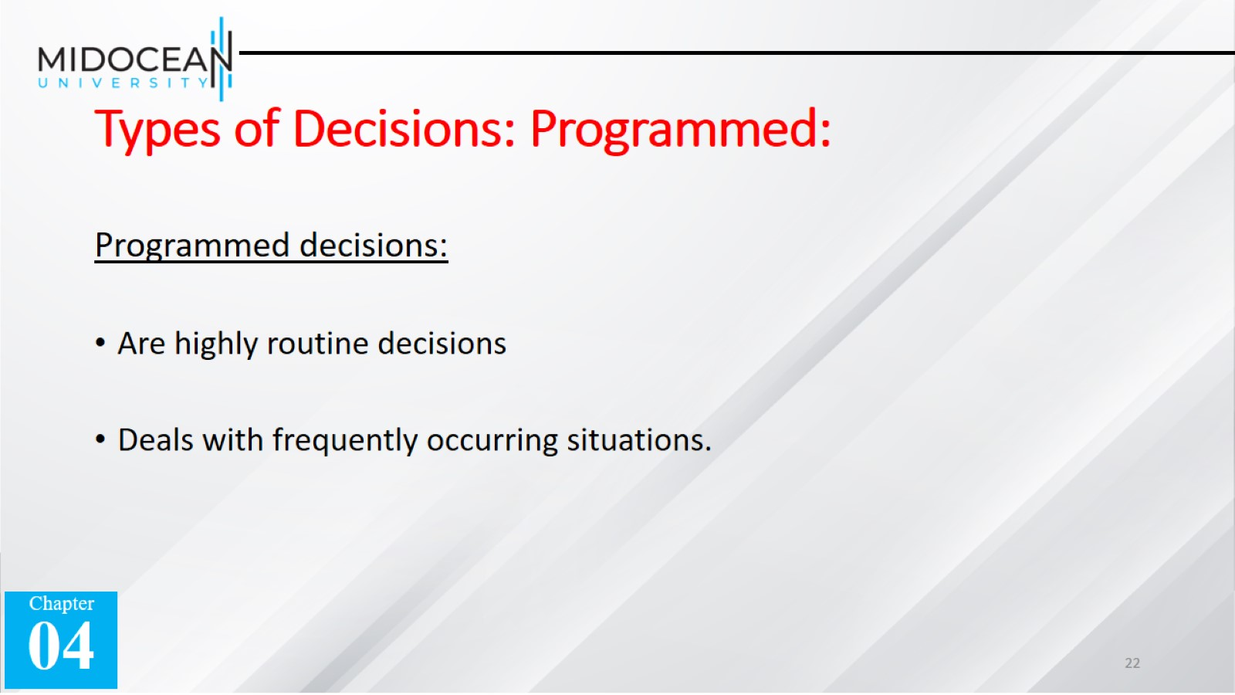
Types of Decisions: Programmed:

Slide 23
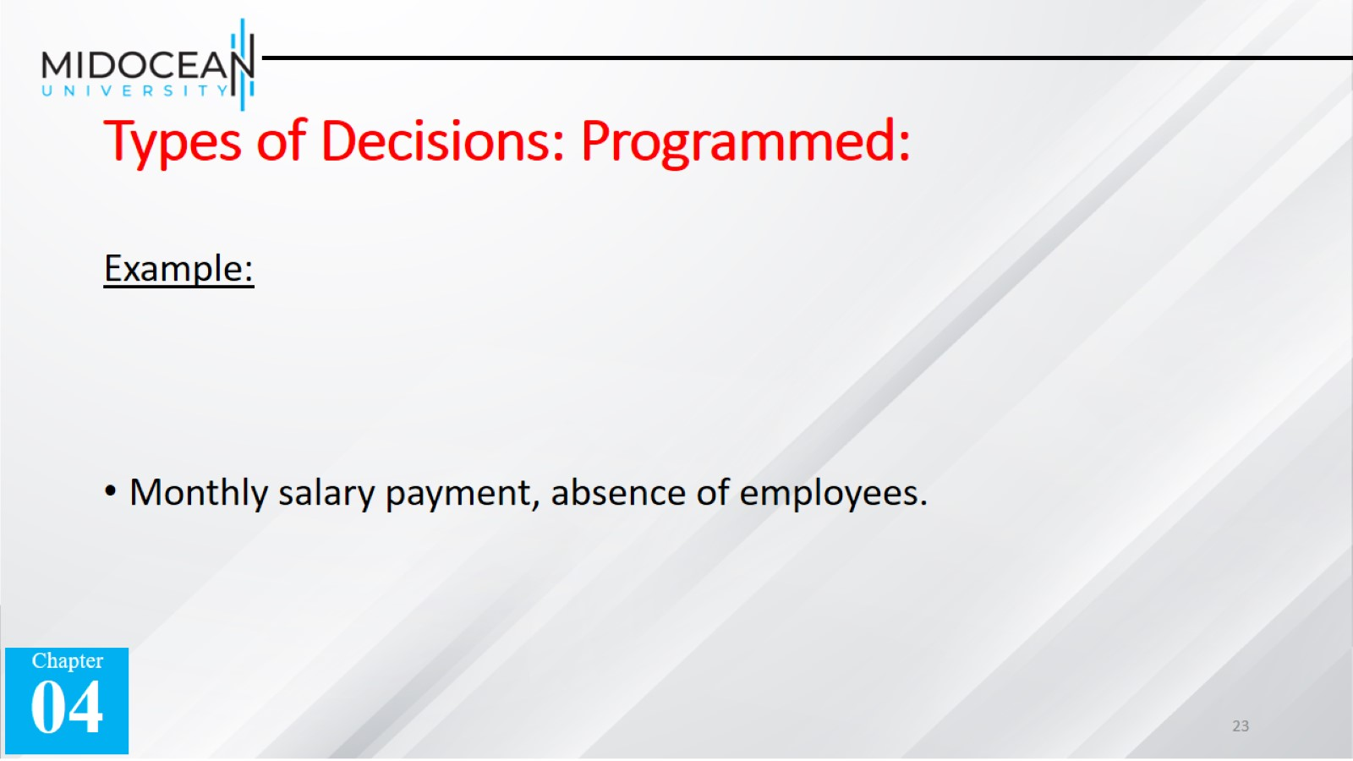
Types of Decisions: Programmed:

Slide 24
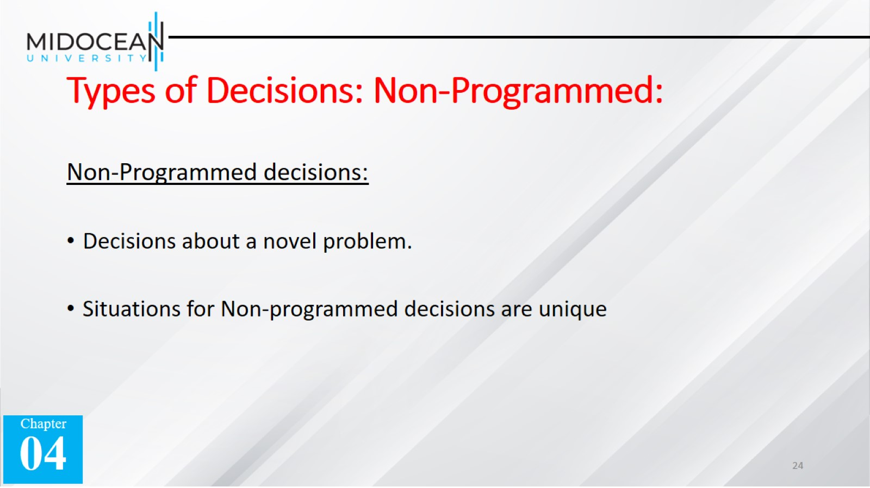
Types of Decisions: Non-Programmed:

Slide 25
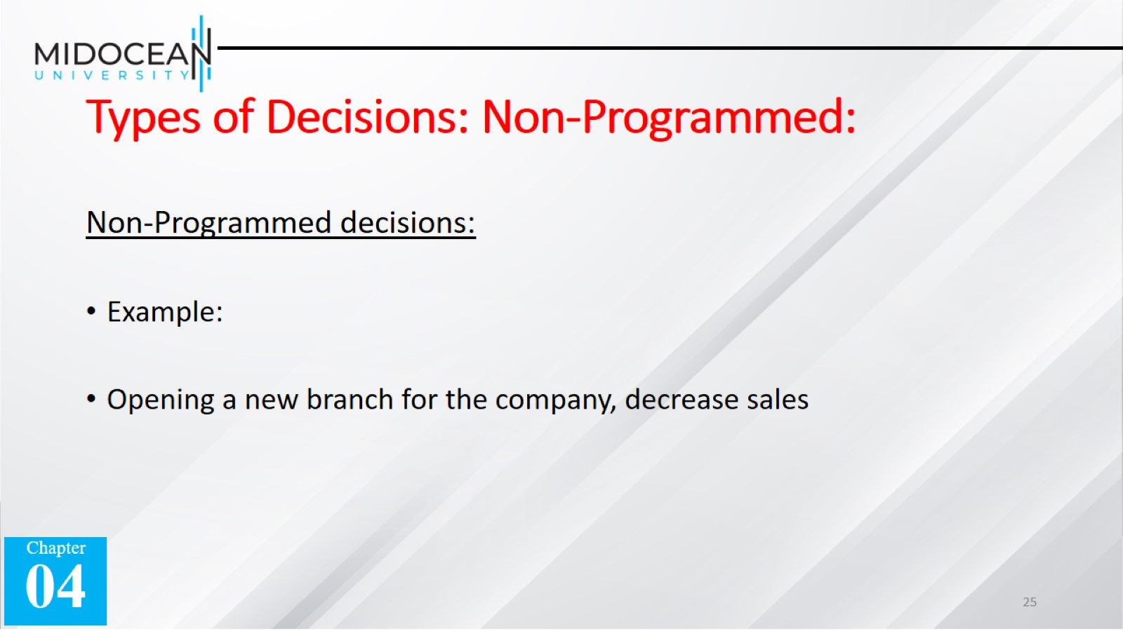
Types of Decisions: Non-Programmed:

Slide 26
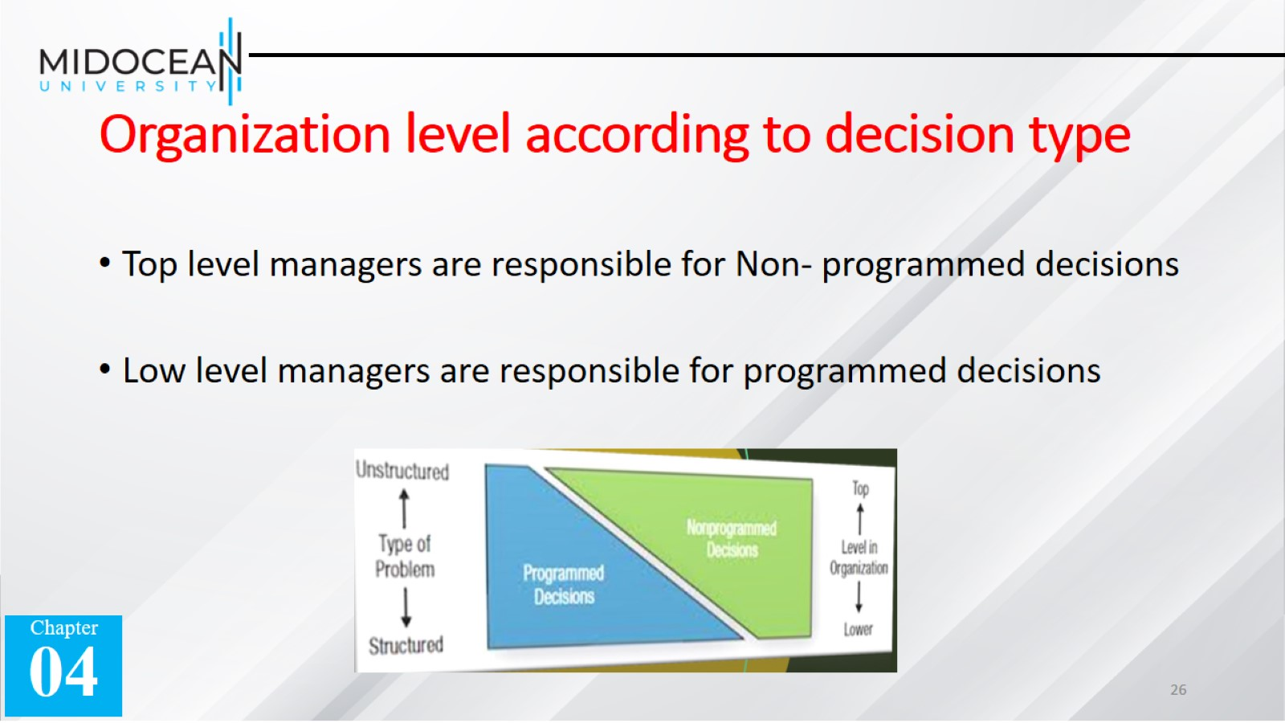
Organization level according to decision type

Slide 27
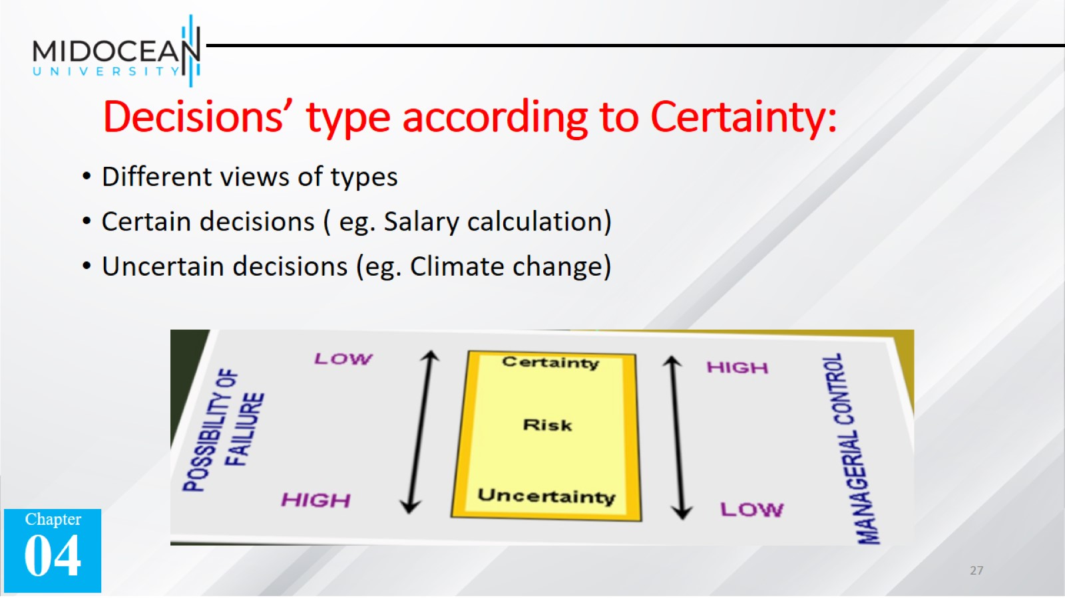
Decisions’ type according to Certainty:

Slide 28
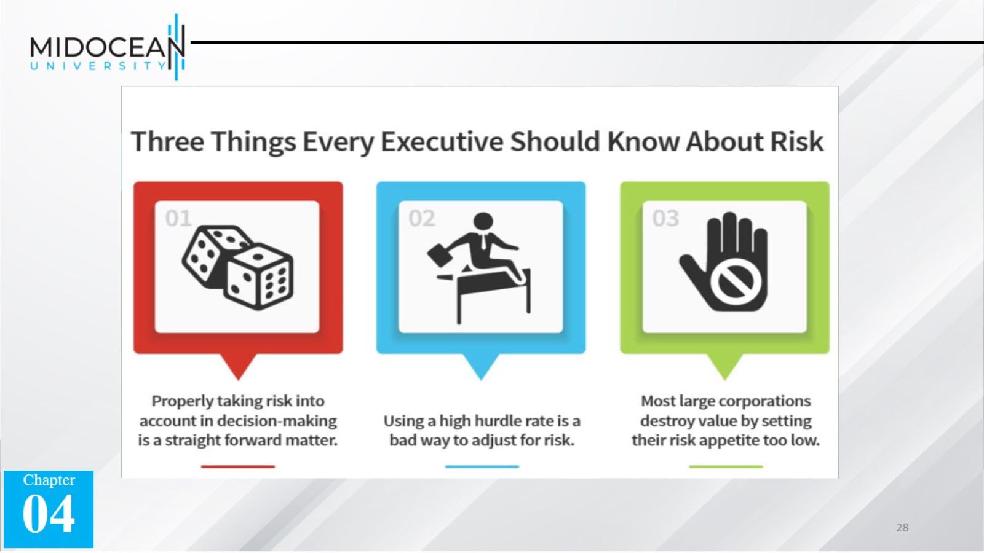

Slide 29


Slide 30

Techniques for decision making:

Slide 31
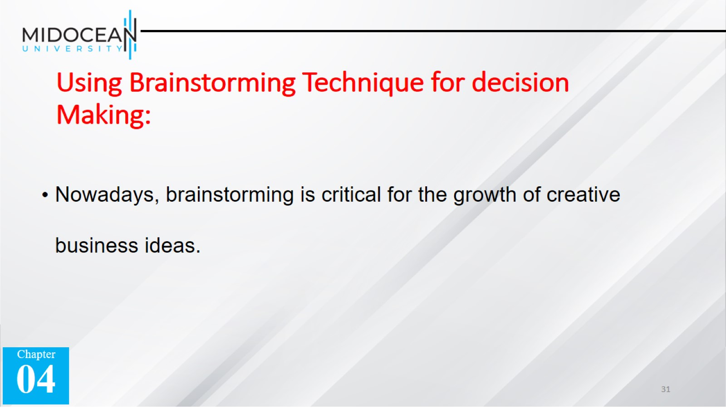
Using Brainstorming Technique for decision Making:

Slide 32
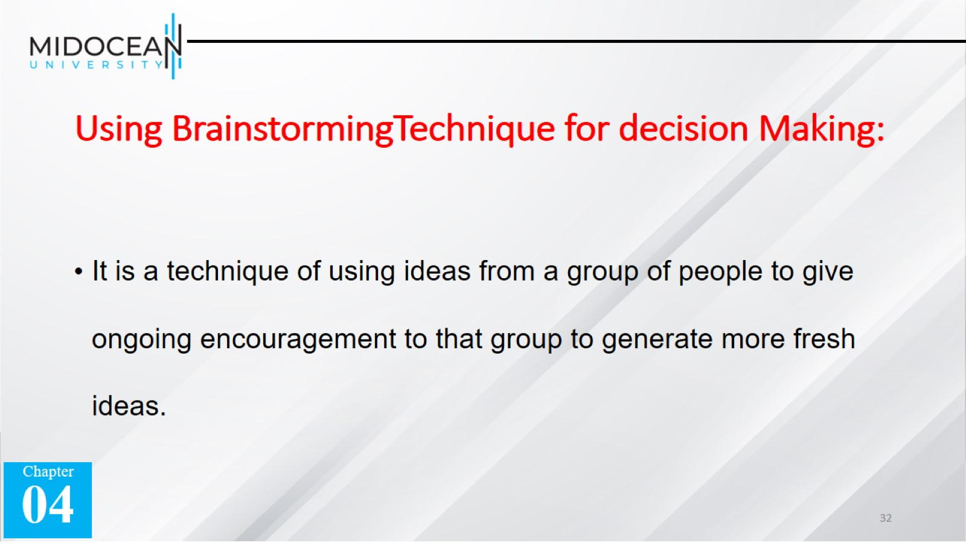
Using BrainstormingTechnique for decision Making:

Slide 33
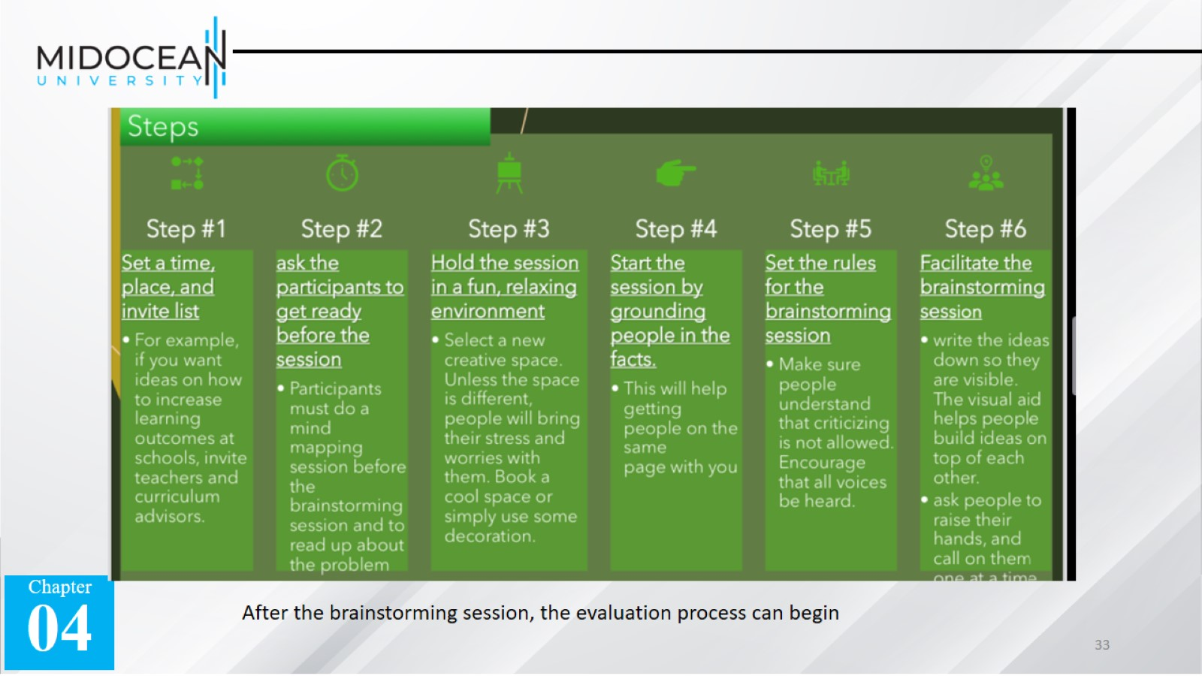

Slide 34
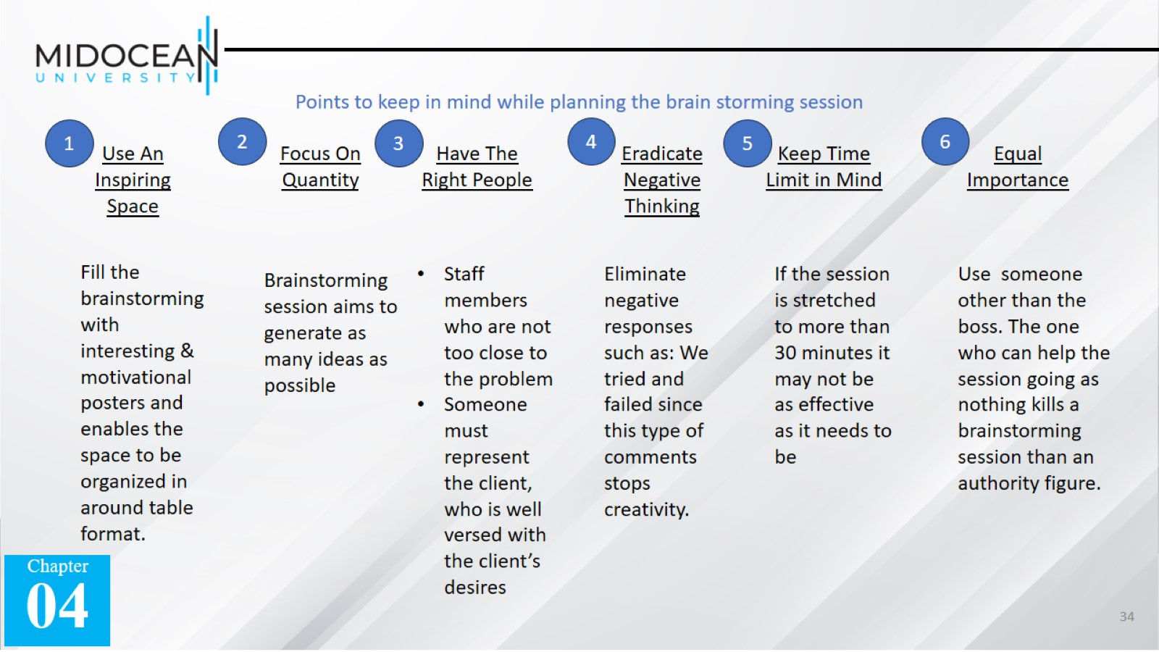

Slide 35
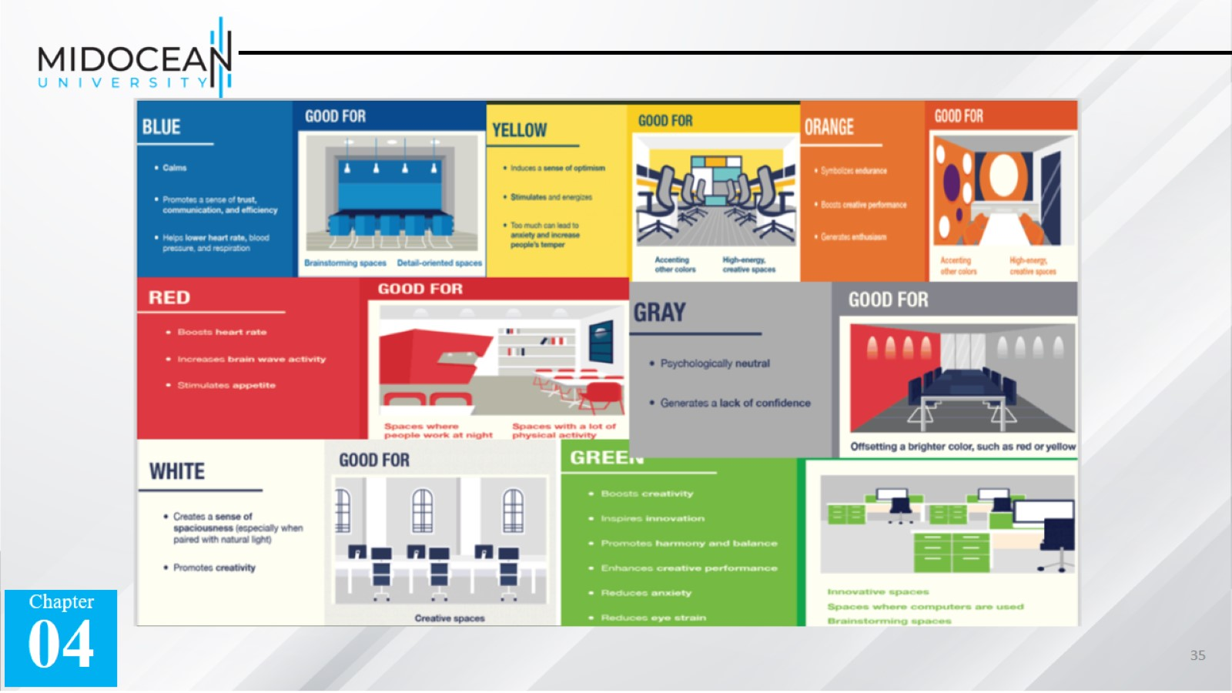

Slide 36


Slide 37
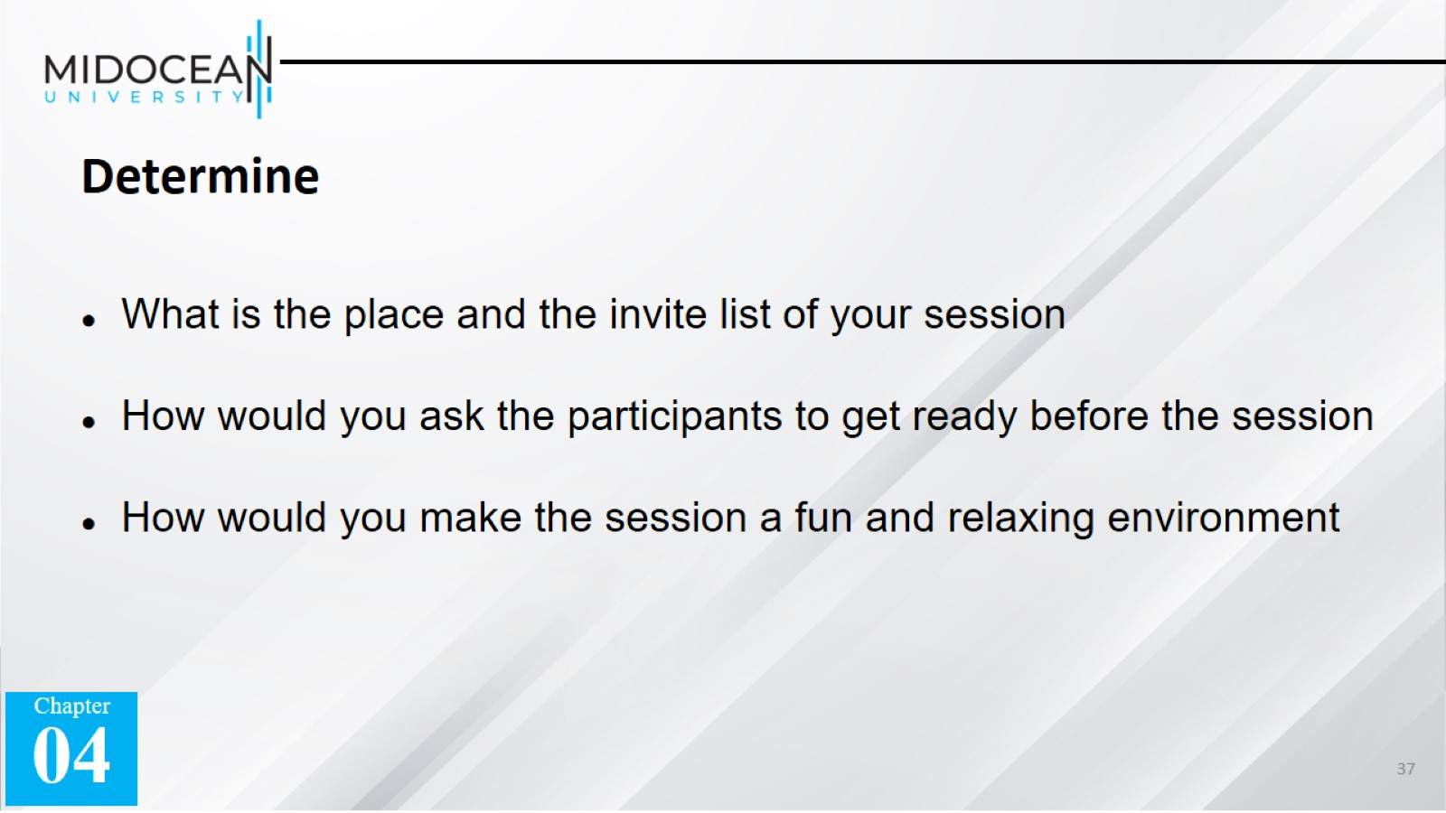

Slide 38
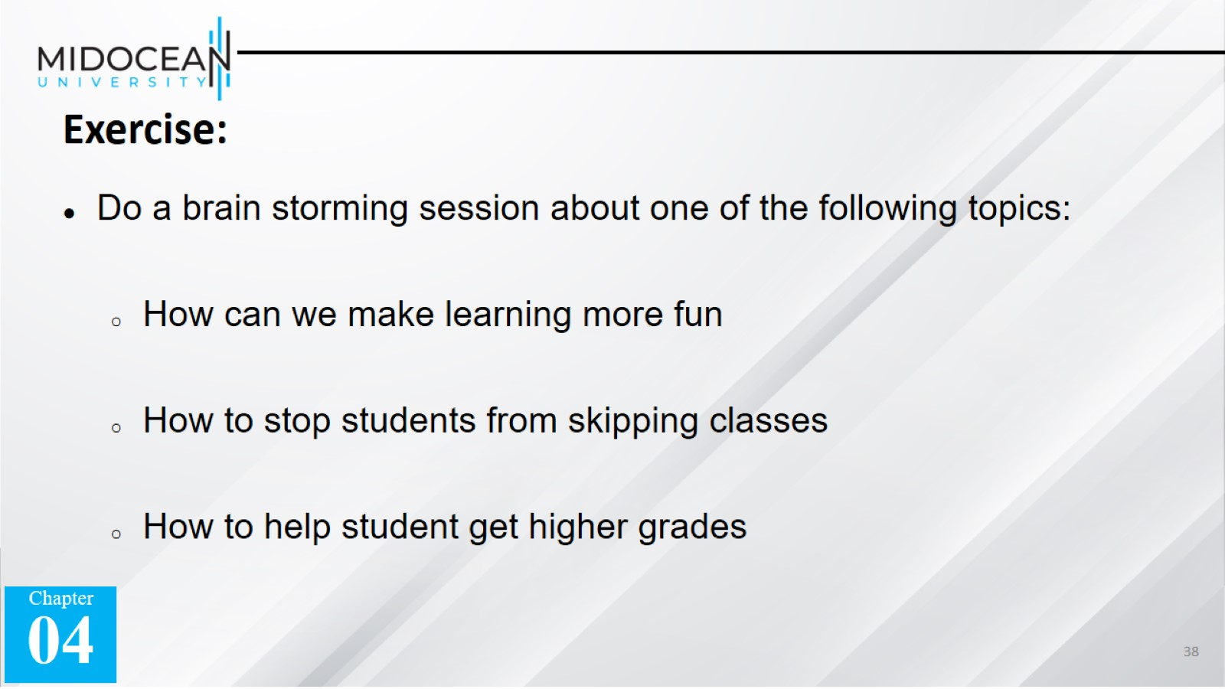

Slide 39
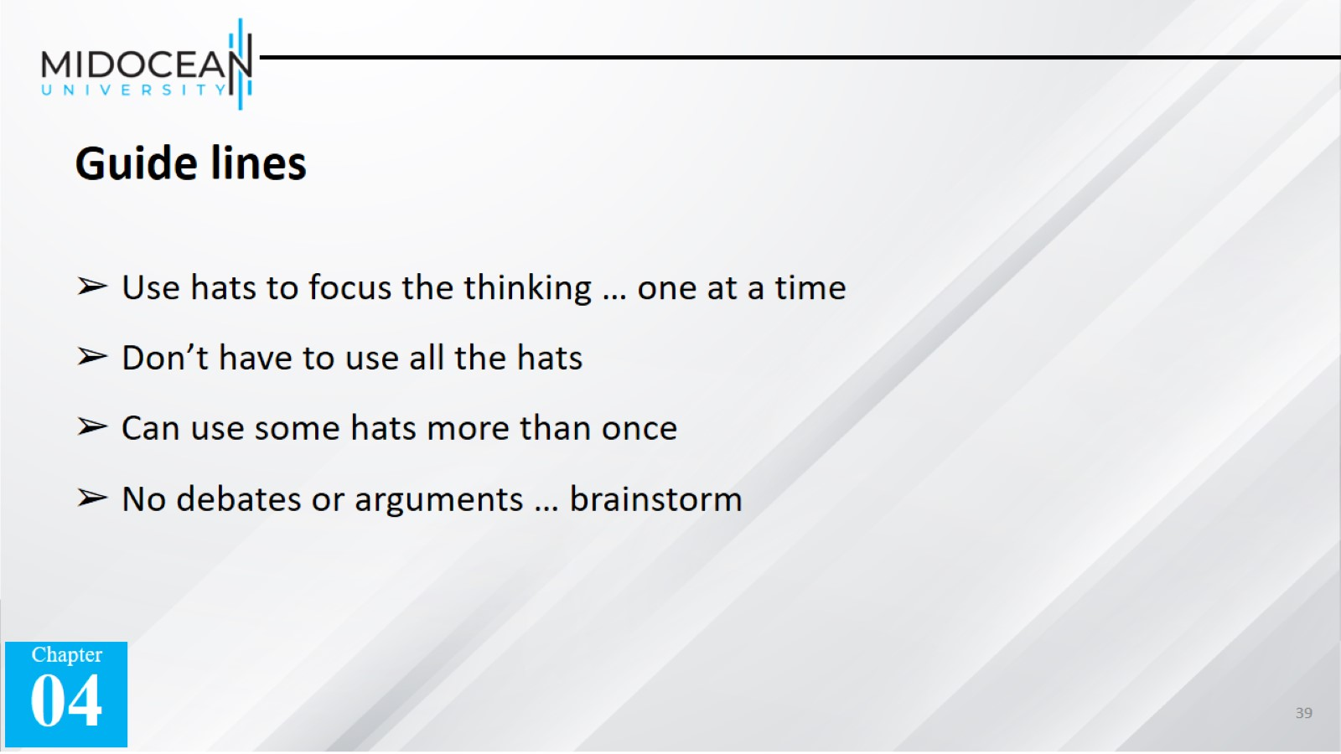

Slide 40


Slide 41


