Slide 1



Application of Cryptographic
Technologies
Lecture 9
HCIA-Security
Prepared by
Dr. Abdelrhman Ahmed

Slide 2
Chapter
09
Forward
• Cryptographic technologies ensure the security of data transmission on the network and protect data from tampering and spying. Signature technologies ensure data integrity and prove the identity of the data sender. PKI certificate authentication technologies verify the validity of public keys and ensure that users access secure and legitimate networks.
• By using these technologies, enterprises can prevent unauthorized users from accessing their enterprise networks. Also, secure channels can be established between enterprise branches to ensure security of enterprise data.

Slide 3
Chapter
09
Objectives
• Upon completion of this course, you will be able to:
□ Describe the scenarios in which cryptographic technologies are applied.
□ Configure different VPN technologies.

Slide 4
Chapter
09
Application of Cryptography
• Cryptography applications include digital envelopes, digital signatures, and digital certificates.
□ Digital envelope: ensures the confidentiality of data in transit using symmetric and asymmetric encryption.
□ Digital signature: ensures the integrity of data transit using hash algorithms.
□ Digital certificate: ensures the non-repudiation of data transmission by authenticating the public key using a third-party authority (CA).

Slide 5
Chapter
Application Scenarios
09
• Digital envelopes, digital signatures, and digital certificates are applied to different scenarios, listed as follows:
• VPN: To ensure data confidentiality, many VPN technologies need to use encryption and decryption technologies, such as IPsec VPN and SSL VPN.
• IPv6: To prevent the device from being spoofed, secure neighbor discovery (SEND) router authorization can be configured on the device. The digital certificate technology can be used for selecting legitimate gateway devices.
• HTTPS login: The administrator can use HTTPS to securely log in to the web Ul of the HTTPS server and manage network devices. To improve security of SSL connections, the CA trusted by the web browser is configured to issue local certificates for the HTTPS client. Then the web browser can verify local certificates, avoiding malicious attacks and ensuring secure login.
• System login authorization: A digest algorithm processes the user password to generate a digest, which is stored and compared with the user-supplied password the next time the user logs in.
• The most important application scenario is VPN.
• This course introduces several encrypted VPNs and some common VPN technologies.

Slide 6
Chapter
09
What is a VPN?
• A virtual private network (VPN) is a private data channel established across a shared public network. It connects all networks or endpoint devices that need to access the virtual network to form a dedicated network that provides a certain degree of security and quality of service (QoS).
• Virtual: Users use the toll lines of the Internet to set up their own private networks, without requiring physical dedicated toll lines.
• Private network: Users can customize a network best suited to their needs.

Slide 7
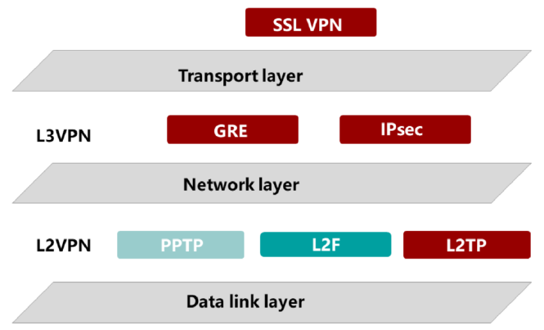
Chapter
Categorization of VPNs
09

Slide 8
Chapter
09
Application Scenarios of VPNs
• Site-to-Site VPN
□ Connection between two LANs
□ Applicable VPN technologies: IPsec, L2TP, L2TP over IPsec, GRE over IPsec, and IPsec over GRE
• Client-to-Site VPN
□ Connection between clients and an enterprise intranet
□ Applicable VPN technologies: SSL, IPsec, L2TP, and L2TP over IPsec

Slide 9
Chapter
Overview of L2TP VPNs
09
• L2TP
□ A tunneling protocol set to transparently transmit PPP packets between a user and an enterprise server. It provides support for the tunnel transmission of packets at the PPP link layer.
• The L2TP VPN applies to the following scenarios:
□ NAS-initiated VPN
□ Automatic dialing on the LAC
□ Client-initiated VPN

Slide 10
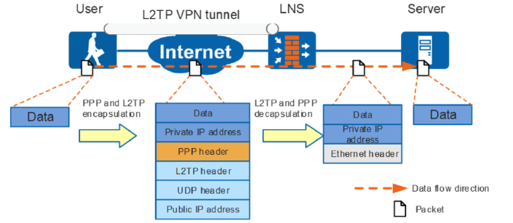
Chapter
09
Client-Initiated L2TP VPNs
Generally, this type of L2TP VPN is used when employees need to access servers at HQ using devices such as PCs and mobile phones when they are on business trips. This is the most commonly used L2TP dial-up mode.

Slide 11
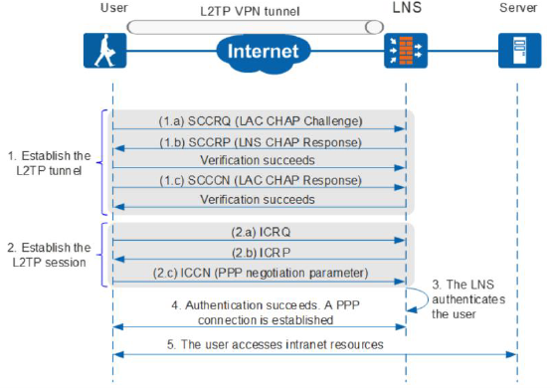
Chapter
09
Client-Initiated VPN Tunneling & Session Establishment Process

Slide 12
Chapter
09
Overview of GRE VPNs
• General Routing Encapsulation (GRE) is a L3VPN encapsulation technology. GRE encapsulates the packets of a wide variety of network layer protocols, such as Internetwork Packet Exchange (IPX), IP, and AppleTalk, into IP tunneling packets, so that these packets can be transmitted over heterogeneous networks. The channel for transmitting packets over heterogeneous networks is called a 'tunnel'.

Slide 13
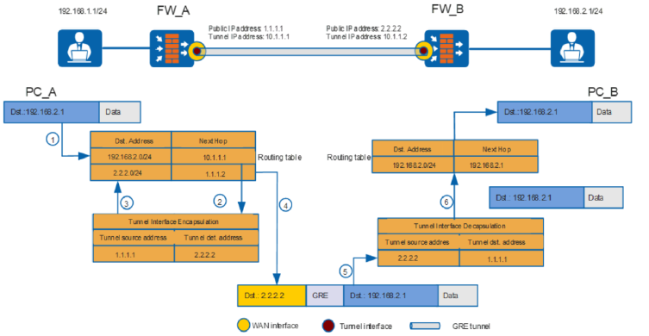
Chapter
09
GRE Packet Handling Process

Slide 14
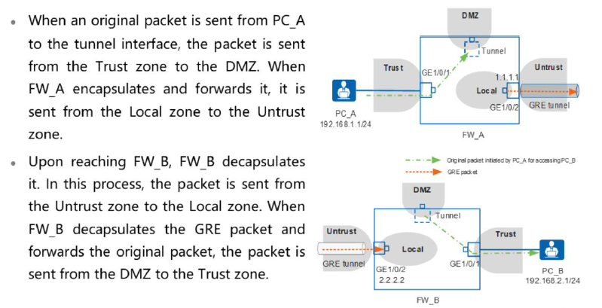
Chapter
09
GRE Security Policies

Slide 15
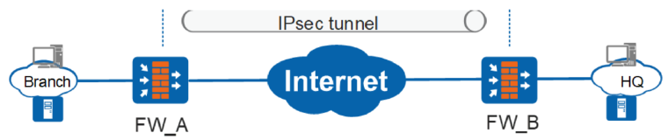
Chapter
09
Overview of IPSec VPNs
• The IP Security (IPsec) protocol suite is a series of security protocols developed by the internet Engineering Task Force (IETF).It provides a cryptology-based, interoperable, and high-quality security protection mechanism for end-to-end IP packet exchange. An IPsec VPN is a network layer VPN established through an IPsec tunnel.

Slide 16
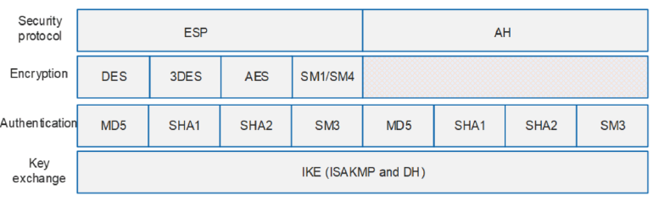
Chapter
09
IPSec Protocol Framework
• IPsec implements secure transmission of IP packets using two security protocols: Authentication Header (AH) and Encapsulating Security Payload (ESP).

Slide 17
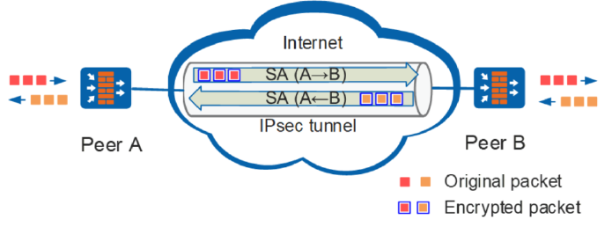
Chapter
09
IPSec SA
• An IPsec security association (SA) needs to be established between IPsec peers (two IPsec endpoints) before IPsec implements secure data transmission.
• The SA is an agreement between IPsec peers in communication.

Slide 18
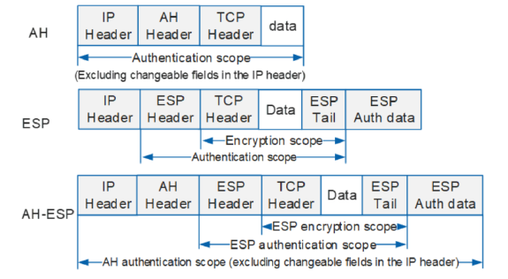
Chapter
09
Encapsulation in Transport Mode
• In transport mode, an AH or ESP header is added between an IP header and a transport-layer protocol header to protect the TCP, UDP, or ICMP payload.

Slide 19
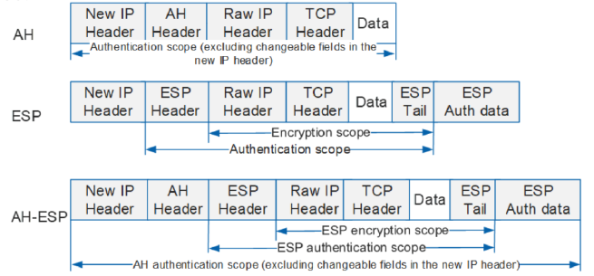
Chapter
Encapsulation in Tunnel Mode
09
• In tunnel mode, an AH or ESP header is added outside the raw IP header, and a new IP header is added outside the AH or ESP header to protect the IP header and Payload.

Slide 20
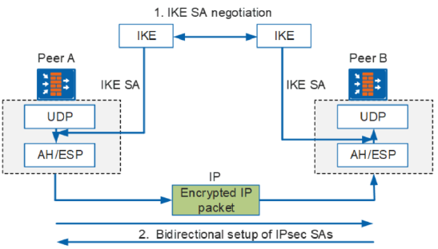
Chapter
09
IKE SA
• The IKE SA serves the IPsec SA by providing automatic key negotiation and establishing the IPsec SA.

Slide 21
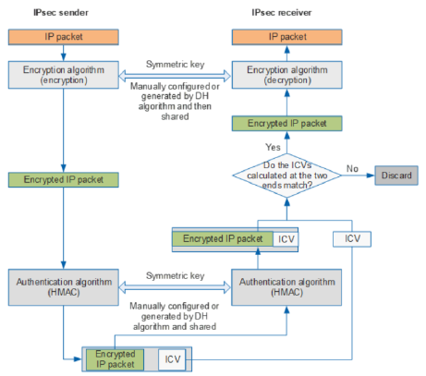
Chapter
IPSec Encryption/Decryption & Authentication
09

Slide 22
Chapter
IPSec Encryption/Decryption & Authentication
09
• IPsec uses symmetric encryption algorithms to encrypt and decrypt data.
• The authentication mechanism allows the data receiver to identify the data sender in IP communications and determines whether data is tampered with during transmission.
• IPsec uses the Keyed-Hash Message Authentication Code (HMAC) function for authentication. The HMAC function verifies the integrity and authenticity of data packets by comparing digital signatures.

Slide 23
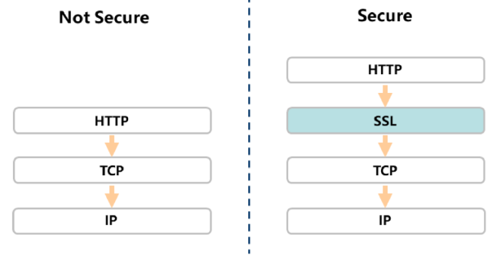
Chapter
09
Overview of SSL VPNs
• SSL is a security protocol. It provides secure connections for TCP-based application layer protocols.
• IPsec implements encryption for secure transmission. However, IPsec encryption and authentication have problems in some scenarios, for example, NAT traversal. Because of its unique attributes, the SSL VPN takes effect only at the application layer and does not require a user security VPN client. Therefore, its application scope is wider, and it is more convenient.
• SSL provides secure connections for HTTP and is widely used in various fields, such as e- commerce and online banking, to ensure secure data transmission.

Slide 24
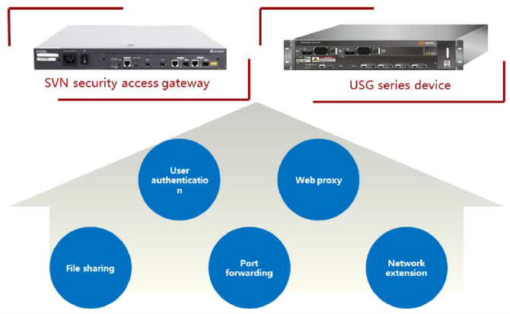
Chapter
09
Main Functions of an SSL VPN

Slide 25
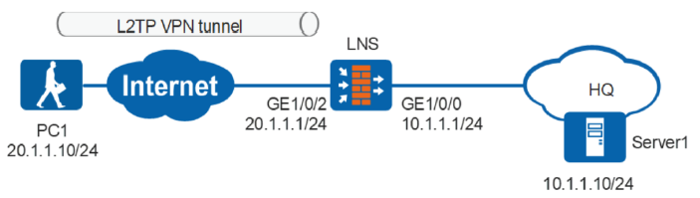
Chapter
09
Application Scenario of Client-Initialized L2TP VPN
• Requirements
□ A company has its own VPN and a VPN gateway (USG firewall) is deployed at the Internet egress of the headquarters. Employees on the move need to communicate with the company's internal servers through L2TP tunnels.

Slide 26
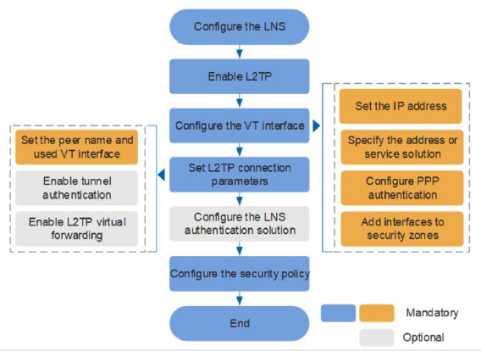
Chapter
09
L2TP VPN Configuration Procedure

Slide 27
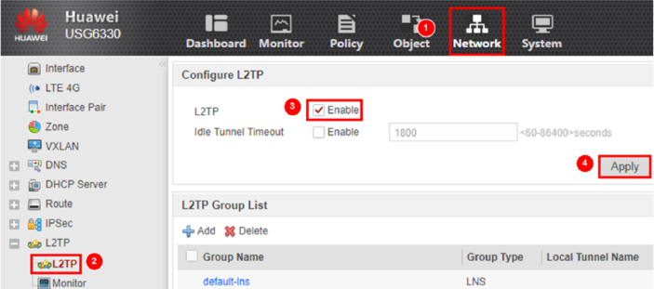
Chapter
09
Enabling the L2TP Function
• Choose Network > L2TP > L2TP. On the Configure L2TP page, select Enable for L2TP and click Apply.

Slide 28
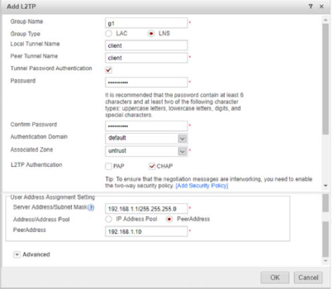
Chapter
09
Setting the L2TP Parameters
• In L2TP Group List, click Add to set L2TP group parameters.

Slide 29
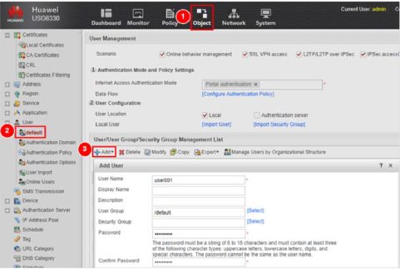
Chapter
09
Setting Dial-up User Information
• Choose Object > User. Click the default authentication domain. On the User Management page, click Add and set the username and password.

Slide 30
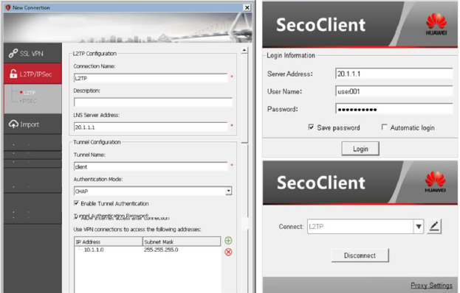
Chapter
09
Setting the VPN Client & Authentication

Slide 31
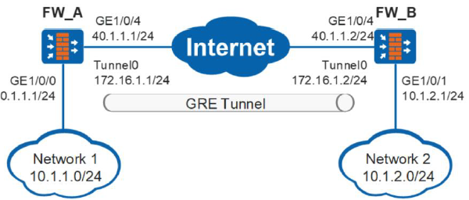
Chapter
09
Application Scenario of GRE
• Requirements
□ The two subnets (Network 1 and Network 2) that run the IP protocol communicate with each other through the GRE tunnel established between FW A and FW B.

Slide 32
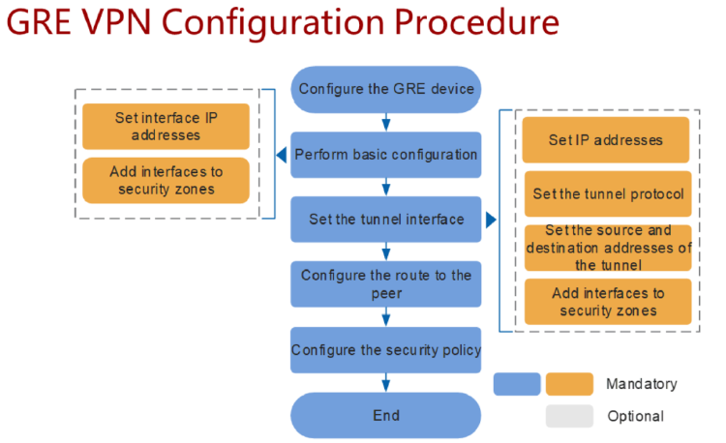
Chapter
09
GRE VPN Configuration Procedure

Slide 33
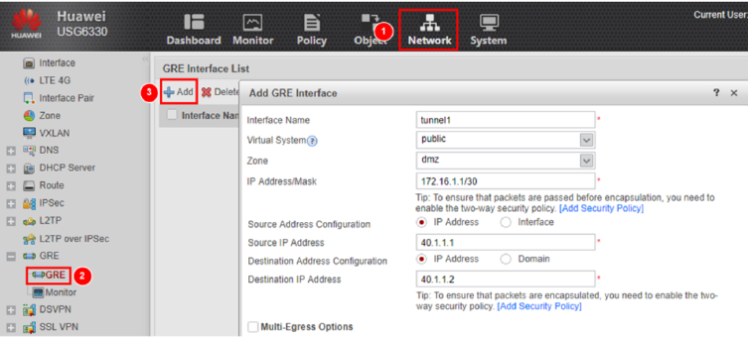
Chapter
09
GRE Interface Configuration- FW_A
• Choose Network > GRE > GRE. Click Add to set GRE interface parameters.

Slide 34
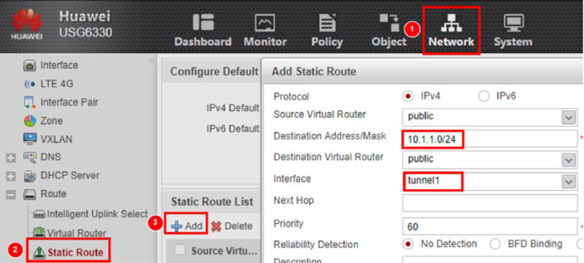
Chapter
09
Route Configuration- FW_A
• Choose Network > Static Route. Click Add to configure a static route to Network 2.

Slide 35
Chapter
09
Configuration Verification
• Verify the following:
PCs on Networks 1 and 2 can ping each other.
A router whose outbound interface is Tunnell and is destined for10.1.2.0/24 can be found (by choosing Network > Route > Routing Table) in the routing table on FW_A.

Slide 36
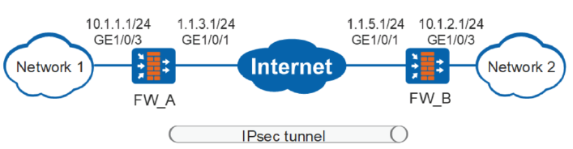
Chapter
09
Application Scenario of Point-to-Point IPSec VPN
• Requirements
□ Network 1 and Network 2 are interconnected through an IPsec tunnel established between FW_A and FW_B.
□ The default values in IPsec and IKE proposals are used.
□ The IPsec tunnel is established in IKE mode.

Slide 37
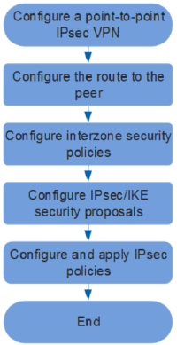
Chapter
09
IPSec VPN Configuration Procedure

Slide 38
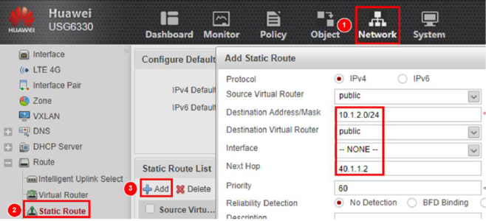
Chapter
09
Configure Routes
• Set the route to the peer end. For example, on FW A, set the next hop to the address of FW B.

Slide 39
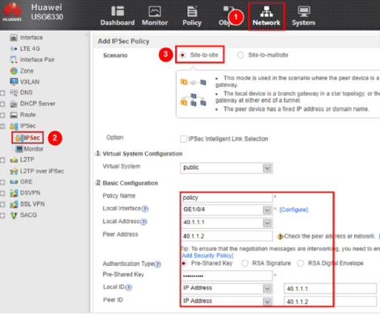
Chapter
09
Setting IPSec Policy Parameters- FW_A

Slide 40
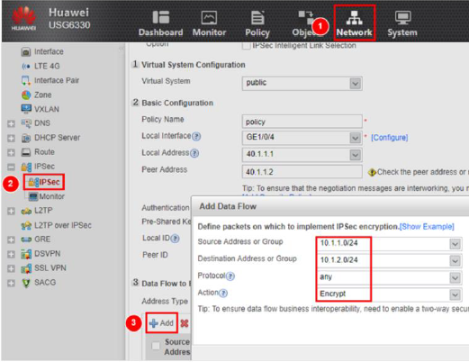
Chapter
09
Configure Encrypted Data Flows

Slide 41
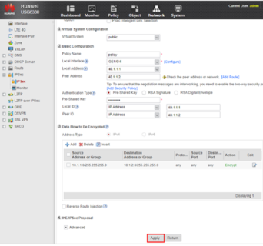
Chapter
09
Application an IPSec Policy
• After the configuration is complete, click Apply at the bottom of the configuration page to save and apply the IPsec policy.

Slide 42



Thank You

