Slide 1

Strategic And Operational Risk Management
PMG630
Prepared by
Dr. Ayman Hassan
  Lecture .4 “Tools and Techniques”

Slide 2


Tools and Techniques,
“Job Safety Analysis”
Chapter 3
Prepared by
Dr. Ayman Hassan
www.midocean.ae

Slide 3



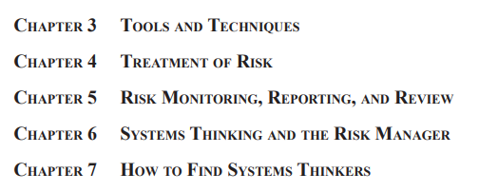
Important note, 1
r
Divided into two parts
2 Chapters
5 Chapters
REF, 1
Dr. Ayman Hassan
www.midocean.ae

Slide 4
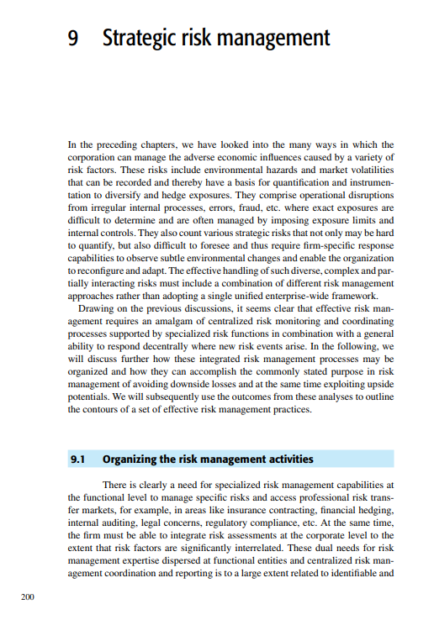

Important note, 2
r
Lecture 10
REF,2
Dr. Ayman Hassan
www.midocean.ae

Slide 5
Lecture No.3, The Content
Summary of the previous lecture .
Introduction
What is JSA, “Job Safety Analysis”
Where and when to use JSA?
JSA Format
Generalized Steps For JSA
Why is the JSA tool important?
summery
www.midocean.ae

Slide 6
Introduction
We have explained in the previous lecture that this chapter talks about many common techniques and principles used in operational risk management. These techniques include preliminary hazard analysis (PHA) and hazard and operability analysis (HAZOP), and we have already discussed both techniques in our previous lecture.
In this lecture, we will explain two risk analysis and evaluation techniques:
Job Safety Analysis (JSA).
www.midocean.ae

Slide 7
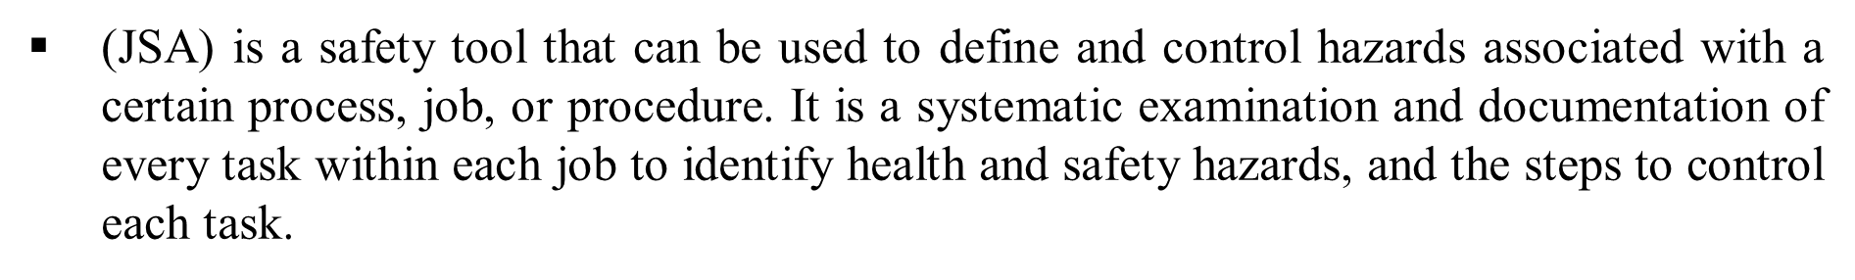
What is JSA, “Job Safety Analysis”
A JSA is a qualitative technique used to identify and control workplace hazards to prevent accidents.
In a JSA, each basic step of the job is examined to identify and address potential hazards.
www.midocean.ae

Slide 8
Job Safety analysis, JSA
The aim is to recommend the safest way to do a job.
It focuses on the relationship between the worker, the task, the tools, and the work environment.
Similar to HAZOP, JSA does not attempt to quantify risk in terms of likelihood or consequence.
www.midocean.ae

Slide 9
JSA concept elements
Focus | Emphasizes the relationship between the worker, the task, the tools, and the work environment
Origin | Traditionally used in manufacturing and construction industries.
Terminology | ‘Safety’ suggests a broader focus on the overall work environment and practices.
Methodology | Follows a step-by-step approach to identify unsafe practices and conditions.
Documentation | Results in the creation of safe job procedures and often integrates with training.
www.midocean.ae

Slide 10
JSA concept elements
Implementation | JSA is generally seen as a proactive measure to prevent accidents.
Regulatory requirements | Some jurisdictions may specifically require a JSA for certain jobs.
Employee involvement | Encourages worker participation to identify unsafe conditions and behaviors.
Outcome | Aims to create a safe workflow and reduce workplace accidents and injuries.
www.midocean.ae

Slide 11

Where and when to use JSA?
Jobs that have taken on changes in procedures, equipment, and materials.
Jobs are affected by new or revised regulations or standards.
Newly created jobs, uncommon or seldom-performed jobs with little or no history, and routine jobs requiring regular or continuous exposure to hazards should undertake a JSA.
www.midocean.ae

Slide 12
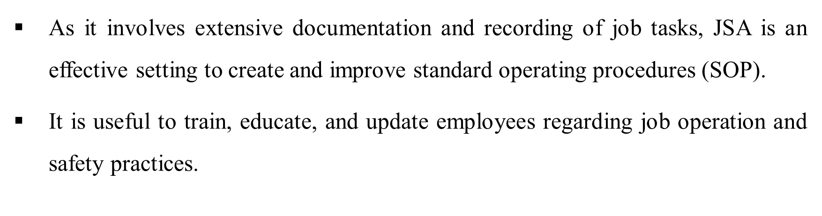
Where and when to use JSA?
Ideally, all jobs should undergo safety analysis. If possible, JSAs should also be performed for no routine activities such as maintenance, repair, or cleaning and jobs that are offsite, either at home or on other job sites (e.g., teleworkers).
Examining hazards to visitors and the public should also be included.
www.midocean.ae

Slide 13
Where and when to use JSA?
It can serve as a guide for employee performance review, training, and accident investigations.
JSAs are widely used in the construction, manufacturing, oil and gas, and many labor-intensive industries.
“JSA can also complement PHA, HAZOP, or other risk studies by providing supporting analysis on specific job- or task-related elements, particularly those that are safety critical or ranked high priority.”
www.midocean.ae

Slide 14
JSA Format
The tabular form or spreadsheet is the typical format of a JSA work-sheet.
An example is shown in Figure 3.4.
Unlike PHA and HAZOP, the columns of the JSA worksheet generally follows only two of the key risk questions of risk management discussed in Chapter 2
www.midocean.ae

Slide 15
JSA Format
What can go wrong?
What can be done to detect, control, and manage them?
The other questions are omitted.
The JSA worksheet is intended to be completed one column at a time.
The following are the descriptions of columns that correspond to the JSA worksheet shown in Figure 3.4.
www.midocean.ae

Slide 16
JSA Format
• What can go wrong?
{ Column 1: Job steps or tasks
{ Column 2: Hazards or unwanted events related to each task
• What are the causes and consequences?
What are the likelihood or chances of occurrence?
{ Omitted in JSA measure
www.midocean.ae

Slide 17
JSA Format
• What can be done to detect, control, and manage them?
{ Column 3: Prevention and control measures for each hazard
{ Column 4: Person responsible for the prevention or control measure
www.midocean.ae

Slide 18
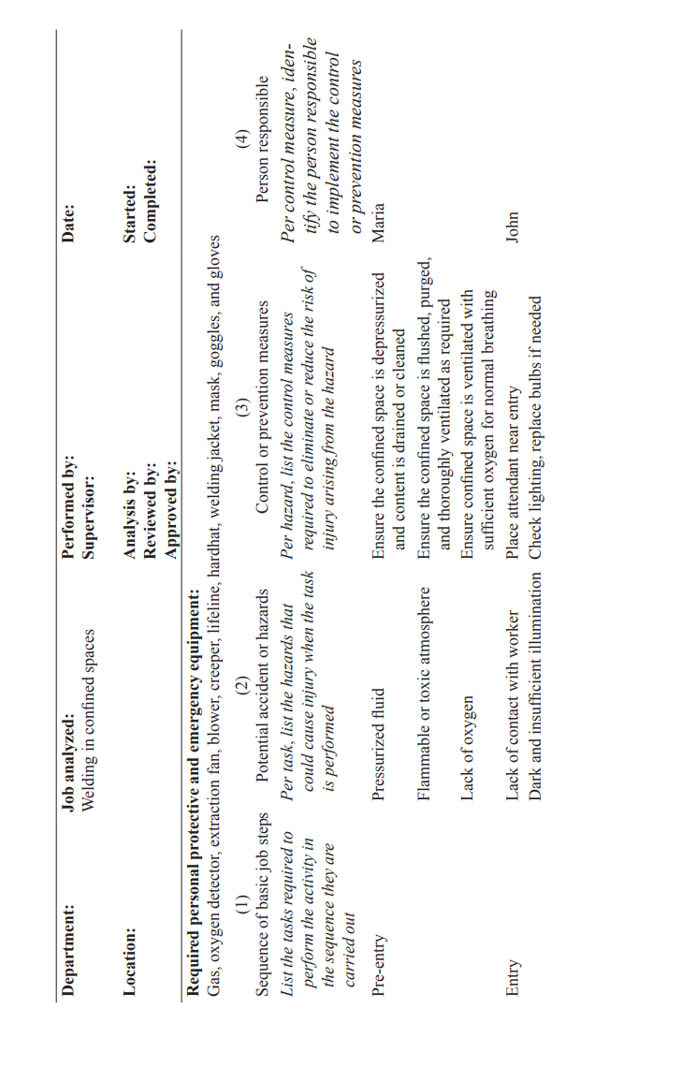
JSA Format
www.midocean.ae

Slide 19
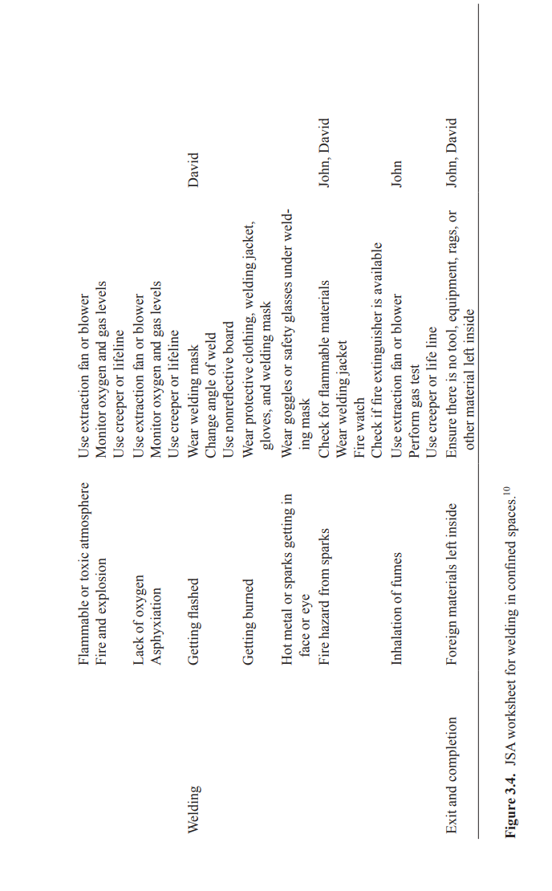
JSA Format
www.midocean.ae

Slide 20
Generalized Steps For JSA
1. Break the job down into a sequence of basic steps or tasks.
2. Identify potential accident or hazards.
3. Determine preventive and control measures to address the hazards.
www.midocean.ae

Slide 21
Generalized Steps For JSA
Step 1
breaks down the job into a sequence of basic tasks or steps.
The listing of the steps is done sequentially according to the order in which the tasks are performed.
This can be done by direct observation or the group discussion method. Observing an experienced employee coupled with enlisting other employees or a supervisor to validate the task steps can be most effective.
www.midocean.ae

Slide 22
Generalized Steps For JSA
The use of action words or phrases (e.g., pick up, turn on) to describe each step helps in breaking down a job into steps.
If observed, steps that are not part of the standardized job (standard operating procedure SOP) should be included (and addressed for appropriateness).
To support high-quality documentation, video recordings of the job in action can be compiled.
Note that the JSA worksheet should be completed one column at a time.
www.midocean.ae

Slide 23
Why is the JSA tool important?
1
Risk management: JSAs are integral to an organization’s risk management strategy.
They help identify risks before accidents occur, allowing for the implementation of preventative measures to save the organization from costly incidents, legal action, and reputation loss.
www.midocean.ae

Slide 24
Why is the JSA tool important?
2
Compliance:
In the United States, the Occupational Safety and Health Administration (OSHA) outlines standards that often require identifying and mitigating workplace hazards.
A JSA helps organizations comply with these regulations, including specific industry standards and general duty clauses.
www.midocean.ae

Slide 25
Why is the JSA tool important?
3
Increased efficiency
Regularly conducting JSAs can lead to improvements in job processes.
By analyzing and updating safety procedures, organizations can make tasks more efficient and reduce the chance of hazardous events.
www.midocean.ae

Slide 26

Why is the JSA tool important?
4
Skills gaps
The JSA process can reveal employee Training and development needs.
Organizations can better train their employees on safety practices and proper responses to potential incidents by understanding the risks associated with a job.
www.midocean.ae

Slide 27
Why is the JSA tool important?
5
Incident assessment
Should an incident occur, a JSA provides a baseline for understanding how it happened and what might prevent it in the future?.
This information is invaluable for effective incident investigation and analysis.
www.midocean.ae

Slide 28
Why is the JSA tool important?
6
Cost-savings
By avoiding workplace incidents and their associated costs (medical care, compensation, downtime, and potential fines),.
A JSA can lead to significant cost savings for an organization.
www.midocean.ae

Slide 29
Why is the JSA tool important?
7
HR Tips
Evaluate each hazard by considering the likelihood of an event or exposure, the severity of any potential outcomes, and the number of employees who might be exposed.
Engage with operational departments to base the JSA on a realistic understanding of day-to-day tasks and the actual conditions under which work is performed.
www.midocean.ae

Slide 30
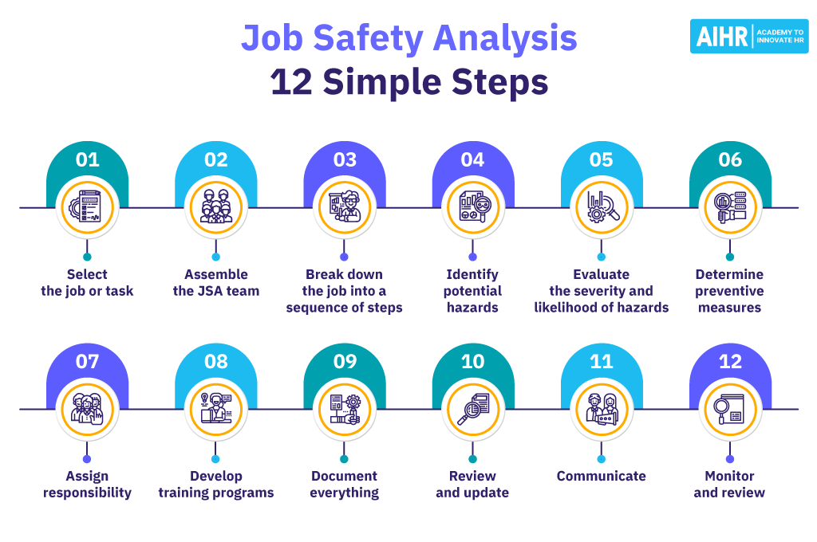
Job Safety Analysis – 12 Simple steps
www.midocean.ae

Slide 31
Job Safety Analysis – 12 Simple steps
Conducting a job safety analysis is a detailed process that involves several key steps.
It has three main elements:
the job at hand,
the potential hazard, or what can go wrong,
the control measure that must be put in place and followed to mitigate the hazard.
However, to achieve these three objectives takes 12 clear steps.
We have captured them as coming .
www.midocean.ae

Slide 32
Job Safety Analysis – 12 Simple steps, 1
1
1. Select the job or task
Identify a job or task to analyze, typically one with a high potential for injury or a history of incidents.
Prioritize complex jobs that are performed infrequently or have changed recently.
www.midocean.ae

Slide 33
Job Safety Analysis – 12 Simple steps, 2
2
2. Assemble the JSA team
Gather a team that includes a cross-section of those involved with the job, including workers, supervisors, and safety professionals.
This team should have firsthand knowledge of the job and its potential hazards.
www.midocean.ae

Slide 34
Job Safety Analysis – 12 Simple steps, 3
3
3. Break down the job into a sequence of steps
Divide the job into its individual steps and describe what is done at each stage. Be detailed enough to capture the nuances of the job without becoming overly complex.
www.midocean.ae

Slide 35
Job Safety Analysis – 12 Simple steps, 4
4
4. Identify potential hazards
Identify hazards that could potentially cause harm for each step. Consider the full range of physical, chemical, biological, and ergonomic risks.
www.midocean.ae

Slide 36
Job Safety Analysis – 12 Simple steps, 5
5
5. Evaluate the severity and likelihood of hazards
Assess each hazard for its potential severity and the likelihood of occurrence. This evaluation can help prioritize which hazards require the most immediate attention.
www.midocean.ae

Slide 37
Job Safety Analysis – 12 Simple steps, 6
6
6. Determine preventive measures to overcome these hazards
Develop strategies to eliminate the hazard or reduce the risk to an acceptable level. Consider engineering controls, administrative changes, or the use of personal protective equipment.
www.midocean.ae

Slide 38
Job Safety Analysis – 12 Simple steps, 7
7
7. Assign responsibility
Clearly assign responsibility for implementing the preventive measures. Specifying which person or department is responsible for each action will encourage accountability as well.
www.midocean.ae

Slide 39
Job Safety Analysis – 12 Simple steps, 8
8
8. Develop training programs
Based on the findings of the JSA, develop or update training programs to ensure all employees are aware of the hazards and know how to work safely.
www.midocean.ae

Slide 40
Job Safety Analysis – 12 Simple steps, 9
9
9. Document everything
Record all aspects of the JSA process, including the job steps, hazards, evaluations, and preventive measures. Documentation should be clear, accessible, and maintained for future reference.
www.midocean.ae

Slide 41
Job Safety Analysis – 12 Simple steps, 10
10
10. Review and update
Periodically review the JSA to make sure it remains relevant and effective. Update the analysis if there are changes in the work process, equipment, or personnel.
www.midocean.ae

Slide 42
Job Safety Analysis – 12 Simple steps, 11
11
11. Communicate
Share the JSA results with all employees who perform the job. Effective communication helps the workforce understand the hazards and measures in place to control them.
www.midocean.ae

Slide 43
Job Safety Analysis – 12 Simple steps, 12
12
12. Monitor effectiveness
After implementing preventive measures, continuously monitor their effectiveness. Review the JSA if there is an incident, a near miss, or if routine monitoring shows a need for improvement.
www.midocean.ae

Slide 44
Finally, The risks of not carrying out a JSA
Failing to perform a job safety analysis can expose an organization to numerous risks with potentially severe consequences.
1.Workplace accidents and injuries:
Without a JSA, an organization might not identify and mitigate potential hazards, leading to higher workplace accidents and injuries.
2.Legal ramifications:
Organizations not complying with safety regulations mandated by entities such as OSHA could face legal repercussions, including fines and penalties.
3.Costs:
For organizations that do not conduct JSAs, the costs associated with workplace injuries, lost productivity, increased insurance premiums, and potential legal action can be significant.
www.midocean.ae

Slide 45
Finally, The risks of not carrying out a JSA
4.Reputational damage:
Workplace accidents can damage an organization’s reputation, impacting customer trust and the ability to attract and retain top talent.
5.Increased turnover rates:
Employees may feel undervalued and at risk, leading to low morale, reduced engagement, and high turnover rates.
6.Loss of productivity:
Accidents can cause significant disruptions to operations, including downtime and the need to reassign or hire new staff.
www.midocean.ae

Slide 46
Finally, The risks of not carrying out a JSA
7.Reduced work output:
Inadequate attention to safety can result in poor job performance and a lower quality of work output.
8.Decreased efficiency:
A lack of JSAs can mean missed opportunities to optimize and streamline work processes for better efficiency.
www.midocean.ae

Slide 47
Safety is HR’s concern
The job safety analysis (JSA) is critical in ensuring workplace safety and compliance with regulatory standards.
HR professionals are ideally placed to design and implement a comprehensive approach to identifying, evaluating, and mitigating hazards associated with specific jobs, preventing workplace injuries and fatalities as a result.
www.midocean.ae

Slide 48


References & Resources
Operational Risk Management, C. Ariel Pinto, Luna Mylene Magpili, Raed M. Jaradat
3. https://www.aihr.com/
www.midocean.ae

Slide 49

01
My Best Wishes …
Dr. Ayman Hassan
www.midocean.ae

