Slide 1

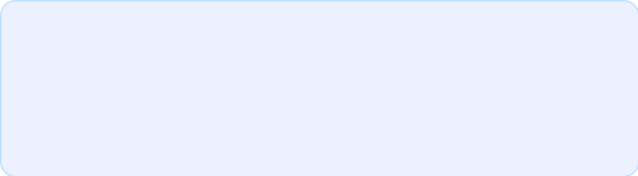
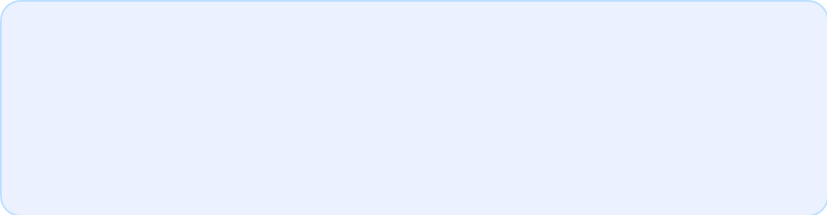


MIDOCEAN
An Efficient Hybrid Framework
Combining Transformer Feature
Encoding and Machine Learning for
Diabetic Retinopathy Classification
UNIVERSITY
Prepared By:
Supervised By:
Dr. Wessam Ahmad
Asraa Alwattar
Rahaf Barakat
College of Informatics,
Midocean University, UAE
Master of Science in Artificial Intelligence
Midocean University | College of Informatics
Thesis Defense Presentation
Midocean University | Master of Science in Artificial Intelligence
1

Slide 2
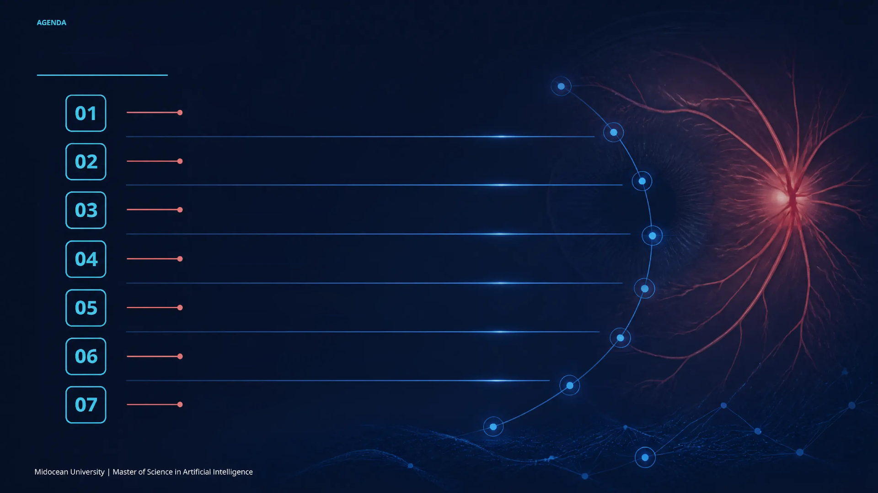
Presentation Outline
Introduction and Background
Contributions
Literature Review
Methodology
Results and Analysis
Conclusion and Future Work
References
2

Slide 3

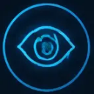


INTRODUCTION AND BACKGROUND
///
Introduction and Background
Diabetic retinopathy is a progressive microvascular
complication of diabetes and a major cause of preventable
visual impairment.
Manual grading of retinal fundus images is time-
consuming, reader-dependent, and difficult to scale for
population-level screening.
AI-based retinal-image analysis enables automated
learning of disease-related patterns and supports more
efficient severity grading.
3

Slide 4
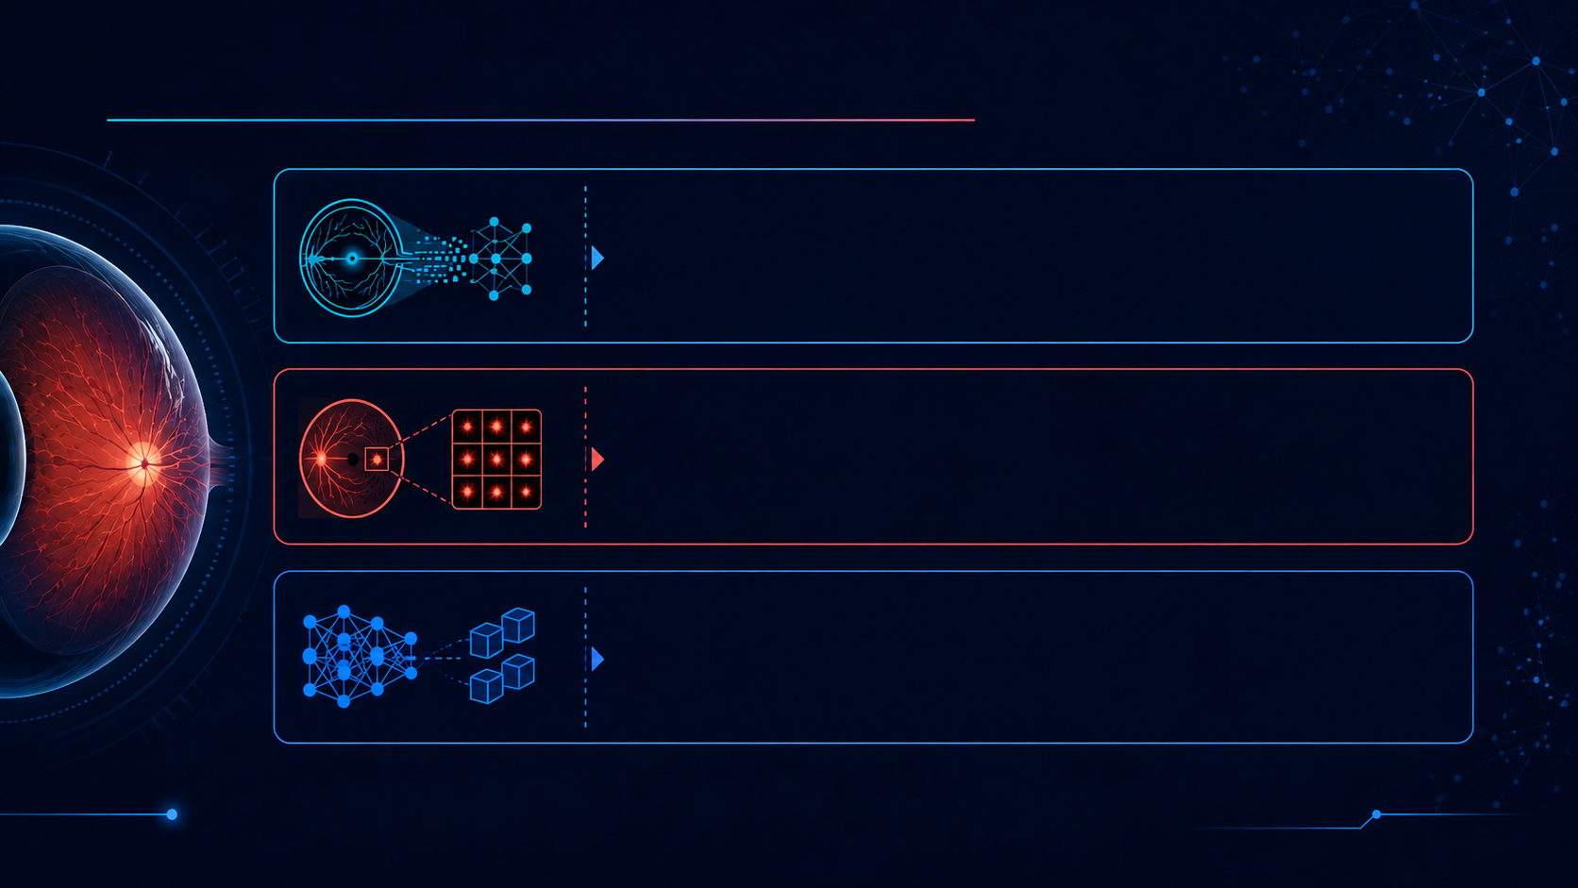
Problem, Objective, and Significance
Automated five-class DR grading is challenged by image-quality variation,
class imbalance, and subtle differences between neighboring disease stages.
Severe and proliferative classes are underrepresented, while local lesion patterns
And broader retinal context must both be represented.
Enhance a reproducible hybrid framework that fuses ConvNeXt-Tiny and
Swin-V2-Tiny embeddings and classifies them using Random Forest.
4
Midocean University | Master of Science in Artificial Intelligence

Slide 5

CONTRIBUTIONS
Key Research Contributions
Hybrid Visual Representation
Fuses ConvNeXt-Tiny and Swin-V2-Tiny features to combine fine-grained local lesion patterns withh global
contextual relationships.
Regularized Final Classifier
Implements Random Forest as the multiclass classifier and selects its configuration without using the testing
subset for model selection.
Class-Sensitive Evaluation
Evaluates the hybrid classifier using per-class and aggregate precision, recall, F1-score, specificity, confusion
matrix, and ROC-AUC.
Midocean University | Master of Science in Artificial Intelligence
5

Slide 6

LITERATURE REVIEW
Comparative Analysis of Related Work
Authors
Year
Method / Model
Dataset
Results
Limitations
Lin and Wu [6]
2023
Revised ResNet50
Kaggle DR images
74.32% accuracy
Remaining train-test gap
Das et al. [7]
2023
DRFEC: 26 pretrained CNNs
EyePACS
79.11% accuracy
Overfitting; high train-validation gap
Jiwani et al. [8]
2022
CNN classifier
IDRiD
~77.6% accuracy
Limited design detail
Mehboob et al. [9]
2022
CNN-based approach + augmentation
EyePACS
~83.78% accuracy
Single dataset; limited generalization
Midocean University | Master of Science in Artificial Intelligence
6

Slide 7




























LITERATURE REVIEW
Identified Gaps and Our Solutions
Gap Category
Current Limitations
Proposed Solution
Single-backbone approaches may emphasize either local or contextual features.
Fuse ConvNeXt-Tiny and Swin-V2-Tiny embeddings into a 1,536-dimensional hybrid vector.
Representation
Class imbalance may bias the model toward majority severity classes.
Apply class-weighted loss to give minority classes higher training importance.
Imbalanced Multiclass Evaluation
Some studies report strong within-dataset results without strict testing separation.
Use validation-based RF selection and reserve the testing subset for final reporting.
Model Selection
Complex pipelines can be difficult to rebuild after training.
Save fixed embeddings and use a controlled preprocessing and evaluation pipeline.
Reproducibility
Midocean University | Master of Science in Artificial Intelligence
7

Slide 8


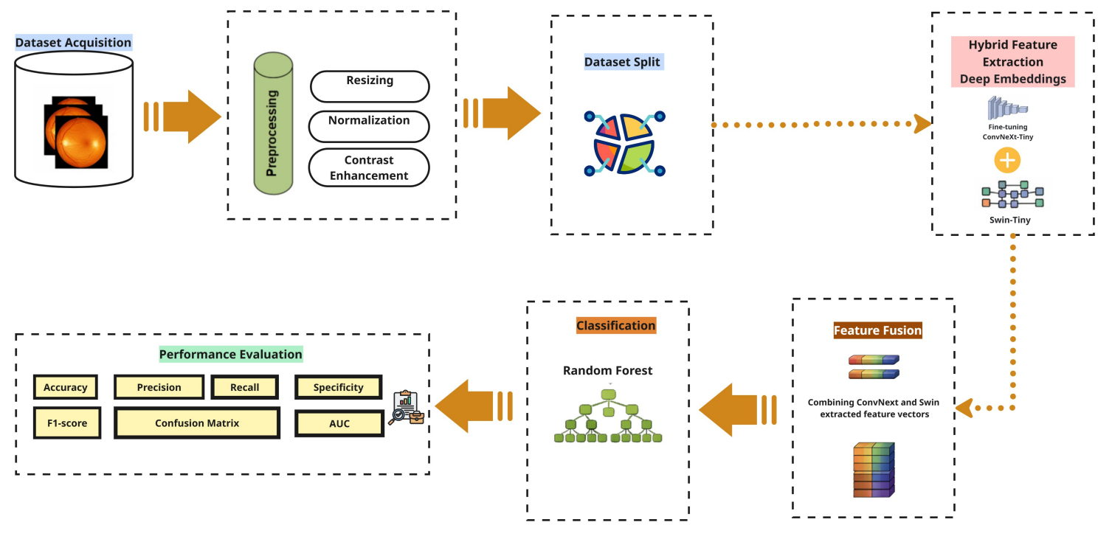
METHODOLOGY
Proposed Framework Architecture
Proposed hybrid framework for diabetic retinopathy classification
Midocean University | Master of Science in Artificial Intelligence
8

Slide 9


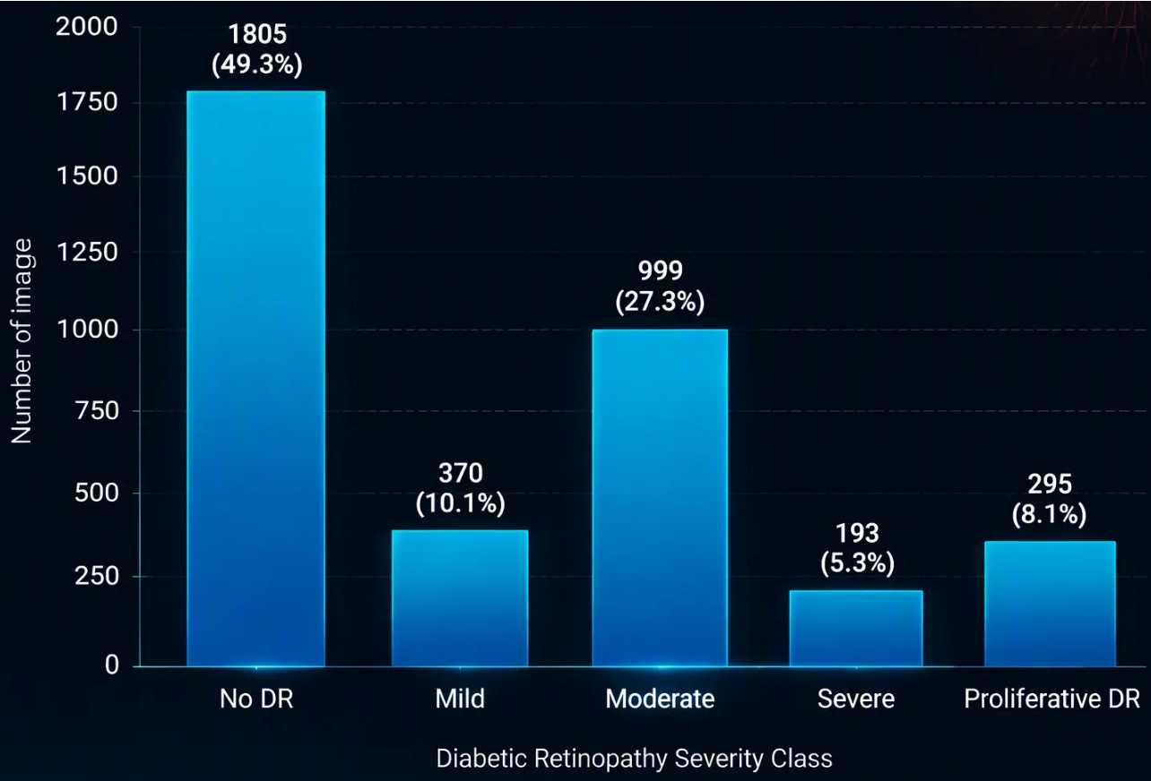
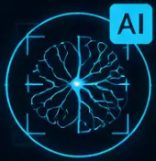

METHODOLOGY
Dataset Description
Original Class Distribution in the APTOS 2019 Dataset
APTOS 2019 Blindness Detection Dataset [1]
3,662 retinal fundus images.
Five clinical severity classes: No DR, Mild,
Moderate, Severe, and Proliferative DR.
Class distribution is highly imbalanced,
with No DR as the majority class and Severe as
the smallest class.
Original class distribution in APTOS 2019
Midocean University | Master of Science in Artificial Intelligence
9

Slide 10
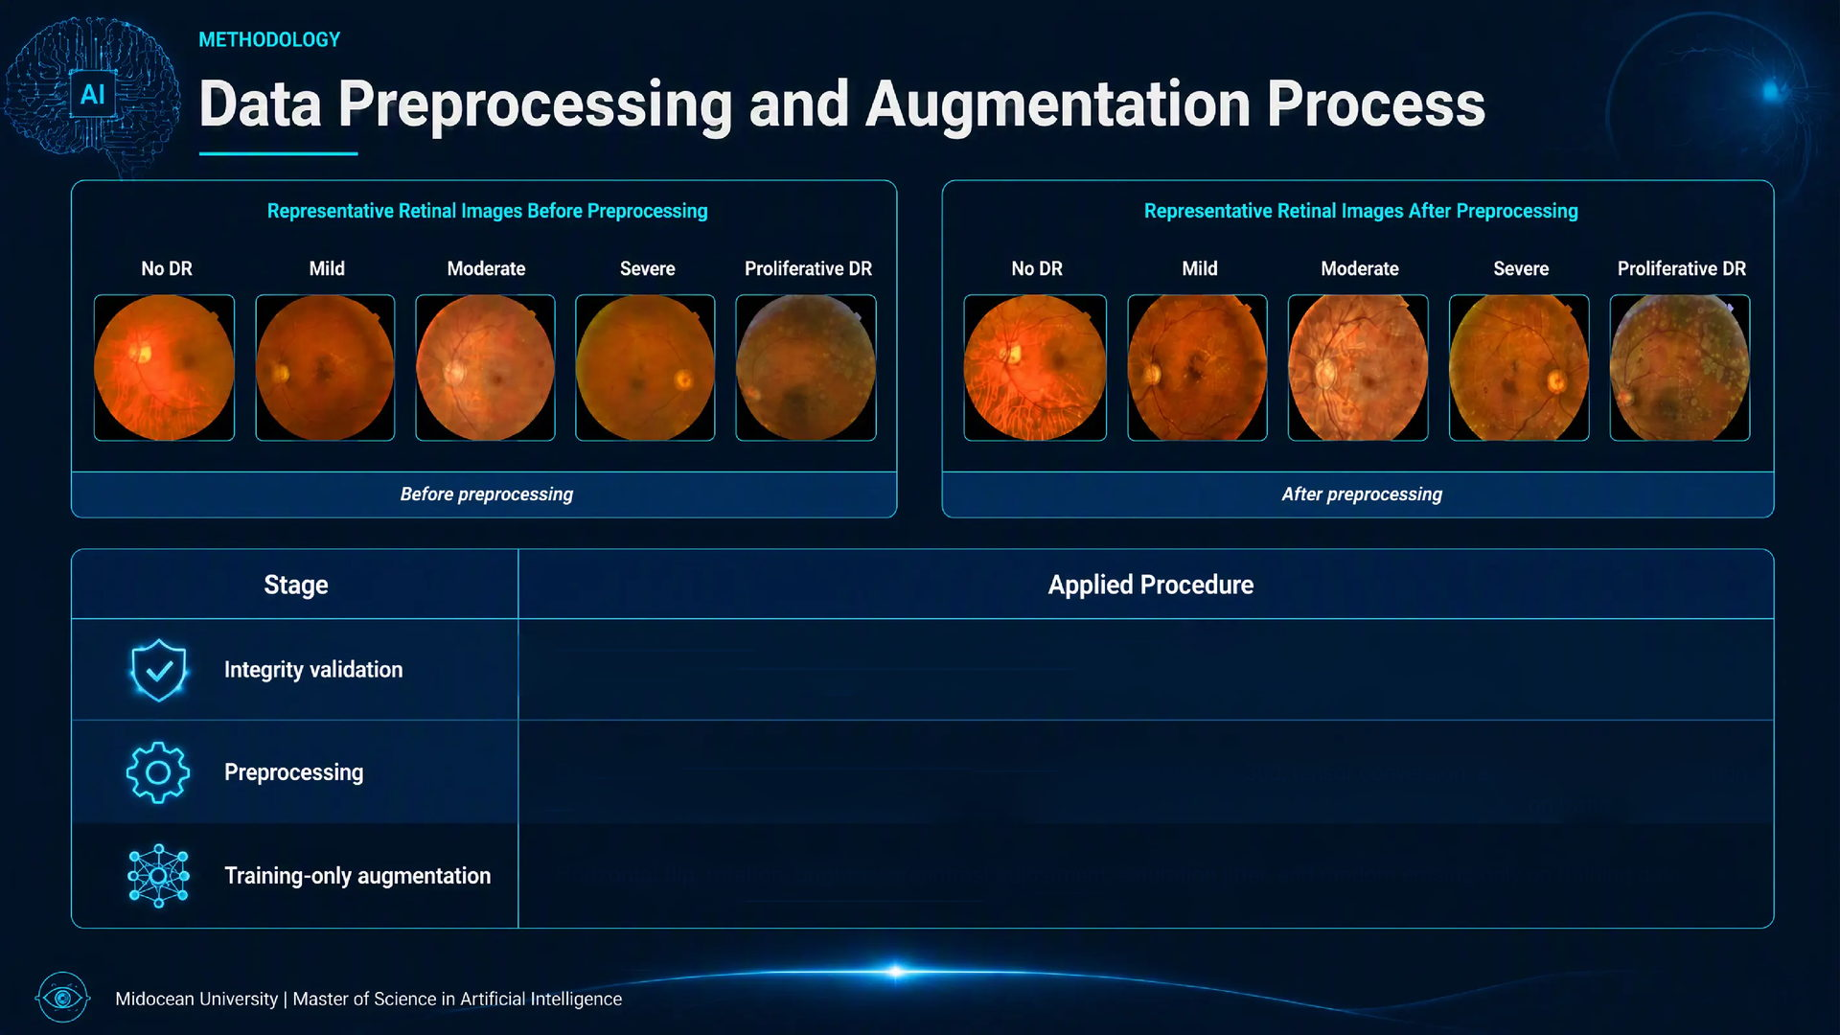
Applied Procedure
Confirmed image-label consistency and removed missing or corrupted entries.
Dark-border cropping, CLAHE contrast enhancement, resizing to 300 × 300, tensor conversion, and ImageNet normalization.
Horizontal flip, rotation, brightness/contrast adjustment, saturation jitter, and random erasing only on training data.
10

Slide 11




















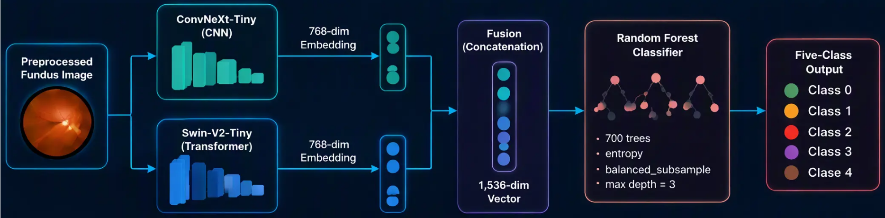
METHODOLOGY
Base Models Architecture
Component
Role
Output / Setting
Convolutional feature extractor for local lesion texture, vessels, and hierarchical retinal patterns.
ConvNeXt-Tiny
768-dimensional embedding; best checkpoint at epoch 15
Transformer-based feature extractor for contextual spatial relationships using shifted-window attention.
Swin-V2-Tiny
768-dimensional embedding; best checkpoint at epoch 10
Final five-class classifier trained on the fused 1,536-dimensional vector.
Random Forest
700 trees; entropy; balanced_subsample; max depth = 3
Feature-level fusion and Random Forest classification
Midocean University | Master of Science in Artificial Intelligence
11

Slide 12
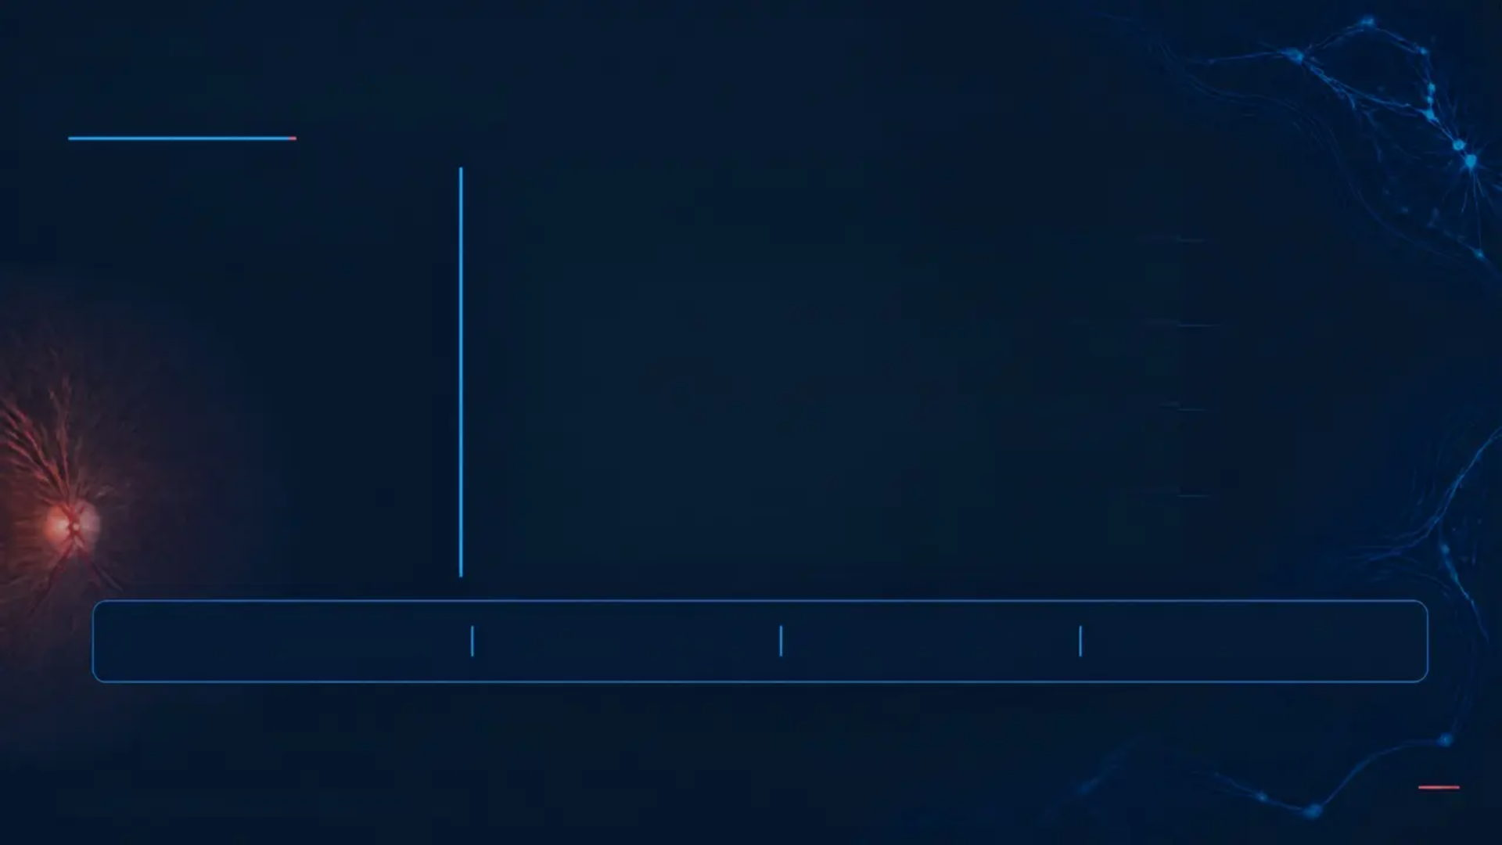
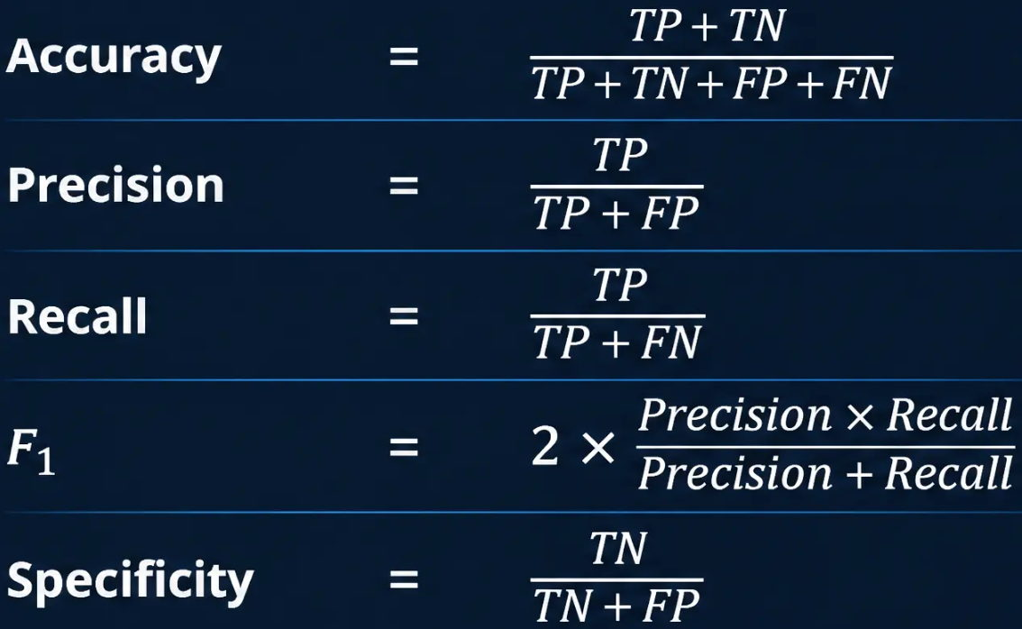
METHODOLOGY
Evaluation Metrics
Comprehensive
Performance Assessment
Classification Metrics:
Where: TP = True Positives
TN = True Negatives
FP = False Positives
FN = False Negatives
Confusion matrices and one-vs-rest ROC-AUC values are also used to examine class-level errors and threshold-
based discrimination across the five DR grades.
Midocean University | Master of Science in Artificial Intelligence
12

Slide 13
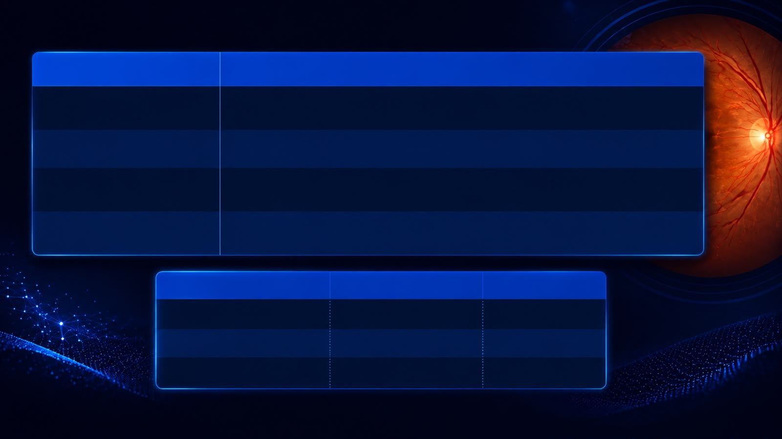
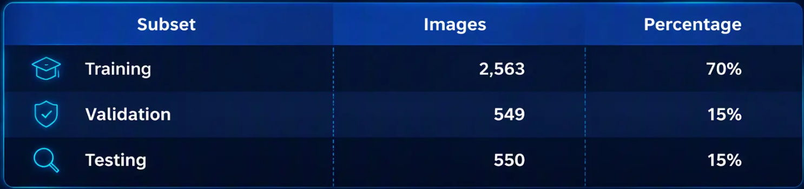
RESULTS AND ANALYSIS
Experimental Design
Experimental Step
Implementation
Dataset split
Stratified 70:15:15 split into training, validation, and testing subsets.
Deep-feature extraction
Fine-tuned ConvNeXt-Tiny and Swin-V2-Tiny generated fixed 768-dimensional embeddings.
Concatenated embeddings formed a 1,536-dimensional vector classified by Random Forest.
Fusion and classification
The held-out test subset was used only after model selection was complete.
Final evaluation
Midocean University | Master of Science in Artificial Intelligence
13

Slide 14
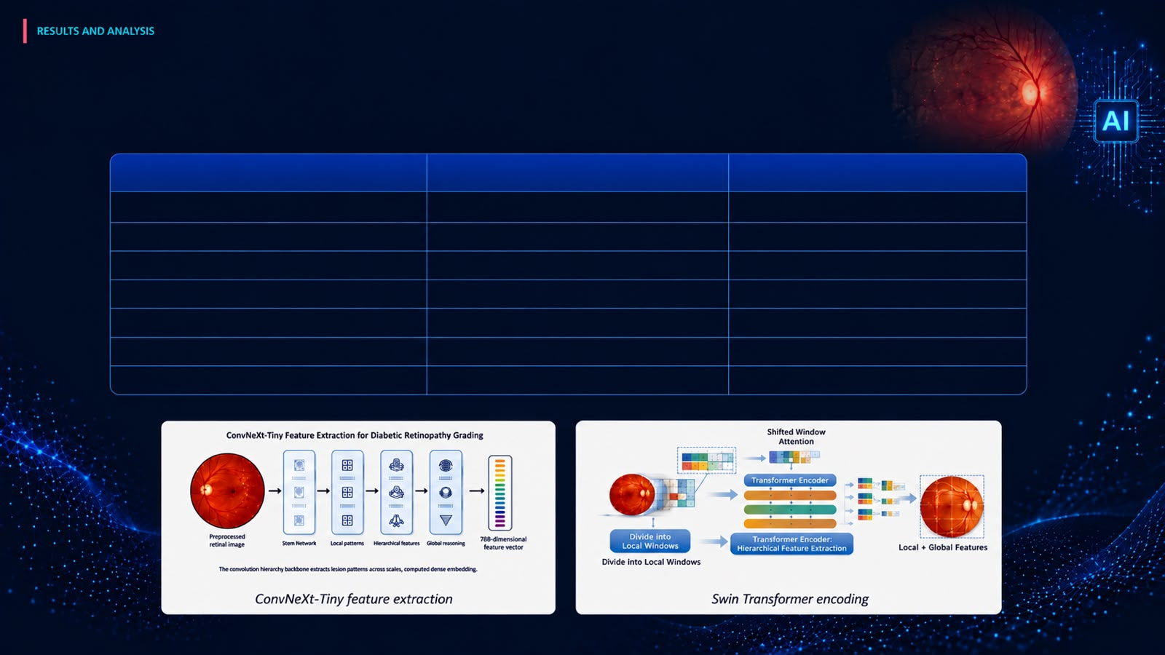
Individual Feature-Extractor Results
The individual backbones were used as complementary feature extractors rather than as the final classifier.
Parameter
ConvNeXt-Tiny
Swin-V2-Tiny
Pretrained weights
ImageNet-1K V1
ImageNet-1K V1
Batch size
32
32
Classifier head
Dropout (0.45) + Linear (768→5)
Dropout (0.20) + Linear (768→5)
Loss function
Class-weighted cross-entropy
Class-weighted cross-entropy
Label smoothing
0.06
0.02
Learning rate
Single (not differentiated)
Backbone 1×10⁻⁵ / Head 2×10⁻⁴
Optimizer
AdamW
AdamW
Midocean University | Master of Science in Artificial Intelligence
14

Slide 15
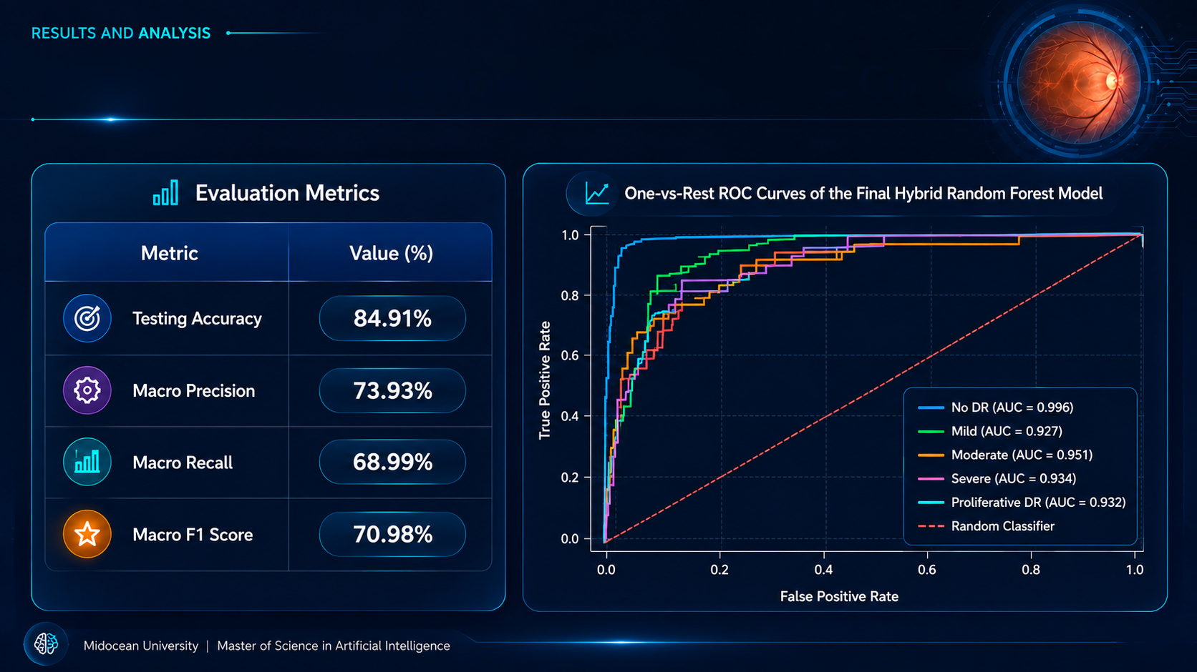
Final Hybrid Framework: Results & ROC Curve
15

Slide 16
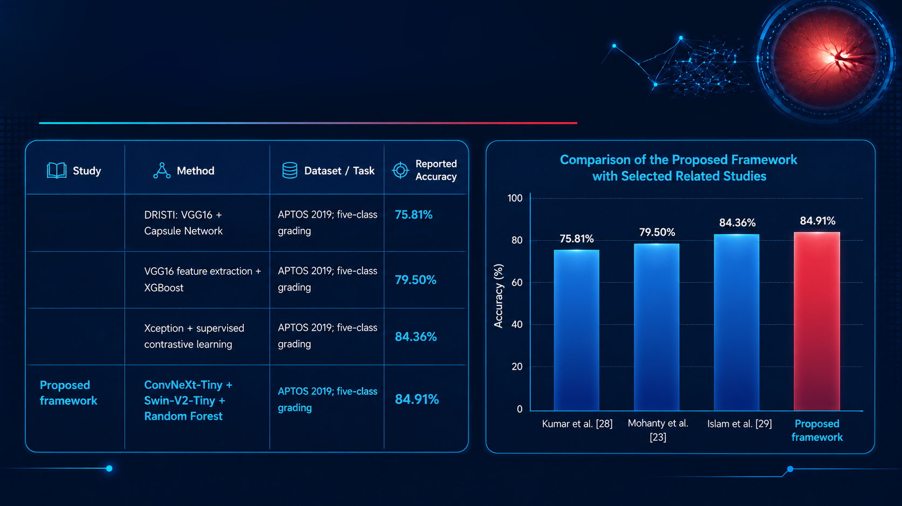
Comparison of the Proposed Framework
with Selected Related Studies
Kumar et al. [10]
Mohanty et al. [11]
Islam et al. [12]
Midocean University | Master of Science in Artificial Intelligence
16

Slide 17
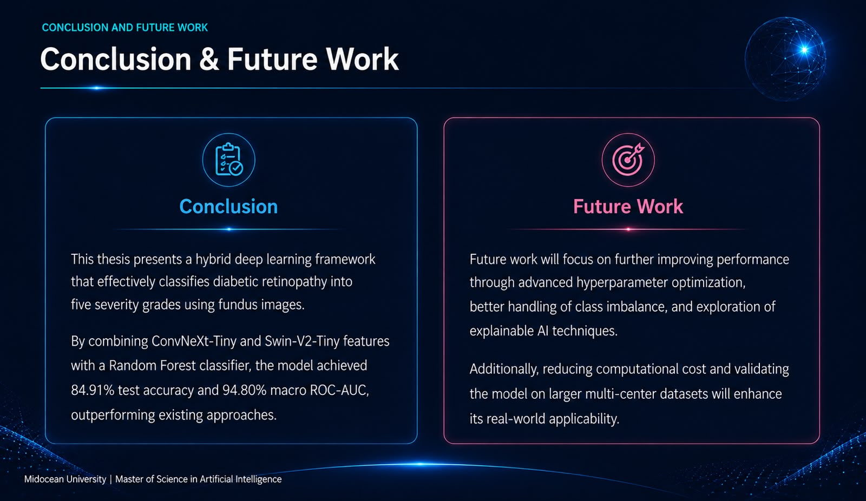
17

Slide 18

REFERENCES
References (1/2)
[1] Karthik, M. & Dane, S. (2019). APTOS 2019 Blindness Detection.
Kaggle. Dataset:
https://www.kaggle.com/competitions/aptos2019-blindness-detection
[6] Lin & Wu (2023) — Revised ResNet-50 for Diabetic Retinopathy
Detection
[2] Liu, Z. et al. (2022). A ConvNet for the 2020s. CVPR.
[7] Das et al. (2022) — DRFEC: CNNs for Feature Extraction
and Classification
[3] Liu, Z. et al. (2022). Swin Transformer V2:
Scaling Up Capacity and Resolution. CVPR.
[8] Jiwani et al. (2023) — CNN-based Diabetic Retinopathy
Classification
[4] Breiman, L. (2001). Random Forests. Machine Learning, 45, 5–32.
[9] Mehboob et al. (2022) — A Deep Learning Based Approach
for Grading of Diabetic Retinopathy Using Large Fundus Image Dataset
Midocean University | Master of Science in Artificial Intelligence
18

Slide 19
REFERENCES
References (2/2)
[10] Kumar, G. et al. (2021). DRISTI: A Hybrid Deep Neural Network for
Diabetic Retinopathy Diagnosis. Signal, Image and Video Processing.
[13] Guefrachi, S. et al. (2025). Diabetic Retinopathy Detection Using
Deep Learning Multistage Training. Arabian Journal for Science
and Engineering.
[11] Mohanty, C. et al. (2023). Using Deep Learning Architectures
for Detection and Classification of Diabetic Retinopathy. Sensors.
[14] Akhtar, S. et al. (2025). A Deep Learning Based Model for Diabetic
Retinopathy Grading. Scientific Reports.
[12] Islam, M. R. et al. (2022). Supervised Contrastive Learning for
Diabetic Retinopathy Detection. Computers in Biology and Medicine.
Midocean University | Master of Science in Artificial Intelligence
19

Slide 20
MIDOCEAN
UNIVERSITY
Thank You
Questions & Discussion
Midocean University | Master of Science in Artificial Intelligence
20

