Slide 1




Discrete Mathematics
Dr. Shahira Ahmed
IT241
Lecture 3

Slide 2


Slide 3
Lecture Outline
Definition of a Function.
  Domain, Codomain
  Image, Preimage
Injection, Surjection, Bijection
Inverse Function
Function Composition
Graphing Functions
Floor, Ceiling, Factorial

Slide 4
Relations vs Functions
A function is a relation where exactly one element of B is related to each element of A.
Example R={(2, 1),(3,6),(2,3),(5, 8)}is a function?
Solution False
Relations
Functions

Slide 5
Functions
Definition: Let A and B be nonempty sets. A function f from A to B, denoted f: A → B is an assignment of each element of A to exactly one element of B.
We write f(a) = b if b is the unique element of B assigned by the function f to the element a of A.
Functions are sometimes
called mappings or
transformations.
Students
Grades
A
B
C
D
F

Slide 6
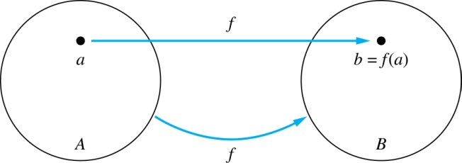
Functions
Given a function f: A → B:
We say f maps A to B or
f is a mapping from A to B.
A is called the domain of f.
B is called the codomain of f.

Slide 7
Functions
If f(a) = b,
  then b is called the image of a under f.
  a is called the preimage of b.
The range of f is the set of all images of points in A under f. We denote it by f(A).

Slide 8
Codomain vs Range
Codomain={A,B,C,D,F}
Range={A,B}
Students
Grades
A
B
C
D
F

Slide 9
Representing Functions
Functions may be specified in different ways:
  An explicit statement of the assignment.
    Students and grades example.
  A formula.
    f(x) = x + 1
  A computer program.
    A Java program that when given an integer n, produces the nth Fibonacci Number

Slide 10
Quiz
z
f(a) = ?
A
B
z
The image of d is ?
a
The domain of f is ?
A
x
The codomain of f is ?
B
b
y
The preimage of y is ?
b
c
d
z
Range →f(A) = ?
{y,z}
The preimage(s) of z is (are) ?
{a,c,d}

Slide 11
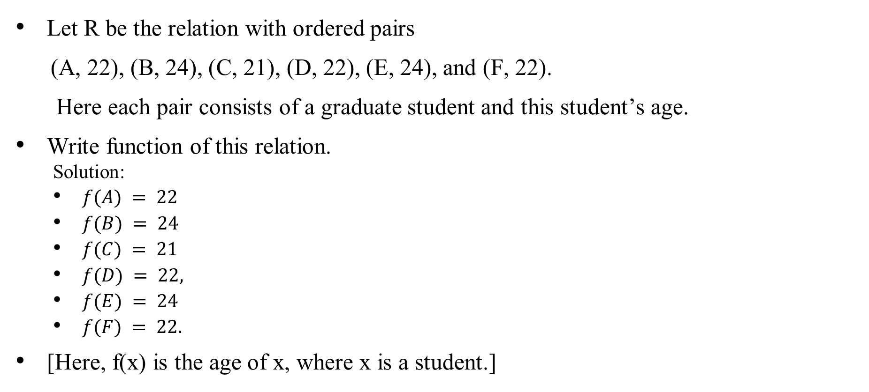
Quiz
Let R be the relation with ordered pairs
(A, 22), (B, 24), (C, 21), (D, 22), (E, 24), and (F, 22).
Here each pair consists of a graduate student and this student’s age.
Write function of this relation.
  Solution:
  $f(A) = 22$
  $f(B) = 24$
  $f(C) = 21$
  $f(D) = 22,$
  $f(E) = 24$
  $f(F) = 22.$
[Here, f(x) is the age of x, where x is a student.]

Slide 12
Quiz
Let R be the relation with ordered pairs (A, 22), (B, 24), (C, 21), (D, 22), (E, 24), and (F, 22). Here each pair consists of a graduate student and this student’s age.
Find Domain, codomain, Range
Solution
  Domain={A, B, C, D, E, F}.
  Codomain
    the set of positive integers between 20-90
  The range ={21, 22, 24}

Slide 13
One-to-One Functions (Injections)
Definition: A function f is said to be one-to-one , or injective, if and only if f(a) = f(b) implies that a = b for all a and b in the domain of f. A function is said to be an injection if it is one-to-one.
A
B
a
x
v
b
y
c
z
d
w

Slide 14
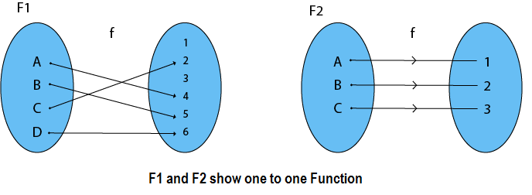
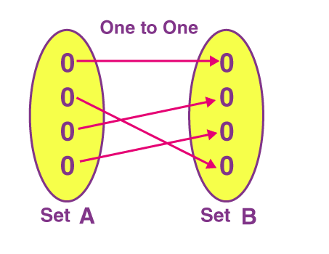
Quiz
Injection

Slide 15
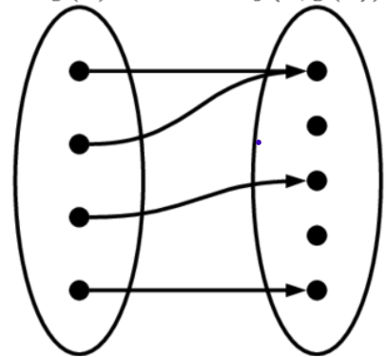
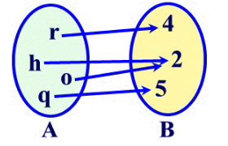
Quiz
Not Injection

Slide 16
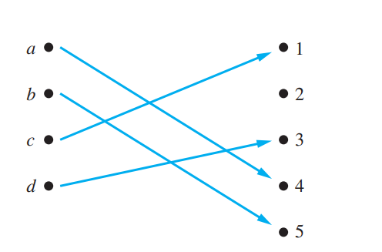
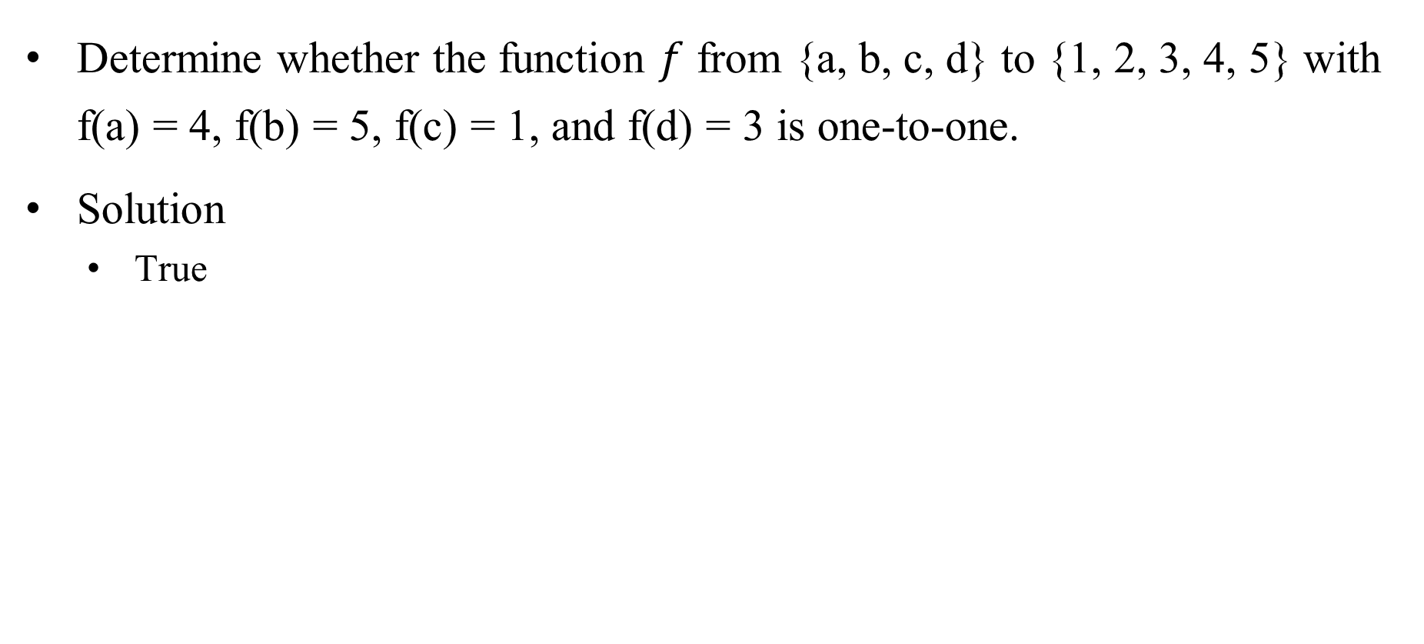
Quiz
Determine whether the function $f$ from {a, b, c, d} to {1, 2, 3, 4, 5} with f(a) = 4, f(b) = 5, f(c) = 1, and f(d) = 3 is one-to-one.
Solution
  True

Slide 17
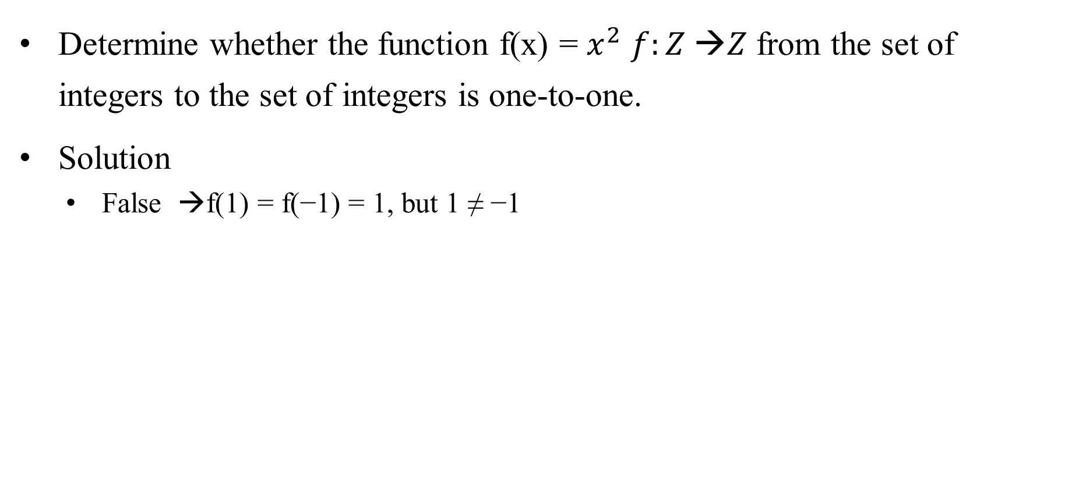
Quiz
Determine whether the function f(x) = $x^{2}$ $f:Z →Z$ from the set of integers to the set of integers is one-to-one.
Solution
  False →f(1) = f(−1) = 1, but 1 ≠ −1

Slide 18
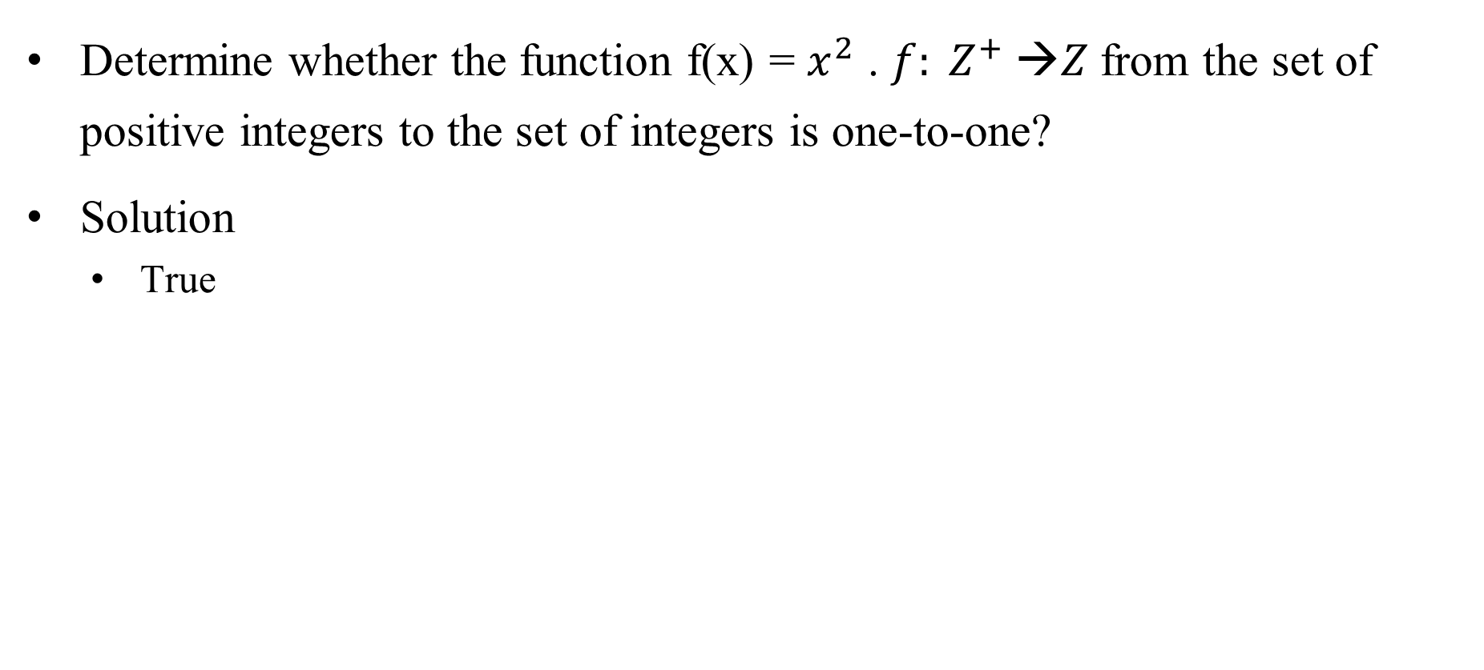
Quiz
Determine whether the function f(x) = $x^{2}$ . $f: Z^{+} →Z$from the set of positive integers to the set of integers is one-to-one?
Solution
  True

Slide 19
Quiz
Determine whether the function f(x) = x + 1 from the set of real numbers to itself is one-to-one.
Solution
  True

Slide 20


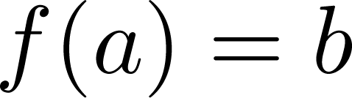
Surjections
Definition: A function f from A to B is called onto or surjective, if and only if for every element there is an element with .
A
B
a
x
b
y
c
z
d

Slide 21
Quiz
Let f be the function from {a, b, c, d} to {1, 2, 3} defined by f(a) = 1, f(b) = 2, f(c) = 1, and f(d) = 3. Is f an onto function?
Solution
  True

Slide 22
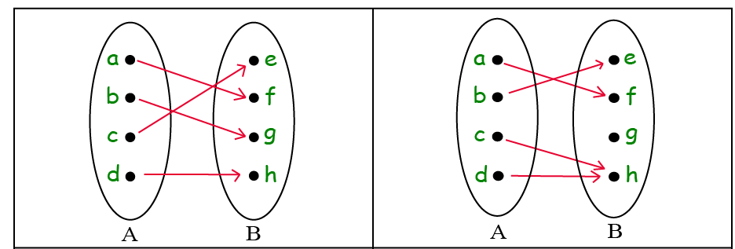
Quiz
surjective
Not surjective

Slide 23
Quiz
Determine whether the function f(x) = x + 1 from the set of real numbers to itself is onto.
Solution
  True

Slide 24
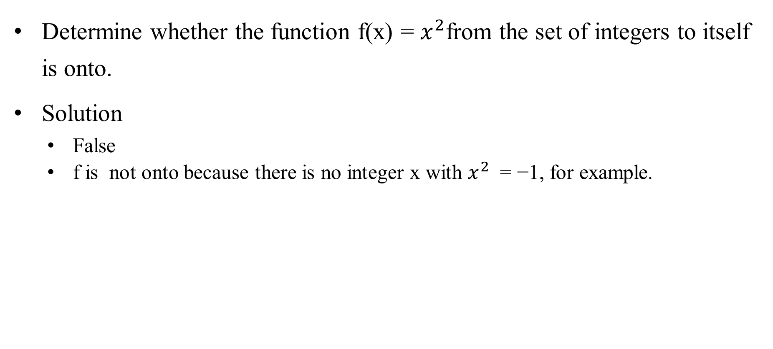
Quiz
Determine whether the function f(x) = $x^{2}$from the set of integers to itself is onto.
Solution
  False
  f is not onto because there is no integer x with $x^{2}$ = −1, for example.

Slide 25
Bijections
Definition: A function f is a one-to-one correspondence, or a bijection, if it is both one-to-one and onto (surjective and injective).
A
B
a
x
b
y
c
d
z
w

Slide 26
Quiz
Let f be the function from {a, b, c, d} to {1, 2, 3, 4} with f(a) = 4, f(b) =2, f(c) = 1, and f(d) = 3. Is f a bijection?
Solution:
  The function f is one-to-one and onto. It is one-to-one because no two values in the domain are assigned the same function value.
  It is onto because all four elements of the codomain are images of elements in the domain.
  Hence, f is a bijection.

Slide 27
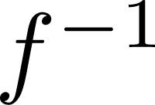
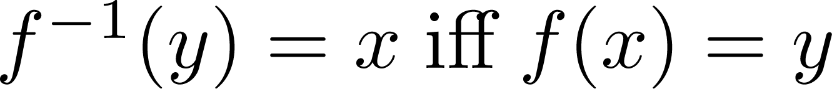
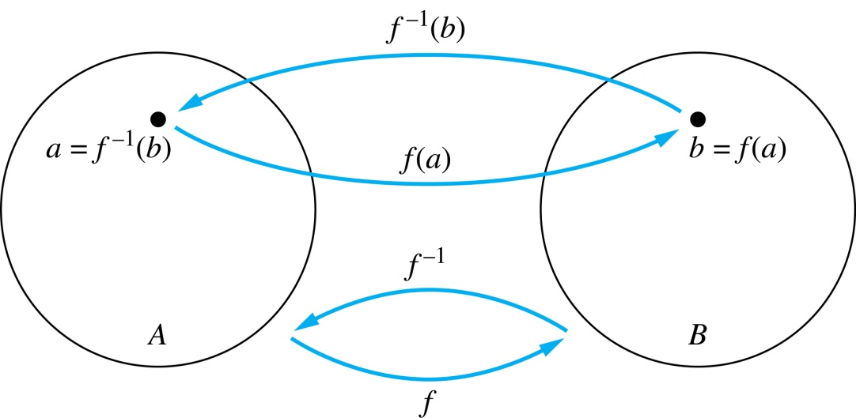
Inverse Functions
Definition: Let f be a bijection from A to B. Then the inverse of f, denoted , is the function from B to A defined as
No inverse exists unless f is a bijection. Why?

Slide 28
Inverse Functions
A
B
A
B
f
a
V
a
V
b
b
W
W
c
c
d
X
d
X
Y
Y

Slide 29
Quiz
Let f be the function from {a,b,c} to {1,2,3} such that f(a) = 2, f(b) = 3, and f(c) = 1. Is f invertible and if so what is its inverse?
Solution: The function f is invertible because it is a one-to-one correspondence. The inverse function f⁻¹ reverses the correspondence given by f, so f⁻¹ (1) = c, f⁻¹ (2) = a, and f⁻¹ (3) = b.

Slide 30
Quiz
Let f: Z → Z be such that f(x) = x + 1. Is f invertible, and if so, what is its inverse?
Solution: The function f is invertible because it is a one-to-one correspondence. The inverse function f⁻¹ reverses the correspondence so f⁻¹ (y) = y – 1.

Slide 31
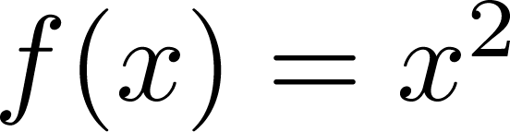
Questions
Example 3: Let f: R → R be such that . Is f invertible, and if so, what is its inverse?
Solution:False, The function f is not invertible because it is not one-to-one .

Slide 32
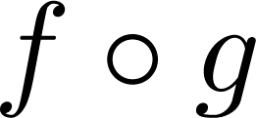
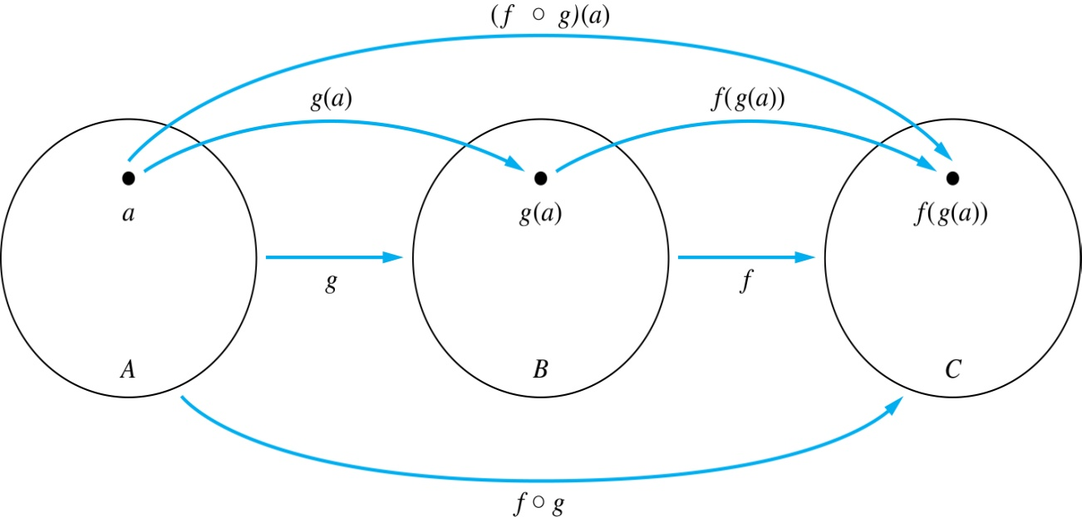
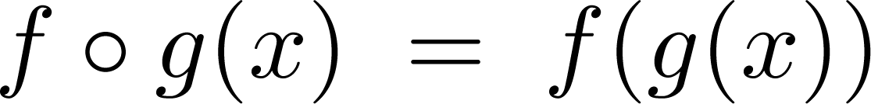
Composition
Definition: Let f: B → C, g: A → B. The composition of f with g, denoted is the function from A to C defined by

Slide 33
Composition
A
g
B
f
C
A
C
V
a
a
h
h
b
i
b
W
i
c
c
X
j
d
d
j
Y

Slide 34
Composition Questions
Let g be the function from the set {a,b,c} to itself such that g(a) = b, g(b) = c, and g(c) = a. Let f be the function from the set {a,b,c} to the set {1,2,3} such that f(a) = 3, f(b) = 2, and f(c) = 1. What is the composition of f and g, and what is the composition of g and f.
Solution: The composition f∘g is defined by
  f∘g (a)= f(g(a)) = f(b) = 2.
  f∘g (b)= f(g(b)) = f(c) = 1.
  f∘g (c)= f(g(c)) = f(a) = 3.
  Note that g∘f is not defined, because the range of f is not a subset of the domain of g.

Slide 35
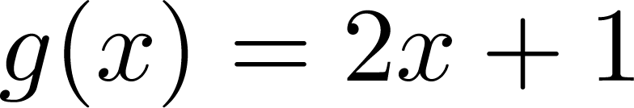
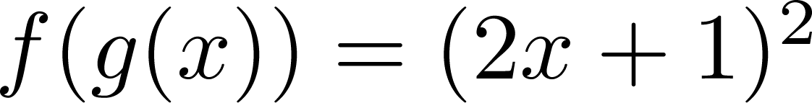
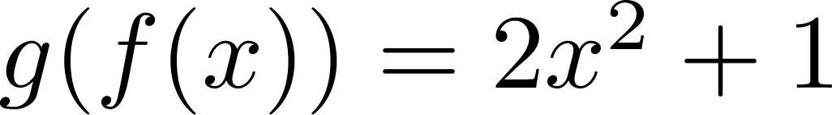
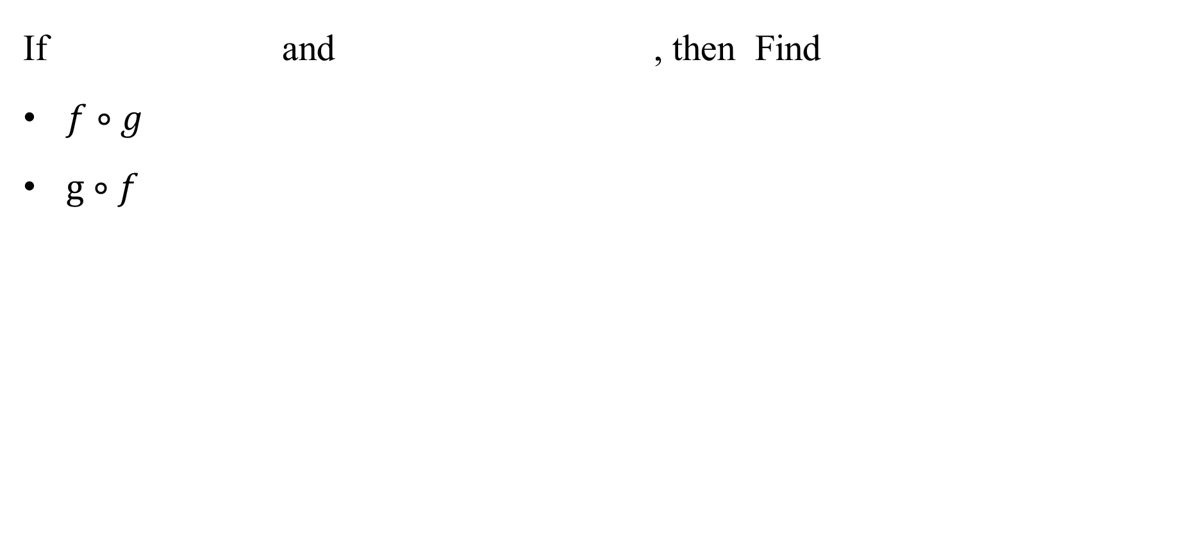
Composition
If and , then Find
$f∘g$
$g∘f$

Slide 36
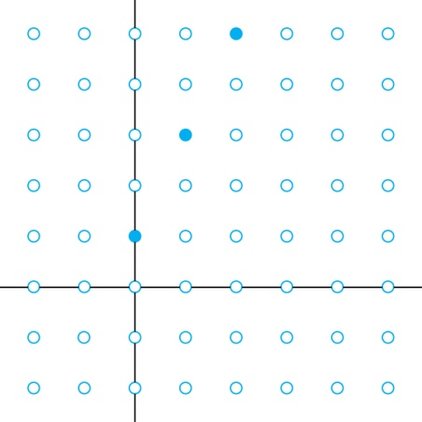
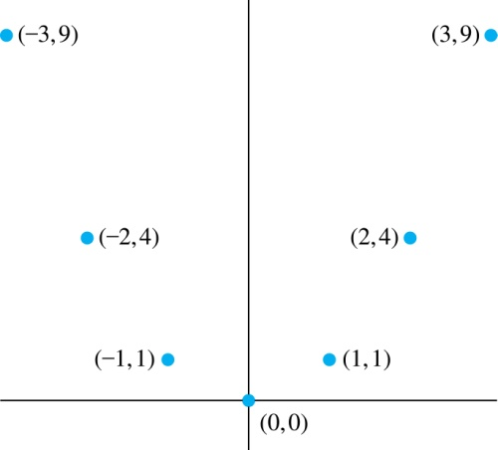
Graphs of Functions
Let f be a function from the set A to the set B. The graph of the function f is the set of ordered pairs {(a,b) | a ∈A and f(a) = b}.
Graph of f(n) = 2n + 1
from Z to Z
Graph of f(x) = x²
from Z to Z

Slide 37
Quiz
Let f and g be functions from the set of integers to the set of integers defined by f(x) = 2x + 3 and g(x) = 3x + 2.
What is the composition of f and g, and also the composition of g and f ?
Solution:
  f∘g (x)= f(g(x)) = f(3x + 2) = 2(3x + 2) + 3 = 6x + 7
  g∘f (x)= g(f(x)) = g(2x + 3) = 3(2x + 3) + 2 = 6x + 11

Slide 38
Quiz
Let f and g be functions from the set of integers to the set of integers defined by f(x) = 2x + 3 and g(x) = 3x + 2.
What is the composition of f and g, and also the composition of g and f ?
Solution:
  f∘g (x)= f(g(x)) = f(3x + 2) = 2(3x + 2) + 3 = 6x + 7
  g∘f (x)= g(f(x)) = g(2x + 3) = 3(2x + 3) + 2 = 6x + 11

Slide 39
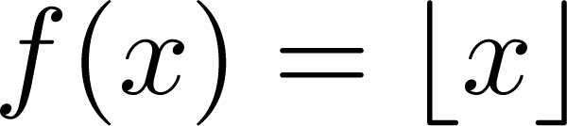
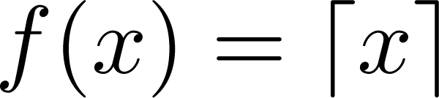
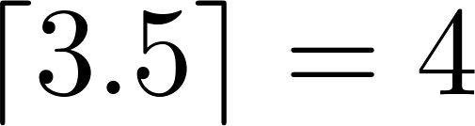
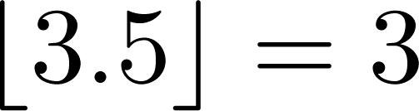
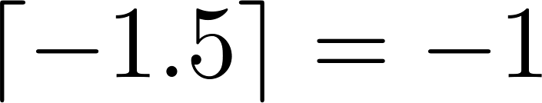
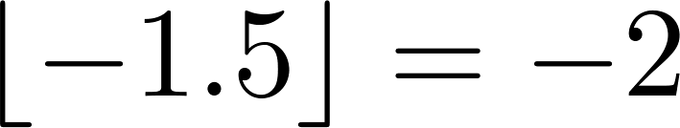
Some Important Functions
The floor function, denoted
is the largest integer less than or equal to x.
The ceiling function, denoted
is the smallest integer greater than or equal to x
Example:

Slide 40
Some Important Functions
The floor function, denoted
is the largest integer less than or equal to x.
The ceiling function, denoted
is the smallest integer greater than or equal to x
Example:

Slide 41
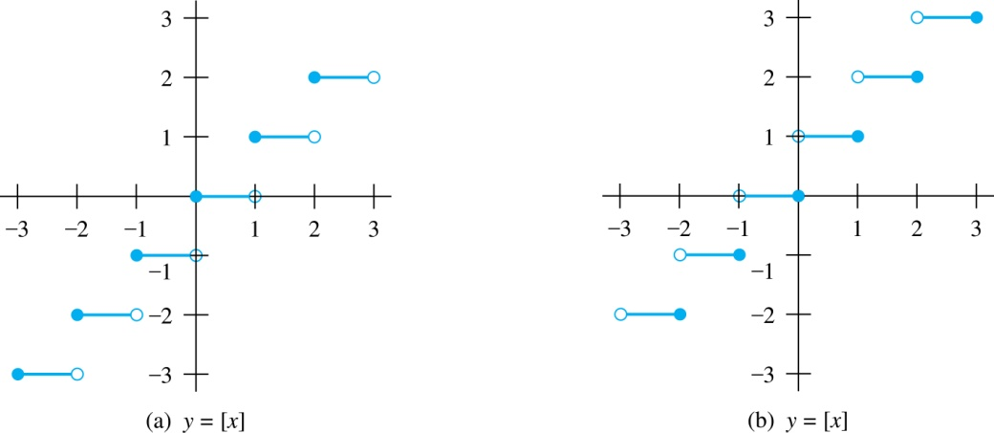
Floor and Ceiling Functions
Graph of (a) Floor and (b) Ceiling Functions

Slide 42
Factorial Function
Definition: f: N → Z⁺ , denoted by f(n) = n! is the product of the first n positive integers when n is a nonnegative integer.
f(n) = 1 ∙ 2 ∙∙∙ (n – 1) ∙ n, f(0) = 0! = 1
Examples:
^{f(1) = 1! = 1}
^{f(2) = 2! = 1 ∙ 2 = 2}
^{f(6) = 6! = 1 ∙ 2 ∙ 3∙ 4∙ 5} ^{∙ 6 = 720}
f(20) = 2,432,902,008,176,640,000.

Slide 43
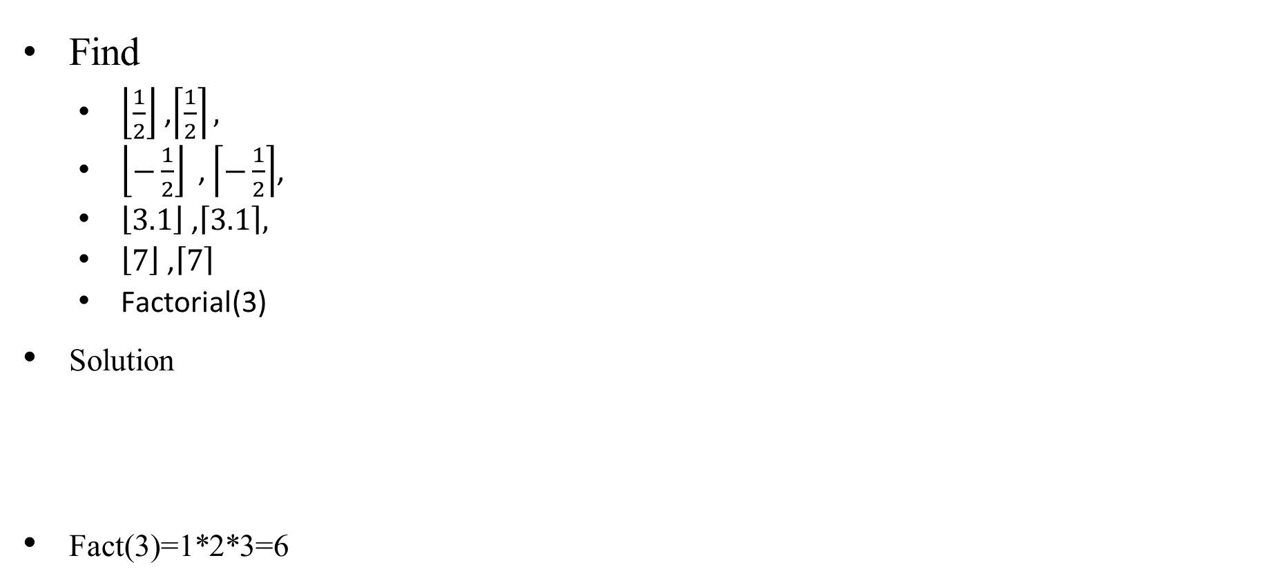
Quiz
Find
  $\left\lfloor \frac{1}{2}\right\rfloor$ ,$\left\lceil \frac{1}{2}\right\rceil ,$
  $\left\lfloor −\frac{1}{2}\right\rfloor \text{ ,}\left\lceil −\frac{1}{2}\right\rceil$,
  $\left\lfloor 3.1\right\rfloor$ ,$\left\lceil 3.1\right\rceil ,$
  $\left\lfloor 7\right\rfloor \text{ ,}\left\lceil 7\right\rceil$
  Factorial(3)
Solution
Fact(3)=1*2*3=6

Slide 44
للاطلاع فقط
Data stored on a computer disk or transmitted over a data network are usually represented as a string of bytes. Each byte is made up of 8 bits. How many bytes are required to encode 100 bits of data?
Solution: To determine the number of bytes needed, we determine the smallest integer that is at least as large as the quotient when 100 is divided by 8, the number of bits in a byte. Consequently, ⌈100∕8⌉ = ⌈12.5⌉ = 13 bytes are required.

Slide 45
للاطلاع فقط
In asynchronous transfer mode (ATM) (a communications protocol used on backbone networks), data are organized into cells of 53 bytes. How many ATM cells can be transmitted in 1 minute over a connection that transmits data at the rate of 500 kilobits per second?
Solution: In 1 minute, this connection can transmit 500,000 ⋅ 60 = 30,000,000 bits. Each ATM cell is 53 bytes long, which means that it is 53 ⋅ 8 = 424 bits long. To determine the number of cells that can be transmitted in 1 minute, we determine the largest integer not exceeding the quotient when 30,000,000 is divided by 424. Consequently, ⌊30,000,000∕424⌋ = 70,754 ATM cells can be transmitted in 1 minute over a 500 kilobit per second connection.

Slide 46
Recap

Slide 47
Quiz
True or False
Given Two sets A,B
  A = {v, w, z}
  B = {1, 2, 3}
  the {(v,1)(v,2)(v,3)} is a function from A-->B
False
A function is a relation where exactly one element of B is related to each element of A.

Slide 48
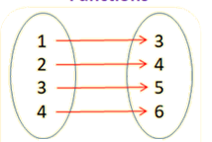
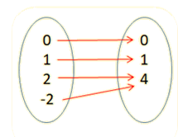
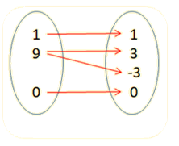
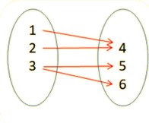
Quiz
Which of the following Figures Represent Function

Slide 49
Quiz
Determine whether the following are functions
a) A = {(1, 2), (2, 3), (3, 4), (4, 5)}
b) B = {(1, 3), (0, 3), (2, 1), (4, 2)}
c) C = {(1, 6), (2, 5), (1, 9), (4, 3)}
Solution:
a) A = {(1, 2), (2, 3), (3, 4), (4, 5)} is a function because all the first elements are different.
b) B = {(1, 3), (0, 3), (2, 1), (4, 2)} is a function because all the first elements are different. (The second element does not need to be unique)
c) C = {(1, 6), (2, 5), (1, 9), (4, 3)} is not a function because the first element, 1, is repeated.

Slide 50
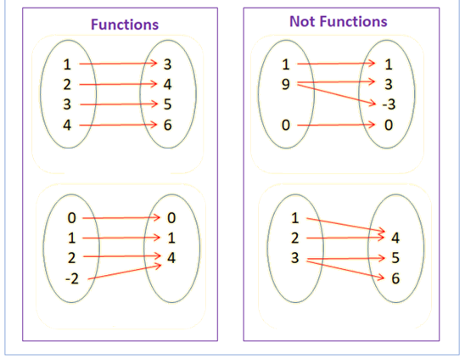
Quiz

Slide 51
Quiz

Slide 52
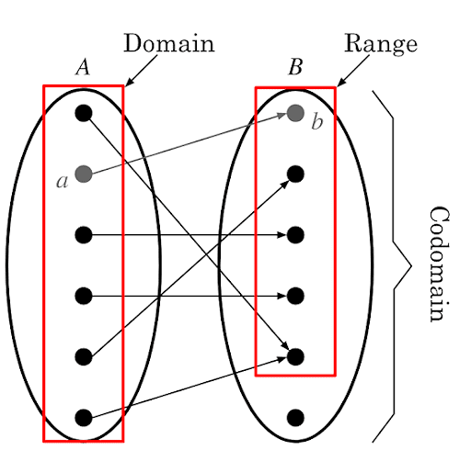
Review
f: A → B
Image
Pre image
If f(a) = b,
  then b is called the image of a under f.
  a is called the preimage of b

Slide 53
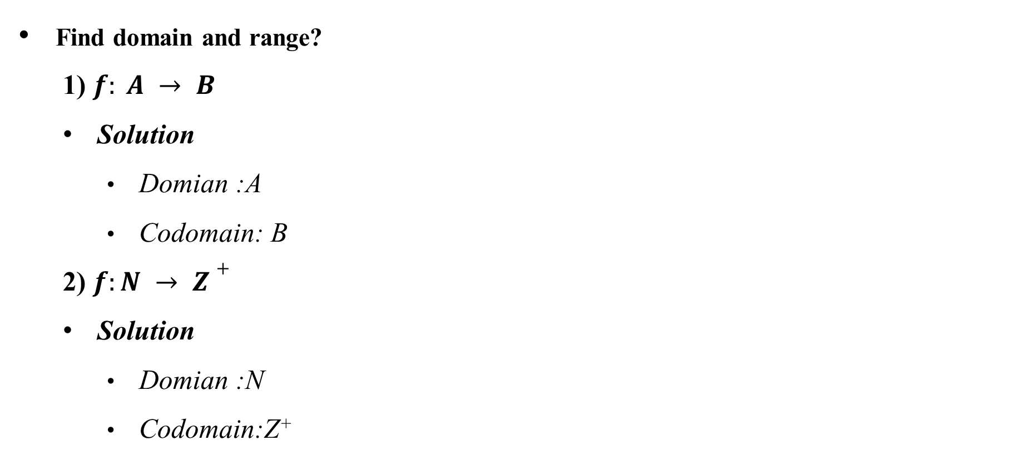
Quiz
Find domain and range?
  1) $f: A → B$
  Solution
    Domian :A
    Codomain: B
  2) $f:N → Z+$
  Solution
    Domian :N
    Codomain:Z⁺

Slide 54
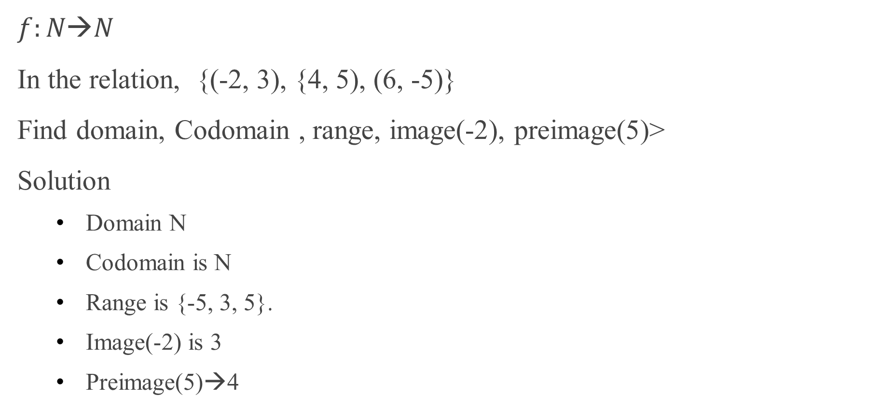
Quiz
$$f:N→N$$
In the relation, {(-2, 3), {4, 5), (6, -5)}
Find domain, Codomain , range, image(-2), preimage(5)>
Solution
  Domain N
  Codomain is N
  Range is {-5, 3, 5}.
  Image(-2) is 3
  Preimage(5)→4

Slide 55
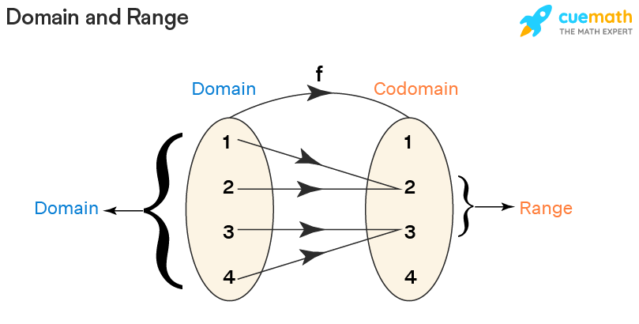
Quiz
R = {(1, 2), (2, 2), (3, 3), (4, 3)}, find domain,codmain,range, f(1).
Domain = {1, 2, 3, 4}
Codomain = {1, 2, 3, 4}
Range = {2, 3}
f(1)={2}

Slide 56
Quiz

Slide 57
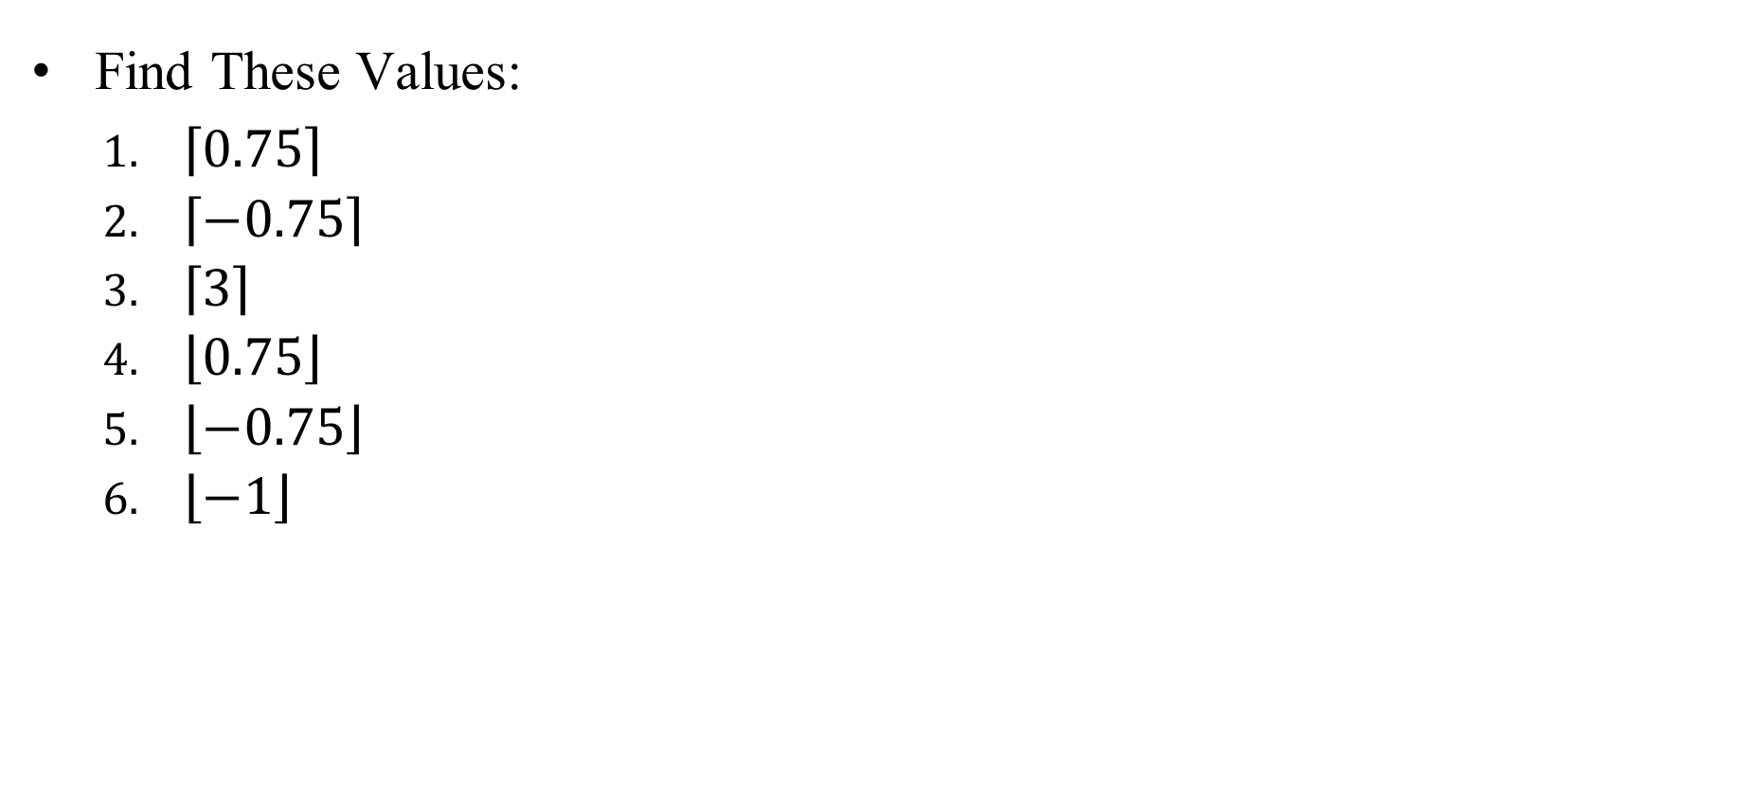
Quiz
Find These Values:
  $\left\lceil 0.75\right\rceil$
  $\left\lceil −0.75\right\rceil$
  $\left\lceil 3\right\rceil$
  $\left\lfloor 0.75\right\rfloor$
  $\left\lfloor −0.75\right\rfloor$
  $\left\lfloor −1\right\rfloor$
Solution
  1
  0
  3
  0
  -1
  -1

Slide 58
Quiz
Determine whether each of these functions from {a, b, c, d} to itself is onto.
f(a) = b, f(b) = a, f(c) = c, f(d) = d
f(a) = b, f(b) = b, f(c) = d, f(d) = c
f(a) = d, f(b) = b, f(c) = c, f(d) = d
Solution
True
False
False

Slide 59
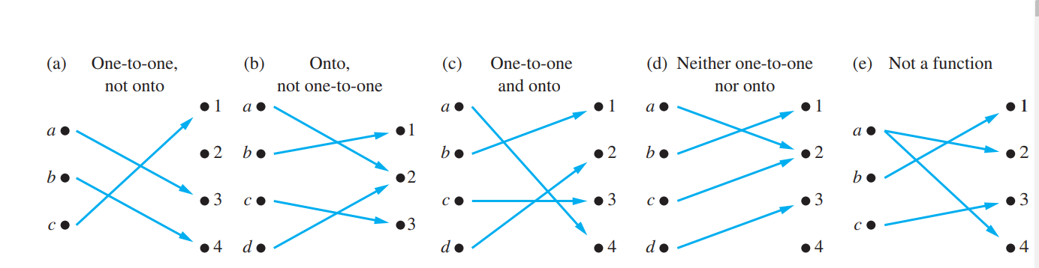
Quiz
State Type of these Function (one to one / onto / not a function)
one-to-one + onto=➔ bijection

Slide 60
Quiz
State Type of these Function (one to one / onto / not a function)
one-to-one + onto=➔ bijection

Slide 61
Quiz
State Type of these Function (one to one / onto / not a function)
one-to-one + onto=➔ bijection

Slide 62
Quiz
Solution

Slide 63
Quiz
Which of the following is bijective Function(Invertible)?
one-to-one + onto=➔ bijection

Slide 64
Quiz
Solution

Slide 65
Quiz
Given f(x) = 2x+3 and g(x) = 3x, find
(f ∘ g)(x)
6x+3
(g ∘ f)(x)
6x+9
(g ∘ g)(x)
9x
(f ∘ f)(x)
4x+9

Slide 66
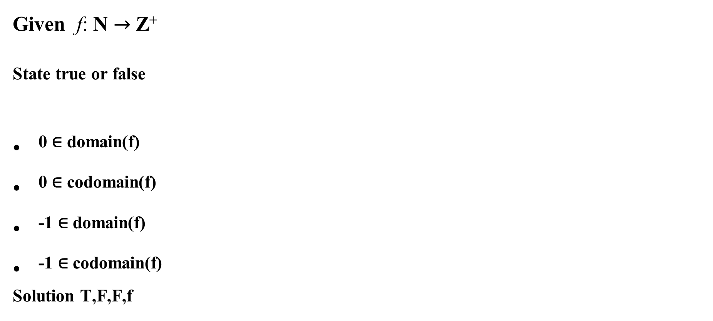
Quiz
Given f: N → Z⁺
^{State true or false}
⁰ $\text{∈}$ ^{domain(f)}
⁰ $\text{∈}$ ^{codomain(f)}
⁻¹ $\text{∈}$ ^{domain(f)}
⁻¹ $\text{∈}$ ^{codomain(f)}
^{Solution T,F,F,f}

Slide 67
Summary
Definition of a Function.
Types of function
Inverse Function
Function Composition
Graphing Functions
Floor, Ceiling, Factorial

