Slide 1


Risk Management
Prepared by Dr. Majid Ghaleb Abdullah
MGM510
Introduction lecture

Slide 2



Risk Management
MGM510
Introduction
Prepared by
Dr. Prepared by Dr. Majid Ghaleb
www.midocean.ae

Slide 3
AGENDA
Academic Agenda
Course Objectives
Course Description
Learning Outcomes
Topics
www.midocean.ae

Slide 4
01
Academic Agenda
الأسبوع 1 | أسبوع توجيهي
الأسبوع 2 | محاضرة 1 + اختبار قصير + حلقة نقاش
الأسبوع 3 | محاضرة 2 + اختبار قصير + حلقة نقاش
الأسبوع 4 | محاضرة 3 + اختبار قصير + حلقة نقاش
الأسبوع 5 | محاضرة 4 + اختبار قصير + حلقة نقاش
الأسبوع 6 | محاضرة 5 + اختبار قصير + حلقة نقاش
الأسبوع 7 | محاضرة 6 + اختبار قصير + حلقة نقاش
الأسبوع 8 | محاضرة 7 + اختبار قصير + حلقة نقاش
الأسبوع 9 | محاضرة 8 + اختبار قصير + حلقة نقاش
الأسبوع 10 | محاضرة 9 + اختبار قصير + حلقة نقاش
الأسبوع 11 | محاضرة 10 + اختبار قصير + حلقة نقاش
الأسبوع 12 | حلقة نقاش
الأسبوع 13 | الاختبارات النهائية
www.midocean.ae

Slide 5
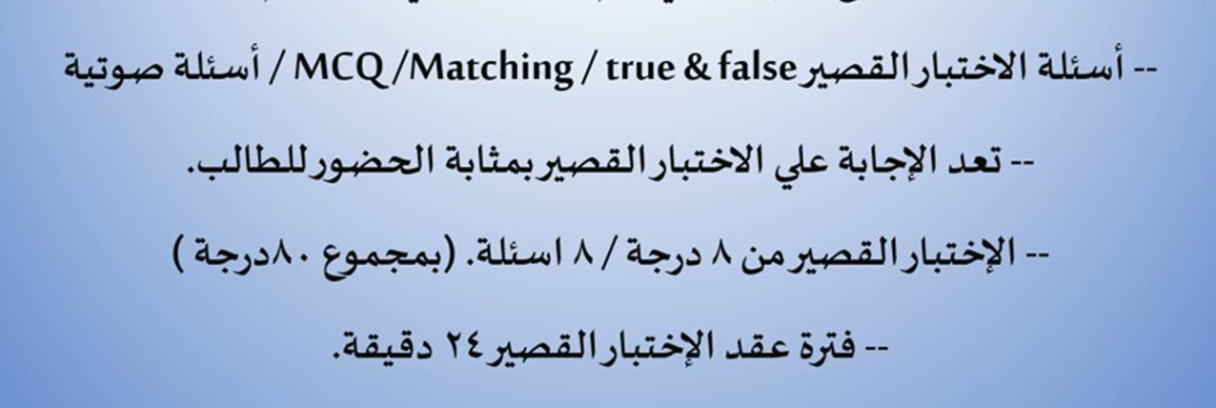
Quizzes & Exams
www.midocean.ae

Slide 6
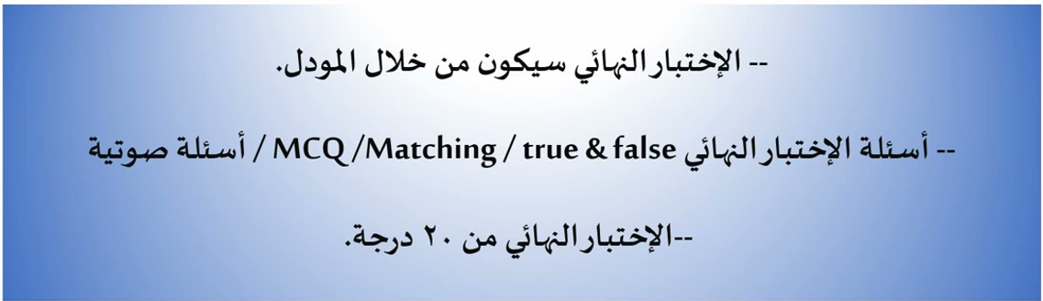
Final Exam
www.midocean.ae

Slide 7
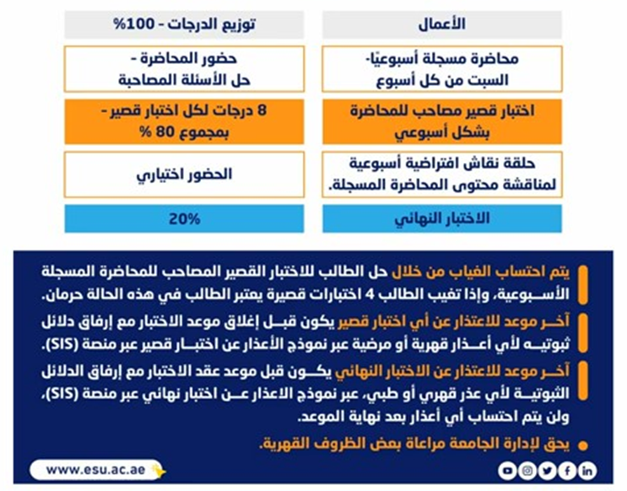

الأعمال وتوزيع الدرجات
أعمال الفصل الدراسي

Slide 8
Introduction
An analysis of the risk management problems in the business enterprise, the course emphasizes methodology for risk analysis, insurance principles and practices, techniques for risk and loss control, insurance underwriting, and rating. It also includes product liability, property damage, and bodily injury in business situations
www.midocean.ae

Slide 9
Course objectives
This course will examine the way in which business and society make an assessment of control and transfer risk. It is designed for the student with no previous knowledge of risk management.
to engage students in active discovery of risk management principles, developing an awareness of the challenges, the tools, and the process of designing and implementing a risk management program.
To focus on the ways in which businesses and society assess, control, and transfer risk. This process, known as the risk management process, is becoming an increasingly important tool in the management of business and personal financial health
www.midocean.ae

Slide 10
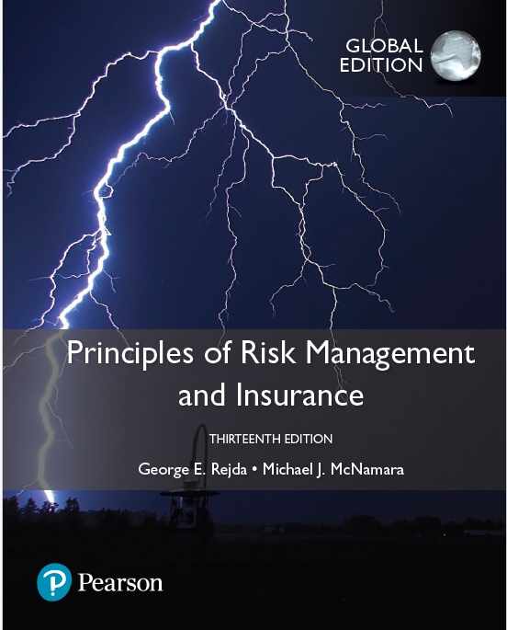
Course Description
Credit Hours: 3 credit hours
The materials and reference for this course will be:
The textbook.
Lecture notes and slides.
Required Textbook: Principles of Risk Management and Insurance, Thirteenth Edition global edition, by George E. Rejda Michael J. McNamara
www.midocean.ae

Slide 11

Learning Outcomes
Conduct a comprehensive assessment of associated physical, reputation, emotional, financial, and facilities risks.
Provide a realistic assessment of those risks along the risk management matrix (probability and severity).
Conduct a comprehensive exploration and examination of options for mitigating actions.
www.midocean.ae

Slide 12
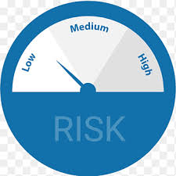
Learning Outcomes
Select the most appropriate mitigating actions for each risk.
Develop contingency and crisis response plans.
Consult with “campus experts” in planning.
Communicate risk management plan to other constituents of event.
Implement event according to pre-established risk management plans.
www.midocean.ae

Slide 13

Learning Outcomes
Document and evaluate outcomes of risk management plans.
Internalize the value of risk management.
Articulate the value of risk management.
www.midocean.ae

Slide 14
Topics
01
Risk in Our Society
Introduction.
Risk definitions
Risk in our society .
“When we take a risk, we are betting on an outcome that will result from a decision we have made, though we do not know for certain what the outcome will be.”
Peter L. Bernstein
Against the Gods: The Remarkable Story of Risk
www.midocean.ae

Slide 15
Topics
02
Insurance and Risk
The basic characteristics of insurance.
The characteristics of an ideally insurable risk from the viewpoint of a private insurer.
The major insurable and uninsurable risks in our society.
The types of insurance.
The social benefits and social costs of insurance
www.midocean.ae

Slide 16
Topics
03
Introduction to Risk Management
Risk management definition
The objectives of risk management objectives
Risk management process steps .
Explain the major risk-control techniques
Explain the major risk-financing techniques.
Apply the principles of risk management to a personal risk management program.
www.midocean.ae

Slide 17
Topics
04
Advanced Topics in Risk Management
.
The risks of terrorism, climate change, and cyber-liability impact risk management.
The underwriting cycle impact Capital market risk-financing alternatives..
Financial analysis and risk management decision making.
Other tools for risk managers.
www.midocean.ae

Slide 18
Topics
05
Types of Insurers & Marketing Systems
The major types of private insurers, (Stock insurers , Mutual insurers , Reciprocal exchanges, Lloyd’s of London ,Blue Cross and Blue Shield plans , Health maintenance organizations).
The major distribution systems for selling life insurance,( Personal selling systems ,Financial institution distribution systems , Direct response system ,Other distribution systems)
The major distribution systems in property and casualty insurance :(Independent agency system, Exclusive agency system , Direct writer , Direct response system , Mixed systems
www.midocean.ae

Slide 19
Topics
06
Insurance Company Operations
The underwriting process steps.
The sales and marketing activities of insurers.
Process of settling a claim steps .
The reasons for reinsurance and the various types of reinsurance treaties.
Importance of insurance company investments
The various types of investments of insurers.
www.midocean.ae

Slide 20
Topics
07
Financial Operations of Insurers
The three major sections of the balance sheet for a property and casualty insurance company:
(assets, liabilities, and policyholders’ surplus).
The sources of revenues and types of expenses incurred by a property and casualty insurance company.
The profitability measurement
how profitability is measured in the life insurance industry.
Objectives of rate making in the property and casualty insurance industry ( judgment rating, class rating, and merit rating).
www.midocean.ae

Slide 21
Topics
08
Government Regulation of Insurance
The major reasons why insurers are regulated.
key legal cases and legislative acts that impact on insurance regulation.
The major areas of insurance that are regulated.
The rate regulation objectives and the rating laws types.
Approaches for modernizing the regulation of insurance.
www.midocean.ae

Slide 22
Topics
09
Fundamental Legal Principles
The fundamental legal principles that are reflected in insurance )indemnity , insurable interest ,subrogation ,utmost good faith)
The legal concepts of representations, concealment, and warranty support the principle of utmost good faith.
The basic requirements for the formation of a valid insurance contract.
How the nature of insurance contracts differs from that of other contracts.
The law of agency
www.midocean.ae

Slide 23
Topics
10
Analysis of Insurance Contracts
The basic parts of any insurance contract.
The common types of deductibles that appear in insurance contracts, including :Straight deductible و Calendar-year deductible
How coinsurance works in a property insurance contract.
How coinsurance works in a health insurance contract.
How losses are paid when more than one insurance contract covers the same loss.
www.midocean.ae

Slide 24
Topics
11
The Liability Risk
Negligence definition and its elements.
The legal defenses that can be used in a lawsuit: (Contributory negligence ,Comparative negligence ,Assumption of risk ,Last clear chance rule)
The law of negligence to specific liability situations application .
The defects in the current tort liability system and the proposals for tort reform.
The tort liability problems: (Defective tort liability system ,Medical sector liability , Liability arising from technological and societal change)
www.midocean.ae

Slide 25



Thank You

