Slide 1

PMG510
Fundamentals of Risk Management
Prepared by Dr. Ayman Elmaasarawy
Impact of risk on Organizations
Lecture 2

Slide 2

Lecture 1 Summery
Risk management in context
Nature of risk
Benefits of risk management
Risk management
Features of risk management
Definitions of risk
Types of risks
Risk description
Inherent level of risk
Risk classification systems
Risk likelihood and magnitude

Slide 3
Lecture 2 Organization
Impact of risk on organizations:
Level of risk
Impact of hazard risks
Attachment of risks
Risk and reward
Attitudes to risk
Risk and triggers
Types of risks:
Timescale of risk impact
Four types of risk
Embrace opportunity risks
Manage uncertainty risks
Mitigate hazard risks
Minimize compliance risks

Slide 4
Chapter 2 Impact of risk on organizations
Level of risk:
By taking a proactive approach to risk and risk management, organizations will be able to achieve the following four areas of improvement:
Strategy, because the risks associated with different strategic options will be fully analyzed and better strategic decisions will be reached.
Tactics, because consideration will have been given to selection of the tactics and the risks involved in the alternatives that may be available.
Operations, because events that can cause disruption will be identified in advance and actions taken to reduce the likelihood of these events occurring, limit the damage caused by these events and contain the cost of the events.
Compliance will be enhanced because the risks associated with failure achieve compliance with statutory and customer obligations will be recognized

Slide 5
Chapter 2 Impact of risk on organizations
Level of risk:
Stakeholders now expect that organizations will take full account of the risks that may cause disruption within operations, late delivery of projects or failure to deliver strategy.
The exposure presented by an individual risk can be defined in terms of the likelihood of the risk materializing and the impact of the risk when it does materialize.
As risk exposure increases, the likely impact will also increase. Guide 73 refers to this measurement of likelihood and impact as being the current or residual ‘level of risk’.
This level of risk should be compared with the risk attitude and risk appetite of the organization for risks of that type.
The risk appetite will sometimes be described as a set of risk criteria.

Slide 6
Chapter 2 Impact of risk on organizations
Level of risk:
The term ‘magnitude’ is used to indicate the size of the event that has occurred or might occur.
The term ‘impact’ is used to define how the event affects the finances, operations, reputation and/or marketplace (FIRM) of the organization.
This use of terminology is also consistent with the use of impact in business continuity planning evaluations. This is a measure of the risk at the current level.
The term ‘consequences’ is used to indicate the extent to which the event results in failure to achieve effective and efficient strategy, tactics, operations and compliance (STOC)

Slide 7
Chapter 2 Impact of risk on organizations
Level of risk:
Example:
Injury to key player
A sports club will wish to reduce the chances of a key player being absent through injury.
However, key players do get injured and the club will need to consider the impact of such an event in advance of it happening. If the injury is serious, the player may be absent for a significant length of time.
There is likely to be a substantial impact, which will be most obvious on the pitch where the success of the team is likely to be reduced.
However, other consequences may also result and these could include the loss of revenue from the sale of shirts and other merchandise with that player’s name and number. Arrangements to reduce the potential for loss of income should also be considered.

Slide 8
Chapter 2 Impact of risk on organizations
Impact of hazard risks:
Hazard risks undermine objectives, and the level of impact of such risks is a measure of their significance.
Hazard risk management is closely related to the management of insurable risks. Remember that a hazard (or pure) risk can only have a negative outcome.
Hazard risk management is concerned with issues such as health and safety at work, fire prevention, avoiding damage to property and the consequences of defective products.
Hazard risks can cause disruption to normal operations, as well as resulting in increased costs and poor publicity associated with disruptive events

Slide 9
Chapter 2 Impact of risk on organizations
Impact of hazard risks:
Hazard risks are related to business dependencies, including IT and other supporting services. There is increasing dependence on the IT infrastructure of most organizations and IT systems can be disrupted by computer breakdown or fire in server rooms, as well as virus infection and deliberate hacking or computer attacks.
Theft and fraud can also be significant hazard risks for many organizations. This is especially true for organizations handling cash or managing a significant number of financial transactions.
Techniques relevant to the avoidance of theft and fraud include adequate security procedures, segregation of financial duties, and authorization and delegation procedures, as well as the vetting of staff prior to employment

Slide 10
Chapter 2 Impact of risk on organizations
Impact of hazard risks:
If a hazard risk materializes, it may have a very large magnitude, for example such as the destruction of the main distribution warehouse of an organization.
This large magnitude event will have an impact on the organization related to potential financial costs, destruction of infrastructure, damage to reputation and the inability to function in the marketplace.
Magnitude represents the gross or inherent level of the risk.

Slide 11
Chapter 2 Impact of risk on organizations
Impact of hazard risks:
However, the impact of the event will be reduced because of the controls that are in place. Impact represents the net, residual or current level of the risk.
These controls reduce the financial impact, the extent of destruction of infrastructure, as well as controls designed to protect reputation and marketplace activities.
But, what is also important for the organization is the consequences of the major warehouse fire. These consequences relate to the effect that the fire might have on the strategy, tactics, operations and compliance activities within the organization.

Slide 12
Chapter 2 Impact of risk on organizations
Impact of hazard risks:
It is possible that a major fire will cause significant financial loss that is covered by insurance, so that this large magnitude event has little impact on the finances of the organization.
Effective crisis management and business continuity will ensure that the consequences of this major fire from the point of view of customers will be so well managed that customers need not be aware that a major fire has taken place.

Slide 13
Chapter 2 Impact of risk on organizations
Impact of hazard risks:
Finally, the importance of compliance risks should not be underestimated.
Compliance risks can be substantial for many organizations, especially those business sectors that are heavily regulated.
In some cases, compliance with mandatory requirements, represents a ‘license to operate’ and failure to achieve the level of compliance activities required by the relevant regulator can have a significant impact on the reputation of the organization and substantial consequences for routine business activities.

Slide 14
Chapter 2 Impact of risk on organizations
Attachment of risks:
Although most standard definitions of risk refer to risks as being attached to corporate objectives, Figure 2.1 provides an illustration of the options for the attachment of risks.
Risks are shown in the diagram as being capable of impacting the key dependencies that deliver the core processes of the organization.
Corporate objectives and stakeholder expectations help define the core processes of the organization.
These core processes are key components of the existing nature and future enhancement of the business model and can relate to operations, tactics and corporate strategy, as well as compliance activities,

Slide 15
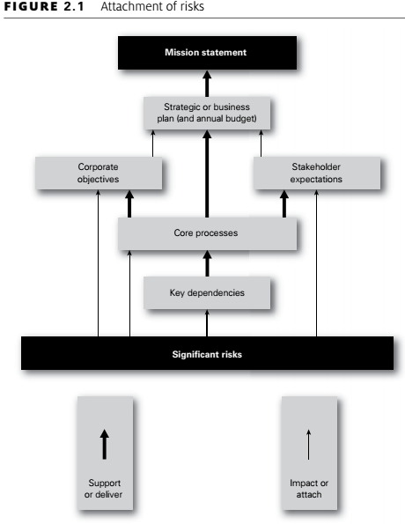
Chapter 2 Impact of risk on organizations
Attachment of risks:

Slide 16
Chapter 2 Impact of risk on organizations
Attachment of risks:
The intention of Figure 2.1 is to demonstrate that significant risks can be attached to features of the organization other than corporate objectives.
Significant risks can be identified by considering the key dependencies of the organization, the corporate objectives and/or the stakeholder expectations, as well as by analysis of the core processes of the organization.
For example, the failure of Northern Rock occurred because the wholesale money markets, on which the bank depended, stopped functioning.

Slide 17
Chapter 2 Impact of risk on organizations
Attachment of risks:
Another way of viewing the concept of attachment of risks is to consider that the features shown in Figure 2.1 offer alternative starting points for undertaking a risk assessment.
For example, a risk assessment can be undertaken by asking ‘what do stakeholders expect of us?’ and ‘what risks could impact the delivery of those stakeholder expectations?

Slide 18
Chapter 2 Impact of risk on organizations
Attachment of risks:
In the build-up to the recent financial crisis, banks and other financial institutions established operational and strategic objectives.
By analyzing these objectives and identifying the risks that could prevent the achievement of them, risk management made a contribution to the achievement of the high-risk objectives that ultimately led to the failure of the organizations.
To be useful to the organization, the corporate objectives should be presented as a full statement of the short-, medium- and long-term aims of the organization.

Slide 19
Chapter 2 Impact of risk on organizations
Attachment of risks:
Internal, annual, change objectives are usually inadequate, because they may fail to fully identify the operational (or efficiency), change (or competition) and strategic (or leadership) requirements of the organization.
The most important disadvantage associated with the ‘objectives-driven’ approach to risk and risk management is the danger of considering risks out of the context that gave rise to them.
For example, using this ‘objectives-driven’ approach facilitates the analysis of risks in relation to the positive and uncertain aspects of the events that may occur, as well as facilitating the analysis of the negative and compliance aspects.

Slide 20
Chapter 2 Impact of risk on organizations
Risk and reward:
Another feature of risk and risk management is that many risks are taken by organizations in order to achieve a reward.
Figure 2.2 illustrates the relationship between the level of risk and the anticipated size of reward. A business will launch a new product because it believes that greater profit is available from the successful marketing of that product.
In launching a new product, the organization will put resources at risk because it has decided that a certain amount of risk taking is appropriate.
The value at risk represents the risk appetite of the organization with respect to the activity that it is undertaking

Slide 21
Chapter 2 Impact of risk on organizations
Risk and reward:
When an organization puts value at risk in this way, it should do so with the full knowledge of the risk exposure and it should be satisfied that the risk exposure is within the appetite of the organization.
Even more important, it should ensure that it has sufficient resources to cover the risk exposure. In other words, the risk exposure should be quantified, the appetite to take that level of risk should be confirmed, and the capacity of the organization to withstand any foreseeable adverse consequences should be clearly established.
Not all business activities will offer the same return for the same level of risk taken. Start-up operations are usually high risk and the initial expected return may be low.

Slide 22
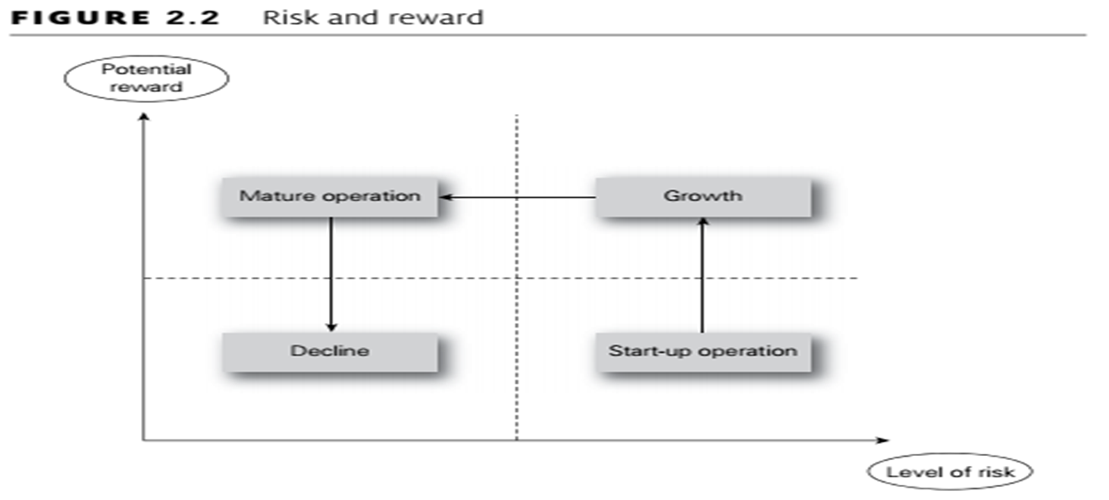
Chapter 2 Impact of risk on organizations
Risk and reward:
Figure 2.2 demonstrates the probable risk versus reward development for a new organization or a new product. The activity will commence in the bottom right-hand corner as a start-up operation, which is high risk and low return.

Slide 23
Chapter 2 Impact of risk on organizations
Risk and reward:
The growth phase for the business or product. As the investment matures, the reward may remain high, but the risks should reduce. Eventually, an organization will become fully mature and move towards the low-risk and low-return quadrant.
The normal expectation in very mature markets is that the organization or product will be in decline.
The particular risks that the organization faces will need to be identified by management or by the organization.
Appropriate risk management techniques will then need to be applied to the risks that have been identified.

Slide 24
Chapter 2 Impact of risk on organizations
Risk and reward:
For opportunity risks, the risk versus reward analysis should result in fewer unsuccessful new products and a higher level of profit or (at worst) a lower level of loss for all new activities or new products. In all cases, profit or enhanced level of service is the reward for taking risk.
Example:
risk versus reward
In a Formula 1 Grand Prix, the Ferrari team decided to send a driver out on wet-weather tyres, before the rain had actually started. Wet-weather tyres wear out very quickly in dry conditions and make the car much slower. If the rain had started immediately, this would have proved to be a very good decision.
In fact, the rain did not start for four or five laps, by which time the driver had been overtaken by most other drivers and his set of wet-weather tyres were ruined in the dry conditions. He had to return to the pits for a further set of new tyres more suited to the race conditions. In this case, a high-risk strategy was adopted in anticipation of significant rewards. However, the desired rewards were not achieved and significant disadvantage resulted.

Slide 25
Chapter 2 Impact of risk on organizations
Attitudes to risk:
Different organizations will have different attitudes to risk. Some organizations may be considered to be risk averse, whilst others will be risk aggressive.
To some extent, the attitude of the organization to risk will depend on the sector and the nature and maturity of the marketplace within which it operates, as well as the attitude of the individual board members.
Risks cannot be considered outside the context that gave rise to them. It may appear that an organization is being risk aggressive, when in fact, the board has decided that there is an opportunity that should not be missed.

Slide 26
Chapter 2 Impact of risk on organizations
Attitudes to risk:
However, the fact that the opportunity entails high risk may not have been fully considered. One of the major contributions from successful risk management is to ensure that strategic decisions that appear to be high risk are actually taken with all of the information available.
Improvement in the robustness of decision-making activities is one of the key benefits of risk management. Attitude to risk is a complex subject and is closely related to the risk appetite of the organization, but they are not the same.
Risk attitude indicates the long-term view of the organization to risk and risk appetite indicates the short-term willingness to take risk. This is similar to the difference between the long-term or established attitude of an individual towards the food they eat and their appetite for food at a particular moment in time.

Slide 27
Chapter 2 Impact of risk on organizations
Attitudes to risk:
Other key factors that will determine the attitude of the organization to risk include the stage in the maturity cycle, as shown in Figure 2.2.
For an organization that is in the start-up phase, a more aggressive attitude to risk is required than for an organization that is enjoying growth or one that is a mature organization in a mature marketplace. Where an organization is operating in a mature marketplace and is suffering from decline, the attitude to risk will be much more risk averse.
It is because the attitude to risk has to be different when an organization is a startup operation rather than a mature organization, that it is often said that certain high-profile businessmen are very good at entrepreneurial start-up but are not as successful in running mature businesses.

Slide 28
Chapter 2 Impact of risk on organizations
Attitudes to risk:
Different attitudes to risk are required at different parts of the business maturity cycle shown in Figure 2.2.
Example:
The referendum in the UK on continued membership of the European Union (EU) in June 2016 resulted in a vote in favour of British exit (Brexit). The UK government has to activate the procedure for the UK to leave the EU. The text box below provides an outline of the most commonly discussed options available to the UK government. Overall, the challenge for the UK government is to ensure the continued success of the UK economy based on a Brexit strategy and tactics that will ensure the continued resilience of the UK.

Slide 29
Chapter 2 Impact of risk on organizations
Risk and triggers:
Risk is sometimes defined as uncertainty of outcomes. This is a somewhat technical, but nevertheless useful, definition and it is particularly applicable to the management of control risks.
Control risks are the most difficult to identify and define, but are often associated with projects. The overall intention of a project is to deliver the desired outcomes on time, within budget and to specification, quality or performance.
For example, when a building is being constructed, the nature of the ground conditions may not always be known in detail. As the construction work proceeds, more information will be available about the nature of the conditions. This information may be positive news that the ground is stronger than expected and less foundation work is required. Alternatively, it may be discovered that the ground is contaminated or is weaker than expected or that there are other potentially adverse circumstances, such as archaeological remains being discovered.

Slide 30
Chapter 2 Impact of risk on organizations
Risk and triggers:
Given this uncertainty, these risks should be considered to be control risks and the overall management of the project should take account of the uncertainty associated with these different types of risk.
It would be unrealistic for the project manager to assume that only adverse aspects of the ground conditions will be discovered. Likewise, it would be unwise for the project manager to assume that conditions will be better than expected, just because s/he wants that to be the case.
Because control risks cause uncertainty, it may be considered that an organization will have an aversion to them. Perhaps, the real aversion is to the potential variability in outcomes that then need to be managed.

Slide 31
Chapter 2 Impact of risk on organizations
Risk and triggers:
A certain level of deviation from the project plan can be tolerated, but it must not be too great.
Tolerance in relation to control risks can be considered to have the same meaning as in the manufacture of engineering components, where the components must be of a certain size, within acceptable tolerance limits.
A means of representing the risk management process so that it becomes more accessible to managers and other stakeholders concerned with risk management activities is constantly developing.

Slide 32
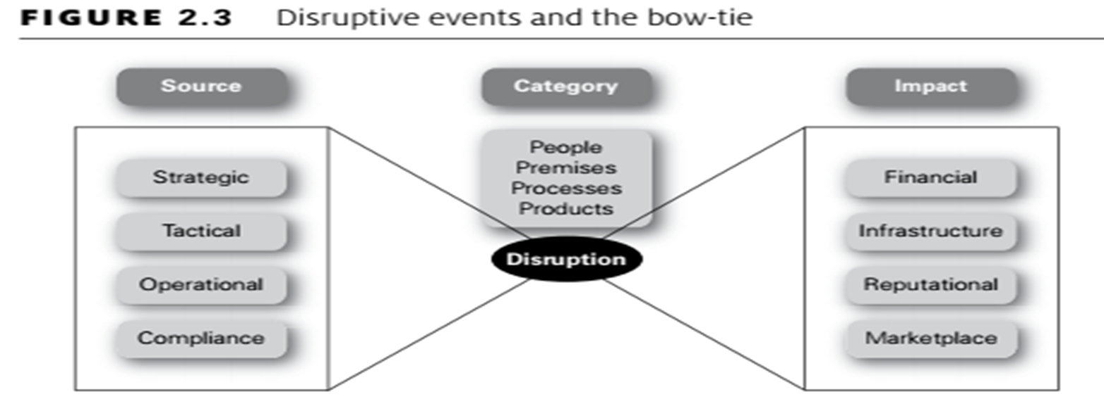
Chapter 2 Impact of risk on organizations
Risk and triggers:
One of the tools for representing risk management activities that has recently been developed is the bow-tie.
Figure 2.3 shows a simple representation of the bow-tie applicable to events that can cause disruption to normal efficient operations.

Slide 33
Chapter 2 Impact of risk on organizations
Risk and triggers:
The left-hand side of the bow-tie represents the source of a particular hazard and will indicate the classification system used by the organization for sources of risk.
In Figure 2.3, these sources of risk used are the high-level sources of strategic, tactical, operational and compliance (STOC) risks.
The right-hand side of the bow-tie sets out the impact should the risk events occur, and Figure 2.3 uses the high-level components of financial, infrastructure, reputational and marketplace (FIRM) impact of a risk materializing.
In the center of the bow-tie is the risk event. Table 3.2 indicates the categories of disruption that can affect organizations, and the same categories of people, premises, processes and products are used here.

Slide 34
Chapter 2 Impact of risk on organizations
Risk and triggers:
The purpose of using the bow-tie illustration is to demonstrate the risk classification systems used by the organization and the potential range of impacts should a risk materialize.
Controls can be put in place to prevent the event occurring and these can be represented by vertical lines on the left-hand side of the bow-tie.
In a similar manner, recovery controls can be represented on the right-hand side of the bow-tie.
The bow-tie representation of the risk management process can be used in many ways, including the representation of opportunity risks.

Slide 35
Chapter 2 Impact of risk on organizations
Risk and triggers:
Use of the bow-tie has become widespread, especially in the public sector. The box below provides a practical application of the bow-tie to the identification of preventive and response controls related to a fire in the kitchen of a residential home.
There are various risk analysis techniques available. The most popular method of analyzing a risk is using a bow-tie.
A bow-tie is a simple way of analyzing a risk to gain a greater understanding. The first stage is to put the risk description into the middle box.
The causes of the risk then need to be recorded along with the preventive controls to stop the risk occurring. The impact of the risk is also considered. This enables the identification of response controls to lessen the impact of the risk should it occur

Slide 36
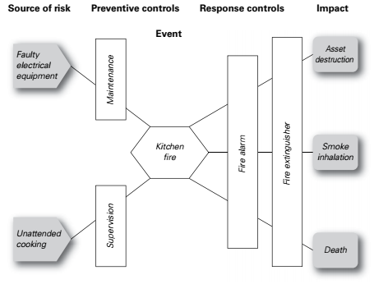
Chapter 2 Impact of risk on organizations
Risk and triggers:
Example Risk analysis using Bow-tie

Slide 37
Chapter 3 Types of risks
Timescale of risk impact:
Risks can be classified in many ways. Hazard risks can be divided into many types of risks, including risks to property, risks to people and risks to the continuity of a business.
Although it should not be considered to be a formal risk classification system, this part considers the value of classifying risks according to the timeframe for the impact of the risk.
The classification of risks as long-, medium- and short-term impact is a very useful means of analysing the risk exposure of an organization.
These risks will be related to the strategy, tactics and operations of the organization, respectively.

Slide 38
Chapter 3 Types of risks
Timescale of risk impact:
In general terms, long-term risks will impact several years, perhaps up to five years, after the event occurs or the decision is taken. Long-term risks therefore relate to strategic decisions. When a decision is taken to launch a new product, the result of that decision (and the success of the product itself) may not be fully apparent for some time.
Medium-term risks have their impact some time after the event occurs or the decision is taken, and typically this will be about a year later. Medium-term risks are often associated with projects or programmes of work.
For example, if a new computer software system is to be installed, then the choice of computer system is a long-term or strategic decision. However, decisions regarding the project to implement the new software will be medium-term decisions with medium-term risks attached.
.

Slide 39
Chapter 3 Types of risks
Timescale of risk impact:
Short-term risks have their impact immediately after the event occurs. Accidents at work, traffic accidents, fire and theft are all short-term risks that have an immediate impact and immediate consequences as soon as the event has occurred.
These short-term risks cause immediate disruption to normal efficient operations and are probably the easiest types of risks to identify and manage or mitigate.
An increasingly important consideration for organizations is what will be the trigger mechanism that causes a risk to materialize.
It may well be the case that the organization faces a number of serious risks and many of these might be catastrophic if they were to materialize. The challenge for management is then based on recognition of the circumstances in which one or more of the significant risk events may be triggered.

Slide 40
Chapter 3 Types of risks
Timescale of risk impact:
Insurable risks are quite often short-term risks, although the exact timing and magnitude/impact of the insured events is uncertain.
In other words, insurance is designed to provide protection against risks that have immediate consequences.
In the case of insurable risks, the nature and consequences of the event may be understood, but the timing of the event is unpredictable. In fact, whether the event will occur at all is not known at the time the insurance policy is taken out.

Slide 41
Chapter 3 Types of risks
Timescale of risk impact:
By way of example,
consider the operation of a new computer software system in more detail. The organization will install the new software in anticipation of gaining efficiency and greater functionality.
The decision to install new software and the choice of the software involves opportunity risks.
The installation will require a project, and certain risks will be involved in that. The risks associated with the project are control risks.
After the new software has been installed, it will be exposed to hazard risks. It may not deliver all of the functionality required and the software may be exposed to various risks and virus infection. These are the hazard risks associated with this new software system.

Slide 42
Chapter 3 Types of risks
timescale of risk impact:
Example:
Triggering major crises
In September 2007, Northern Rock – a bank formed by the conversion of the Northern Rock Building Society to banking status in 1997 – found that the liquidity crisis resulted in customers queuing to withdraw their savings. This was the first ‘run’ on a UK bank by its depositors for more than 150 years.
The immediate trigger for the crisis was the drying up of liquidity in the global institutional debt markets – known as the ‘wholesale’ markets – following a rise in mortgage defaults in the United States. These defaults were concentrated in ‘sub-prime’ mortgages – home loans to borrowers with a poor credit quality.
Northern Rock had been building up its mortgage portfolio very rapidly. Simultaneously it was becoming more and more reliant on the wholesale markets for finance, rather than personal savers. With the drying up of liquidity in the wholesale markets, Northern Rock’s business model began to unravel. All this happened despite the fact that there was no evidence that the credit quality of the Northern Rock assets – its mortgages and loans – was in question.

Slide 43
Chapter 3 Types of risks
Four types of risk:
Risks can be divided into four categories and definitions of these four types of risk are:
Compliance risks;
Hazard risks;
Control risks;
Opportunity risks.
A common language of risk is required throughout an organization if the contribution of risk management is to be maximized.
The use of a common language will also enable the organization to develop an agreed perception of risk and attitude to risk.
Part of developing this common language and perception of risk is to agree a risk classification system or series of such systems.

Slide 44
Chapter 3 Types of risks
Four types of risk:
For example, consider people reviewing their financial position and the risks they currently face regarding finances. It may be that the key financial dependencies relate to achieving adequate income and managing expenditure.
The review should include an analysis of the risks to job security and pension arrangements, as well as property ownership and other investments. This part of the analysis will provide information on the risks to income and the nature of those risks (opportunity risks).

Slide 45
Chapter 3 Types of risks
Four types of risk:
As a practical example of the nature of compliance, hazard, control and opportunity risks, Table 3.1 considers the risks associated with owning a car.
In this case, the compliance risks relate to the legal obligations associated with owning and driving a car. The hazard risks relate to events that the owner does not want to occur.
Uncertainties are the costs that are known to be involved, but these may vary. Finally, the opportunities are the benefits that car ownership offers.

Slide 46
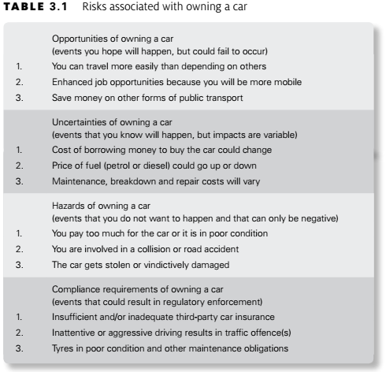
Chapter 3 Types of risks
Four types of risk:

Slide 47
Chapter 3 Types of risks
Embrace opportunity risks:
Opportunity risks are the type of risk with potential to enhance (although they can also inhibit) the achievement of the mission of the organization. These risks are the ones associated with embracing business opportunities.
All organizations have some appetite for seizing opportunities and are willing to invest in them
There will always be a desire for the organization to have effective and efficient operations, tactics and strategy.
Opportunity risks are normally associated with the development of new or amended strategies, although opportunities can also arise from enhancing the efficiency of operations and implementing change initiatives.

Slide 48
Chapter 3 Types of risks
Embrace opportunity risks:
Opportunity risks are the type of risk with potential to enhance (although they can also inhibit) the achievement of the mission of the organization. These risks are the ones associated with embracing business opportunities.
All organizations have some appetite for seizing opportunities and are willing to invest in them
There will always be a desire for the organization to have effective and efficient operations, tactics and strategy.
Opportunity risks are normally associated with the development of new or amended strategies, although opportunities can also arise from enhancing the efficiency of operations and implementing change initiatives.

Slide 49
Chapter 3 Types of risks
Embrace opportunity risks:
The example below, related to personal lifestyle decisions, considers risk factors by classifying them as controllable and uncontrollable. Although the example relates to personal health risk factors, consideration of whether business risks are within the control of the organization or not is an important component of successful business risk management.
Example:
Heart disease risk factors
Controllable risk factors for heart disease and stroke are those that can be changed through diet, physical activity and no tobacco use. These risk factors are in contrast to those that are uncontrolled, such as age, gender, race or genetic traits. Having one or more uncontrollable risk factors does not mean a person will have a heart attack or stroke; however, with proper attention to those risk factors that are controllable, one may reduce the impact of those risk factors that cannot be controlled or changed.
Controllable risk factors for heart disease or stroke include high blood pressure, high blood cholesterol, type-2 diabetes and obesity. Healthy lifestyle habits, such as developing good eating habits, increasing physical activity and abstaining from tobacco use, are effective steps in both preventing and improving the controllable risk factors.

Slide 50
Chapter 3 Types of risks
Manage uncertainty risks:
Uncertainty or control risks are an inevitable part of undertaking a project. A contingency fund to allow for the unexpected will need to be part of a project budget, as well as contingent time built into project schedules.
When looking to develop appropriate responses to control risks, the organization must make the necessary resources available to identify the controls, implement the controls and respond to the consequences of any control risk materializing.
Uncertainty represents a deviation from the required or expected outcome. When an organization is undertaking a project, such as a process enhancement, the project has to be delivered on time, within budget and to specification. Also, the enhancement has to deliver the benefits that were required.

Slide 51
Chapter 3 Types of risks
Mitigate hazard risks:
In the case of health and safety risks, it is generally accepted that organizations should be intolerant of these and should take all appropriate actions to eliminate them.
In practice, this is not possible and organizations will minimize safety risks to the lowest level that is cost-effective and in compliance with the law.
For example, an automatic braking system fitted to trains to stop them passing through red lights is technically feasible.
However, this may represent an unreasonable investment for the train operating company. The consequences of trains going through red lights may be regarded as the risk exposure or hazard tolerance of the organization but the cost of introducing the automatic braking system may be considered to be prohibitively high.

Slide 52
Chapter 3 Types of risks
Mitigate hazard risks:
Example: Shop Security Standards
An example can be seen in the operation of a security-conscious jewellery shop. Customers are allowed into the shop one at a time. They are recorded on CCTV as they wait to enter.
Items are held securely, and customers are invited to ask to see specific items under the suspicious gaze of the shop assistants. Of course, some customers are put off, but equally the shops suffer negligible rates of shoplifting.
Contrast this with a supermarket, where there are no barriers on entry and customers are allowed to handle all of the items.
There is CCTV monitoring the shops, and there are likely to be store detectives patrolling – but the object of the security is to deter rather than to prevent shoplifting. Shoplifting does occur, but at rates that are acceptable to the shop owners. Conversely, few potential customers are put off visiting the shop because of the measures.

Slide 53
Chapter 3 Types of risks
Mitigate hazard risks:
Table 3.2 provides a list of the events that can cause unplanned disruption or inefficiency. These events are divided into several categories, such as people, premises, processes and products.
For each category of hazard risks, the organization needs to evaluate the types of incidents that could occur, the sources of those incidents and their likely impact on normal efficient operations.
Management of hazard risks involves analysis and management of three aspects of the hazard risk.

Slide 54
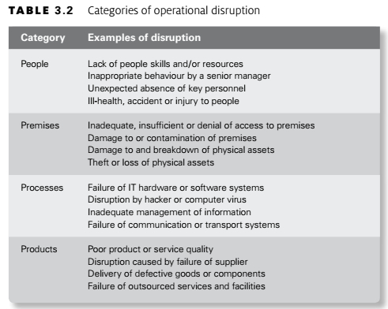
Chapter 3 Types of risks
Mitigate hazard risks:

Slide 55
Chapter 3 Types of risks
Minimize compliance risks:
Generally speaking, organizations will work towards ensuring full compliance with all applicable rules and regulations and, thereby, minimize the compliance risks.
In many cases, dedicated teams of specialist risk professionals will be employed and this is particularly the case in relation to health and safety, money-laundering and security arrangements.
It is important for organizations to recognize their compliance risks and include consideration of these risks in their risk management activities.
It is also important to ensure that the various areas of risk management expertise within the company co-operate with each other, so that an organized and/or coordinated approach to compliance is achieved.

Slide 56
Conclusion

Slide 57
Thanks

