Slide 1


Introductory Concepts
Prepared by Dr. Hesham Mousli
MHA613
Statistics in Healthcare
Lecture 1

Slide 2

Chapter
INTENDED OBJECTIVES
01
Understand the application of statistics in healthcare management.
Develop skills to interpret statistical data for decision-making.
Identify and categorize various healthcare data types.
Recognize the role of statistics in enhancing efficiency and patient care.

Slide 3

Chapter
IMPORTANT QUOTES
01
“It is the mark of a truly intelligent person to be moved by statistics “
(George Bernard Shaw)
“You can't manage what you can't measure"
(Peter Drucker)

Slide 4
Chapter
CASE SCENARIO
01
Alex is the General Manager of “X” Hospital, a busy healthcare facility in a growing city. Recently, the hospital has been facing challenges with patient flow, resource allocation, and staff scheduling. The board of directors has tasked Alex with improving these aspects to enhance patient care and operational efficiency.

Slide 5
Chapter
STATISTICS UTILIZATION
01
Trend analysis to identify patterns in hospital admissions.
Inventory levels of critical supplies and equipment.
Frequency of shortages and excesses.
Patient volume by time of day and day of the week.
Patient wait times.
Staff satisfaction and turnover rates.

Slide 6
Chapter
DATA AND STATISTICS
01
Statistics involves the methods of collecting, summarizing, analyzing and drawing conclusions from the data.
We use statistical techniques to achieve our aim to convert data into information.

Slide 7
Chapter
DATA AND STATISTICS
01
Data may take many different forms.
We need first to know what form every variable takes before we can make a decision regarding the most appropriate statistical methods to use.

Slide 8
Chapter
DATA AND STATISTICS
01
The purpose of most decision makers is to collect Data to obtain Information about a particular area of managerial interest.
Our data include Observations on one or more variables.
Any quantity that varies is termed a Variable.

Slide 9
Chapter
DATA AND STATISTICS
01
For example, we may collect basic Clinical (Blood pressure, Blood glucose level,……etc.) and Demographic (Age, Gender, geographical area,…….etc.) data on patients with a Particular illness.

Slide 10

Statistic: Value of a variable across all members of a sample.
Parameter: Comparable value for the population.
Chapter
01
Statistic vs. Parameter
Purpose: Determine a value for a variable or establish relationships between variables.

Slide 11
Chapter
SAMPLE VS. POPULATION
01
Our data are usually obtained from a Sample of individuals that represents the Population of interest.
So, Our aim is to deal with these data obtained from a Sample in a meaningful way and extract useful information from them.

Slide 12
Population
Sample
Sample Data
Information & Decisions

Slide 13
Chapter
INDEPENDENT VS. DEPENDENT VARIABLES
01
Independent Variables: Variables that can be manipulated to observe their effect on dependent variables.
Dependent Variables: Variables that are measured and expected to change in response to the independent variable.

Slide 14
Chapter
INDEPENDENT VS. DEPENDENT VARIABLES
01
Examples:
Examining how diet (independent) affects blood sugar levels (dependent).
Examining how staff-to-patient ratio (independent) affects patient satisfaction scores (dependent).

Slide 15

Chapter
TYPES OF DATA
01
Categorical (qualitative) data:
These occur when each individual can only belong to one of a number of distinct categories of the variable.

Slide 16
Chapter
1. CATEGORICAL (QUALITATIVE) DATA
01
Nominal data :
  The categories are not ordered but simply have names.
  Examples include blood group (A, B, AB and O) and marital status (married/widowed/single, etc.).

Slide 17
Note: There is no implication that one category (e.g., being married) is better or worse than another (e.g., being single).

Slide 18
Chapter
1. CATEGORICAL (QUALITATIVE) DATA
01
Ordinal data :
  The categories are arranged in a specific order, either in ascending or descending sequence."
  Examples include systems for staging diseases (advanced, moderate, mild, none), and levels of pain (severe, moderate, mild, none).

Slide 19
Note that: “A categorical variable is considered binary or dichotomous when it has only two possible categories.
Examples include 'Yes/No,' 'Alive/Dead,' or 'Patient has disease/Patient does not have disease.”

Slide 20
Chapter
TYPES OF DATA
01
Numerical (quantitative) data:
These occur when the variable is represented by a numerical value.

Slide 21
Chapter
NUMERICAL (QUANTITATIVE) DATA
01
Discrete data:
  This occurs when the variable can only take specific whole (integer) numerical values.
  These are often counts of events, such as number of hospital admissions of a patient during a month.

Slide 22
Chapter
NUMERICAL (QUANTITATIVE) DATA
01
Continuous data:
  Occurs when there are no restrictions on the values a variable can take, allowing for fractions or decimals, such as weight or height.

Slide 23

Chapter
TRANSORMATION OF DATA
01
It is relatively easy to convert continuous numerical data into categorical data after collection.

Slide 24
Form of categorical data | Form of numerical data
Short | 150 – 160 cm height.
Medium | 161 – 180 cm height.
Tall | 181 – 200 cm height.

Slide 25
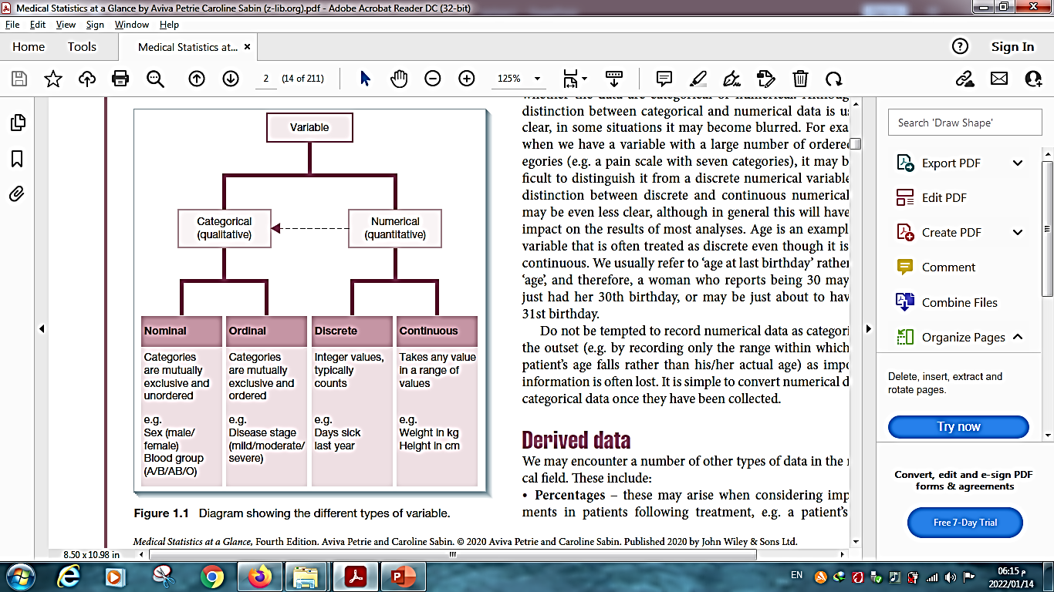

Slide 26
Chapter
DERIVED DATA
01
You might come across various other types of data in the healthcare sector.
These could include:
  Percentages.
  Ratios.
  Rates.

Slide 27
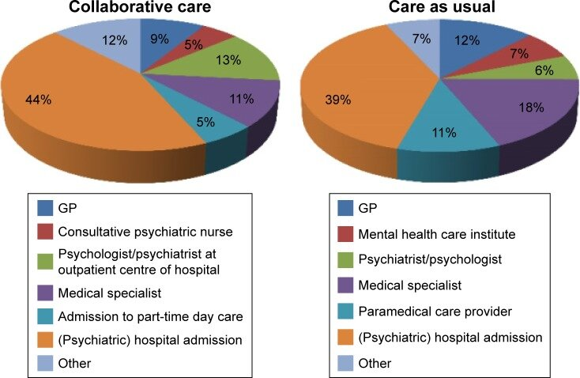
Chapter
DERIVED DATA
01
Percentages:
  These may be used to reflect the improvements in patients after undergoing treatment.

Slide 28
Chapter
DERIVED DATA
01
For example, after implementing a new patient care protocol, the percentage of patients who report a significant improvement in their quality of life may increase by 30%.
This percentage reflects the proportion of patients who experienced enhanced well-being as a result of the new protocol.

Slide 29
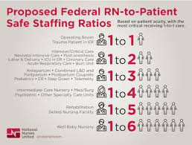
Chapter
DERIVED DATA
01
Ratios:
  Sometimes, you may go through the ratio of two variables.

Slide 30
Chapter
DERIVED DATA
01
For example: Patient-to-Nurse Ratio: This ratio is used to assess the staffing levels in a healthcare facility. It is calculated by dividing the number of patients by the number of nurses.
For example: if a hospital has 150 patients and 30 nurses, the patient-to-nurse ratio is 5:1., This indicates that, each nurse is responsible for 5 patients.

Slide 31
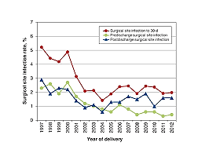
Chapter
DERIVED DATA
01
Rates:
  It is typically data that related to time.

Slide 32
Chapter
DERIVED DATA
01
For example: Patient Admission Rates: calculated by dividing the number of patient admissions to a hospital by the total number of days over which admissions are tracked.
For example: if a hospital had 1,200 admissions in a year and 3,000 patient-days, the admission rate would be 1,200 admissions per 3,000 patient-days. This rate shows how often patients are admitted relative to the total patient-days.

Slide 33
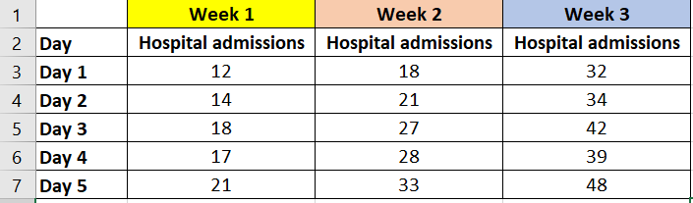
Chapter
01
Hospital admissions: Discrete data
Gives an idea about admissions trend numerically.

Slide 34
Chapter
TO WRAP UP
01
Statistics are applied in staffing, resource management, and optimizing workflows.
Statistical analysis helps monitor patient outcomes and reduce errors in healthcare.
Sample (a subset of individuals selected from a population) and a Population (the entire group of individuals of interest).

Slide 35
Chapter
TO WRAP UP
01
Independent variables are manipulated to observe their effect on dependent variables, which are the outcomes being measured.
Differentiation between categorical (qualitative) and numerical (quantitative) data in healthcare contexts.
Know how percentages, ratios, and rates are used to make informed decisions in healthcare.

Slide 36



Thank You

