Slide 1


Creative and Scientific Thinking
Prepared by Prof. Shereen Taie
CRE252
Information Technology Department
Lecture 4

Slide 2




Creative and Scientific
Thinking
Lecture 4
CRE252
Information Technology Department
Prepared by
Prof. Shereen Taie
www.midocean.ae

Slide 3
Learning Objectives:
Bloom`s Taxonomy
Bloom`s Taxonomy Levels
Bloom`s Taxonomy Examples
Bloom`s Taxonomy Definition
Levels of thinking: Bloom Taxonomy
                Low level of thinking
                High level of thinking
                Using Bloom’s Taxonomy in Designing a Course
Components of Scientific Thinking
Chapter
02
www.midocean.ae

Slide 4
Bloom`s Taxonomy
Chapter
02
www.midocean.ae

Slide 5
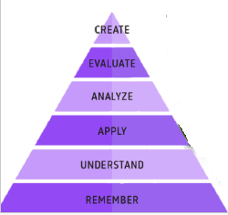
Bloom`s Taxonomy Levels:
Chapter
02
www.midocean.ae

Slide 6
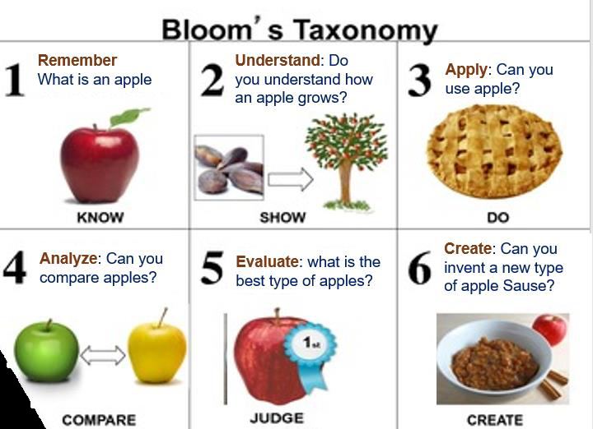
Example 1:
Chapter
02
www.midocean.ae

Slide 7

Chapter
02
Bloom`s Taxonomy Definition
www.midocean.ae

Slide 8
Bloom`s Taxonomy Definition:
Bloom`s taxonomy is a framework for educational achievement in which each level depends on the one of the following:
    Create
    Evaluate
    Analyze
    Apply
    Understand
    Remember
Chapter
02
www.midocean.ae

Slide 9
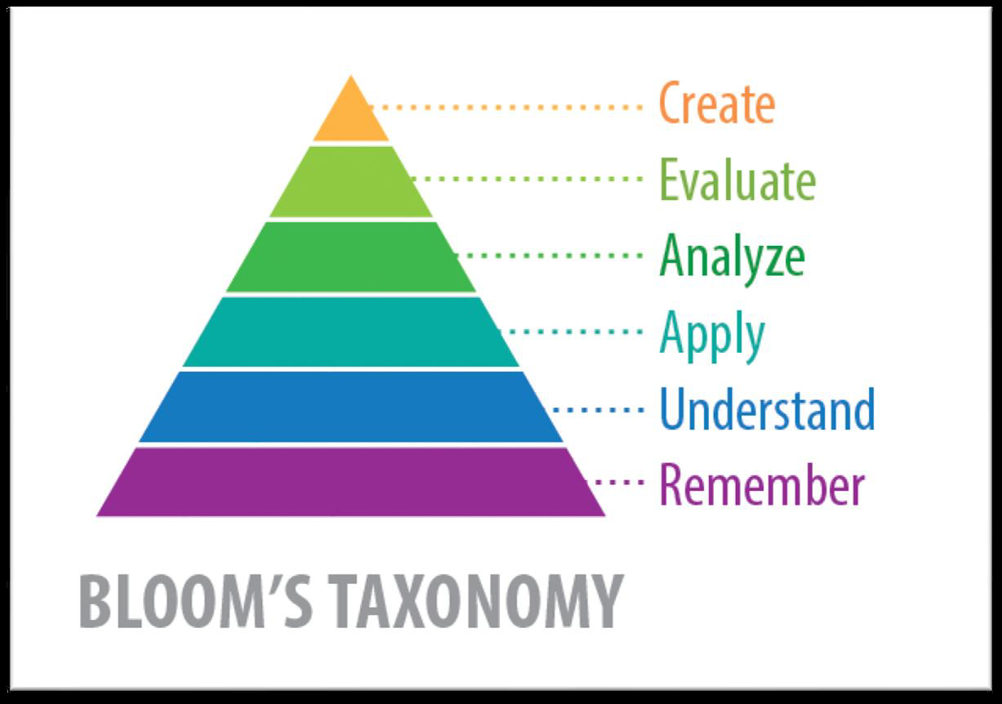
Bloom`s Taxonomy:
Chapter
02
www.midocean.ae

Slide 10
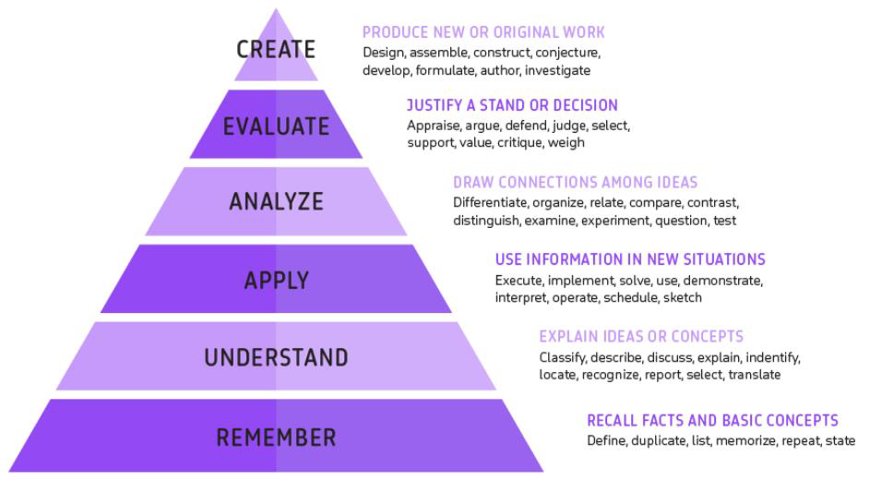
Levels of thinking: Bloom Taxonomy
Chapter
02
www.midocean.ae

Slide 11
Levels of thinking: Bloom Taxonomy Definition
Levels of thinking using Bloom Taxonomy is a method to categorize the brain thinking as six level.
Chapter
02
www.midocean.ae

Slide 12
Levels of thinking: Bloom Taxonomy
The levels of thinking using Bloom Taxonomy are organized into two groups.
                Low level of thinking
                High level of thinking
Chapter
02
www.midocean.ae

Slide 13
Levels of thinking: Bloom Taxonomy
A. Low level of thinking: includes
    1. Remember
    2. Understand
    Apply
Chapter
02
www.midocean.ae

Slide 14
Levels of thinking: Bloom Taxonomy
B. High level of thinking: includes
    4. Analysis
    5. Evaluate
    6. Create
Chapter
02
www.midocean.ae

Slide 15
Chapter
02
The Six Levels of thinking: Bloom taxonomy
www.midocean.ae

Slide 16
                Bloom`s Taxonomy
                Low level of thinking
Chapter
02
www.midocean.ae

Slide 17
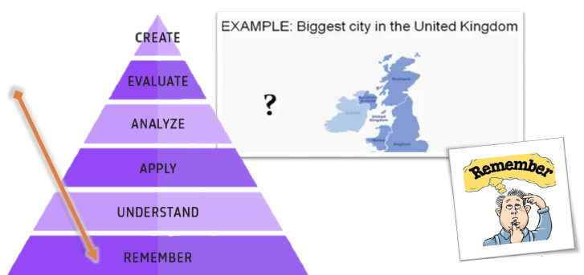
Level 1 of thinking: Bloom taxonomy
Remember:
Is about recalling facts and concepts.
A student can define and duplicate, make a list, memorize points, repeat
information, and make valid statements.
It does not prove understanding.
Chapter
02
www.midocean.ae

Slide 18
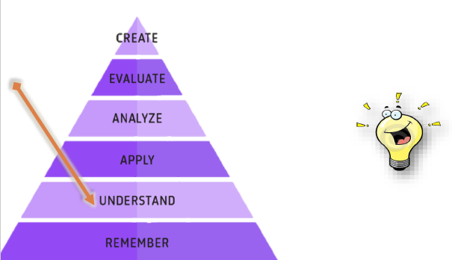
Level 2 of thinking: Bloom taxonomy
Understand:
This is where the student understand.
The student explains ideas, explains what they mean and translates the
facts in some way.
Chapter
02
www.midocean.ae

Slide 19
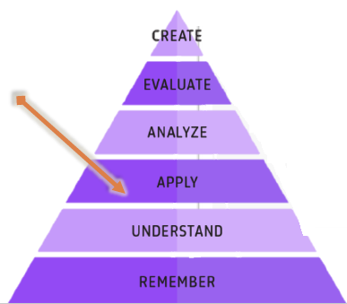

Level 3 of thinking: Bloom taxonomy
Apply:
In this level, students use the information.
They have learned in new situations, whether it’s to solve a problem,
demonstrate an idea.
Chapter
02
www.midocean.ae

Slide 20
Level 3 of thinking: Bloom taxonomy
Apply:
In Apply level of thinking using Bloom Taxonomy:
  Be able to use / apply knowledge – to solve problems in new situations.
  Example: How would you use what you know to detect a flaw in the structure?
Chapter
02
www.midocean.ae

Slide 21
                Bloom`s Taxonomy
                High level of thinking
Chapter
02
www.midocean.ae

Slide 22
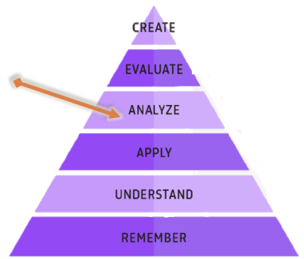
Level 4 of thinking: Bloom taxonomy
Analyze:
The students must draw connections between ideas in the analyze level
of Bloom’s taxonomy.
In the analyze level of Bloom’s taxonomy, they must examine, question
or test their knowledge.
Chapter
02
www.midocean.ae

Slide 23
Level 4 of thinking: Bloom taxonomy
Analyze:
Critical thinking finally comes into play, as the student distinguishes
between fact and opinion, and breaks information down into component
parts.
Chapter
02
www.midocean.ae

Slide 24

Level 4 of thinking: Bloom taxonomy
Analyze:
In Analyze level of thinking using Bloom Taxonomy:
Be able to:
  Break up any new information to parts (Identify Reasons, Causes, Motives. etc…)
  Find evidence to support view.
  Example: Why are Dolphins called mammals?
Chapter
02
www.midocean.ae

Slide 25
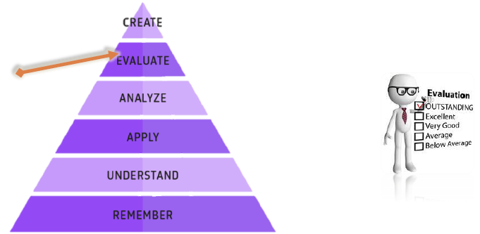
Level 5 of thinking: Bloom taxonomy
Evaluate:
In the Evaluate stage, the student can justify a decision by arguing,
defending, judging, supporting, or weighing in with thoughts based on the
knowledge and application they have acquired thus far.
Chapter
02
www.midocean.ae

Slide 26
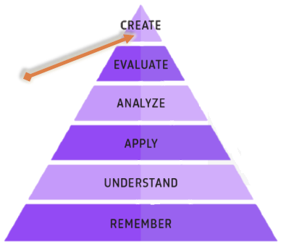
Level 6 of thinking: Bloom taxonomy
Create:
In the final level Create of Bloom’s taxonomy:
The student Create full knowledge by applying what they have learned,
analyzed and evaluated, and built.
Chapter
02
www.midocean.ae

Slide 27
Level 6 of thinking: Bloom taxonomy
Create:
They can design a piece of machinery, or revising a process to improve the
results.
Chapter
02
www.midocean.ae

Slide 28

Level 6 of thinking: Bloom taxonomy
Create:
In Create level of thinking using Bloom Taxonomy:
Be able to:
  Defend Opinion / Findings based on Evidence.
  Example: Why is Benjamin Franklin so famous?
Chapter
02
www.midocean.ae

Slide 29
Chapter
02
Using Bloom’s Taxonomy in Designing a Course
www.midocean.ae

Slide 30
Examples
Chapter
02
www.midocean.ae

Slide 31
Example 2: Using Bloom’s Taxonomy in designing a course(Newton’s three laws of motion)
We are going to use the 6 levels to structure the learning objectives, lessons, and assessments of courses.
Chapter
02
www.midocean.ae

Slide 32
Example 2: Using Bloom’s Taxonomy in designing a course(Newton’s three laws of motion)
The Newton’s three laws of motion:
Newton’s First law:
Objects in motion tend to stay in motion and objects at rest tend to stay at rest unless acted upon by an unbalanced force.
Newton’s Second law:
Force equals mass times acceleration (F = ma).
Newton’s Third law:
For every action there is an equal and opposite reaction.
Chapter
02
www.midocean.ae

Slide 33
Example 3: Using Bloom’s Taxonomy in designing a course(Newton’s three laws of motion)
Before you can Understand–a concept, you must be able to remember it.
To apply a concept you must first (understand)it.
In order to evaluate a process, you must have analyzed it.
To create an accurate evaluation, you must have completed a thorough aware of it.
Chapter
02
www.midocean.ae

Slide 34
Chapter
02
EXERCISE
www.midocean.ae

Slide 35
EXERCISE:
Think about Types of Thinking Skills
Are you using all six thinking skills?
Reflect on your life in the past three weeks and identify specific examples where you used each of the thinking skills.
Use the comment column to write notes about the skills that are natural to you and those you would like to develop further.
Chapter
02
www.midocean.ae

Slide 36
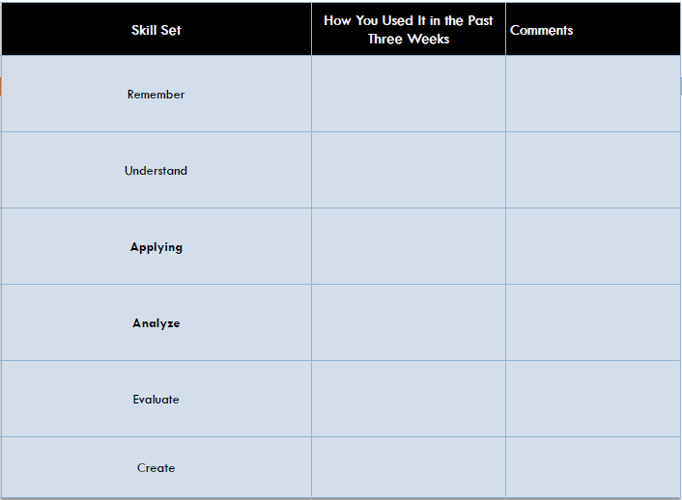
EXERCISE:
Think about Types of Thinking Skills
Chapter
02
www.midocean.ae

Slide 37
Components of Scientific Thinking
Chapter
02
www.midocean.ae

Slide 38
Whatever the type of thinking, scientific thinkers use three components of thinking:
The three components of scientific thinking are:
Empiricism
Rationalism
Skepticism
Chapter
02
www.midocean.ae

Slide 39
Whatever the type of thinking, scientific thinkers use three components of thinking:
The three components of scientific thinking are:
Empiricism التجريبية :
(the theory that the origin of all knowledge is sense experience)
Rationalism العقلانية :
(is the philosophy that knowledge comes from logic)
Skepticism الشك.
Chapter
02
www.midocean.ae

Slide 40




Thank You

