Slide 1


System Administration (2)
IT401
Prepared by
Dr. Ahmed El-Douh
Lecture 7

Slide 2



System Administration 2
Lecture 7
IT401
Managing Linux Networking
Prepared by
Dr. Ahmed El-Douh

Slide 3
Objectives
Upon completion of this lecture, you will be able to:
  Understand key computer networking concepts.
  Check and test current network configuration using basic tools.
  Manage network devices using nmcli and NetworkManager.
  Edit configuration files to modify network settings.
  Configure and test host names and name resolution.
www.midocean.ae

Slide 4
Chapter
Outlines
07
Networking Concepts and Practice
Validating Network Configuration
Configuring Networking with nmcli
Editing Network Configuration Files
Managing Host Names and Name Resolution
www.midocean.ae

Slide 5


Networking Concepts and Practice
www.midocean.ae

Slide 6
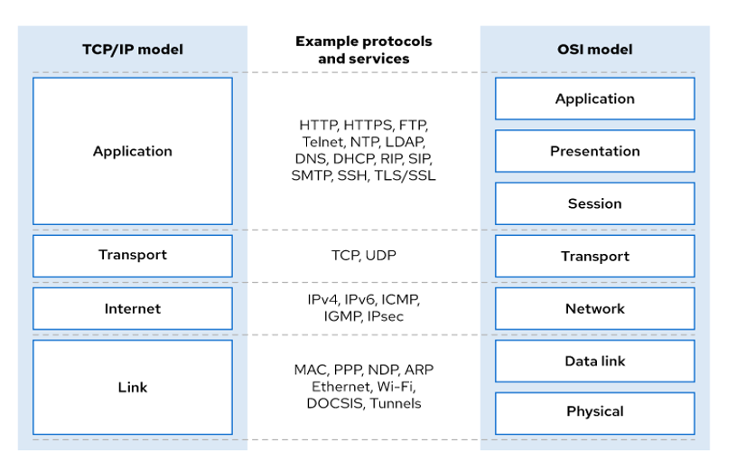
IPv4 Networking
IPv4 Networking:
The TCP/IP standards are based on a four-layer network model, as defined in RFC 1122
www.midocean.ae

Slide 7
The TCP/IP standards are based on a four-layer network model
Application Layer:
Each application has communication standards to let clients and servers exchange data across platforms.
Common protocols: SSH (remote login), HTTPS (secure web), NFS/CIFS (file sharing), SMTP (email delivery).
Transport Layer:
The main transport protocols are TCP and UDP.
  TCP provides reliable, connection-oriented communication.
  UDP is a connectionless datagram protocol.
Applications use TCP or UDP ports for communication.
A list of common ports is stored in the /etc/services file.
When data packets are sent, the port number and IP address together form a socket — each packet has a source socket and a destination socket, used for monitoring and filtering.
www.midocean.ae

Slide 8
The TCP/IP standards are based on a four-layer network model
Internet Layer:
  Moves data from the source host to the destination host.
  Each host has an IP address and a network prefix.
  Routers connect different networks.
  Uses the ICMP protocol for control messages.
  The ping command sends ICMP Echo Request and receives Echo Reply to test connectivity.
Link Layer:
  Provides the physical connection to the network medium.
  Common types: Ethernet (802.3) and WLAN (802.11).
  Each device has a MAC address, used to identify the destination of packets within a local network.
www.midocean.ae

Slide 9
IPv4 addresses
An IPv4 address is a 32-bit number written as four octets (0–255) separated by dots.
It’s divided into two parts: network part and host part. IP:
Devices in the same subnet share the same network part.
The network part identifies the subnet; the host part identifies the device.
The netmask defines how many bits belong to the network and how many to the host.
The lowest address in a subnet (host part = 0) is the network address.
The highest address (host part = 1s) is the broadcast address used to send data to all devices on the subnet.
www.midocean.ae

Slide 10
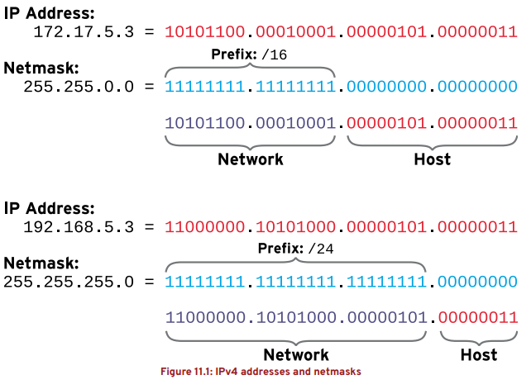
IPv4 Networking
www.midocean.ae

Slide 11
Network Masks and CIDR Notation
Network masks can be written in two forms:
  Old form: 255.255.255.0
  CIDR form: /24
Both forms mean the same thing: the first 24 bits represent the network part.
The prefix (/n) shows how many bits in the IP address are used for the network.
These examples show the relationship between the IP address, netmask (prefix), network part, and host part.
www.midocean.ae

Slide 12

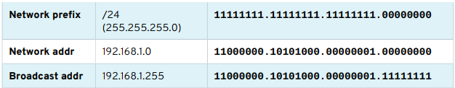
Calculating the Network Address (Example)
www.midocean.ae

Slide 13
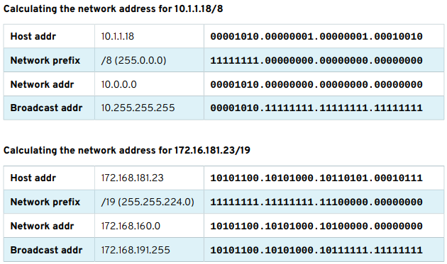
IPv4 Networking
www.midocean.ae

Slide 14
Configuring and Securing OpenSSH Service
www.midocean.ae

Slide 15
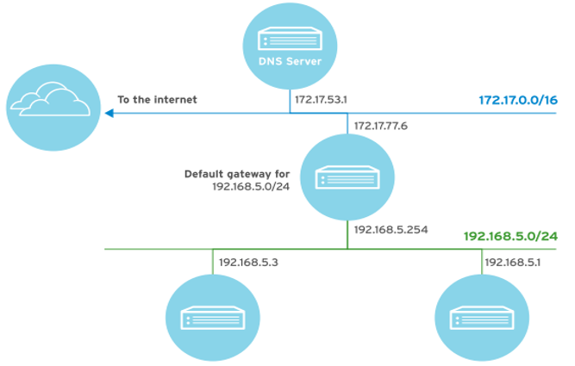
Network routing and DNS concepts
www.midocean.ae

Slide 16
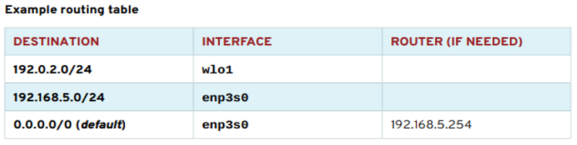
IPv4 Routing
Every host has a routing table that decides how to send packets to other networks.
Each route specifies:
  Destination network
  Interface to send traffic
  Router (gateway) if needed
If no specific route matches, the system uses the default route (0.0.0.0/0) to send traffic to the Internet through a router.
Routers forward packets using their own routing tables until the packet reaches its final destination.
www.midocean.ae

Slide 17
IPv4 Networking
Names and IP Addresses
  Computers use IP addresses to communicate.
  Humans prefer using names instead of numbers.
  DNS (Domain Name System) maps names to IP addresses using nameservers.
  The nameserver doesn’t need to be on the same network, only reachable.
DHCP or Static Network Configuration
  DHCP automatically assigns network settings at system startup.
  If no DHCP server is available, a static configuration must be used manually.
  DHCP tracks devices by their hardware (MAC) address.
  A network interface may have one or more IP addresses (IPv4 and IPv6).
www.midocean.ae

Slide 18
IPv4 Networking
Network Interface Names
  Older Linux systems used simple names like eth0, eth1, eth2.
  In RHEL 7, interfaces get predictable names based on firmware, topology, and device type.
Naming Rules:
  en → Ethernet interfaces
  wl → Wireless LAN (Wi-Fi) interfaces
  ww → WWAN (cellular) interfaces
Additional letters:
  o → Onboard
  s → Hotplug slot
  p → PCI location
  x → Uses MAC address
Example:
  eno1 → Onboard Ethernet interface
  enp2s0 → PCI Ethernet interface on slot 2
If the system cannot determine a fixed name, traditional names like ethN are used.
www.midocean.ae

Slide 19
Validating Network Configuration
www.midocean.ae

Slide 20
Validating Network Configuration
Objective:
Students should be able to test and review current network configuration using basic utilities.
Displaying IP Addresses:
The command /sbin/ip is used to display device and address details.
Example:
ip addr show eth0
Explanation:
1️⃣ UP → Interface is active
2️⃣ link/ether → MAC address of the device
3️⃣ inet → IPv4 address and prefix
4️⃣ brd → Broadcast address and scope
5️⃣ inet6 → IPv6 address information
www.midocean.ae

Slide 21
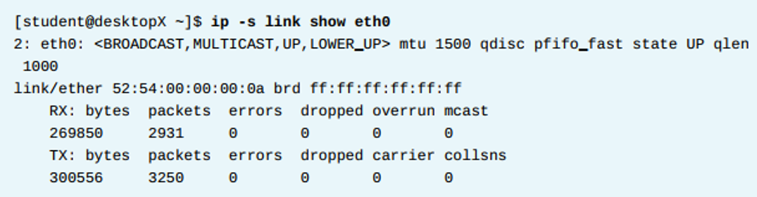
Validating Network Configuration
Checking Network Statistics
The ip command can also display network performance data:
-RX (Received) and TX (Transmitted) packets, bytes, and errors.
Command: ip -s link show eth0
www.midocean.ae

Slide 22
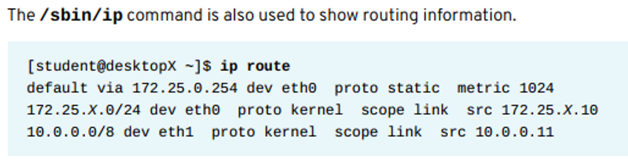
Troubleshooting Routing
www.midocean.ae

Slide 23
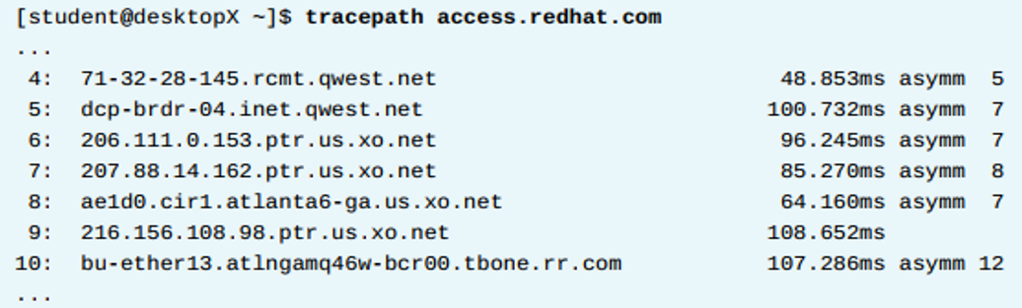
Troubleshooting Routing
Tracing Network Path
  Use traceroute or tracepath to trace the route to a remote host.
  These commands show all network hops between your system and the destination.
  tracepath works with UDP packets by default.
traceroute can use:
  UDP (default)
  ICMP with -I
  TCP with -T
www.midocean.ae

Slide 24
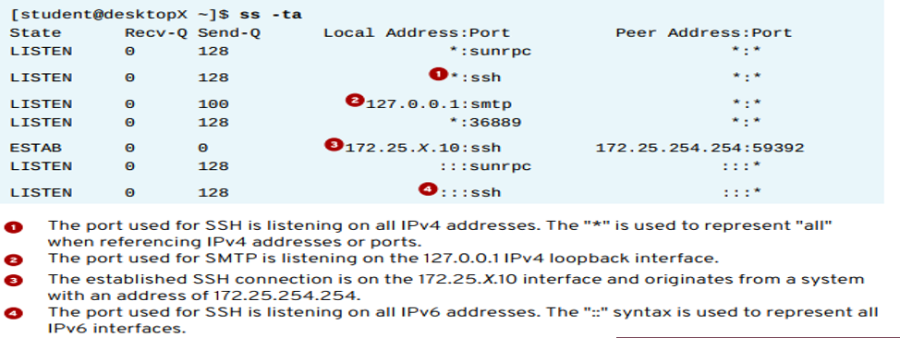
Troubleshooting Ports and Services
TCP services use IP addresses, protocols, and ports to communicate.
Services listen on specific ports for connections.
Standard ports are listed in /etc/services.
Command: ss -ta
The ss command shows socket and connection details.
It replaces the old netstat command.
www.midocean.ae

Slide 25
Configuring Networking with nmcli
www.midocean.ae

Slide 26
Configuring Networking with nmcli
Objectives:
Learn how to manage network settings and devices using nmcli and NetworkManager.
NetworkManager:
  A daemon that monitors and manages network connections.
  Provides automatic network configuration and status monitoring.
  Works with both command-line tools (like nmcli) and graphical interfaces.
  Saves configuration files in /etc/sysconfig/network-scripts.
www.midocean.ae

Slide 27
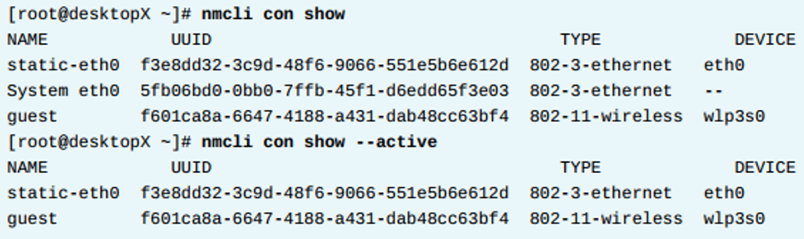
Viewing Network Information with nmcli
Viewing Network Information with nmcli
  To list all saved connections, use: nmcli con show
  To show only active connections, use: nmcli con show –active
Output Columns:
  NAME: Connection name
  UUID: Unique identifier for each connection
  TYPE: Connection type (wired or wireless)
  DEVICE: Network interface used (e.g., eth0, wlp3s0)
www.midocean.ae

Slide 28
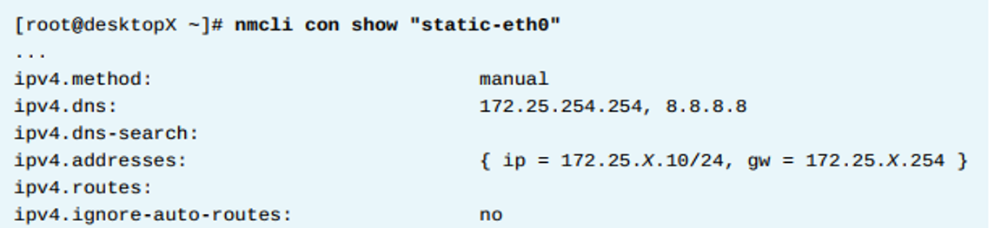
Viewing Connection Details with nmcli
To see the detailed configuration of a specific connection, use:
nmcli con show "connection-name"
  Example:
  nmcli con show "static-eth0"
Explanation of Key Fields:
  ipv4.method: Connection type (manual or auto via DHCP).
  ipv4.dns: DNS servers used for name resolution.
  ipv4.addresses: IP address and subnet mask.
  ipv4.routes: Gateway or routing information.
  ipv4.dhcp-send-hostname: Whether the hostname is sent via DHCP.
www.midocean.ae

Slide 29
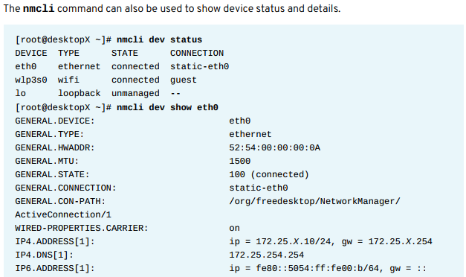
Viewing Connection Details with nmcli
www.midocean.ae

Slide 30
Creating Network Connections with nmcli
When creating a new connection, the order of arguments matters.
Start with common options: type and interface name.
Then specify connection details like IP address, prefix, and gateway.
You can assign multiple IPs to a single device.
Extra settings (e.g., DNS server) can be added later by modifying the connection
www.midocean.ae

Slide 31
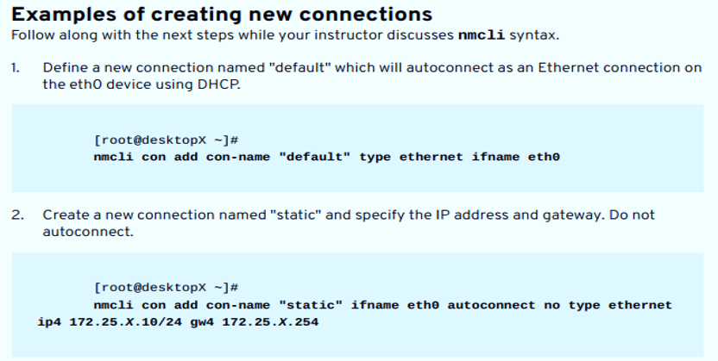
www.midocean.ae

Slide 32
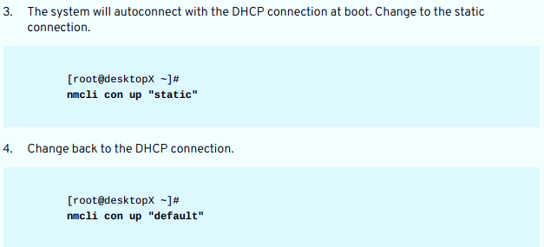
www.midocean.ae

Slide 33
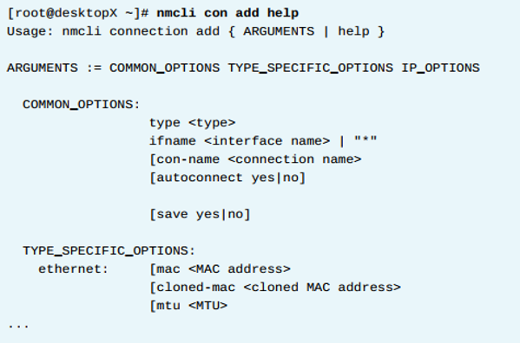
Type Options
Connection options depend on the type (e.g., ethernet, wifi, bridge, bond, VPN, VLAN).
Ethernet connections may include optional settings like MAC address or MTU.
Wi-Fi connections must specify SSID and may include extra options.
To view all available options, use: nmcli con add help
www.midocean.ae

Slide 34
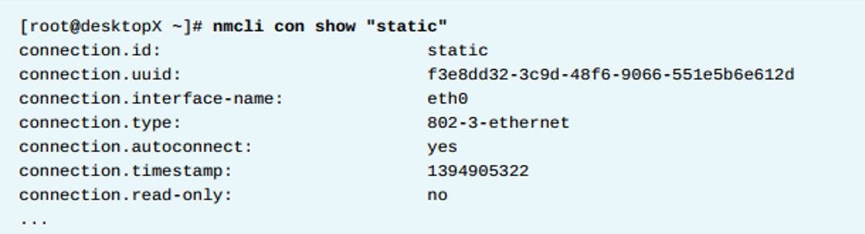
Modifying Network Interfaces with nmcli
www.midocean.ae

Slide 35
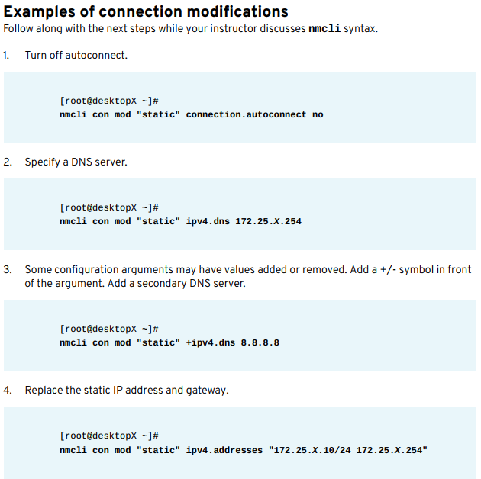
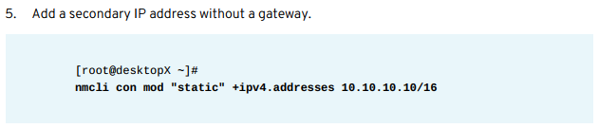
www.midocean.ae

Slide 36
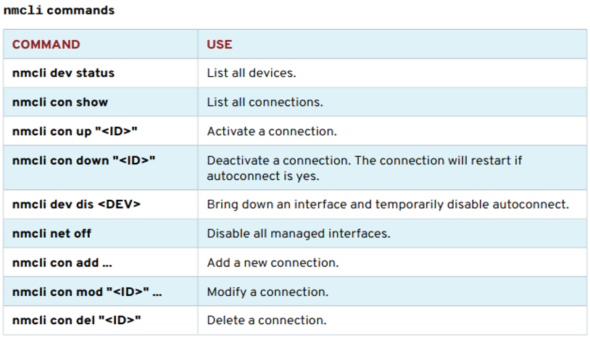
Summary of nmcli Commands
www.midocean.ae

Slide 37
Configuring Host Names and Name Resolution
www.midocean.ae

Slide 38
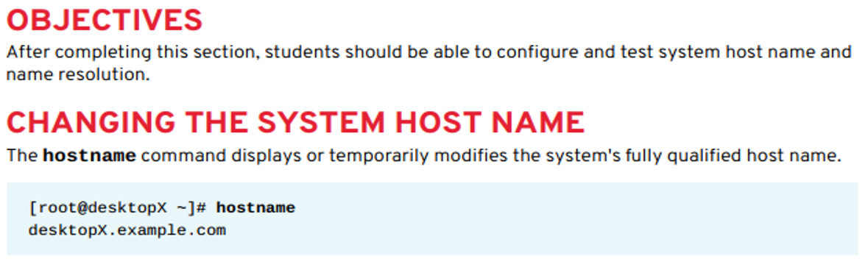

Configuring Host Names and Name Resolution
www.midocean.ae

Slide 39
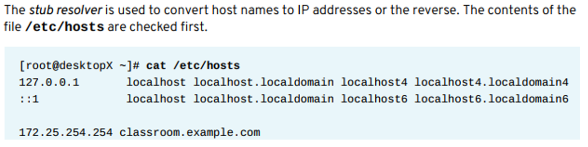
Configuring Name Resolution
www.midocean.ae

Slide 40
Configuring Name Resolution
Host Name Resolution with getent
  The command getent hosts hostname is used to test how the system resolves host names.
  It first checks the /etc/hosts file for the entry.
  If not found, it queries a DNS nameserver as defined in /etc/resolv.conf.
/etc/resolv.conf parameters:
  nameserver: Defines the IP address of the DNS server (up to 3 can be listed for backup).
  search: Specifies domain names to append when resolving short hostnames.
  domain: Used for defining a default domain (should not be used with search in the same file).
www.midocean.ae

Slide 41



Thank You

