Slide 1


Foundation of
Group Behaviour
In Decision Making
Prepared by Dr. Ahmad AL-Naimi
Lecture 7

Slide 2
A Model of Group Formation and Development
Types of Groups
Formal
1. Command
2. Task
3. Team
Informal
1. Interest
2. Friendship
Reasons for Group Formation
- Security need
satisfaction
- Social need
satisfaction
- Esteem need
satisfaction
- Proximity &
attraction
- Group goals
- Economic
reasons
Stages of Group Development
1. Forming
2. Storming
3. Norming
4. Performing
5. Adjourning
Some Group Characteristics
End Results
- Composition
- Status
hierarchy
- Roles
- Norms
- Leadership
- Cohesiveness
- Performance
- Satisfaction
- Development

Slide 3
Defining and Classifying Groups
Group(s)
Two or more individuals interacting and interdependent, who have come together to achieve objectives.
Formal Group
A designated work group defined by the organization’s structure.
Informal Group
A group that is neither formally structured nor organizationally determined; appears in response to the need for social contact.

Slide 4
Defining and Classifying Groups (cont’d)
Command Group
A group composed of the individuals who report directly to a given manager.
Task Group
Those working together to complete a job or task.
Formal Group
Interest Group
Those working together to attain a specific objective with which each is concerned.
Friendship Group
Those brought together because they share one or more common characteristics.
Informal Group

Slide 5
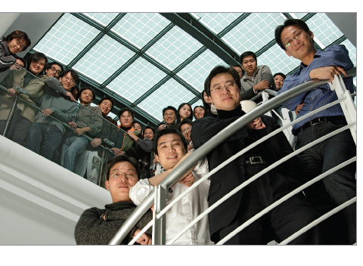
Why People Join Groups
Security
Status
Self-esteem
Affiliation
Power
Goal Achievement

Slide 6
Why People Join Groups
Security – by joining a group, individuals can reduce the insecurity of “standing alone”.
Status – inclusion in a group that is viewed as important provides recognition & status for its members.
Self-esteem – groups can provide people with feelings of self-worth.
Affiliation – groups can fulfill social needs.
Power – what cannot be achieved individually often becomes possible through group action. There is power in numbers.
Goal Achievement – when it takes more than one person to accomplish a particular task – there is a need to pool talents, knowledge, or power in order to complete a job. In such cases, management will rely on formal groups.

Slide 7
Why People form Groups
Slide 1 of 2
Need Satisfaction
Proximity & Attraction
Social Needs
Security Needs
Esteem Needs
Proximity is the physical distance between employees. Attraction is typically engendered by similarities in attitudes, performance or motivations.

Slide 8
Why People form Groups
Slide 2 of 2
Achievement of Group Goals
Economic Benefits
Group goals, if clearly understood, can be a reasons why people are drawn to a group.
In many cases, groups form because people believe they can derive greater economic benefits from their jobs if they organize.

Slide 9
The Five-Stage Model of Group Development
Forming Stage
The first stage in group development, characterized by much uncertainty.
Storming Stage
The second stage in group development, characterized by intragroup conflict.
Norming Stage
The third stage in group development, characterized by close relationships and cohesiveness.

Slide 10
…Group Development (cont’d)
Performing Stage
The fourth stage in group development, when the group is fully functional.
Adjourning Stage
The final stage in group development for temporary groups, characterized by concern with wrapping up activities rather than performance.

Slide 11
The Five-Stage Model of Group Development
Forming Stage
The first stage in group development, characterized by much uncertainty about the group’s purpose, structure, & leadership.
Members are ”testing the waters” to determine what types of behavior are acceptable.
People tend to be polite during this stage and will defer to the existing authority of a formal or informal leader who must provide an initial set of rules & structures for interaction.
Members experience a form of socialization as they try to find out what is expected of them & how they will fit into the team/group.

Slide 12
The Five-Stage Model of Group Development
Storming Stage
The second stage in group development, characterized by intragroup conflict.
Members accept the existence of the group, but there is resistance to the constraints that the group imposes on individuality.
There is a conflict over who will control the group.
This stage is marked by interpersonal conflict as members become proactive & compete for various group roles.
Coalitions may form to influence the team/group`s goals & means of goal attainment.
Members try to establish norms of appropriate behavior & performance standards. This is a tenuous (weak) stage in the team`s development.

Slide 13
…Group Development (cont’d)
Norming Stage.
The third stage in group development, characterized by close relationships and cohesiveness.
There is now a strong sense of group identity.
During this stage the group develops its first real sense of cohesion as roles are established & a consensus forms around group objectives.
Members develop common expectations & assumptions about how the team`s goals should be accomplished.

Slide 14
…Group Development (cont’d)
Performing Stage
The fourth stage in group development, when the group is fully functional.
The structure at this point is fully functional & accepted.
Group energy has moved from getting to know & understand each other to performing the task at hand.
Group members have learned to coordinate & resolve conflicts more efficiently.
There is a climate of mutual support in which team members feel comfortable about taking risks, making errors, or asking for help.

Slide 15
…Group Development (cont’d)
Adjourning Stage
  The final stage in group development for temporary groups, characterized by concern with wrapping up activities rather than performance.
For permanent work groups, performing is the last stage in their development.
Temporary groups, task forces & similar groups prepare for disbandment, in this stage.
Attention is directed toward wraping up activities.
In this stage, some members may be basking in the group`s accomplishments while others may be depressed/sad over the loss of relationship/friendship.

Slide 16
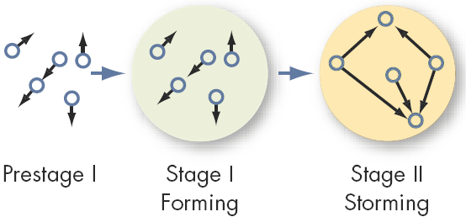
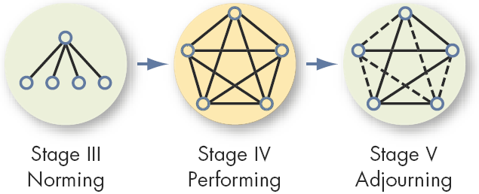
Stages of Group Development

Slide 17
An Alternative Model: Temporary Groups with Deadlines
Punctuated-Equilibrium Model
Temporary groups under time constrained deadlines go through transitions between inertia and activity---at the half-way point, they experience an increase in productivity.
Sequence of actions:
Setting group direction
First phase of inertia
Half-way point transition
Major changes
Second phase of inertia
Accelerated activity

Slide 18
The Punctuated-Equilibrium Model
Temporary groups with deadlines do not seem to follow the five-stage model.
Their first meeting sets the group’s direction.
This first phase of group activity is one of inertia
A transition takes place at the end of this first phase, which occurs exactly when the group has used up half its allotted time
A transition initiates major changes
A second phase of inertia follows the transition , and
The group’s last meeting is characterized by markedly accelerated activity.

Slide 19
Group Development .... compared
Punctuated-Equilibrium Model characterizes groups as exhibiting long periods of inertia interspersed ( things scattered or placed at intervals) with brief revolutionary changes triggered primarily by their members` awarness of time & deadlines.
If compared with Five-stage group development model, the group begins by combining the forming & normring stages, then goes through a period of low performing, followed by storming, then a period of high performance, and , finally, adjourning.

Slide 20
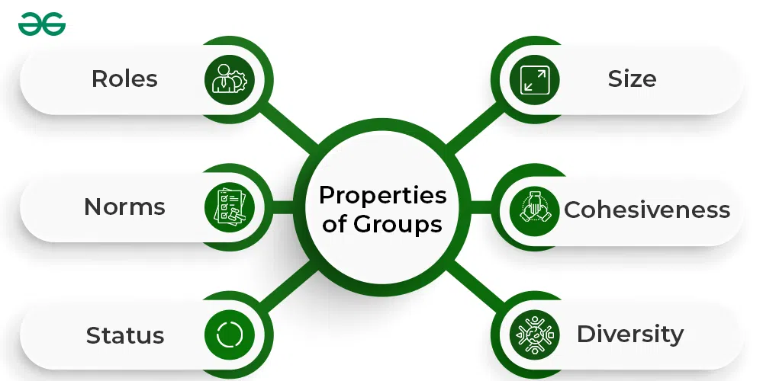
Group Properties

Slide 21
Group Properties - Roles
Role(s)
A set of expected behavior patterns attributed to someone occupying a given position in a social unit.
Role Identity
Certain attitudes and behaviors consistent with a role.
( promotion to the next higher rank may invoke certain attitudes & behaviors)
Role Perception
An individual’s view of how he or she is supposed to act in each situation.

Slide 22
Group Properties - Roles (cont’d)
Role Expectations
How others believe a person should act in each situation. (e.g., an Imam selling a concert tickets)
Psychological Contract
An unwritten agreement that sets out what management expects from the employee and vice versa.
Role Conflict
A situation in which an individual is confronted by divergent role expectations.

Slide 23
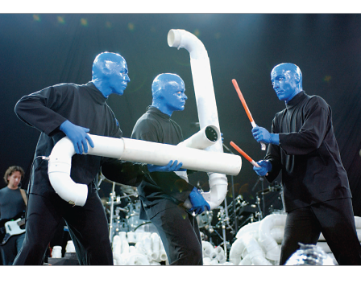
Group Properties - Norms
Norms
Acceptable standards of behavior within a group that are shared by the group’s members.
Classes of Norms:
Performance norms
Appearance norms
Social arrangement norms
Allocation of resources norms

Slide 24
Common Class of Norms
Performance Norms: Work groups typically provide their members with explicit cues on how hard they should work, how to get the job done, their level of output, appropriate levels of tardiness, and the like. These norms are extremely powerful in affecting an individual employee`s performance.
Appearance Norms: This includes things like appropriate dress, loyalty to the work group or organization, when to look busy etc. Some organizations have formal dress codes.
Social Arrangement Norms: These norms come from informal work groups and primarily regulate social interactions within the group. With whom group members eat lunch, friendships on & off the job, social games, and the like are influenced by these norms.
Allocation of Resources Norms: These norms can originate in the group or in the organization & cover things like pay, assignment of difficult jobs, and allocation of new tools & equipment.

Slide 25
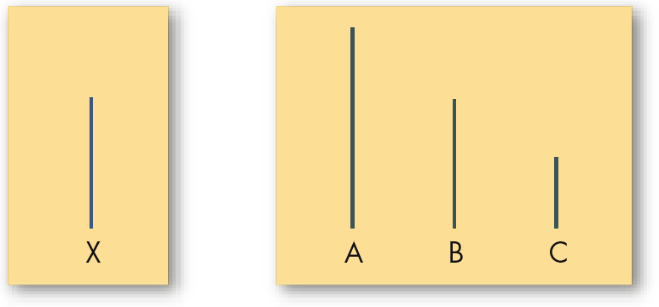
Group Properties – Common Classes of Norms
Conformity
Adjusting one’s behavior to align with the norms of the group. (When an individual's opinion of objective data differs significantly from that of others in the group, he or she is likely to feel extensive pressure to align his/her opinions to conform with those of the others)
Asch Study
Reference Groups
Important groups to which individuals belong or hope to belong and with whose norm's individuals are likely to conform.

Slide 26
Group Properties - Norms (cont’d)
Deviant Workplace Behavior
Antisocial actions by organizational members that intentionally violate established norms and result in negative consequences for the organization, its members, or both.
Group norms can influence the
presence of deviant behavior.

Slide 27
Typology of Deviant Workplace Behavior
Category Examples
Production Leaving early
Intentionally working slowly
Wasting resources
Property Sabotage
Lying about hours worked
Stealing from the organization
Political Showing favoritism
Gossiping and spreading rumors
Blaming coworkers
Personal Aggression Sexual harassment
Verbal abuse
Stealing from coworkers
E X H I B I T 9–5

Slide 28
Group Properties - Status
Status: A socially defined position or rank given to groups or group members by others.
Power over Others
Norms & Interaction
Ability to Contribute
Group Member
Status
Personal Characteristics
Other things influencing or influenced by status
Status Inequity
National Culture

Slide 29
Group Properties - Status
Status:
A socially defined position or rank given to groups or group members by others.
Status has some interesting effects on the power of norms & pressures to conform.
For example, high status members of groups often are given more freedom to deviate from norms than are other group members.
High-status people also are better able to resist conformity pressures than their lower-status peers.
Notes:
[

Slide 30
Group Properties - Size
Social Loafing
The tendency for individuals to expend less effort when working collectively than when working individually.
Performance
Other conclusions:
Odd number groups do better than even.
Groups of 5 to 7 perform better overall than larger or smaller groups.
Expected
Actual (due to loafing)
Group Size

Slide 31
What causes Social Loafing effect?
It may be due to the belief that others in the group are not carrying their fair share. If you see others as lazy or inept, you can reestablish equity by reducing your effort.
Dispersion of responsibility.Because the results of the group cannot be attributed to any single person, the relationship between an individual`s input & the group`s output is clouded. ( free-rider)
In other words, there will be a reduction in efficiency where individuals think that their contribution cannot be measured.

Slide 32
Group Properties - Cohesiveness
Cohesiveness
Degree to which group members are attracted to each other and are motivated to stay in the group.
Increasing group cohesiveness:
Make the group smaller.
Encourage agreement with group goals.
Increase time members spend together.
Increase group status and admission difficultly.
Stimulate competition with other groups.
Give rewards to the group, not individuals.
Physically isolate the group.

Slide 33
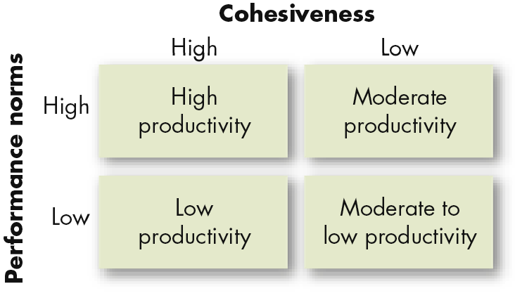
Relationship Between Group Cohesiveness, Performance Norms, and Productivity
E X H I B I T 9-7

Slide 34
Group Decision Making
Decision-making
  Large groups facilitate the pooling of information about complex tasks.
  Smaller groups are better suited to coordinating and facilitating the implementation of complex tasks.
  Simple, routine standardized tasks reduce the requirement that group processes be effective for the group to perform well.

Slide 35
Group Decision Making (cont’d)
Strengths
  More complete information
  Increased diversity of views
  Higher quality of decisions (more accuracy)
  Increased acceptance of solutions
Weaknesses
  More time consuming (slower)
  Increased pressure to conform
  Domination by one or a few members
  Ambiguous responsibility

Slide 36
Group Decision Making (cont’d)
Groupthink
Phenomenon in which the norm for consensus overrides the realistic appraisal of alternative course of action.
Groupshift
A change in decision risk between the group’s decision and the individual decision that member within the group would make; can be either toward conservatism or greater risk.

Slide 37
Group Decision-Making Techniques
Interacting Groups
Typical groups, in which the members interact with each other face-to-face.
Nominal Group Technique
A group decision-making method in which individual members meet face-to-face to pool their judgments in a systematic but independent fashion.

Slide 38
Nominal Group Decision-making Technique
Members meet as a group but, before any discussion takes place, each member independently writes down his/her ideas on the problem.
After this silent period, each member presents one idea to the group. Each member takes his/her turn, presenting a single idea until all ideas have been presented & recorded. No discussion takes place untill all ideas have been recorded.
The group now discusses the ideas for clarity & evaluates them.
Each member silently & independently rank-orders the ideas. The idea with the highest aggregate ranking determines the final decision.

Slide 39
Group Decision-Making Techniques
Brainstorming
An idea-generation process that specifically encourages all alternatives, while withholding any criticism of those alternatives.
Rules of Brainstorming:
Do not criticize ideas. Provide as many ideas as possible. Say all ideas that come to mind, no matter how wild. Combine & improve ideas suggested by others.
Electronic Meeting
A meeting in which members interact on computers, allowing for anonymity of comments and aggregation of votes.

Slide 40
Evaluating Group Effectiveness
TYPE OF GROUP
Effectiveness Criteria Interacting Brainstorming Nominal Electronic
Number and quality of ideas Low Moderate High High
Social pressure High Low Moderate Low
Money costs Low Low Low High
Speed Moderate Moderate Moderate Moderate
Task orientation Low High High High
Potential for interpersonal
conflict High Low Moderate Low
Commitment to solution High Not applicable Moderate Moderate
Development of High High Moderate Low
group cohesiveness

Slide 41



Thank You
Notes:
aaaaaaaaaaaaaaaaaaaaaaaaaaaaaaaaaaaaaaaaaaaaaaaaaaaaaaaaaaaaaaaaaaaaaaaaaaaaaaaaaaaaaaaaaaaa

