Slide 1

Project risk management
Lecture 10
Everyone’s Smart
University
PMG510
Project Risk Management

Slide 2

Introduction to project risk management
Project risk management should be seen as an extension of conventional project planning.
The main requirements for any project are that it is delivered on time, within budget and to specification or performance. Risk is often defined in terms of uncertainty or deviation from the expected/required outcomes.

Slide 3
Introduction to project risk management
Within project management, variability of outcomes is very undesirable. Therefore, the focus of risk management in projects is often on the reduction in the variability of outcomes and the management of control risks.
The requirements of project risk management are to identify the events that could give rise to uncertainty and respond to the event appropriately.
The style of risk management most relevant to project risk management is control management.

Slide 4
Development of project risk management
Because of the nature of projects, historical loss data will not usually be available. Accordingly, project risk management needs to be forward-looking in order to anticipate problems before they arise.
Compliance hazard, control and opportunity risks need to be considered as part of the successful management of any project.

Slide 5
Development of project risk management
There are risks associated with failure to obtain necessary permissions and approvals (compliance risks). There are risks to the project that can prevent it being delivered on time and within budget (hazard risks). There are risks to the project concerning the specification, performance and quality of the final outcome (control risks). Finally, there are risks that can enhance the delivery of the project, such as earlier than expected availability of materials (opportunity risks).

Slide 6
Uncertainty in projects
In order to manage uncertainty in projects, organizations have a range of possible actions they can take. An organization can decide to respond in one of the following ways:
  accept the risk or uncertainty;
  adapt activities and procedures;
  adopt contingency plans and responses;
  avoid the risk or uncertainty.

Slide 7
Uncertainty in projects
For low-exposure/low-uncertainty risks, the organization (or project) will usually accept uncertainty attached to each risk. For high-exposure/low uncertainty risks, the organization will adapt activities and procedures and introduce controls, including (when appropriate) insurance. For low risk/ high-uncertainty risks, the organization will adopt appropriate contingency plans and for high-exposure/high-uncertainty risks, the organization will wish to avoid the uncertainty attached to the risk.

Slide 8
Uncertainty in projects
The figure below illustrates the use of the risk matrix to plot the possible range of risks on the project. The matrix plots the possible time delay that could result against the potential for cost increases associated with that event. This diagram will help the project manager identify whether the risks fit into the comfort, cautious, concerned or critical zones. The other variable shown in the diagram equates to the likelihood of each event occurring, and this is indicated by the size of the bubble used to represent that risk.

Slide 9
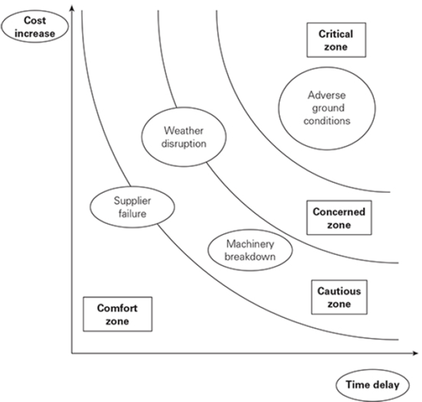
Uncertainty in projects

Slide 10
Uncertainty in projects
The figure below represents the risk management process in project management as a bow-tie.
The purpose of this bow-tie representation is to illustrate that controls can be introduced to reduce the uncertainties in the centre of the bow-tie, manage the uncertainties as they arise, and introduce further controls to limit the impact of those uncertainties on quality, cost, time and compliance.

Slide 11
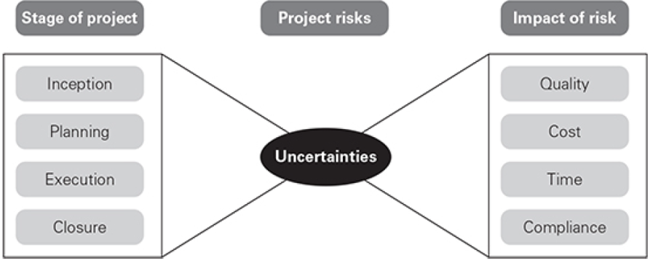
Uncertainty in projects

Slide 12
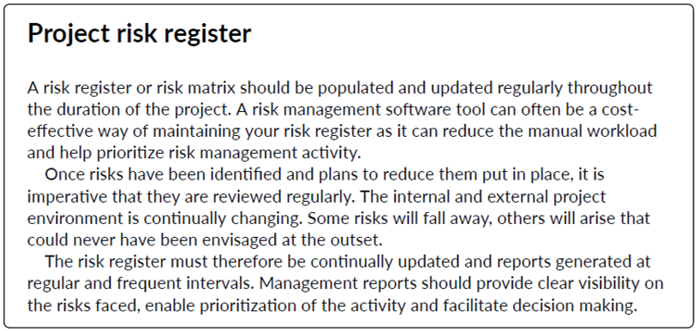
Uncertainty in projects

Slide 13
Project lifecycle
Whatever the size of the project, a number of specific stages will always be present. The figure below illustrates the key stages in the project lifecycle.

Slide 14
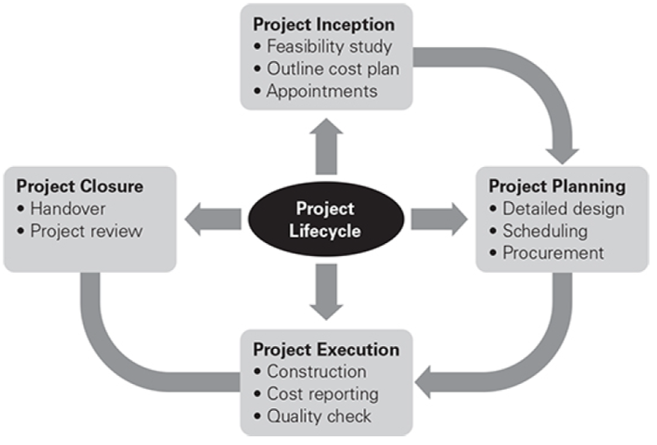
Project lifecycle

Slide 15
Project lifecycle
Each stage of the project lifecycle will have significant risk and uncertainty issues embedded within it. The uncertainty embedded in each stage of the project will include such issues as defining the project precisely, agreeing the timescale and budget, and confirming the performance/specification. There will also need to be arrangements for changes and developments within the project specification, as well as arrangements for any deviation from expected circumstances.

Slide 16
Project lifecycle
It is important to understand the stages in the project lifecycle, so that the risk management inputs into each stage can be planned and executed, and the required benefits obtained.
The figure below illustrates how uncertainty decreases during the various stages of a project. Uncertainty can be associated with cost, time and quality.

Slide 17
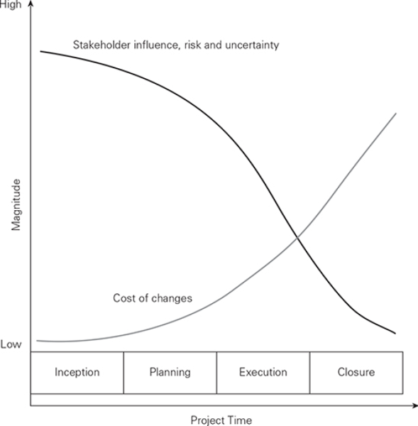
Project lifecycle

Slide 18
Opportunity in projects
Often a number of projects will need to be undertaken at the same time.
A collection of projects of this sort is referred to as a programme.
Very frequently, the specification of a project will change during the course of the work. A well risk-managed project will take the opportunity of change to specifications to provide a greater level of customer satisfaction, as well as a greater level of income for the organization delivering the project.

Slide 19
Opportunity in projects
As well as achieving the opportunities offered by undertaking the project, organizations will also wish to take advantage of opportunities that are offered within the project. These opportunities may reduce costs, reduce time and/or increase quality.
For example, if a construction project assumes a certain level of ground contamination but this proves to be less than expected, there would be an opportunity for the project to be delivered ahead of schedule and at reduced cost.

