Slide 1


AI-Based Nowcasting of National CO₂ Emissions
Using Satellite-Derived Indicators
A Hybrid Framework for GCC Countries
Master's Thesis in Artificial Intelligence
Satellite-Based Nowcasting for Climate Monitoring
Mohammad Wajeeh Bader
Supervisor: Dr. Amjad

Slide 2
The Problem
1,158 Mt
GCC CO₂ Emissions (2023)
CRITICAL CHALLENGE
The GCC region lacks real-time, granular carbon monitoring systems despite being one of the world's highest per-capita emitters.
3.1%
KEY GAPS
of Global Emissions
Annual reporting delays of 1-2 years
No integration of satellite-based environmental indicators
Limited regional ML-based forecasting studies
Vision 2030 requires actionable environmental intelligence
58.8M
Population Affected

Slide 3
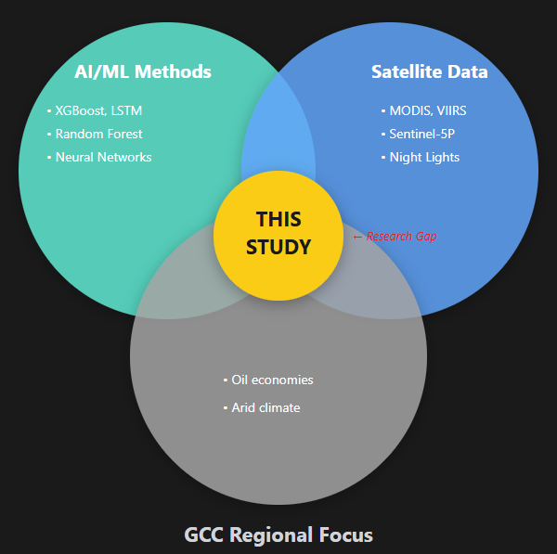
Research Gap: This Study's Position

Slide 4

Research Objectives
PRIMARY OBJECTIVE
Develop an AI-enhanced framework for nowcasting CO₂ emissions in Saudi Arabia and the GCC region using satellite data integration.
BASELINE
INTEGRATE
VALIDATE
Establish temporal baseline using XGBoost with 24 years of emissions data (2000-2023)
Integrate satellite-derived features from Google Earth Engine (LST, NDVI, Nightlights)
Evaluate model performance at country level across all six GCC nations
Target: R² ≥ 0.70
Target: Quantify accuracy-timeliness trade-off
Target: MAPE < 15%

Slide 5
Literature Review
EXISTING RESEARCH (20+ STUDIES REVIEWED)
IDENTIFIED RESEARCH GAP
AI/ML-Based Forecasting
LSTM networks for time-series prediction
No existing study combines temporal ML forecasting with satellite-derived features specifically for the GCC region.
XGBoost for feature-based modeling
Ensemble methods achieving R² 0.85-0.95
Most studies focus on single data sources
GCC's unique climate patterns ignored
Satellite-Based Monitoring
OCO-2/3 for direct CO₂ measurement
Multi-country regional models rare
MODIS LST as emission proxy
Oil economy factors underexplored
Nightlights for urbanization tracking
THIS RESEARCH ADDRESSES
Regional Studies
First integrated framework combining XGBoost temporal modeling with GEE satellite features for GCC-wide emissions monitoring.
China, EU, USA dominant focus
Limited GCC-specific research

Slide 6
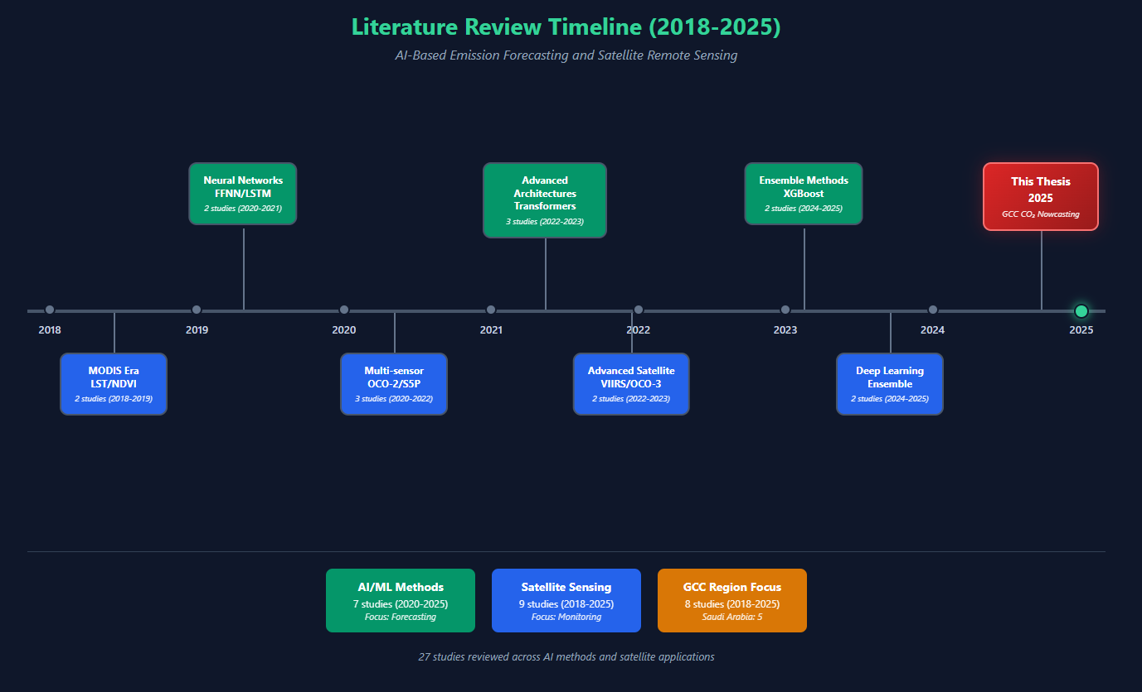
Literature Review

Slide 7
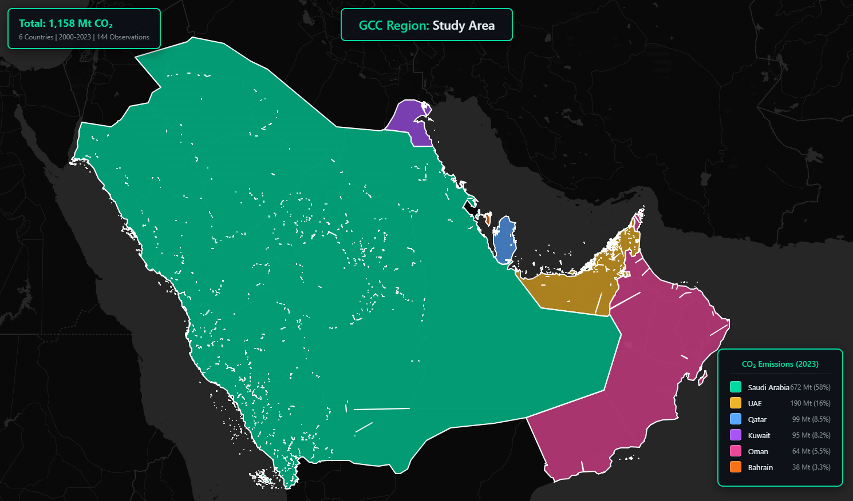
Study Area: GCC Region
GEOGRAPHIC COVERAGE
TOTAL EMISSIONS
POPULATION
1,158 Mt CO₂
58.8M
Saudi Arabia
UAE
672 Mt
190 Mt
58% of GCC | 18.2 t/capita
16% of GCC | 19.3 t/capita
Qatar
Kuwait
99 Mt
95 Mt
8.5% of GCC | 32.8 t/capita
8.2% of GCC | 21.6 t/capita
Oman
Bahrain
64 Mt
38 Mt
5.5% of GCC | 12.4 t/capita
3.3% of GCC | 23.1 t/capita

Slide 8
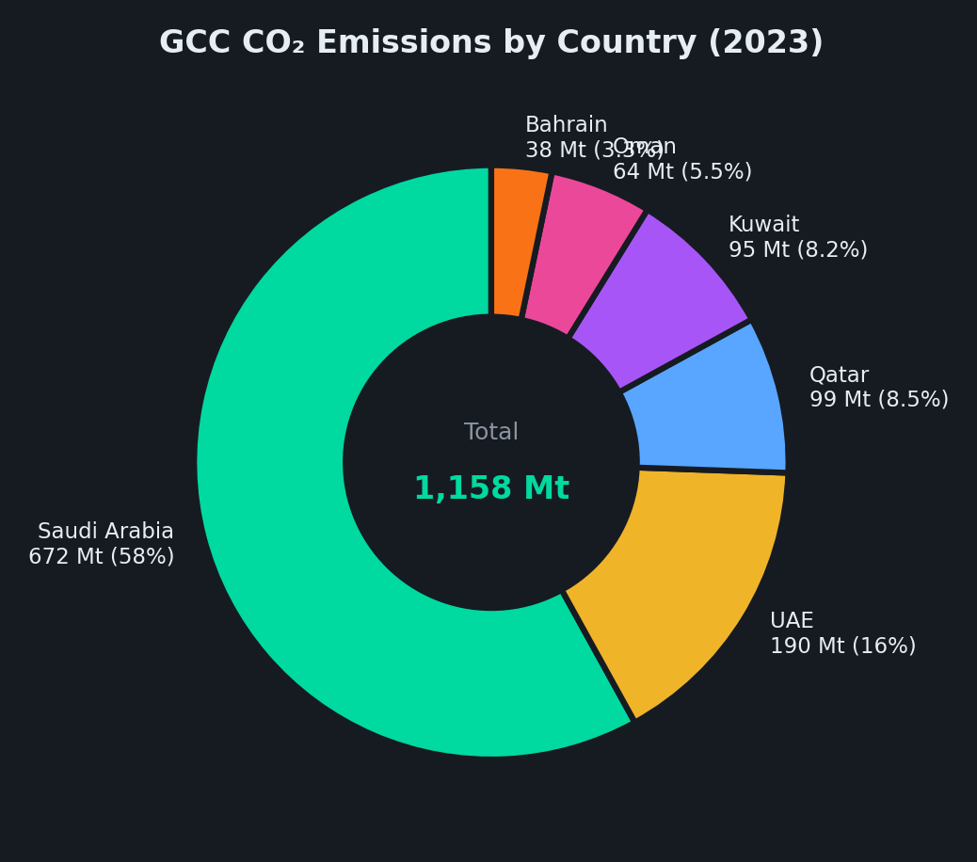
GCC Emissions Distribution

Slide 9
Data Sources
SOCIOECONOMIC DATA
SATELLITE DATA (Google Earth Engine)
Our World in Data
MODIS Land Surface Temperature
CO₂ Emissions
Per Capita Emissions
MOD11A2 | 8-day composites | Day/Night LST | Emissivity
Energy Consumption
Primary Energy Mix
World Bank API
MODIS Vegetation Index
GDP (current USD)
Population
MOD13A2 | 16-day composites | NDVI | EVI
Urban Population %
Industry Value Added
Final panel used in this thesis: 144 country–year observations (6 GCC countries × 24 years, 2000–2023), combining OWID / World Bank socioeconomic indicators with satellite features from MODIS (LST, NDVI), VIIRS night lights, MERRA-2 AOD, and Sentinel-5P NO₂.
100%
144
VIIRS Nighttime Lights
Data Completeness
Country-Years
VIIRS DNB Monthly | Annual composites | Radiance | Lit Area
Sentinel-5P TROPOMI
NO₂ Column Density | (2018+)

Slide 10
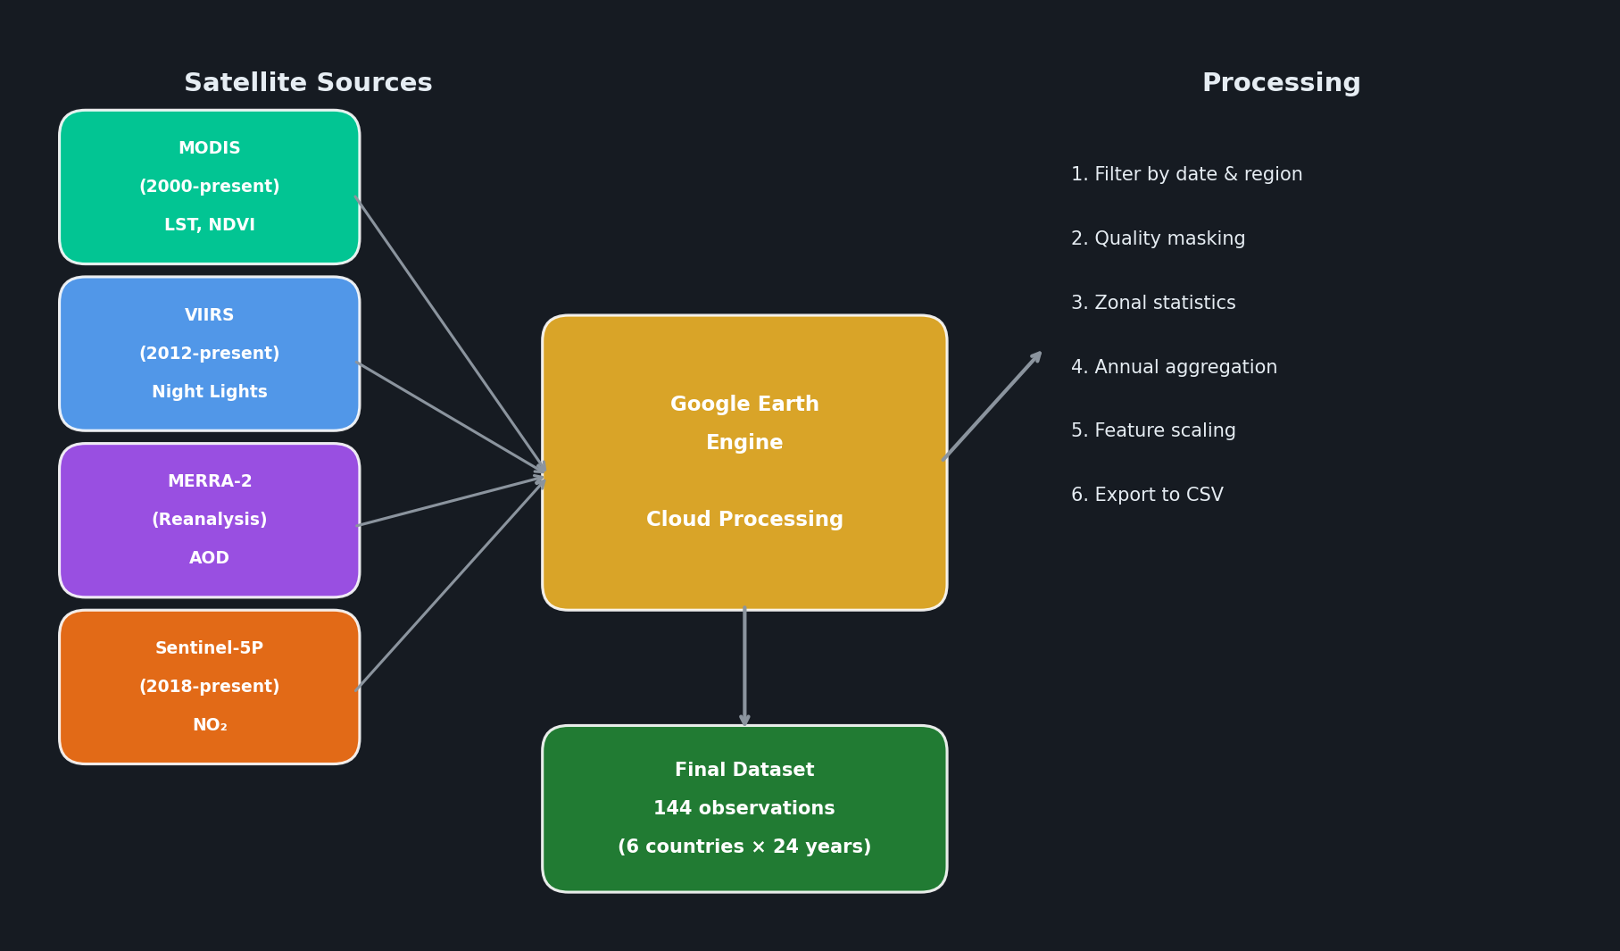
Satellite Data Sources & Pipeline

Slide 11
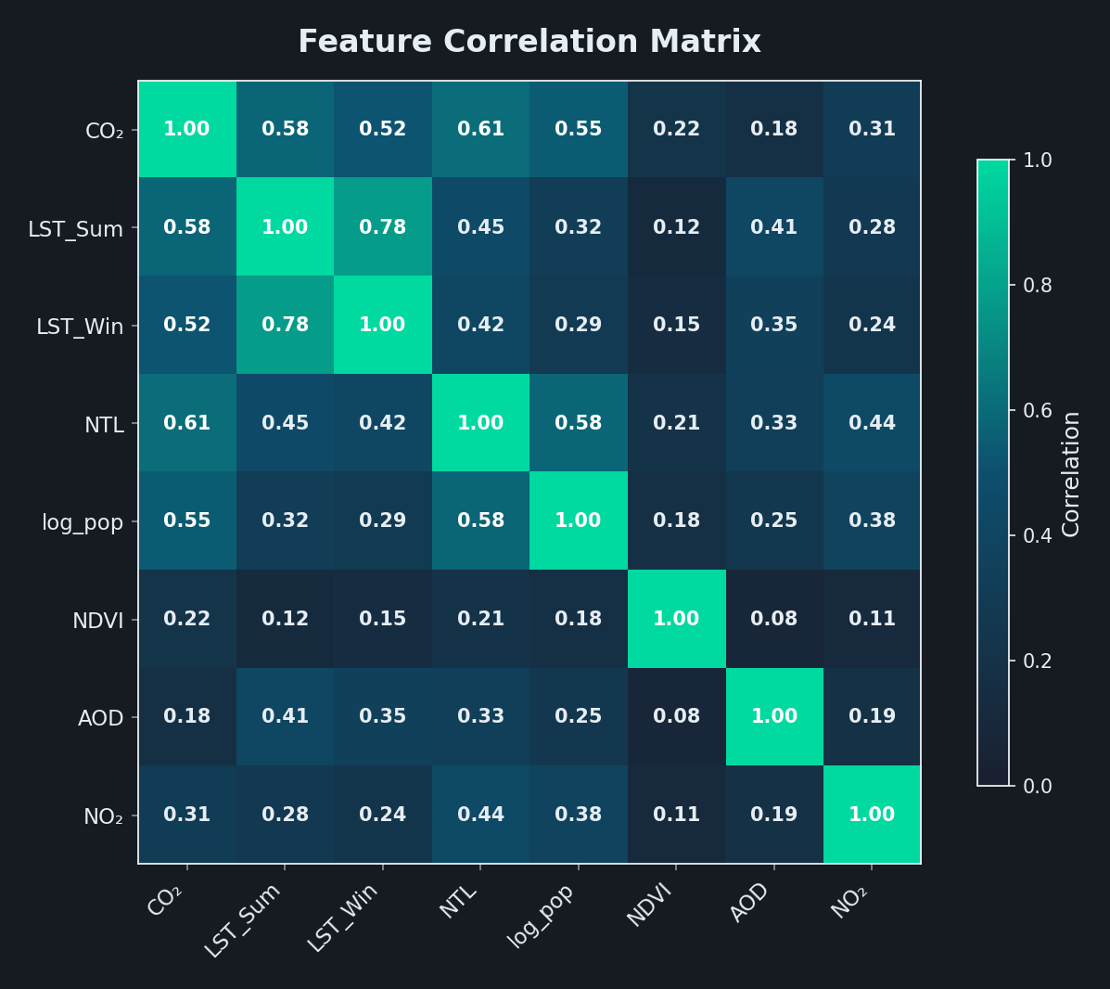
Feature Correlation Analysis

Slide 12



Research Framework
DATA COLLECTION
PREPROCESSING
FEATURE ENG.
MODELING
EVALUATION
Our World in Data
Missing data handling
Feature engineering
XGBoost Regressor
R², RMSE, MAPE
World Bank API
Temporal alignment
seasonal aggregation
derived features
3-Model comparison
Feature importance
Google Earth Engine
Feature scaling
Temporal split
Country-level analysis
Model A
Model B
Model C
Socioeconomic Only
Satellite + Population
Satellite Only
GDP, Population, Energy, CO₂ Intensity
(5 features)
LST, NDVI, Nightlights, AOD + Population Density
(6 features)
LST (Summer/Winter), NDVI, Nightlights, AOD )NO₂
(5 features)

Slide 13
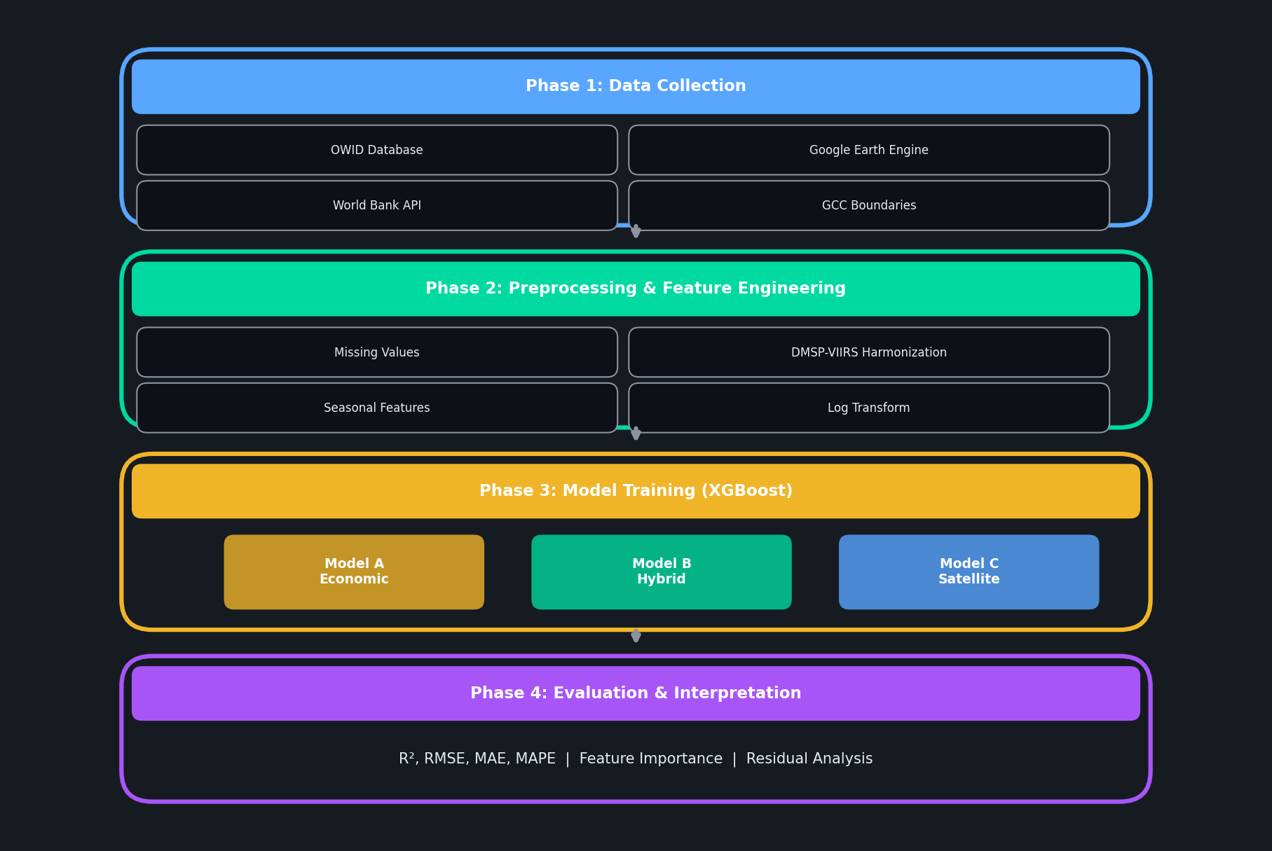
Research Methodology: 4 Phases

Slide 14
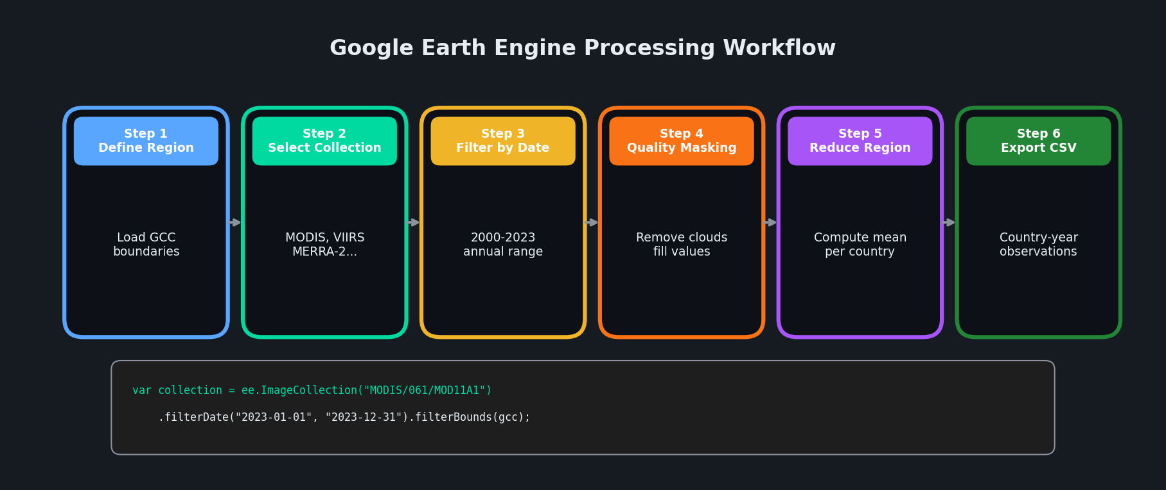
Google Earth Engine Workflow

Slide 15
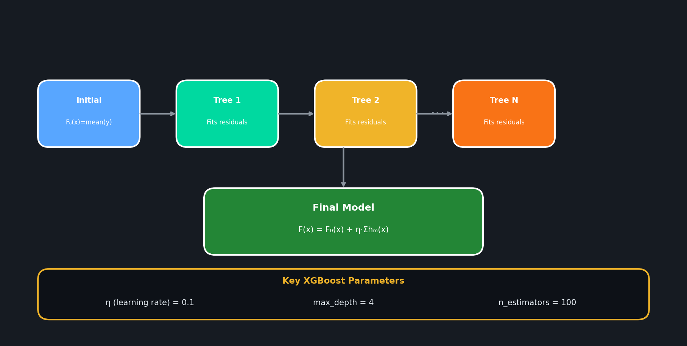
XGBoost: Gradient Boosting

Slide 16
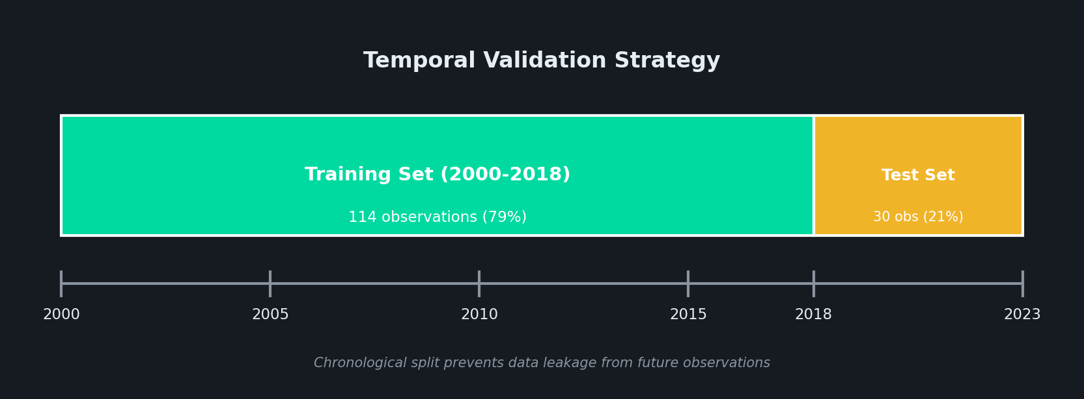
Temporal Validation Strategy

Slide 17

Results: Model Performance
MODEL A
MODEL B
MODEL C
Socioeconomic Only
Satellite + Population
Satellite Only
0.96
0.69
0.67
Test R²
Test R²
Test R²
46.3
8.7%
124.2
18.3%
129.1
19.8%
RMSE (Mt)
MAPE
RMSE (Mt)
MAPE
RMSE (Mt)
MAPE
TRADE-OFF
Trade-off
OVERFITTING CHECK
TARGET ACHIEVEMENT
Train R²
Test R²
Gap
R² ≥ 0.70 near target (0.69)
0.96
0.69
27%
MAPE < 15% 18.3% (not met)
Accuracy cost for near-real-time data
Model B trades accuracy for near-real-time data availability (days vs years)
Moderate train–test gap indicates some overfitting; the model still generalizes reasonably but requires cautious interpretation.
Satellite improvement Trade-off

Slide 18
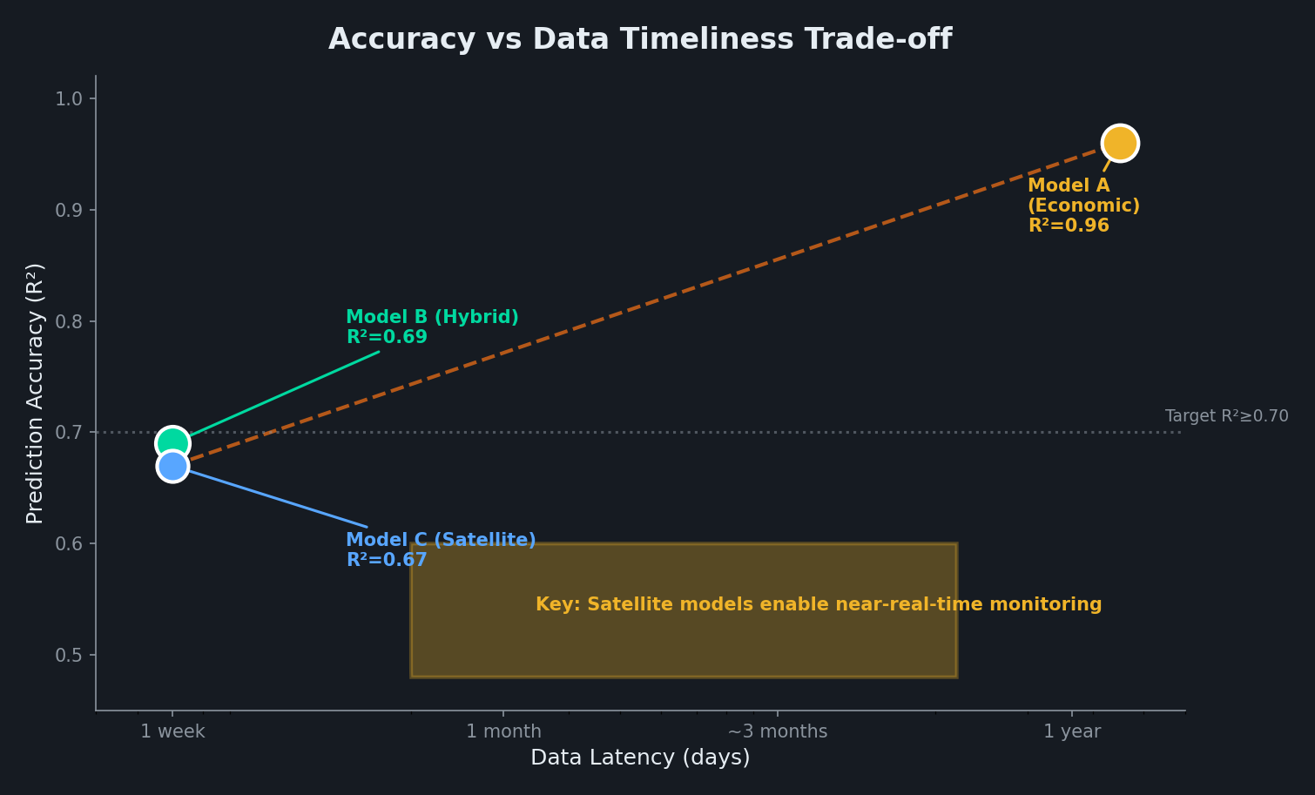
Key Finding: Accuracy vs Timeliness

Slide 19






Feature Importance Analysis
FEATURE CONTRIBUTION
56%
44%
MODEL B FEATURES
Temperature (LST)
Other Features
LST Summer (34%)
LST Winter (22%)
KEY INSIGHT
Night Lights (22%)
Temperature features (LST Summer + Winter) account for 56% of predictive power, reflecting cooling demand as primary emission driver in GCC.
NDVI (5%)
AOD (4%)
Pop. Density 13%
SATELLITE VALUE
Pop. Density (13%)
LST Summer is the most important feature, capturing seasonal energy demand patterns.
Other
IMPLICATION
Satellite features enable near-real-time emissions estimation with R²=0.69, trading some accuracy for immediate data availability.

Slide 20
Country-Level Performance
Saudi Arabia
UAE
Qatar
0.72
68.4 Mt
0.68
28.3 Mt
0.65
18.2 Mt
R²
RMSE
R²
RMSE
R²
RMSE
Kuwait
Oman
Bahrain
0.67
14.1 Mt
0.64
12.8 Mt
0.61
8.4 Mt
R²
RMSE
R²
RMSE
R²
RMSE
PATTERN OBSERVED
SMALLER COUNTRIES
Larger economies (SA, UAE) show better predictions due to more stable emission patterns and data availability.
Bahrain and Oman show higher variability - may benefit from country-specific models.

Slide 21
Limitations & Future Work
LIMITATIONS
FUTURE DIRECTIONS
Data Temporal Coverage
Higher Resolution Modeling
Satellite data limited to 2000-2023; Sentinel-5P only from 2018
City-level or grid-based predictions using downscaling techniques
Annual Resolution
Deep Learning Integration
Country-level annual data; cannot capture sub-annual or regional variations
LSTM, Transformer models for temporal sequence learning
Sample Size
Real-time Dashboard
144 observations across 6 countries may limit complex model training
Web-based monitoring system with automated GEE data pipeline
Model Scope
Sectoral Disaggregation
XGBoost only; deep learning methods not explored
Industry, transport, residential emission breakdowns

Slide 22
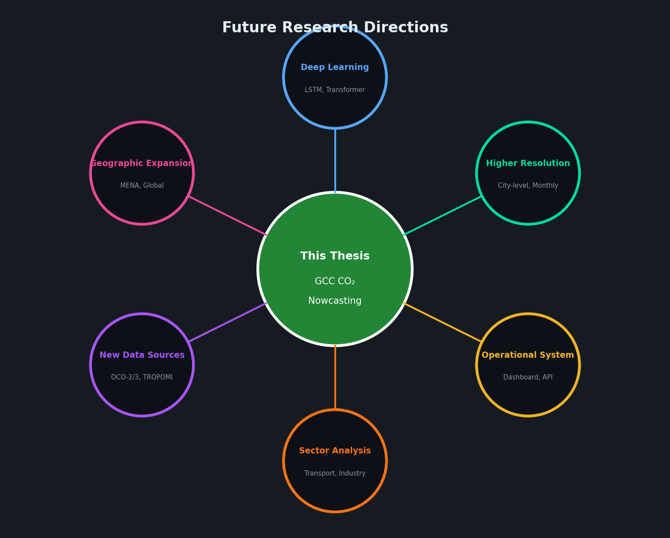
Future Research Directions

Slide 23

Conclusions
This research demonstrates that using satellite-derived features with population density enables near-real-time CO₂ emission estimation for the GCC region, achieving R² ≈ 0.69 and supporting Vision 2030 environmental monitoring goals.
NOVEL FRAMEWORK
SATELLITE VALUE
REGIONAL INSIGHTS
First integrated AI framework combining XGBoost temporal modeling with Google Earth Engine satellite data for GCC emissions monitoring.
Quantified satellite contribution: Temperature (summer and winter LST) and Nighttime Lights together account for ~78% of the model’s feature importance in Model B.
Country-level analysis reveals performance patterns: larger economies (Saudi Arabia R²=0.72) benefit most from integrated approach.
PRACTICAL IMPACT
POLICY RELEVANCE
Framework can reduce emission reporting delays from 1-2 years to near real-time estimates.
Supports Saudi Vision 2030 and GCC climate commitments with actionable environmental intelligence.

Slide 24
Thank You
Questions & Discussion
Mohammad Wajeeh Bader
Master's Student in Artificial Intelligence
Midocean University
251000462@st.midocean.edu.km
Supervisor: Dr. Amjad Qtaish
AI-Based Nowcasting of National CO₂ Emissions
A Hybrid Framework for GCC Countries

