Slide 1


Effective Planning in Healthcare Quality Management
Prepared by Dr. Hesham Mousli
MHA623
Healthcare Quality
Lecture 5

Slide 2

Intended Objectives
Chapter
05
Understand the principles of quality improvement methodologies, including Six Sigma and PDSA cycles.
Identify and utilize common planning tools in healthcare quality management.
Comprehend the steps involved in team creation and the stages of team development.
Apply root cause analysis techniques, including the Ishikawa Diagram and Five Whys Technique.
Differentiate between containment actions and corrective actions in problem-solving.

Slide 3

Our Roadmap
Quality improvement methodologies Overview
Common planning tools
Six-Sigma methodology
1
3
5
2
4
6
Planning phase orientation
PDSA cycle
Accreditation overview

Slide 4
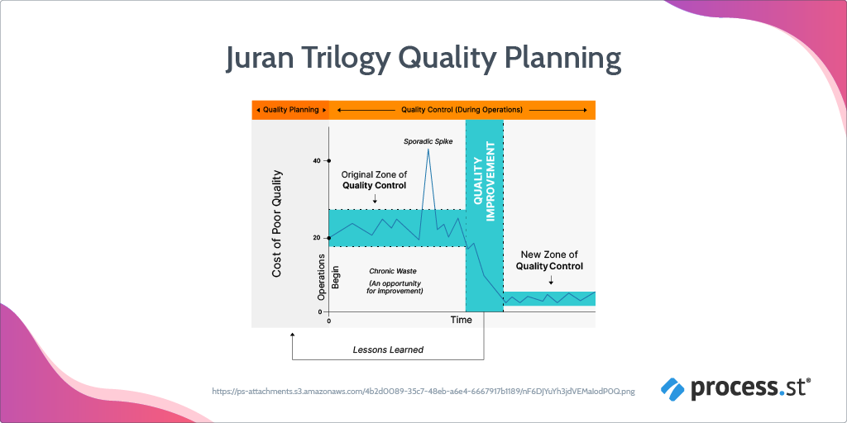
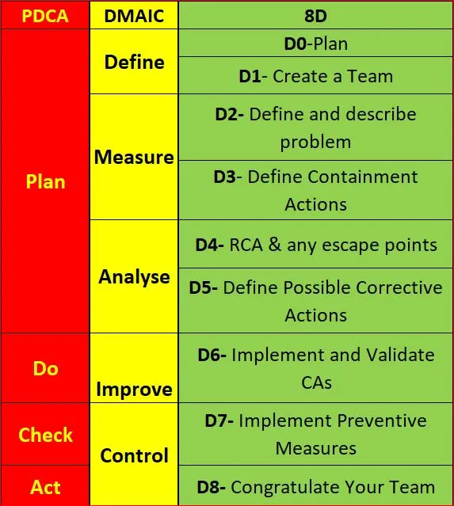
Chapter

Slide 5
Our Roadmap
Quality improvement methodologies Overview
Common planning tools
Six-Sigma methodology
1
3
5
2
4
6
Planning phase orientation
PDSA cycle
Accreditation overview

Slide 6

Chapter
Planning Phase
05
Team Creation

Slide 7
Team Creation
Chapter
05
Team: A small group of people committed to a common purpose, who possess complementary skills and who have agreed on specific performance goals for which the team members hold themselves mutually accountable.
“Not all groups are teams”

Slide 8
Team Creation
Chapter
05
Common types of Teams:
  Work teams.
  Parallel teams.
  Project teams.
  Management teams.

Slide 9
Team Creation
Chapter
05
Project teams:
  Time-Limited Teams: Project teams are formed for a specific duration to accomplish a defined goal.
  One-Time Outputs: They deliver unique outcomes, such as:
    A new product or service.
    A new information system.
    A new facility or plant.

Slide 10
Team Creation
Chapter
05
Project teams:
  Nonrepetitive Tasks: The work is not repetitive and requires:
    Significant application of knowledge.
    Judgment and expertise.
  Types of Outputs:
    Incremental improvements to existing concepts.
    Development of entirely new, innovative ideas.

Slide 11
Team Creation
Chapter
05
Project teams:
  Composition:
    Teams consist of members from different disciplines and functional units.
    Specialized expertise is applied to accomplish project goals.
  Examples:
    Quality improvement teams in healthcare or other industries.

Slide 12
Team Creation
Chapter
05
Project teams:
  Post-Completion Roles:
    Team members either return to their original functional units or transition to new projects.
  Advantages:
    Saves time by enabling simultaneous handling of multiple activities (not sequentially).
    Encourages collaboration and integration of diverse expertise.

Slide 13

Team Creation
Chapter
05
Steps in creating a team
  Step 1: Establish leadership To build trust and discipline.
  Step 2: Establish relationships between leader and every single employee.
  Step 3: Build relationships between your employees.
  Step 4: Foster teamwork.
  Step 5: Set ground rules for the team.

Slide 14
Team Creation
Chapter
05
Stages of team development:
  Stage 1: Forming:
    Lack of Team Cohesion: Members feel more like individuals in a group than part of a unified team.
    Limited Interaction: Minimal exchange of ideas, low socialization, and guarded behavior among members.
    Weak Commitment: Members show low dedication and connection to one another.

Slide 15
Team Creation
Chapter
05
Stages of team development:
  Stage 2: Storming:
    Expression and Confrontation: Team members begin expressing feelings and addressing unresolved issues.
    Emergence of Disagreements: Conflicts and differing opinions surface as part of team dynamics.
    Team Progression: Members start taking risks, listening actively, and transitioning from a group to a cohesive team.

Slide 16
Team Creation
Chapter
05
Stages of team development:
  Stage 3: Norming:
    Team Dynamics: Members become more sensitive to each other, fostering collaboration and mutual respect.
    Work Structure: Clear methods, roles, and responsibilities are established, leading to a balanced contribution and a consistent work pattern.
    Consensus: Agreement and unity develop, creating a strong sense of teamwork.

Slide 17
Team Creation
Chapter
05
Stages of team development:
  Stage 4: Performing:
    Shared Vision: Clear purpose, guiding values, and strong collaboration.
    High Performance: Achieves goals with a positive, productive atmosphere.
    Independence: Functions autonomously without leader involvement.

Slide 18
Team Creation
Chapter
05
Stages of team development:
  Stage 5: Adjourning:
    Completion: Goals are achieved, and the team focuses on final tasks and documenting results.
    Transition: Team members are reassigned to other teams, and the team disbands.
    Acknowledgement: Celebrating success through a ceremonial acknowledgment is beneficial.

Slide 19
Chapter
Planning Phase
05
Definition & description of problem

Slide 20
Definition & description of problem
Chapter
05
Background / Business case:
  Which issue or problem do we wish to solve?
  Why this issue is important to solve now?
  What benefits do we anticipate from solving this issue (e.g.: Quality, Timeliness, Cost, Customer/employee satisfaction).

Slide 21
Definition & description of problem
Chapter
05
Stakeholders:
  Who are the internal / external customers?
  Listing all the team members who will share in solving the problem.

Slide 22
Definition & description of problem
Chapter
05
Current condition:
  Identify what you know about the problem (e.g., customer feedback, process data, error trends, frequency).
  Determine where, when, and who is involved in the errors.
  Identify what you don’t know and need to investigate further.

Slide 23
Definition & description of problem
Chapter
05
Current condition:
  Define the data/information to be collected.
  Assign responsibility for data collection and visualization (e.g., bar chart, trend graph).
  Set deadlines for completing and presenting the visuals.

Slide 24
Definition & description of problem
Chapter
05
Developing the final problem statement:
  What specific measure needs to be improved?
    It can be developed after understanding the scope and nature of the problem after answering the aforementioned questions.
    More analysis may be needed if the team still cannot write a problem statement.
  Problem statement Example: we need to reduce/increase the number/percentage of (?) from (current level) to (desired level) by (date).

Slide 25
Chapter
Planning Phase
05
Root Cause Analysis (RCA)

Slide 26
Ishikawa Diagram
(Cause & Effect Diagram)
Chapter
05
This diagram is used to identify and organize all probable causes of a significant problem (effect) and to analyze the relationship between the effect and its causes.
Known as the Ishikawa Diagram, this tool was first introduced by Japanese quality expert Kaoru Ishikawa in the 1960s.
It is also called the Fishbone Diagram because its shape resembles the bones of a fish.

Slide 27
Ishikawa Diagram
(Cause & Effect Diagram)
Chapter
05
This tool is to be used by the team.
Once the diagram is completed, team members begin discussions to identify the causes that have the greatest impact and can be addressed.
Example: To find the causes of a medication error in the hospital, the causes are analyzed as shown.

Slide 28
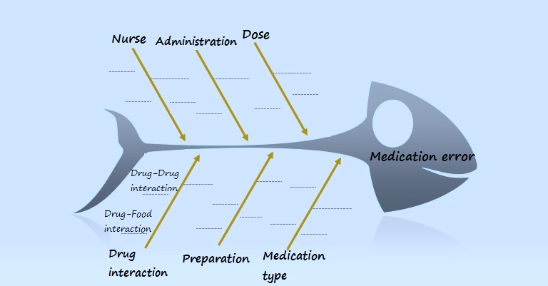
Chapter
05
Causes
Effect
Causes

Slide 29
Pareto principle (20/80 Rule)
Chapter
05
What is the 20/80 Rule?
  The 20/80 Rule is called the powerful few and weak multitude. The rule provides on “20% of the causes we take, achieve about 80% of the results we get. However, the result 80% of the causes achieve only 20% of the results.”
So, We can classify the causes of a problem to:
  Causes responsible for 20% of the problem (which represent 80% of the total causes).
  Causes responsible for 80% of the problem (which represent 20% of the total causes). They require effective monitoring and control because, although they are few, they are responsible for 80% of the problem size.

Slide 30

Pareto principle (20/80 Rule)
Chapter
05
Before drawing a graphical representation of the Pareto rule (80/20) to clarify the causes of a problem, a cumulative frequency table must be created (A table shows the recurrence of each cause in descending order and its percentage of the total recurrences).

Slide 31

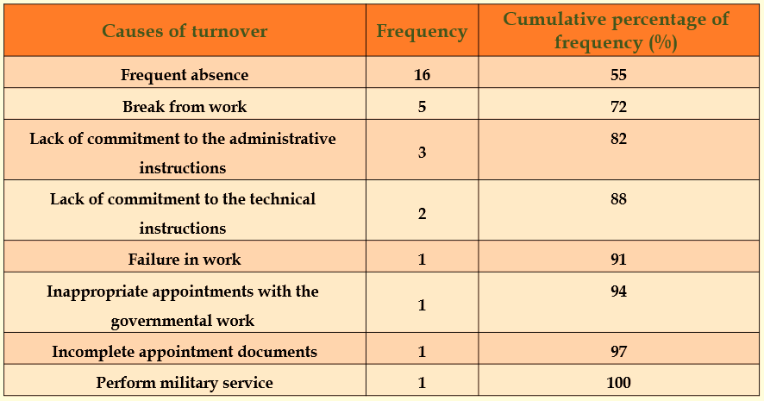
Example: Causes of nurses’ high turnover rate
Chapter
05

Slide 32
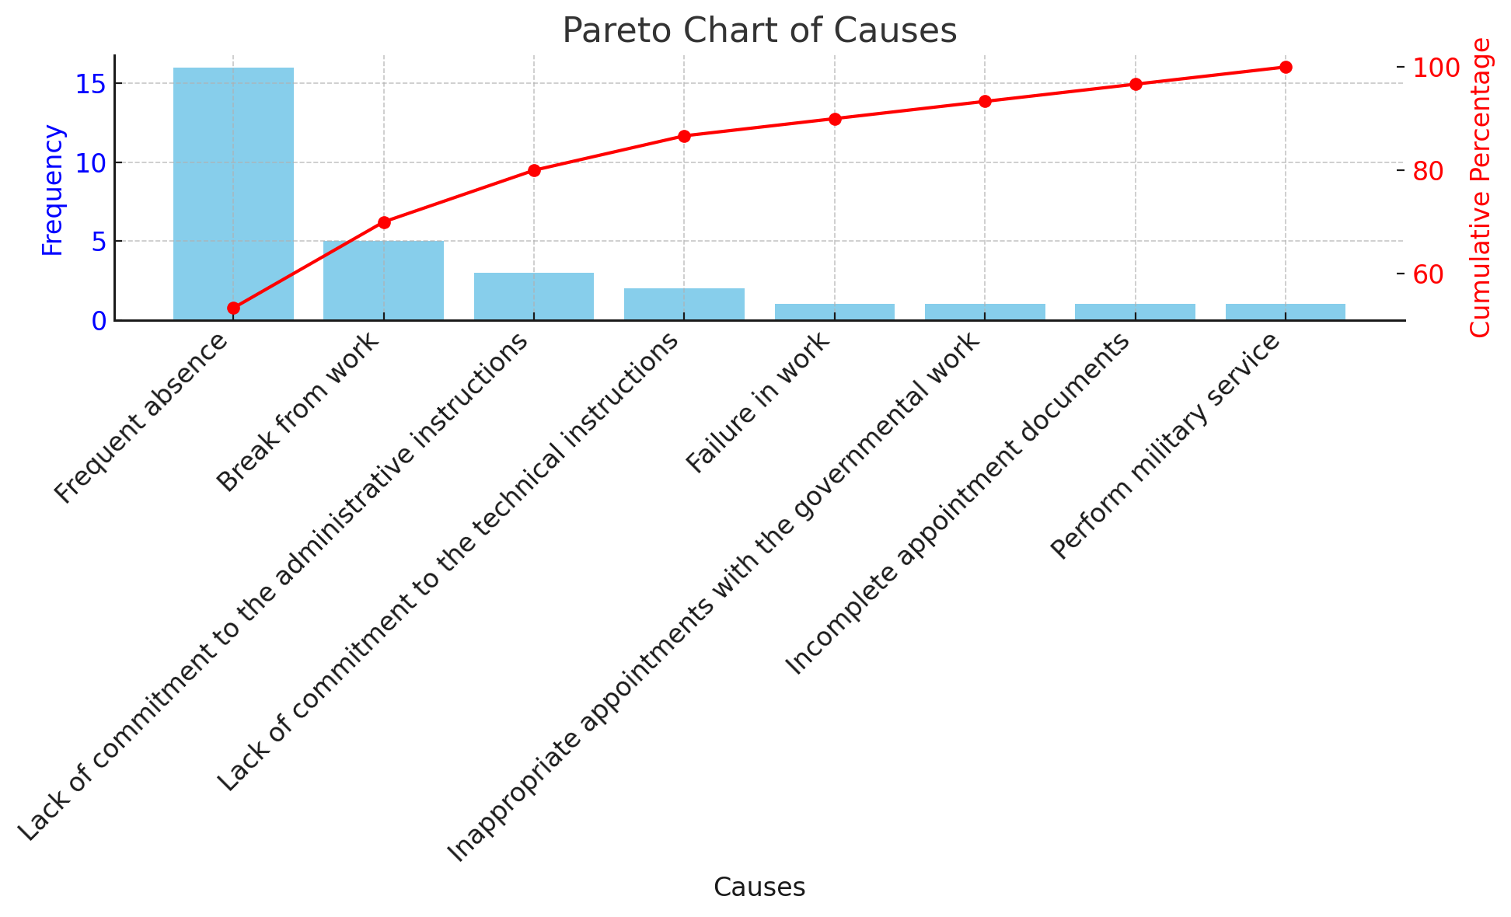
Vital causes
(represent 20% of the total causes)
Useful causes
(represent 80% of the total causes(

Slide 33

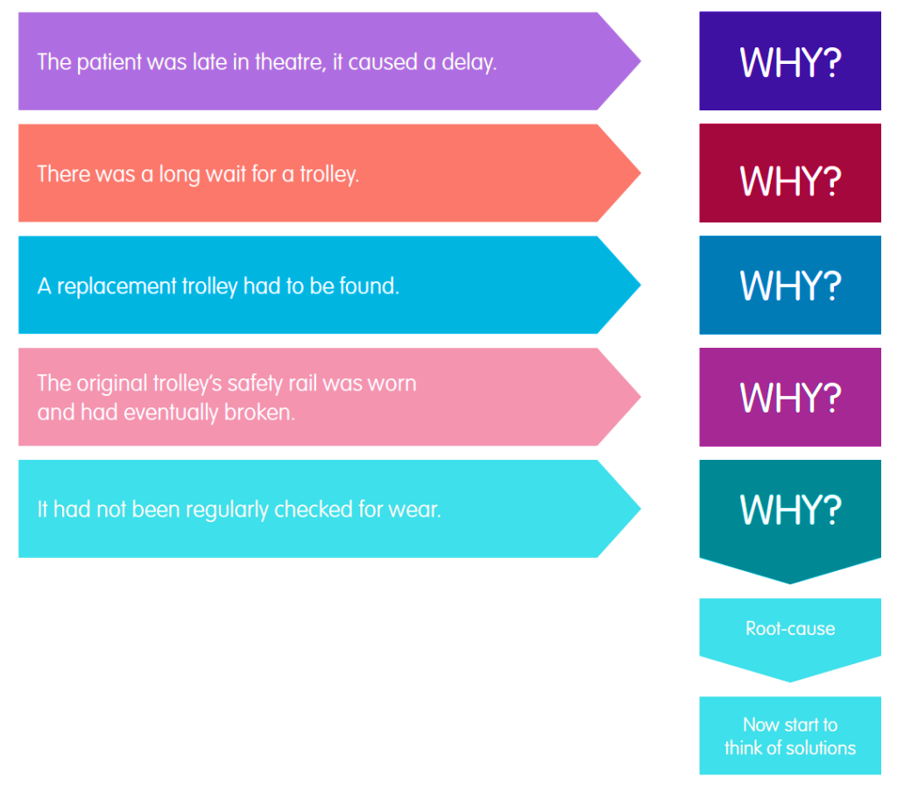
Five (5) Whys’ technique
Chapter
02

Slide 34
Chapter
Planning Phase
05
Define Containment Actions & Corrective Actions

Slide 35
Define Containment Actions & Corrective Actions
Chapter
05
Containment Actions: Temporary measures to control the immediate impact of a problem. They prevent the issue from escalating but do not address the root cause.
Corrective Actions: Long-term solutions to eliminate the root cause and prevent recurrence.

Slide 36
Define Containment Actions & Corrective Actions
Chapter
05
Some of the questions to ask when determining the best containment/corrective action plan would be:
  Is it a reliable solution?
  Is it cost-effective?
  Is it easy to implement?
  Would there be any delay in implementation if we need interim solutions?
  Are there potential problems/complications from this plan?

Slide 37

Criteria | Containment Actions | Corrective Actions
Purpose | Address and control the immediate impact of an existing problem or incident. | Identify and eliminate potential risks to prevent future occurrences
Timing | After an issue has occurred | Before an issue occurs
Focus | Reactive: resolving current issues | Proactive: avoiding future problems
Objective | Control the problem and limit its impact | Anticipate and prevent safety hazards or errors
Scope | Specific to the incident or problem encountered | Broader, affecting policies, procedures, or systems
Examples in Healthcare | Medication Error: Retraining staff after a wrong drug was administered. Equipment Failure: Repairing a faulty ventilator after it malfunctioned. | Medication Safety: Implementing barcode scanning to avoid drug errors. Equipment Maintenance: Regular checks to prevent device malfunctions.
Chapter

Slide 38
Wrap Up
Chapter
05
Quality improvement in healthcare relies on systematic methodologies like Six Sigma and PDSA.
Effective planning tools are essential for identifying and addressing quality issues.
Team creation and development stages are crucial for successful project implementation.
Root cause analysis helps identify underlying issues rather than just treating symptoms.

Slide 39
Wrap Up
Chapter
05
The Ishikawa Diagram and Five Whys Technique are valuable tools for cause-and-effect analysis.
The Pareto Principle helps prioritize causes by focusing on the vital few impacting the majority of the problem.
Containment actions provide temporary solutions, while corrective actions offer long-term fixes.
Proper planning and evaluation ensure the effectiveness and sustainability of quality improvement initiatives.

Slide 40



Thank You

