Slide 2





Welcome to the professional PJOM track.
The four approaches that were based on the PMBOK from the first edition until the sixth edition cannot:
1-Dliver effective PCI
2-Meet project operations success factors,
3Meet project management success requirements, maximize the project success rate, or deliver PVA.

Slide 3
The target of the lecture
How the HPJOMS Is being able to consistently deliver the most effective PJFT with superior PCI .

Slide 4

Lecture outline
Section 1
The PJOMS pitfalls
The comparison between the PJOMS and the HPJOMS
The secret of the valuable HPJOMS
The HPJOMS bottom-lines
Section 2 : The HPJOMS success factors
1- the PJFT
        The difference between the PJT &PJFT
        The process of the PJFT
2- the PCI
        The Components of the PCI
        The PCI transformation process
        The transformation process efficiency level between the resultant deliverables and the readiness deliverables
Section 3 :
HPJOMS lifecycles and its integration with the HPMQS

Slide 5
The PJOMS pitfalls :
Projects mostly deliver late, overbudget, or without meeting the functionality requirements of the project sponsor and end-users;
Project managers do it ‘their way’ as there are no, or poor, standards for project management processes and techniques;
Project management is regarded as an overhead instead of being recognized as providing business value.
The project work undertaken by resources from within the line organization is not carefully planned for as part of the operations.
There is no overall insight available on all the projects being undertaken in the organization, nor their cost versus the added value.
The required work for managing projects proactively is not included in the project plan.
Projects may be somehow ‘successful’ in the end, but only through heavy stress and overtime work.

Slide 6
Holistic Project operations management
The value of using HPJOMS management processes will enable better communication to deal with contingencies proactively.
  This will substantially and continuously increase the chances of project success.
  It will establish new PJOMS procedures and processes.
  IT is concerned with managing the ongoing "doing" and “making” progress activities throughtout HPM till closing the BPP.

Slide 7
Comparison between
the PJOMS and the HPJOMS

Slide 8
 | PJOMS | HPJOMS
1-Based on PMBOK | 6th | 7th
2-Based on approach | Creating deliverables system | Delivering value added system
3-Business impact | (-) business impact leads to business loss | (+) business impact Leads to sustainable business success
4-Working on achieving | The project objectives | BPP objectives
5-Targets | Project success by completing the project while meeting stakeholder expectations | Project management success by delivering PVA with superior BVA

Slide 9
 | PJOMS | HPJOMS
6-Delivering | (-) PVA as COCA | (+) PVA as APPLE
7-The PCI | None and forcing on integration with the project management integration plan | Delivering positive PCI that lead to +PVA
8-The integration technicality | Based on Competence based on the tradeoffs between the (scope, cost and time ) Competence is the ability to do something successfully or efficiently (Competence integration ) | Based on integration between the both operations technically : DFT based on HPMQS PJFT based on HPJOMS (Compliance integration )
9-Its operational technicality | Using normal project technicality which is indetified ,planned ,developed and executed throughout the PLC | Using the PJFT which is structured based on BPP ,designed and developed during HPJOM and PJOMP during the PLC .
10-Conducting on | Only throughout the PLC (Project environment ) | Before ,during and after the PLC (Business and project environments )

Slide 10
 | PJOMS | HPJOMS
11-Project management team | The PJOMS team has to perform activities like monitoring and controlling the execution phase. | The HPJOM team has to perform activities like defining, developing, structuring, planning, monitoring, and controlling PLC and its PCI processes, and reviewing the post-project impact of PVA on the business environment.
12-The nature of their work | It is a unique task with a temporary ending at the project closure phase. | It is a very unique task, not ending at the project closure phase but continuing until the BPP phase.
13-The complexity level | PJOMS is quite difficult, as responsibilities are more in project management. | HPJOMS is quite smarter than PJOMS.
14-The efficiency of the delivered product | It delivers a new product, but with new improvements and features as they improve the process. | It delivers PFS with new improvements and features as they continuously improve the process.

Slide 11
The secret of the valuable HPJOMS
The HPJOMS is a subset of the HPMQS.

Slide 12












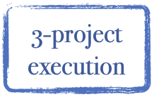




BPP
BVA
5-Developing HPJOMP
6- Developing PJOMP
4-PCI
source: designed and developed by Dr.Mahmoud Ibrahim @2023

Slide 13
What is the Holistic Project Operations Management System
HPJOMS
It is a holistic, systematic process of identifying, designing, planning, directing, and controlling the human and other project operational capacity requirements of the project-fit technicality (PJFT) and the execution, monitoring, and controlling of its operational activities throughout its PCI procedures with the DFT during PLC to effectively meet stakeholder expectations and the BPP objective of delivering positive value (PVA) to sustain business success.

Slide 14
Some of the benefits of the HPJOMS
‘Deliver as promised’ by realistic expectation-setting through up-front
Holistically project definition, planning, and estimation;
Faster delivery through the reuse of common and known project
Applying HPMQS management processes;
Less ‘surprises’ during project execution, utilizing proactive project
management processes;
Improved customer satisfaction and less rework by delivering the right product or service, right, the first time.
The value can be quantified in a number of areas including:
      Improved performance of the overall project fulfillment and delivery process
      Improved estimating for future projects
      Validation of duration, cost, effort and quality objectives for the project
      Identification and communication of best practices
      Improved client satisfaction

Slide 15
The HPJOMS success factors
1- Designing an efficient PJFT
2-Monitoring ,assessing and controlling a superior PCI

Slide 16
The PJFT
.The definition of the PJFT
.The PJFT process
.The difference between the PJT and the PJFT

Slide 17
PJFT
(product of the HPJOMS)
It is the governance holistic process, procedures, and methods of how far the project performance and progress operations are fitting the PFS requirements and the selective project requirements and ensuring alignment with project objectives by delivering the most valuable project value to the business pain points (BPP).

Slide 18
The difference between the PJT &PJFT
 | Traditional Project technicality (PJT) | Project-fit technicality (PJFT)
1-The relationship between each other | Stand alone (in the box) | integrated with the HPMQS cycle and integrated with the pLC (Outbox )
2-Its project management plan | Managed by only the compilation criteria stated on the project charter in addition to the project execution plan | Managed by the PJOMP that integrated with the PLC and project plans
3-Its role with HPMQS | Very limited | Fully integrated with HPMQS

Slide 19
The difference between the PJT &PJFT
 | Traditional Project technicality (PJT) | Project-fit technicality (PJFT)
4-Definition | It is the governance process and procedures for project team performance of the project tasks in managing the project integration, with the limitation of balancing between the planned scope, planned ime, and planned cost. | It is the governance process, procedures, and methods of how far the project performance and progress are fitting the product-fit solution requirements and the selective project requirements and alignments with project objectives for delivering the most valuable project value to the business pain points (BPP).
5-Focusing 100% on | On the loop between scope, time, cost,cost and quality | Well-managing the efficiency of the "doing" project performance and the effectiveness of the “making” project progress to keep the project technicality on the right track
6-Managed by | Fully managed by project management | Managed by the HPJOM manager
7-Impact on project success | Minimizing the success rate of the project and confirming the dissatisfaction of the clients | Maximizing not only the project success rate but also the effectiveness of the project progress in delivering PVA

Slide 20
PJFT processes for having PVA
1- it is defined at the BPP and
2-its operational required identified at the prepare action phase from HPMQS
3-its capabilities requirements is design ing and developing at the HPJOMS first phase which is called (developing HPJOM),That fit to the both the designed PFS and the selective project structure and methodology .
4- developing PJOMP to be intergrated with DFT throughout the PLC ( the efficient ICP )
5- the first end after having transforming the readiness deliverable to the readiness deliverable
And the official ending to the HPJOMS after the official 100 % completed deliverable after the customers sign of the accepted deliverables (PFS)

Slide 21
PCI
Its definition
The Components of the PCI
The PCI transformation process
The transformation process efficiency levels between the resultant deliverables and the readiness deliverables

Slide 22
PCI
It is the transformation process of the resultant deliverable to the readiness deliverable by shifting the official approved informational decisions to execute operational decisions to effectively integrate the DFT with PJFT throughout the PLC to generate the positive (PVA).

Slide 23
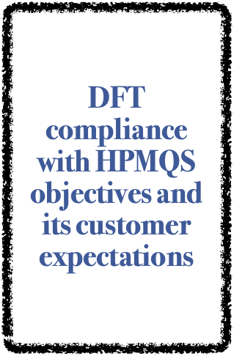
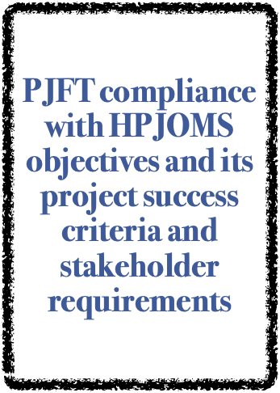

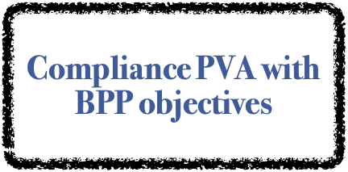
The Components of the PCI

Slide 24


The PCI transformation process
PJFT compliance
(HPMQA)
Accepted - Deliverables
(100% completed
deliverables)
PFS +PVA
PDQP
Resultant
deliverables
Readiness
deliverables
Project integration management
(performing the execution phase )
PJOMP
  DFT conformance
Designed and developed by Dr.Mahmoud.Ibrahim@2023

Slide 25


The transformation process efficiency levels between
the resultant deliverables and the readiness deliverables
Finished
+
DFT
poorPjT
Poor project results
Customers satisfaction
Project success
No PVA
Well designed DFT
Well planned PjFT
Excellent project results
Customers satisfaction
Project success
PVA
efficient transformation
Efficiency
Resultant-deliverables
Inefficient transformation
No DFT
poorPjT
Poor project results
Customers dissatisfaction
Project failed
No PVA
No DFT
poorPjT
Poor project results
Customers dissatisfaction
Project failed
No PVA
Inefficient transformation
Unfinished
-
Unfinished
-
Efficiency
Readiness - Deliverables
Finished
+
Designed and developed by DrMahmoud.Ibrahim@2023

Slide 26
The HPJOMS lifecycle

Slide 27
The section 1:the integration between the HPMQS and HPJOS
It is common between the HPMQS and the HPJMOS that the high-level project management baselines and their success requirements are defined, identified, designed, and planned for the DFT and PJFT of the project to ensure the delivery of PVA.

Slide 28









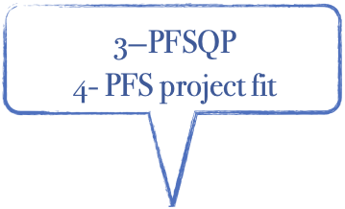
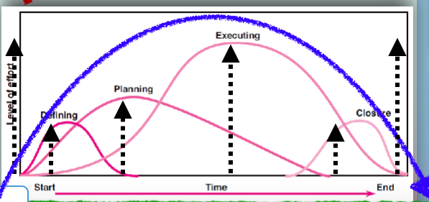











Developing
DFT & PJFT
Delivering
PVA
source: designed and developed by Dr.Mahmoud Ibrahim @2023

Slide 29
At the Preparation phase
1. Avoid overestimating the expectations of the BPP.
2. Confirm the well-designed project-fit technicality (PJFT) based on the right capacity requirements, including human skills, financial resources, and other resources that will be needed to perform the PJFT and its impact on the project progress, and then ensure the project management success.
3: Designing an effective integration between project monitoring and control during the execution phase based on the project management plan
4: Confirming the right availability of the technical skills
5-Ensuring efficient project operations planning and implementation that require continuous and open, effective collaboration between the core project team and the other project supporting teams

Slide 30
Section II (phase 1:developing HPJOM)
It's the first phase of the HPJOMS called HPJOM, which is:
1. Developing and structuring (tailoring) the project technical and operational capabilities of the required PJFT and its performance and progress operations
2.Metrics selection process that fits the PM objectives

Slide 31
Why do we need efficient Metrics
PJOMP metrics provide a more factual and quantitative basis for understanding how you are doing and the things that can be done better. Without at least some basic metric information, all discussions on performance and improvement are based on anecdotal evidence, perceptions, and guesses. If you want your project's success or failure to be based on factual information, you need to determine the success criteria ahead of time and how to measure these criteria. Then collect the metrics, even if they are imperfect and imprecise. They still provide a better foundation than recollections, perceptions, and guesses.

Slide 32
Project Performance operation
Performance metrics are monitored, analyzed, and used to make data-driven decisions.
The metrics help project managers:
1-identify the operational risks,
2- assess project health, and
3- take proactive measures to ensure project success.

Slide 33
Project Progress operation
The knowledge gained from progress control metrics can contribute to the overall assessment of project performance. By effectively tracking and controlling the project's progress using progress control metrics, project managers can improve their chances of achieving the desired outcomes evaluated by project performance measure metrics.

Slide 34
Section III (2nd phase: PJOMP)
Implenteting the PJOMP throughtout the PLC and intergrated with PDQP and its DFT to get the Positive PCI

Slide 35
Section IV: (4th phase PCI )
Implementing the PJOMP throughout the PLC and integrating it with PDQP and its DFT to get the positive PCI

Slide 36
Project operations management plan
(POMP)
It provides a framework for the structure, processes, and procedures for planning, executing, monitoring, and controlling PJFT, ensuring that it is carried out in alignment with project objectives.
.PJOMP is a vital component of the comprehensive project management plan, supporting the overall success of the project and the project management .

Slide 37
The major benefit of PJOMP
It aligns with and supports the overall project management plan by providing detailed strategies, processes, and procedures for efficiently executing project operations.
It ensures that project performance and project progress operational tasks and activities are carried out efficiently and effectively, contributing to the successful completion of the project and delivering PVA.

Slide 38
Section V : ( transformation phase )
At the end of the project execution phase, the transformation of the resultant deliverables to the readiness deliverable is completed, and the customer signs off on the readiness deliverable and has PVA.

Slide 39
Section VI :Closing BPP
The post-impact review after transformation of the PVA to BVA and closing effectively BPP
(sustainable business success)

