Slide 1

Chapter 7
Everyone’s Smart
University
Leadership and
Resolving Conflict
PMG511
Project Leadership
Dr.Sara Adel

Slide 2


Learning Outcomes:
    7.1 Definition of Conflicts .
    7.2 Organizational Conflict Is Beneficial Or Not?
    7.3 Definition of Conflict resolution.
    7.4 How Leaders Effectively Manage Conflict.
    7.5 Sources Of Project Conflict .
    7.6 What Causes Team Conflict?
    7.7 Conflicts Arise from Differing Needs .
    7.8 Symptoms of Team Conflict .
    7.9 Conflict-resolution Techniques.
    7.10 Thomas-Kilmann Conflict Mode Instrument
    7.11 Leaders’ Keys To Resolving Conflict.
    7.12.Summary and Conclusions.
    7.13 Self Assessment.
Dr.Sara Adel

Slide 3
7.1 Definition of Conflicts
Dr.Sara Adel

Slide 4
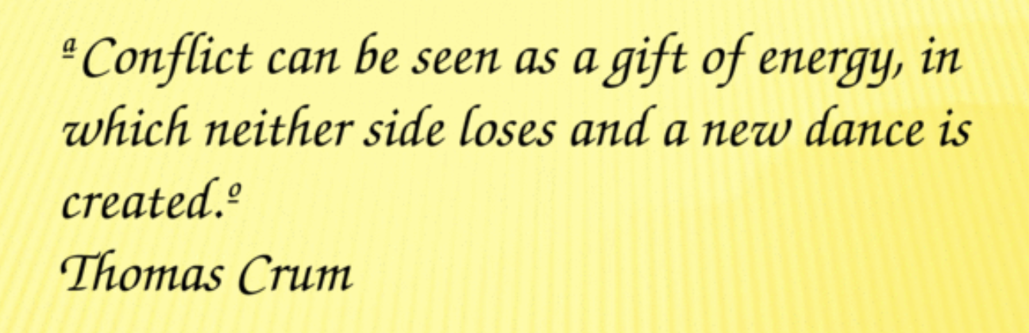
Dr.Sara Adel

Slide 5
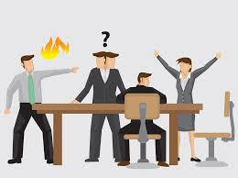
What is Conflict?
Conflict is a natural ingredient in every organization.
The ability to manage conflict is considered to be a core leadership competence and can help project teams to grow and advance. However, conflict management is one of the most difficult soft skills that someone can master and develop.
Dr.Sara Adel

Slide 6
7.2 Organizational Conflict Is Beneficial Or Not?
Dr.Sara Adel

Slide 7

Understanding Conflict:
Conflict is normal and healthy (if managed appropriately).
Conflict arises from differences.
Conflict can either stimulate or hinder progress, growth, and productivity.
Conflict that is mismanaged can derail leaders and limit their efficacy.
Conflict can not and should not be avoided forever.
Leaders have ways in which they prefer to handle or resolve conflict.
Dr.Sara Adel

Slide 8
GOOD conflict:
Produces new ideas.
Solves continuous problems.
Gives opportunity for people to expand skills
Allows creativity, and
Improves performance.
BAD conflict:
Lowers team energy or morale.
Reduces productivity.
Prevents job accomplishment.
Creates destructive behavior, and
Fosters poor performance.
Dr.Sara Adel

Slide 9
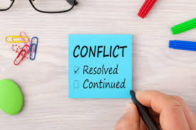
write down 10 words related to “conflict”..
Dr.Sara Adel

Slide 10
7.3 Definition of Conflict resolution
Dr.Sara Adel

Slide 11

What is Conflict resolution?
- Conflict resolution is a daily occurrence at work that can either propel or disrupt the momentum for a leader, a team or the entire organization.
- The workplace can become a toxic environment when leaders allow conflict to fester rather than confront it head-on. Managing conflict can be a tricky thing – especially when you are not familiar with the larger ecosystem in which the particular individual or department creating the conflict, and how efforts to resolve conflict will reverberate throughout that ecosystem.
Dr.Sara Adel

Slide 12
7.4 How Leaders Effectively Manage Conflict
Dr.Sara Adel

Slide 13

Leaders Effectively Can Manage Employee Conflict
An effective leader builds teams that work well together.
As a leader, he facilitate the resolution of conflicts that distract the team members, decrease productivity, destroy motivation and lead frustration and anger.
Dr.Sara Adel

Slide 14
In order to understand team members’ leaders need to differentiate between a motivational / situation model and a behavioral model of each member.
The behavioral model focuses on patterns of behavior and characteristic traits that define a specific type of personality—this model is recognizing what someone does based on his or her personality.
The motivational / situation model looks behind behavior to understand what are the factors that drive behavior (situation)—this model is recognizing why someone is likely to do something based on his motivational value.
Dr.Sara Adel

Slide 15
7.5 Sources Of Project Conflict
Dr.Sara Adel

Slide 16
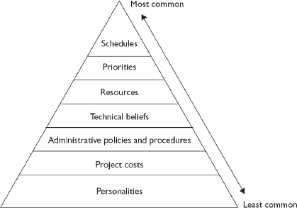
According to Thamhain and Wilemon (1975), the seven major sources of project conflict and team disagreements are (sorted by significance are)
Dr.Sara Adel
Notes:
.

Slide 17
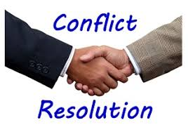
Based on research by Thamhain and Wilemon (1975), there are seven major sources of project conflict and team disagreements are:
Personalities.
Project costs.
Administrative policies and procedures.
Technical beliefs and performance trade-offs.
Manpower resources.
Project Priorities.
Schedules.
Dr.Sara Adel

Slide 18
In the organizational set up, there seems to be conflict among the managers, subordinates, team members and others also.
Sources of interpersonal conflict:
  Personal differences: Everyone is unique. Family background, culture, values and so many indicators vary from one person to another. So, conflict may arise. There exists individual difference where intelligence, ability, attitude, motivation vary from one person to others.
  Information deficiency: There seems to be indication of communication gap and also there seems to be indication of misinformation.
  Role incompatibility: This type of interpersonal conflict mainly draws from both intra-individual role conflict and inter-group conflict.
Dr.Sara Adel

Slide 19
  Environmental stress: This is mainly due to stressful environmental condition. Here downsizing, competition, uncertainty.
  Besides this there exists inter-group conflict in any organizational set up. The reasons are mainly as follows:
  Competition for resources
  Task interdependence
  Status struggle
Dr.Sara Adel

Slide 20
7.6 What Causes Team Conflict?
Dr.Sara Adel

Slide 21
What Causes Team Conflict?
Team conflict can be cause by various factors. Some of these factors include:
Poor communication or no communication;
Lack of problem solving skills or getting to “root cause”;
Lack of clarity in purpose, goals, objectives, team & individual roles;
Uncertainty/lack of resources and sources for help and support;
Poor time management;
Lack of leadership and management;
Team members bored, not challenged, not really interested;
Lack of skills and abilities in team members;
Personality conflicts;
Personal problems; and
High turnover rates .
Dr.Sara Adel

Slide 22
7.7 Conflicts Arise from Differing Needs
Dr.Sara Adel

Slide 23
Everyone needs to feel understood, and supported, but the ways in which these needs are met vary widely.
Differing needs for feeling comfortable and safe create some of the most severe challenges in our personal and professional relationships.
It is important to acknowledge that both parties’ needs to play important roles in the long-term success of team members relationships, a lack of understanding about differing needs can result in distance, arguments, and conflicts,
Build a trust, To feel secure.
Dr.Sara Adel

Slide 24
7.8 Symptoms of Team Conflict
Dr.Sara Adel

Slide 25
Symptoms of Team Conflict
The typical symptoms of team conflict are the following:
Absenteeism
Complaining
Filing lawsuits
Finger pointing
Gossiping
Hiding information that should be shared
Dr.Sara Adel
Notes:
.

Slide 26
The typical symptoms of team conflict are the following (CONT.)
Not attending required meetings
Not completing work on-time or to quality goals
Not responding to requests for information
Not returning phone calls or e-mails
Passive/aggressive behavior
Physical violence
Verbal abuse
Dr.Sara Adel

Slide 27
7.9 Conflict-resolution Techniques / Approaches
Dr.Sara Adel
Notes:
.

Slide 28
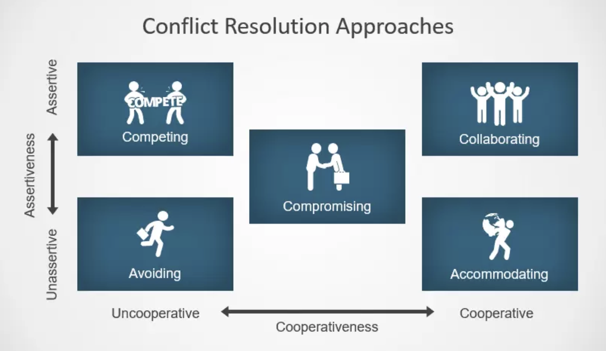
The Thomas-Kilmann conflict mode instrument
Dr.Sara Adel

Slide 29
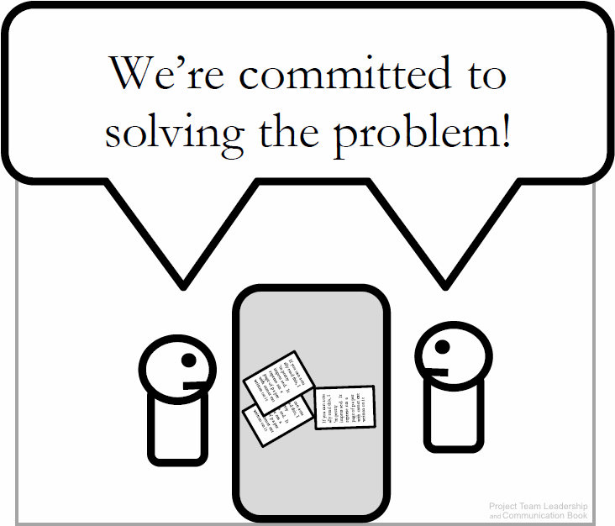
1- Confronting / Problem Solving
The optimal solution, following a standard problem-solving process:
  Define the real/root problem
  Analyze the problem
  Identify solutions
  Choose a solution (this can be difficult)
  Implement a solution
  Review the solution, and confirm that it solved the problem and repeat if necessary
Often takes the longest – not appropriate if deadlines are tight.
Dr.Sara Adel
Diagram: Malachowsky, Samuel. Project Team Leadership and Communication. Lintwood Press. 2018. p. 128.

Slide 30
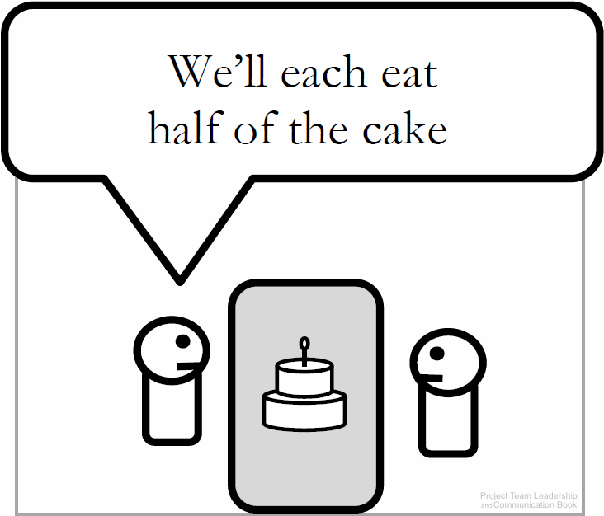
2- Compromising
Each party makes concessions to the other, and a mutually-accepted conclusion is reached.
Works best with issues that can be divided.
Is often the quickest solution.
May result in a ‘lose-lose’ situation because everyone gets only a subset of what they want.
Dr.Sara Adel
Diagram: Malachowsky, Samuel. Project Team Leadership and Communication. Lintwood Press. 2018. p. 128.

Slide 31
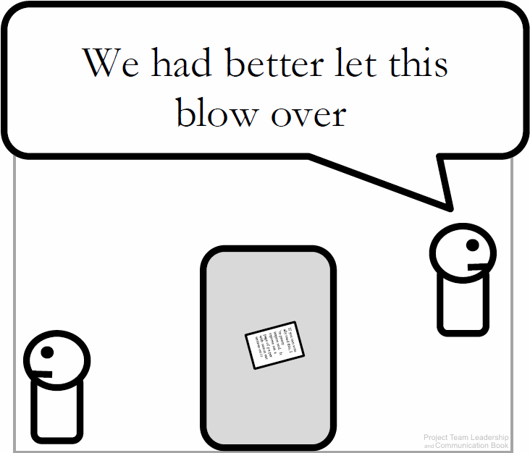
3- Withdrawal / Avoidance
One or more parties choose to withdraw from or avoid the other to end or delay the conflict.
Useful when debate is trivial or emotions are high.
May be needed until an authority can intervene.
Often doesn’t directly solve the conflict.
Dr.Sara Adel
Diagram: Malachowsky, Samuel. Project Team Leadership and Communication. Lintwood Press. 2018. p. 129.
Notes:
.

Slide 32
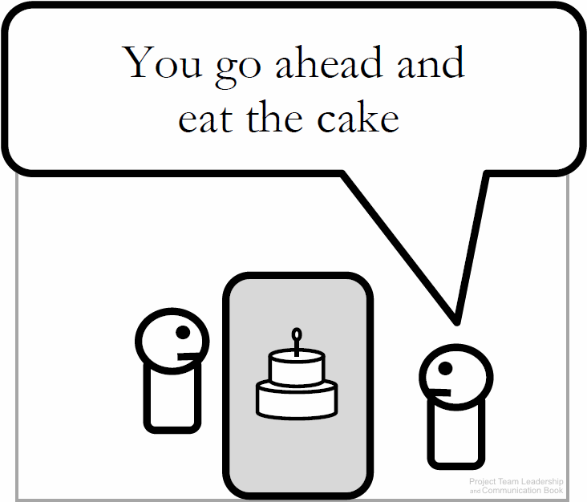
4- Smoothing / Accommodating
One party concedes, giving the other the ‘win’.
Useful when the issue is clearly more important to one party or satisfying one party is important to the overall success of the project.
Can delay conflict, as the accommodating party may change their mind and the disagreement still is in place.
Potential for abuse of the situation is present.
Dr.Sara Adel
Diagram: Malachowsky, Samuel. Project Team Leadership and Communication. Lintwood Press. 2018. p. 129.

Slide 33
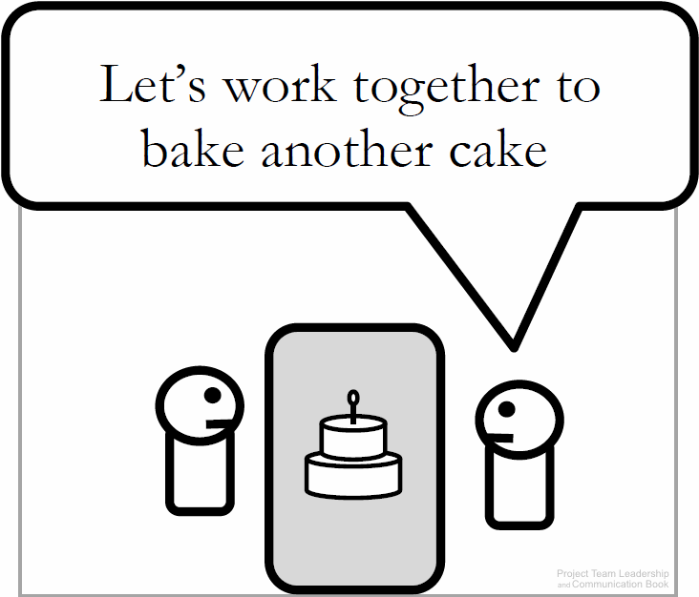
5- Collaborating
Parties work together to find a mutually-acceptable solution, often a previously-unconsidered third option.
Considered to be an optimal solution to most conflicts.
Takes longer than most techniques.
If parties don’t trust each other, collaborating is nearly impossible.
Dr.Sara Adel
Diagram: Malachowsky, Samuel. Project Team Leadership and Communication. Lintwood Press. 2018. p. 129.

Slide 34
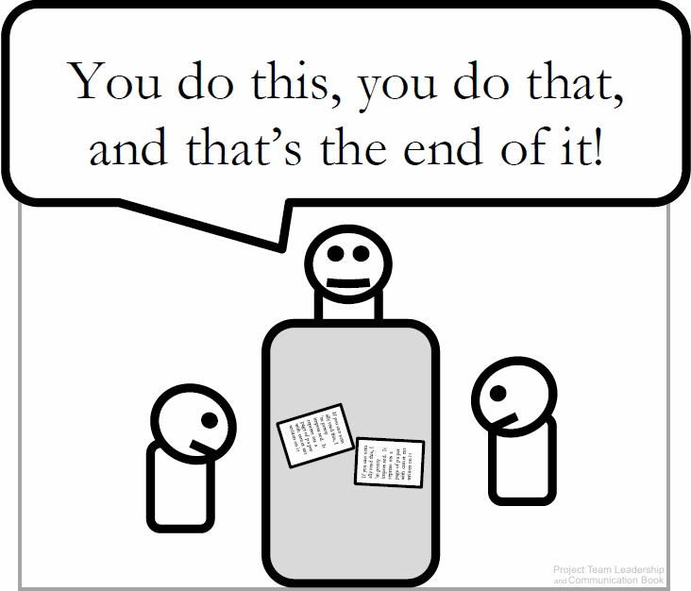
6- Forcing
Authority figure resolves the conflict/makes the decision, forcing all parties to end their conflict.
Effective when the conflict is petty, unimportant, or one party’s opinion is unethical.
Often used as a last-resort.
May not resolve the conflict, which can reappear at another time in the future.
Dr.Sara Adel
Diagram: Malachowsky, Samuel. Project Team Leadership and Communication. Lintwood Press. 2018. p. 130.
Notes:
.

Slide 35
7.10 Thomas-Kilmann Conflict Mode Instrument
Dr.Sara Adel

Slide 36
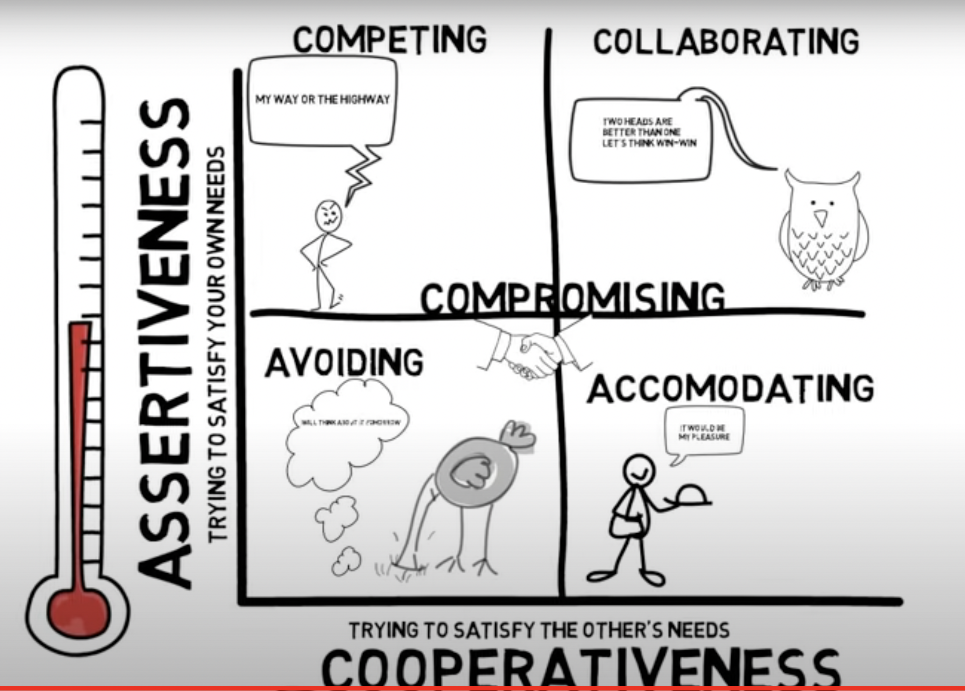
Dr.Sara Adel

Slide 37
The Thomas-Kilmann conflict mode instrument was developed by K. W. Thomas and R. H. Kilmann (1974, 2000).
According to Thomas-Kilmann conflict mode instrument:
Competing/ Forcing is a win-lose resolution technique.
Collaborating is a win-win resolution technique.
Compromising is a lose-lose resolution technique.
Avoiding is a lose-lose resolution technique.
Accommodating is a lose-win resolution technique.
Dr.Sara Adel

Slide 38
Types of Conflict Resolutions
Whatever conflict we have, there are only three types of conflict resolutions:
Win-Win: | To reach a solution acceptable to anyone
Lose-Lose: | Everyone gets something that does not accomplish the goals
Win-Lose: | Power struggle where one party wins
Dr.Sara Adel

Slide 39
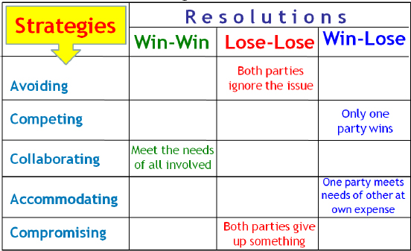
Comparing the conflict strategies from the one side and the conflict resolutions from the other side, we have the following two-dimensions table:
Dr.Sara Adel

Slide 40
7.11 Leaders’ Keys To Resolving Conflict
Dr.Sara Adel

Slide 41
Leaders Effectively Can Manage Any Conflict
Leaders must ensure they continuously communicate with their team as well as articulate a vision.
Leaders must act responsibly to be respected.
Leadership is not a popularity contest; it is a serious responsibility that primarily involves developing and guiding the full potential in people, teams and the organization at-large.
An important part in the process of developing potential is knowing how to see conflict and when to seize the opportunity within the conflict before healthy tension turns into overly disruptive matter.
Dr.Sara Adel

Slide 42
Keys To Resolving Conflict by leaders:
Act Responsibly.
A leader must act responsibly when handling conflict. If the leader is not responsible, respect for the leader may be affected.
Good self-control:
This is an important prerequisite in resolving conflicts. Though one may be highly tensed up and unwilling to listen to anybody other than having their own way during a conflict, .
Dr.Sara Adel
Notes:
.

Slide 43
Patient listener:
Another good qualification is to be a patient listener and assess the problem realistically without getting emotional or biased.
To have a give and take attitude:
If you are really interested in resolving a conflict and having lasting peace, as happens a good conflict resolution strategies.
Dr.Sara Adel
Notes:
.

Slide 44
Right Timing
Leaders who avoid conflict at all cost will find themselves regretting it later. Timing is everything when it comes to managing conflict, and the best time to take action is when there is hard evidence/proof that an employee has a track record of wrongdoing that is negatively impacting the performance of others.
Know Your Boundaries
Conflict can become something much more complicated and unmanageable if you don’t know the limitations and boundaries of your employees.
Dr.Sara Adel
Notes:
.

Slide 45
Respect Differences
Rather than impose your influence, hierarchy or rank – respect the unique differences in people and learn to see things from differing points of view Conflict resolution is rarely black and white. In fact, there are more and more grey areas.
Confront the Tension
Leadership is often about doing the things that most other people don’t like doing. Conflict resolution is one of those things – but as leaders we must confront the tension head-on. Don’t wait, but rather activate your leadership to address the conflict before circumstances force your hand.
Dr.Sara Adel

Slide 46
Identify a goal.
The leader must be careful when addressing only one person’s point of view. The leader must gather information, develop their own self-awareness, and be ready for the unexpected.
Dr.Sara Adel

Slide 47
Make conflict resolution the priority rather than winning or “being right”
Maintaining and strengthening the relationship, rather than “winning” the argument, should always be your first priority.
Focus on the present, focus on what you can do in the here and how to solve the problem.
Dr.Sara Adel

Slide 48
7.12 Summary and Conclusions
Dr.Sara Adel

Slide 49
Summary and Conclusions
Conflict is a natural ingredient in every organization.
The ability to manage conflict is considered to be a core leadership competence and can help project teams to grow and advance.
The workplace can become a toxic environment when leaders allow conflict to fester rather than confront it head-on.
Based on research by Thamhain and Wilemon (1975), there are seven major sources of project conflict and team disagreements.
conflict-resolution techniques.
Leaders’ Keys To Resolving Conflict.
Dr.Sara Adel

Slide 50
7.13 Self Assessment.
Dr.Sara Adel

Slide 51

Self Assessment
1- Explain: Conflict is a normal and necessary part of healthy relationships.
Dr.Sara Adel

Slide 52
Self Assessment
Activity 1– Conflict Management
Consider the following scenario:
Finley and Blair have worked well together in the past, but the new project has increased stress levels significantly. The last week has been particularly difficult – the next phase is about to begin and their disagreement on which toolset to implement must be resolved – the choice will affect the entire 5-month phase!
For each conflict management technique (Confronting, Compromising, Withdrawal, Smoothing, Collaborating, and Forcing), answer the following questions:
How could the parties use the technique?
What are the potential advantages and positive outcomes of the technique?
What are potential disadvantages and negative outcomes of the technique?
Dr.Sara Adel

Slide 53
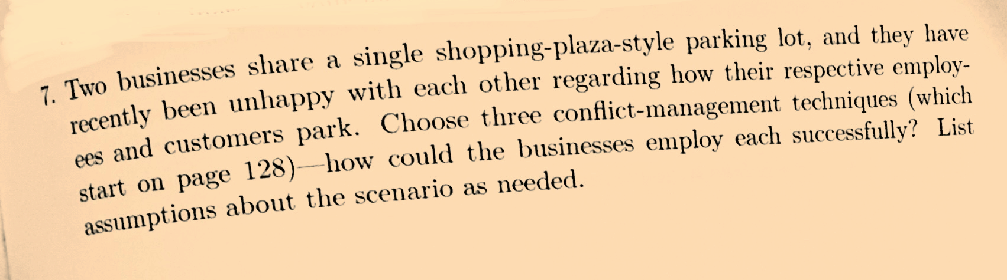
Self Assessment
Activity 2– Conflict Management
Dr.Sara Adel

Slide 54
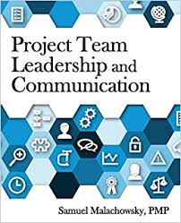
Resources:
Duggan, T. (2017, November 21). Leadership Vs. Conflict Resolution. Retrieved from https://smallbusiness.chron.com/leadership-vs-conflict-resolution-10581.html
Jr., J. D. (2018, September 11). The Art Of Conflict Resolution Among Leadership. Retrieved from council/2018/03/22/the-art-of-conflict-resolution-among-leadership/#7dc420261bd6
Llopis, G. (2014, November 28). 4 Ways Leaders Effectively Manage Employee Conflict. Retrieved from /4-ways-leaders-effectively-manage-employee-conflict/#712ba1305e15.
Giotis, T. C. (2010). Leadership through conflict: grow and advance project teams! Paper presented at PMI® Global Congress 2010—EMEA, Milan, Italy. Newtown Square, PA: Project Management Institute.
Project Team Leadership and Communication by Samuel Malachowsky, 2018.
Dr.Sara Adel

Slide 55
THANKS!
Dr.Sara Adel

