Slide 1

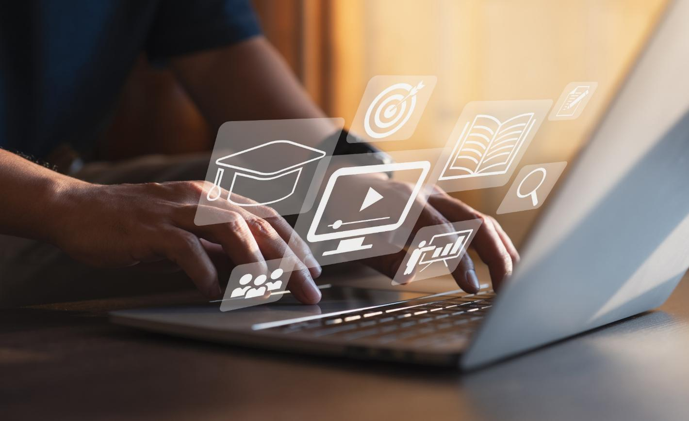

Digital Media
Lecture 09
LAW 614
English Language for Digital Law
Prepared by
Samara Jasim
midocean.edu.com

Slide 2


Lecture
09
INTRODUCTION
DEFINITION AND EVOLUTION
Today, we embark on a journey into the realm of digital media, a cornerstone of the modern information age. At its core, digital media refers to the myriad forms of content that exist in the digital realm.
midocean.edu.km

Slide 3
Lecture
09
INTRODUCTION
DEFINITION AND EVOLUTION
This includes everything from text, images, audio, and video to interactive experiences that are stored, transmitted, and accessed through electronic devices and networks. The seamless blending of these various content types has transformed the way we consume, create, and share information.
midocean.edu.km

Slide 4
Lecture
09
INTRODUCTION
DEFINITION AND EVOLUTION
In our digital age, the evolution of media has been remarkable. We have witnessed the transition from traditional forms of communication, such as newspapers and radio, to the dynamic landscape of digital media.
midocean.edu.km

Slide 5
Lecture
09
INTRODUCTION
DEFINITION AND EVOLUTION
This shift has been driven by the rapid advancements in technology, particularly the rise of the internet and the proliferation of smartphones and other connected devices. This transformation has not only revolutionized how we communicate but has also introduced new challenges and opportunities in the realm of law.
midocean.edu.km

Slide 6
Lecture
09
INTRODUCTION
DEFINITION AND EVOLUTION
Digital media's impact is profound, as it transcends geographical boundaries and temporal constraints. The speed at which information can be disseminated across the digital landscape is unparalleled, granting individuals the power to connect, collaborate, and communicate with a global audience instantly. This democratization of communication, while empowering, also raises crucial legal considerations.
midocean.edu.km

Slide 7
Lecture
09
INTRODUCTION
DEFINITION AND EVOLUTION
As we delve deeper into this exploration, keep in mind that digital media isn't limited to a single format. It consists of an array of content types that span textual articles, visual imagery, captivating videos, interactive animations, and even immersive experiences like virtual reality. This multifaceted nature of digital media has created a new era of engagement and interactivity, necessitating a legal framework that can effectively navigate these complexities.
midocean.edu.km

Slide 8

Lecture
09
INTRODUCTION
TRADITIONAL TO DIGITAL MEDIA
To comprehend the significance of digital media in the realm of digital law, it's imperative to trace its roots back to the historical evolution from traditional media forms. This journey through time offers us insights into how technological advancements have shaped the landscape of communication and information dissemination.
midocean.edu.km

Slide 9
Lecture
09
INTRODUCTION
TRADITIONAL TO DIGITAL MEDIA
Before the advent of digital media, the world relied heavily on what we now refer to as traditional media. This encompassed mediums such as newspapers, magazines, radio broadcasts, and television.
midocean.edu.km

Slide 10
Lecture
09
INTRODUCTION
TRADITIONAL TO DIGITAL MEDIA
These forms of communication were characterized by their one-way nature, where information was disseminated from a few centralized sources to a passive audience. Control over content creation and distribution was tightly held by media conglomerates, limiting the diversity of voices and perspectives.
midocean.edu.km

Slide 11
Lecture
09
INTRODUCTION
TRADITIONAL TO DIGITAL MEDIA
The catalyst for change arrived with the proliferation of the internet in the late 20th century. This transformative technology laid the foundation for the gradual shift from traditional to digital media.
midocean.edu.km

Slide 12
Lecture
09
INTRODUCTION
TRADITIONAL TO DIGITAL MEDIA
The internet's decentralized structure and accessibility revolutionized the way information was produced, shared, and consumed. Suddenly, individuals had the power to become content creators, blurring the lines between producers and consumers of information.
midocean.edu.km

Slide 13
Lecture
09
INTRODUCTION
TRADITIONAL TO DIGITAL MEDIA
The rise of digital media platforms like blogs, social media networks, and online news portals marked a turning point. These platforms empowered users to share their thoughts, opinions, and experiences on a global scale, bypassing the traditional gatekeepers of information.
midocean.edu.km

Slide 14
Lecture
09
INTRODUCTION
TRADITIONAL TO DIGITAL MEDIA
This democratization of content creation led to an expansion of diverse perspectives and real-time interactions, fundamentally altering the dynamics of communication.
midocean.edu.km

Slide 15
Lecture
09
INTRODUCTION
TRADITIONAL TO DIGITAL MEDIA
The radical transformation towards digital media didn't merely impact content creation and distribution; it also revolutionized the nature of engagement. The interactivity offered by digital media platforms fostered a sense of community and engagement that was previously unimaginable with traditional media. Audiences became active participants, reshaping the narrative, and challenging established norms.
midocean.edu.km

Slide 16
Lecture
09
INTRODUCTION
TRADITIONAL TO DIGITAL MEDIA
As we navigate the intricate web of digital law in the realm of digital media, understanding this historical context becomes pivotal. The evolution from traditional media to digital media has profound implications for intellectual property, privacy, free speech, and platform liability.
midocean.edu.km

Slide 17
Lecture
09
INTRODUCTION
TRADITIONAL TO DIGITAL MEDIA
By tracing this trajectory, we gain valuable insights into the challenges and opportunities that lay ahead, enabling us to craft a legal framework that aligns with the dynamic nature of digital communication.
midocean.edu.km

Slide 18
Lecture
09
INTRODUCTION
THE IMPORTANT ROLE OF DIGITAL MEDIA
As we explore further into the complexity of digital media within the framework of digital law, it's essential to recognize the profound role that digital media plays in shaping the information landscape, molding public opinions, and catalyzing dynamic public discourse.
midocean.edu.km

Slide 19
Lecture
09
INTRODUCTION
THE IMPORTANT ROLE OF DIGITAL MEDIA
Digital media stands as a formidable force in spreading information. With the rise of the internet and the expansion of digital platforms, information can now be shared globally within seconds, transcending geographical boundaries.
midocean.edu.km

Slide 20
Lecture
09
INTRODUCTION
THE IMPORTANT ROLE OF DIGITAL MEDIA
News, articles, research findings, and personal narratives find their way into the digital realm, creating a vast repository of knowledge accessible to anyone with an internet connection.
midocean.edu.km

Slide 21
Lecture
09
INTRODUCTION
THE IMPORTANT ROLE OF DIGITAL MEDIA
The democratization of information through digital media empowers individuals, enabling them to access diverse viewpoints and engage with topics of interest on a scale that was previously unimaginable.
midocean.edu.km

Slide 22
Lecture
09
INTRODUCTION
THE IMPORTANT ROLE OF DIGITAL MEDIA
Online news portals, blogs, podcasts, and social media platforms act as conduits, allowing both mainstream and marginalized voices to contribute to the ever-expanding conversation.
midocean.edu.km

Slide 23
Lecture
09
INTRODUCTION
THE IMPORTANT ROLE OF DIGITAL MEDIA
However, with this power comes the responsibility to critically evaluate the information we encounter. The ease of content creation and distribution in the digital space can also give rise to misinformation, rumours, and the spread of false narratives.
midocean.edu.km

Slide 24
Lecture
09
INTRODUCTION
THE IMPORTANT ROLE OF DIGITAL MEDIA
As digital law professionals, it becomes our duty to discern the veracity of information and ensure that legal mechanisms are in place to address the potential harm caused by misinformation.
midocean.edu.km

Slide 25
Lecture
09
INTRODUCTION
THE IMPORTANT ROLE OF DIGITAL MEDIA
One of the most transformative aspects of digital media lies in its ability to shape opinions and influence public discourse. Social media platforms, for instance, have evolved into dynamic arenas where conversations around political, social, and cultural issues unfold in real time.
midocean.edu.km

Slide 26
Lecture
09
INTRODUCTION
THE IMPORTANT ROLE OF DIGITAL MEDIA
Hashtags, trending topics, and viral content can propel ideas from obscurity to the forefront of public attention, driving conversations and even impacting policy decisions.
midocean.edu.km

Slide 27
Lecture
09
INTRODUCTION
THE IMPORTANT ROLE OF DIGITAL MEDIA
The role of digital media in influencing public discourse isn't limited to news and politics. It extends to cultural phenomena, marketing campaigns, and advocacy efforts. Brands, organizations, and individuals leverage digital media to engage audiences, share narratives, and foster a sense of community.
midocean.edu.km

Slide 28
Lecture
09
INTRODUCTION
THE IMPORTANT ROLE OF DIGITAL MEDIA
This dynamic interaction between creators and consumers shapes the cultural zeitgeist, underscoring the power of digital media to reflect and mould societal norms.
midocean.edu.km

Slide 29
Lecture
09
INTRODUCTION
THE IMPORTANT ROLE OF DIGITAL MEDIA
As we navigate the multifaceted landscape of digital media within the realm of digital law, it is imperative to strike a balance between the freedom of expression inherent in digital platforms and the ethical responsibilities associated with information dissemination.
midocean.edu.km

Slide 30
Lecture
09
INTRODUCTION
THE IMPORTANT ROLE OF DIGITAL MEDIA
The legal framework must address issues of copyright, privacy, defamation, and the regulation of digital platforms to ensure that the influence of digital media is wielded responsibly and ethically.
midocean.edu.km

Slide 31

Lecture
09
INTRODUCTION
TYPES AND FORMATS OF DIGITAL MEDIA
In our exploration of digital media's intricate relationship with digital law, we now turn our attention to the diverse and dynamic types and formats that constitute this vibrant digital landscape.
midocean.edu.km

Slide 32
Lecture
09
INTRODUCTION
TYPES AND FORMATS OF DIGITAL MEDIA
Textual Content:
Text remains a foundational pillar of digital media. From informative articles and thought-provoking blogs to concise social media posts, textual content remains the backbone of online communication.
midocean.edu.km

Slide 33
Lecture
09
INTRODUCTION
TYPES AND FORMATS OF DIGITAL MEDIA
It provides a platform for expressing ideas, conveying information, and engaging in meaningful discussions. The ease of sharing text online has democratized the creation and dissemination of written content, reshaping how we interact with information.
midocean.edu.km

Slide 34
Lecture
09
INTRODUCTION
TYPES AND FORMATS OF DIGITAL MEDIA
Visual Content:
Visual media transcends language barriers, conveying messages through images, graphics, and infographics.
midocean.edu.km

Slide 35
Lecture
09
INTRODUCTION
TYPES AND FORMATS OF DIGITAL MEDIA
Memes, for instance, have become a cultural phenomenon, expressing humor, social commentary, and even political opinions in a concise visual format. The rise of platforms like Instagram and Pinterest underscores the potency of visual storytelling, offering a canvas for creativity and self-expression.
midocean.edu.km

Slide 36
Lecture
09
INTRODUCTION
TYPES AND FORMATS OF DIGITAL MEDIA
Audio Content:
The resurgence of audio content is evident in the popularity of podcasts and music streaming platforms.
midocean.edu.km

Slide 37
Lecture
09
INTRODUCTION
TYPES AND FORMATS OF DIGITAL MEDIA
Podcasts offer a unique blend of education and entertainment, allowing listeners to engage with topics of interest during commutes, workouts, or leisure time. Music streaming platforms provide access to an extensive library of songs, catering to diverse musical tastes and preferences.
midocean.edu.km

Slide 38
Lecture
09
INTRODUCTION
TYPES AND FORMATS OF DIGITAL MEDIA
Interactive Content:
The digital realm opens doors to interactive experiences that engage users in unique ways. Online quizzes, surveys, and polls encourage participation and provide instant feedback.
midocean.edu.km

Slide 39
Lecture
09
INTRODUCTION
TYPES AND FORMATS OF DIGITAL MEDIA
Augmented reality (AR) and virtual reality (VR) push the boundaries of immersion, offering experiences that blend the real and the digital in ways previously unattainable.
midocean.edu.km

Slide 40
Lecture
09
INTRODUCTION
TYPES AND FORMATS OF DIGITAL MEDIA
Understanding these diverse forms of digital media is pivotal as we traverse the digital law landscape. Legal considerations extend beyond text to cover copyright protection for images, fair use principles for visual content, licensing for audio content, and privacy concerns within interactive experiences. Crafting an effective digital legal framework necessitates an appreciation for the multifaceted nature of digital media and its various formats.
midocean.edu.km

Slide 41
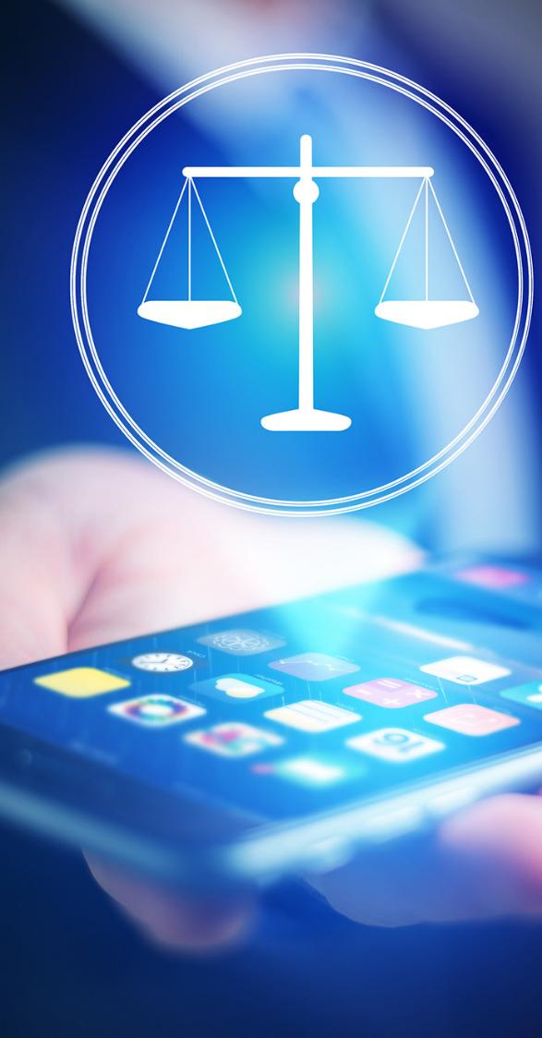
Lecture
09
INTRODUCTION
DIGITAL LAW & DIGITAL MEDIA
As we delve deeper into the intersection of digital media and digital law, it becomes evident that the digital landscape presents a myriad of legal implications and challenges that require careful consideration.
midocean.edu.km

Slide 42
Lecture
09
INTRODUCTION
DIGITAL LAW & DIGITAL MEDIA
Intellectual Property Rights (IPR) in Digital Media:
Digital media's accessibility and ease of distribution have reshaped the landscape of intellectual property. Copyright issues take centre stage as digital content is effortlessly reproduced, distributed, and adapted across the internet.
midocean.edu.km

Slide 43
Lecture
09
INTRODUCTION
DIGITAL LAW & DIGITAL MEDIA
The concept of fair use, allowing limited use of copyrighted material without permission, raises questions about the balance between protecting creators' rights and enabling freedom of expression.
midocean.edu.km

Slide 44
Lecture
09
INTRODUCTION
DIGITAL LAW & DIGITAL MEDIA
Privacy Concerns:
The vast amount of personal data collected by digital media platforms raises serious privacy concerns.
midocean.edu.km

Slide 45
Lecture
09
INTRODUCTION
DIGITAL LAW & DIGITAL MEDIA
User information is often used to personalize content, target advertisements, and even influence political opinions. Regulations like the General Data Protection Regulation (GDPR) in the European Union address these concerns by imposing strict guidelines on data collection, consent, and user rights.
midocean.edu.km

Slide 46
Lecture
09
INTRODUCTION
DIGITAL LAW & DIGITAL MEDIA
Defamation and Misinformation:
The rapid spread of information through digital media has amplified concerns about defamation and the spread of false information.
midocean.edu.km

Slide 47
Lecture
09
INTRODUCTION
DIGITAL LAW & DIGITAL MEDIA
Online platforms are grappling with the responsibility of moderating content and curbing the dissemination of harmful or false narratives. Striking a balance between the freedom of speech and responsible content dissemination poses a significant challenge.
midocean.edu.km

Slide 48
Lecture
09
INTRODUCTION
DIGITAL LAW & DIGITAL MEDIA
Cybersecurity and Digital Media:
As digital media platforms amass vast amounts of user data, they become prime targets for cyberattacks and data breaches.
midocean.edu.km

Slide 49
Lecture
09
INTRODUCTION
DIGITAL LAW & DIGITAL MEDIA
Hacking incidents can compromise personal information, leading to identity theft and other cybercrimes. Establishing robust cybersecurity measures and ensuring prompt data breach notifications are essential in safeguarding user information.
midocean.edu.km

Slide 50
Lecture
09
INTRODUCTION
DIGITAL LAW & DIGITAL MEDIA
Navigating these legal implications and challenges necessitates a comprehensive understanding of digital law. As digital law professionals, it is our responsibility to advocate for balanced legal frameworks that protect the rights of creators, users, and society at large. The dynamic nature of digital media calls for a nimble and adaptive legal approach that keeps pace with the ever-evolving digital landscape.
midocean.edu.km

Slide 51


Thank You

