Slide 1

CCNA (200-301) Cisco Certified Network Associate
Prepared by Eng. Taghreed Elsayed
Lecture 8
IPv6

Slide 2

Chapter
03
IP version 6
What is IPv6?
IPv6 is the most recent version of Internet Protocol (IP). It's designed to supply IP addressing and additional security to support the predicted growth of connected devices in IoT, manufacturing, and emerging areas.
Why use IPv6 vs IPv4?
The primary reason to make the change is due to IPv6 addressing. IPv4 is based on 32-bit addressing, limiting it to a total of 4.3 billion addresses.
IPv6 is based on 128-bit addressing and can support 340 undecillion, which is 340 trillion³ addresses. Having more addresses has grown in importance with the expansion of smart devices and connectivity.

Slide 3
Chapter
03
IP Version 6
IPv6 provides more than enough globally unique IP addresses for every networked device currently on the planet, helping ensure providers can keep pace with the expected proliferation of IP-based devices.
In addition to addressing, IPv6 benefits include:
Stateless address auto configuration
Optional NAT (Network Address Translation)
Easier administration with DHCPv6
Improved quality of service with flow labeling
Header length of 20 bytes in ipv4 whereas header length of ipv6 is 40bytes.

Slide 4
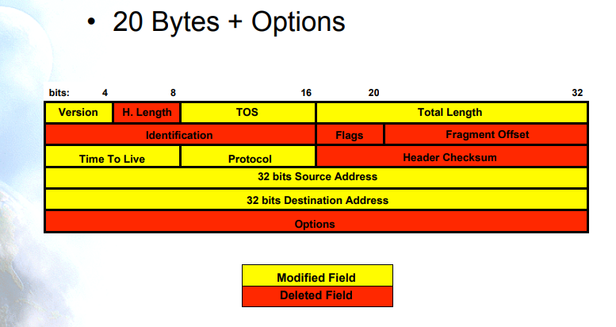
Chapter
03
Ip version 6
IPv4 Header Format

Slide 5
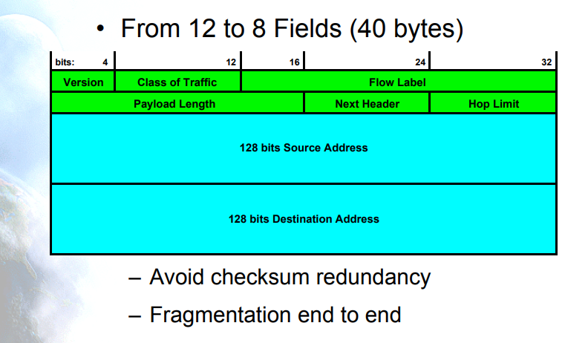
Chapter
03
IP Version 6
IPv6 Header Format

Slide 6
Chapter
03
IP version 6
Solution for IPv4 Reduction before using ipv6:
Use sub netting : companies and ISP does not use class A , B or C but use subnet from them.
Using NAT (Network Address Translation) :
Hosts inside network use only single registered IP called public IP to communicate with each other network.
While using a block of ip address called private ip for internal communication.

Slide 7
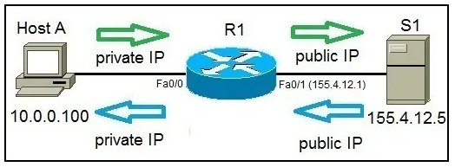
Chapter
03
IP Version 6

Slide 8
Chapter
03
IPv6
IPv6 writing
IPv6 consists of 128 bits
Written in hexadecimal in 32 digits
48(binary) =1 digit (hexadecimal)
For example:
FD00 : 1311 : AAAA : 0001 : 3413: 2222: 7713 : 1131
Every quartet consists of 16 bits or 4 hexadecimal digit
IPv6 consists of 8 quartets
Network
Interface ID
first quartet
eighth quartet

Slide 9
Chapter
03
IPv6
Compacting IPv6
Neglect all leading zero in any quartet:
EX: 2300 : 0001 : 3200 : 4111 : 0013 : 1112 : 3111
2300 : 1 : 3200 :4111 : 13 :1112 : 3111
2.Replace any number of continuous quartets contain all digit zero by[::] (only one time).
2300 :0000 :0000:1141 :0000: 0000: 0000:1111
:: 1141 :: 1111 X
2300 :: 1141 :0:0:0: 1111 √
2300:0:0: 1141 :: 1111 √

Slide 10
Chapter
03
IPv6
IPv6 Sub netting
IPv6 ➔ 2300 : AAAA : 1111 : 8913 : 1111 : 2222 : 3333 : 4444 /64
2300 : AAAA : 1111 : 8913 :: /64 ➔➔ Network id
IPv6 ➔ 2300 : AAAA : 1111 : 8913 : 1111 : 2222 : 3333 : 4444 /55

Slide 11
Chapter
03
IPv6
IPv6 Sub netting
2300 : AAAA : 1111 : 8800 :: /55 ➔➔ Network id
IPv6 ➔ 2300 : AAAA : 1111 : 8913 : 1111 : 2222 : 3333 : 4444 /55

Slide 12
Chapter
03
IPv6 Types
IPv6Types
This information shows the categories of different IPv6 address types, and explains the uses for each of them.
IPv6 addresses are categorized into these basic types:
1.Unicast address
The unicast address specifies a single interface. A packet sent to a unicast address destination travels from one host to the destination host.
The two regular types of unicast addresses include:

Slide 13
Chapter
03
IPv6
A- Local unicast address (Private IP)
FD00:: /8
1111 1101
B-Global unicast addresses(Public IP ) are designed for use on any network. The prefix used for a global address begins with binary 001
2000:: /3
0010→ 2xxx
0011→ 3xxx

Slide 14
Chapter
03
IPv6
C-There are two special unicast addresses defined:
1.Unspecified address
The unspecified address is 0:0:0:0:0:0:0:0. You can abbreviate the address with two colons (::). The unspecified address indicates the absence of an address, and it can never be assigned to a host. It can be used by an IPv6 host that does not yet have an address assigned to it. For example, when the host sends a packet to discover if an address is used by another node, the host uses the unspecified address as its source address.
2.Loopback address
The loopback address is 0:0:0:0:0:0:0:1. You can abbreviate the address as ::1. The loopback address is used by a node to send a packet to itself.

Slide 15
2.Multicast address
The multicast address specifies a set of interfaces, possibly at multiple locations. The prefix used for a multicast address is ff. If a packet is sent to a multicast address, one copy of the packet is delivered to each member of the group.
FF00:: /8
1111 1111
3. Link-local address
Link-local addresses are designed for use on a single local link (local network). Link-local addresses are automatically configured on all interfaces. The prefix used for a link-local address is FE80::/10. Routers do not forward packets with a destination or source address containing a link-local address.
Chapter
03
IPv6

Slide 16
Chapter
03
IPv6
3. Link-local address
Like APIPA assign ip address to any IPv6 enabled host.
Any coat used IPv6 have address on the following subnet:
FE80:: /64 → interface id → 64 bits
Using Mac address (48 bits ) and (FFFE) hexadecimal digits.
For example:
If we enable ip v6 in host with interface have the following Mac :
00-13-A1-31-4D-AF Network part→ Fe80 /64

Slide 17
00 31 : A1FF : FE 31 : 4D AF
7 ‘th bit from the left must be 1
0000 00 0 0
1 0 2 1 3 :A1FF : FE 31 : 4D AF
J
Chapter
03
IPv6
Part of Interface ID :
00 - 31 - A1 - 31 – 4D - AF

Slide 18
Chapter
03
IPv6 address assignment
IPv6 Assignment
Static Configuration
Write entire 128 bits with any prefix
Dynamic Configuration
Stateful DHCP
Stateless DHCP
EUI-64
1.Write network part with 64 bits
2.Host calculated with interface id
Mac address (48 bits)+(FFFE) 16 bits

Slide 19
Chapter
03
IPv6
Stateful DHCP
Configured like DHCPv4
Configuration include
ip address pool
Prefix /subnet mask
Default gateway ip
Preferred and alternative DNS
What ids the difference between DHCPV4 and DHCP v6

Slide 20
Chapter
03
IPv6
In DHCPv4 Discover packet use destination ip address 255.255.255.255 , so all hosts process this packet data but, only DHCP server replies .
In DHCPv6 Discover packet use FF02::2:1 which resend to DHCP server (Multi cast) so , all hosts know from the header if they complete the process of data if they are DHCP server
Or discard which reduce the processing on host .

Slide 21
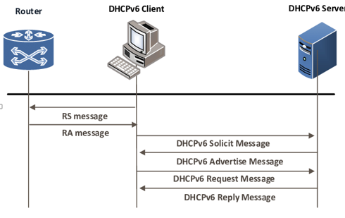
Chapter
03
Stateful DHCPv6

Slide 22
Chapter
03
IPv6
2. Stateless DHCP server
use EUI-64 to assign interface ID to host automatically
But the host used protocol called NDP (neighbor discovery protocol) to get the network address and default gateway ip.
NDP used two types of message :
1.RS: router solicitation
2.RA :router advertisement

Slide 23
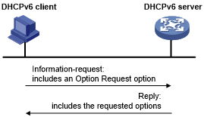
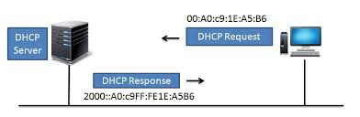
Chapter
03
Stateless DHCPv6

