Slide 1

Interaction Design (DGM 729)
Prepared by
Dr. Mohamed Owies
Lecture 4
Interaction Design(DGM 729)

Slide 2
Chapter 4
Professional Growth and Career Development in UX
Interaction Design

Slide 3

Lecture 4
Content
lecture 4 includes the following points:
Professional Communities
Continuing Education
Making a Case for Career Growth
Moving Out and On
If You Only Do One Thing

Slide 4

Lecture 4
Professional Communities
Be it formal or informal, having a community of like-minded professionals can be one of the most important things you do for your career. It will give you people you can learn from (or mentor), people you can share experiences and best practices with, and people to commiserate with, and can often lead to future job opportunities. Professional communities come in lots of different flavors.
Most professions have professional communities. These are third-party organizations that exist for the sole purpose of connecting professionals and advancing the cause of their field. There are several well-established professional communities that UX professionals can belong to.

Slide 5
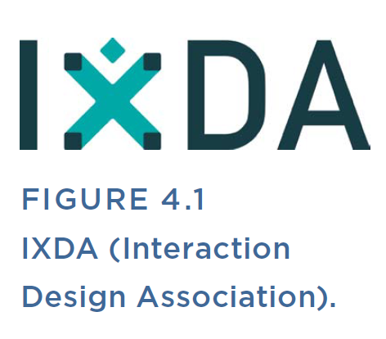
Lecture 4
Professional Associations
Members typically receive benefits, such as access to job listings, access to other members of the network, special publications of the professional community, discount rates at events and conferences, and access to community discussion lists.
IXDA (the Interaction Design Association) is dedicated to the field of interaction design, but judging by its vibrant discussion list, it covers all aspects of user experience design. With 20,000+ members, it’s an active global community(www.ixda.org/).

Slide 6
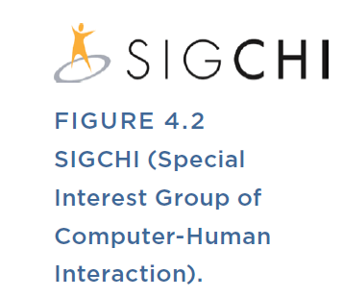
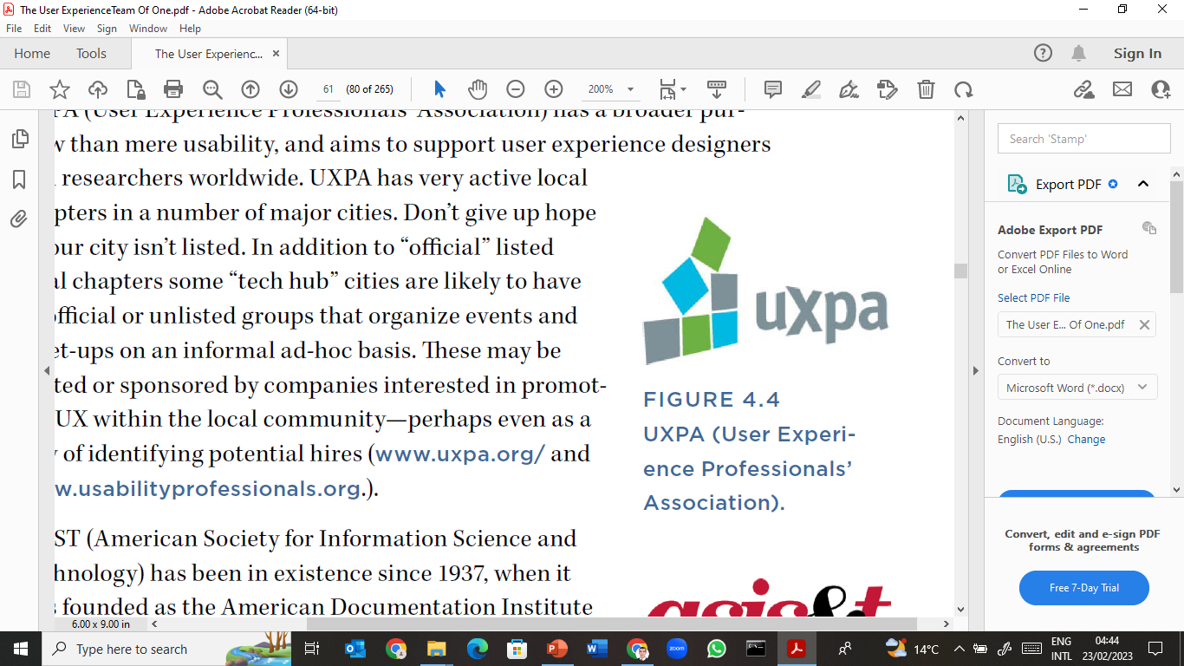
Lecture 4
Professional Associations
SIGCHI (Special Interest Group of Computer-Human Interaction) is a part of the ACM, or Association for Computing Machinery. This long-standing group has been around since the 1980s and tends to have a more academic focus than some of the other professional associations (www.sigchi.org/).
Known until recently as the Usability Professionals’ Association, the UXPA (User Experience Professionals’ Association) has a broader purview than mere usability and aims to support user experience designers and researchers worldwide. UXPA has very active local chapters in a number of major cities. (www.uxpa.org/ andwww.usabilityprofessionals.org.).

Slide 7
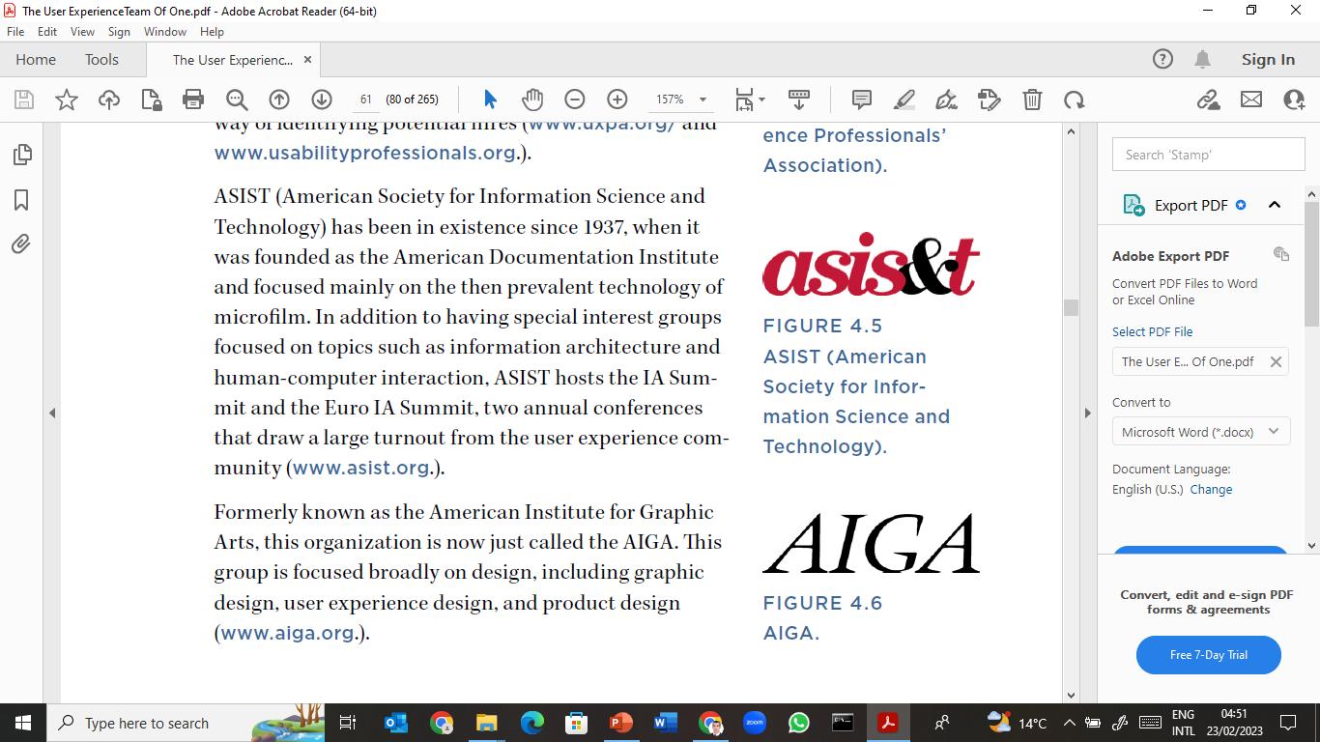
Lecture 4
Professional Associations
ASIST (American Society for Information Science and Technology) has been in existence since 1937, when it was founded as the American Documentation Institute and focused mainly on the then prevalent technology of microfilm. In addition to having special interest groups focused on topics such as information architecture and human-computer interaction, ASIST hosts the IA Summit and the Euro IA Summit, two annual conferences that draw a large turnout from the user experience community (www.asist.org.).
Formerly known as the American Institute for Graphic Arts, this organization is now just called the AIGA. This group is focused broadly on design, including graphic design, user experience design, and product design (www.aiga.org.).

Slide 8
Lecture 4
Discussion Lists and Online Communities
All of these professional associations have discussion lists that you can sign up for. For many people, discussion lists are the richest and most active resource that a professional community provides. Often, for a specific question or just a bit of perspective, the discussion thread will give you more ideas than you need. Many UX practitioners subscribe to these lists by email or through RSS feeds.
These are some popular discussion lists for user experience professionals:
IXDA: www.ixda.com/discussion
IA Institute: http://lists.iainstitute.org/listinfo.cgi/
iai-members-iainstitute.org/
SIGCHI: www.sigchi.org/connect/mailing-lists
Anthrodesign: http://groups.yahoo.com/group/anthrodesign
Stack Exchange: http://ux.stackexchange.com/

Slide 9
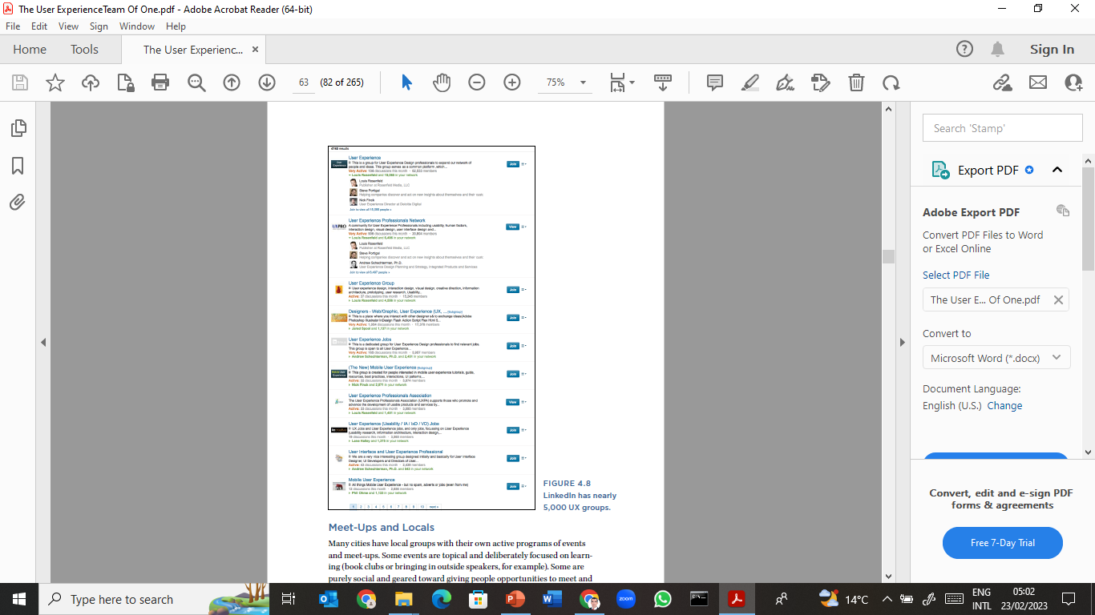
Lecture 4
Discussion Lists and Online Communities
Social networks can also be a good place to find an online discussion. LinkedIn has thousands (yes, thousands) of groups with a focus on UX (see Figure 4.8). Many of them are quite large. Do a search for “UX” in the groups section of LinkedIn to get started. witter can also be a great resource for connecting to others in the user experience community.

Slide 10
Lecture 4
Discussion Lists and Online Communities
toward lots of experienced UX practitioners who regularly tweet about the field. You’ll also find plenty of great general UX resources, such as UX companies, UX job lists, and feeds that aggregate the latest UX news and methods.

Slide 11

Lecture 4
Meet-Ups and Locals
Many cities have local groups with their own active programs of events and meet-ups. Some events are topical and deliberately focused on learning (book clubs or bringing in outside speakers, for example). Some are purely social and geared toward giving people opportunities to meet and mingle.
In either case, these are fantastic occasions to gain professional connections, talk shop, and trade war stories. To see if there are local chapters and events in your area, start with an Internet search. Or you may be able to find others in your area by posting to one of the discussion lists cited earlier.

Slide 12

Lecture 4
Consider Hosting a Local Meet-Up
Brian is a team of one who started a local IXDA chapter. He has found that in addition to putting him in touch with other UX professionals, it has actually sparked more interest in UX in his
organization. His current manager and his previous manager both now attend IXDA meetings with him, and he’s talking with his company about the possibility of sponsoring a future IXDA event.
This is a great approach because it not only makes you feel less isolated as a UX team of one, but it also helps your co-workers see that UX is part of a larger trend that goes well beyond the walls of your organization.

Slide 13
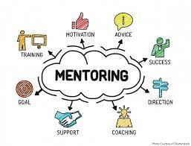
Lecture 4
Mentors and Buddies
Some professional associations offer mentorship programs, where you can pair up with someone who is more experienced and establish an ongoing relationship to seek guidance, wisdom, and periodic sanity checks. Or, if you’d like to share your own experiences to help another practitioner, you can volunteer as a mentor. Either way, you are guaranteed to learn more about how to balance perspective, people skills, and practical expertise. Again, check your professional association’s website to see if this service is offered.

Slide 14
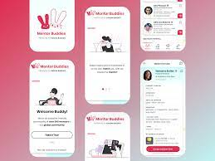
Lecture 4
Mentors and Buddies
If it isn’t, consider looking to the people you already know. Is there someone you met in the professional community who might make a good mentor? Why not ask her? Or maybe someone you work with might be helpful. This person doesn’t necessarily have to be a UX-savvy individual. Even someone who can help you examine and evolve the way you position your work for maximum effectiveness can be a tremendous support.

Slide 15

Lecture 4
The Rule of Threes
Here’s a fun fact. Social network theory has a concept called the Rule of Threes, which states that you’re likely to feel a network effect at up to three degrees of separation. All kinds of things spread according to the Rule of Threes: obesity, happiness, and jobs. It’s a well-known fact that most people get jobs from someone they know, for example, through their networks (see Figure 4.9).
It’s a less well-known fact that most of these jobs come from someone who is only weakly connected to you—for example, not someone who you currently see or work with on a regular basis. It stands to reason, then, that if you want to increase your opportunities, you need to grow your second and third-ring networks. Becoming a part of a professional community is how you do it.

Slide 16
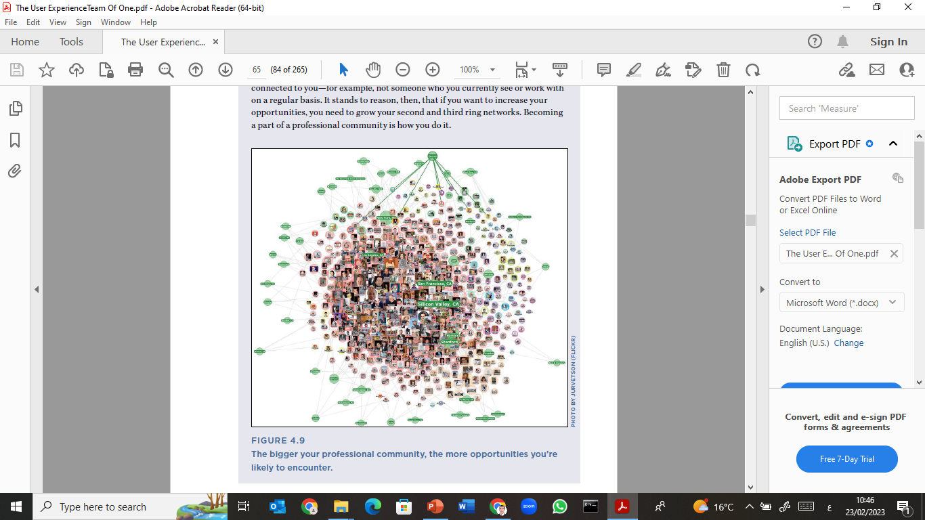
Lecture 4
The Rule of Threes

Slide 17

Lecture 4
Continuing Education
One reason why continual growth is a good idea for teams of one (or indeed, any UX practitioner) is that the field is changing fast. Maybe you started out focusing on the Web, and then gradually discovered that now you need to conduct research and design for mobile. Tomorrow, it might be a tablet, or even device-independent connected service strategies.
The simple truth is that technology is a fast-changing field, and since you are responsible for designing people’s experiences with technology, you need to be able to move fast, too. To keep up with the pace of change, UX teams of one can benefit from a variety of continuing education options, ranging from classroom learning in degree-granting programs to online education in the comfort of your own home.

Slide 18



Lecture 4
Continuing Education
Online Resources
You can find an abundance of informative, well-written online newsletters and magazines that focus on UX, which you can sign up to receive by email. These magazines are a more curated alternative to a discussion list, but they share the same virtue of authentic content from fellow user experience professionals. Here are some of the most popular ones:
• UX Booth: www.uxbooth.com/
• UX Matters: www.uxmatters.com/
• A List Apart: www.alistapart.com/

Slide 19
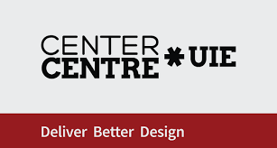



Lecture 4
Continuing Education
Online learning generally gives good value for your buck. Many resources are free. The ones that charge tend to be relatively inexpensive (far less than the cost of attending a conference or taking an in-person class). Many online content providers know that this happens and tacitly encourage it. To find online learning options, check out the following providers:
User Interface Engineering Virtual Seminars: www.uie.com/events/virtual_seminars/
Rosenfeld Media Virtual Seminars: http://rosenfeldmedia.com/seminars/
TreeHouse: http://teamtreehouse.com/
Slideshare: www.slideshare.net

Slide 20
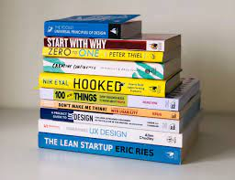
Lecture 4
Continuing Education
Another great resource is videos of conference proceedings, which are often posted online once a conference is over.
Books:
Kudos to you for picking up this book. Of course, there are lots of other great ones out there. In fact, a handful of publishers specialize in books of relevance to user experience professionals. Browsing their catalogs may turn you on to new titles that you were unaware of. To get started, check out the following publishers:

Slide 21
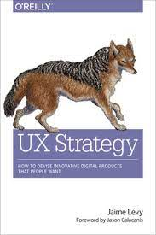

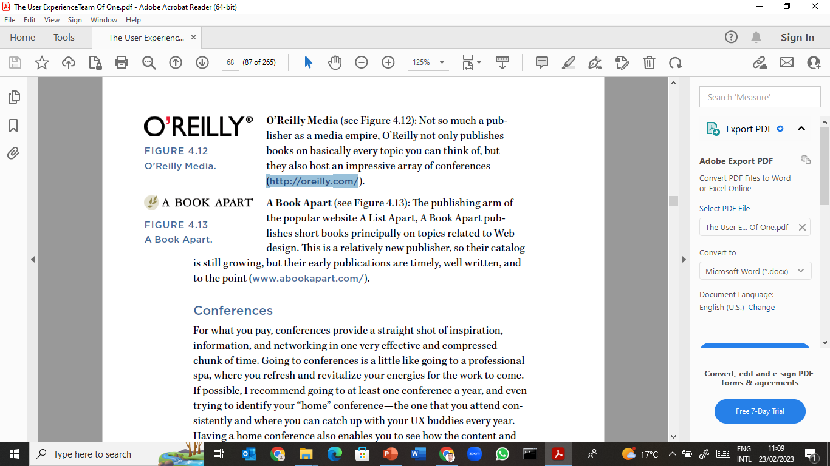
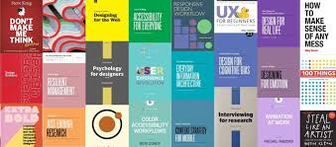
Lecture 4
Continuing Education
Rosenfeld Media (see Figure 4.10): Publisher of user experience titles exclusively (and the publisher of this book). Founded by one of the authors (Lou Rosenfeld) of a foundational text of our field, Information Architecture for the World Wide Web (http://rosenfeldmedia.com/).
O’Reilly Media (see Figure 4.12): Not so much a publisher as a media empire, O’Reilly not only publishes books on basically every topic you can think of, but they also host an impressive array of conferences (http://oreilly.com/).

Slide 22

Lecture 4
Continuing Education
Conferences:
For what you pay, conferences provide a straight shot of inspiration, information, and networking in one very effective and compressed chunk of time. Going to conferences is a little like going to a professional spa, where you refresh and revitalize your energies for the work to come.
If possible, I recommend going to at least one conference a year, and even trying to identify your “home” conference—the one that you attend consistently and where you can catch up with your UX buddies every year.

Slide 23


Lecture 4
Continuing Education
So, how do you cover the cost of traveling to and attending a conference?
• Start by asking if your employer will pay for it. Many companies recognize conferences as a beneficial form of continuing professional development and are willing to cover your attendance as a reasonable part of continuing education costs.
• If your employer won’t cover the costs, don’t give up. Many conferences provide opportunities to go for free or at a reduced cost if you are willing to volunteer some of your time to help out during the conference. Send the conference organizers an email asking if they have any volunteer opportunities.
• Another way to attend a conference and get some or potentially all of your costs covered is to be a presenter.

Slide 24
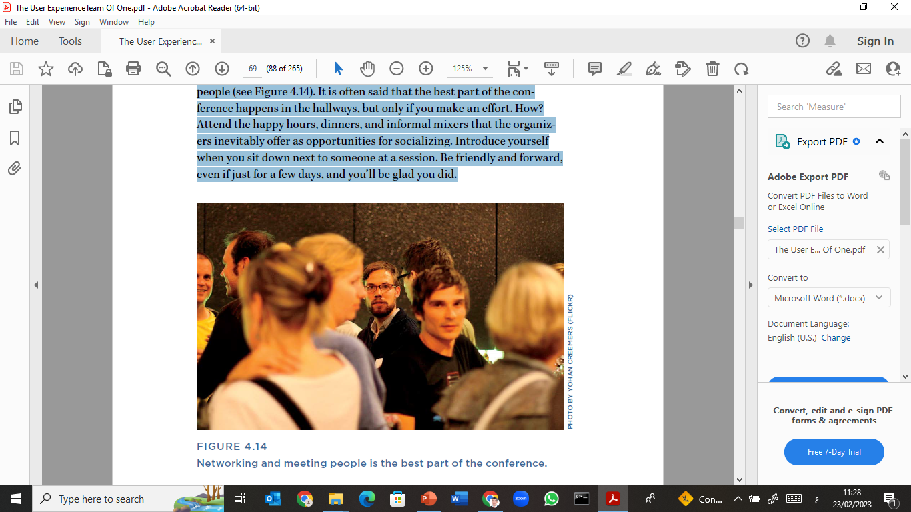
Lecture 4
Continuing Education
The most beneficial thing you can do at a conference is to meet other people (see Figure 4.14). It is often said that the best part of the conference happens in the hallways, but only if you make an effort. How? Attend the happy hours, dinners, and informal mixers that the organizers inevitably offer as opportunities for socializing. Introduce yourself when you sit down next to someone at a session. Be friendly and forward, even if just for a few days, and you’ll be glad you did.

Slide 25
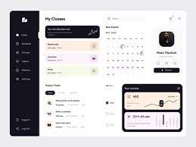

Lecture 4
Continuing Education
Classes and Courses:
In person, group-based training can cost a bit more than an online seminar, but can also serve as a boot camp or intensive to take you quickly from a newbie level of knowledge to expert. These options tend to be more limited, but the organizations that do them often schedule tours, taking their curriculum to different parts of the world. Check out:
• User Interface Engineering UX Immersion: www.uie.com/
events/#uxim
• Nielsen Norman Group: www.nngroup.com/

Slide 26
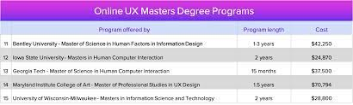

Lecture 4
Continuing Education
Degree Programs: This is a good idea if you’re interested in becoming more specialized in the field of UX, or if you want to earn more money. Although our field is still somewhat new, many more formal education options exist now than did even just a few years ago. Here is a list of some of the established and well-regarded schools that offer graduate degrees in UX-related disciplines as of this writing.
University of Indiana, Bloomington, Indiana, U.S.
Stanford, Palo Alto, California, U.S.
The University of Sydney, Sydney, Australia

Slide 27

Lecture 4
Continuing Education
In Your Organization:
For some, your own organization may not be the first option that comes to mind. You are trying to help them grow a user experience practice. How can you expect them to help you? Even though they may not be experts in user experience, well-intentioned employers often have programs and structures in place that are designed to help their employees continue to grow and ensure that their work contributes meaningfully to the organization’s goals.

Slide 28
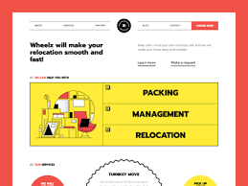
Lecture 4
Moving Out and On
Hey, it happens. You may at some point decide that you’ve exhausted the learning opportunities and resources that your current situation can provide. If that happens, the most important thing a UX team of one can do is to take his or her career into their own hands and decide the next step. At this point, there are a few important questions to ask yourself.
• Team of one, or team of many? Do you prefer to continue being a solo UX practitioner, or do you want to work with other user experience folks and learn from them? There are pros and cons to both situations.

Slide 29

Lecture 4
Moving Out and On
Innie or outie? Do you want to work inside an organization, or do you prefer to consult with a variety of organizations? Being on the inside can give you lots of practice in owning and evolving your own product.
Employed or independent? Do you prefer to work for a company, where the work is steady (if not always of your choosing), or do you prefer to be your own boss, making your own hours and running your own show (but also responsible for drumming up your own business)? Note that certain parts of the world may be easier to freelance in.

Slide 30
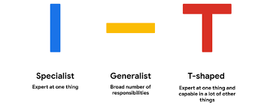
Lecture 4
Moving Out and On
What topic or touch point? Are you passionate about mobile? Social? Search? Consider whether there are certain areas of user experience that you are particularly inspired by and where you would like to focus your work. Or you may like working on a variety of touch points and problems, and that’s okay, too.
Specialist or generalist? Finally, what do you want the balance of your work to be? When you are a UX team of one, usually you don’t have a choice. You’re doing your own research, creating your own designs, running your own validation testing, and even managing your own project.

Slide 31
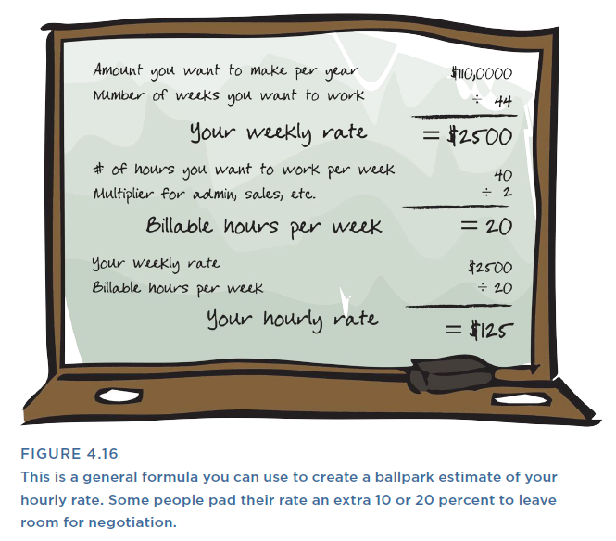
Lecture 4
Getting Paid
Your rate will be affected by several factors: your experience level, norms in your local market, and how aggressive you are about it. The following techniques can help you make sure that you’re earning enough to keep yourself in business.
Calculate your rate. UX professionals who go independent and stay independent have figured out a rate and a schedule that puts enough in the bank, even if they encounter a slow period. Be thoughtful when you set your rate (see Figure 4.16). Spend some time thinking about how much you actually plan to work, and how much of that time you can reasonably expect to be billable hours.

Slide 32
Lecture 4
Getting Paid

Slide 33
Lecture 4
Getting Paid
Negotiate. If you don’t have to negotiate, you’re probably pricing yourself too low. See the previous guidelines for pricing yourself, and then, no matter what they offer, promise yourself you’ll haggle a little.
Establish a fee schedule that protects you. It’s common to ask for some money up front and then the rest upon completion (or to coincide with the delivery of major deliverables). Some may argue that this kind of formality isn’t really necessary if you have good relationships with your clients. You’ll ultimately have to decide for yourself what is right for your business.

Slide 34
Lecture 4
Position Your Engagements for Success
Here are a few tips to make sure you really know what you’re getting yourself into.
Do a project brief. Ask good questions about the project and the organization up front. Take a moment to ask yourself and your contacts hard questions about timelines, team, goals, your role, total team skills, ultimate decision makers, how success will be measured, and biggest risks to success. Then ask yourself if you still want to do it. When your gut tells you “no,” respect it. Taking the time to complete a “Project Brief” (see Chapter 5) can help with this.

Slide 35

Lecture 4
Position Your Engagements for Success
Here are a few tips to make sure you really know what you’re getting yourself into.
Be choosy about what you call yourself. If you can position yourself as a consultant rather than a freelancer, your time and work may be perceived as more valuable. It’s a semantic sleight of hand to call yourself a consultant instead of a freelancer, but I believe it makes a difference. As a freelancer, you run the risk of being perceived as staff augmentation.

Slide 36

Lecture 4
Manage Your Time
In design work, there are usually two things that contribute to how long something takes:
1) how much time it takes you to make the thing, and
2) how much time it takes to communicate about, revise, and get buy-in on the thing.
Ideally, you want to be able to bill for both. One of the biggest threats to scope creep (and your profitability) is when you have accurate estimates and agreements for the first part, but not for the second. To manage the first part well, know thyself and know thy process. To manage the second, know thy client.

Slide 37

Lecture 4
Manage Your Time
• Estimate conservatively. There’s a popular misperception that going independent makes life less busy. You’re doing 60 hours a week in your current job, working for the man? Scale back! Become your own boss! In an ideal situation, independents can make as much as a full-time employee in 75% or 50% of the time. But that requires formidable time management skills, a keen sense of focus, and a very healthy client list. It’s very common, at least initially, to find yourself working a lot. The key is to make brutally realistic estimates about how long something will take and track your time well.

Slide 38
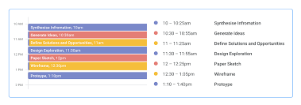
Lecture 4
Manage Your Time
• Create timeboxes. Your own perfectionism can be another risk to timely completion. It’s dangerously easy to lose yourself in your work and suddenly realize that something has taken far longer than it should have. That creates problems whether you work for a company or for yourself, but it exacts a particularly personal toll when you’re working for yourself. Ultimately, it comes out of time that you would otherwise have for yourself and the people you love. It’s also

Slide 39
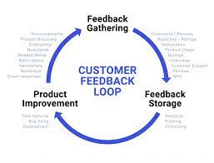
Lecture 4
Manage Your Time
Manage feedback loops. Managing that second category of time— he time it takes for others to digest, give input, and approve—can be its own full-time job. At a minimum, you should assume that there will be some communication time at major decision points.
However, because it’s charged with the extra energy of humans discussing and in some cases disagreeing, you don’t want to exacerbate it by pinching or curtailing the discussion to protect the schedule.

Slide 40
Lecture 4
Career Evolution in UX Design
The field of User Experience (UX) design is rapidly evolving, especially with the integration of Artificial Intelligence (AI). A UX designer’s career typically begins with mastering foundational skills such as user research, information architecture, and prototyping.
As they grow, they move into more strategic roles like UX strategist or design lead. Career development in UX requires continuous learning, adaptability, and a strong focus on understanding user behavior. The ability to stay up-to-date with emerging tools and methodologies is now more critical than ever.

Slide 41
Lecture 4
How AI is Reshaping UX Careers
Artificial Intelligence is transforming how UX professionals approach their work. AI-powered tools now assist in automating repetitive tasks, generating user personas, conducting predictive analytics, and even suggesting design layouts. Platforms like Figma, Adobe XD, and Uizard are integrating AI to streamline the design process.
As a result, UX designers are expected to develop new competencies, such as prompt engineering, human-AI interaction design, and ethical considerations in AI interfaces. Rather than replacing designers, AI is enhancing their creativity and decision-making.

Slide 42
Lecture 4
Upskilling and Future UX Roles with AI
To grow professionally in the AI-powered UX landscape, designers must actively upskill. Key areas for development include data-informed design, conversational interface creation, and accessibility in intelligent systems. New roles are emerging, such as AI UX Specialist, Voice UI Designer, and Human-AI Interaction Expert.
Staying competitive requires a mindset of continuous learning, openness to experimentation, and collaboration with AI rather than competition. The future of UX will belong to those who can blend creativity, empathy, and technological fluency.

Slide 43
Lecture 4
If You Only Do One Thing…
This chapter hopefully reinforces that UX teams of one are not alone. Far from it, you are part of a dynamic and growing community.
How you choose to engage that community is a matter of personal preference, but whether to engage should not be. Keeping yourself connected to other user experience professionals outside your organization is especially important. It will help you experience continual growth and greater professional satisfaction.
So if you only have time to do one thing from this chapter, focus on finding your community and getting plugged into it in whatever format makes sense, whether that be a digital discussion list, or live and in person.

Slide 44
Lecture 2
Thank You

