Slide 1



Project Leadership
PMG 511
Lecture 0
Overview
Prepared by
Dr Hakem Sharari
www.midocean.ae

Slide 2
Session Outline
Academic Agenda
Course Objectives
Course Description
Learning Outcomes
Topics
Conclusion

Slide 3
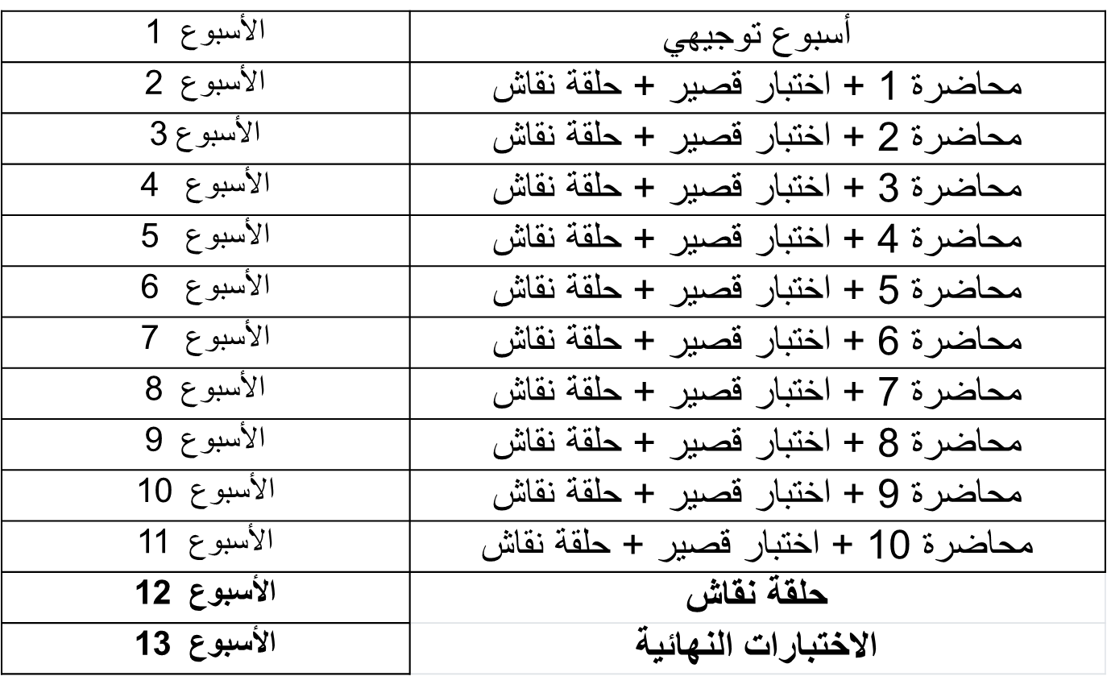
Academic Agenda

Slide 4
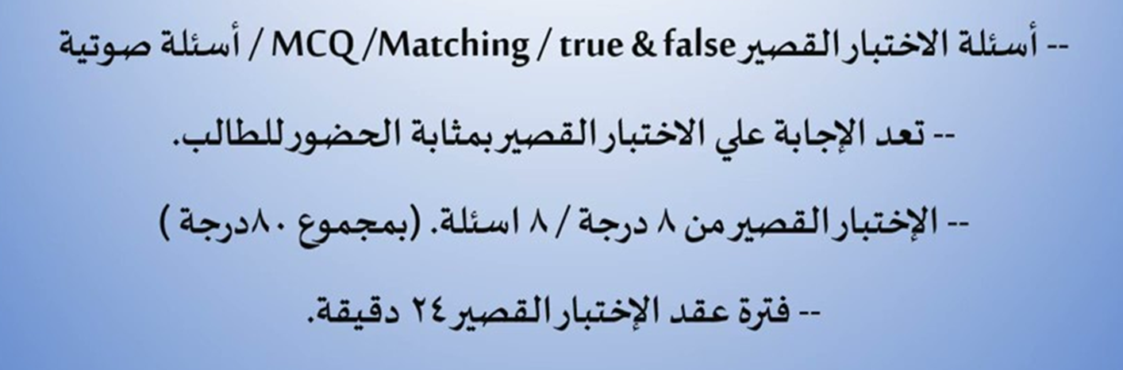
Quizzes & Exams

Slide 5

Final Exam

Slide 6
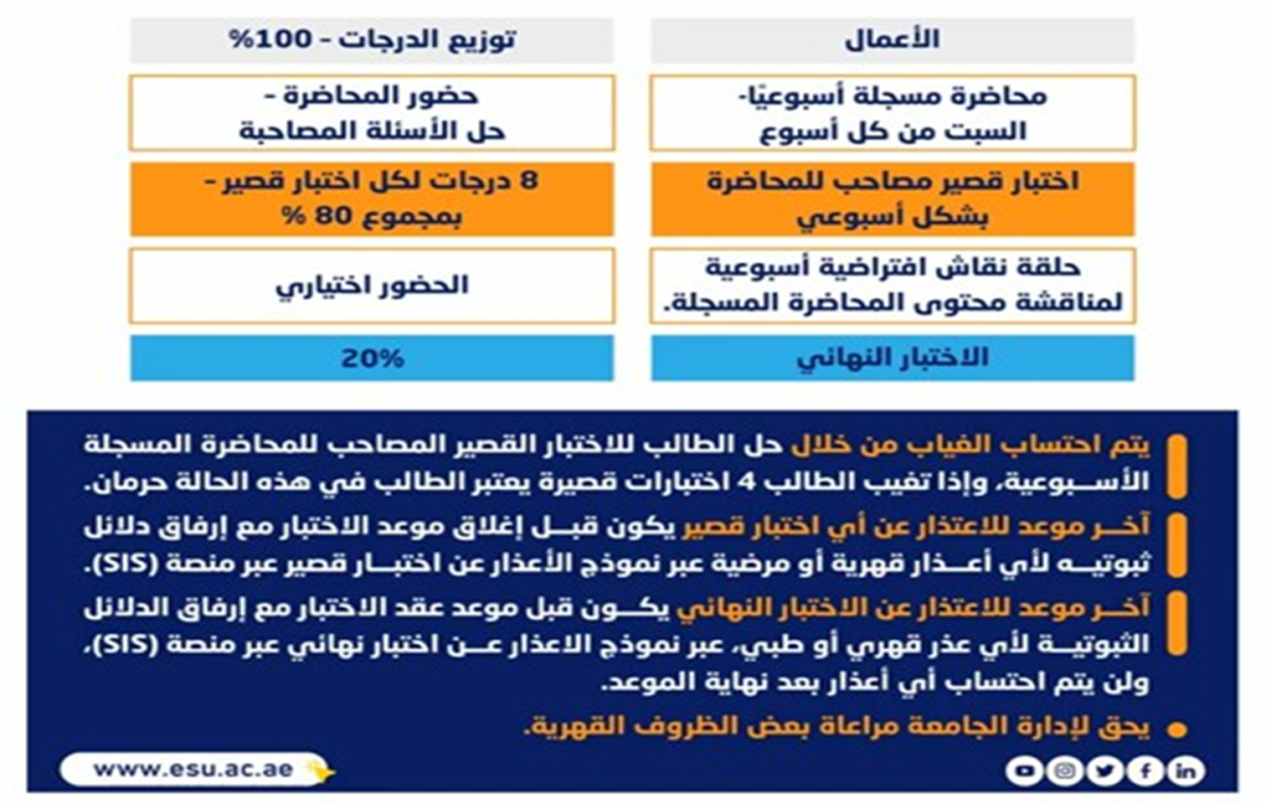
Obligations and Grading

Slide 7

Course Description
Credit Hours: 3 credit hours
The materials and reference for this course will be:
The textbook: Project Team Leadership and Communication by Samuel Malachowsky.
Lecture notes and slides.

Slide 8
Online Lecture
Answer your questions/inquiries.
Solve different issues/problems.
Discuss your opinions with the instructor/classmates.
Trigger activities related to previous session topics.

Slide 9
Course Objectives
Prepare students for the host of challenges that come with leading a team:
Oppressive schedules.
Demanding customers.
People who just can’t seem to get to work.
Help students to understand how to fulfil the expectations of a team leader:
Gaining a basic grasp of what makes a project a project.
Estimating time and creating schedules.
Communicating reports, metrics, and numbers to those who care about your project.

Slide 10
Learning Outcomes
Understand the principles of leadership, and how they apply to you as a professional and those you work with.
Properly prioritize tasks, project schedules, and customer demands.
Analyze and manage the expectations of those important to the project through consistent, planned communication.
Build trust, foster commitment, and manage conflict within your team.
Identify and stop common project issues in their tracks and much more.

Slide 11
Course Topics
Introduction to project leadership.
Understanding Leadership.
Theories of Leadership.
Decision-making: An Essential Leadership Skill.
Project Fundamentals.
Prioritization: The Core of Project Leadership.
Team Structure and Development.
Communication and Expectation Management.
Pitfalls to Identify and Avoid.

Slide 12
Introduction to project leadership
What is a project?
Leadership vs Management.
Leader vs Manager.
Impact of leadership on projects.
Major project leadership skills.

Slide 13
Understanding Leadership
The Leader’s Title.
Leadership Styles.
Influence.
Motivators.
Matching Leadership with Culture.
Who We Lead.
The Discipline of Project Management.
Chapter Tool: Who We Are as Leaders.

Slide 14
Understanding Leadership
The Leader’s Title:
Understand that title isn’t synonymous with the need or authority to engage in leadership.
Leadership Styles:
Describe 7 basic leadership styles.
Recognize the importance of choosing an appropriate style.
Identify common pitfalls related to appropriate leadership styles.
Influence:
Describe 5 types of influence.
Recognize personal preferences and their relationship to influence.

Slide 15
Understanding Leadership
Motivators:
Describe 6 types of motivators and give examples of each.
Classify the 6 motivators as extrinsic or intrinsic.
Relate biases individuals may have towards or against individual motivators.
Matching Leadership with Culture:
Define ‘culture’ in the context of a project, team, and organization.
Recognize contexts that affect and are affected by culture.

Slide 16
Understanding Leadership
Who We Lead:
Define ‘stakeholder’ in the context of a project effort.
Identify 3 common groups of project stakeholders.
The Discipline of Project Management:
Relate the various leadership titles and the field of project management.
Describe several aspects of professional discipline and ethics.

Slide 17
Theories of Leadership
Understand different leadership theories.
Types of leadership power (influence).
Motivators.
Culture.
Professional Discipline and Ethics.

Slide 18
Decision-making: An Essential Leadership Skill
What is decision-making?
Decision-making and leadership.
Importance of decision-making.
Types of decision-making.
Decision-making style.
Stages of decision-making process/models.
Decision-making from leaders' perspective.
Decision-making skills.

Slide 19
Project Fundamentals
What is a Project?
The Nature of a Project.
The Project Environment.
Values, Needs, and Process.
Quality and the Project Triangle.
Defining Project Outcomes: a Layered Approach.
The Project’s Early Stages.
Chapter Tool: Planning Project Quality.

Slide 20
Project Fundamentals
What is a Project?
Define ‘project,’ identifying 2 defining features.
List 4 project phases and 1 additional element.
Recognize the interactions between projects/phases and the product lifecycle.
The Project Environment:
Identify 3 types of organizations in the context of how projects are organized.
Recognize strengths and weaknesses of each of the 3 organizational types.

Slide 21
Project Fundamentals
Values, Needs, and Process:
Recall factors influencing the values and needs of a project, team, or organization
List 3 fundamental process models and summarize the strengths and weaknesses of each
Recognize varying levels of detail/abstraction in documented processes
Quality and The Project Triangle:
Define ‘quality,’ identifying 4 main aspects/concerns.
Give examples of elements that are ‘cost of quality’ and ‘cost of poor quality’ in a project.
Label the project triangle’s 4 components.
Relate examples of each project triangle component and the relationships between them.

Slide 22
Project Fundamentals
Defining Project Outcomes: A Layered Approach:
Relate the concept of project goals, including examples of such.
Relate the concept of project scope statements, including examples of such.
Relate the concept of project requirements/specifications, including examples of such.
Describe ‘the layered approach’ to project outcome definition.
The Project’s Early Stages:
Identify the primary objectives of a project kickoff meeting.
List the essential elements of a basic project plan.

Slide 23
Prioritization: The Core of Project Leadership
Why is Prioritization So Essential?
Estimation Methods.
Estimates vs. Commitments.
Accuracy and Precision.
Project Scheduling.
Project Tracking.
Risk Management.
Chapter Tool: Prioritizing Stakeholders.

Slide 24
Prioritization: The Core of Project Leadership (
Why is Prioritization So Essential?
Identify the connection between the concept of prioritization and individual project activities.
Estimation Methods:
Describe 5 basic estimation methods
Recognize the strengths, weaknesses, and appropriate application of each estimation method.

Slide 25
Prioritization: The Core of Project Leadership
Estimates vs. Commitments:
Relate issues and negative conditions that may arise during the estimation process
Accuracy and Precision:
Define the terms ‘accuracy’ and ‘precision’ in a general context.
Relate the concepts illustrated in the ‘cone of uncertainty’.
List several ways to accurately express low-precision estimates.

Slide 26
Prioritization: The Core of Project Leadership
Project Scheduling:
Describe how ‘work breakdown structures’ are constructed and recorded.
Relate ‘precedence techniques’ including diagramming and related terms/techniques
List 3 common project schedule visualization tools.
Relate scheduling activities to basic process concepts.
Project Tracking:
Define ‘project visibility’ in the context of project tracking.
Describe the concept of ‘earned value’ in the context of a project.
List 2 common project tracking visualization tools.

Slide 27
Prioritization: The Core of Project Leadership
Risk Management:
Define ‘risk,’ identifying 3 essential elements in the context of a project.
Relate techniques for identifying project risks, including SWOT analysis.
Identify basic project risk analysis/quantification techniques.
Describe 4 basic project risk response techniques.

Slide 28
Team Structure and Development
What Makes a Team Successful?
Team Structure.
Team Development.
Needs and the Team.
Building Trust.
Managing Conflict.
Achieving Commitment.
Embracing Accountability.
Focusing on Results.
Chapter Tool: Evaluating Your Team’s Maturity.

Slide 29
Team Structure and Development
What Makes a Team Successful?
Identify 6 basic factors for team success.
List 3 basic team categories and their defining features.
Team Structure:
Name 4 basic project team structures.
Identify defining features, strengths, and potential pitfalls for each project team structure.
Recall factors that influence organizational team structures.
Relate 5 common team roles, their basic responsibilities, and the basic skills needed for each.

Slide 30
Team Structure and Development
Team Development:
Identify each of Tuckman’s 4 stages of team development.
Relate factors related to progression through the team development stages.
Needs and the Team:
Identify 5 basic needs of a project team.
Building Trust:
Relate the factors that affect trust within a project team.
Identify basic techniques team leaders can implement to build trust.

Slide 31
Team Structure and Development
How leaders effectively manage conflict.
Sources of project conflict .
What Causes Team Conflict?
Conflicts arise from differing needs .
Symptoms of team conflict .
Conflict-resolution techniques.
Thomas-Kilmann conflict mode instrument
Managing Conflict:
Definition of conflicts.
Organizational conflict is beneficial or not?
Definition of conflict resolution.
Recognize the role of conflict within a team.
Identify basic ‘ground rules’ of conflict within a team.
Describe 6 conflict resolution techniques.

Slide 32
Team Structure and Development
Achieving Commitment:
Identify 3 parties involved in commitment in the context of a project.
Describe factors for achieving commitment for each party.
Recognize how commitment affects project team outcomes.
Embracing Accountability:
Identify 3 angles of accountability in the context of a project team.
Recognize basic techniques for strengthening peer-to-peer accountability.
Relate how to use the ‘RASCI accountability matrix’.

Slide 33
Team Structure and Development
Focusing on Results:
Identify 4 core competencies incumbent to achieving results in the context of a successful project team.
Describe how a team’s results may differ from combined individual results.

Slide 34
Communication and Expectation Management
The Importance of Project Communication.
Basic Communication Concepts.
Push/Pull Communication: A Hybrid Approach.
Communications within the Team: Meeting Success.
Ethics in Communication.
Communicating with Metrics and Reports.
Stakeholder Expectation Management.

Slide 35
Communication and Expectation Management
The Importance of Project Communication:
Summarize the impacts and importance of modern project communication.
Basic Communication Concepts:
Relate the concept of communication channels and communication types in the context of project communication.
Identify obvious and less obvious communication blockers in the context of project communication.

Slide 36
Communication and Expectation Management
Push/Pull Communication: A Hybrid Approach:
Define push, pull, and interactive communication.
Relate the concept of ‘hybrid communication’ as a beneficial strategy.
Communications within the Team: Meeting Success:
Identify common, negative aspects of team meetings.
Give examples of rules and strategies for successful meetings.
Ethics in Communication:
Relate the importance of ethics in project environments.
Identify 4 communication-related ethical considerations.

Slide 37
Communication and Expectation Management
Communicating with Metrics and Reports:
Define ‘metrics’ and their 2 main categories.
Describe multiple factors to consider when communicating metrics or reports.
Relate 6 basic project metrics.
Describe 5 project reports.
Stakeholder Expectation Management:
Define the concept of stakeholder expectation management.
Identify 2 main types of stakeholders and factors of communication for each.
Relate several factors that affect stakeholder expectations.

Slide 38
Pitfalls to Identify and Avoid
In the conclusion of this course, we present an extensive list of common team and project issues with the hope that the reader can learn to regularly identify and avoid them.
Team Pitfalls.
Process and Product Pitfalls
Chapter Tool: Pitfall “Hot Spots”.

Slide 39
Pitfalls to Identify and Avoid
Team Pitfalls:
Discuss 8 common team pitfalls, including how to prevent them from occurring.
Process and Product Pitfalls:
Discuss 7 common process and product pitfalls, including how to prevent them from occurring.
Pitfall “Hot Spots”:
Define ‘downstream’ in the context of a project.
Identify causes and effects of 15 pitfalls in the context of the primary project phases.

Slide 40
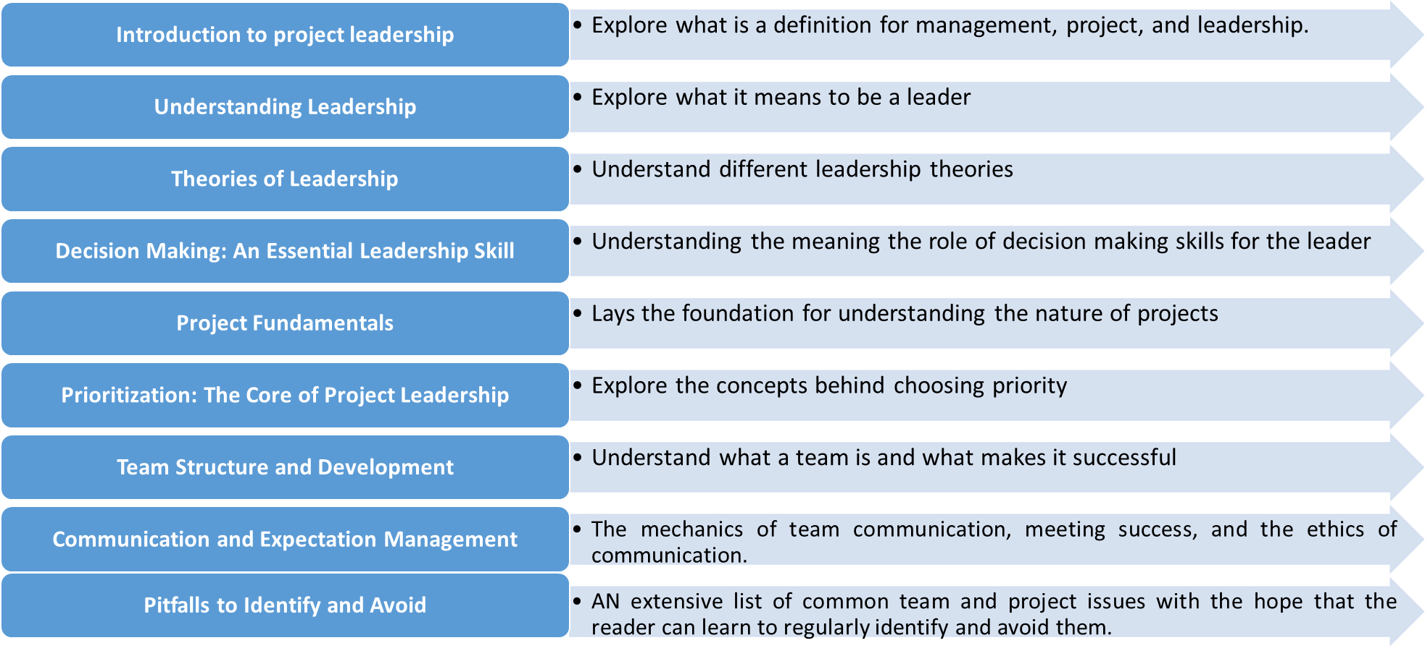
Conclusion

Slide 41

Reference

