Slide 1


Entrepreneurial Leadership & Organizational Behaviour
ENT 612
Lecture 1

Slide 2

Introduction to Entrepreneurial leadership

Slide 3
This lecture covers the following topics
Overview of the Entrepreneurship terms
Who is the Entrepreneur?
Definition of a Leader
The 3P's
What is the Leadership
Entrepreneurship
Entrepreneurial leaders
The five forms of entrepreneurial leadership
The five steps of the “Opportunity Model”

Slide 4
Overview of the Entrepreneurship terms
1911
  Innovative creativity
  Creative destruction
1980
  Small business development in local communities
Entrepreneurship
1989
Catch the available opportunities to make a profit
  Transferring new technology and creating something from nothing
2005
  Organizing efforts to introduce new goods or services

Slide 5
Who is the Entrepreneur?
An entrepreneur is someone who has an idea and who works to create a product or service that people will buy, as well as an organization to support that effort. An entrepreneur takes on most of the risk and initiative for their new business and is often seen as visionary or innovator.

Slide 6
Who is the Entrepreneur?
Someone
A team
An organization
Who changes an opportunity into a commercial success.

Slide 7


Definition of a Leader
A leader is "a person who influences a group of people towards the achievement of a goal". A mnemonic for this definition would be 3P's - Person, People, and Purpose as illustrated by the following diagram.

Slide 8
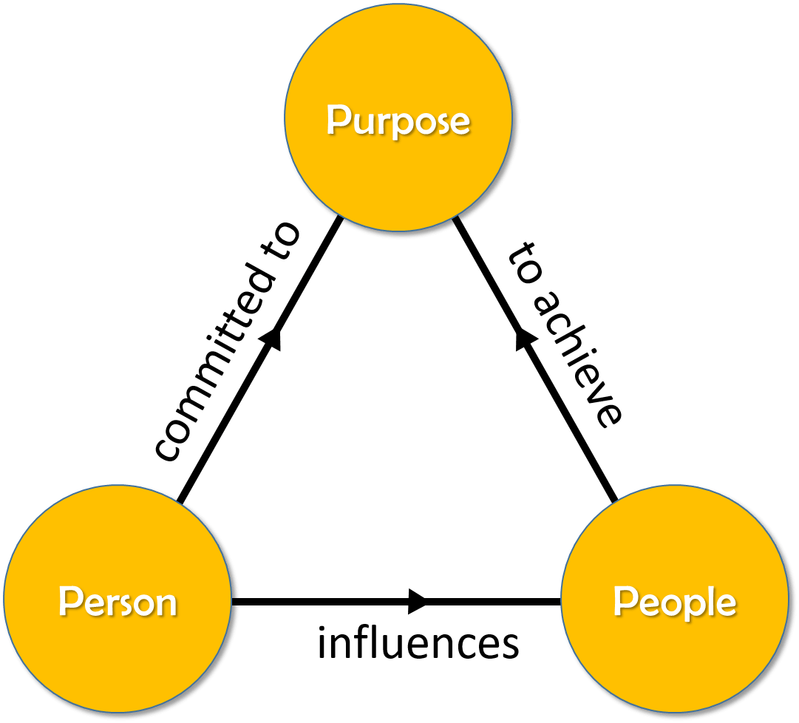
1. Person
A leader by this meaning is one who goes first and leads by example so that others are motivated to follow him. This is a basic requirement. To be a leader, a person must have a deep-rooted commitment to the goal that he will strive to achieve it even if nobody follows him!

Slide 9
2. Purpose
A requirement for leadership is personal vision - the ability to visualize your goal as an accomplished fact; a thing already achieved.

Slide 10
3. People
The next requirement is the realization that the goal cannot be achieved alone, without the help of others. Is there a natural grouping of people from whom you can elicit help? Or do you have to recruit your followers? In the latter, you face a greater challenge.

Slide 11
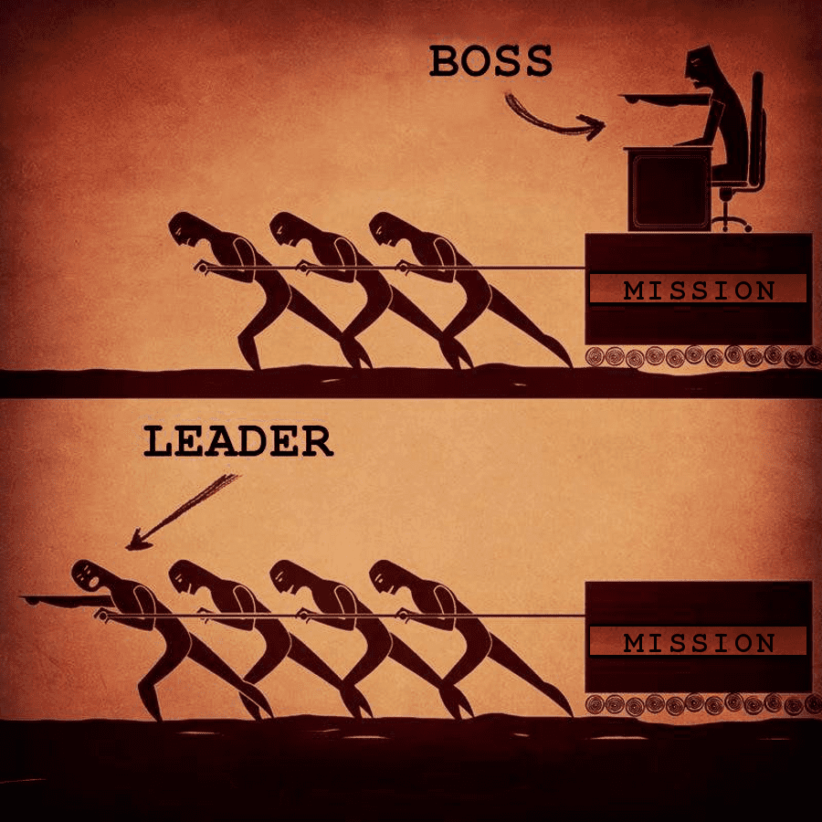
What is the Leadership
Leadership is the accomplishment of a goal through the direction of human assistants.

Slide 12

This special form of leadership begins with the creative process often referred to as “being entrepreneurial. ” This process is often characterized by taking financial risks in the hope of making a profit, or “being enterprising.”

Slide 13
Entrepreneurship, however, is much more than this; it is a process whose purpose is to generate new business. “Business,” for the purposes of our discussion, is defined as products, services, and the organizations needed to deliver them.
The process starts with the ability to recognize an opportunity worth pursuing and knowing what is needed to bring it to market and make it successful

Slide 14
As a preliminary measure, the good entrepreneurial leader realizes that contrary to what might be the prevailing business ethos the art of generating new business is selfless, and not selfish.
He or she understands that the business world should be a “you” world, not a “we” or “me” world.
By that I mean that good entrepreneurial leaders focus on the needs and wants of the consumer, knowing that by satisfying the consumer first, the “we” and “me” will benefit later.

Slide 15

Often, I’ve heard aspiring entrepreneurs referred to as “dreamers.” Yet up-and-coming entrepreneurial leaders are not dreamers, nor for that matter high-risk takers. They are visionaries who are goal-oriented and who take calculated risks.
I define a goal as “a dream with an achievable plan”.
Successful entrepreneurial leaders always have effective plans by which they can achieve their goals. They are long-term, rather than short-term, thinkers

Slide 16

In the words of Steve Case, co-founder of AOL said that “The great entrepreneurs that really have had a significant impact in the world take a long-term view.
They really think of it in decades, not years or months. They really believe that in the long run, they’re going to have a tremendous impact.”

Slide 17

Amazon founder Jeff Bezos also emphasizes the importance of long-term thinking.
“If everything you do needs to work on a three-year time horizon, then you’re competing against a lot of people,” Bezos told Wired magazine in 2011.
“But if you’re willing to invest on a seven-year time horizon, you’re now competing against a fraction of those people, because very few companies are willing to do that.”

Slide 18

Since entrepreneurial leaders are “bred,” not born, entrepreneurial leadership is a process that must be learned over time.
I have a good idea… if only it were me!
This is the mantra of almost every beginning entrepreneur. However, most ideas aren’t business-generating opportunities, and looking for opportunities through one’s own ideas most often ends up in frustration.

Slide 19
Throughout the twentieth and twenty-first centuries, scholars have struggled to define the concept of “entrepreneurial leadership.”
Joseph Schumpeter, one of the most influential economists of the twentieth century, noted that entrepreneurship itself had no fewer than five “forms.” These included, among others, “the introduction of a new method of production,” “the exploitation of a new source of supply,” and the “re-engineering of business management practices.”

Slide 20
Other scholars fell on the opposite side of the line, oversimplifying the concept of entrepreneurship. Entrepreneurship, said Ludwig Von Mises, one of the last members of the original Austrian School of economics, is the driving force of the market that is to say, of civilized society while entrepreneurship professor William B.
Gartner defined it as “the creation of new organizations.”

Slide 21
Entrepreneurial leadership is not, as many people seem to believe, just the ability to form an organization. No, entrepreneurial leadership is much more than creating start-ups. It is a process whose purpose is to generate new business.
The process involves recognizing an opportunity to pursue and forming a team and an organization to deliver it, keeping in mind that entrepreneurial leaders are the driving force behind generating new business.

Slide 22
As soon as I’d defined entrepreneurship, the five-step Opportunity Model fell into place. It highlights the process of generating new business. This process isn’t confined to privately owned companies, publicly traded companies, or non-profits. It’s certainly not confined to companies just starting out, either.
Entrepreneurial leadership is vital to all forms of organizations at all stages of their development. Entrepreneurial leaders are the driving force behind generating new business, and all organizations need new businesses to sustain themselves and grow.

Slide 23
While working for Carl, I developed unique pricing strategies and designed catchy “point-of-purchase” materials. The net result of my efforts was a 35 percent increase in business the first year they were introduced. From that point on, I never stopped generating new business throughout my career.
With each new promotion, the process of generating new business grew easier. When I eventually became the owner of Adirondack Beverages, I helped our people develop a highly effective new-product program, a program that is the basis of my Opportunity Model

Slide 24

The model can be applied to any venture in the world, and every one of these ventures would benefit by having an entrepreneurial leader in its ranks.
entrepreneurial leadership is needed by all organizations regardless of size, or whether they’re profit or non-profit.

Slide 25
Entrepreneurship is “risky” because “so few of the so-called entrepreneurs know what they are doing
According to a recent report, nearly 80 percent of would-be entrepreneurs in the United States are millennials, or those born from approximately 1980 to 1994.
“[Millennials are] enthusiastic about entrepreneurship.
The Internet and the success of young entrepreneurs like Facebook founder Mark Zuckerberg have all impacted this influential group.

Slide 26

No matter what age business owners might be, entrepreneurial leadership remains an extremely important subject for all.
Sadly, the failure rate of US start-ups remains staggering, at more than %50.
Many entrepreneurial leaders are still in need of a practical compass.

Slide 27
The five steps of the “Opportunity Model”

Slide 28

The entrepreneurial process begins with recognizing an opportunity, which is the chance to create a product, service, or organization and successfully bring it to market. Recognizing an opportunity can happen in the start-up stage, or in the midst of a well-established company or organization. The most critical thing an entrepreneurial leader must know how to do is recognize an opportunity worth pursuing.
Where Do I Begin?

Slide 29

Identify a Commercially Viable Problem

Slide 30

Identify a Commercially Viable Problem
The problem you identify must be ready to be solved, and the solution to the problem must be commercially viable.
In other words, there must be a large enough demand for a solution if the product or service is to be commercially viable.

Slide 31
Create a Product or Service That Has a Strong Competitive and Comparative Advantage

Slide 32

2. Create a Product or Service That Has a Strong Competitive and Comparative Advantage
Your product or service must be unique, in that it must be positioned as better in some way than existing products and services. Securing effective distribution channels, as well as creating awareness for your product or service, is also essential to achieving a competitive and comparative advantage.

Slide 33
Ensure That Your Product or Service Is Sustainable through Patents, Trademarks, First-Mover Advantage, and Continuous Improvement

Slide 34

3. Ensure That Your Product or Service Is Sustainable through Patents, Trademarks, First-Mover Advantage, and Continuous Improvement
Successfully launching your product or service is a great first step, but long-term success is dependent on protecting your intellectual capital with patents or trademarks, or both. Staying ahead of your competitors also means continuously improving your product or service.

Slide 35

Secure Your Product or Service’s Profitability

Slide 36

4. Secure Your Product or Service’s Profitability
Due to initial start-up costs, very few products or services are profitable when they’re first introduced. Yet survival and success are dependent on taking in more than you pay out. Profits are for a company what a salary is to an employee.

Slide 37

Build an Effective Team

Slide 38

5. Build an Effective Team
While all new products or services begin with a sole individual’s idea, they seldom get off the ground without a team. That team should include both the entrepreneurial leader and team members with complementary skills.

Slide 39

Conclusion
Overview of the Entrepreneurship terms
Who is the Entrepreneur?
Definition of a Leader
The 3P's
What is the Leadership
Entrepreneurship
Entrepreneurial leaders
The five forms of entrepreneurial leadership
The five steps of the “Opportunity Model”

Slide 40
References
- Entrepreneurial Leadership: A practical Guide to Generating New Business by Angelo Mastrangelo 1st Edition.
- Definition of a Leader: https://www.vtaide.com/gleanings/leader.html
Understanding Leadership, Harvard Business Overview:https://hbr.org/2004/01/understanding-leadership

Slide 41

Wish you all the best

