Slide 1



Programming
Foundations in
Python
Prepared by Dr. Hamada I. AbdulWakel
Lecture 9

Slide 2



Object-Oriented
Programming II
Lecture 9
Prepared by
Dr. Hamada I. AbdulWakel
www.midocean.ae

Slide 3
Lecture
RECAP: LECTURE 8
09
Understanding the basics of Object-Oriented Programming.
The building blocks and principles of OOP.
Difference instance and class attributes.
www.midocean.ae

Slide 4
Lecture
LECTURE MAIN POINTS
09
Learning more about classes behaviors.
The meaning of using the operator overloading.
The meaning and uses of inheritance and polymorphism.
www.midocean.ae

Slide 5
Lecture
09
THE GETTER AND SETTER METHODS
getattr(obj, 'paramName'): returns the current value of this parameter.
setattr(obj, 'paramName', value): allows you to set/change the value of an attribute.
hasattr(obj, 'Name'): checks whether the object has this attribute or not.
isinstance(obj, className): returns True if the specified object is of the specified type, otherwise False .
www.midocean.ae

Slide 6
Lecture
09
THE GETTER AND SETTER METHODS
Cont'd
Example:
class Point:
def __init__(self, x=0, y=0):
self.x = x
self.y = y
p1 = Point(1, 2)
print(getattr(p1, 'x'))
print(setattr(p1, 'y', 5))
print(hasattr(p1, 'z'))
print( isinstance(p1, Point) )
www.midocean.ae

Slide 7
Lecture
09
THE OPERATOR OVERLOADING
Example:
class Point:
def __init__(self, x=0, y=0):
self.x = x
self.y = y
p1 = Point(1, 2)
p2 = Point(2, 3)
print(p1+p2)
www.midocean.ae

Slide 8
Lecture
09
THE OPERATOR OVERLOADING
Cont'd
You can change the meaning of any operator in Python depending upon the operands used to be suitable to your class.
For example, the + operator will perform arithmetic addition on two numbers, merge two lists, or concatenate two strings.
But, if you perform it on two instances of a user-defined class it will give you a TypeError because these instances are unsupported operand type(s) for + operator.
www.midocean.ae

Slide 9
Lecture
09
THE OPERATOR OVERLOADING
Cont'd
Among the special functions for operators are:
  + by overloading __add__(self, otherObj) for obj1 + obj2
  - by overloading __sub__(self, otherObj) for obj1 - obj2
  * by overloading __mul__(self, otherObj) for obj1 * obj2
  / by overloading __div__(self, otherObj) for obj1 / obj2
  % by overloading __mod__(self, otherObj) for obj1 % obj2
  ** by overloading __pow__(self, otherObj) for obj1 ** obj2
www.midocean.ae

Slide 10
Lecture
09
THE OPERATOR OVERLOADING
Cont'd
Python does not limit operator overloading to arithmetic operators only. We can overload comparison operators as well.
Among the special functions for these operators are:
  < by overloading __lt__(self, otherObj) for obj1 < obj2
  <= by overloading __le__(self, otherObj) for obj1 <= obj2
  > by overloading __gt__(self, otherObj) for obj1 > obj2
  >= by overloading __ge__(self, otherObj) for obj1 >= obj2
  == by overloading __eq__(self, otherObj) for obj1 == obj2
  != by overloading __ne__(self, otherObj) for obj1 != obj2
www.midocean.ae

Slide 11
Lecture
09
THE OPERATOR OVERLOADING
Cont'd
Example:
class Point:
def __init__(self, x=0, y=0):
self.x = x; self.y = y
def __add__(self, other):
x = self.x + other.x
y = self.y + other.y
return Point(x, y)
p1 = Point(1, 2); p2 = Point(2, 3);
print(p1+p2)
www.midocean.ae

Slide 12
Lecture
09
THE OPERATOR OVERLOADING
Cont'd
Example:
class Point:
def __init__(self, x=0, y=0):
self.x = x; self.y = y
def __lt__(self, other):
selfCords = (self.x ** 2) + (self.y ** 2)
otherCords = (other.x ** 2) + (other.y ** 2)
return selfCords < otherCords
p1 = Point(1, 2); p2 = Point(2, 3);
print(p1 < p2)
www.midocean.ae

Slide 13
Lecture
09
THE OPERATOR OVERLOADING
Cont'd
Example:
class Fruit:
def __init__(self, weight, name = "none"):
self.name = name
self.weight = weight
def __add__(self, x):
if isinstance (x, Fruit):
return Fruit(self.weight + x.weight)
if isinstance (x, int):
return Fruit(self.weight + x, self.name)
www.midocean.ae

Slide 14
Lecture
09
THE OPERATOR OVERLOADING
Cont'd
Example (con't):
class Fruit:
def __eq__(self, x):
if self.name == x.name:
print("Both are the same fruits")
else:
print(self.name, "and", x.name, "are different fruits.")
def __str__(self):
return "Name: {0}, Weight: {1}\n".format(self.name,
self.weight)
www.midocean.ae

Slide 15
Lecture
09
THE OPERATOR OVERLOADING
Cont'd
Example (con't):
f1 = Fruit(5, "Strawberry")
f2 = Fruit(100, "Watermelon")
f3 = Fruit(20, "Mango")
print( f1, f2, f3 )
print( f1 + f2 + f3 )
print( f1 == f2 )
www.midocean.ae

Slide 16
Lecture
09
CLASSES RELATIONSHIPS
Classes relationships describe how classes and classes’ objects interact with each other.
There are two types of these relationships:
  Inheritance.
  Composition.
Both enable code reuse, but they operate in different ways.
www.midocean.ae

Slide 17
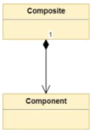
Lecture
09
CLASS COMPOSITION
Composition: is a concept that models a has a relationship.
It enables creating complex types by combining objects of other types.
This means that a class Composite can contain an object
of another class Component.
A composition relationship occurs if one class has an instance
attribute which is an object from the other class (car has wheels).
www.midocean.ae

Slide 18
Lecture
09
CLASS COMPOSITION
Cont'd
Example:
class Course:
def __init__(self, name):
self.cname = name; self.hours = 3
class Student:
def __init__(self, name):
self.course = Course("OOP")
self.name = name
s = Student("ahmed")
print( s.course.cname )
www.midocean.ae

Slide 19
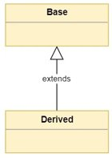
Lecture
09
INHERITANCE
Inheritance: models what is called an is a relationship.
A class can inherit all the methods and attributes of another
class. These methods and attributes become available to the
new class without the need to redefine them from scratch.
A derived class that inherits from a Base class.
class DrivedClassName(BaseClassName):
# body
www.midocean.ae

Slide 20


Lecture
09
INHERITANCE EXAMPLE
Student Management System Case Study
Student has:
1- Name
2- Address
3- NumofCourse
4- Hours
5- Grades []
6- getGrades()
Teacher has:
1- Name
2- Address
3- NumofCourse
4- Hours
5- PayRate
6- getSalary()
www.midocean.ae

Slide 21

Lecture
09
INHERITANCE EXAMPLE
Cont'd
Person has:
1- Name
2- Address
3- NumofCourse
4- Hours
DRY: Don't Repeat Yourself
Student has:
1- Grades []
2- getGrades()
Teacher has:
1- PayRate
2- getSalary()
www.midocean.ae

Slide 22
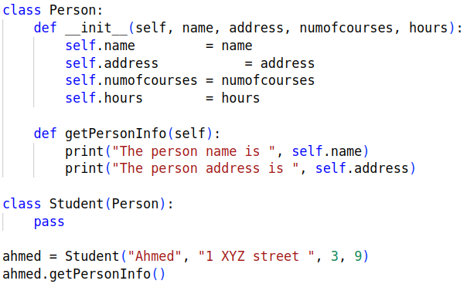
Lecture
09
INHERITANCE EXAMPLE
Cont'd
www.midocean.ae

Slide 23
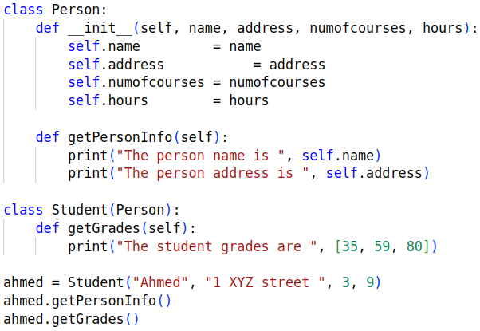
Lecture
09
INHERITANCE EXAMPLE
Cont'd
More behaviors than parent !!
www.midocean.ae

Slide 24
Lecture
09
INHERITANCE EXAMPLE
Cont'd
Example:
class Point:
def __init__(self, x, y):
self.x = x
self.y = y
def __str__(self):
return f"The point is located in ({self.x}, {self.y})"
def displayX(self):
print("The point x coordinate = ", self.x)
www.midocean.ae

Slide 25
Lecture
09
INHERITANCE EXAMPLE
Cont'd
Example (con't):
class Circle(Point):
def __init__(self, r, x, y):
Point.__init__(self, x, y)
self.radius = r
def __str__(self):
print(Point.__str__(self))
return f"The circle radius = {self.radius}"
www.midocean.ae

Slide 26
Lecture
09
INHERITANCE EXAMPLE
Cont'd
Example (con't):
c1 = Circle(2.5, 2, 3)
print(c1)
c1.displayX()
print( isinstance(c1,Circle) )
issubclass( Circle, Point )
www.midocean.ae

Slide 27
Lecture
09
POLYMORPHISM
Polymorphism is taken from the Greek words Poly (many) and morphism (forms).
it means that the methods with the same name can be executed on many objects or classes.
There are two ways to perform polymorphism:
  Using functions.
  Using class methods.
www.midocean.ae

Slide 28
Lecture
09
FUNCTION POLYMORPHISM
You need to define a function that can take any object, for which the methods' calling in the function body will be applied.
Previously, there are some functions in Python which are compatible to run with multiple data types.
L1 = [ 1, 2, 3, 4]
T1 = (1, 2, 3, 4)
print( len( L1 ) )
print( len( T1 ) )
www.midocean.ae

Slide 29
Lecture
09
FUNCTION POLYMORPHISM
Cont'd
Example:
class Student:
def workplace(self):
print("At Midocean University")
class Employee:
def workplace(self):
print("In free-business or at an international company")
www.midocean.ae

Slide 30
Lecture
09
FUNCTION POLYMORPHISM
Cont'd
Example (con't):
def applyPolymorphism( obj ):
obj.workplace()
Std1 = Student()
Emp1 = Employee()
applyPolymorphism(Std1)
applyPolymorphism(Emp1)
www.midocean.ae

Slide 31
Lecture
09
CLASS POLYMORPHISM
Polymorphism defines methods in the child class that have the same name as the methods in the parent class.
The inherited child class method will modify the parent's implementation with an implementation that suitable for the child class.
This process of re-implementing a method in the child class is known as Method Overriding.
www.midocean.ae

Slide 32
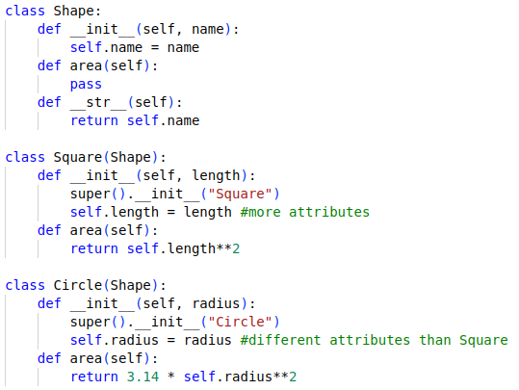
Lecture
09
CLASS POLYMORPHISM
Cont'd
Same method with different code !!!
www.midocean.ae

Slide 33
Lecture
09
CLASS POLYMORPHISM
Cont'd
Example:
class Bird:
def flight(self):
print("Most of the birds can fly but some cannot")
class parrot(Bird):
def flight(self):
print("Parrots can fly")
class penguin(Bird):
def flight(self):
print("Penguins do not fly")
www.midocean.ae

Slide 34
Lecture
09
CLASS POLYMORPHISM
Cont'd
Example:
obj_bird = Bird()
obj_parr = parrot()
obj_peng = penguin()
obj_bird.flight()
obj_parr.flight()
obj_peng.flight()
www.midocean.ae

Slide 35
Lecture
09
QUESTIONS FOR ONLINE DISCUSSION
Write code to create a Vehicle class with max_speed and mileage instance attributes, and add methods as you can in this class. Then, create a Bus class that inherits from the Vehicle class. Give the capacity argument a default value of 50 and define seating_capacity() inside Bus to modify the capacity value.
www.midocean.ae

Slide 36


Thank You

